Slide 1
Education for the Roma: surveillance vs. empowerment
Lecture 1
Education as an agent of racializing the Roma

Slide 2
Aims and objects:
Explore different approaches to theorizing the (in)educability of the Roma
Introduce suitable theoretical concepts for deconstructing the education for the Roma
Practice whiteness as a possible framework for interlinking theoretical and applied approaches to education for the Roma

Slide 3
Strategic litigation of the educational rights for the Roma
D.H. and Others vs. the Czech Republic (2007)
the Sampanis and Others v. Greece (2008);
Oršuš and Others v. Croatia (2010);
case of Horvath and Kiss v. Hungary (2013)
the misdiagnosis of Roma children
subsequent placement in
segregated special schools
the dubious concept
of “familiar disability”

Slide 4
Introductory task
Does the decision passed by the Great Chamber of the European Court of the Human Rights on the Case D.H. and Others vs. the Czech Republic (2007) establish the options for overcoming segregation against the Roma in educational system?

Slide 5
Two main stances regarding the Case D.H. and Others vs. the Czech Republic
landmark step towards Roma’s equality prescribing to education and educators the role of agency – as capable to make choices in favour of integration and to stop segregation
a heavy speculation and tokenism against the real needs of the Roma, educators and communities; education for the Roma was shaped by the combination of socio-demographic and economic structures of segregation – unlikely open for immediate changes in line with the decision

Slide 6
Against which racism was the Judgement?
Racism by intent
founded upon custom and tradition, but shatters against social scientific principles
Racism by consequences
operates at the macro level of society, and represents an historical evolution

Slide 7
In favour of what education?
Education as a provider of human capital: equip by competencies to be independent
Education as a realm of human rights: provide access to the diversity of educational trajectories and practice autonomy

Slide 8
Triple conflation of White-Christian-European
healthy mode of life based upon Christian morality and/or beliefs around proper pathway of progress;
predominance of clearness understood either as racial purity (Aryanism) or allegiance to social hygiene and more humoral understanding of purity;
reliability of particular ethnic group as whiteness benchmark aimed at translating this pattern to others and building hierarchies of whiteness

Slide 9
Educability as a possibility of whiteness
missionary universalism: all people throughout the world are at least potentially improvable
racist assimilationism: linguistic, social and even more biological assimilation
overt racism: humans are only those who are educable, Whites are more educable or even more exceptionally educable

Slide 10
Time-space compression of whiteness in the education for the Roma
Modernity | National Socialism / overt racism | Socialist concept Liberal racism | Human rights
Grellmann and Maria Theresa’s reforms | Ritter/Justin and extermination of the Roma | Several generations of eugenically thininking scholars and emancipation of the Roma from their community | Negation of whiteness and total inclusion as the mainstream for educating the Roma
Humoral vs. Racial conception of blackness in modern concepts of non-whites | Eugenic white-trash surveys | Racial assimalationism, Aleš Hrdlička | Eliminationism: Afro-Americans’ struggle for access to education

Slide 11
Grellmannian approach to the Roma: the pillars of never-catch whiteness?
Heinrich Moritz Gottlieb Grellmann (1756-1804)
Die Zigeuner, ein historischer Versuch über die Lebensart, Verfassung und Schicksale dieses Volkes in Europa, nebst ihrem Ursprunge” (1787)

Slide 12
Scientific method by Grellmann
the method of analogies to deconstructing the past and present of the Gypsies
“the rude unpolished creatures that nature formed them, or, at most, have only advanced one degree towards humanity ”

Slide 13
Grellmann’s theoretical framework
Humoral approach
various external factors
the change of mode of life would bring in action the change of skin colour
Linnaeus’s classification from “Systema Naturea”
Racial approach
colours of skin linked with different races – in favour of whiteness supremacy
Interlinking race and religious affiliation

Slide 14
Humoral approach
“the dark colour of the Gypsies, which is continued from generation to generation, is more the effect of education, and manner of life, than descent”
“Gypsy women… frequently smear their children over with a particular kind of ointment, and then lay them in the sun, or before the fire, in order that the skin may be more completely parched, and their black beauty thereby increased”

Slide 15
Humoral approach
“The Laplanders, Samoieds, as well as the Siberians, likewise, have brown yellow-coloured skins, in consequence of living, from their childhood, in smoke and dirt, in the same manner as the Gypseys ... Only observe a Gypsey from his birth, till he reaches man's estate; and you must he convinced that their colour is not so much owing to their descent, as to the nastiness of their bodies.”

Slide 16
Humoral approach
“must necessarily, when they [Gypsies] first adopted a different mode of life, have borne the marks of the dirt contracted during this period. How much less, then, should we be able to distinguish a Gypsey if taken when a child from its sluttish mother, and brought up under some cleanly person!”

Slide 17
Racial approach: civilised West vs. savage East
The countries of Western world were defined as “ripe for further instruction: then came the great Sower —Christ scattered the seed, and it prospered”
Oriental people including Gypsies were seen as entirely infantile and also leading by the Mahomet , who recognized it and abused it: “Mahomet, on the contrary, before he became strong enough to enforce conviction with the sword, brought about his purpose by art: knowing that the weak side of his countrymen was their veneration for every thing handed down from their forefathers.”

Slide 18
Gypsy parenting as genetically unfit with moral obligations
“Their dancing is the most disgusting that can be conceived, always ending with fulsome grimaces, or the most lascivious attitudes and gestures … They are trained up to this impudence from their earliest years, never suffering a passenger to pass their parents' hut, without endeavouring to obtain something by frisking about naked before him.”

Slide 19
Genderising the whiteness
the parents and majority of girls were defined as “the old stock, on whom no efforts will have effect”
“At Fahlendorfin Schiitt, and in the district of Pressburg, all the children of the Gipseys were carried away in wagons during the night of the 21st of December, 1773; in order that, at a distance from their parents or relations, they might be more usefully educated, and become accustomed to work. Among the children taken away on this occasion, was a girl fourteen years old, who was forced to submit to be carried off in her bridal state. She tore her hair for grief and rage, and was quite beside herself with agitation: but she recovered a composed state of mind; and, in 1776, in Fasching, obtained permission to accomplish her marriage.”

Slide 20
Optimistic hypothesis?
“If we except soldiers, who are kept in order by the discipline of the corporal, with some of the Transylvanian gold washers, who apply to music —and, living separate from their own caste, in constant habits of inter course with people of a better sort, have thereby acquired more civilised manners, and learned the distinction, if not between right and wrong, at least between social honour and disgrace —the remainder are, in the most unlimited sense, arrant thieves”

Slide 21
Driving force of educability
“It may be hoped, that while we are endeavouring to ameliorate the condition of our African brethren, the civilisation of the Gypsies, who form so large a portion of humanity, will not be overlooked”
“Banishment was not the proper method to be adopted; it would have been no advisable to make them penitentiaries or galley-slaves: but care should have been taken to enlighten their under standings, and to mend their hearts”

Slide 22
Nazi eugenics: the obstructive existence of the ‘little Gypsies’
Robert Ritter:
“Gypsies never grew out of childhood, so it wasn’t all that illogical for a child psychiatrist to occupy himself intensively with them”
“an exotic primitive people who ever since prehistoric times had wandered about, lacking the capacity to adapt to changing social circumstances”

Slide 23
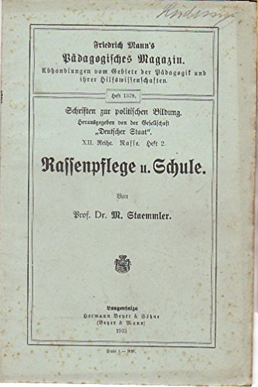
The impact of American eugenics

Slide 24
Main concept
“white trash” those rural poor whites who were genetic defective.
“infectious and sexually promiscuous, violent, alcoholic, lazy
“Jenischen” – those who “made into a relic of a prehistorical population but ethnically related to a backward segment of the German people whose most important characteristic was their itinerant way of life the infusion of sedentary German blood”.
“The whole society does not want to continue more than one-hundred years dangerous state policy, and we all claim right now “No Gypsy trash! (Nicht-Zigeuner-Gesindel)”

Slide 25
Taxonomy by Ritter
pure Gypsies or Gypsies;
two mixed or a Gypsy half-cast groups, first and second grades;
and non-Gypsy

Slide 26
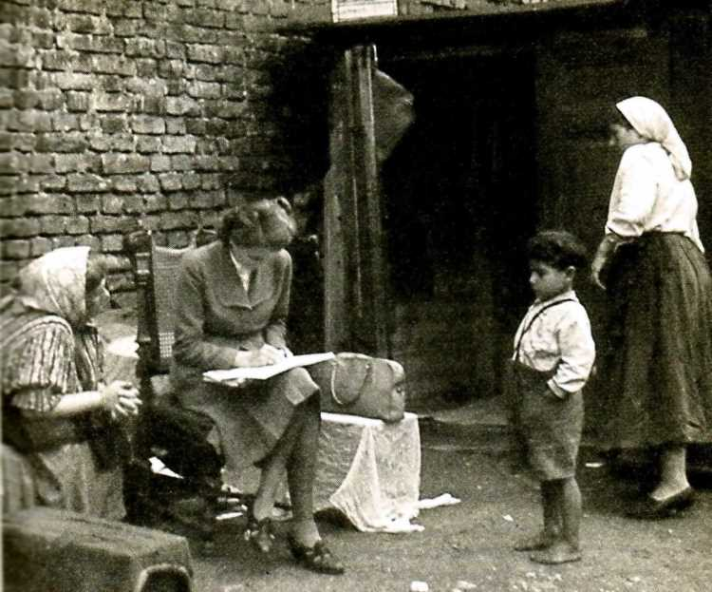
The doctoral Thesis by Eva Justin
“The destiny of Gypsy children brought up out of families and observation under them” (“Lebensschicksale artfremd erzogener Zigeunerkinder und ihrer Nachkommen”)

Slide 27
Family tree method

Slide 28
Physical anthropology

Slide 29
In-depth psychological assessment
Women and adolescents in correctional institutions
The Roma children in residential care settings and from mixed families

Slide 30
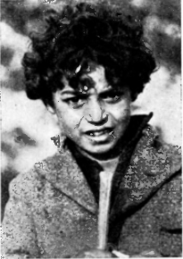
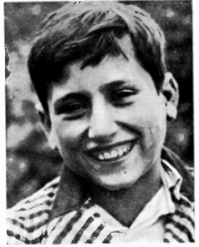
Ineducability of the Roma for their complete dehumanization
„little strange creatures” (die kleinen fremdartigen Geschopfe)

Slide 31
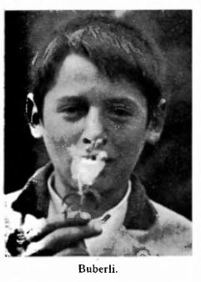
The mask of trained pet (dressierten Zöglings)
Because normally the Gypsies are not feeble-minded, thus, by being placed into the schools for such children, they become totally impudent and disobedient

Slide 32
Multilevel ineducabilty

Slide 33
Multilevel ineducabilty

Slide 34
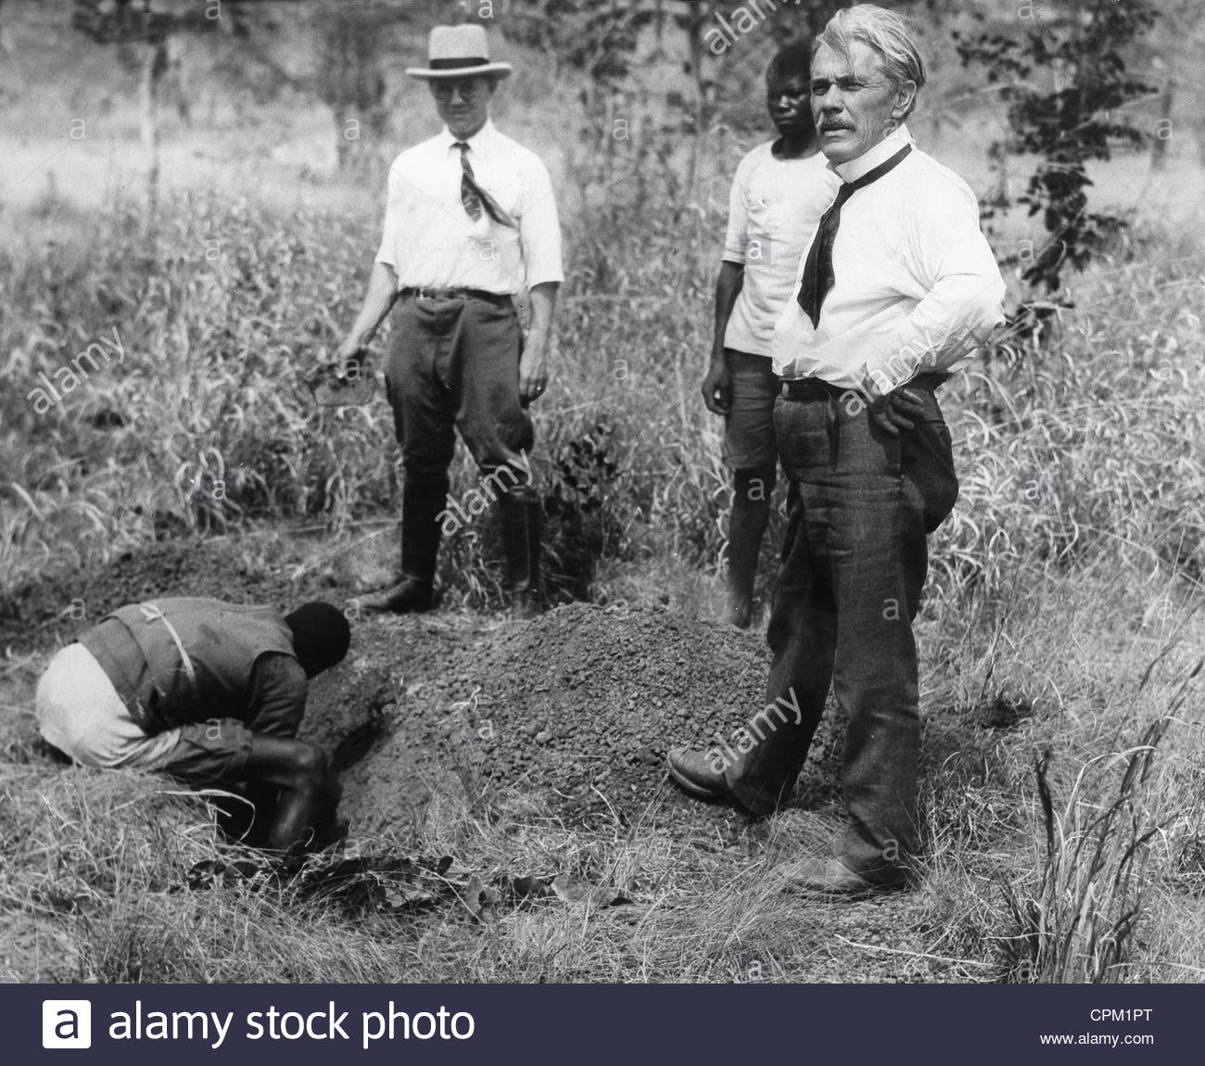
Racial assimilationism and education for the Roma in the Czech lands
Environment mapped by the dichotomy of primitivism vs. civilization: “Racial factors determined by heredity are very few, main differences are environmental factors“
Aleš Hrdlička

Slide 35
Rusyns: ‘not enough Slavs’
While the Rusyns whose historical development according to Suk was inseparable from Slavic, European part of lands belonged to the Dinaric type, the Rusyns from non-historical Northern part reproduced according to Suk’s outputs Lapponoid type
Vojtěch Suk: Antropological notes on the peoples of Carpathian Ruthenia with remarks on races in general and on some new methods in anthropology. Preliminary report, Přírodovědecká fakulta Masarykova univerzita Brno 1932

Slide 36
The bodies lost for the nation
Vojtěch Suk: Antropological notes on the peoples of Carpathian Ruthenia with remarks on races in general and on some new methods in anthropology. Preliminary report, Přírodovědecká fakulta Masarykova univerzita Brno 1932
Vojtěch Suk: Racial Herd. Immunity Lancet, London November 1931, N 5646, Vol. CCXXI

Slide 37
Potential bodies of the nation
Source: The Photographs for presenting the Czechoslovak Rep. during the International Exhibition of Hygiene, Dresden, 1930. National Archive, Sig. MZD1, box 44, Prague
Source: Annual Report of the Local Board of Child Protection and Other Charity Unions in Holešov, 1931
Okresní péče o mládež A - 25 (1911-1949) Okresní archiv, Kroměříž

Slide 38
Health as an indispensable part of whiteness
generalized concept of primitives as healthy only in their potential to become White: nutrition, mode of life, level of education
Hierarchies: not all Eskimo, Rusyns or the Roma were inferior but only those who remained totally isolated from the civilized or ‘White’ majority

Slide 39
Intersectionism of disability and race
Aleš Hrdlička Anthropological Investigations on One Thousand White and Colored Children of Both Sexes, the Inmates of the New York Juvenile Asylum, with Additional Notes on One Hundred Colored Children of the New York Colored Asylum ( New York 1899)
“The white children of both sexes possess on an average a decidedly larger proportion of inborn abnormalities. On the other hand, the negro children acquire in early life a larger percentage of irregularities than the white children”

Slide 40
Invalidization of the Roma during the First Republic: functional health
„Even that individual either adult or child who has a permanent or unrecoverable physical disability cannot be labelled as impaired until his or her disability remains not such hard that the individual’s ability to work would be significantly reduced“
“Gypsy contagion” (cikánská nákaza):
“They [Roma] contaminate by their moral devastation future generations, e.g. their own generations”

Slide 41
Eugenic approach to the Roma
František Štampach (1895 -1967)
Sociologický výzkum cikánů v čsr [Sociological research of Gypsies in Czechoslovakia], 1932
“there is no other way to define the Roma sociologically than as a dispersed nation with common characteristics as origins, language, the past, customs, folk art and also the racial characteristics which differentiate consistently, but missing characteristics such as national identity and options for being united within particular area”

Slide 42
Racist analogies during the interwar period
„there is the analogy with primitive society in which the women take responsibility for feeding the family and community while their men have fun going to hunt – we could compare Gypsy’s obsession to steal with this archaic love to hunt.”
“the Gypsies were so comparable with the Jews in their otherness that they shared their destiny“
The vagrant Gypsies are on the level of primitive foraging, on the level of parasitic economy similar to that of nomadic tribes in Eastern Indies Northern Africa “
“We could compare the Gypsies in their proudness for the art of stealing with the feeling of Fijians for whom a murder is a matter of ambitiousness”
“The isolation of the Gypsies also can be determined by the practice of incest – which is solved by the Gypsies in quite different ways than by other primitives who strongly forbid incest”

Slide 43
Racist analogies: socialist supplementation
“The gypsies are the odd social group extremely different in terms of the process in classes’ relations, different ethnic group which significantly retards in social development due to its specific isolation as well as the isolation of society from Gypsies. The process of classes differentiation is determined by these specific traits, and their development in terms of class relation is extremely backward” (Nováček 1968)
“They [Gypsies] practiced the reproduction within their own groups, the pattern of self-contained isolated group operated as a dominant scenario of their development. This practice fixed controversial anthropological features which remain inseparable part of their [the Roma‘s] social development” (Malá 1974)

Slide 44
Linguistic assimilation: invalidating the Roma language
“Gypsy language is cultural phenomena transformed by the pressure of various social factors, communication with the most diverse languages, cultures and nations resonating with social and ethnic isolation” František Štampach Cikání v československé republice [Gypsies in Czechoslovak Republic] Prahe: Akademie věd 1929)
“the oligophrenic Roma child who speaks the Roma and meets other languages during later periods of his ontogenesis is in a disadvantage situation …[and] needs more time for understanding foreign language” Josef Štěpán, “About the current situation with language among mentally retarded Roma” 1975

Slide 45
Bad parenting & deficient childhood: the negation of the Roma family
„The Gypsy child who would be not hungry, raggedly dressed, forced to beg but on the contrary would attend school, and will grow up to become a hardworking and capable citizen“František Štampach 1929
“Living on the skirt of towns and cities supports unlimited development of left handedness among mentally retarded Roma children. Small dwelling normally consisting of one room for living in the Gypsy settlements does not operate for daily life, thus the Roma child spends his life mainly outside or on the skirts of old parts of the cities. There within his quasi-wild military games, when he is either scattering stones or gathering sticks the oligophrenic Roma child prefers that hand which is relevant to genotype laterality. Tellingly, he is not forced to re-learn to use right hand”
Josef Štěpán ‚K lateralitě mentální retardovaných žáků cikánského původu‘ [About the Laterality of Mentally Retarded Students of Gypsy Origin]. Otázky defektologie 8 (1976): 316-20

Slide 46
Bad parenting & deficient childhood: the negation of the Roma family
The Roma mother who adopted two Roma girls placed into institution in their early age
The brothers who were placed into boarding school after 7 years old

Slide 47
The only way of assimilation
schoolarization (školarizace) as the only one even possible strategy “for interaction of genetic grounds with the social factors of external environment”
“The gradual dissolution of Roma among the major Czechoslovak ethnic groups should be achieved by mutual social and gradually elaborated biological contact“(Malá 1984)

Slide 48
Residential care: one-way solution for the de-invalidization of the Roma
First day in children’s home
After six months
Source: Holub, Olga (1933) The first Gypsy children in boarding school for girls under the local board of child protection in Jilemnici úchylná mládež 3, 1 s.44-46

Slide 49
The anthropometric profile comparable with the Czech child
The anthropometric profile far from the norm

Slide 50
Interconnection between overt and liberal racisms
Overt racism
legitimation
Liberal racism

Slide 51
The case of Brown v. Board of Education (1954)

Slide 52
Arendt’s critique ‘Reflections on Little Rock’ Dissent 6 (1959): 45 – 56
the high probability to violate the right to autonomy of the parents and children: “To force parents to send their children to an integrated school against their will means to deprive them of the private right over their children and the social right to free association”
Such a view can lead to the awful experiences with which we are only too familiar of children being “abducted” from their parents when the latter belong to a particular social group because certain “well-intentioned” people feel constrained to impose their conception of life on all.” Borrego Borrego, 2007

Slide 53
Arendt’s critique ‘Reflections on Little Rock’ Dissent 6 (1959): 45 – 56
high risk in relying on children as the agents of integration: „As for the children, forced integration means a very serious conflict between home and school, and while such conflicts are common in adult life, children cannot be expected to handle them and therefore should not be exposed to them”

Slide 54
Strategic litigation: missing the intersectionist response to intersectionist nature of whiteness
introducing poverty as a core source of the Roma’s issues
prioritizing those who already achieved the position of White as an example for the rest of them
no space for rethinking the interrelation between disability and ethnicity in order to recognize the role of diverse educational trajectories as a precondition for ensuring the rights to education
“an example of the sad human tradition of fighting racism through racism” Borrego Borrego

