Slide 1
Special and Inclusive Education

Slide 2
Pupils/students with SEN/D
Intellectual disabilities
Physical disabilities
Hearing impairment
Visual impairment
Speech or language impairment
Multiple disabilties
Autism
Learning disability
Behaviour disturbance
Special educational needs:
Health disability
Health disadvantage
Social disadvantage
Long-term illness
Mild learning disabilities requiring modification in education
Family background with low socio-economic status
At risk of harmful influence
Imposed institutional or protective institutional care
Asylum-seekers
Person aplying for international protection in the Czech Republic
Schooling Act No. 516/2004, Sb. Par. 16

Slide 3

Disabilitiy categories according to IDEA (1990)
Learning disability
Speech or language impairment
Mental retardation (cognitive/intellectual disability)
Emotional disturbance
Autism
Hearing impairment
Visual impairment
Deaf-blindness
Orthopedic impairment
Traumatic rain injury
Other health impairment (cancer, diabetes...)
Multiple disabilities
Developmental delay (up to the age of 9)
How do these two approaches differ?

Slide 4
Influences on current special education practices
Notes:
In US – Brown v. Board, 1957 – it was unlawful under the 14th Amendment to discriminate arbitrarily against any group of people. The court applied the concept to education as well and ruled that state-mandated seoparate education of African Ameriacan pupils could not be equal education.
The court decision iontroduced the concepti of INTEGRATION to public education.
In CZ – Court for Human Rights in Strasbourgh vs. Czech Republic – 2007 přeřazením 18 romských dětí do zvláštních škol porušila jejich právo na vzdělání a diskriminovala je.

Slide 5
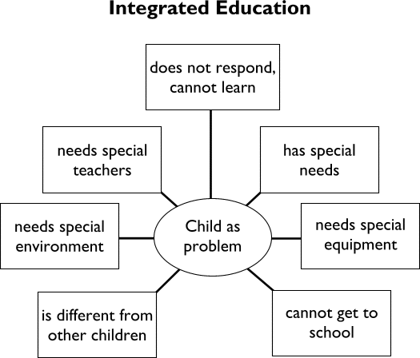
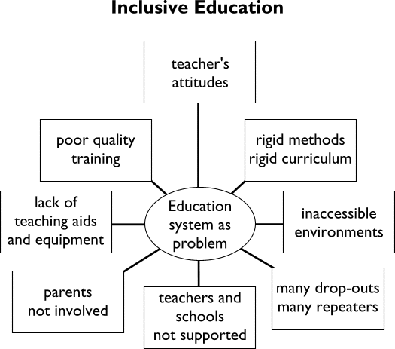
Two track system of education in the Czech Republic
Special Education
Child as a problem
Separate setting
SEN teachers
Special method
Special environment and equipment

Slide 6
Continuum of placement options
SCAN

Slide 7
Support for students with SEND/D
5 levels of „supportive measures“:
  1st level – school alone, with school counsellor, psychologist, SEN teacher
  2nd – 5th – counselling centre (outreach centre)
  Katalog podpůrných opatření

Slide 8
Students with learning difficulties

Slide 9
Students/pupils with learning difficulties
LD result in significant difficulties in the acquisition and use of listening, speaking, reading, writing, reasoning, and/or mathematical skills
Think of an LD pupil. Write down ways the child acts in a class, its typical problems and behaviour.
Notes:
So-called high-incidence disabilities
Together with emotional disturbances, language disabilities and mild intellectual disabilities – together up to 80% of all students with disabilities

Slide 10
Characteristics
difficulty reading, writing, spelling, and/or using mathematical concepts in contrast with average to superior skills in other areas.
poor handwriting
trouble listening to a lecture and taking notes
easily distracted by noise or visual stimulation - unable to pay attention
trouble understanding and following directions
confuses/reverses some letters ('b' and 'd', etc.) or words ('was' and 'saw', etc.) and numbers ('41' to '14)
omits or adds words when reading
repeatedly forgets things, loses things
appears clumsy and poorly coordinated
confuses left and right, gets lost
often late for class, cannot sense time
misinterprets subtleties in language - tone of voice - sarcasm

Slide 11
Visual perception
Oral expression
Reading comprehension
Processing problems
Spatial orientation

Slide 12
Comprehension has to do with background knowledge!
Direct instruction
Systematic and explicit presentation of knowledge
Review and check the previous day´s work (and reteach if neccessary).
Present new content or skills.
Provide guided student practice (and check for understanding)
Provide feedback and correction (and reteach when neccessary).
Provide independent student practice
Review frequently.
(Friend, M. & Bursuck, W. D. (2014) Including Students with Special Needs)
Notes:
Guided practice – Q and A. choral responding, etc.

Slide 13
Dyslexia
difficulties with accurate and/or fluent word recognition
poor spelling and decoding abilities (orthographic representation and specific sound)
difficulty with spatial orientation (b,d, etc.)
inability to accurately and fluently decode single words
difficulty rapidly retrieving and stating names of letters, eventhough they know their names

Slide 14
Dysgraphia - Symptoms:
Generally ilegible writing
Random punctuation
Spelling errors
Syllable omissions
Mixture of print and cursive
Unfinished letters, omitted words
Cramped, unusual grip

Slide 15
Writing a paper:
P – plan your paper
O – organize thoughts and ideas
W – write your draft
E – edit your work
R - revise your work, producing a final draft

Slide 16
Dyspraxia
Impairment of the organisation of movement
immaturity in the way brain processes information

Slide 17
A S with dyspraxia has difficulties with:
planning their movement
perception
co-ordination of body parts
laterality
manual + practical work, handwriting
concentration, short-time memory
response to external stimulation

Slide 18
Daily Life
avoid tight neck holes
trousers with elastical waist
don´t fill cups too full, use straw
damp towels under plates (stop moving), sit down to eat
keys and purses on a chain tight to clothing
keep to daily rutine

Slide 19
LD at school
difficulties organizing information
limited store of background knowledge to academic activities
ineffective ways of learning

Slide 20
Educational Approaches
education should include:
  opportunity for Ss to express themselves
  learn problem-solving skills
  meaningful way of learning
  effective, explicit instruction
  learning strategies

Slide 21
Explicit Instruction
carefully designed materials and activities
sufficient range of examples
step-by-step strategies
broad Qs, guidelines to focus attention at deep processing
frequent, positive feedback
practice opportunities

Slide 22
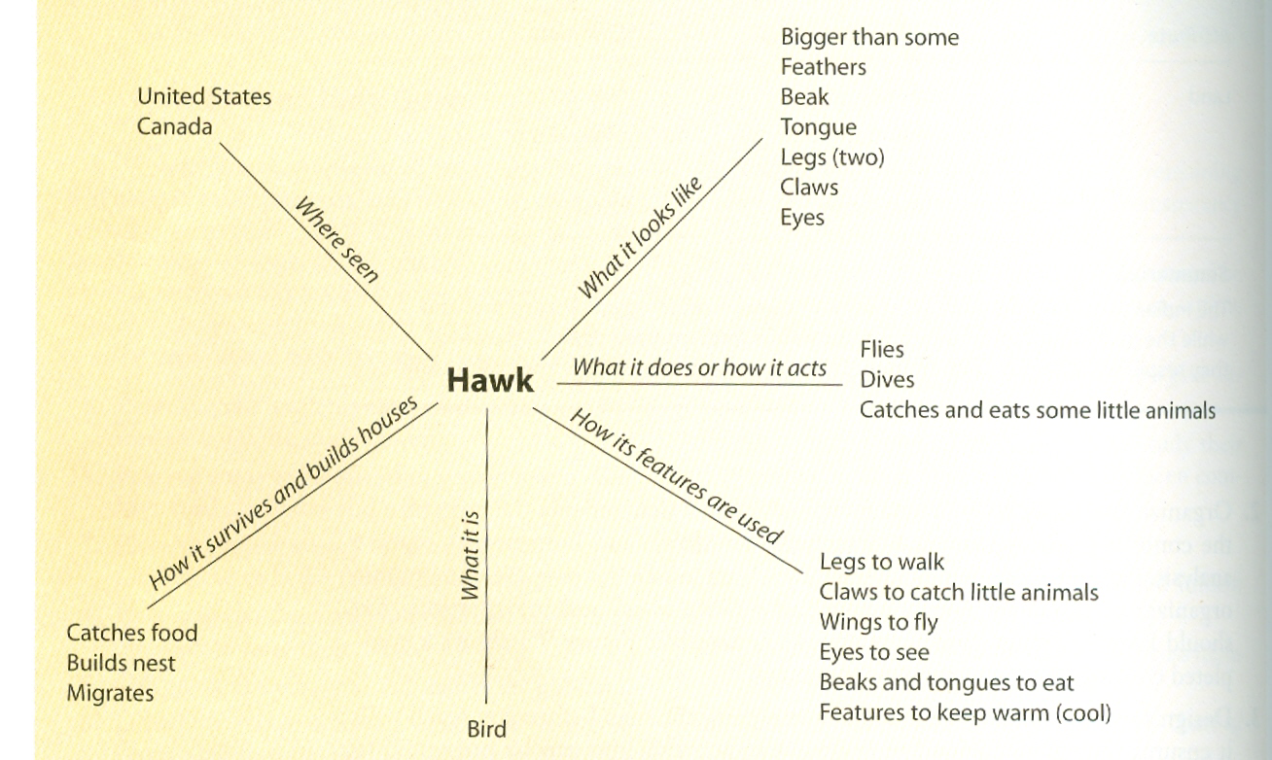
Graphic organizer:

Slide 23
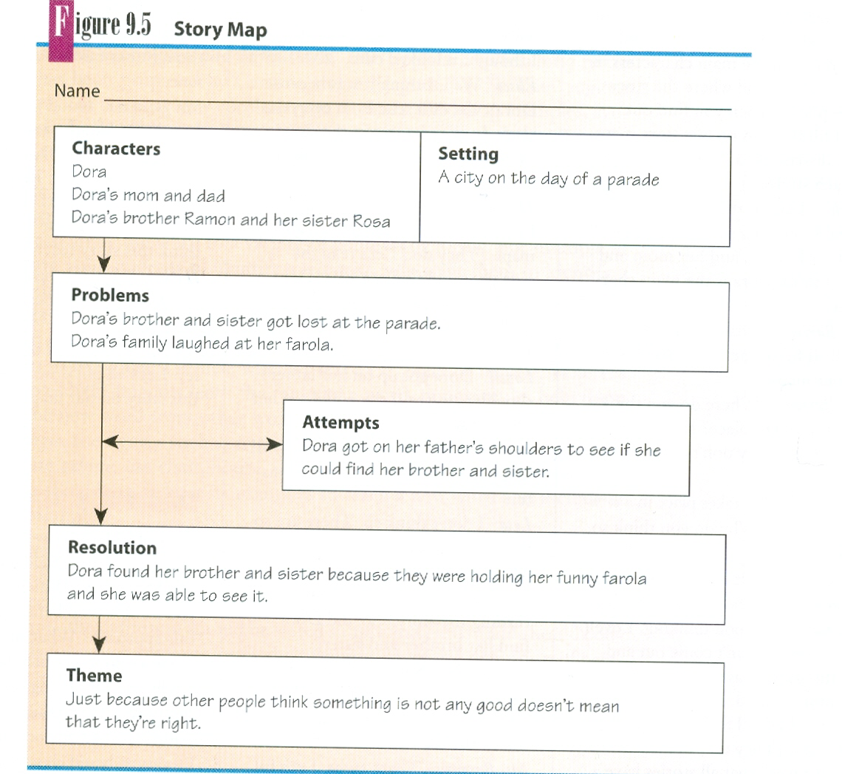
Graphic organizer 2:

Slide 24
What are the most important skills of students from teachers point of view?

Slide 25
Student Skill/Behaviour
follow directions in the class
comes to class perpared with materials
uses class time wisely
makes up assignments and tests
treats Ts and Ss with courtesy
completes homeworks in time
works cooperatively in student groups

Slide 26
Students with visual impairment

Slide 27
Over 40 million people in the world are blind, and over 120 million people have significant Low Vision conditions
that cannot be corrected, cured or treated by conventional refraction, medicine or surgery.
This number is
expected to double by the year 2020.
(World Health Organization, 2004)

Slide 28
Visual acuity impairment /WHO/:
Normal vision: 5/5 , 5/7.5 and better
Low vision:
  Medium – 6/18 – 6/60
  Severe – 6/60 – 3/60
  Profound – 3/60 – 1/60, visual field narrowed to 20 °
Blindness:
  Practical – less than 1/60, visual field narrowed to 5-10°
  Factual - incorrect / no light perception

Slide 29
Definition of visual impairment in the USA:
Legal:
  a person who is legally blind has visual acuity of 20/200 or less in the better eye even with correction or has a field of vision so narrow that its widest diameter subtends an angular distance no greater than 20 degrees
  A person who is partially sighted has visual acuity falling between 20/70 and 20/200 in the better eye with correction

Slide 30
Educational:
  Stresses the method of reading instruction
  Persons who are blind or severely impaired learn to read in Braille
  Persons with low vision can read print /with the help of magnifying devices or large print-books/

Slide 31
Implications for teaching
Academic achievement
Health implications
Methods of instruction

Slide 32
Educational considerations:
Students with VI have to rely on other sensory modality to acquire information
Modification of the teaching process necessary
  Braille
  Use of remaining sight
  Listening skills
  Mobility training

Slide 33
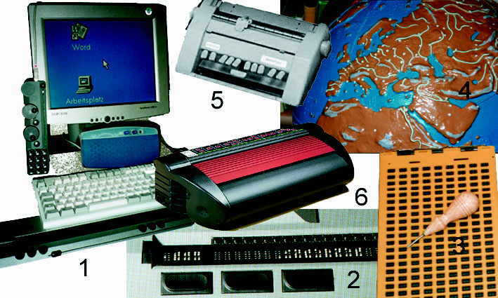
Teaching aids for the blind and partially sighted:
1.
3.
5.
2.
4.
6.

Slide 34
Scanner with Optical Character Recognition /OCR/ software
2. Braille display
6. Braille emboser
3. Braille writing board
5. Braille machine
4. Tactile models

Slide 35
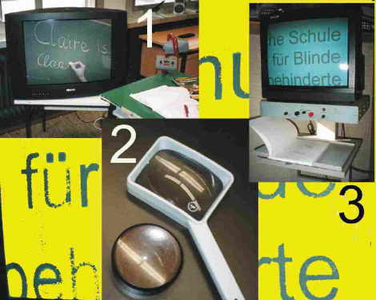
Low-vision aids:
Try to read with a magnifier.

Slide 36
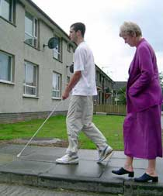
Mobility training:
The long cane
Symbol cane (identification cane)
White walking sticks (support cane)
Guide dogs
Human guides

Slide 37
When speaking with a person who is blind or has low vision, consider the following tips:
Identify yourself - don't assume the person will recognise you by your voice.
Speak naturally and clearly. Loss of eyesight does not mean loss of hearing.
Continue to use body language. This will affect the tone of your voice and give a lot of extra information to the person who is vision impaired.
Use everyday language. Don't avoid words like "see" or "look" or talking about everyday activities such as watching TV or videos.
Name the person when introducing yourself or when directing conversation to them in a group situation.
Never channel conversation through a third person.
In a group situation, introduce the other people present.
Never leave a conversation with a person without saying so.
Use accurate and specific language when giving directions. For example, "the door is on your left", rather than "the door is over there".
Avoid situations where there is competing noise.
Always ask first to check if help is needed.
Relax and be yourself.

Slide 38
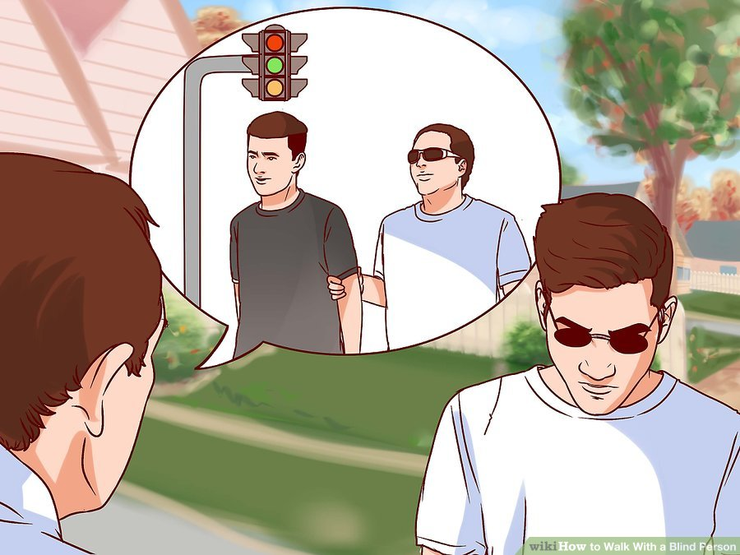
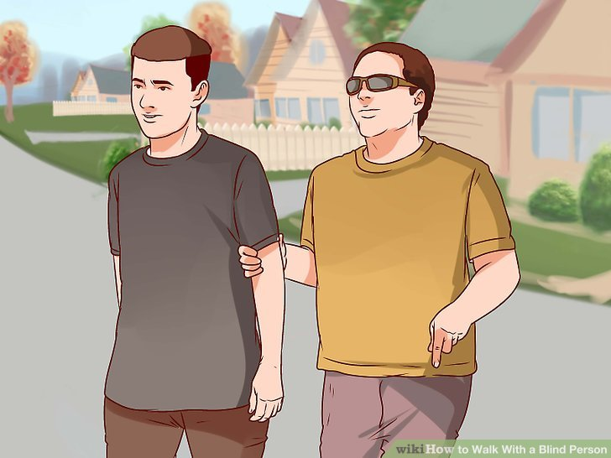
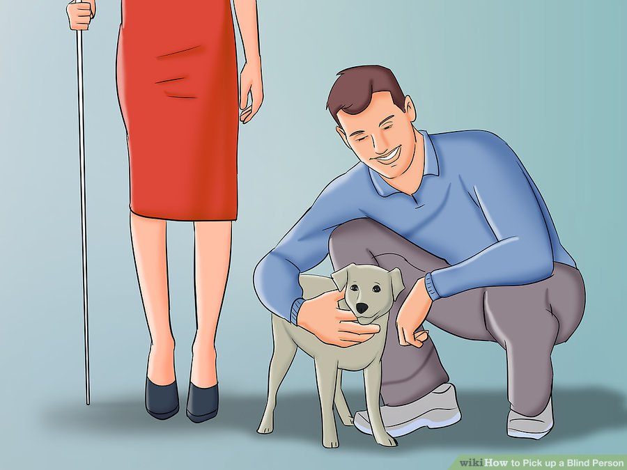
Everyday life
Offering help or information
Guiding
Sitting and getting on/off tram (car, etc.)
Notes:
Approach, ask, then help, respect
Do tnot pet dog – treat it as a part of the person´s body

Slide 39
PE for student with visual impairment
  6:48 – 15:41
Blind football – Avoy
3:35
Skiing with a guide

Slide 40
Students with hearing impairment

Slide 41
A HI is a decrease in one´s ability to hear (perceive auditory information)
HI ranges in severity from mild to profound
Deaf
Hard-of-hearing
Mild (26-54 dB)
Moderate (55-69 dB)
Severe (70-89 dB)
Profound (90 dB and more)

Slide 42
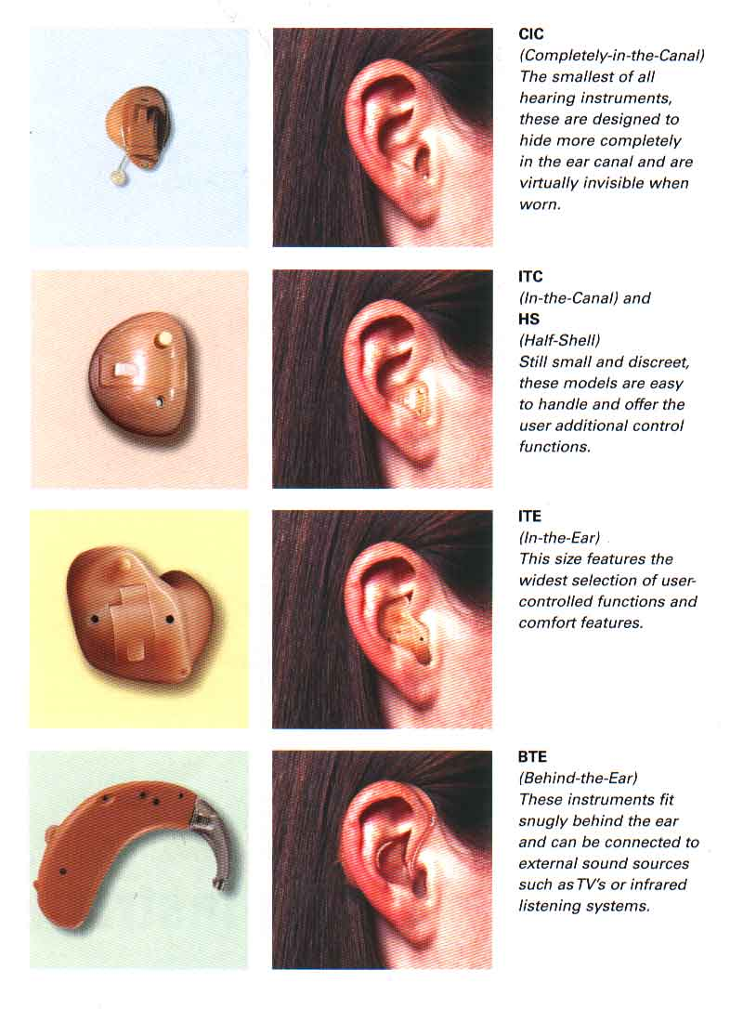
Hearing Aids:
Worn behind the ear
Worn in the ear
Worn in the canal of the ear
Hearing aids make sounds louder, not clearer.
Hearing aid at school

Slide 43
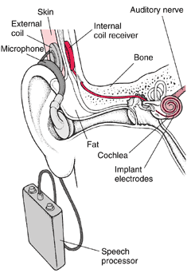
Cochlear Implant:
A small microphone worn behind the ear
A small computerized speech processor worn by the person
An implanted internal coin
Electrodes implanted in the inner ear

Slide 44
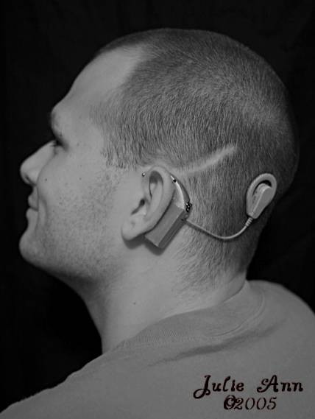
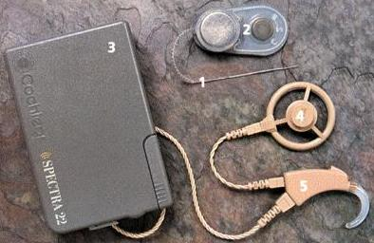

Slide 45
Tips for classroom management
Reading and comprehension
  Complex sentences
  Sarcasm, irony, metaphor
  Distorted timeline

Slide 46
Communication with people with hearing impairment
Face the hearing impaired person directly, on the same level and in good light whenever possible
Do not talk from another room. .
Speak clearly, slowly, distinctly, but naturally, without shouting or exaggerating mouth movements.
Say the person's name before beginning a conversation.
Avoid talking too rapidly or using sentences that are too complex.
Keep your hands away from your face while talking.
Try to minimize extraneous noise when talking.
Avoid situations where there will be loud sounds when possible.
If the hearing impaired person has difficulty understanding a particular phrase or word, try to find a different way of saying the same thing,
Acquaint the listener with the general topic of the conversation.
If you are giving specific information, have them repeat the specifics back to you.
Whenever possible, provide pertinent information in writing, such as directions, schedules, work assignments, etc.
Take turns speaking and avoid interrupting other speakers.

Slide 47
Students with physical impairment

Slide 48
If a student has a physical impairment, it is highly likely that in some way the student's development and learning may be affected in one or more of the following areas:
muscle tone, muscle strength, posture
gross motor skills
mobility
fine motor skills
communication skills
psycho-social skills.

Slide 49
Memory
Attention
Gross and fine motor skills
Anxiety – spasm, involuntary movements

Slide 50
Recommendations:
Never act or decide on behalf of the person.
When meeting a person in wheelchair, we face him/her.
Never talk on behalf of the person (at shops, institutions, etc.).
Pay attention to the angle from which people in wheelchair can see.
Every time we stop, we pull breaks of the wheelchair
We lift the wheelchair holding only fixed parts.
We are acquainted with the wheelchair – parts, folding, basic maintenance.
Notes:
Táborníci s tělesným postižením
Tělesné postižení je velice široká kategorie, do které spadá vše od skoliózy, kterou má velká část populace, po těžké tělesné postižení vyžadující trvalou asistenci druhé osoby.
Širokou skupinou jsou táborníci, kteří používají invalidní vozík. V rámci seznamování s táborníky první večer musí hlavní vedoucí zajistit, že všichni vedoucí znají zásady bezpečné manipulace. Patří sem například to, že člověka vždy zvedáme ve dvou, je to pro bezpečnost zvedaného i zad těch, kteří zvedají. Vysvětlíme, jak daného člověka zvedat z postele, usazovat na WC a do vozíku.
Sedět celý den je nadlidský úkol a každý si potřebuje odpočinout. Nemůžeme ale čekat na to, až si náš táborník řekne, že už potřebuje změnit polohu. Lidé po úrazu míchy a i lidé s mozkovou obrnou mají často narušený cit v dolní polovině těla nebo v důsledku mentálního postižení nejsou schopni tělesné vjemy srozumitelně vyjádřit. Pokud se věnujeme klidové aktivitě, snažíme se vždy vytvořit prostor pro to, aby si táborník mohl lehnout (nebo sednout mimo vozík). Pokud vyrážíme na výlet mimo tábor, bereme s sebou karimatku, aby se táborníci mohli třeba během svačiny protáhnout a narovnat. Když táborníkovi pomáháme usadit se do vozíku, kontrolujeme, že má správně srovnané oblečení a nikde se nevytváří zbytečné sklady, které by mohly způsobit otlaky. To platí i pro horní polovinu těla. Kontrolujeme, že táborník sedí rovně, nohy má srovnané a opřené o podnožku, atd.
Při oblékání ponožek kontrolujeme, že guma příliš neobepíná nohu a není shrnutá tak, že se zařezává do lýtka. Do bot ponožky a prsty pečlivě narovnáme. Cirkulace v dolních končetinách může být horší a proto musíme věnovat pozornost těmto detailům.
V případě slunečného počasí krémem na opalování s vysokým faktorem natřeme zátylky, předloktí, hřbety rukou, kolena a nárty! Táborníci na vozíku se na slunci velice snadno a nepříjemně spálí, neboť během dne nemění polohu tolikrát, co my ostatní. Dbáme na pitný režim. V horkých dnech je také velice důležitá osobní hygiena, zejména u osob, které jsou inkontinentní.
V případě chladnějšího počasí máme na paměti, že táborníci na vozíku by měli mít alespoň o vrstvu více než my ostatní. V chladu kontrolujeme teplotu chodidel a rukou.
Co se týče vozíku samotného, všichni vedoucí by měli být seznámeni se zásadami správné manipulace, skládáním a rozkládáním vozíku. Vedoucí také musí vědět, jak táborníka správně usadit, popř. použít popruhy, vestu, atd. Vždy s sebou vozíme pumpičku a sadu na lepení duše. Pokud se jedná o elektrický vozík, hlídáme si dobití baterie, zejména před delší procházkou. Tlačit elektrický vozík s vybitou baterií třeba jen kilometr v terénu je v pravdě heroický výkon.
Při všech hrách a soutěžích se snažíme prostor zorganizovat tak, aby i v sedě bylo dobře vidět. Cedule s úkoly pověsíme do takové výšky, aby je mohli přečíst i hráči na vozíku. S tím souvisí i to, že vozík vždy postavíme tak, aby táborník byl součástí skupiny a otočený do centra dění. Při vědomostních soutěžích připravíme karimatky a válce nebo jiné pomůcky pro pohodlné sezení/ležení do první řady. Pokud plánujeme vyrazit do přírody, trasu bychom měli znát a vědět, že je sjízdná (popř. že potřebujeme dva statné vedoucí a mnohem více času).
U lidí s tělesným postižením může být zasažena také jemná motorika a grafomotorika. Na táboře se to projeví například při výtvarných a rukodělných aktivitách. Každou činnost plánujeme tak, abychom nabídli více možností a technik. Například při malbě temperami nabídneme kromě štětce také kartáčky na zuby nebo houby a velké formáty papíru. My vybíráme spíše netradiční techniky, kolektivní práce, tvoření z hlíny a přírodnin.
Mimovolní pohyby a spasmus, kterými mohou táborníci trpět, se obvykle zhoršují při nervozitě a únavě. Snažíme se tedy soutěže pojímat jako kolektivní práci celého oddílu/týmu, abychom předešli zbytečnému napětí a s tím souvisejícím obtížím.
Na pobytových akcích s lidmi na vozíku bychom měli mít alespoň jeden náhradní vozík. Využijeme ho nejen jako záložní v případě defektu, ale také na delší procházky a výlety nebo cesty do terénu, pokud máme táborníky, kteří k pohybu potřebují berle nebo chodítka.

Slide 51
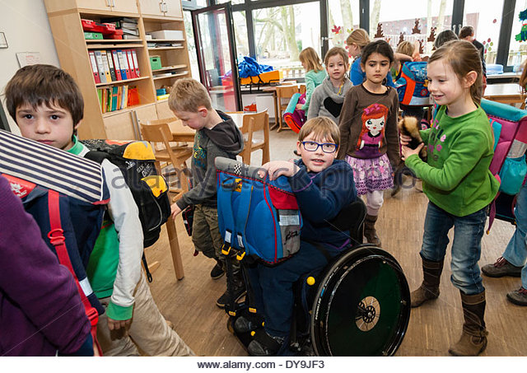
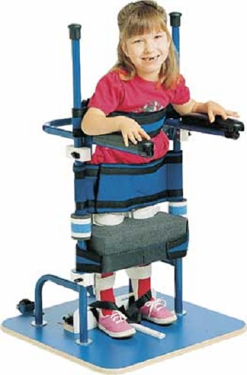
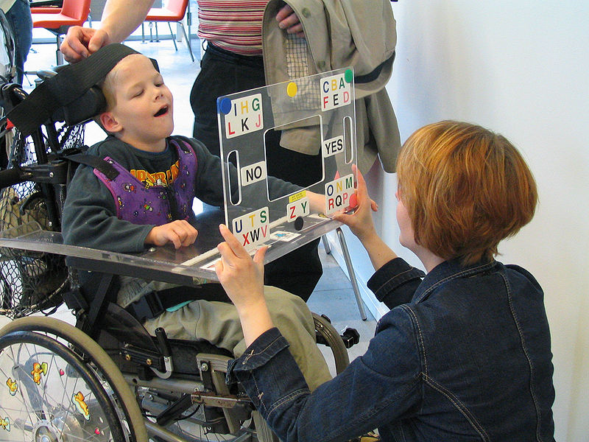
At school:

