Slide 1
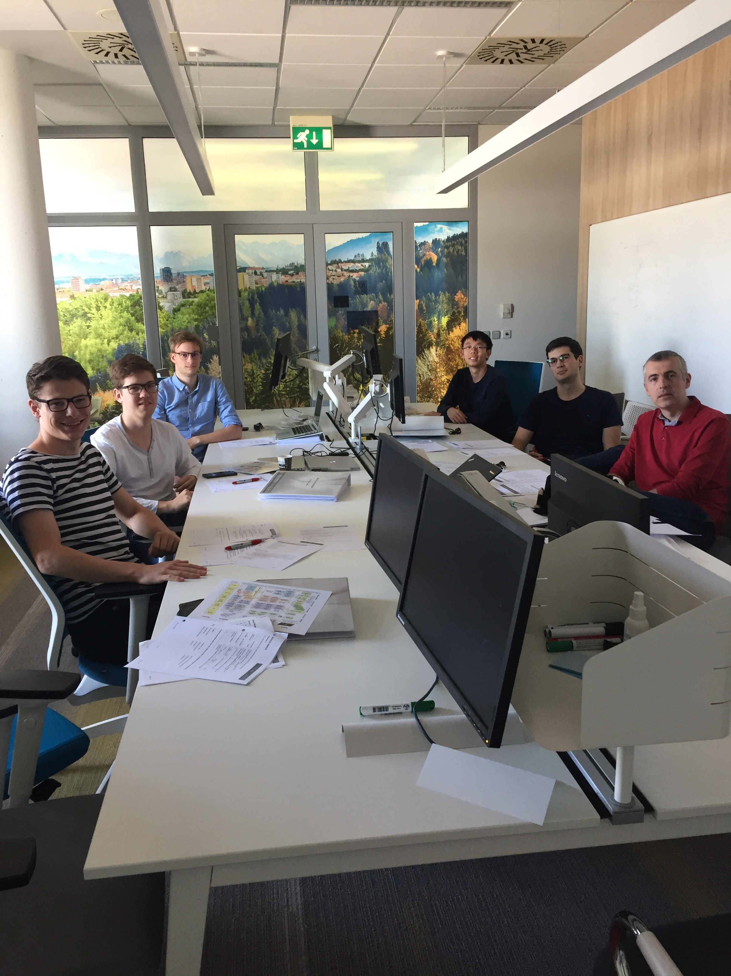
IBM SMARTER UNIVERSITY BRNO Are you interested in internship position?
Check available positions here:
https://ibm.box.com/v/SmarterUniversityBrno
If you found one position available in the catalog apply here or contact for more details:
Katerina Pankova
Smarter University Program Leader
—
katerina.pankova@cz.ibm.com
Kristyna Kovandova
University Relations Leader
—
kristyna.kovandova@cz.ibm.com
+420 778 766 336

