Slide 1
Word association!

Slide 2
Last week…

Slide 3
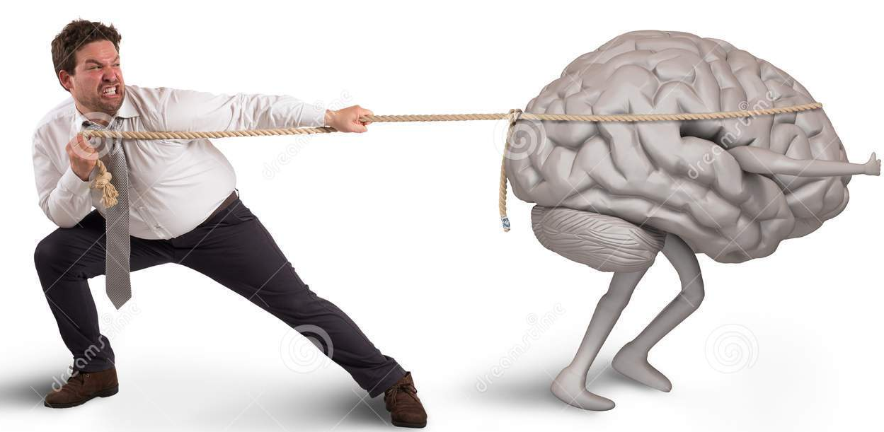
This week…

Slide 4
Watch the video and answer the questions:
How many English graduates now live outside the country?
What percentage of students studying abroad don’t (immediately) return home?
Which students are least likely to return home?
Approximately what percentage of African inventors live outside their home country?
How did Taiwain encourage its talented citizens to return home? A) B) C)
What other factors can pull immigrants home?
https://www.youtube.com/watch?v=5IUcFDE3COc

Slide 5
Why is brain drain considered to be a problem? Who is it a problem for? Are there any benefits of brain drain?
What are your push (from) and pull (to) factors in the Czech Republic?

Slide 6
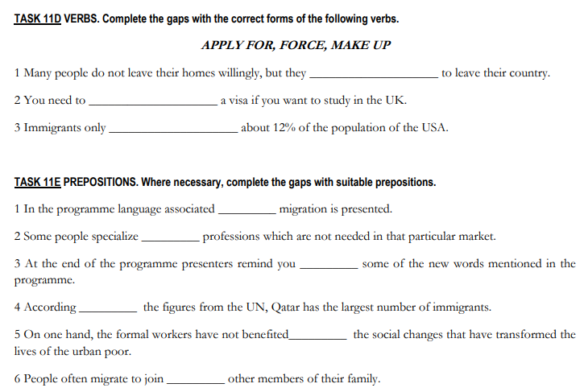

Slide 7
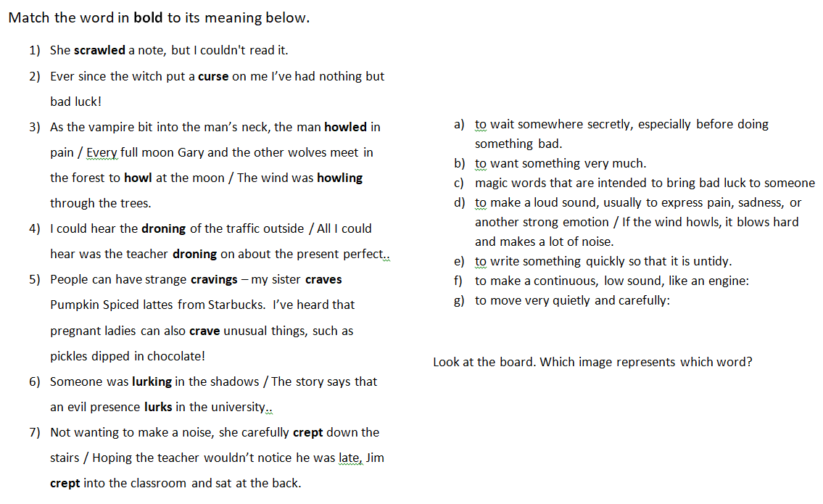

Slide 12
Consider…
Who is there?
What are they doing there?
How long have they been there?
What are they looking for?
What is so frightening?
What might happen to them?
Where possible, use the vocabulary sheet.

Slide 13
https://www.youtube.com/watch?v=fw4gwwS-nFI

