Slide 1
Special and Inclusive Education
Autumn 2018
Helena Vaďurová

Slide 2
Getting to know the group
Group 1: Introduce yourselves briefly.
Group 2: Prepare a label on your T-shirt.
Group 3: Write down 3 numbers and let others guess.
Group 4: Your life in one sentence.
Group 5: Find someone who…..

Slide 3
´For sale: children shoes. Never worn.´
Ernst Hemingway
Longed for him. Got him. Shit.
Margaret Atwood
Alone at home. Cat on lap.
Notes:
Ernst Hemingway
“It is said that in 1920, when meeting with journalists, the brilliant novelist Ernst Hemingway was challenged by one of the journalists to write a really short novel. He bet 10 dollars that Hemingway cannot write a novel having only 36 words. After a while, Hemingway returned to the group of journalists and read: ´For sale: children shoes. Never worn.´ He won the bet.”

Slide 4
Teaching tolerance
Introduce students to people with disabilities.
Focus on language.
Use the school and its surroundings.
Bring math into problem-solving.
Involve parents and let them know what to expect.
Listen to the students.

Slide 6
Literature and resources
JARKOVSKÁ, Lucie, Kateřina LIŠKOVÁ a Jana OBROVSKÁ. "We treat them all the same, but…". Disappearing ethnic homogeneity in Czech classrooms and teachers' responses. Race Ethnicity and Education, 2015, roč. 18, č. 5, s. 632-654. ISSN 1361-3324.
TITUS, D. Teaching tolerance and appeciation for diversity: Applying the research on prejudice reduction. Annual Meeting for Curriculm Development (presentation), 1998. online: WWW https://files.eric.ed.gov/fulltext/ED461623.pdf
www.tolerance.org

Slide 7
What do you expect?

Slide 8
What to expect…
Discussions
Group work
Hands-on activites

Slide 9
Syllabus
1. Inclusion and exclusion: what fairy tales teach us.
2. Inclusion in education, international documents: Are the Beatles a brand-new band?
3. Multidisciplinary team in inclusive education: Who is the captain?
4. Work with heterogeneous group of pupils at school and in free-time activites
5. Support needs based on a pupil´s health disability and other health conditions
6. Students with learning difficulties: What is it like to study in Chinese?
9. Support needs derived from a pupil´s cultural environment and other life conditions and pupils in substantial risk of school failure
10. Supporting students with sensory impairment: when talking loud is not enough.

Slide 10
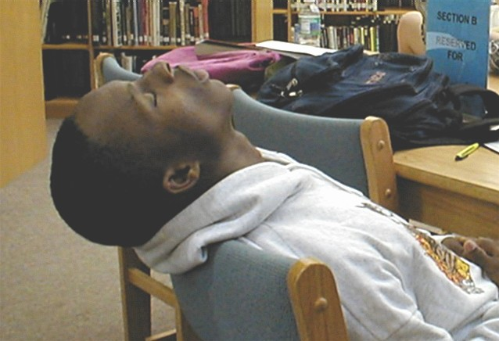
Requirements
Attendance and active participation
Group project and presentation

Slide 11
Group project
Choose and aktivity
Choose who attends the aktivity
Mind map about accessibility
Try out and videotape.
Present in the class and discuss.

Slide 12
Pre-test…..

