Slide 1
An Introduction to Narratology
doc. PhDr. Ondřej Sládek, Ph. D., podzim 2018

Slide 2
The aim of the course is to introduce essential narratological concepts to the students in English, familiarize them with basic theories and methods in the study of narrative. The course objective is to outline in this context:

Slide 3
short history of narrative theory and narratology in the context of study of literature in the 20th century,
the main concepts of narrative theory (e.g. story, narrative, narration etc.),
basic theories and methods using in the study of narrative,
the structure of narrative,
the main components of narrative,
the surface of narrative,
text, narrative and fictional world.

Slide 4
Compulsory Literature
DOLEŽEL, Lubomír. Narativní způsoby v české literatuře. Vyd. 2. Příbram: Pistorius & Olšanská, 2014.
RIMMON-KENAN, Shlomith. Poetika vyprávění. Vyd. 1. Brno: Host, 2001.
SCHMID, Wolf. Narratology: An introduction. Berlin: De Gruyter, 2010.
FLUDERNIK, Monika. An Introduction to Narratology. 1st pub. London: Routledge, 2009.
PRINCE, Gerald. A Dictionary of Narratology. Rev. ed. Lincoln: University of Nebraska Press, 2003. xi, 126.

Slide 5
Literature (in Czech)
J. Mukařovský: Studie I, II, Brno 2000, 2001
F. Vodička: Počátky krásné prózy novočeské, Praha 1994 [1948]
J. Koten: Jak se fikce dělá slovy, Brno 2013
B. Fořt: Teorie vyprávění v kontextu Pražské školy, Brno 2008
T. Kubíček: Vypravěč, Brno 2007
T. Kubíček, J. Hrabal, P. A. Bílek: Naratologie, Praha 2013
A. Jedličková, S. Fedrová: Viditelné popisy, Praha 2016
L. Doležel: Heterocosmica (I-III), Praha 2003, 2014, 2018

Slide 6
Literature (in English)
Handbook of Narratology (see The Living Handbook of Narratology )
http://www.lhn.uni-hamburg.de/
Bal, Mieke. Narratology: Introduction to the Theory of Narrative. 3rd ed. Toronto: University of Toronto Press, 2009.
Narratology. An Introduction. Edited by José Angel García Landa - Susana Onega. 1st pub. London: Longman, 1996.
Current Trends in Narratology. Edited by Greta Olson. New York: De Gruyter, 2011.
What is Narratology? Questions and Answers Regarding the Status of a Theory. Edited by Tom Kindt - Hans-Harald Mèuller. New York: Walter de Gruyter, 2003.

Slide 7
Postclassical Narratology: Approaches and Analyses. Edited by Jan Alber - Monika Fludernik. Columbus: Ohio State University Press, 2010.
Narratology in the Age of Cross-disciplinary Narrative Research. Edited by Sandra Heinen - Roy Sommer. Berlin: Walter de Gruyter, 2009.
Narratology Beyond Literary Criticism, Mediality, Disciplinarity. Edited by Jan Christoph Meister - Tom Kindt - Wilhelm Schernus. New York: Walter de Gruyter, 2005.
Fludernik, Monika. Towards a „Natural" Narratology. London: Routledge, Taylor & Francis Group, 1996.
The Dynamics of Narrative Form Studies in Anglo-American Narratology. Edited by John Pier. New York: Walter de Gruyter, 2004.
Storyworlds Across Media: Toward a Media-conscious Narratology. Edited by Marie-Laure Ryan - Jan-Noël Thon. Lincoln: University of Nebraska Press, 2014.

Slide 8
Scientific Organizations
International Society for the Study of Narrative (ISSN)
http://narrative.georgetown.edu/
European Narratology Network (ENN)
http://narratology.net/

Slide 9
Credit requirements
Credit requirements: students pass the final test which contains questions related to the topics listed in the syllabus. The test is scored. Students must obtain at least 70 % right answers.

Slide 10
An Introduction to Narratology

Slide 11
Story and Narrative
A story is generally understood as a set of events organized in time and in terms of causality.

Slide 12
Story and Narrative
Zoo Story (2010)
The Story of Fossils (2007)
The Story of World (2007)
The Story of Buddhism (2001)
The Story of Art (1950)
Philosophical Stories (2010)

Slide 13
Narrative is a structured sequence of events. It is a narration about “what happened”, when and how it happened (chronology), and such narration also comprises the participants of these events.
Narration may be defined as a presentation of the story.
Story/Narrative Narration

Slide 14
Story/Narration Narration
His story = history
What?
When?
How?
Příběh: při- + sloveso běhat, slovensky príbeh.
Příběh = pribegáť = přibíhat, ale také obracet se oč, žádat apod.
Příběh = (se) přiběhlo, co se seběhlo; co se událo, co se přihodilo.
přihoditi se = při- a slovesa hoditi; to je odvozené ze stč. hoditi sě = strefiti se (tj. v pravé místo zasáhnout) při vrhání oštěpu. Významově blízké je slovo trefiti, které může objasnit i další významy: přihoditi se (přitrefiti se), příhoda aj. (srov. Machek 1997: 173).
Zajímavé je, že slova příběh i příhoda mají v základu sloveso vyjadřující pohyb: běžeti, hoditi.

Slide 15
vyprávět = vy- a slova praviti, které primárně znamená něco „říkati, říci“.
Odvoz: vypravovati, vyprávěti, rozprávěti, odtud rozprava.
Ve slovenštině se objevují slova vyprávať, rozprávať, z toho je odvozeno slovo rozprávka, tj. pohádka.
Praviti = pravý; „říci, říkati to, co je pravé, pravdivé“, „něco jako pravé, pravdivé tvrditi“

Slide 16
Narrative is a structured sequence of events. It is a narration about “what happened”, when and how it happened (chronology), and such narration also comprises the participants of these events.
Narration may be defined as a presentation of the story.
Story/Narrative Narration (diff. Medium)

Slide 17
Story and Narrative
The term narrative = commonly is used in humanities, sciences, and also education. However, in each of these fields the term is used in different ways and for different purposes.
Narratives play important functions in humanities, sciences, and education.

Slide 18
Narrative realism
Like Plato’s realism, narrative realism is based on the belief that narrative structures “exist in human world as such, not only in the stories humans narrate of this world” (Fay 2002: 214). In this sense people find stories in their lives rather than invent them.
We live in stories

Slide 19
Narrative constructivism
Narrative constructivists claim that the flow of events is entirely chaotic and incomplete and that it is us who ascribe them meaning. Our perception of the world is narrative but only because we see the world around us, the objective reality, through the lens of a time sequence of events and a causal grid.
David Hume, Immanuel Kant and modern cognitivists alike believe that both grids are an integral part of the pre set structuring of our mind.
We think in stories

Slide 20
Narrative imagination
According to some cognitive scientists, but also narratologists, narrative imagination represents the fundamental instrument of our thought (cf. Turner 1996).

Slide 21
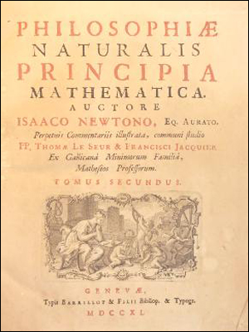
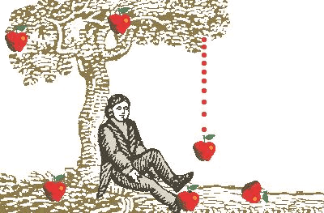
Isaac Newton (1643-1727)

Slide 22
Six key explanatory functions of the narrative in science and humanities
The illustrative function
The historical function
The popularization function
The didactic function
The modelling function
The legitimization function

Slide 23
The other functions of narratives
The other functions of narratives allow us to understand the narrative not as a mental (cognitive) activity, but primarily as a phenomenon with a social dimension.
Narratives also fulfil the role of a means of social and cultural communication.

Slide 24
History
Plato: (Constitution)
Real World (the world of ideas)
Our World (the world of shadows)
Artists vs. Philososphers
Poetics (gr. = poiésis; techné poiétiké; the art of poetics)
Artists = Reflection/Imitation of the world
Imitation = gr. Mimésis (general concept)

Slide 25
Drama/novel/creative writing
      MIMÉSIS + DIEGÉSIS
      DIRECT SPEECH INDIRECT SPEECH
      CHARACTERS NARRATOR (STORYTELLER)

Slide 26
Aristotle (Poetics)
Artists = creative people; can make arguments about the real world
Mimésis / imitaion = gener. concept of art (poetics and aesthetics)
Homér
Tragedy
Writings: fiction vs. realism
                Falsity Truth
                Probability

Slide 27
      Plato´s poetics:
      MIMÉSIS + DIEGÉSIS
      DIRECT SPEECH INDIRECT SPEECH
      CHARACTERS NARRATOR (STORYTELLER)
Henry James: The Art of Fiction (1884)
Percy Lubbock: The Craft of Fiction (1920)
Edward Morgan Forster: Aspects of the Novel (1927)
    SHOWING + TELLING

Slide 28
MIMÉSIS DIEGÉSIS
SHOWING TELLING
Dialogues Descriptions
Evoke situation short summary of the situation
Direct speech (not only) Indirect speech
States, facts
Narrator tell readers what they should think and feel
Describes a situation
May describe the character (sees, hears, smells, feels)

Slide 29
E. Morgan Forster: Story and Plot
E. M. Forster: A Room With a View (1908)
            Howard´s End (1910)
            A Passage to India (1924)
Aspects of the Novel (1927)
Story vs. Plot
Fable vs. Sujet
Story: The King died and then the Queen died.
(story = events arranged in their time sequences)
Plot: The King died and then the Queen died because of grief.
(chronology and causality = narrative)

Slide 30
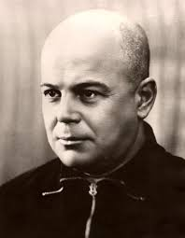
Russian formalism
Moscow linguistic circle (Roman Jakobson)
OPOJAZ (OPOYAZ) - The Society for the Study of Poetic Language
(Peterburg);
Viktor Šklovskij/Viktor Skhlovsky
Jurij Tyňanov/Yuri Tynyanov
Boris Tomaševskij /Boris Tomashevsky
V. Skhlovsky: Theory of Prose (1925)
- „Art as Technique“, 1917

Slide 31
V. Skhlovsky: „Art as Technique“, 1917
The purpose of art is to impart the sensation of things as they are perceived and not as they are known. /Cílem umění je dát pocit věcí jako faktů vidění, nikoli faktů poznání.
The technique of art is to make objects „unfamiliar“
Unfamiliar/actualisation/foregrounding = ozvláštění/aktualizace
Unfamiliar vs. familiar (automatisation)
Study of literature = an analysis the technique of works of art
Not only WHAT? – but: HOW? WHY?
V. J. PROPP: Morphology of the Folktale, 1928
1. Functions of characters serve as stable, constant elements in a tale, independent of how and by whom they are fulfilled. They constitute the fundamental components of a tale.
2. The number of functions known to the fairy tale is limited.

Slide 32
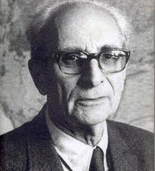
French structuralism
    Claude Lévi-Strauss: myths are narratives which have a special
    logic (human logic);
    explains special order in family relationships
    Myth; Narrative
    Totemism, kinship
    Structural and functional analytical method (structuralist methodology)
    1955, Tristes Tropiques
    1958, Structural Anthropology
    1962, The Savage Mind

Slide 33
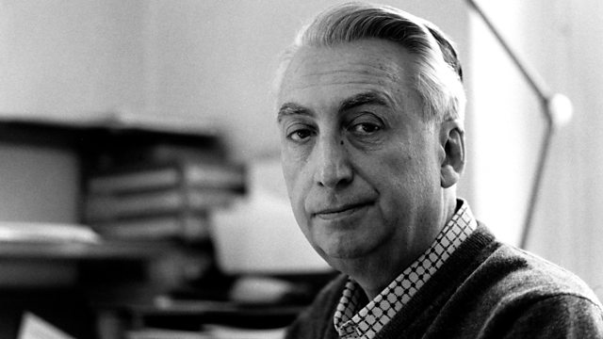
Journals: Communications (esp. no. 8, 1966); Poétique
Classical Narratology or Structural Narratology
Roland Barthes (1915-1980)
  „An Introduction to the Structural Analysis of Narrative“ [1966]
1953 Le Degré zéro de l'écriture
1957 Mythologies
1964 Essais critiques
1965 Eléments de sémiologie
1966 Critique et vérité
1967 Système de la mode
1967 La morte de l’auteur
1970 S / Z
1970 L'Empire des signes
1973 Le Plaisir du texte (Rozkoš z textu).

Slide 34
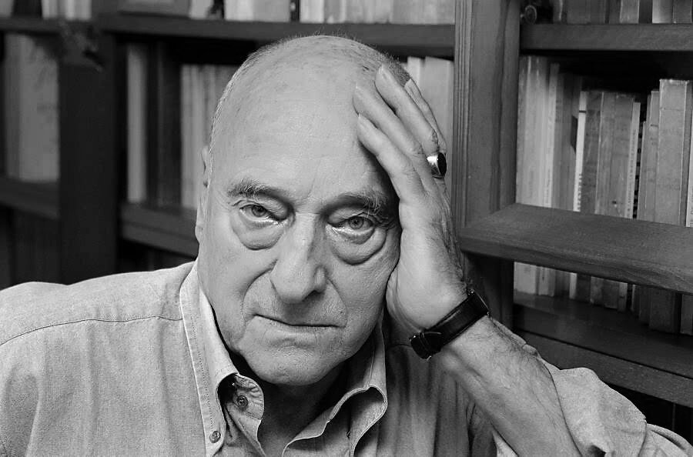
Gérard Genette (1930-2018)
1972, Discours du récit [Narrative Discours] in: (Figures III)
Figures I-V (1967-2012)
Introduction à l'architexte, 1979.
Palimpsestes: La littérature au second degré, 1982.
Nouveau discours du récit, 1983 (transl. as Narrative Discourse Revisited, 1988).
Seuils, 1987. (transl. as Paratexts. Thresholds of interpretation, 1997)
Fiction et diction, 1991.
Métalepse: De la figure à la fiction, 2004.

Slide 35
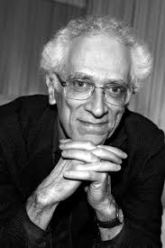
Tzvetan Todorov (1939-2017)
    Edition: An Anthology of Russian Formalism, 1965
    Tzvetan Todorov: Grammaire du „Décaméron“, 1969
    Narratology = Science of Narrative
The Poetics of Prose (1971)
Introduction to Poetics (1981)
The Conquest of America (1982),
Mikhail Bakhtin: The Dialogical Principle (1984)
Facing the Extreme: Moral Life in the Concentration Camps (1991)
On Human Diversity (1993), A French Tragedy: Scenes of Civil War, Summer 1944 (1994), Voices from the Gulag: Life and Death in Communist Bulgaria (1999) etc.

Slide 36
    Narratology (Classical Narratology or Structural Narratology)
= Theory of Narration / Narrative Theory
Postclassical Narratologies = 1980s, 1990s (interdisciplinarity; narrative in sociology, psychology, congnitive sciences etc.)
New Narratology = 2010s (critical revision of classical narratology)

Slide 37
Author Text / Work of Art Reader/Perceiver
            NARRATIVE
Fictional World

Slide 38
Text
Language level: Phones, Word, sentences, paragraphs; selection of words, designation, syntax etc.
Thematic level: motives, characters, settings, fictional world, ideas, plot etc.
Composition level: language + theme
Semantic level (incl. in all of levels)
Intertextuality/intertext (J. Kristeva)
Paratexts (reviews, texts about the text etc.)

Slide 39
Types of representation
Mimésis
Direct representation
Direct speech
Diegésis
Indirect representation
Indirect speech
Category of form:
If form
Er form
Du form

Slide 40
Direct speech FDD FID Indirect speech
Free indirect speech (FID)
Polopřímá řeč
Free indirect discourse
Free indirect style
FID’s use in the eighteenth-century European novel was rudimentary
V. Woolf, J. Joyce
Free direct speech (FDD)
Neznačená přímá řeč, polopřímá řeč
Inner ideas; stream of consciousness

Slide 41
As the International Society for the Study of Narrative defines FID
Free indirect speech [or] free indirect discourse involves both a character’s speech and the narrator’s comments or presentation. Famously utilized by James Joyce, free indirect discourse is a more comprehensive method of representation—one which many times makes indistinguishable the thoughts of the narrator and the thoughts of a character. Thus, the method typically privileges the past tense, yet cannot be discerned through merely grammatical indicators. (“Free Indirect Discourse”)
- past tense
- 3th person
- 1st person = inner monologue == FDD

Slide 42
FID
Lydia was exceedingly fond of him. He was her dear Wickham on every occasion; no one was to be put in competition with him. He did every thing best in the world; and she was sure he would kill more birds on the first of September, than any body else in the country. (J. Austen: Pride and prejudice)
FDD
He said: „ I love her“. She looks so pretty. „And I would like…“, softly whispered he and continued, „ I would like….“

Slide 43
Grammatical tense
DD
He said: „I love her“. (present)
ID
He said that he loved her. (past)
FID
He loved her (past)

Slide 44
DD
He said: „I loved her“. (past)
ID
He said that he had loved her. (past perfect) -- posunutí do minulosti
FID
He had loved her (past perfect) == zachováván posunutí do minulosti
The function of FID: polyphony of voices

Slide 45
Thematic level
Motif, motives, theme
What is it?

Slide 46
Motif = semantic unit (word, sentence)
Motif = the smallest unit of a theme
Theme (= complex of several motives)
fictional world;
characters, settings, ideas, plot etc.
Narrative

Slide 47
TEXT
FICTIONAL WORLD
TIME AND SPACE
CHARACTERS
IDEAS
SETTING

Slide 48
Fictional Worlds
1970´s = Theory of Fictional Worlds: L. Doležel, U. Eco, R. Ronen, T. Pavel etc.
L. Doležel: Heterocosmica
U. Eco: Six Walks in the Fictional Woods
Fictional worlds of literature are "a special kind of possible worlds; they are aesthetic artifacts constructed, preserved, and circulating in the medium of fictional texts" (Doležel 1998, 16).
A fictional possible world - a fictional world - may be regarded as a frame of reference for all entities constructed by the fictional text.
A fictional world is a macrostructure consisting of entities (characters, objects and places) and relations between them. It is however subjected to certain restrictions shaping its nature in a crucial way:

Slide 49
Fictional Worlds
fictional worlds are worlds existing only by virtue of the semantic energy of the text; in other words: a fictional world is accessible through semiotic channels only (reinstated in the act of reading);
fictional worlds and their individual components have the status of unused possibilities;
fictional worlds are "small worlds" (see Eco 1989; 1990, 64-81);
fictional worlds inevitably contain gaps as they are constructed by finite texts (which themselves contain many a gap);
these gaps arise in the act of creation of the fictional world and their nature is therefore primarily ontological.

Slide 50
Character
Fictional entities (fictive people, animals…)
Fictional counterparts (fikční protějšky; historical persons: Napoleon, TGM)
Character and action
Characters = literary types (donor, hero, helper, princess, false hero etc.)
Typization
Characterization: direct/indirect
Name (nickname, abbreviation)
Number of characters
Types of characters: the main/side/accidental
Evaluation: positive/negative
Natural/supranatural/fantastic charactes
Characters: flat/more highly organized
D. Hodrová: character-hypothesis; character-definition

Slide 51
B. Tomashevsky:
Boris Tomasevsky: Theory of Literature, 1925
Fable: events arranged in their time sequences; but also causality
Sujet: fable is material for sujet; sujet = artistic construction of events
E. M. Forster:
Aspects of the Novel, 1927
Story: The King died and then the Queen died.
(story = events arranged in their time sequences)
Plot: The King died and then the Queen died because of grief.
(chronology and causality = narrative)

Slide 52
Narrative
Definition: 2 components
story + plot
story + text
fable + sujet
histoire + discours
histoire + récit
Příběh + xyz (vyprávění)
Definition: 3 components
1. histoire – récit – narration
2. story – plot – discourse

Slide 53
Structuring narratives
Aristotel
Process of rising and falling action through several phases
One plot narratives
Multi-plot narratives
Structural pattern:
Exposition
Complication
Climax
Reversal
Catastrophe

Slide 54
Narrator
Is the agent, the agency or „instance“ that tell or transmits everything (existents, fictional entities, states, events)
Real Author – Text – Real Reader
Real Author – Implied Author – (Narrator) – (Narratee) – Implied Reader- Real Reader
Text: Narrator
Wayne Booths: reliable x unreliable narrator
implied author
Gérard Genette: homodiegetic x heterodiegetic narrator (con. with point of view
focalisation)

Slide 55
fokalizace hlas | Vnitřní | Vnější
Heterodiegetický v. | Portrét umělce, Proces, Paní Dallowayová,úvodní část Hordubala, Lidé na křižovatce, Pan Teodor Mundstock, Informátor | Zabijáci, Cikáni, Křivoklad,Kalibův zločin, Markéta Lazarova
Homodiegetický v. | U tří lilií, Marinka, Škvoreckého cyklus s Dannym, Žert, Obsluhoval jsem anglického krále, Příliš hlučná samota, Český snář | Gil Blas, Bílá velryba, Běsi, Petrolejové lampy

Slide 56
Narrative speed
= the relation between „story time“ (the durationn of events on the level of action) and „discours time“ (the time it takes to reount the events).
Storytelling slows down when action is presented scenically (description) and speeds up in summary.

