Slide 1
SZ6600/SZ6626
Introduction to Education and Psychology
The Introduction into Education – Mgr. Kateřina Lojdová, Ph.D.

Slide 2
Welcome at Masaryk University!
https://www.youtube.com/watch?v=_FQBx_lGoLY

Slide 3
Psychology
SZ6600 – prof. Buckova – Wednesdays from 7th October
SZ6626 – Mgr. Havelka – Friday 1th November, 13:00--16:50

Slide 4
Final exam
SZ6600 + SZ6626
Test – includes Education and Psychology
SZ6626
- Essay – how do I imagine a good teacher (1 page) - upload in Information system till 13th December
- attendance (or substutional assignment from Education/Psychology)

Slide 5
Lesson 1:
Definiton of educational sciences
A Brief history of education

Slide 6
Educational sciences
What is the subject of educational sciences?
Subject: educational reality
Educational reality includes its:
determinants
process
outcomes
effects

Slide 7
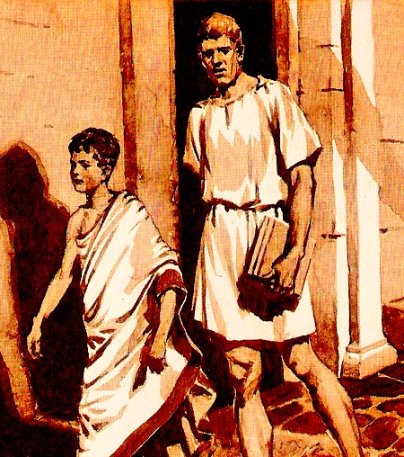
Educational science x Pedagogy
Pedagogy - etymology
from Greek paidagogos:
"slave who escorts boys to school and generally
supervises them“

Slide 8
A brief historical overview
up to the end of the 19th century, pedagogical thoughts were totally embeded in Philoshopy (cf. Plato, Aristotle, Jean-Jacques Rousseau, John Locke…)
    Reading: Jean-Jacques Rousseau: Emile, or On Education
Jon Amos Comenius (1592 – 1670) - formulated the general theory of education
Reading: Didactica Magna/Great Didactic: https://archive.org/details/cu31924031053709/page/n17, chapter IX, X, XII
german philoshopher Johann Friedrich Herbart (1776 –1841) can be considered as a founder of pedagogy as an academic discipline
G. A. Lindner (1828-1887) the first professor of pedagogy at the Czech Charles-Ferdinand University, since 1882
John Dewey (1859 – 1952) an american philosopher, psychologist and educational reformer

Slide 9
A brief historical overview
Normative Pedagogy vs. Exploratory Pedagogy
Normative theories of education provide the norms, goals, and standards of education.
From the twentieth century onwards, empirical research became one of the constitutive elements of educational science.
The turn of the paradigm?
Set of concepts or thought patterns, including theories, research methods, postulates, and standards for what constitutes legitimate contributions to a field.
  Read: Kuhn: The Structure of Scientific Revolutions

Slide 10
Educationalal sciences
educational research is often conceived as the interdisciplinary study of educational processes and practices
Educationalal sciences:
History of Education
Didactics
Comparative Education
Special Education
Sociology of education
Educational psychology
Economics of education
Discuss interdisiciplinarity of educational sciences:
Philosophy
History
Sociology
Psychology

Slide 11
The Introduction into Education
Lesson 2
Mgr. Kateřina Lojdová, Ph.D.

Slide 12
Teaching profession
Helping profession
A profession that nurtures the growth of or addresses the problems of a person's physical, psychological, intellectual, emotional or spiritual well-being.
Career system
Code of ethics
https://www.aaeteachers.org/index.php/about-us/aae-code-of-ethics

Slide 13
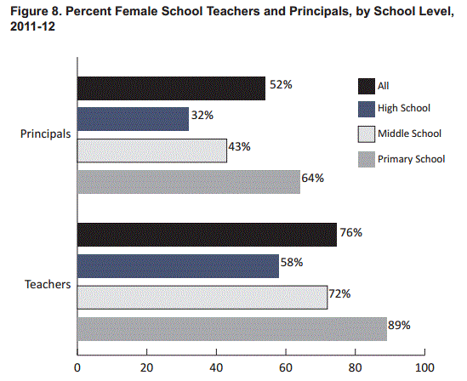
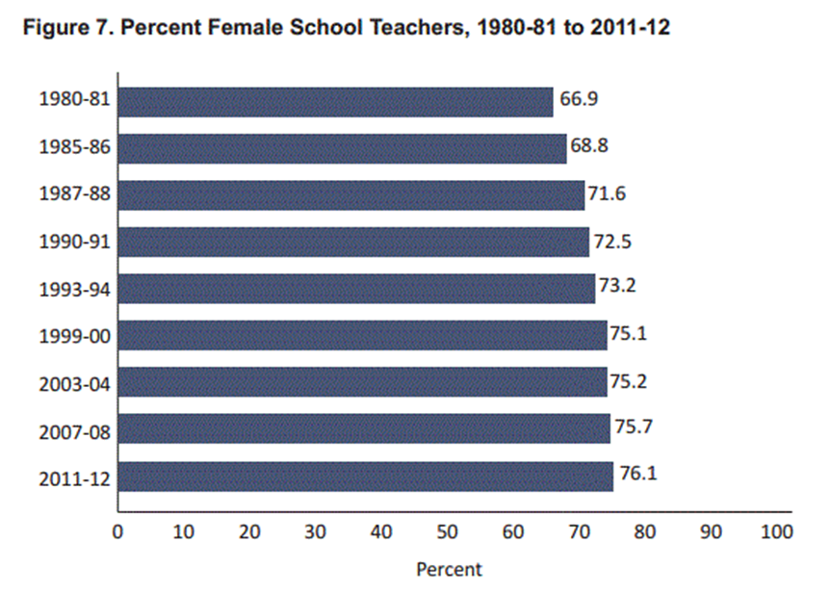
Teaching profession
Feminization (U. S. example)
Many traditionally male professions (doctors, lawyers, architects, ...) have opened up to women over the last several decades. Surprisingly, this has not translated into fewer women entering teaching:

Slide 14
Teaching profession
Feminization (U. S. example)
Many traditionally male professions (doctors, lawyers, architects, ...) have opened up to women over the last several decades. Surprisingly, this has not translated into fewer women entering teaching
Ingersoll, Merrill and Stuckey conclude that this trend is worrisome:
"If the trend continues, soon 8 of 10 teachers in the nation will be female. An increasing percentage of elementary schools will have no male teachers. An increasing number of students may encounter few, if any, male teachers during their time in either elementary or secondary school. Given the importance of teachers as role models, and even as surrogate parents for some students, certainly some will see this trend as a problem and a policy concern. Moreover, an increasing proportion of women in teaching may have implications for the stature and status of teaching as an occupation. Traditionally, women’s work has been held in lower esteem and has paid less than male-dominated work. If the feminization of teaching continues, what will it mean for the way this line of work is valued and rewarded?"

Slide 15
Teaching profession
Fenstermacher (1990) notes three critical differences between the practice of teaching and that of medicine:
“the mystification of knowledge”
teaching requires that teachers impart their knowledge not only to their students but also, to parents. This requirement stands in marked contrast to the traditional efforts of most professions to lock away their specialized knowledge even when it is of the most elementary nature.
“social distance”
Impersonality, another characteristic of professional practice, similarly makes little sense with teaching. Students are not “cases” with very specific needs to diagnose and meet, and to treat them in such a fashion contradicts what we know about good teaching.
“reciprocity of effort”
In order to learn, students must engage in the learning process—they must expend effort. This sustained “reciprocity of effort” is another factor that distinguishes teaching from other professions.

Slide 16
Paraprofessionals in education
The paraprofessional is able to perform tasks requiring significant knowledge in the field, and may even function independently of direct professional supervision, but lacks the official authority of the professional.
Teaching Assistant
http://education.ufl.edu/spense/files/2013/05/parasFinal.pdf

Slide 17
Summary of research findings
(Teachers' Qualifications and Their Impact on Student Achievement Findings from TIMSS-2003 Data in Israel )
Teachers’ Formal Education
Findings related to teachers' academic degrees (e.g., bachelors or masters, etc.) are inconclusive
Teacher Education in Pedagogical Studies
Studies have found somewhat stronger, and more consistently positive, influence of education and pedagogical coursework on teacher effectiveness
Duration of the Preparation Period
5-year programs result in a higher retention rate and career satisfaction of their graduates than 4-year programs. It has not been shown that these graduates become more effective teachers.
Years of Experience
Studies on the effect of teacher experience on student learning have found a positive
relationship between teacher effectiveness and their years of experience, but not always a
significant or an entirely linear one

Slide 18
Teaching profession
According to Fenstermacher (1994), there's not always congruence between the knowledge that the teachers obtain during their education and the knowledge acquire through experience. Therefore, he discriminated two types of knowledge in the teachers, formal knowledge and practical knowledge.

Slide 19
The Introduction into Education
Lesson 3: Reflection and Portfolio in teacher education and teaching professions
Mgr. Kateřina Lojdová, Ph.D.

Slide 20
Reflection and self-reflection in teaching professions
Reflection
The insight gained through the conscious or unconscious internalization of our own or observed experiences which build upon our past experiences or knowledge (Beard and Wilson, 2002:16);
Reflection is a form of mental processing, like a form of thinking that we may use to fulfill a purpose or to achieve some anticipated outcome (Moon)
Reflection includes self-reflection (Danielson).
Reflection and learning
‘It is not sufficient simply to have an experience in order to learn. Without reflecting upon this experience it may quickly be forgotten, or its learning potential lost. It is from the feelings and thoughts emerging from this reflection that generalisations or concepts can be generated. And it is generalisations that allow new situations to be tackled effectively.’ (Gibbs 1988)

Slide 21
Why reflect?

Slide 22
Why should be teacher a reflective practitioner?
Teaching is an act of thoughtfulness
Thoughtful teachers engage in reflective practice as a way to think about their teaching and about ways to continually develop and implement curriculum that is personally meaningful and culturally relevant to students
Reflective teaching means looking at what you do in the classroom, thinking about why you do it, and thinking about if it works - a process of self-observation and self-evaluation.

Slide 23
Tools of reflection
Teacher diary
Videorecord of the lesson
Feedback from colleague
Feedback from students
Diagnostic tools
Portfolio

Slide 24

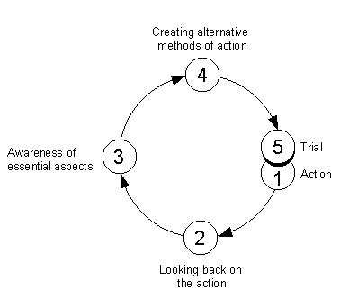
How to reflect?
Fred Korthagen: ALACT

Slide 25
Deepening Reflection
moving beyond the descriptive, and subjecting your experience to greater scrutiny
Description: What is the stimulant for reflection? ( incident, event, theoretical idea ) What are you going to reflect on?
Feelings: What were your reactions and feelings?
Evaluation: What was good and bad about the experience? Make value judgements.
Analysis: What sense can you make of the situation? Bring in ideas from outside the experience to help you. What was really going on?
Conclusions (general): What can be concluded, in a general sense, from these experiences and the analyses you have undertaken?
Conclusions (specific): What can be concluded about your own specific, unique, personal situation or ways of working?
Personal Action plans: What are you going to do differently in this type of situation next time? What steps are you going to take on the basis of what you have learnt?

Slide 26
Professional portfolio
A professional portfolio is a collection of carefully selected artifacts that represent your progress
and accomplishments in learning to teach. It is a professional learning tool that you can use to
reflect on your growth as a teacher over time.
Main goals:
- presentation
- reflection
- self-reflection
- documentation
https://www.youtube.com/watch?v=RAtNNsOUgjo&t=477s

Slide 27
Student portfolio
As you engage in reading, writing, thinking, interacting and demonstrating activities to enhance your professional learning in the teacher preparation program, you will also gather and reflect upon various artifacts that will become potential portfolio items:
seminar papers
book and journal notes, summaries
curriculum overviews
lesson plans, materials
assessment tools and results
posters
videotapes
pictures

Slide 28
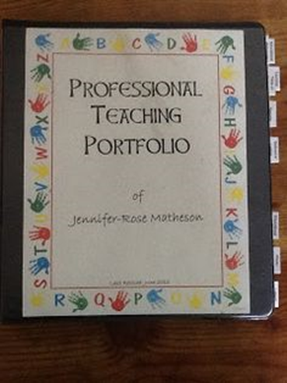
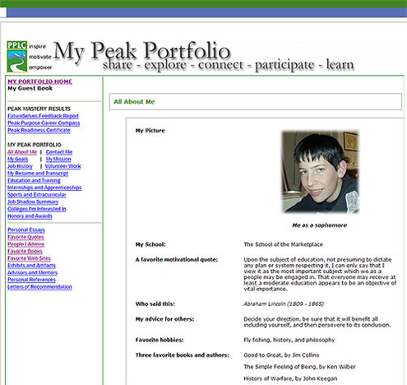

Student portfolio

Slide 29
The Introduction into Education
Lesson 4: Pupil At School
Mgr. Kateřina Lojdová, Ph.D.

Slide 30
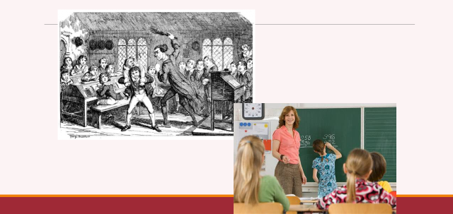
A matter of changed?

Slide 31
Pedocentrism
Ellen Key: The Century of the Child, 1909
„Not leaving the child in peace is the greatest evil of present days methods of training children.“
„Education is determined to create a beautiful world in which child can grow.“
Read here:
https://archive.org/details/centurychild00frangoog

Slide 32
Pedocentrism
Reform schools (beginning of 20th century)
• Waldorfs (https://www.youtube.com/watch?v=tZmAX5adCl0)
• Montessori
• Dalton
• Jena plan
• Freinet pedagogy
Criticism of traditional school
    Intelectualism (lack of complex development: aesthetical, health…)
    Mechanical learning
    Authoritative education
    Lack of individualism
    Isolation of school and family

Slide 33
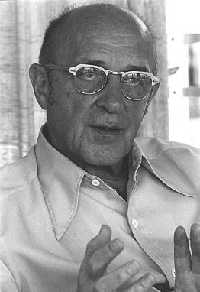
Pedocentrism
1921: Summerhill founded by Alexander Sutherland Neill – democratic school
https://www.youtube.com/watch?v=2Shah1Ulf98
Carl Ransom Rogers (1902 –1987)
student-centered learning, also known as learner-centered education
aims to develop learner autonomy by putting responsibility for the learning path in the hands of students.
puts students' interests first
emphasizes each student's interests, abilities, and learning styles
placing the teacher as a facilitator of learning for individuals
Carl Ransom Rogers

Slide 34
Structural Arrangements of Childhood
Social and cultural background
Social and cultural capital
Gender
Race
Ethnicity
Structural arrangements of these categories will affect the nature of childhood (Corsaro, 2015).
Family provides the basis for its race, cultural and social capital, family traditions and social status.
During adolescence, the child can emancipate itself from some of the family’s characteristics, but not from all (Allport, 1958).

Slide 35
Social and cultural background
James S. Coleman (1926–1995):
- differential achievement of poor children attending private, Catholic, and public schools
Catholic high schools possessed more "social capital„.
Explained the importance of social cohesion that has diminished with social progress.

Slide 36
Social capital
Social capital is the sum of the resources, actual or virtual, that accrue to an individual or a group by virtue of possessing a durable network of more or less institutionalized relationships of mutual acquaintance and recognition. (Bourdieu)
‘It’s not what you know, it’s who you know’,
Coleman’s approach leads to a broader view of social capital, where it is not seen only as stock held by powerful elites, but notes its value for all kinds of communities, including the powerless and marginalised.

Slide 37
Cultural capital
Non-financial social assets that promote social mobility beyond economic means. Examples can include education, intellect, style of speech, dress, or physical appearance.
Forms of knowledge, skills, education, and advantages that a person has, which give them a higher status in society. Parents provide their children with cultural capital by transmitting the attitudes and knowledge needed to succeed in the current educational system.

Slide 38
Why social backgound matters at school?
Bourdieu (1998) points out that school contributes to the continuation and transfer of cultural capital division and thus also social space structure. It maintains existing order, namely the distance between pupils with various volumes of cultural capital.

Slide 39
Why social backgound matters at school?
Basil Bernstein: Theory of language code
Elaborated code and restricted code
There are two factors which contribute to the development of either an elaborated or restricted code:
the nature of the socialising agencies (family, peer group, school, work)
the values within the system.
According to Bernstein (1971), “The orientation towards these codes may be governed entirely by the form of the social relation, or more generally by the quality of the social structure” (p. 135).

Slide 40
Why social backgound matters at school?
Bernstein and educational research
He argued that schools are the main place where students shape their own values and intuitive and practical views of the world.
Bernstein’s most recent development of his code theory can help the educational researcher to analyze the social processes within educational organizations.
Bernstein’s Code Theory and the Educational Researcher:
http://citeseerx.ist.psu.edu/viewdoc/download?doi=10.1.1.674.5974&rep=rep1&type=pdf

Slide 41
Gender
Gender is the range of characteristics pertaining to, and differentiating between, masculinity and femininity.
Gender is not determined biologically, as a result of sexual characteristics of either women or men, but is constructed socially.
Gender impacts a child’s experience at school across the grades.
Schools have a tremendous opportunity and responsibility to be inclusive of all students, regardless of their gender identity.
Gender sensitive education.

Slide 42
Gender differences between boys and girls at school
Small or negligible overall gender differences have been found on IQ tests and tests of reasoning
The gender gap arises mainly because of differences between boys and girls in language and literacy skills, reflected in differences in performance in English and other subjects which are literacy based.
The gender gap is small or negligible for Maths and Science.
Pre-school gender differences in social, cognitive and communication measures have been found, as well as gender differences in the activities that parents carry out with their children:
Parents are more likely to read and teach songs and nursery rhymes with their daughters than their sons.
Boys are more likely than girls to be identified with special educational needs:
  Boys are more likely than girls to attend special schools.
  Girls are more likely than boys to have been the victim of psychological bullying while boys are more likely than girls to have been the victim of physical bullying.
  Boys are more likely to have committed a criminal offence (e.g. handling stolen goods, stealing, carrying a weapon) than girls (33 percent compared to 21 percent)
The social class attainment gap at Key Stage 4 (as measured by percentage point difference in attainment between those eligible and not eligible for free school meals) is three times as wide as the gender gap.
Some minority ethnic groups attain significantly below the national average and their under-achievement is much greater than the gap between boys and girls.

Slide 43
Reasons of the Gender Gap
Girls and boys tend to use different styles of learning. Girls tend to show greater levels of motivation and respond differently to the materials and tasks given to them.
Girls find it easier to succeed in school settings.
Type of school does not appear to influence the gender gap: across schools in England, there are hardly any where boys make greater progress than girls.
Boys are more likely to be influenced by their male peer group which might devalue schoolwork.
Gender and education: the evidence on pupils in England
http://webarchive.nationalarchives.gov.uk/20090108131525/http:/dcsf.gov.uk/research/data/uploadfiles/rtp01-07.pdf

Slide 44
Cultural clash
Fordham a Ogbu (1986)
- perception of academic achievement by black students
Hendrickson: Student Resistance to Schooling: Disconnections With Education in Rural Appalachia
Student reasons for resisting engagement with school.
Student resistance to school is considered within a White, working-class student population in three main themes: family values and expectations, quality and relevance of education, and misunderstandings between teachers and students.
These themes underscore the various tensions experienced by students whose schools encourage higher education and abstract concepts, but whose parents encourage values of family and vocational work. Thus, the students do not value the education provided by the school, leading to disengagement and misunderstandings with teachers.

Slide 45
Summary: discuss
Pedocentrism as an approach in education.
Structural characteristics affecting schooling: social status and gender.
Elaborated and restricted language code at school.
Gender vs. sex. Gender and schooling.
Gender sensitive education.
Read to understand pupils:
Corsaro, W. A. (2015). The sociology of childhood (4th ed.). Thousand Oaks, Calif.: SAGE Publications.
Read to understand democracy at school:
Neill, A. S., & Lamb, A. (c1992). Summerhill School: a new view of childhood. New York: St. Martin's Griffin.
Read to understand person-centered teaching :
Rogers, C. R., Lyon, H. C., & Tausch, R. (2014). On becoming an effective teacher: person-centered teaching, psychology, philosophy, and dialogues with Carl R. Rogers and Harold Lyon. London: Routledge.

Slide 46
Educational System and Curriculum
Lesson 6
Katerina Lojdova
lojdova@ped.muni.cz

Slide 47
Basic facts – Czech educational system
Compulsory school attendance
Literacy rate
Classification system: 1 – 5
Preschool enrollment is compulsory for children in their last year before entering elementary school
Elementary education takes 9 years, usually from ages 6-15
Elementary education is divided into two stages: primary (grade 1 – 5) and lower secondary (stage 6-9)
In addition, children have the option to apply for gymansium or concervatory
Upper secondary education can be general or vocational
Upper secondary education takes 3 – 4 years and is mandatory
Tertiary education: Bologna process

Slide 48
ISCED
https://www.czso.cz/csu/czso/1-46002d8b18

Slide 49
Basic education in the Czech Republic
Educational reform: Act No. 561/2004 Sb.

Slide 50
Framework Educational Programme for Basic Education
www.msmt.cz/file/9481_1_1/
Defines initial education as a whole.
The Framework Educational Programmes devone binding educational norms across various stages: pre-school education, basic education and secondary education (for pupils and students from 3 to 19 years of age)are based on a new education strategy, stressing key competencies, their interlinking with educational contents and the application of acquired knowledge and skills in practical life; build on the concept of life-long learning promote the educational autonomy of schools as well as teachers’ professional responsibility for the outcomes of the educational process.

Slide 51
Objectives of basic education
Create preconditions for pupils to acquire basic learning strategies and motivate them to life-long learning
Stimulate and encourage pupils to creative thinking, logical reasoning and problem solving
Guide pupils to engage in efficient, effective, open communication on all aspects of their life
Develop pupils’ abilities to cooperate and to value their own work and achievements as well as the work and achievements of others
Guide pupils so that they should become free and responsible individuals who exercise their rights and meet their obligations
Induce in pupils the urge to express positive feelings and emotions in their behaviour, ways of acting and when experiencing important situations in their lives; develop in them sensitivity and responsiveness towards other people, the environment and nature

Slide 52
Objectives of basic education
Teach pupils to actively develop and protect their physical, mental and social health and to be responsible for it
Guide pupils to tolerance and consideration for other people, to a respect for their culture and spiritual values; teach pupils to live together with others
Help pupils to discover and develop their own abilities and skills in the context of actual opportunities and to use their abilities and skills in combination with their acquired knowledge when making decisions regarding the aims of their own life and profession

Slide 53
Educational fields
Language and Language Communication (Czech Language and Literature, Foreign Language)
Mathematics and Its Applications (Mathematics and Its Applications)
Information and Communication Technologies (Information and Communication Technologies)
Humans and Their World (Humans and their World)
Humans and Society (History, Civic education)
Humans and Nature (Physics, Chemistry, Natural Sciences, Geography)
Arts and Culture (Music, Fine Art)
Humans and Health (Health Education, Physical Education)
Humans and the World of Work (Humans and The World of Work)

Slide 54
Key competencies
learning competencies;
problem-solving competencies;
communication competencies;
social and personal competencies;
civil competencies;
working competencies

Slide 55
Cross-Curricular Subjects
Cross-curricular subjects in the FEP BE are subjects related to contemporary present-day issues and represent an important and inseparable part of basic education. They represent an important formative element of basic education.
This contributes to the pupils’ comprehensive education and positively influences the formation and development of their key competencies.
Cross-curricular subjects represent a mandatory part of basic education. Schools must include all cross-curricular subjects contained in the FEP BE10 into Stages 1 and 2 of education. Not all crosscurricular subjects, however, must be represented at each grade level. It is the school’s responsibility to, over the course of basic education, gradually offer pupils all thematic areas contained in the individual cross-curricular subjects.

Slide 56
Cross-curricular subjects
Personal and Social Education
Democratic Citizenship
Education towards Thinking in European and Global Contexts
Multicultural Edu cation
Environmental Education
Media Education

Slide 57
Learning outcomes:
After completing the course, the student will be able to:
• understand the basics and terminology of education and psychology;
• read common educational and psychological texts for teacher, understand them and think about them creatively;
• distinguish between academic education and psychology knowledge and common popular education and psychology knowledge.
Literature
Wood, K. (2012). Education: the basics. Routledge.
International handbook of teacher education. Edited by John Loughran - Mary Lynn Hamilton. Singapore: Springer, 2016.
The Sage handbook of curriculum, pedagogy and assessment. Edited by Dominic Wyse - Louise Hayward - Jessica Zacher Pandya. Los Angeles: Sage Reference, 2016.

Slide 58
What are the up-to date topics of educational research? – chce educational journals
Czech educational journals (read English issues):
Pedagogika:
http://pages.pedf.cuni.cz/pedagogika/?lang=cs
Pedagogická orientace:
https://journals.muni.cz/pedor
Studia paedagogica:
http://www.phil.muni.cz/journals/studia-paedagogica
Orbis Scholae:
http://www.orbisscholae.cz/

