Slide 1
theoretical definition
Jana Kratochvílová
Educational Diagnostics

Slide 2
diagnostic and intervention skills (Vašutová, J., 2004 ).
The teacher:
can use the resources of pedagogical diagnostics when teaching for diagnosing the individual needs of the student and the social relationships in the classroom
is able to identify students with specific learning and behaviour differences and is able to adapt the selection of subject matter and teaching methods for their needs
Manages to find ways to teach gifted students in the classroom
is able to recognize socially pathology, bullying, abuse and knows and employs ways to prevent and remedy it.
Manages to ensure discipline in the classroom and knows how to solve behavioural situations and behavioural problems within the school context
Individualisation and differentiation in the educational process

Slide 3
The concept of pedagogical diagnostics
from the Greek diagnósis = knowledge
the student in an educational situation
Educational group (school class)
the teacher’s own educational activities (self-diagnosis)
It is often perceived as a new pedagogical discipline, but its roots go deep into the past.
It is bound to the school environment and is most often associated with the activities of the teacher.
Requires theoretical knowledge, methodological equipment, practical experience, a lot of time and effort not only for the diagnostic work itself, but also for evaluation (the time aspect is often a reason why teachers neglect to undertake quality diagnostic activities).

Slide 4
Definition of Educational Diagnostics
A combination of practical teaching and teaching theory
Educational diagnostics can be spoken about as a field of pedagogical theory and related methodological practice:
finding out, identifying, classifying, characterizing and evaluating the level and projected pedagogical development of a pupil (or group of pupils in relation to the objectives set.)

Slide 5
Diagnosing and Diagnosis
Diagnosing – the activity
Finding out information
Processing the information gained
Evaluation
Introduction of measures and…
Initial diagnosing
Continuous diagnosing
Final diagnosing
Diagnosis
is the result of the process of diagnosing
is a subsidiary aim on the basis of which the teacher directs his/her activities (Prucha)

Slide 6
Approaches and current trends in educational diagnostics
Psychometric strategy (educometric)
Based on the assumption that to some extent we all have basically the same inclinations which are therefore measurable.
This leads to the transfer of information on quantifiable data (transferable units, points), which are evaluated with the help of statistics.
The extent of observed phenomena is measured.
Usually normative or criterion-based diagnostics
Cased-based clinical strategy (cognistic)
Focused on the individuality of the diagnosed person (e.g. outward behaviour of the pupil in the class with regard to classmates or teachers).
Empathy and acceptance of the diagnosed person are emphasised, understood as a partner who we want to help.
Based on qualitative exploration of the phenomena and description of the individual case.

Slide 7
Typology of pedagogical diagnostics
Informal diagnosis - microdiagnosis (implicit, hidden)
Formal diagnosis - the diagnostic situation is clearly demarcated at certain stages of teaching. There are notes and records about it and specific methods used (explicit)
Formative diagnosing - This helps the teacher to shape the pupil. It serves as feedback on the teacher’s work. The teacher can take measures based on this.
Summative diagnosing - the aim is to determine the level reached by the student for a specified period. It summarizes information about the student.
Normative– the result of an individual is compared with the results of a representative sample of the population in the same test. Comparison among peers.
Criterion-based– a comparison with external benchmarks, with objectively defined tasks (the pupil manages to use i and y correctly when writing...)
Individualised– comparing the child only in relation to him/herself, without comparison with peers.
Differential– used to distinguish problems that may have the same symptoms but different causes

Slide 8
Hypothesis
Collection and processing of data
The core of the process
Fieldwork using diagnostic methods and tools
Development and organization of data
Evaluation and interpretation
Correcting errors - work with error (error detection, identification, interpretation, correction)
The diagnosis
Educational measures
Analysis of the data collected, description, categorization
This is created by comparing the current state of the pupil with the state required - criteria, standards, aims of the teacher
Forecasting
Discover the pupil’s abilities, forecast the pupil’s further development
communication
student
parents
psychologists, educational consultants, teachers
Diagnostic assumption that gives a certain direction to the activities
Implicit or explicit
Confirm or refute.
Conclusion
Explanation again, more practice, use of other methods, motivation, moving the pupil

Slide 9
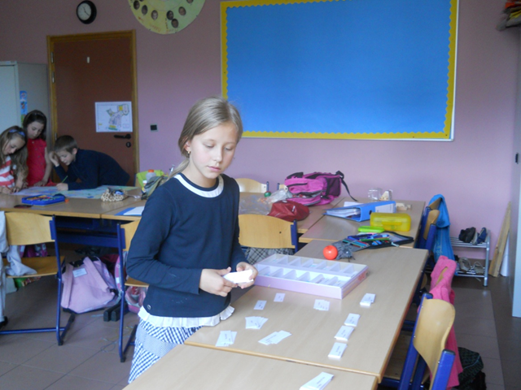
Two planes OF diagnosing IN THE classroom
Descriptive-analytical
Prescriptive-analytic
what is the pupil like, diagnosis of the pupil
What is the pupil like, diagnosis
+
What am I like as a teacher
increasing the effectiveness of teaching
discovering the abilities of the pupil
organizing teaching to fit the pupil’s individual needs
mastering the lessons
responsibility of the teacher for the quality of teaching and pupil outcomes

Slide 10
Methods of educational diagnosis
Method: process, way, means of discovering the pupil's personality
The steps that we need to take to arrive at comprehensive knowledge of the pupil (see stages of diagnostic procedure)
Based on the research methods for pedagogy.
It is a whole system of methods.
The methods vary in their intensity of preparation, implementation and evaluation.
Using them requires certain experience with diagnosis.
During the process of diagnosing, not only one method should be relied on (triangulation), but the methods of pedagogical diagnosis must be appropriately combined.

Slide 11

diagnostic methods
Oral examinations
formative
summative
Written examinations
formative x summative
individual x group
short-term x long-term work (projects, book reports,)
  Finding out the results – levels of skills achieved and outcomes from individual fields of education (knowledge, skills, attitudes ...)

Slide 12
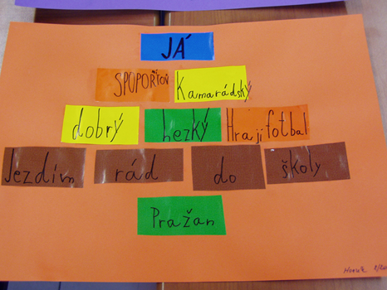
Diagnostic methods - Analysis of the products OF pupil activity
used to obtain information about:
people’s hidden mental states, attitudes, values of an individual ​​
skills and knowledge
short-term x long-term results of work
articles, written work, drawings), notes, letters ....
portfolio - a set of a pupil's work over a certain period

Slide 13
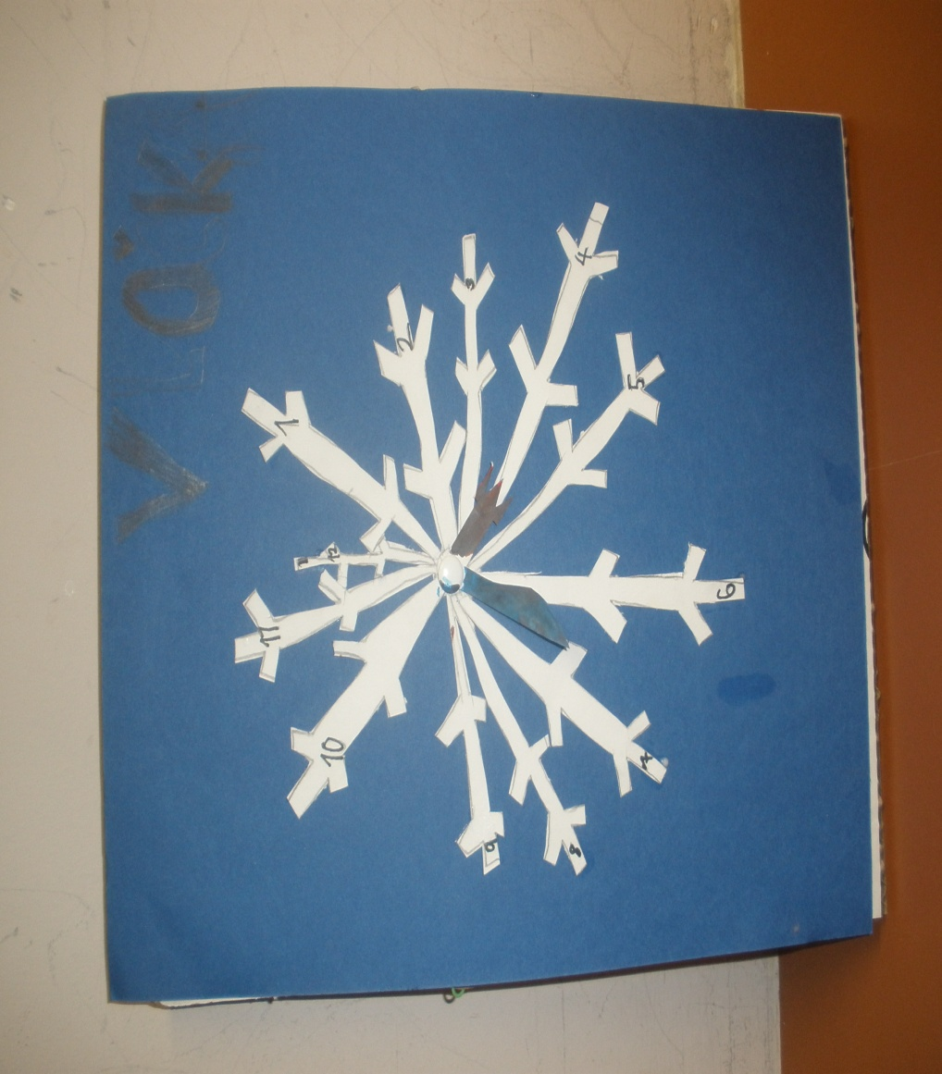
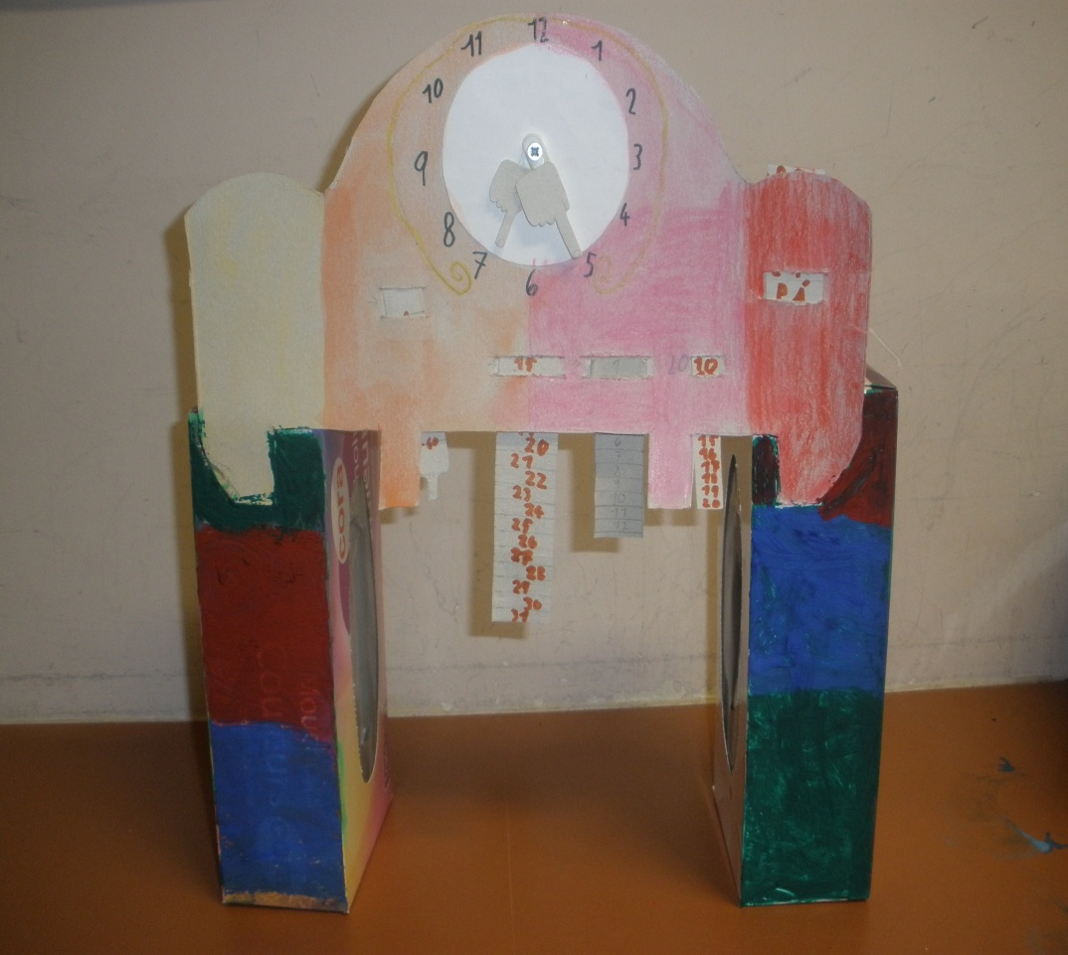
What information can be obtained from analysing these products?

Slide 14
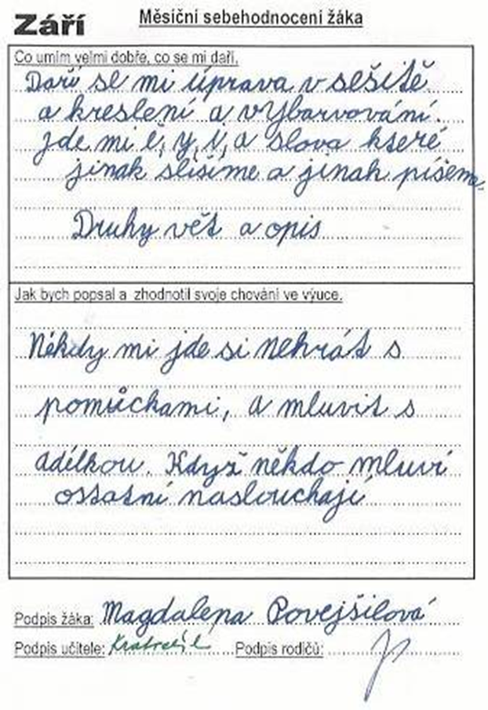
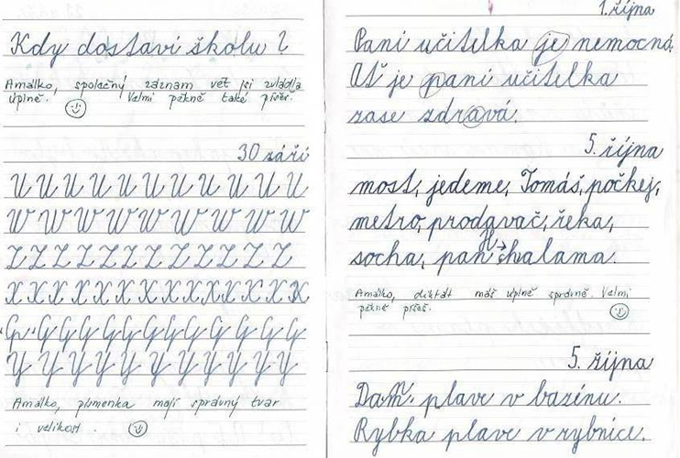
Texts – analysis
In school exercise books: dictations, individual work, rewriting, copying
Free writing - creative writing
Project texts
Own notes, letters to friends, messages

Slide 15
observation
1) Length of observation
    Short-term
    Long-term
2) Who are we observing
    Introspection- inspecting ourselves
    Extrospection –observing others
3) Participation in observation Direct
Indirect– from recordings
4) Aim of the observations
    Individual
    Group
5) Intervention in the observation
    Natural (free)
    Induced (guided)
6) Preparation for the observation
    Structured– we determine the types of phenomena, categories, and observational tool - system.
    Unstructured– observation of spontaneous activity in a given situation without preparing an observation system.

Slide 16
The process of observing
determine the purpose and object of observation (why, what, who)
determine the conditions and duration of observation (where, when)
choose the method of recording observations (how)
observation, recording of results
analysis of the records
interpretation of results, formulation of diagnosis
educative measures, prognosis
self-reflective diagnostic activity (how to do it better)

Slide 17
What we can observe
observation techniques
What we can see and hear of the pupil’s behaviour
We can measure, describe and record it
We watch the activity and behaviour of the pupil
We evaluate everything
pedagogical journal
observation sheets
observation systems
protocol
records about the student
We use - rating (observational scales)

Slide 18
Diagnostic methods - Interviews
One of the most widely used diagnostic methods → at school there are many opportunities and a lot of space to conduct an interview with a student
Provides information on the basis of immediate verbal contact with the researched person (student, parent)
The most effective method has been shown to be a conversation where the pupil does not realize that the teacher is gathering information in a deliberate way.
You will need: to create a pleasant atmosphere without the feeling that anyone will be criticized or judged for what they say (parent and child)
The interview usually leads systematically from basic questions to questions that lead to deeper understanding and diagnosis of the problem
It has clear steps and a goal which we want to reach.
The questions are clear and understandable for a pupil of this age

Slide 19
Interview
Aim
Preconcepts
What do you want?
Preparation
Place
Time
The course of the interview
Questions
Evoking the atmosphere
Open x closed
Knowledge
Attitudes
Interest
Learning style
Relationship
Strategy
The “opening”
Method of recording
Asking questions
Conclusion
Type of interview
Errors in interviews
Not being prepared
Free
Controlled (structured, unstructured, semi-structured),
Individual x group
Authoritative guidance
Rapid alteration of questions and answers
Influencing
Length
Premature conclusions
Closed questions

Slide 20
LiteraturE
Gavora, P. Výzkumné metody v pedagogice. Brno : Paido, 1996, p. 65–71.
GAVORA. P. Diagnostikovanie a hodnotenie žiaka vo vyučovaní. In. KOLLÁRIKOVÁ, Z., PUPALA, B. Předškolní a primární pedagogika. Praha: Portál, 2001. p. 237.
MOJŽÍŠEK, L. Teoretické otázky pedagogické diagnostiky. Praha: Academia, 1987. p.15-16.
PRŮCHA, J.(Ed.). (2009) Pedagogická encyklopedie. Praha: Portál.
Spáčilová, H. Pedagogická diagnostika v primární škole. Olomouc : UP, 2003, p. 41–44.
Tomanová, D. Úvod do pedagogické diagnostiky v MŠ. Olomouc : UP, 2006,
p. 53–55.
VAŠUTOVÁ, J. (2004). Profese učitele v českém vzdělávacím kontextu. Brno: Paido.
ZELINKOVÁ, O. Pedagogická diagnostika a individuální vzdělávací program. Praha: Portál, 2001. p. 12.

