Slide 1

A snapshot from my personal experience with diversity: Culturally responsive practices & the Czech Republic
Sheri Kingsdorf, Ph.D., BCBA-D
Institute for Research in Inclusive Education
Masaryk University

Slide 2
Goals
Describe culture.
Define the relationship between diversity and inclusive education.
Select culturally responsive teaching practices.
Identify how cultural responsiveness can be incorporated into classroom management.

Slide 3
Culture
A human-made construct.
Ideas, customs, and behaviors of a group of people.
Cultural identity may include these:
  Race, ethnicity, age, geographic region, sexuality, religion, social status, language and ability.
(Liang & Zhang, 2009)
Notes:
https://www.tandfonline.com/doi/full/10.1080/09500790903082354?casa_token=j_7rU8vtLJMAAAAA:WQ5Lszw6R4wPVm0BM7UczL5_q4o8Fttp9k7zjWrejSYYVSvZ4wMsWaM_a5J89lJeFxhsxKofg_7A

Slide 4
Poll
With which of the following categories do you most strongly identify?
Czech
European
White
None of these.
Notes:
CRT 1

Slide 5
Personal identification
At some point in my life:
Ashkenazi Jew
Female
White
Agnostic
Mother
American
Behavior analyst
Teacher

Slide 6
Cultural Competence
A set of behaviors, skills, attitudies, and abilities that enable you to teach effectively across cultures.
Includes:
  Humility
  Open mindedness
  Positive disposition toward diversity
  Comfort in cross-cultural interactions
(Ukpokodu, 2001)
Notes:
https://www.tandfonline.com/doi/full/10.1080/01626620.2011.627033?casa_token=XAIoz7jw9QIAAAAA:ZuF7L0u40Vh6gaxVIiiOi0Cqm9LvRIziRGn9gvT0ct67udp3GQkDVr5UncUQurMiOoeYZWh6gqLN

Slide 7
Poll
How much do you think cultural competence is being demonstrated in Czech schools?
All of the time
Some of the time
None of the time
Notes:
CRT 1

Slide 8
Diversity
Differences among groups of people and individuals based on :
  Ethnicity
  Race
  Socioeconomic status
  Gender
  Exceptionalities
  Language
  Religion
  Sexual orientation
  Geographical area
Notes:
https://www.tandfonline.com/doi/full/10.1080/09500790903082354?casa_token=j_7rU8vtLJMAAAAA:WQ5Lszw6R4wPVm0BM7UczL5_q4o8Fttp9k7zjWrejSYYVSvZ4wMsWaM_a5J89lJeFxhsxKofg_7A

Slide 9
Diversity Awareness in Education
Recognizing these differences to:
Avoid misreading interactions, communications, and relationships.
Avoid misreading student aptitudes, attitudes, abilities, intentions, and behaviors.
Avoid using unsupported discipline or teaching practices.
(Ukpokodu, 2001)
Notes:
https://www.tandfonline.com/doi/full/10.1080/01626620.2011.627033?casa_token=XAIoz7jw9QIAAAAA:ZuF7L0u40Vh6gaxVIiiOi0Cqm9LvRIziRGn9gvT0ct67udp3GQkDVr5UncUQurMiOoeYZWh6gqLN

Slide 10
Poll
In the context of being a student, have you experienced teaching practices that recognized your diversity (difference)?
Yes
No
I am not sure.
I do not identify with a category of diversity.
Notes:
CRT 1

Slide 11
Mother of a minority
Good luck figuring out what is going on!
  No one-on-one communication
  Most signs handwritten
  Difficulty using a translator app
  No emails sent or replied to
  Communication through child or other parents
Cultural differences
  Changing of clothes
  Slippers
  Birthdays
  Holidays
Notes:
Sharing specific experiences here.

Slide 12
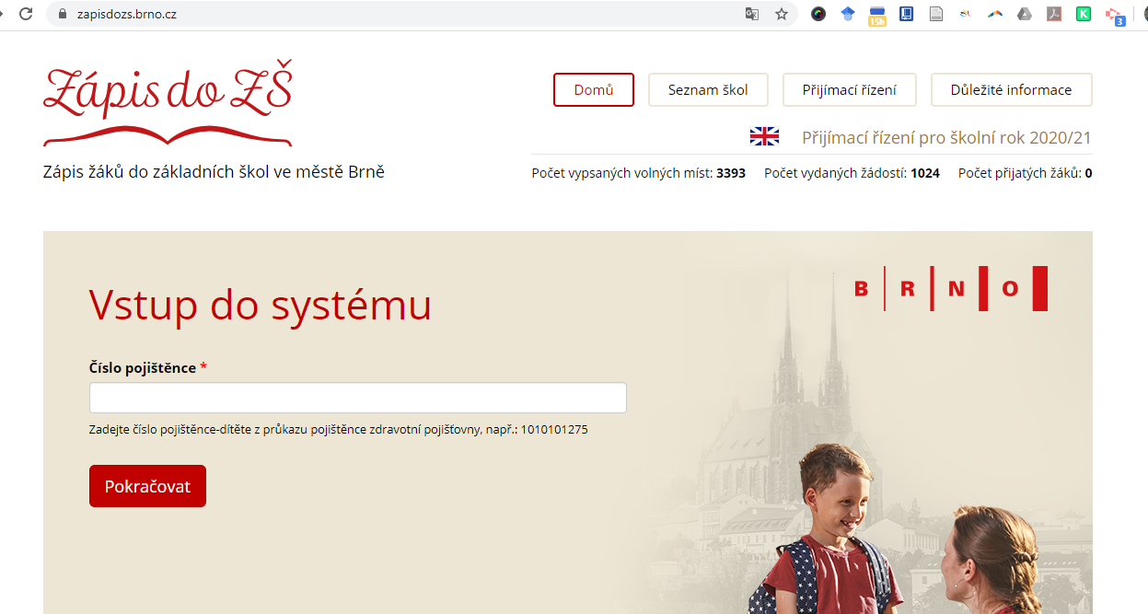

Brno is recognizing diversity in the education system!

Slide 13
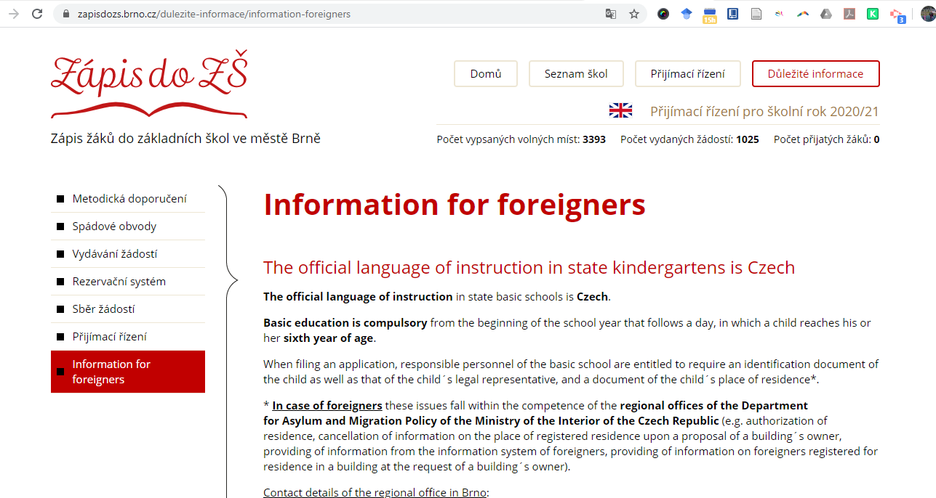

But then….

Slide 14
What pre-service teachers at MUNI (initially) think about culture, diversity, and teaching…..

Slide 15
“Czech Republic isn’t exactly culturally varied country.”
“Czech teachers in general miss out on the unique dynamics that come with living in a multicultural society”
“It is hard to find practical ways to use the culturally responsive teaching practices in our country since there is not much cultural diversity.”
“Topics like discrimination, racism or prejudice are usually simplified by only providing the definition and saying that we should treat everyone equally.”
“..honestly, I am not sure how many teachers actually think of a student’s background before making an opinion.”
“Romani pupils in the mainstream elementary school classroom face challenges..”

Slide 16
Education & Diversity in CR
We’ve looked at foundations of diversity and culture- and touched upon awareness.
Personal experiences have been shared.
What’s next?
…. A look inward!

Slide 17
To build awareness...
A look at bias
A cause for prejudice for or against someone or something
  Can manifest as feelings and actions
Common, and generally accepted, bias example:
  Your parents thinking that you are the most beautiful child in your class photo
Unaccepted bias example:
  Your parents thinking that you are better at math than your sister because you are male

Slide 18
Poll
Be honest, do you think you have hidden biases?
Yes
No
I don’t know
Notes:
CRT 1

Slide 19
What do your think?
“A father and son were involved in a car accident in which the father was killed and the son was seriously injured. The father was pronounced dead at the scene of the accident and his body was taken to a local morgue. The son was taken by ambulance to a nearby hospital and was immediately wheeled into an emergency operating room. A surgeon was called. Upon arrival and seeing the patient, the attending surgeon exclaimed “Oh my God, it’s my son!’ Can you explain this?”
Retrieved from: https://cultureplusconsulting.com/2018/08/16/a-ha-activities-for-unconscious-bias-training/

Slide 20
Hidden Biases Assessment
Take a few moments to look at the shared assessment document and complete it on your own.

Slide 21
Hidden Biases & Teaching
Identifying your hidden biases is important as a human and a teacher!
All teachers, regardless of location, are likely to encounter diversity.
Diversity is more than meets the eye.
What differences might you not see?

Slide 22
Education & Disability
Diversity is inclusive of disability.
In the world of education we encounter diversity in many realms- disability is likely to be one of them.
Practicing cultural competence and diversity awareness aligns with inclusive educational practices.
But it does not end there…..

Slide 23
Poll
Do you think there is a problem with the over representation of RCELD students in special education?
Yes
No
I am not sure
Notes:
CRT 2

Slide 24
Disproportionality in Behavioral Interventions (and SPED)
Over representation of students with racial, cultural, ethnic, and linguistic diversity (RCELD) in special education has been an ongoing problem.
Racial, cultural, ethnic, and linguistic diversity is not a need for special education services- it is not a problem with the learner. The environment needs to be adjusted:
  Changing teaching practices
  Modifying curriculum
  Being data driven
  Using empirically validated approaches
(Fiedler et al., 2008)
Notes:
https://journals.sagepub.com/doi/pdf/10.1177/004005990804000507

Slide 25
So…
Understanding culture, diversity, and effective behavior change are important to:
Promote the success of all students
Make sure that “behavior issues” are not mistaken for disability
Ensuring that you are being a culturally responsive educator focusing on making the environment most welcoming for the behaviors you want to see in the classroom.

Slide 26
STRATEGIES FOR SUCCESS!

Slide 27
Diversity Practice in Education
Culturally responsive teaching as using students’ backgrounds, social experiences, and prior knowledge in daily lessons.
Using imaginative practices where children bring their own backgrounds as capital to producing, enacting, and directing.
Having students create artwork that reflects their worldview in response to a current event.
Follow the contemplative art making with story telling.
(Iyer & Ramachandran, 2019)
Notes:
file:///C:/Users/Sheri/Downloads/83-Article%20Text-355-2-10-20190810.pdf

Slide 28
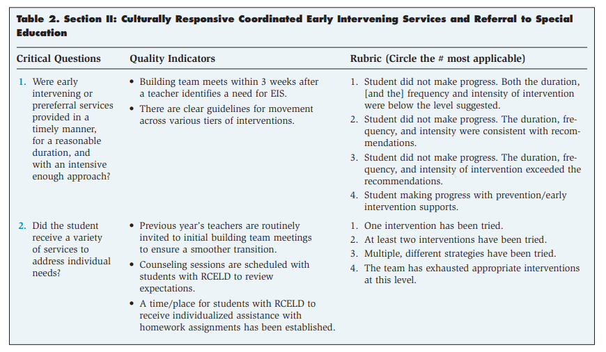
DATA
Checklist for Addressing this Disproportionality (Fiedler et al., 2008)

Slide 29
Diversity practices in behavior change: PALS
Positive behavior, interactions and learning environment in school- PALS.
Promote social competence through positive behavior support and to prevent and reduce problem behavior in students using a PBIS model.
Application of social learning principles.
Goal to decrease anti-social behavior by teaching the ability to handle social interactions.
Focuses on helping immigrant children be successful in school.
(Ogden et al., 2007)

Slide 30
Culturally Responsive Classroom Management
Not about compliance and control, but creating an environment where everyone can access learning within the space.
Behavior problems, associated with the need for classroom management strategies, often consider the diversity focus to be disability centered, but there is a lot more to consider.
The goal is to get to the point where desired behavior occurs as a result of social responsibility.
Generally a 5 part strategy.
(Metropolitan Center for Urban Education, 2008)
Notes:
https://research.steinhardt.nyu.edu/scmsAdmin/uploads/005/121/Culturally%20Responsive%20Classroom%20Mgmt%20Strat2.pdf

Slide 31
Culturally Responsive Classroom Management
Part 1: Recognition of one’s own cultural biases.
Explore your own attitudes towards other cultures.
Consider how your perceptions could result in identifying a behavior problem or disability when one is not really present.
(Metropolitan Center for Urban Education, 2008)
Notes:
https://research.steinhardt.nyu.edu/scmsAdmin/uploads/005/121/Culturally%20Responsive%20Classroom%20Mgmt%20Strat2.pdf

Slide 32
Culturally Responsive Classroom Management
Part 2: Knowledge of students’ cultural backgrounds.
Needed for skills of cross-cultural interactions.
Have students create projects to share their backgrounds.
Make connections with the family (e.g., home visits).
(Metropolitan Center for Urban Education, 2008)
Notes:
https://research.steinhardt.nyu.edu/scmsAdmin/uploads/005/121/Culturally%20Responsive%20Classroom%20Mgmt%20Strat2.pdf

Slide 33
Culturally Responsive Classroom Management
Part 3: Awareness of the broader, social, economic and political context.
Consider how certain policies or practices in discipline might discriminate against certain children.
Engage children in the discussion on and development of classroom rules.
(Metropolitan Center for Urban Education, 2008)
Notes:
https://research.steinhardt.nyu.edu/scmsAdmin/uploads/005/121/Culturally%20Responsive%20Classroom%20Mgmt%20Strat2.pdf

Slide 34
Culturally Responsive Classroom Management
Part 4: Ability and willingness to use culturally appropriate management strategies
Evaluate how current classroom management practices might be blocking access to learning for certain students.
Creating appropriate goals and expectations while working with families.
Setting up the classroom environment to welcome all learners (e.g., maps of different regions, welcome signs in different languages).
Assume that regardless of cultural differences parents care about the education of their children.
(Metropolitan Center for Urban Education, 2008)
Notes:
https://research.steinhardt.nyu.edu/scmsAdmin/uploads/005/121/Culturally%20Responsive%20Classroom%20Mgmt%20Strat2.pdf

Slide 35
Culturally Responsive Classroom Management
Part 5: Commitment to building caring classroom communities.
Spending some time on rapport building.
Creating a positive learning experience.
Showing your enthusiasm for the unique qualities of your students (e.g., languages spoken).
(Metropolitan Center for Urban Education, 2008)
Notes:
https://research.steinhardt.nyu.edu/scmsAdmin/uploads/005/121/Culturally%20Responsive%20Classroom%20Mgmt%20Strat2.pdf

Slide 36
Cultural Awareness Skills in Practice
Develop self-awareness of own cultural systems.
  Talking about your behavior can help achieve self-awareness.
Practice scientific mindfulness.
  Undivided attention on the data from the family.
When interventions are not being followed by families, and therefore unsuccessful, consider if the plan is not culturally appropriate.
Conduct an analysis of cultural identity and use it to inform treatment planning.
  May involve a wider community than typical.
(Fong et al., 2016)
Notes:
https://www.ncbi.nlm.nih.gov/pmc/articles/PMC4788642/

Slide 37
General strategies
Data based decision making - using the data instead of your own judgement.
Culturally-representative (but not stereotyped) materials.
High expectations for everyone!
Talk about implicit biases and educate others on their impact.
(Capatosto, 2015)

Slide 38
General strategies
Using materials that counter stereotypes.
Using materials that share diverse cultural values.
Heterogeneous grouping.
True classroom inclusion.
Clear behavior expectations (observable and measurable).
(Capatosto, 2015)

Slide 39
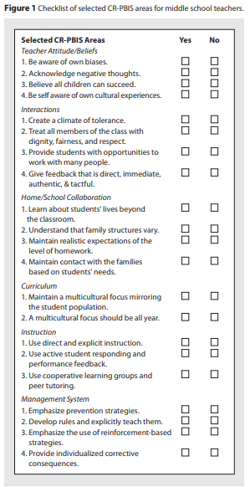
Culturally Responsive PBIS Checklist
(Cramer & Bennett, 2015, p.23)

Slide 40
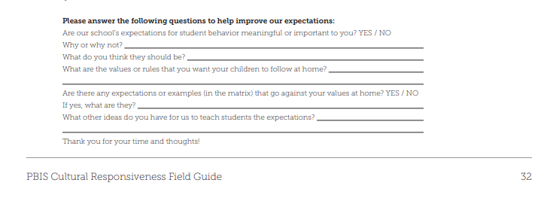
Parent Involvement & Cultural Responsiveness
(Leverson et al., 2016, p. 32)

Slide 41
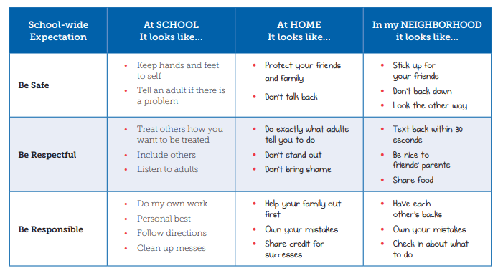
Cultural Responsiveness- Student Perspective
(Leverson et al., 2016, p. 40)

Slide 42
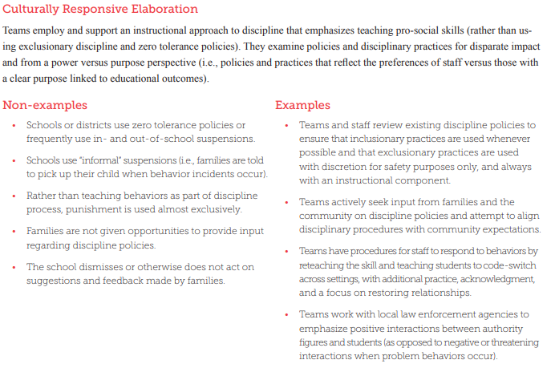
Culturally Responsive Elaboration (Leverson et al., 2016, p. 12)

Slide 43
What might you take away for your future teaching practices?
Here is what others at MUNI have….

Slide 44
“..thinking about someone's behavior as wrong according to my understanding of this behavior in my cultural context is normal and I don't have to feel guilty. What is important is what I will do next.”
“I can recognize that a foreign student’s problematic behavior may be caused by a new environment, new people, new culture and unknown language- as opposed to a disability.”
“..involve school staff and also students and their parents in creating positive reinforcers, acknowledgments..”
“..we might talk about personal stories of people who experienced prejudice and then ask students to share their own..”
“..transform the classroom into a space that doesn’t promote the dominant culture..”

Slide 45
Remember...
Diversity exists in the classroom- even in the Czech Republic
Recognize your own biases before entering the classroom
Select teaching strategies that support all students- regardless of their differences

Slide 46
THANK YOU!!!!
If you want to know more….
sherikingsdorf@mail.muni.cz

Slide 47
References
“A-ha” Activities for Unconscious Bias Training | Include-Empower.Com. (2018, August 16). Retrieved March 5, 2020, from Include-Empower.Com website: https://cultureplusconsulting.com/2018/08/16/a-ha-activities-for-unconscious-bias-training/
Capatosto, K. (2015).Strategies for addressing implicit bias in early childhood education.Retrieved from Kirwan Institute for the Study of Race and Ethnicity. http://kirwaninstitute.osu.edu/wp-content/uploads/2016/04/Implicit-Bias-Strategies-Early-Childhood.pdf
Cramer, E. D., & Bennett, K. D. (2015). Implementing Culturally Responsive Positive Behavior Interventions and Supports in Middle School Classrooms. Middle School Journal, 46(3), 18-24.
Fiedler, C. R., Chiang, B., Van Haren, B., Jorgensen, J., Halberg, S., & Boreson, L. (2008). Culturally responsive practices in schools: A checklist to address disproportionality in special education. Teaching Exceptional Children, 40(5), 52-59.
Fong, E. H., Catagnus, R. M., Brodhead, M. T., Quigley, S., & Field, S. (2016). Developing the cultural awareness skills of behavior analysts. Behavior Analysis in Practice, 9(1), 84-94.
Iyer, I. N., & Ramachandran, S. (2019). Diversity consciousness in the classroom: A case for opening new spaces and generating ‘new’ knowledge for critical literacy using imaginative practices. Journal of Pedagogical Research, 3(2), 63.
Leverson, M., Smith, K., McIntosh, K., Rose, J., & Pinkelman, S. (2016). PBIS cultural responsiveness field guide: Resources for trainers and coaches. Office of Special Education Programs Technical Assistance Center on Positive Behavioral Interventions and Supports.
Liang, X., & Zhang, G. (2009). Indicators to evaluate pre-service teachers’ cultural competence. Evaluation & Research in Education, 22(1), 17-31.
Lu, W. (2016, September 26). 13 Microaggressions People With Disabilities Face On A Daily Basis. Retrieved March 5, 2020, from Bustle website: https://www.bustle.com/articles/186060-13-microaggressions-people-with-disabilities-face-on-a-daily-basis
Metropolitan Center for Urban Education. (2008). Culturally responsive classroom management strategies. NYU Steinhardt School of Culture, Education, and Human Development. Retrieved from http://steinhardt.nyu.edu/scmsAdmin/uploads/005/121/Culturally%20Responsive%20Classroom%20Mgmt%20Strat2.pdf
Ogden, T., Sørlie, M. A., & Hagen, K. A. (2007). Building strength through enhancing social competence in immigrant students in primary school. A pilot study. Emotional and behavioural difficulties, 12(2), 105-117.
Santos Rego, M. A., & Moledo, M. D. M. L. (2005). Promoting interculturality in Spain: assessing the use of the Jigsaw classroom method. Intercultural education, 16(3), 293-301.
Ukpokodu, O. (2011). Developing teachers' cultural competence: One teacher educator's practice of unpacking student culturelessness. Action in Teacher Education, 33(5-6), 432-454.

