Slide 1
AlternativE schools and their possibilities in the Czech republic

Slide 2
Alternative school - definition
all types of schools (private, public, state) which are different from the mainstream of standard schools or standard educational system
schools with the other methods and learning organizations that usually try to bring the content with using the form of games, discussions, problem tasks, independent work etc.
Schools which use innovative programs for intended elimination of deficiency of traditional school and try to better meet the needs of modern society.

Slide 3
Work in groups
1. group – objections to traditional education
2. group – benefits of alternative education
3. group – limitation of alternative education

Slide 4
What are the objections to traditional education?
,,detechment“ of life
excessive amount of information
Curriculum set by institution for everyone
authoritarian behavior and the position of the teacher
insufficient attention to the individuality of the student
Grading system

Slide 5
Benefits?
Opposition to traditional educational system
Inspiration for traditional schools – methods, communication, approach to the students...
Student as the individual
Benefits for pedagogical theory

Slide 6
Limitations?
Is this approach to the student sufficient for performance-oriented society?
Insufficient teacher education
continuity to the higher level of education
Can we compare students from traditional educational systems and children from alternative schools?

Slide 7
Overview of the best known
Montessori education
Waldorf education
Dalton plan
Jena plan
Modern school of Celestine Freinet
Winnet system
Step by Step
Engaged Learning
Healthy school

Slide 8
Alternative schools in ČR
Waldorf (kindergarten, primary and secondary, high schools)
Montessori (kindergarten, primary and secondary schools)
Dalton (kindergarten, primary and secondary, high schools)
Jena (primary school)
Step by Step (kindergarten, primary schools)
Healthy School (kindergarten, primary and secondary, high schools)
Integrated Thematic Learning (kindergarten, primary schools)
Family learning (primary and secondary schools)

Slide 9
General Principles of altenrative schools
an effort to promote a natural desire to know new things and phenomena
the relationship between the teacher and the pupil, the support of their quality and originality (the mistake is understood as a degree of learning, a part of learning, not a problem)
cooperation with the child´s family
active involvement of the child, support of cooperation and development of communication
transfer of responsibility for the decisions on children
connection of subjects
child-friendly environment (easy-to-use tools)
teaching governed by passion or fatigue children (
verbal evaluation

Slide 10
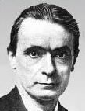
Waldorf education
founder Rudolf Steiner (1861 – 1925)
founded in 1919 (city Waldorf)
based on the philosophical direction of anthroposophy (a science about the spiritual essence of man, when man is the focus of attention and the image of the universe mirrors)
the school provides all-round development of the child in the practical and artistic fields, discovers the pupil's abilities, does not include encyclopaedic knowledge
textbooks are not used, it does not fall, the certificate is verbal

Slide 11
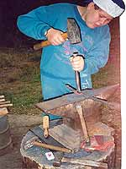
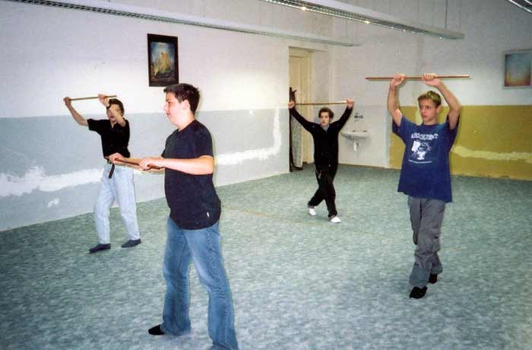
Waldorf Education
teaching is divided into main and vocational subjects
main subjects (mother language, mathematics, geography, history, physics, chemistry) taught in two-hour blocks, which are only 3 to 6 weeks dedicated to one subject
the main subject will be replaced twice a school year
vocational subjects (foreign languages, religion, eurythmia) taught classically in one hour classes
an important part of teaching is painting, rhythm and movement = eurythmy (specific subject, esetic-rhythmic teaching)

Slide 12
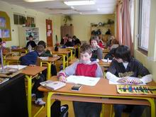
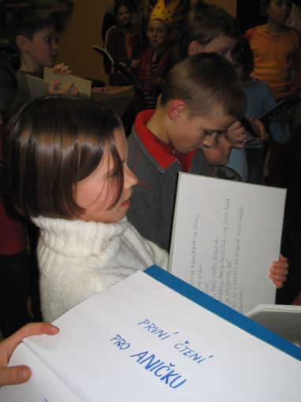
Waldorf education
twelve school grades(same colective) 1. – 8. grade lower grade (1 teacher for everything) 9. – 12. grade higher grade (professional teachers)
13. grade – possibility of state leaving exam
during the school year celebrations, excursions
teachers are using prepared materials, pupils' work and epoch-booklets, books are only supplement
medias are not used in the classroom

Slide 13
Waldorf education
Positive
the development of creativity and independence
varied school program
more interesting teaching methods
the development of responsibility and self-reflection
Negative
a small connection to a common education system
excessive freedom of pupils
does not place sufficient emphasis on the standard educational university degree of a teacher
implies a certain style of education for pupils, does not open to scientific criticism

Slide 14
https://www.youtube.com/watch?v=BkrgkslnD9g

Slide 15
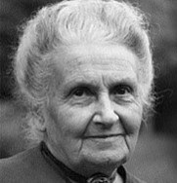
Montessori education
founder Maria Montessori (1870 – 1952)
founded 1907 (Roma – Cassa di Bambini)
children have different learning abilities and talents, not need the same pace („ Help me to do it myself“)
it proceeds from a specific to an abstract, focusing on a human being, independent development
learning areas - practical life, sensory education, language education, mathematics, movement, musical and visual skills, cosmic education

Slide 16
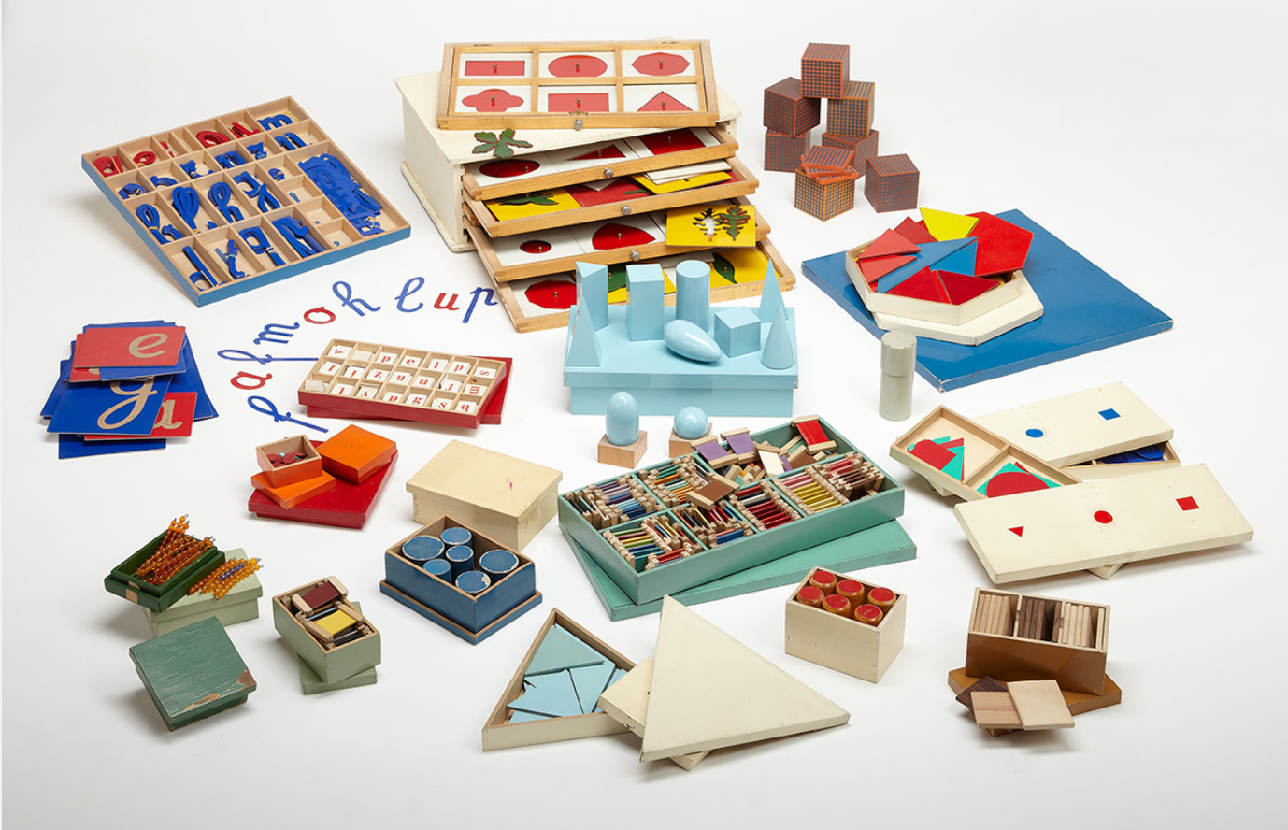
Montessori Education
cosmic education is the study of everything that surrounds us
to be free means to be independent, autonomous and responsible
silence and peace promotes concentration to work
activity must be completed
error is a natural part of learning
the center of events is the pupil, the teacher is in the background
mixed classes (three years)

Slide 17
Principle of freedom and authonomy
Working with an error
Principle of social education
Principle of normalization
Principle of movement
Principle of silence and peace
Principle of leadership
Principle of age heterogenity
Help me to do it myself

Slide 18
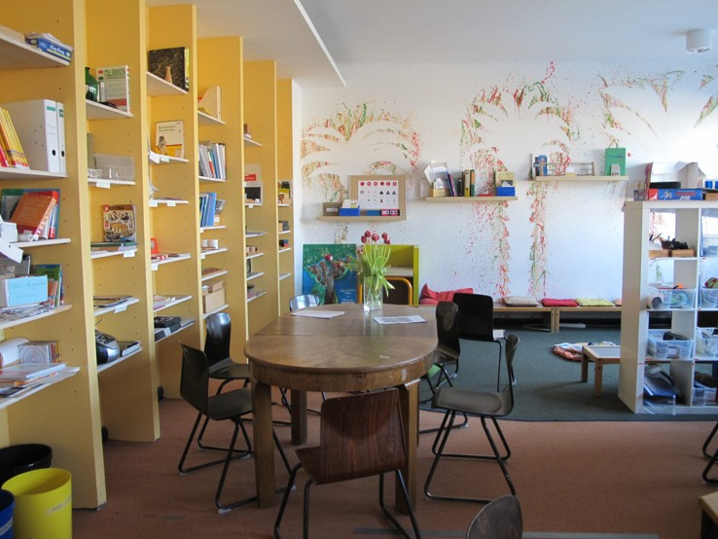
Montessori Education
natural motion is supported, ellipse walking
a specially developed set of tools for each learning area
using a sensitive phase (a period of increased sensitivity of the child) to acquire some skills
teaching takes place in weekly cycles
compulsory group lessons, introduced market for teachers (program offer and pupil chooses)
tribal classrooms, 20 students per class

Slide 19
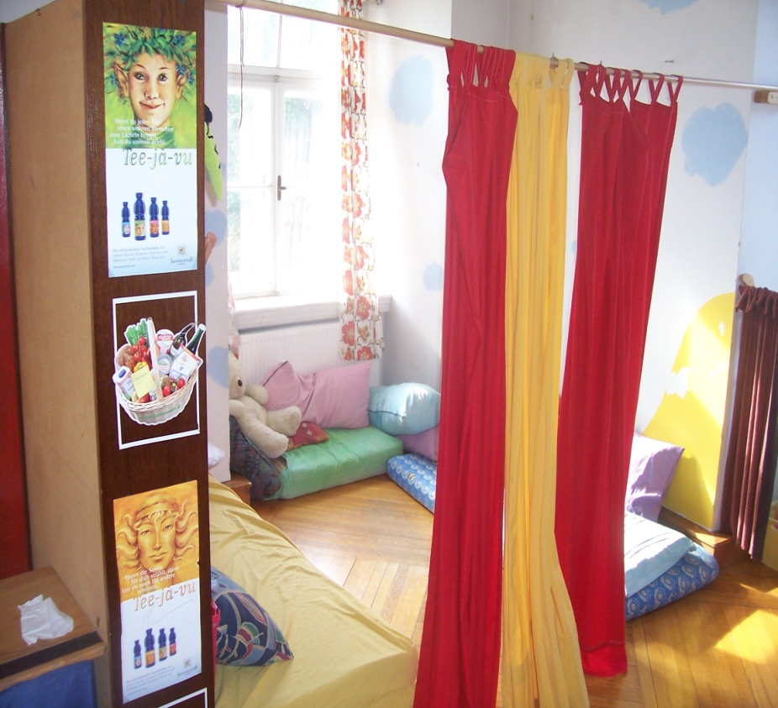
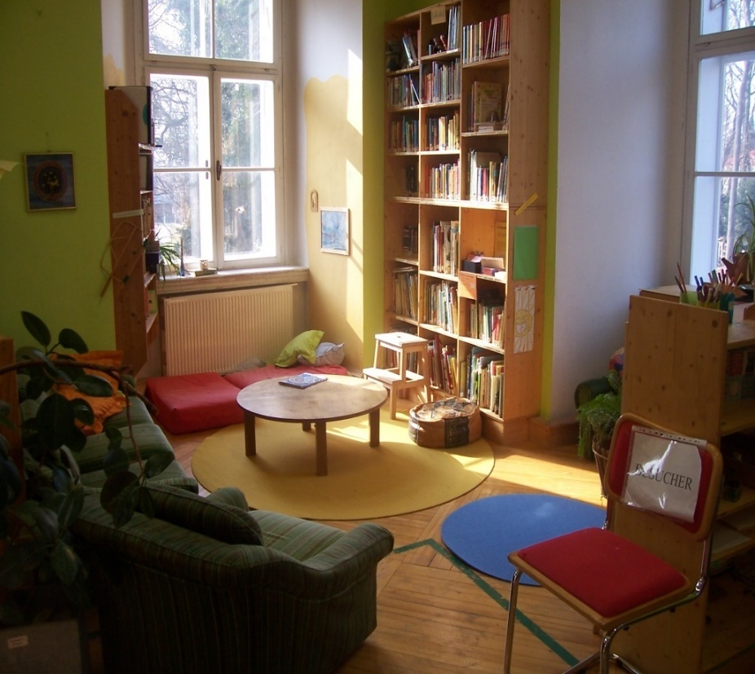
Montessori education
free choice and responsibility of the pupil
prepared environment - libraries with tools
teacher observes, consults - learning guide
self-evaluation of the pupil
twice per year teacher evaluation, one-time per year student profile (more teachers)
parents' participation in school management and teaching
transition to standard school - annual acclimatization

Slide 20
https://www.youtube.com/watch?v=UzmvtVAuuyI

Slide 21
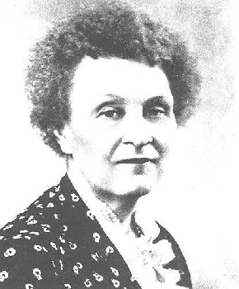
Dalton plan
founder Helen Parkhurst (1886 – 1973)
founded 1920 (Dalton, USA)
Dalton is not a method or system, Dalton is an influence
the essence is the development of pupil's individuality by means of self-controlled self-management
three basic principles - freedom (and responsibility), autonomy and cooperation
freedom is not represented by absolute freedom, the pupil chooses the time, the place, where and when to study

Slide 22
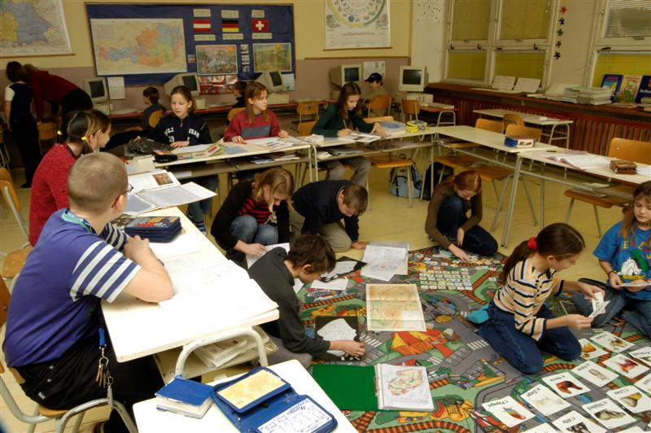
Dalton plan
the pupil acts independently, he/she is co-responsible for education
when dealing with tasks pupils can work with others
there are cooperative (joint work) and auxiliary groups (independent but with the possibility to consult with a classmate) used
work patterns include long-term tasks - longer duration, the target set, the pupil concludes a contract (a contract between the teacher and the pupil), only once one contract has been completed, it can proceed to the next one

Slide 23
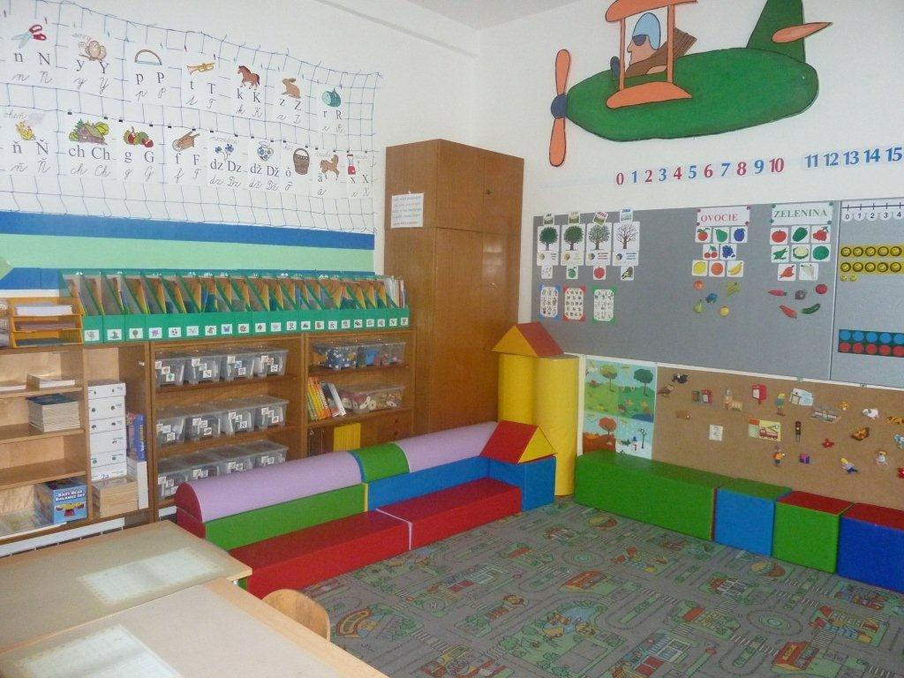
Dalton plan
„house“ – a group of pupils in the tribe class and a discussion about school issues and their own problems
laboratory – a predefined hour focusing on own projects, the teacher enters only on request
extended attention - Czech form, teacher is not available, pupils work independently; there is one agreed symbol (toy) which presents the impossibility of working with the teacher and the need to work independently or with classmates

Slide 24
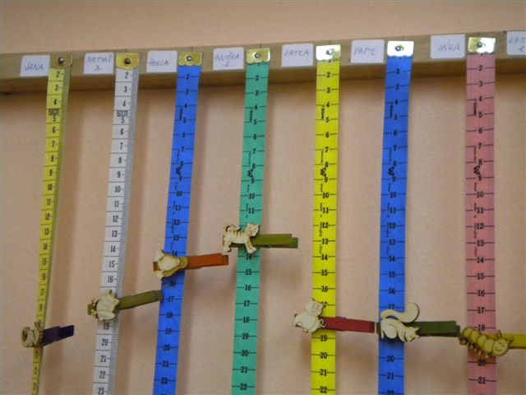
Dalton plan
the teacher is essential, but must give up the dominant position
prepares plans, tests, task, communicates with pupils, parents
canceled traditional hours (does not ring), class divided into subject areas with tools according to years
the curriculum is divided into 10 contracts per month
pensum – learning content managed over a certain period
use a system of colors symbolizing the days of the week or individual courses, Dalton meters

Slide 25
Dalton plan
Positive
the variability of teaching
education for freedom
education to responsibility
education for cooperation
Negative
insufficient repetition of the curriculum
unsystematic acquisition of knowledge
curriculum is little discussed
over-reliance on pupils independence

Slide 26
https://www.youtube.com/watch?v=qMvH16anq-g&t=65s

Slide 27
Alternative schools in brno
Waldorf
Plovdivská
Montessori
Gajdošová, Pastviny, Šrámkova
Dalton
Husova, Chalabalova, Křídlovická, Mutěnická, Staňkova ad.
Step by Step
Heyrovského, Stará, Vejrostova

