Slide 1
Multiple Intelligence theory
Masoumeh Ramezani

Slide 2
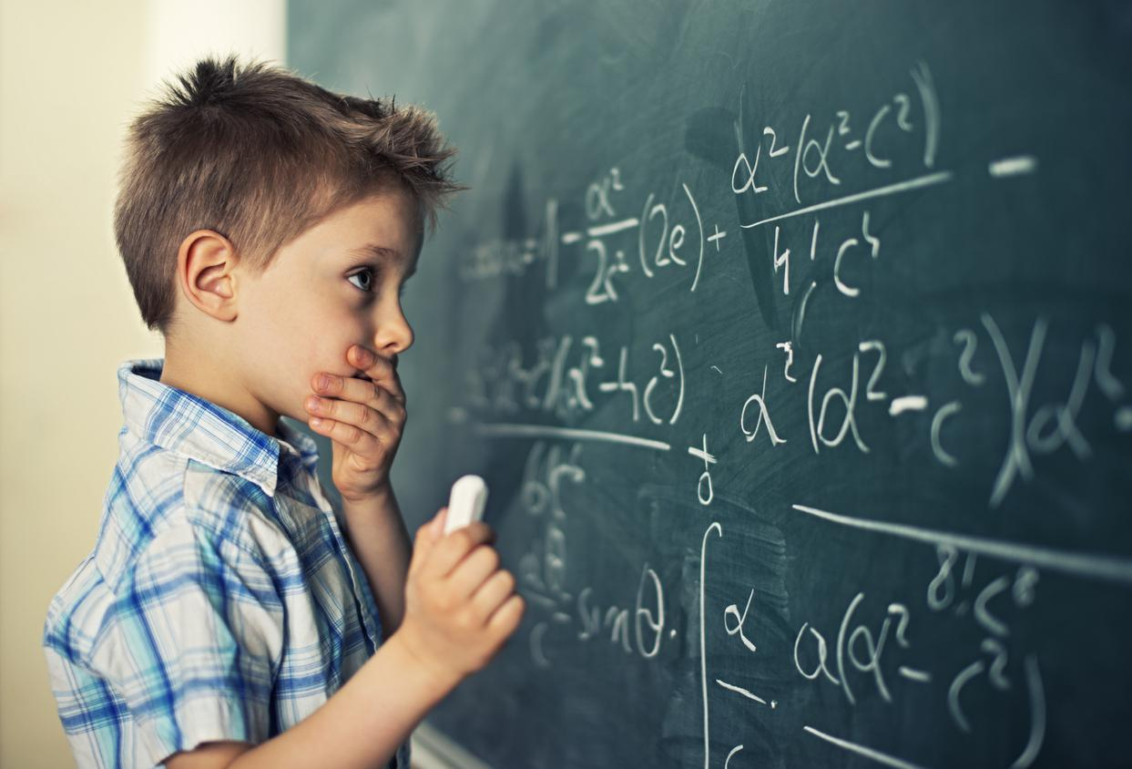
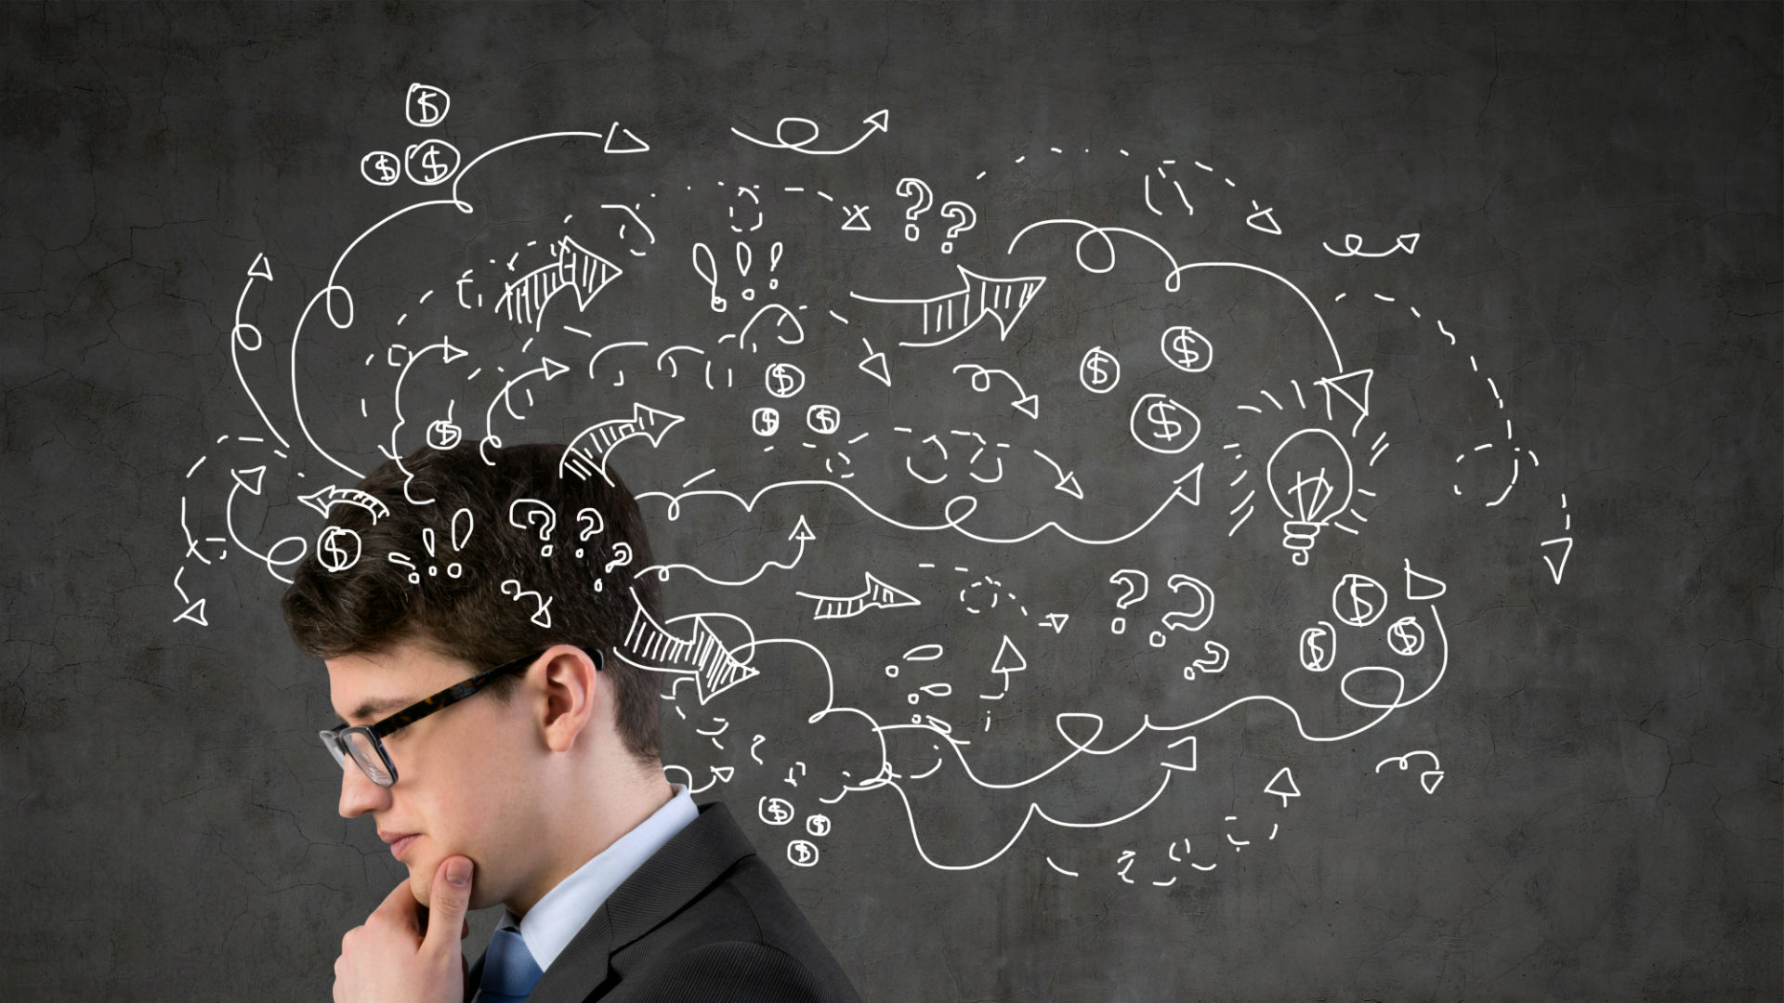
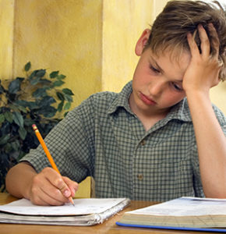

Slide 3
What is intelligence?
an intelligence test
a child of high/average/low intelligence
It's the intelligence of her writing that impresses me.
I can't believe that someone of his intelligence can read such trash!
He believes that all children are born with equal intelligence.
He is blessed with both good looks and intelligence.
You can't do that, man - use your intelligence!
She handled the situation with great intelligence and maturity.

Slide 4
What is intelligence?
the ability to learn and understand things quickly and easily
the ability to make judgments or have opinions that are based on reason
Intelligence is often defined as our intellectual potential; something we are born with, something that can be measured, and a capacity that is difficult to change.
intelligence is the ability to:
Learn from experience: The acquisition, retention, and use of knowledge is an important component of intelligence.
Recognize problems: To put knowledge to use, people must be able to identify possible problems in the environment that need to be addressed.
Solve problems: People must then be able to take what they have learned to come up with a useful solution to a problem they have noticed in the world around them.

Slide 5
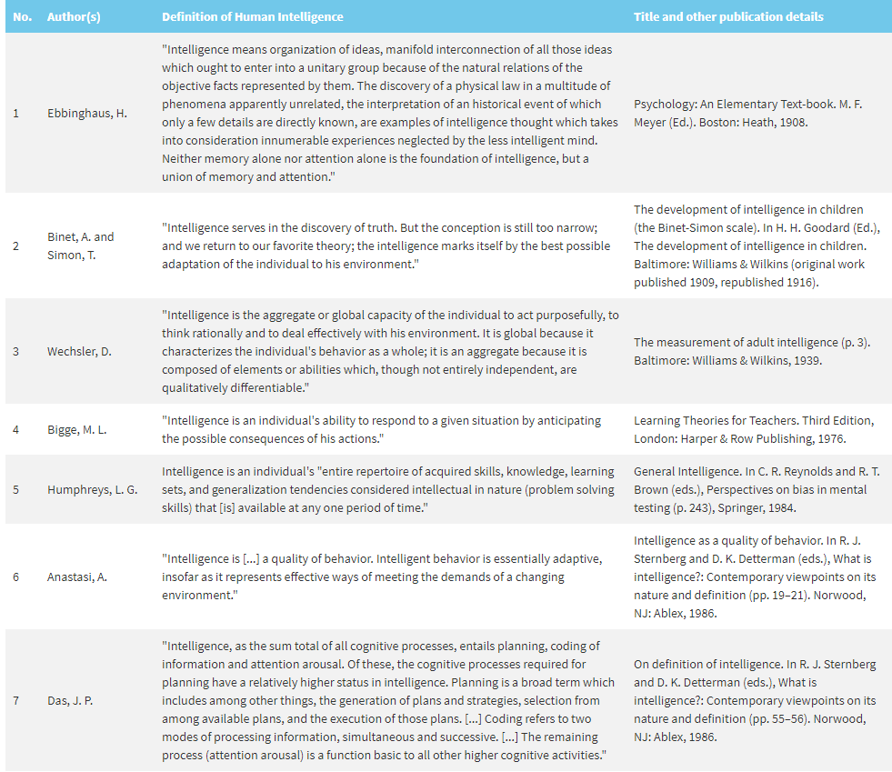

Slide 6
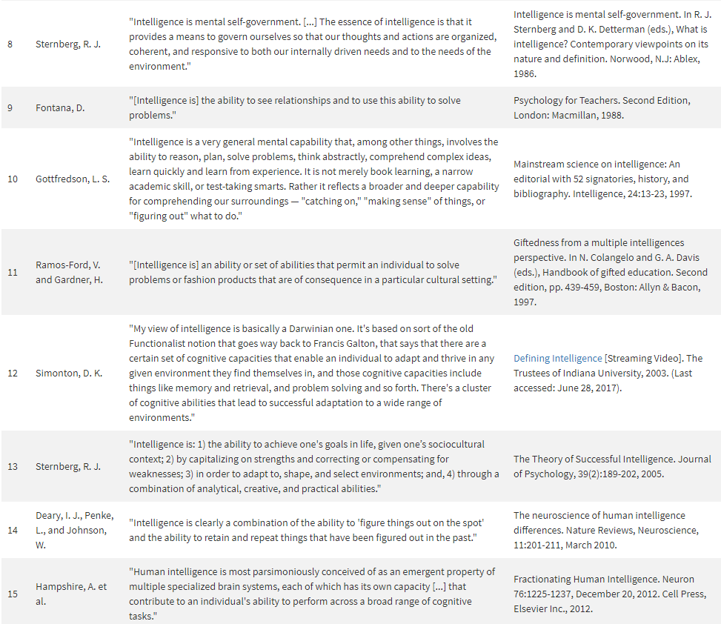

Slide 7
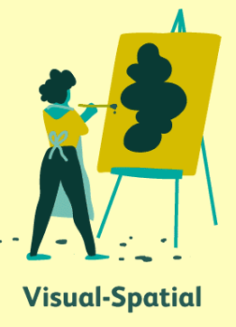
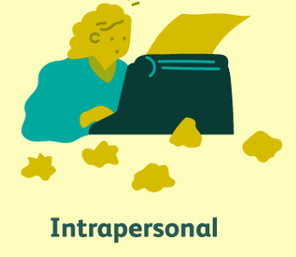
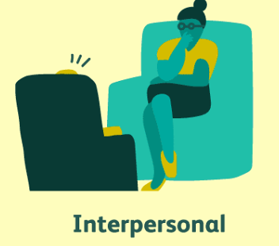
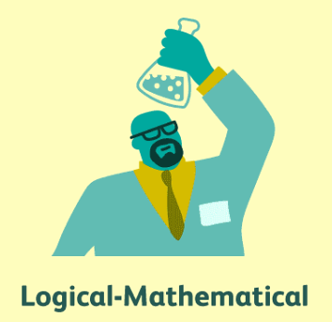
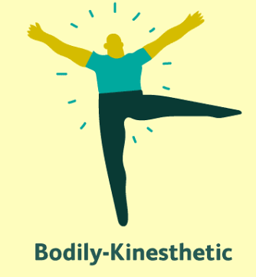
Those that recognize and
classify features of the
environment; remember
outdoors features, are
comfortable outdoors.
Those who turn first to the
graphs, charts, and pictures;
who like to “web” their ideas,
and enjoy videos and movies.
Reflecting and analyzing self;
awareness of inner feelings,
desires, dreams, and
understanding role in
relationship to others.
Writing, story telling, teaching;
those who enjoy convincing
others of their point of view.
The Eight Intelligences
Seeing multiple points of view,
listening, using empathy, cooperating with groups.
Problem solvers; those who can
handle long chains of reason
and perform complex
mathematical calculations, as
well as work with geometric
shapes.
Creators or builders; those who
enjoy acting, dancing, and
activities that are “hands-on” or
“crafty.”
Listening, singing,
remembering melodies.

Slide 8
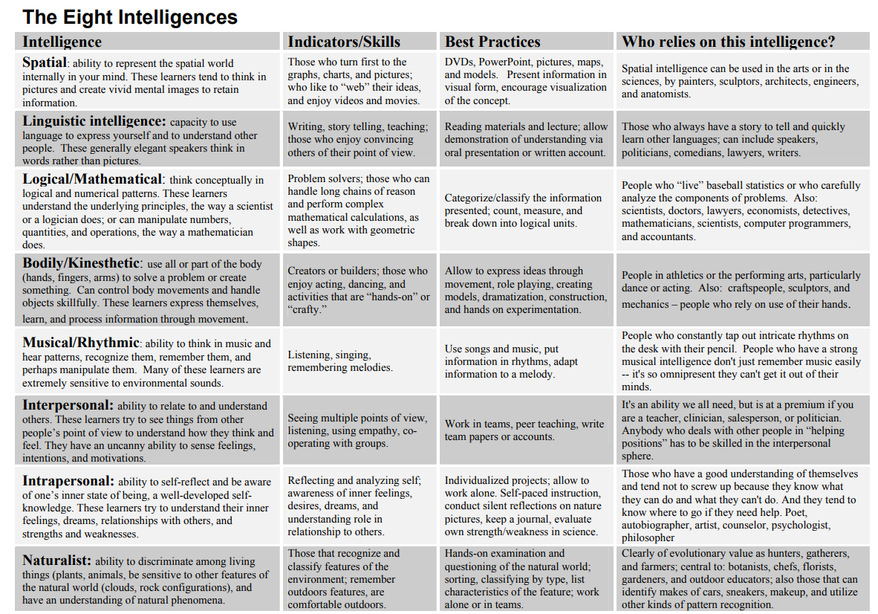

Slide 9
Visual-Spatial Intelligence
People who are strong in visual-spatial intelligence are good at visualizing things. These individuals are often good with directions as well as maps, charts, videos, and pictures.
Strengths
Visual and spatial judgment
Characteristics
People with visual-spatial intelligence:
Read and write for enjoyment
Are good at putting puzzles together
Interpret pictures, graphs, and charts well
Enjoy drawing, painting, and the visual arts
Recognize patterns easily
Potential Career Choices
If you're strong in visual-spatial intelligence, good career choices for you are:
Architect
Artist
Engineer

Slide 10
researches
Yalmanci & Gozum, 2013
Ghamrawi, 2014
Tahriri & Yamini, 2010
Abdi & Rostami, 2012
Hanafin, 2014
Kaya, Doğan, Gökçek, Kılıç, & Kılıç, 2007
Xie & Lin, 2009
Pourmohammadi, Zainol Abidin, & Yang Ahmad, 2012
Gunst (2004)

Slide 11
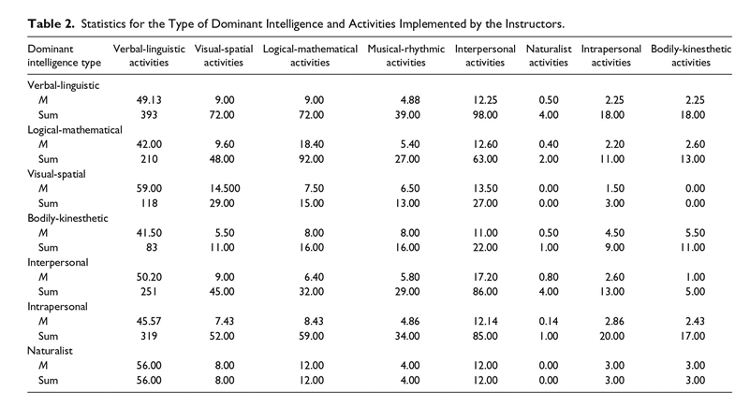
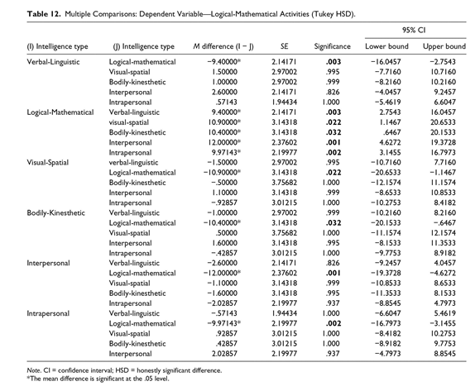

Slide 12
critical evaluation (advantages/disadvantages) of Gardner's theory
https://www.wtc.ie/images/pdf/Multiple_Intelligence/mi11.pdf

Slide 13
Gardner’s MI theory has two important advantages in education
First, it paves the ways for planning the education program in a way that students realize their potentials and move toward their desires.
Second, it makes it possible for us to reach students who are more active because learning would be more attractive in a condition that learners are trained through the use of these intelligences.

Slide 14
Multiple Intelligences Test
https://www.literacynet.org/mi/assessment/cgi-bin/results.cgi
https://personalitymax.com/multiple-intelligences-test/
https://www.teacherspayteachers.com/Product/Multiple-Intelligence-Test-120491?st=65e0f3588d1e77629ad7c514ad69cbb6

Slide 15
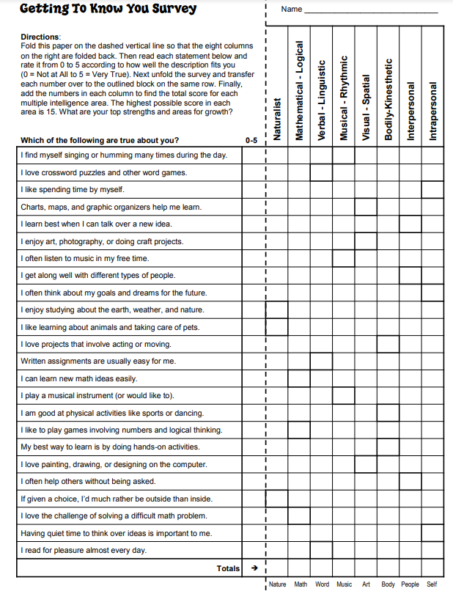
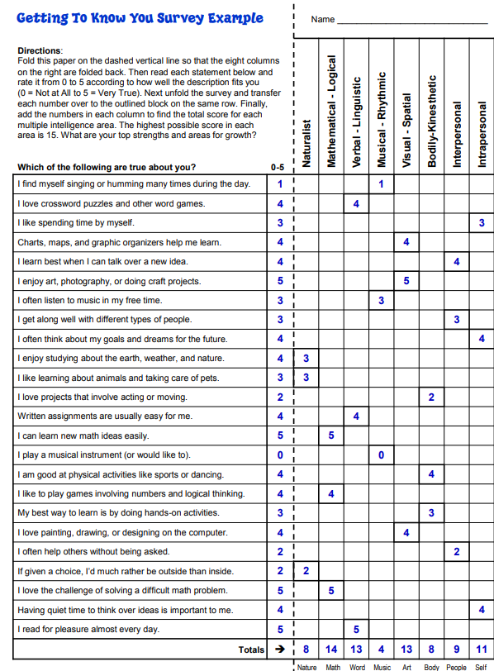

Slide 16
What can we do as a teacher?

Slide 17
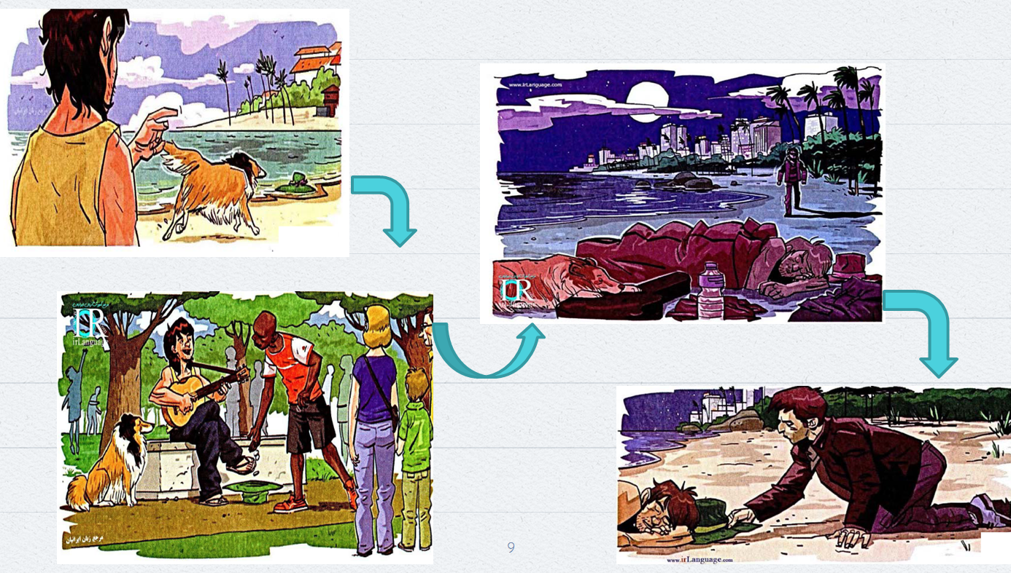
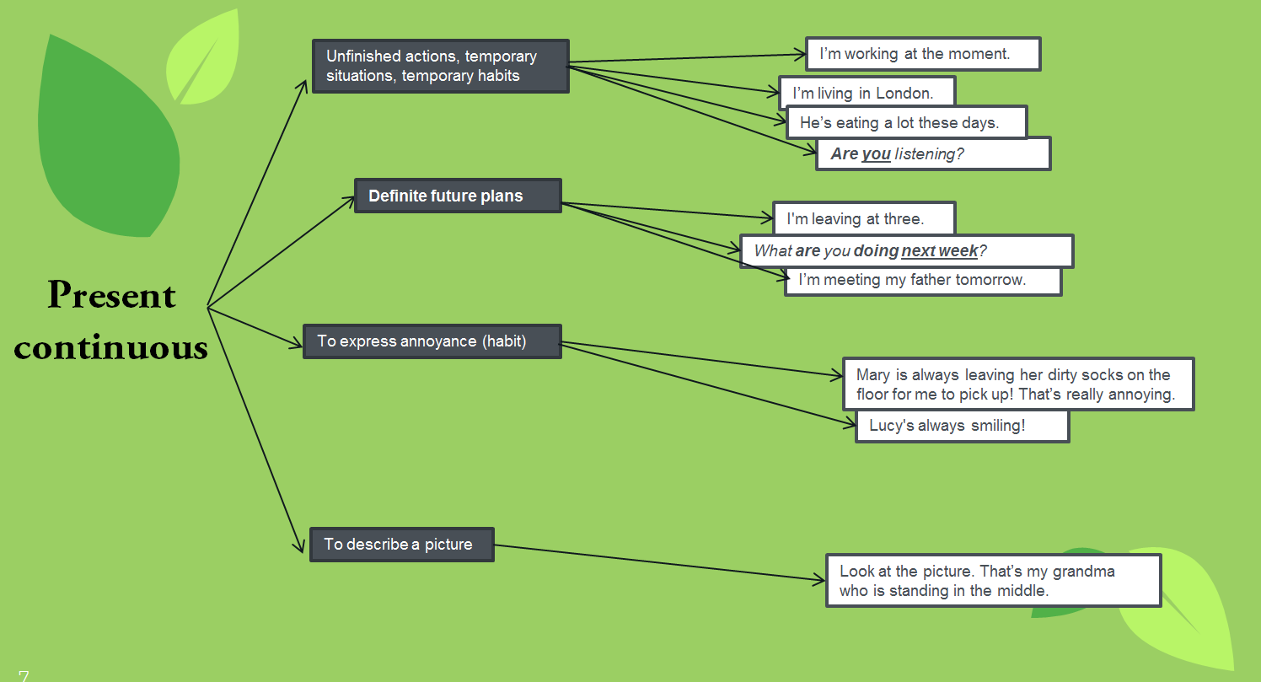
Visual spatial intelligence

Slide 18
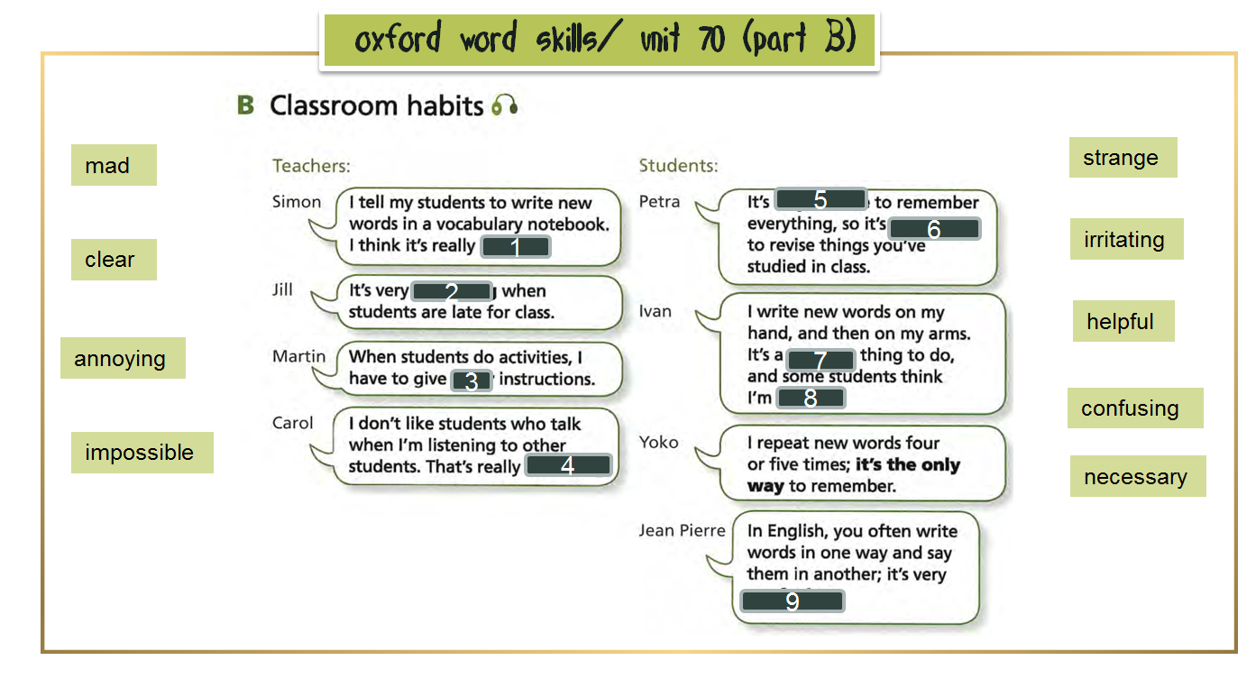
Linguistic intelligence

Slide 19
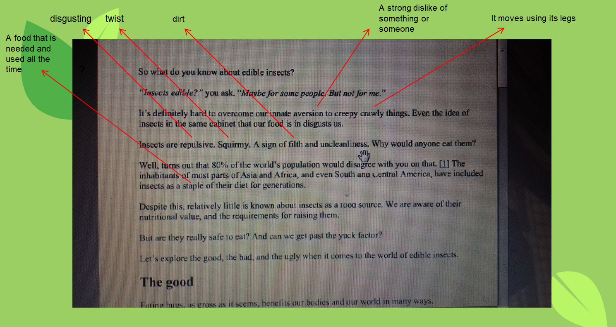
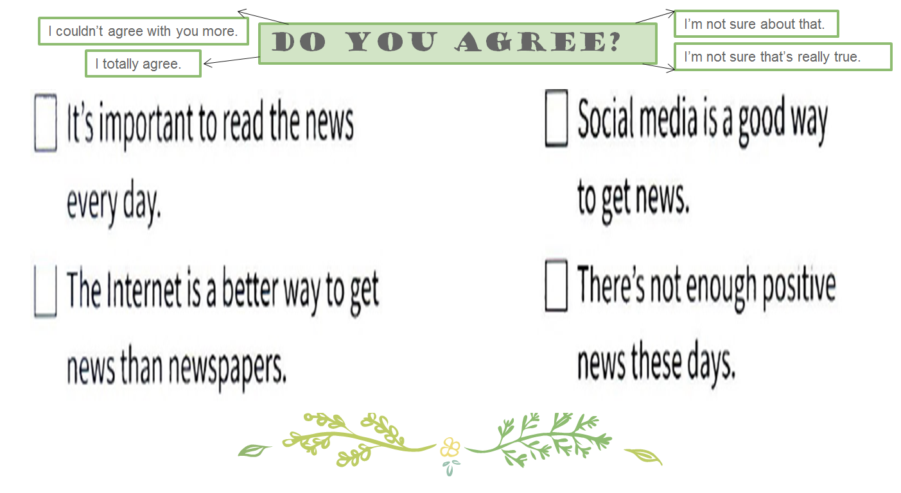
logical-mathematical intelligence

Slide 20
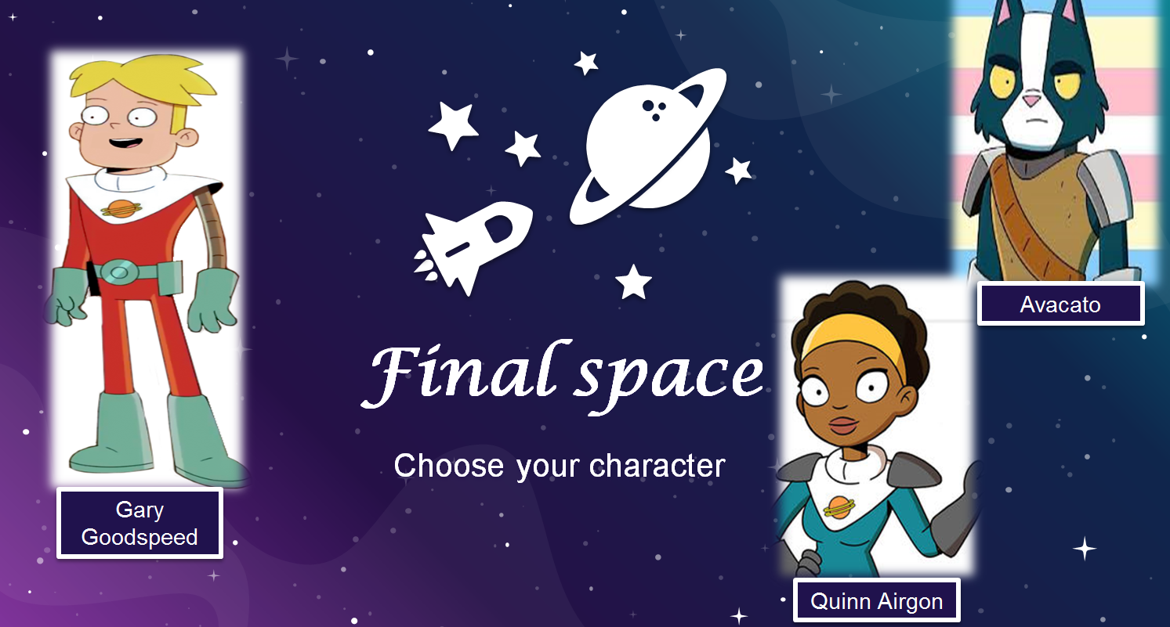
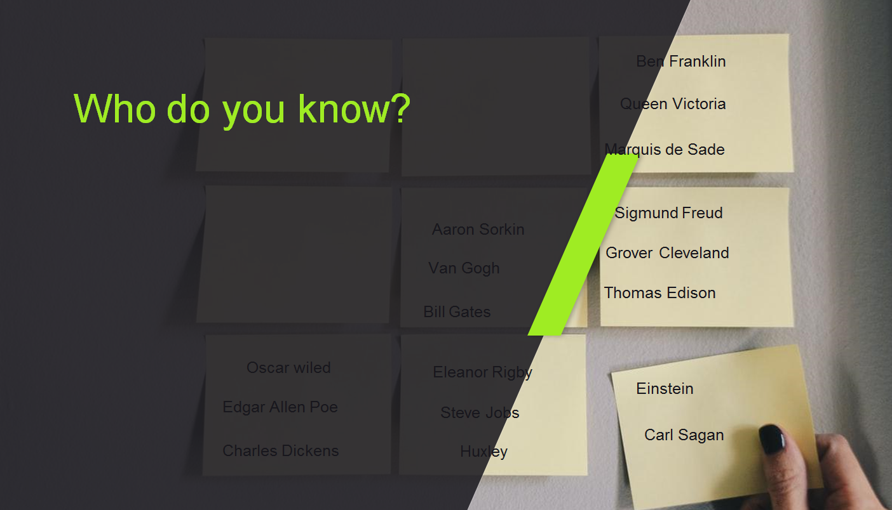
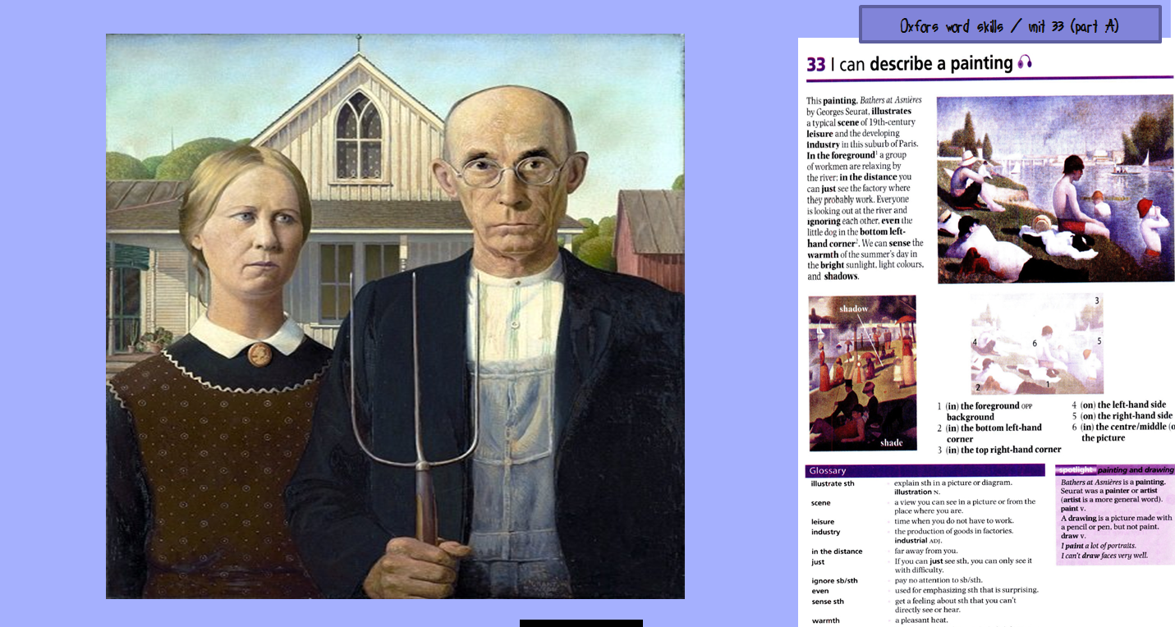
bodily-kinesthetic intelligence
interpersonal intelligence

Slide 21
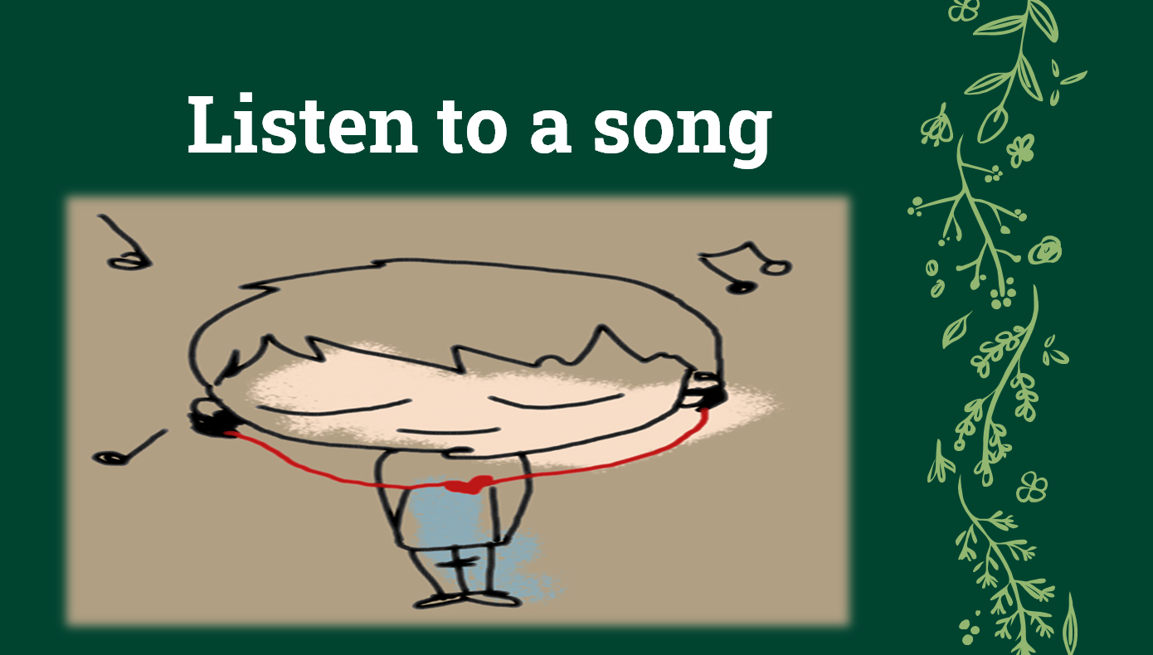
musical and rhythmic intelligence

Slide 22
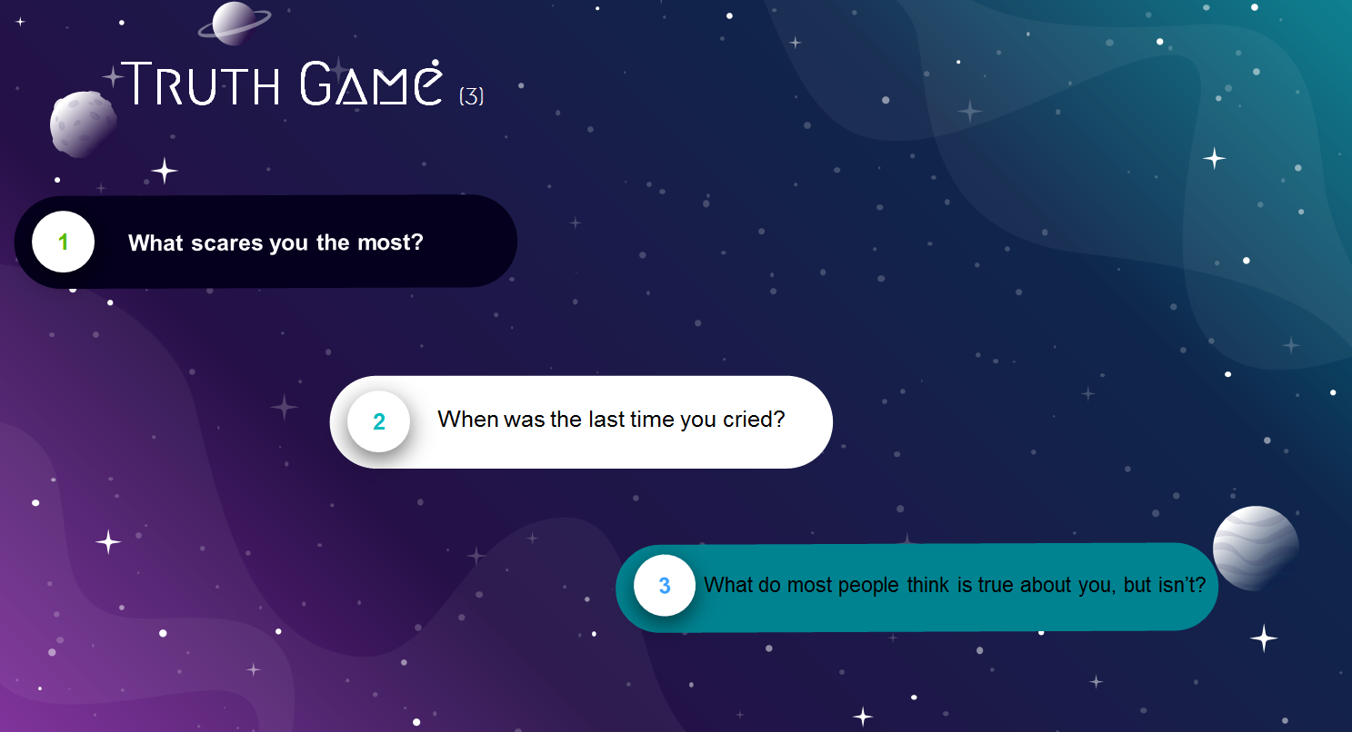
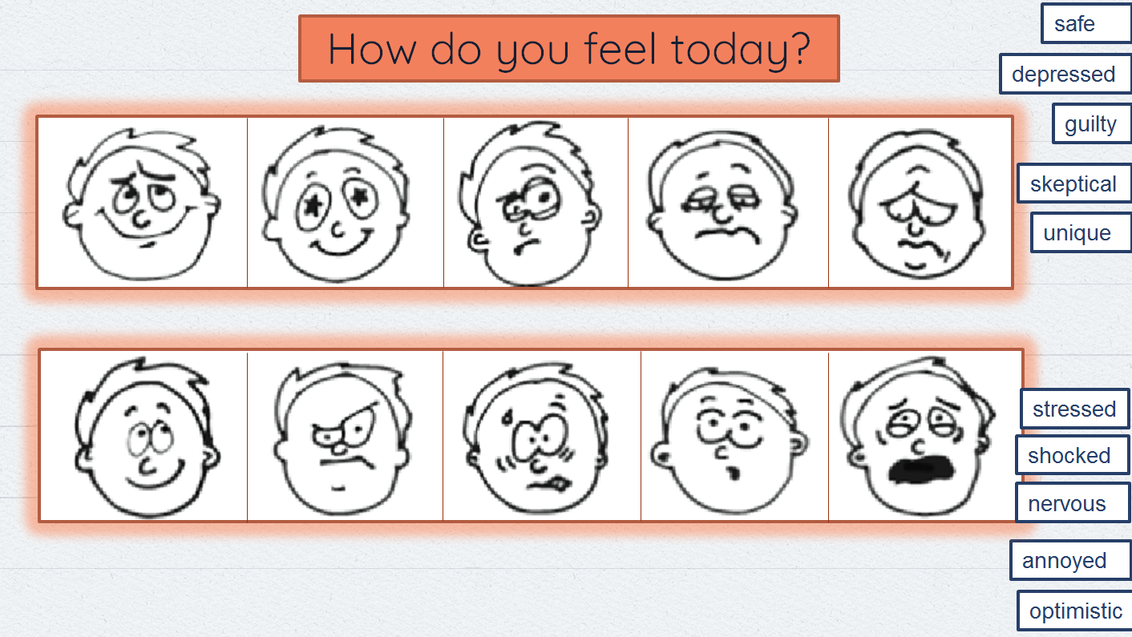
Intrapersonal intelligence
naturalist intelligence

Slide 23
Will awareness of their own intelligence profiles help our students become more independent learners?
How can teacher and student, working collaboratively, a) identify the student’s strongest intelligences through MI based assessment and classroom activities? b) use the understanding of these intelligences to guide the learning process?
What impact do ESOL activities informed by the MI theory have on student engagement and learning strategies?
How does knowledge of Multiple Intelligence Theory broaden a multi-sensory approach to the teaching of writing? How does the application of Multiple Intelligence Theory enhance a multi-sensory approach to the teaching of reading?

Slide 24
References
Teacher Research Reports From the Adult Multiple Intelligences Study Editors Silja Kallenbach & Julie Viens:
https://www.worlded.org/WEIInternet/inc/common/_download_pub.cfm?id=16687&lid=3
University of Nevada, Las Vegas:
https://digitalscholarship.unlv.edu/cgi/viewcontent.cgi?referer=https://www.google.com/&httpsredir=1&article=1006&context=pli_environment_education
.
EFL Teachers’ Multiple Intelligences and Their Classroom Practice:
https://journals.sagepub.com/doi/full/10.1177/2158244017722582
Gardner's Theory of Multiple Intelligences:
https://www.verywellmind.com/gardners-theory-of-multiple-intelligences-2795161
Theories of Intelligence:
https://www.simplypsychology.org/intelligence.html
.
Definitions of Human Intelligence:
http://agisi.org/Defs_intelligence.html

