Slide 1
Analyse of Experience and Behaviour
Perspective of
Personality
< ---
Structural
Ego State Model
Perspective
of Reality
-→
Frame of Reference
EXPERIENCE
BEHAVIOUR
Relational Perspective
Organisation and Pattern
of Relationship
Transactions, Games,…

Slide 2
We can observe in everyday life patterns
which are repeating themselves consistently and appear frequently,
and are as unconscious to us.
If we look closer, particular topics and processes become noticeable,
particular actions and reactions,
in which their fixed roles are observable.
From the participant’s present initially not understandable
complex social patterns
are described with the model of psychological games.

Slide 3
The model of psychological games is
On the level of communication the presentation
of a particular procedure
of a relationship with its open and hidden aspects.
On the intrapsychic level the presentation
of an unsolved problem.
On the level of context the try to repeat
earlier experienced social patterns
and to establish the earlier status quo
in the here and now of the relation.

Slide 4
The reason and “benefit” of psychological games
 | External use | Internal use
Social level | Superficial contact with people, pastime, small talk | spending predictable time with so-called ‚good‘ friends
Psychological level | Avoidance of intimacy, responsibility, no direct request for strokes | A pattern to get feelings that are depending on the script
Existential level | Biological needs for stimulation and attention (‘negative attention is better than none’) | Basic positions of one’s life are confirmed, rackets are supported, the script is strengthened.

Slide 5
The drama triangle
Victim
The rescuer cares about others and takes over responsibility without being asked openly to do so.
The persecutor criticizes, devalues, condemns and knows better than others.
The victim is helpless, suffering and covertly asks others to take over responsibility.
Persecutor
Rescuer

Slide 6
GAME PLAN
This version is from T.A Today, adapted from John James by Laurence Collinson.
1. WHAT KEEPS HAPPENING TO ME OVER AND OVER AGAIN?
2. HOW DOES IT START?
3. WHAT HAPPENS NEXT?
4. (MYSTERY QUESTION)
5. AND THEN?
6. (MYSTERY QUESTION)
7. HOW DOES IT END?
8. HOW DO I FEEL?
9. HOW DO I THINK THE OTHER PERSON FEELS?

Slide 7
Playing schedule of ………………………………………….
(as you perceive him/her)
What happens to the child/colleague over and over again respectively which behavioral pattern or which problem is this person ‘practicing’ consistently? What fairy tale, what kind of film fits to this event? What is the topic of the process?
How does it start? It’s not about fault! Games are social processes which can only be shaped and organized together.
What happens next respectively how do the others react to it?
In-depth questions 1: Which is the child’s secret, psychological message for the other person and how does the child think about him/herself? How would a child of four or five years express these ideas? How could the child/the colleague think different about him/herself?
How is the sequel of the game?
In-depth question 2: Which is the other person’s secret, psychological message for the child/colleague (what is your assumption) respectively what do you assume, how your client is perceiving this message?
How does this sequence end? What ideas does the child/the colleague have on ‘a good ending’? How shall it end?
How does the child/ the colleague feel and what do they think about themselves? In which thoughts about themselves are they confirmed?
What do you assume how the other person is feeling respectively what does the child/the colleague assume how the other person is feeling?
In-depth question 3: Are these emotions and thoughts important in the child’s life? Does the child have these emotions and thoughts on a regular basis or in important moments?
In-depth question 4: Where does the child know these emotions and feelings from? What situation has been restaged? Who did the participants replace respectively what transferences have been made?
In-depth question 5: Which unsolved concern is conveyed within the game? How can the child/the colleague take responsibility in a good and protecting way?
In-depth question 6: In this moment, for what is it useful to still practice this form of relationship?

Slide 8
DEALING WITH GAMES
* Use Options – positive ego-states
* Catch the opening “Con”
- Straight: Adult
- O.T.T. Child/Parent response
* Watch for the Discounts and the Drivers – confront discount
* Disown the Negative Payoff
* Go straight for the Positive Payoff
* Move to Intimacy at the Switch
* Replace Game Strokes
* Accept less intense Strokes

Slide 9
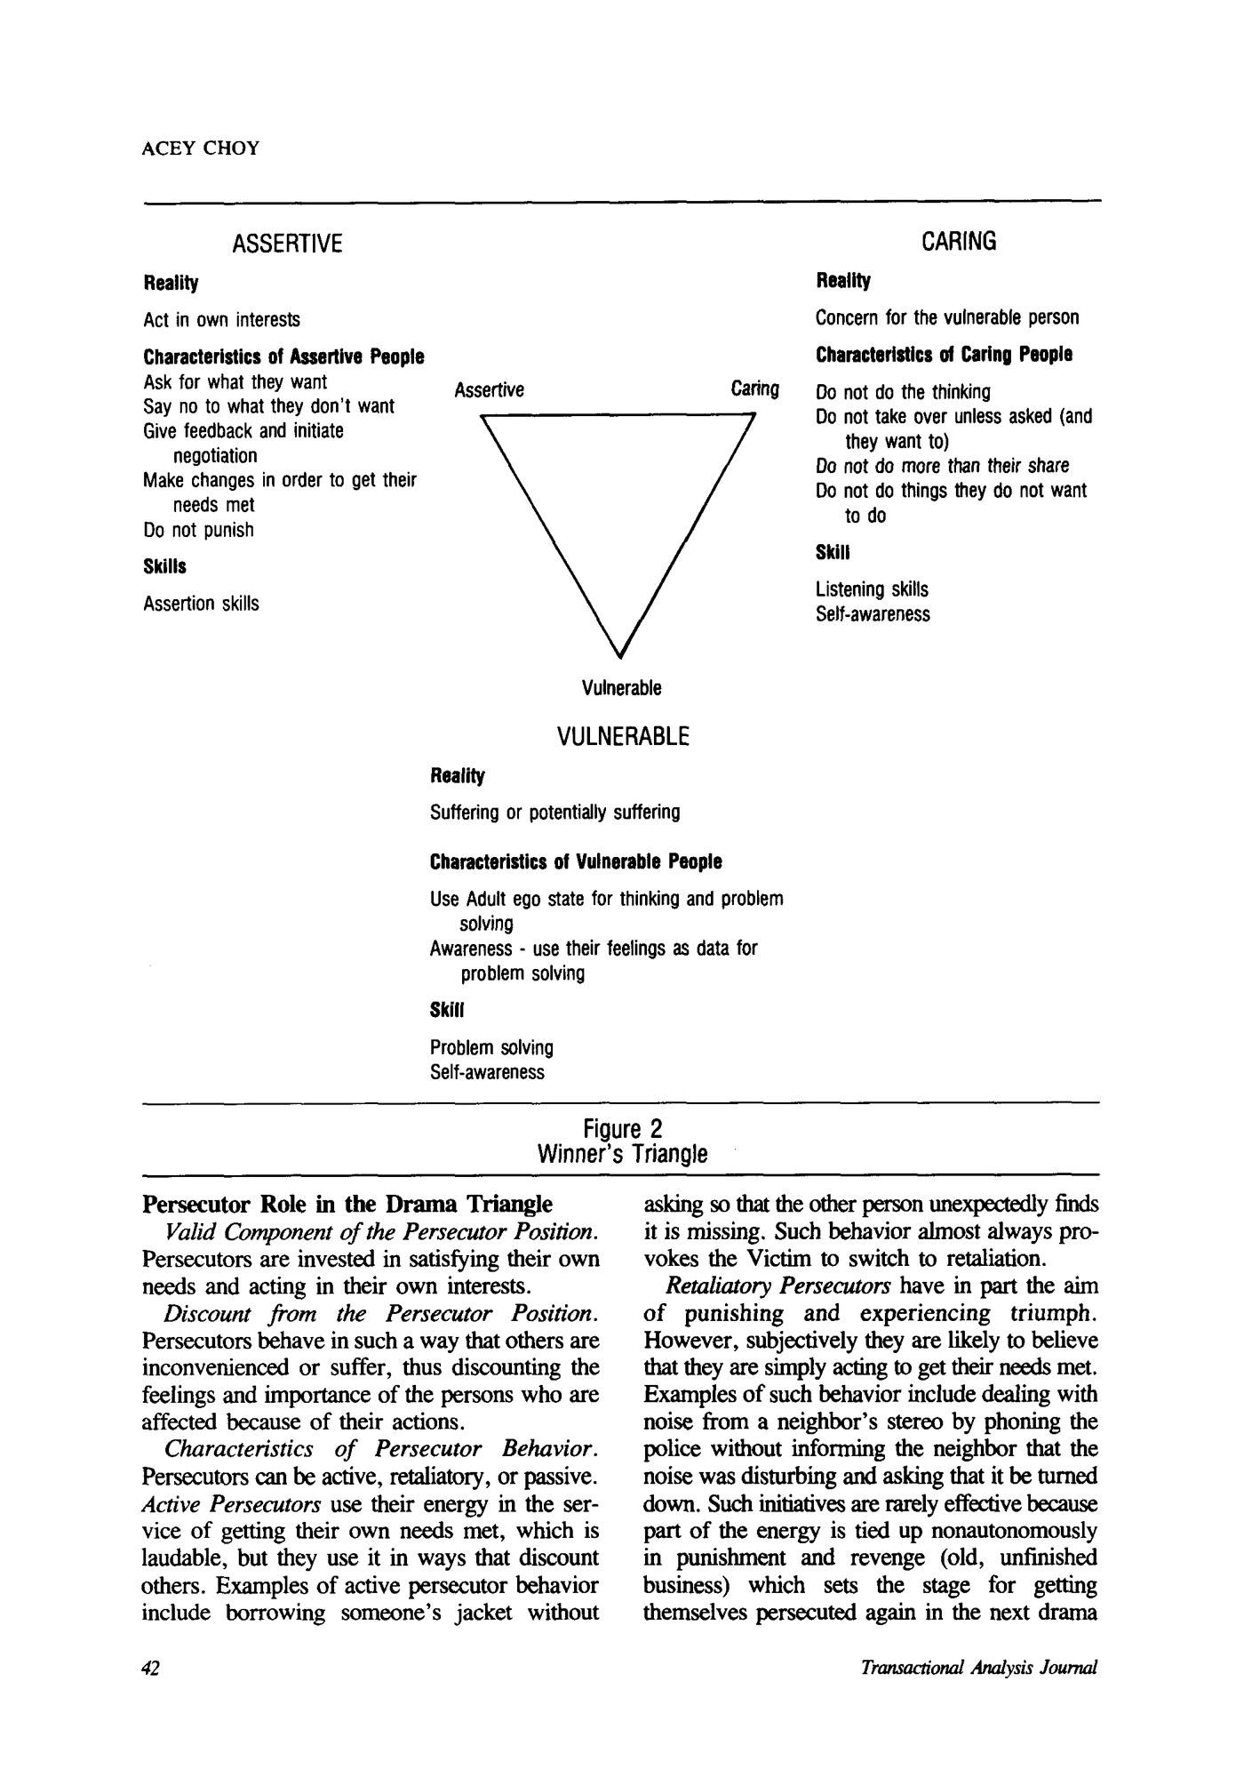

Slide 11
The roof : Output of learning What is visible? What has changed? What knowledge is increased? What skills are increased? What challenges are to observe?
Rooms | Liberal | Progressive
Steps | Humanistic | Technological
Doors | Radical | Dogmatic
Fundament: What exist? What further
expiriences are there?
Assumptions about learning, beliefs, strategies,
knowledges, skills, age, Intelligence,personality, motivation, interests, usefulness, ....

