Slide 1
The Comparison of educational system between Japan and Czech Republic
Sato Tomohiko, 3nd year, faculty of education
Notes:
I’m going to talk about mainly the educational system of Japan and, also, I’ll compare it from this country. Specifically, the topic would be with respect to ISCED, the goal of basic education, the subject, and key competency. Now, lets get it started.

Slide 2
What the ISCED in Japan looks like?
Notes:
First, I’d like to introduce about the ISCED(International standard classification of edu) in Japan.

Slide 3
ISCED in Japan
Doctor
(3yrs)
(4yrs)
Master
(2yrs)
(1yrs)
Uni.
(6yrs)
Advanced
Courses
(2yrs)
Professional
Training college
(1-4yrs)
Advanced
Courses
(2yrs)
University
(4yrs)
Junior
College
(2-3yrs)
Technical
school
(5yrs)
High school
(3yrs)
Upper secondary
Specialized training
Sch. (1-3yrs)
Secondary
School
(6yrs)
Middle school
(3yrs)
Primary school
(6yrs)
Kindergarten
(2-4yrs)(3-6 age)
Nursery school
(0-6 age)
Childcare center
(0-6 age)
Pre -
Notes:
In Japan, as a pre-school education, you have three options, kindergarten, nursery school and childcare center. The differences is each jurisdiction. Kindergartens are under the jurisdiction of the ministry of education, and nursery school is the ministry of health, labor and welfare, whereas, childcare center is Cabinet office. Then its followed by primary, middle and high school. Although the compulsory education is just for this 9 years, primary and middle school, more than 98% of people go to High schools. Basically, secondary schools are divided into two sections, but some are integrated and you can get consistent education there for 6 years. After graduation from high school, off cause, you would go university, junior college, or training college. In case of Faculty of doctor, veterinary medicine and dentistry, you should study for at least 6 years. Also, some go to graduate school and get master and doctor degree.

Slide 4

The differences of ISED among the two countries
Age: 0~
Age: 6~
Age: 12~
Age: 15~
Age: 18~
There is almost no possibilities to repeat a year
①University
②Junior college(2-3yrs)
③Pro training college(1-4yrs)
Classes taught by specialized teachers.
①General-
②Training-
③Technical – (5yrs)
①Nursery school
②Childcare center
③Kindergarten(age:3~)
Normally classes taught by
a single teacher.
KOSEN(高専)
1-6. grade
1-3. grade
1-3. grade
Primary education
Middle school
High school
Higher ed. /Tertiary pro ed.
Life-long learning etc.
Pre-primary
Lower secondary
Higher secondary
①Childcare facilities
(~age:3)
②Children’s groups
(age:6 months~)
③Nursery schools
(age:2~)
④Preparatory classes
10-13. grade
Since 2005, only through this stage, homeschooling became legal.
The majority attends 8-year gymnasiums after 5th grade
<STAGE 1>
1-5. grade
①University
(Bacherer’s:3-4yrs)
(Master’s:1-3, 4-6yrs)
(Doctor’s: 3yrs)
②Higher pro schools
<STAGE2>
6-9. grade
①Gymnasium
②Pro high sch.
③Vocational sch.
For children who postponed entrance period by 1 year.
Age: 6-7~
Age: 19~
＊Compulsory school attendance
Notes:
◎Then I put together about the differences between the two countries in this table.
○In the Czech republic, pre-primary education is compulsory from the beginning of the school year after the child’s fifth birthday before compulsory school attendance. And you can postpone your entrance period of primary school by 1 year by going to preparatory classes. In contorary, in Japan, there is a similar educational system as well, however, it’s a quite rare case people do it.
○In Japan, Primary education has 6 years and it’s applicable to STAGE1 in Czech. Interestingly, homeschooling is not accepted in Japan, but it became legal in this country through this stage. Then, next, in Japan, you’re suppose to go to middle schools for 3 years, and it’s relevant to STAGE2. One interesting fact is that there is almost no possibilities to repeat a year during compulsory school in Japan unlike the Czech republic.
○After compulsory education, in both countries, you can choose from these similar options. But I must say that in Czech students have the option to apply to 6 or 8-year gymnasiums either after their 5th or 7thyear of elementary education. Gymnasiums are schools targeted toward a specific area of study, but still provide elementary education.
○Then, regarding higher education, just I will mention about Technical school called “Kosen” in Japan since it’s kind of an educational system wherein European countries don’t have. Even though Kosen include higher secondary edu, it’s deemed as higher ed. Basically it’s for 5 years and, indeed, the content of ed is highly evaluated by OECD and other foreign institutions because it contributes a lot to the industry in Japan thanks to the consistant ed for 5 years.
(Higher professional schools offer professional tertiary education and are usually connected with professional high schools.)

Slide 5
The goals of basic education in Japan
are to cultivate the following abilities…
Notes:
Secondly, I‘ll talk about the goals of basic education in Japan, and after that, I’ll introduce some similarities of the goals between Japan and the Czech republic.

Slide 6
・An attitude to proactively participate in the formation of society and contribute to its development
・A spirit of respect for life and nature and an attitude to contribute to the preservation of the environment
・A correct understanding of the present situation and history of Japan and an attitude of love for own
country. Plus, to respect them as well as other countries and contribute to the peace and development
of international society
・A basic understanding and skills in the roles of the family and home, and in the clothing, food, housing,
information, industry, and other matters necessary for daily life
・Basic knowledge and skills about occupations, an attitude of respect for work, and ability to choose
a future course according to one’s individuality
・A basic understanding and skills in music, fine art, literature and other arts that enrich our lives
・The habits necessary for a healthy, safe, and happy life, and to develop physical strength through exercise
for the harmonious development of body and mind
…
School Education Act, article 21 (1947)
Notes:
Here is almost all of the sentences with regard to the goals of basic education. I won’t explain respectively, but according to this legal provision, you can find some interesting facts.
As you can see the red colored lines, so, in Japan, to cultivate an attitude of love for own country is one of the goals of basic education. In my point of view, I would say the basic education in Japan cherish the Love for own country and hometown. I’m not sure about the details, but, because of that, I suppose many of Japanese nationals have a common sense as a Japanese citizens.

Slide 7
How to achieve the goals in Japan?
An attitude of proactive learning and to develop students’ individuality
Proactive,
Dialogic,
And deep learning
Knowledge
and skills
The ability to think, to make decisions, to express themselves
*From the education guidelines(2019) by the Ministry of Education
Notes:
◎So, how to achieve the goals in Japan?
○The answer would be this learning method: Proactive, dialogic and deep learning so called “active learning”. Through this way of learning, you’re expected to cultivate these three things, An attitude of proactive learning and to develop students’individuality, knowledge and skills and the ability to think, to make decisions, to express themselves. Not only basic education, but also other stage of education, this is the fundamental and core way of thinking.
○As you know, the previous slide is based on a law created a few decades ago, but this time, it’s based on the education guidelines created just recently by the ministry of education. What is important is that the guidelines are published so that you can receive a same level of quality education everywhere in Japan, also, it’s revised every one decade to adapt to the changing social needs.
①主体的な学び=To have an interest in learning, to relate it to the direction of one's career development, to work persistently with a sense of perspective, and to reflect on one's own learning activities in order to move on to the next.
②対話的な学び=Broaden and deepen one's own thinking through collaboration among children, dialogue with teachers, staff, and community members, and thinking based on the ideas of philosophers.
③深い学び=In the learning process of acquisition, utilization, and exploration, students are encouraged to use "ways of seeing and thinking" according to the characteristics of each subject, and to relate knowledge to each other to gain a deeper understanding, to examine information to formulate ideas, to find problems and think of solutions, and to create based on their thoughts and ideas.

Slide 8

Abilities to cooperate and value
their own work and achievements
as well as the work and achievements
of others
Develop own abilities and skills in the context of actual opportunities and to use their abilities and skills in combination with their acquired knowledge when making decision regarding the aims of their own life and profession
Carrier Education
Creative thinking, logical reasoning and problem solving
The sense of toleration, consideration and respect for other people
Inclusive Education
Notes:
In addition, off course, I found a bunch of similarities of contents between Framework Educational Programme(issued by Czech) and the educational guidelines(issued by Japan)
Probably, here would be typical examples of abilities and skills which are expected children to acquire.
As I don’t have enough time left, I’ll skip this two, but I should mention this field of education called Carrier education. In both countries, through every possible approach as well as job experiences, it’s absolutely significant to let children think about their future job and discover own way of living. Moreover, the sense of toleration, consideration and respect for other people is also important. Japan is in the possess that the ministry of education tries to develop the Inclusive education system in order to realize a symbiotic society.

Slide 9
What do you learn in basic education
in Japan?
Notes:
Next slide is about the subject which you learn in basic education in Japan.

Slide 10
Primary school
Middle school
・Japanese
・Social studies
・Mathematics
・Foreign language
・Science
・Domestic science
・Music
Became a subject of 5th and 6th year of primary schools from 2020.
・Arts and crafts
・Physical education
・Socio-environmental studies
・Fine arts
・Technology
・Health and physical education
・Moral education
・the Period of Integrated Study
・Special activities
Became a special subject from 2018
＋
Programming education has been required at primary schools since 2020.
Notes:
◎This is a table which shows the subjects, and off course, it’s not the same between primary and middle school. I will just focus on the subjects of foreign language and moral education.
○In Japan, it’s required to teach Foreign language (Basically English) from 3rd year at primary school as just activities, and then from 5th year, it became a subject from 2020. Off course, before 2020, it was common to learn English at a primary school. However, given the low level of English skills of Japanese, schools are starting to focus on English learning than before.
○Then, I suppose that moral education is one of characteristics of Japanese education. And it became a special subject from 2018 in the context of the bullying problems.
○Just recently, programming education has been required at primary schools and this would be adapted to middle and high school gradually. This education would allow students to get skills to make use of computer and develop their logical thinking.
info and communi tech は総合的な学習の時間の中で行われてる感じ、最近プログラミング科目化した
humans and Their world は生活科に似てる
家庭科はHUMANS AND THE WORLD OF WORK
Human and society はHistory と civil education に分かれている 19thと20thに重きを置いていたり、civil eduのんかあでPupils learn to respect and apply moral principles and rules of social coexistence and to take responsibility for their opinions, behaviour and the results of their behaviour. They develop their citizenship

Slide 11
How to survive in this changeful society ?
Notes:
Finally, I will talk about key competencies which is needed to survive in this changeful society.

Slide 12
Key competencies
defined
by OECD
A. Get on well with others
B. Cooperate with each other
C. Handle conflicts and solve them
Interact in
Heterogeneous
groups
・Problem-solving competencies
・Social and personal competencies
・Civil competencies
・Learning competencies
Reflectiveness
Act autonomously
Use tools interactively
・Communication competencies
Act from a general standpoint
B. Make a life plan and carry it out
C. Express one‘s rights, interest, need
and limits.
A. Use language, symbols and texts
interactively
B. Use knowledge and info interactively
C. Use technologies interactively
・Working competencies ? (but it doesn’t include entrepreneurial thinking)
Notes:
◎In the first place, I must say the definitions of key competencies are kind of different between OECD(Organization for economic cooperation and development) and EU.
In case of OECD, and I mean Japan, competencies are classified into these three categories, and the core idea is reflectiveness.
○And like this, you can find similar contents between the two definitions, however, what is interesting is the Key competencies define by OECD doesn't include entrepreneurial thinking. Based on this fact and my own experiences, actually, there is few opportunities in Japan to learn about business, how to make benefits in basic education.

Slide 13
What is interesting facts to me?
Notes:
So, as a conclusion, here is the facts I found it interesting

Slide 14
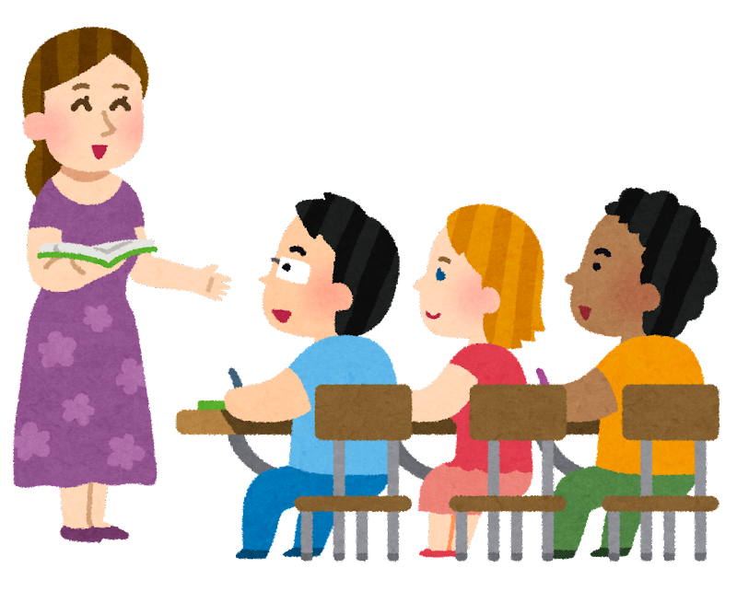
Interesting facts
◎The fact wherein you can postpone entrance period of primary school and repeat the school
year once at each educational stage in Czech is distinct from the situation in Japan. Both has
pros and cons and the system could discourage children with learning difficulties but get ready
to follow the classes.
◎Homeschooling is accepted for a specific educational stage in Czech though it’s not allowed
by laws in Japan. Despite that it’s not common for some reasons in Czech, it’s one of
advantages in terms of educational freedom, I think.
◎As you can see from the School Education Act, in Japan, basic education cherish the love for own
country and hometown. In my point of view, it could be a reason why many of Japanese nationals
have a common sense as a Japanese citizens.
◎Based on the Key competencies defined by OECD, basic education in Japan doesn’t pay much
attention to entrepreneur spirits, but to the abilities to act from a
general standpoint and make a life plan and carry it out.
Notes:
As I already mentioned this, I’ll skip this slide.

Slide 15
References
・UNESCO Institute for Statics「ISCED Mappings」
http://uis.unesco.org/en/isced-mappings
・Ministry of Education, Culture, Sports, Science and Technology – Japan HP
https://www.mext.go.jp/a_menu/shotou/new-cs/youryou/syo/
・Public Relations Office, Government of Japan
https://www.gov-online.go.jp/useful/article/201903/2.html
・Framework Educational Programme for Basic Education, 2007
・Ministry of Education, Youth and Sports, Areas of work
https://www.msmt.cz/areas-of-work/preschool-education

Slide 16
Thank you all for listening
Notes:
That brings me to the end. Thank you for listening!

