Slide 1


Turkish Education System
“Education does not only aim training the individual in the most equipped way, it also serves to the purpose of providing qualified labour to the country.”

Slide 2


Education in Turkey is one of the basic functions of the state and is carried out under the control and supervision of the state.
The Ministry of National Education is structured in the form of central organization, provincial organization and foreign organization.

Slide 3
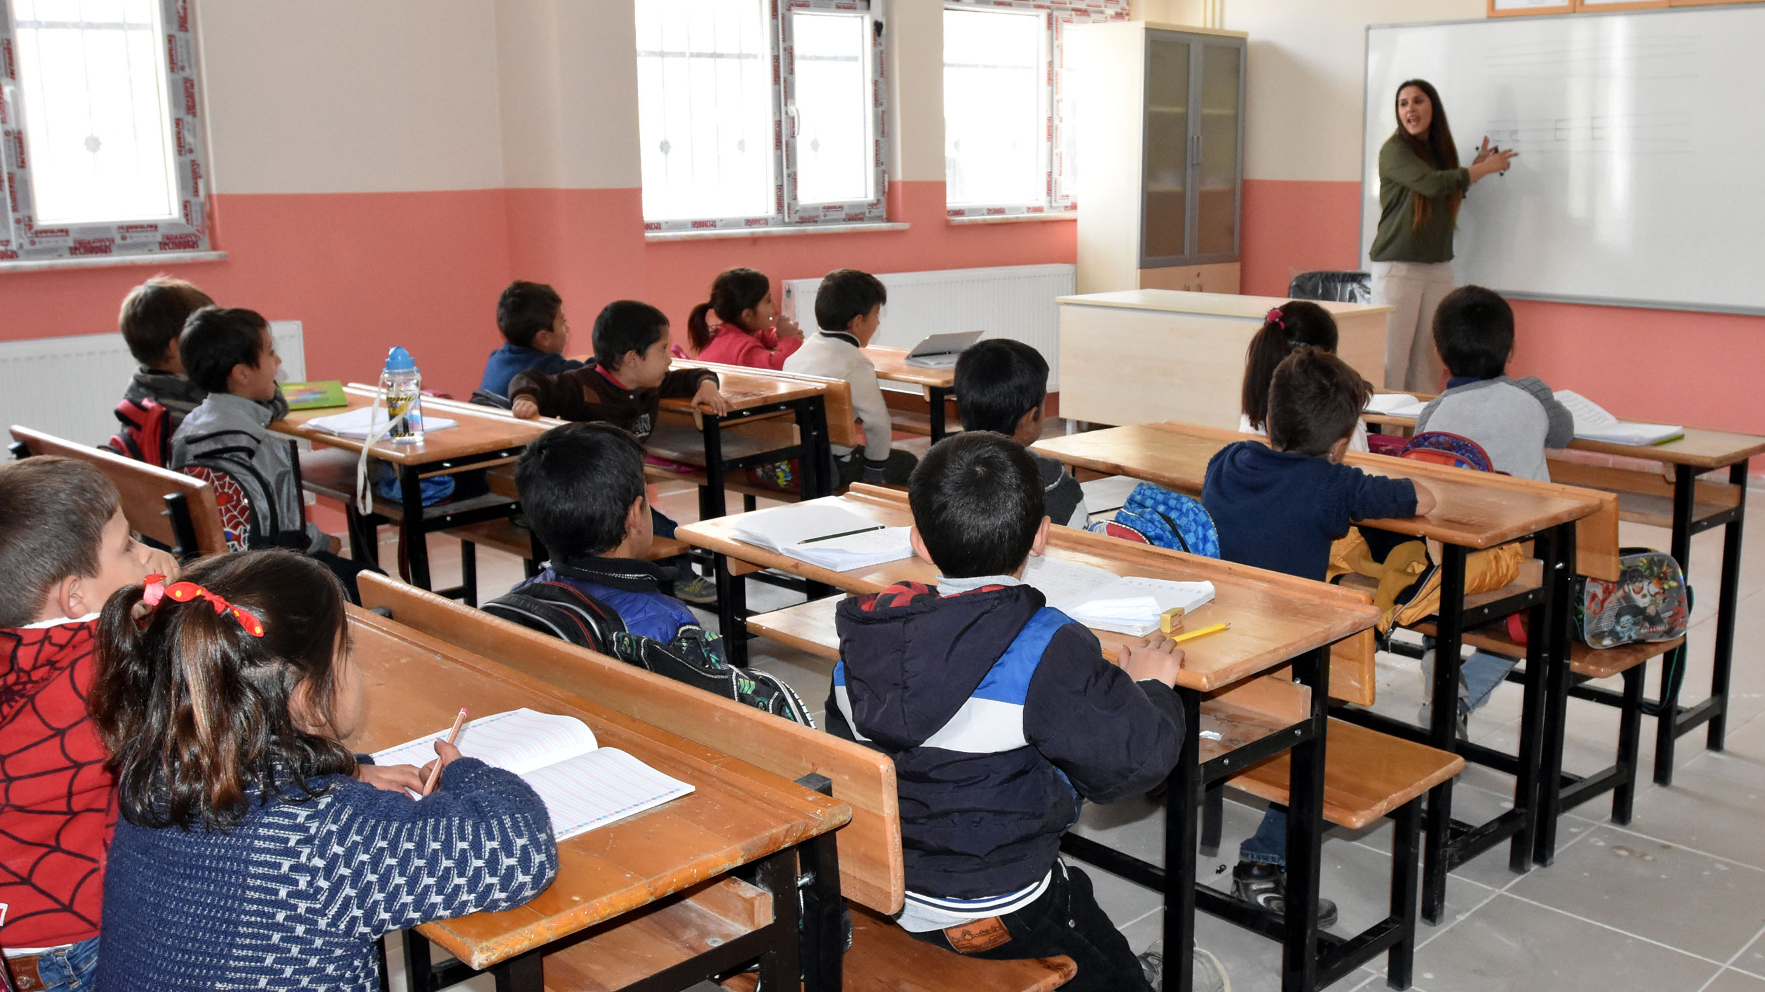
Education in Turkey is governed by a national system which was established in accordance with the Atatürk's Reforms after the Turkish War of Independence. It is a state-supervised system designed to produce a skillful professional class for the social and economic institutes of the nation.

Slide 4

In Turkey, the National Ministry of Education is responsible for planning, programming, advancing, monitoring, and inspecting all educational and training services and activities.
After new legislation on primary and secondary education was passed by the Grand National Assembly in 2012, the duration of compulsory education was established as 12 years in Turkey. The new “4+4+4” system covers four years of primary school, four years of lower secondary school, and four years of upper secondary school.

Slide 5
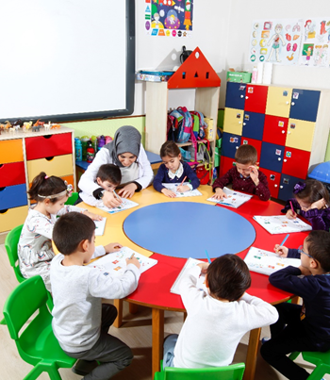
Early Childhood/Pre-School Education

Slide 6
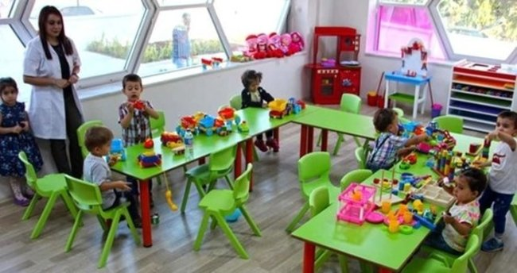
Early Childhood Education in Turkey covers the Nursery and Day Care Centres for children of 0-36 months, There are also early childhood educational centres in special education kindergartens, and Guidance Services for 0-36-month-old children who are in need of special education.
Early Childhood/Pre-School Education
Optional Kindergarten education, up to 6 years
of age.
Children aged 57-68 months are enrolled in kindergarten, nursery class and practice classes. 36-56 months old children can be registered in kindergarten and practice classes, and 45-56 months old children in kindergarten classes with physical facilities. Pre-school education is carried out under the responsibility of the Ministry of National Education.

Slide 7
Pre-Primary education is an optional education for children between 3-5 years of age who are under the age of compulsory primary education.
The purpose of this education is to ensure physical, mental and sensory development of children and the acquisition of good habits, to prepare children for primary education, to create a common atmosphere of growth for those living in inconvenient circumstances and to ensure that Turkish is spoken correct and well.
Pre-school education is given in kindergartens, daycare homes, nursery classes in primary schools, and in private nurseries, all under the supervision of the Ministry.
Early Childhood/Pre-School Education

Slide 8
Primary School

Slide 9
-Primary Education (ages 5 to 13) lasts eight years, is free of charge, and is compulsory.
-Primary education is provided in 4 year primary schools and 4 year lower secondary schools.

Slide 10
The objective of primary education is ensuring that Turkish children acquire the necessary knowledge, skills and behaviors to become good citizens, that they are raised in accordance with national morals, and that they are prepared for life and for the next level of education according to their interests and capabilities.
In the 2014–2015 school year, there were 27,544 primary schools in Turkey, of which 1,205 were private.

Slide 11
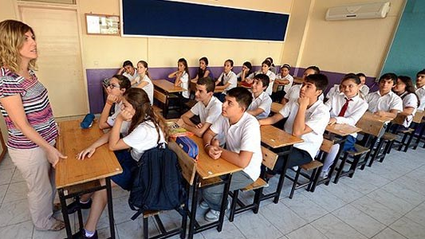
Upper Secondary Education

Slide 12
Upper Secondary Education
Upper secondary education (Grades 9 to 12) lasts four years. It is free of charge and compulsory. In Turkey, there are two types of upper secondary school: general high schools and vocational and technical high schools.
General high schools accept students based on their scores on the Passing from Basic Education to Higher Education Examinations, which consist of examinations in mathematics, science, foreign languages, religious culture and ethics, history of the Turkish revolution, and Atatürk principles.
High schools with a specific focus include Anatolian high schools (where the curriculum emphasizes English and maths), science high schools (where the curriculum emphasizes science), fine arts and sports high schools, and social science high schools.
Vocational and technical high schools provide education and training leading to different careers.

Slide 13
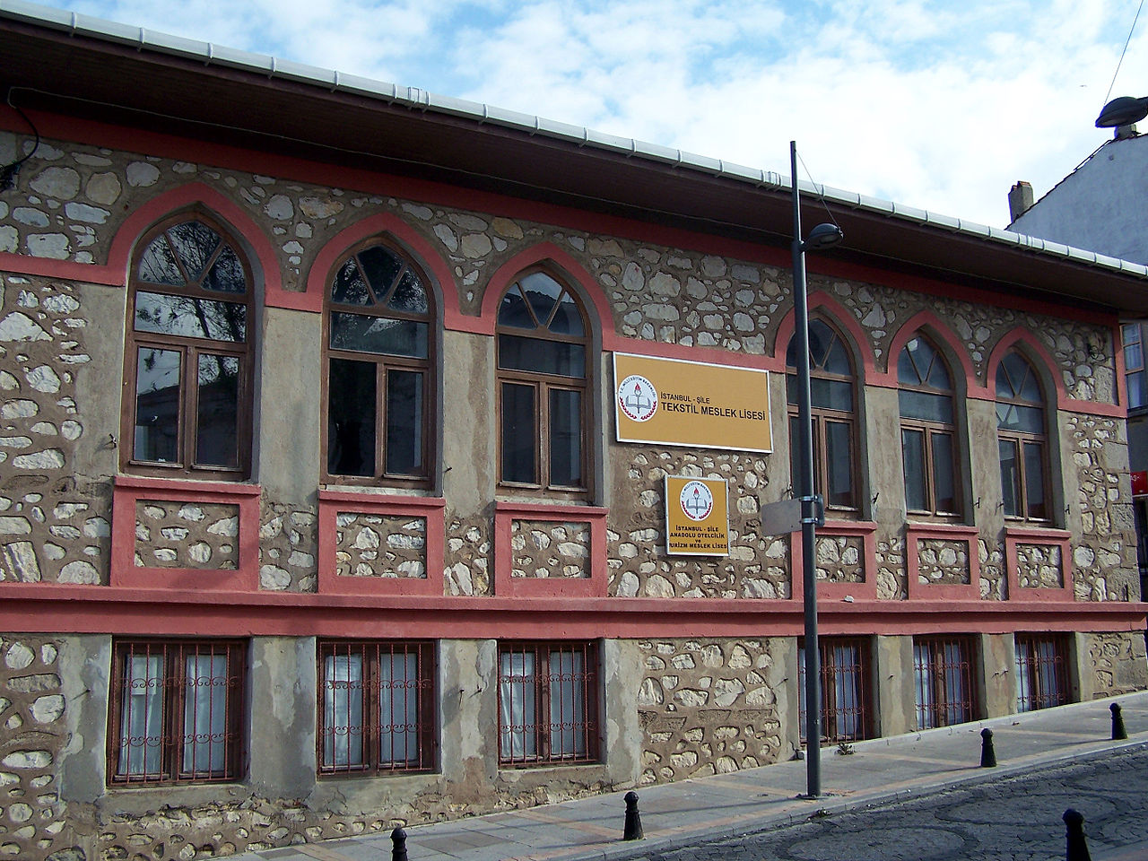
Upper Secondary Education
Vocational and technical secondary education involves the institutions that both raise students as manpower in business and other professional areas, prepare them for higher education and meet the objectives of general secondary education.
Vocational and technical secondary education includes technical education schools for boys, technical education schools for girls, trade and tourism schools, religious education schools, multi-program high schools, special education schools, private education schools and health education schools.

Slide 14
Upper Secondary Education
4 years of High School Education (15-17/18) years of age.
High schools are mostly owned by the government and provide free education.
Although the curriculum differs according to the specific purpose of each type of school, the goals of secondary education are to provide students in all school types with the following: common, basic, overall knowledge; familiarity with the problems of the individual and society and the ability to seek solutions; awareness that will contribute to the socioeconomic and cultural development of the country; and preparation for higher education, a profession, life, and employment according to student interests and aptitudes.

Slide 15
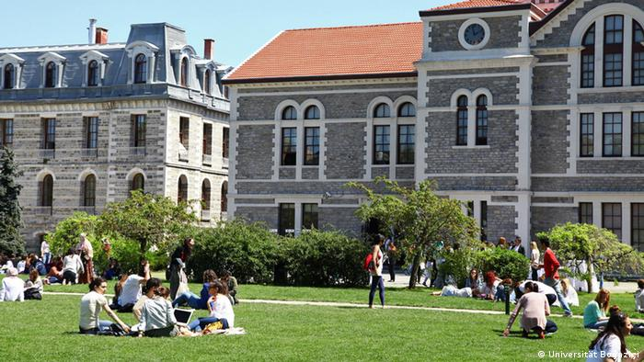
Higher Education

Slide 16
Higher Education
Higher education includes all the educational institutions that are based on secondary education and provides at least two years of higher education. Universities provide higher education for students who hold high school diplomas. The objectives of secondary education, in accordance with the general purposes and basic principles of education established at the national level, are as follows:
Train students according to the country’s science policies and the need for labor at various levels of society according to their interests, aptitude, and abilities
Provide scientific training at various levels
Conduct research, exploring the sciences in further detail in order to find solutions to scientific, technical, and cultural problems, especially to problems related to the country
Provide society with research results and analyses focusing on the country’s progress and development and involving the coordination of the government and other institutions
Publish research results that facilitate scientific and technological progress
Provide educational services, such as publishing scientific data, that can improve Turkish society and enlighten the public

Slide 17
Higher Education
Higher education institutions include universities, institutes, colleges, conservatories, vocational colleges, and centers for practice and research.
4 years of University, or 2 years at Higher Vocational Schools. Some schools have an additional year of language study.
Master’s study lasts 2 years, PhD 3-5 years.

Slide 18
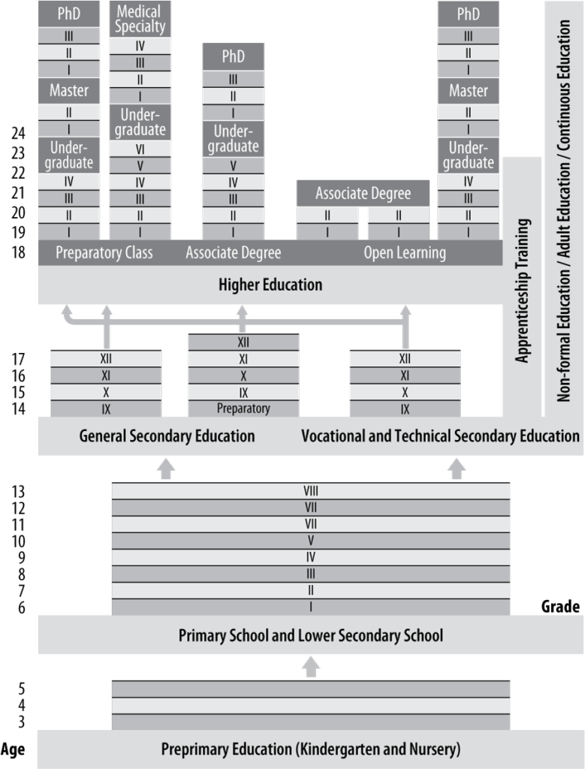
The General Structure of the Turkish Educational System

Slide 19
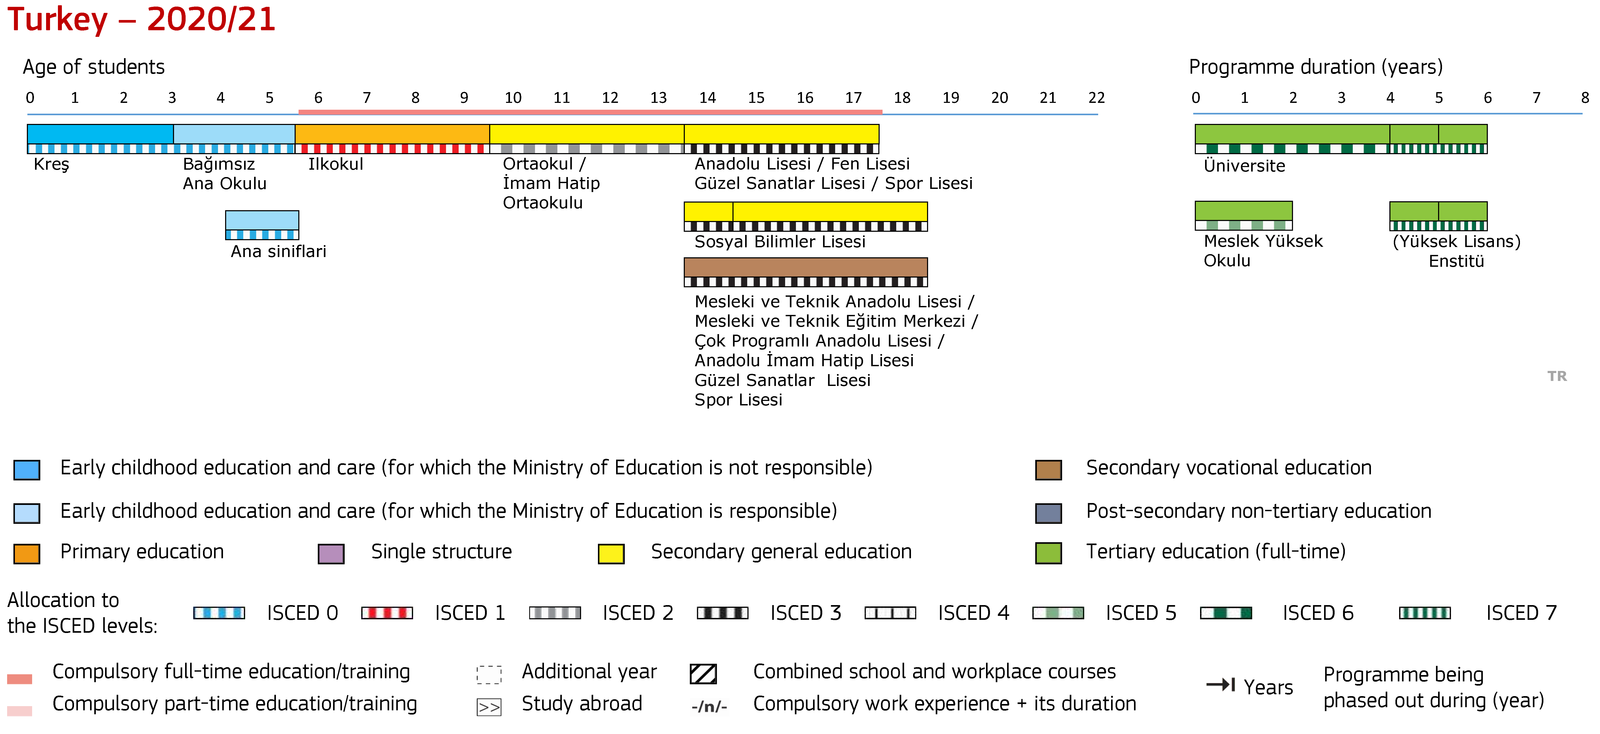

Slide 20
Turkish Education
There are four core subjects at First, Second and Third Grades which are; Turkish, Maths, Hayat Bilgisi (literally meaning "Life Knowledge") and Foreign Language.
At Fourth Grade, "Hayat Bilgisi" is replaced by Science and Social Studies. The foreign language taught at schools and the most common one is English, while some schools teach German, French or Spanish instead of English. Some private schools teach two foreign languages at the same time.

Slide 21
The most common foreign language is English, which in public schools is taught from 2nd grade onwards through to the end of high school. In high school a second foreign language is introduced. In many cases employ native speakers of English as teachers.
After 2012, Ministry of Education also included Abkhaz, Adyghe, Standard Georgian, and Laz and Kurdish languages in 2013, and Albanian as well as Bosnian languages in February 2017.
In 2015, the Ministry of Education announced that as of the 2016-17 academic year, Arabic courses (as a second language) will be offered to students in elementary school starting in second grade. The Arabic courses will be offered as an elective language course like German, French and English.

Slide 22
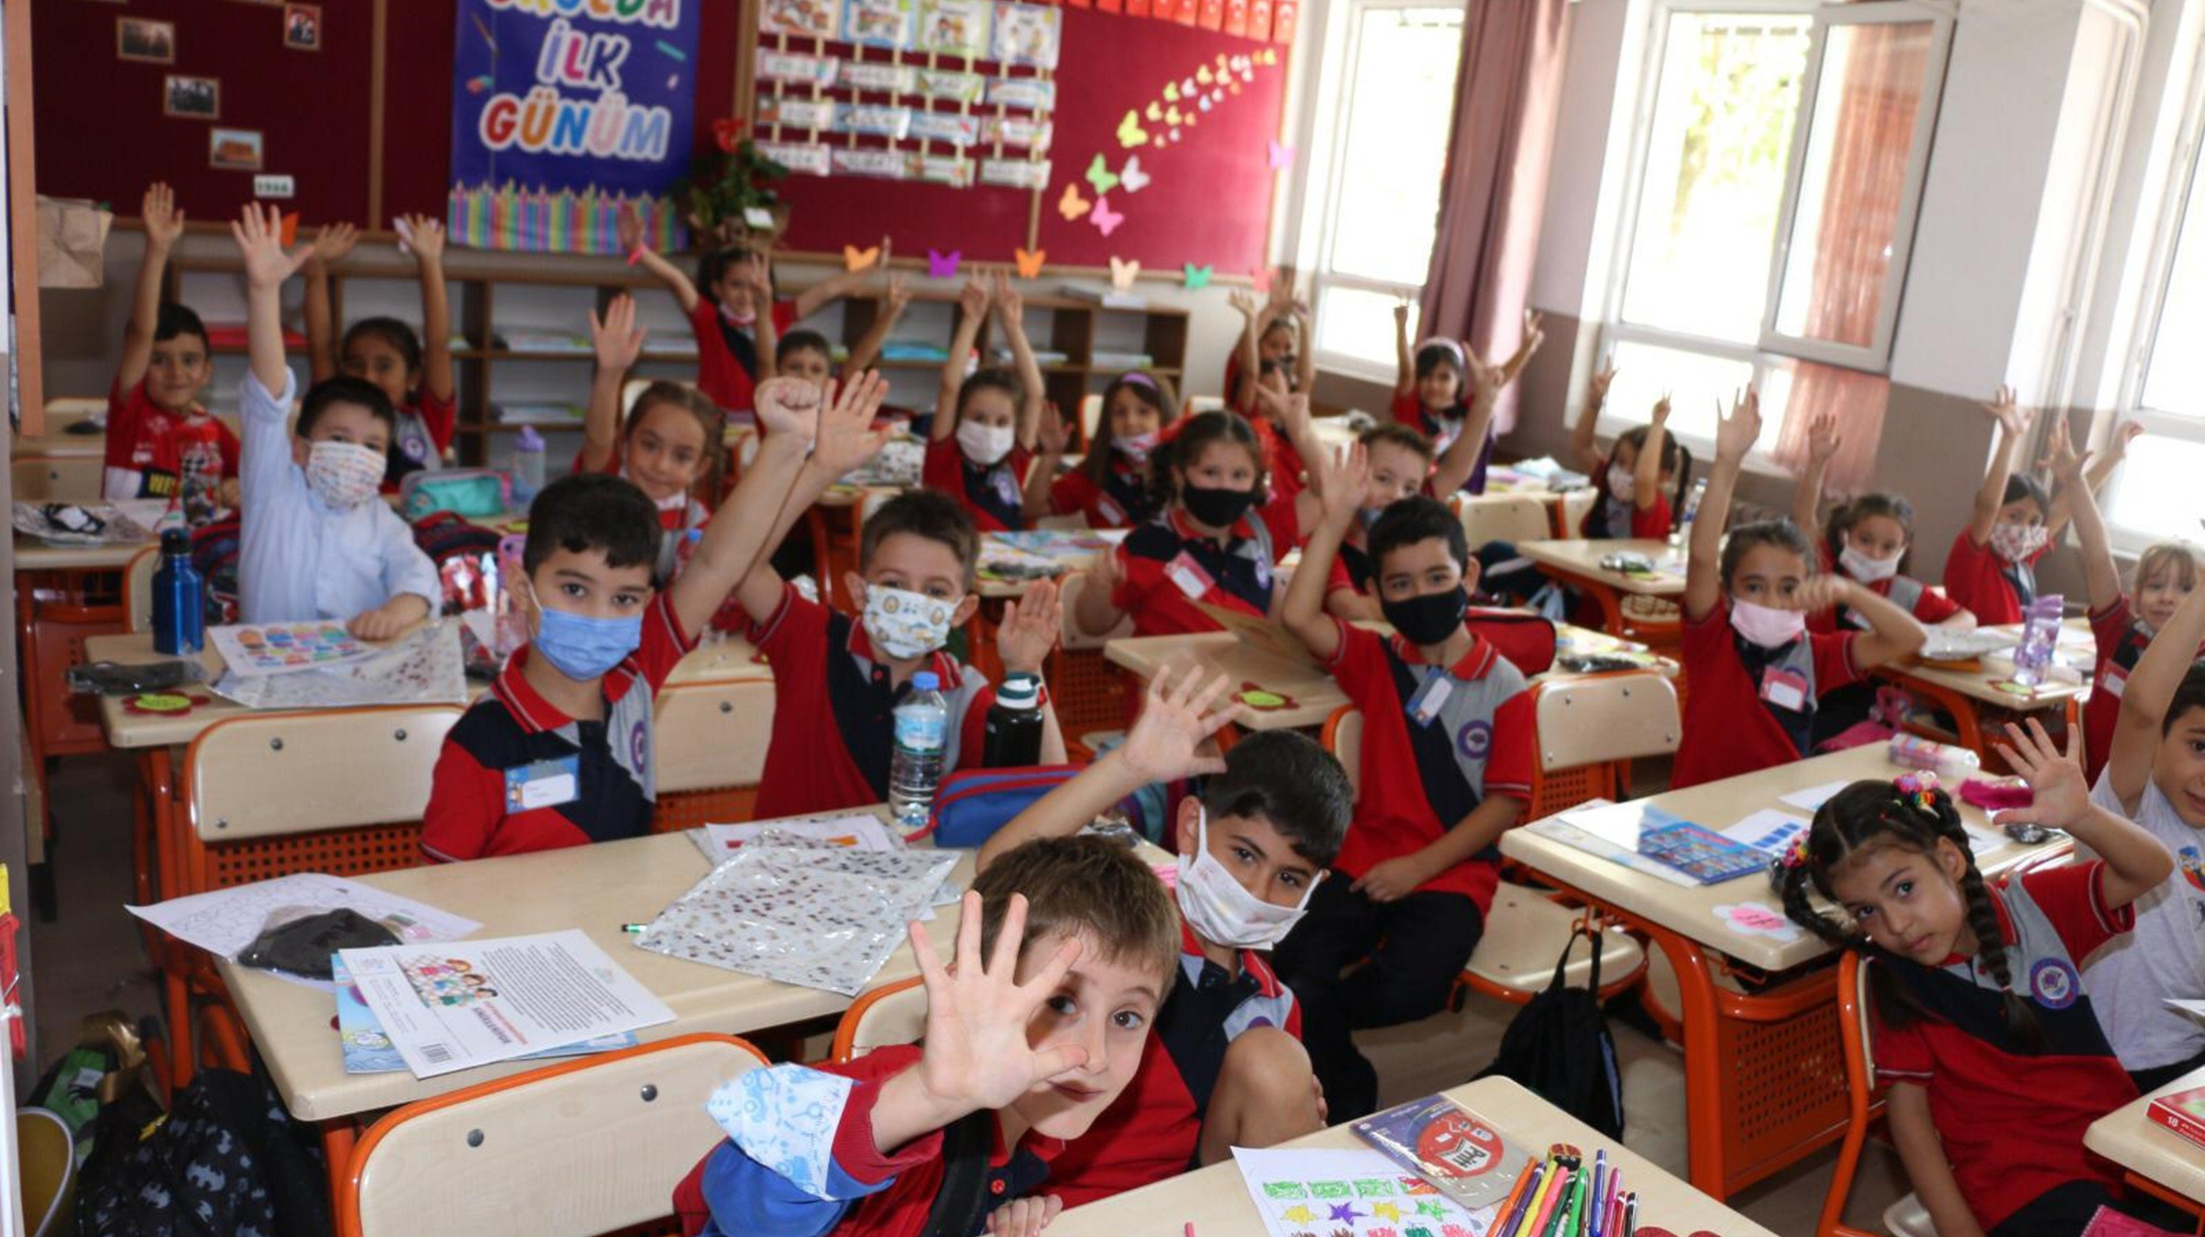
THANK YOU FOR WATCHING!
Melike DAĞCAN

Slide 23
SOURCES
https://en.wikipedia.org/wiki/Education_in_Turkey
https://odinland.vn/education-system-in-turkey/?lang=en
http://timss2015.org/encyclopedia/countries/turkey/
https://eacea.ec.europa.eu/national-policies/eurydice/content/turkey_en
https://www.oecd-ilibrary.org/sites/71ee93b4-en/index.html?itemId=/content/component/71ee93b4-en
https://www.oecd.org/education/school/39642601.pdf

