Slide 1
lesson 1
Social psychology
David Havelka
The role of socialization
Social learning theory (Bandura A.)
Social relationships in early childhood, attachment theory (Bowlby, J. and M. Ainsworth)

Slide 2
Why to study social psychology?
To understand the social dimension of the student
+
based on the social context, we can anticipate people's behavior
(to some extent )
we can choose appropriate preventive strategies and behavior thus avoid unnecessary conflicts between students and strenghten the class climate

Slide 3

The Meaning and Importance of Social Psychology
zóon polítikon - Aristotle
Man is a „political (social) animal"
In other words: without contact with others man would not actually develop.
Social Psychology study the influence of social factors (socio-cultural environment) on the formation of human psyche (in three dimensions: intrapersonal, interpersonal and social).
Notes:
Tady bych je mohl nejddřív nechat se zamyslet a pak až to teprve rozbalit

Slide 4
Definitions of social psychology
Social psychology is the scientific study of how people's thoughts, feelings, beliefs, intentions and goals are constructed within a social context by the actual or imagined interactions with others.
-Saul McLeod (2007)-
Social psychology is the scientific study of how people think about, influence, and relate to one another.
- David G. Myers (2010)-

Slide 5
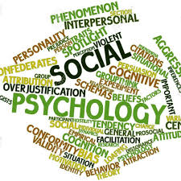
Main topics of social psychology
Role behavior
  E.g.: the role of teacher (duties, rights, expectations, behaviour, norms)
Interaction and communication
  e.g.: school environment
Perception of other people
  Teacher - students
Opinions, attitudes and their change
  Effects in education process
Formation of social groups and group dynamics.
  Classroom, school as a whole, school climate,….

Slide 6
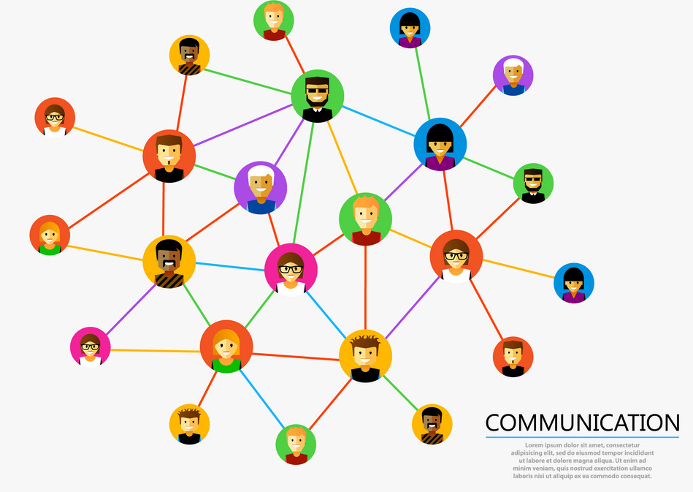
Interaction and Communication
Core terms of social psychology!
Interaction
the mutual relationship between individuals (groups; groups and individuals)
Communication
basic condition for social interaction; without any form of communication society would not exist.

Slide 7
Interpersonal communication - schema
Mr. Communicator
Mr. Recipient
coding
Communication barrier
decoding

message, communique
feedback

Slide 8

Interpersonal communication
We are not communicating just "information“, people also communicate their:
mental states
emotions
moods
beliefs
and so on….
Home study: Types of communication
https://sourceessay.com/types-of-nonverbal-communication-social-psychology/

Slide 9
Communication in schools
Educational communication can be defined as transactional process in which educators and students create a joint communication climate which changes from moment to moment as conversation unfolds and the thoughts, attitudes and behaviors of both parties influence each other in some way.
To learn more: https://slideplayer.com/slide/13325574/

Slide 10
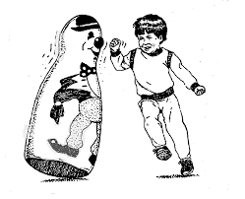
Social Learning Theory
Albert Bandura

Slide 11
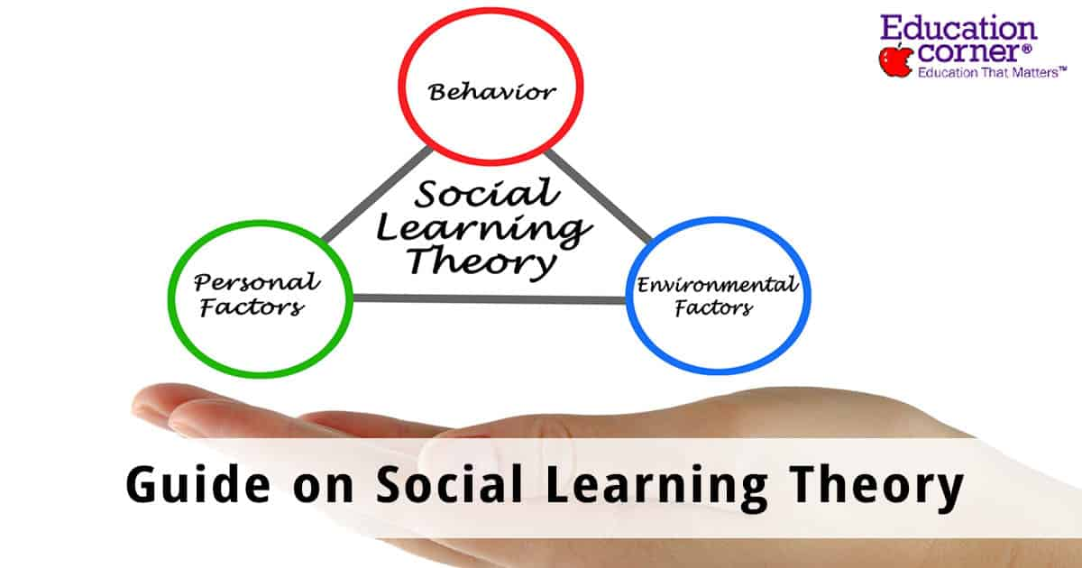
Social Learning Theory
People are not driven by either inner forces or environmental stimuli in isolation; instead behaviors are learned through continuous interaction of personal and environmental determinants and all learning from direct experience occurs by observing other people’s behavior. (Burton, Moore, & Magliaro, 1996).

Slide 12
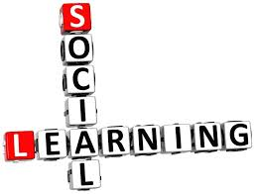
Basic forms of social learning
Social stenghtening
Imitation
Identification
Observational learning
Anticipation
Association

Slide 13

Products of social learning
Social roles
Attitudes
Values
Ideals, etc….

Slide 14
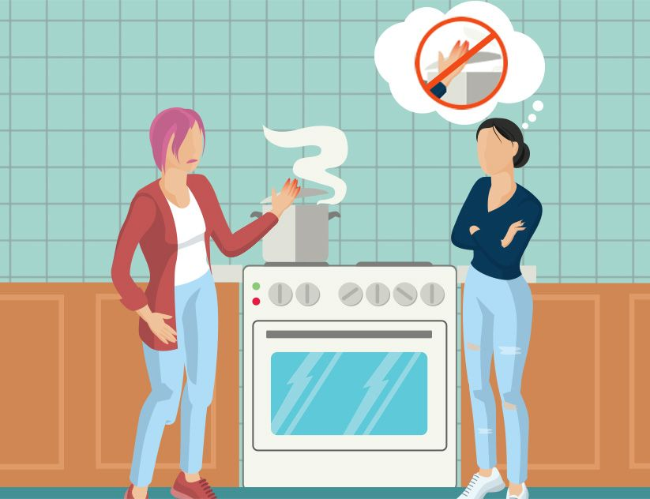
Observational Learning
A. Learn by watching: you don't have to do something in order to learn it
B. Abstract, decide, engage: learners see something in the environment, abstract what they've seen, decide if it is important and then repeat the behavior.

Slide 15
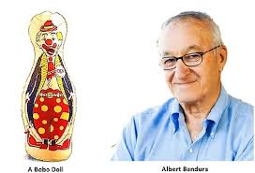

Slide 16
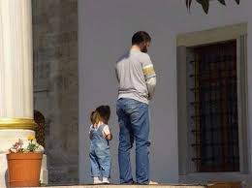
What are the lectures from this experiment for teaching practice?

Slide 17
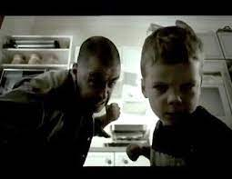
Social learning theory in practice
https://www.youtube.com/watch?v=jOrGsB4qG_w

Slide 18
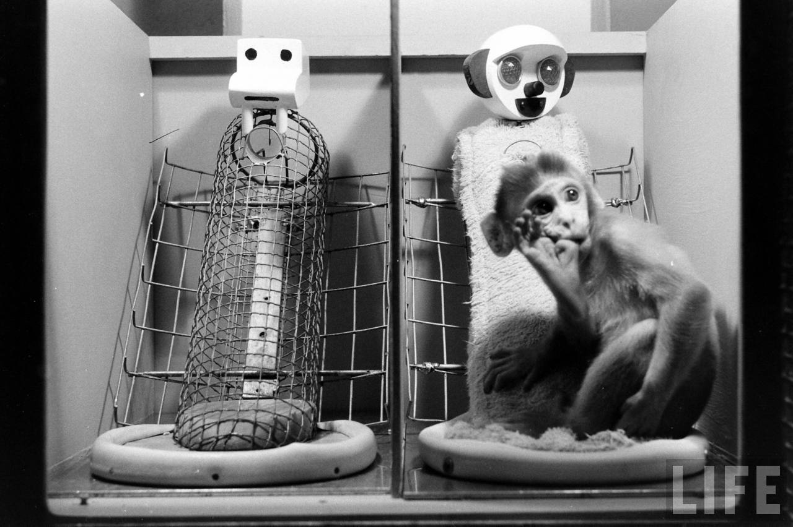
Attachment theories

Slide 19
Attachment - definition
„Attachment theory explains how the parent-child relationship emerges and influences subsequent social development and functioning.“
„Lasting psychological connectedness between human beings.“
Attachment is a deep and enduring emotional bond that connects one person to another across time and space (Ainsworth, 1973; Bowlby, 1969)
Attachment is characterized by specific behaviors in children, such as seeking proximity to the attachment figure when upset or threatened (Bowlby, 1969).
Attachment behavior in adults towards the child includes responding sensitively and appropriately to the child’s needs. Such behavior appears universal across cultures.
The attachment theory has had a large impact on social psychological theories of close relationships, emotion regulation, and personality.

Slide 20
Theories and authors
R. Spitz (development of "object" relationships, depression from abandonement)
https://www.youtube.com/watch?v=VMWb8rfU-rg&t=494s
M. Mahler: phases of Ego development, process of separation and individuation
https://www.youtube.com/watch?v=X2Go1-40yRM
D. W. Winnicott: development of "self", "good enough mother", transition objects
https://www.youtube.com/watch?v=gQkZYP-F6eU
W. R. Bion – "Containment" of the affective states of the child
https://www.youtube.com/watch?v=9bee-xDMNmg
https://www.youtube.com/watch?v=yDpaF6l6Exs
Jurist, Fonagy, Target – “Mentalization” of affects
https://www.youtube.com/watch?v=MJ1Y9zw-n7U
The theory of early emotional attachment (attachment; J. Bowlby, M. Ainsworth)

Slide 21
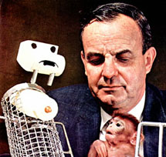
Harlow's experiments with maternal deprivation
Harry F. Harlow, “Love in Infant Monkeys”, 1959
Maternal deprivation in makak rhesus monkeys

Slide 23
Discussion:
What happened:
How many hours a day the baby makak spent with a wire mother?
How many hours a day baby spent with a cloth mother?
What happened:
Which „mother“ the baby makak would choose, seeing the diabolical creature (wire/cloth)?
What happens then, and why….
What happened:
How would each baby makak react in a strange room test?
A) room without mother
B) room with wire mother
C) room with cloth mother
What are the lectures from this experiments for homo sapiens?

Slide 24
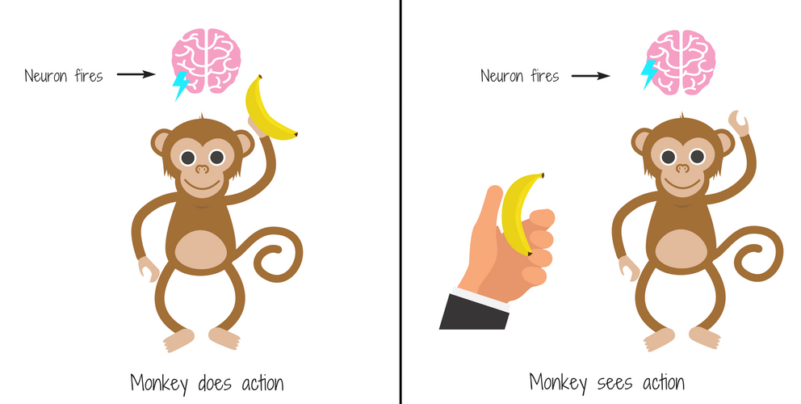
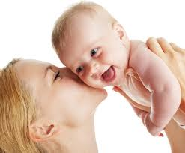
Attachment formation process in Homo sapiens
Child obviously wants to stay close to it´s attachment figure…
However in it´s first year is unable to follow it´s attachment figure…
Therefore there are inborn patterns, mirror
neurons, etc. that helps to make a bond
with the attachment figure….

Slide 25
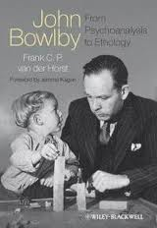
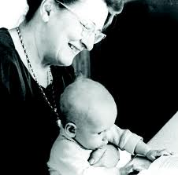
Theory of development of emotional attachment
(attachment)
John Bowlby (1907–1990) – development of attachment
Mary Ainsworth (1913–1999) – types of attachment

Slide 26


Slide 27
Development of attachment
1) before the onset of attachment (asocial stage, uncritical sociability; approx. 0-3 months)
2) beginnings of emotional attachment – undifferentiated bond, first formation phase (about 6th to 8th month)
3) specific attachment (7 – 9 months)
4) multiple attachments (10 months and more)

Slide 28
Strange situation test– SST (M. Ainsworth)
Observation of the child (up to 2 years) during separation. It takes about 90 minutes, has 8 sequences:
1. Mother and child enter the unknown room
2. The mother sits down and the child is free to move around
3. comes an unknown person
4. Mother goes away leaving child with unknown person
5. Mother returns, stranger leaves
6. The mother leaves, leaving the child alone in the room
7. stranger returns
8. stranger goes away and mother returns

Slide 29
Strange situation test– SST (M. Ainsworth)
Observation:
  the degree of proximity that children seek with their mothers before and after separation
  the degree of proximity that children seek from strangers when mother leaves a room for a while by the mother
  separation protest after mother leaves the room, behavior after return of mother

Slide 30
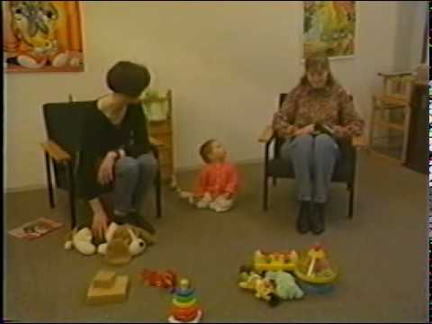
Strange situation test– SST (M. Ainsworth)
https://www.youtube.com/watch?v=QTsewNrHUHU&t=63s

Slide 31
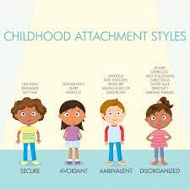
Types of attachment
  Secure
  Avoidant
  Anxious
      ambivalent
      disorganized

Slide 32
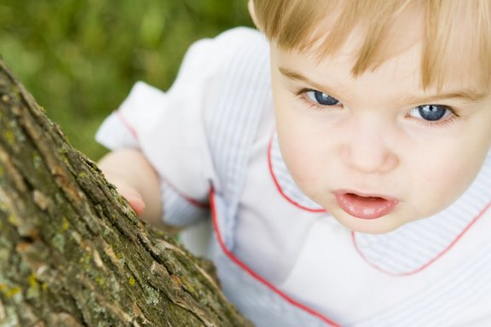
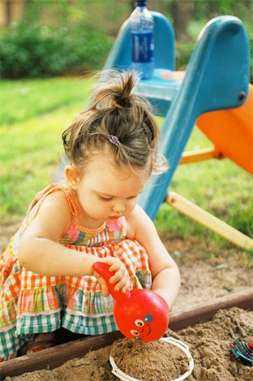
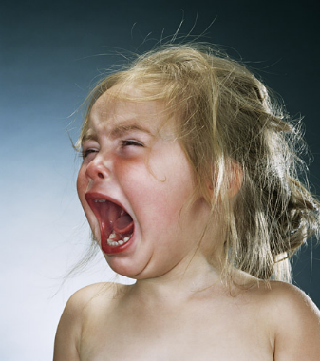
Behavior in SST
  Secure
  Children stay close to their mother, act confidently and play when she is present. They are upset when the mother leaves, but after her return they calm down and continue to play.
Avoidant
  Children are not too close to their mother and do not prefer her to a stranger, but they may protest when a mother leaves.
Anxious ambivalent
  Children stay close to their mother, but may reject her initiative, protest when she leaves, show signs of active or passive hostility to their mother upon return.

Slide 33
…and in life
Children with secure attachment are confident and balanced:
Whether they are calm or lively, they give the impression that they can enjoy life and its challenges. They are not afraid to try new things, but they are also able to ask for help when they need it.
Children with avoidant attachment are afraid of great experiences/feelings:
  Excessively try to do everything right (and be correct and kind).
  Have difficulties coping with anger
  Tend to mask negative feelings with false positives (they smile even if they feel bad)
  May be quieter and more self-sufficient than their physical age. They don't like to depend on anyone. They have trouble asking for help.

Slide 34
Children with anxious – ambivalent attachment may give the impression that they constantly require someone's attention.
It is uncomfortable for them to be alone or "lost in the crowd" (overlooked) in a group of other children. In a group of children, they can take on the role of a "jester" or someone who is still talking.
It is difficult for them to concentrate on some activity when they do not have the adult's attention.

Slide 35
What helps in "improving" an unsecure bond?
The importance of physical presence of an adult
Control yourself - don't go to power struggle
Providing choices
Daily routine & rules
Self discipline - stop, prepare and then act
Natural consequences instead of punishment
Encouragement instead of praise

Slide 36
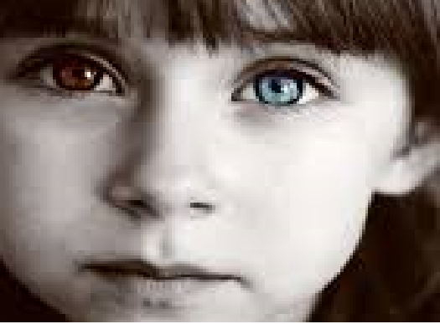
Blue eyes / brown eyes experiment
"When our leader J.F. Kennedy was killed several years ago, his widow held us together. Who's going to control your people?“
"Oh Great Spirit, keep me from ever judging a man until I have walked a mile in his moccasins."

Slide 37
Process of studying the experiment
Watch this movie:
https://www.youtube.com/watch?v=nmXr-rC5F-4
Read these articles:
https://en.wikipedia.org/wiki/Jane_Elliott
https://www.pbs.org/wgbh/frontline/article/an-unfinished-crusade-an-interview-with-jane-elliott/
https://www.smithsonianmag.com/science-nature/lesson-of-a-lifetime-72754306/
https://files.eric.ed.gov/fulltext/ED300491.pdf
https://www.academia.edu/4823591/Do_the_Eyes_Have_It_A_Program_Evaluation_of_Jane_Elliotts_Blue-Eyes_Brown-Eyes_Diversity_Training_Exercise1
Write for yourself an reflective essay (2-3 pages - voluntary) on the documentary (e.g. personal experience of a pupil and a student, your own feelings and thoughts towards the teacher) and how it will affect your teaching practice – you can also use the articles about this experiment. Link your reflections to the themes and theory of eduacational psychology (influence of teacher´s behavior on student´s motivation, learning, aktivity and development of a student, classroom climate, etc…)

