Slide 1
Educational research in teachers profession

Slide 2
How do you make decisions for your teaching?
Intuition?
Logic?
Tradition?
Role model?
Other?

Slide 3
Teacher intuition: the main issue of the profession?
Many teachers show excellent skills to organize teaching and solve educational problems.
Difficulties arise if they have to justify why they used a certain procedure, or why they reacted to the situation one way or another.

Slide 4
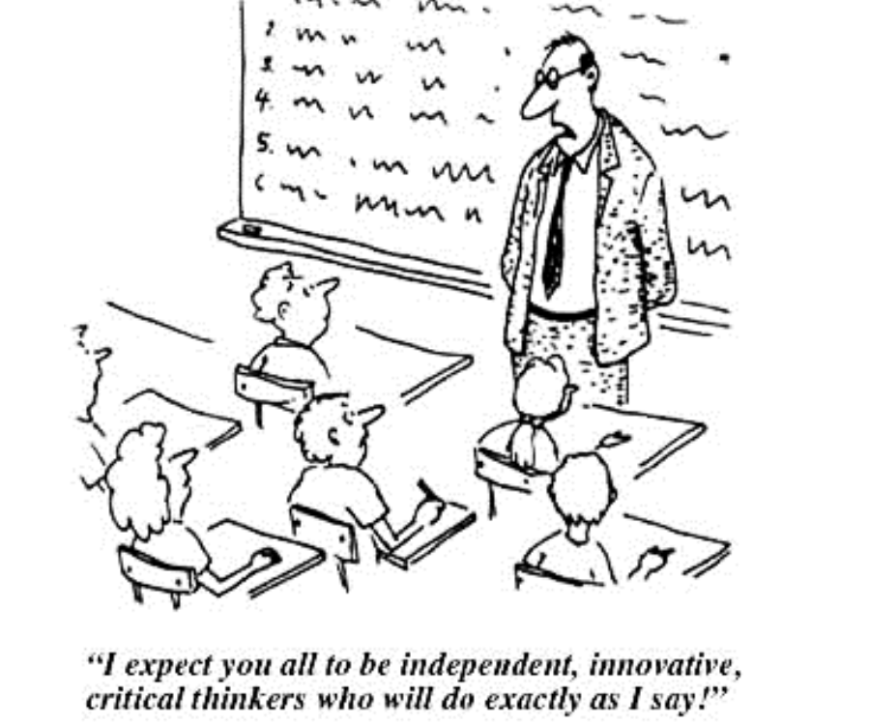

Slide 5
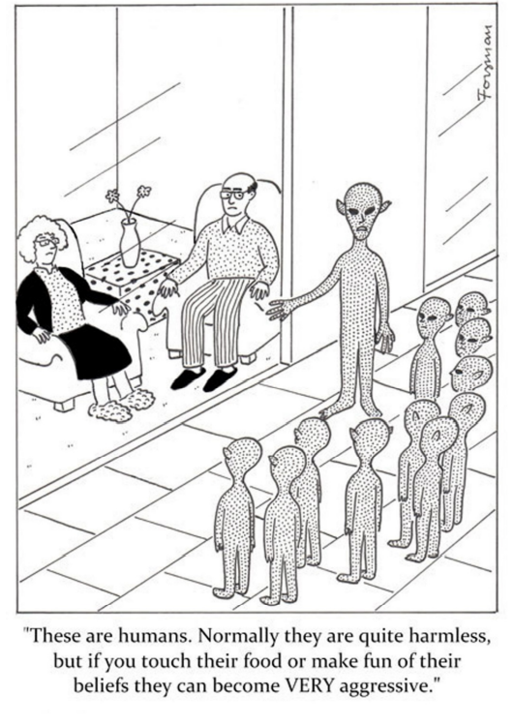

Slide 6
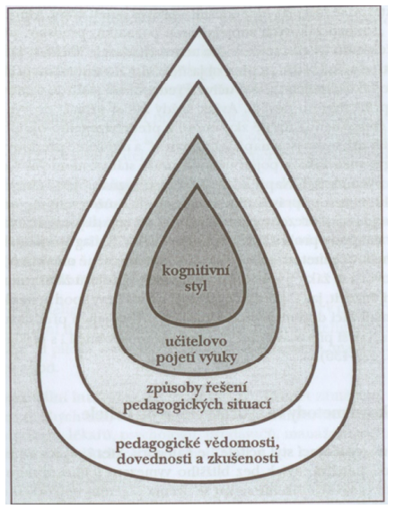
Layers of teacher‘s instructional style
(Maňák & Švec, 2003, p. 38)

Slide 7
Teacher intuition: a source of cognitive uncertainty
.
Teachers often do not have the knowledge (concepts) through which they would be able to justify their decisions.
They are able of only moderate professional communication on issues related to teaching.
Weakened professional communication in relation to teaching practice undermines the creation of pedagogical theory.

Slide 8
This is the source of a relatively high degree of cognitive uncertainty which leads to routine activities.

Slide 9
Teaching is an isolated profession
Do you agree? Why yes/no?

Slide 10
Classroom isolation prevents teachers from talking about their thoughts and solving common issues.

Slide 11
Educational research: the basis of school education
.
How do you know what works well?
Are there methods that do not work?
What am I doing well? What am I doing wrong?
What is better? To make the pupils enjoy learning or to have
results?
We often confuse common practice with the best practice.
Answers to these questions are searched by pedagogical research
.

Slide 12
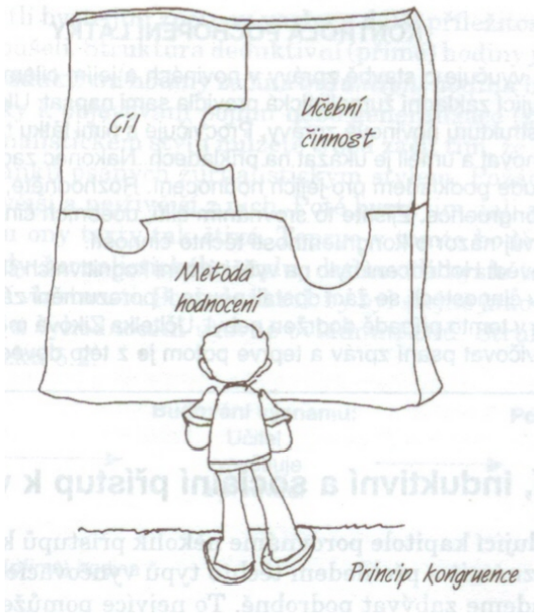
(Pasch et al., 1998, s. 193

Slide 13
Evidence – based approach
„Evidence rather than tradition or authoritative personal opinion.“

Slide 14

Where to look for the evidence?
Portál elektronických informačních zdrojů MU (muni.cz)
Learning and Instruction | Journal | ScienceDirect.com by Elsevier

Slide 15

Hattie effect size list - 256 Influences Related To Achievement (visible-learning.org)
Glossary of Hattie's influences on student achievement - VISIBLE LEARNING (visible-learning.org)

Slide 16
Task
Based on an article of your choice or your study of academic journals, outline the topics that are currently discussed in educational sciences.

