Slide 1
Insights into Czech Music Culture (HV070)
Michaela Šilhavíková
447933@mail.muni.cz

Slide 2
Moravian customs and traditions
In ethnology usually covered by the terms custom tradition, ceremonial culture or annual customs
Expressions related to:
Particular calendar dates = annual customs
Events in human life = family customs
Many of them have their origins in the old pagan Slavic culture
After Christianization, some of them changed their original meaning

Slide 3
Annual customs (calendar customs)
Related to the cycle of nature’s life during the year
February / March | Masopust (Shrovetide)
April | Spring welcoming (Easter)
May | Maypole raising
June | Summer solstice / Kupala (St John’s Eve)
August / September | Harvest celebrations
August to November | Feasting
December | Winter solstice (Advent and Christmas)

Slide 4
Masopust
Carnival full of colorful customs:
Masques (Straw-man, bear, horse…)
Passing of carnival “right”
Door-to-door processions
Dancing…
Origins in pre-Christian Slavic celebrations of the end of winter
Season of feasting and merriment
Masopust from Hlinecko – UNESCO
https://www.kudyznudy.cz/ceska-nej/unesco/masopustni-obchuzky-na-hlinecku

Slide 5
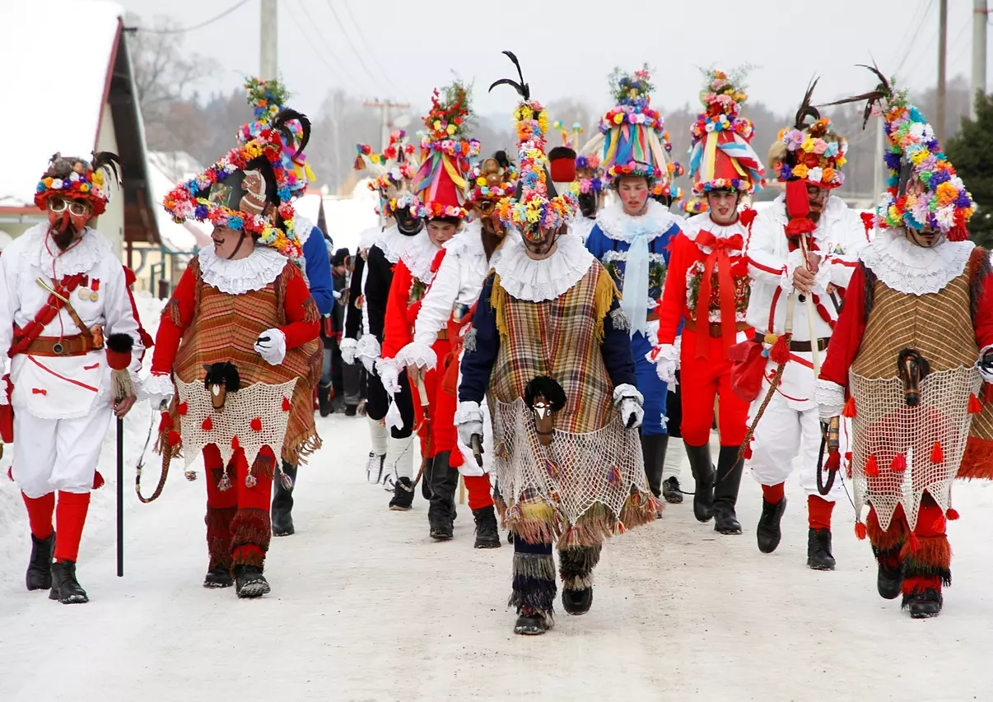
https://www.kudyznudy.cz/ceska-nej/unesco/masopustni-obchuzky-na-hlinecku

Slide 6
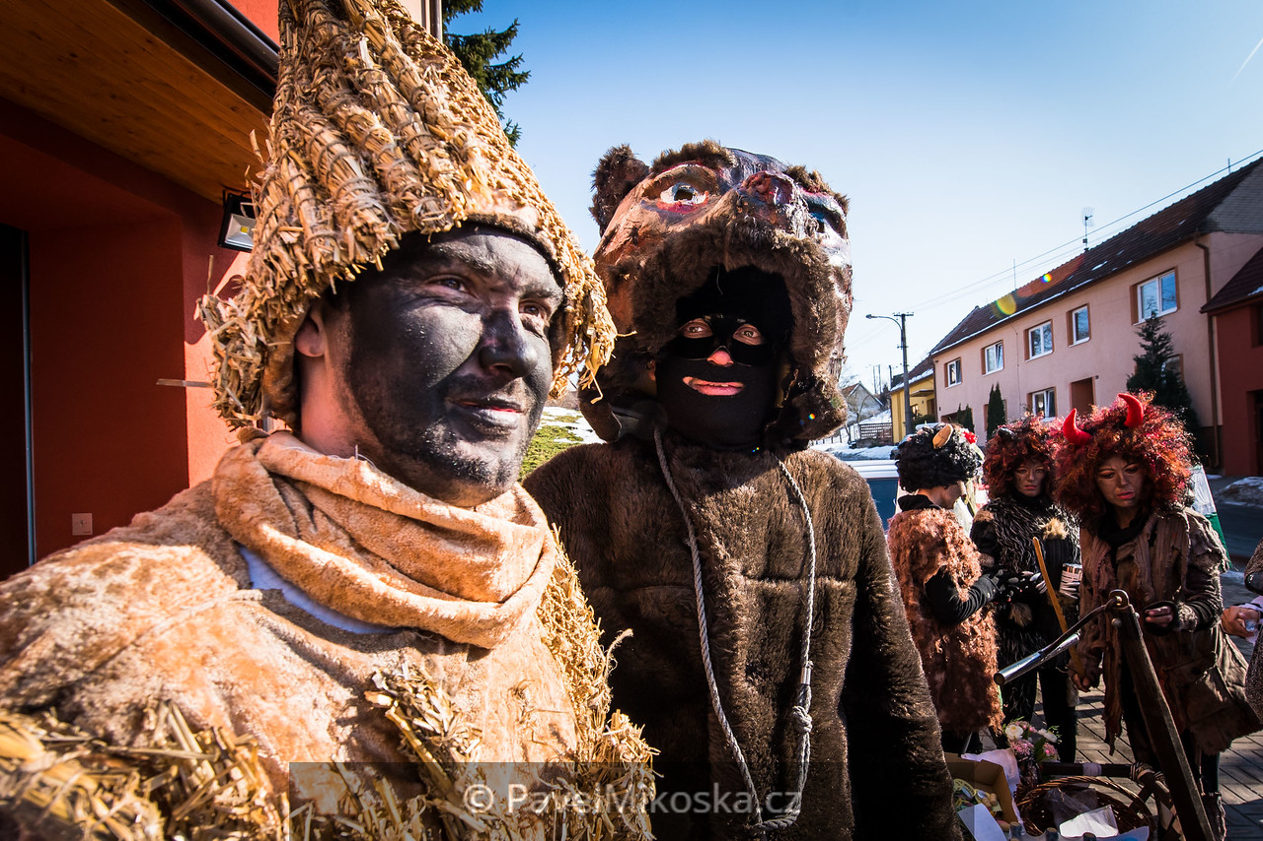
https://www.pavelmikoska.cz/Folklor/Mistrice-Masopust-14-02-2015/

Slide 7
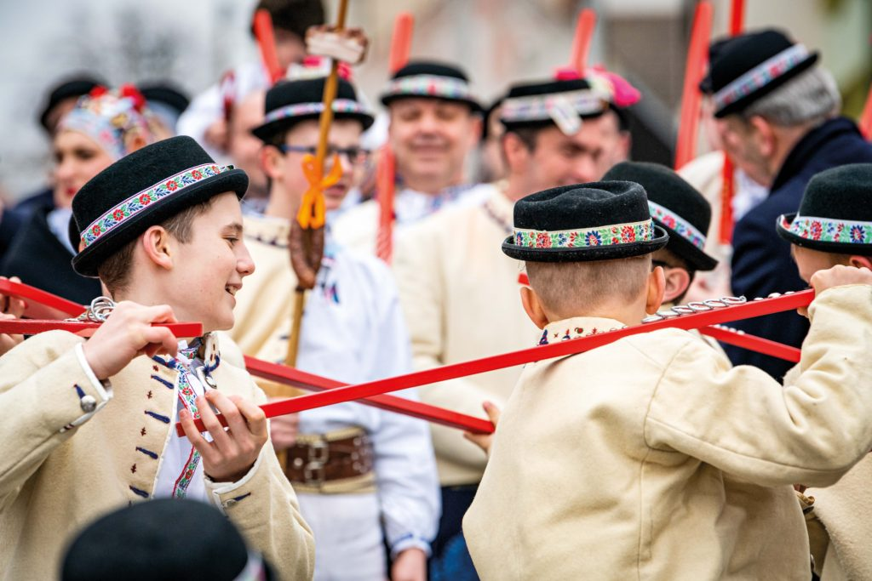
https://krasnyrok.cz/folklorni-masopust-ve-strani/

Slide 9
Spring welcoming
Ritual of carrying out Morana (Slavic goddess of death)
Procession of young girls
Archaic songs
The doll is thrown into water or set on fire
Winter’s death, the rebirth of spring
https://www.zcm.cz/pro-navstevniky-zcm/kalendar-akci/vitani-jara-v-plzni-vynaseni-morany-202302211010

Slide 10
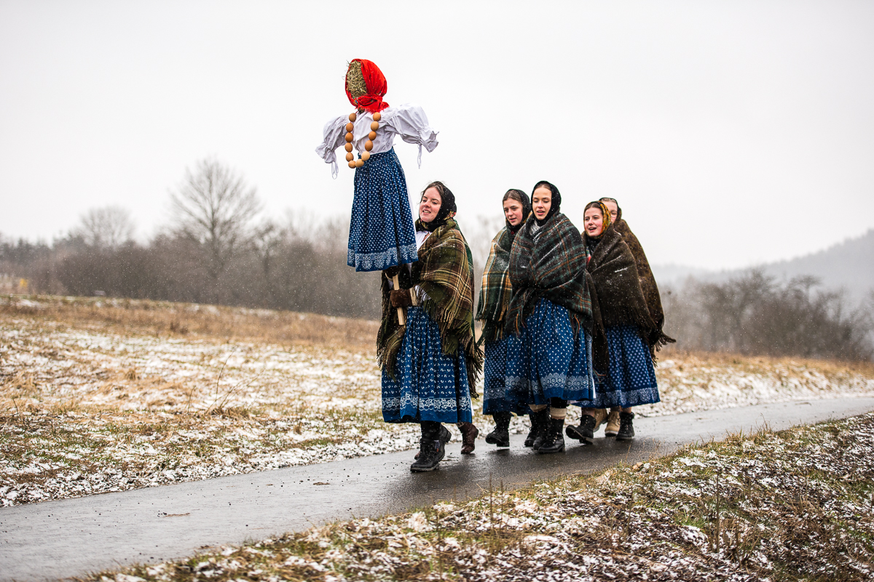
https://www.hornilidec.cz/vynaseni-mareny-valasek/gs-1187

Slide 12
Spring welcoming
Ceremonial whipping pomlázka
Lads are whipping girls and women with braided willow twigs
Belief in life-giving force of vegetation, which was transmitted to humans by touching them
The girls reward the lads with decorated eggs (symbol of fertility and new life)
https://english.radio.cz/moravian-easter-a-celebration-new-life-8133134

Slide 13
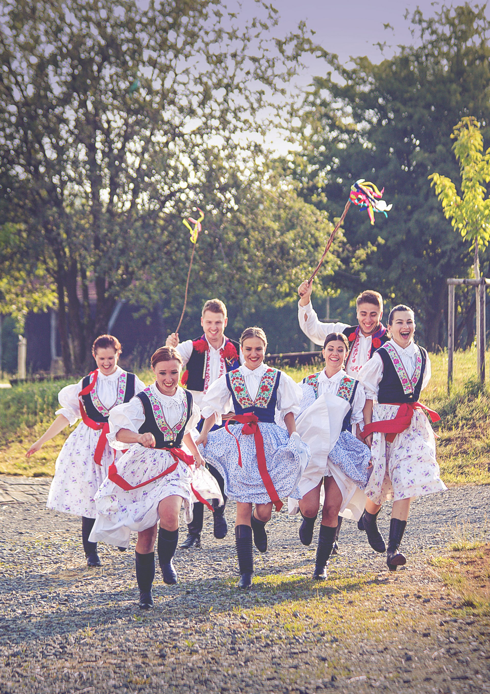
https://www.fs-lintava.cz/aktualne

Slide 14
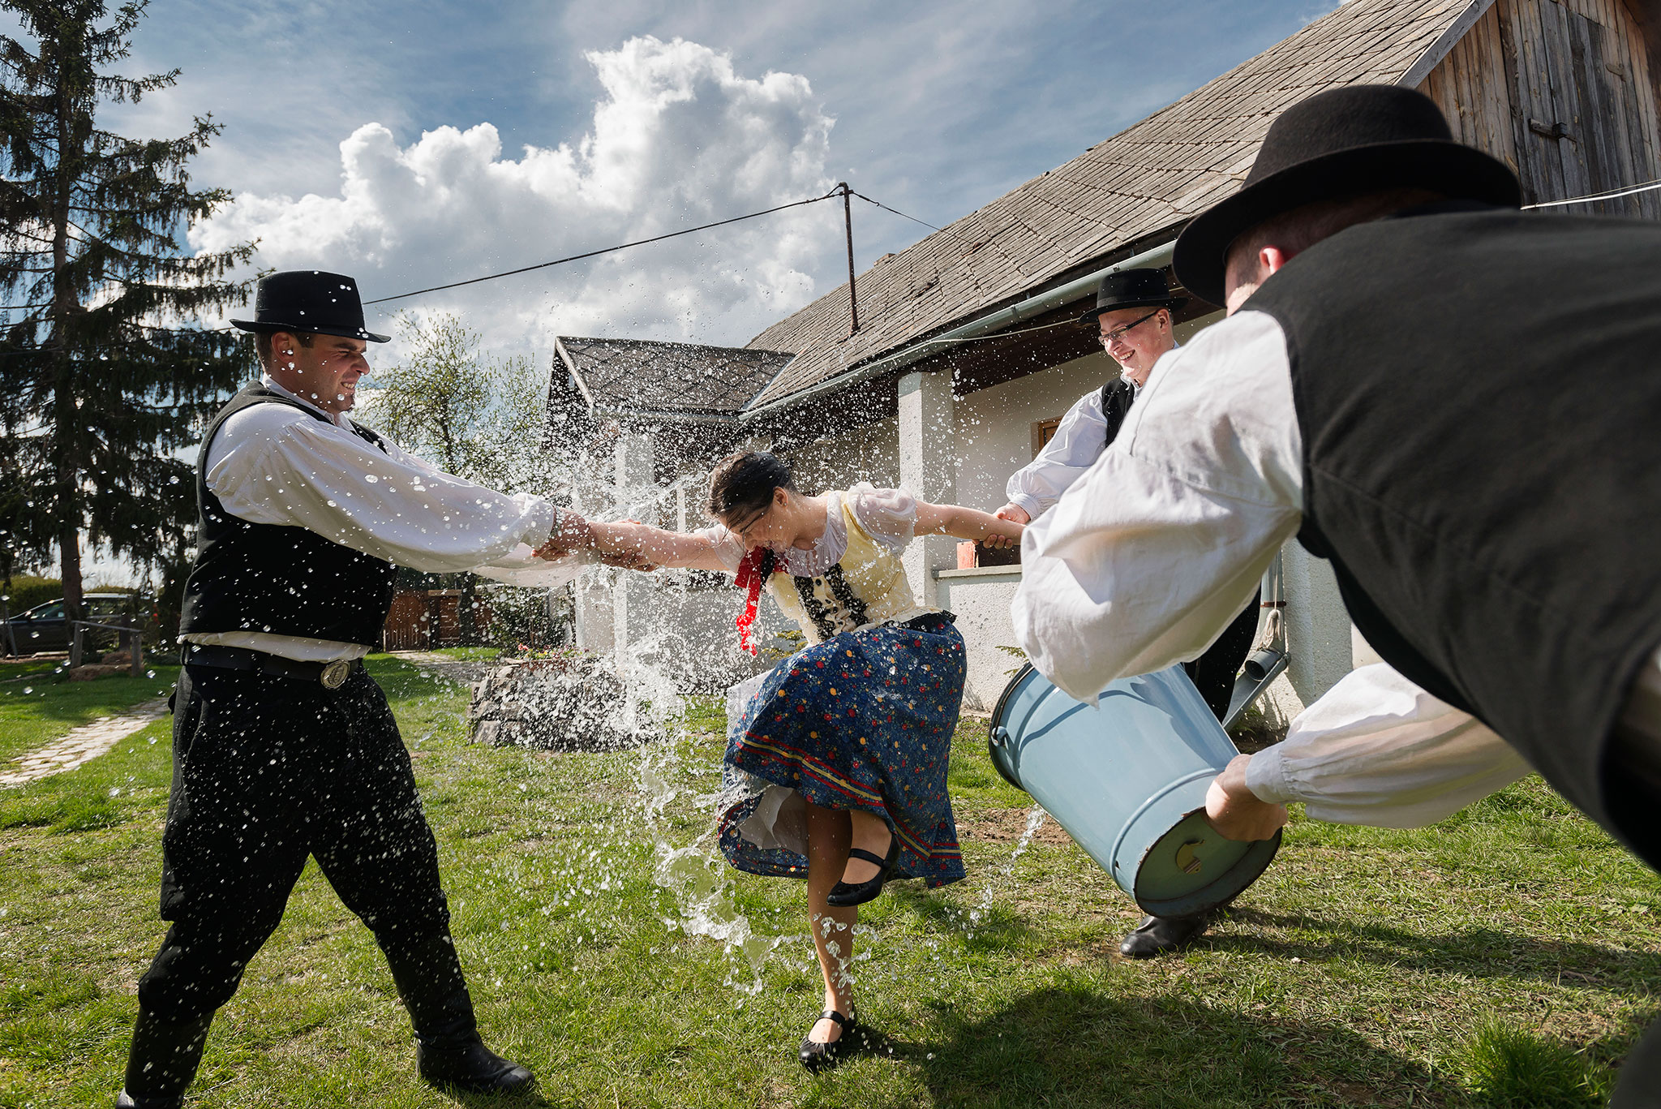
https://www.nationalgeographic.com/culture/article/160325-easter-bunny-holidays-nation-religion-traditions

Slide 15
Maypole raising
Individual maypoles outside girls’ house as an expression of love
Community maypole in the village center
Youngsters must guard the maypole from being cut down or stolen by lads from other villages
https://www.fotoaparat.cz/fotogalerie/fotografie/430898/

Slide 16
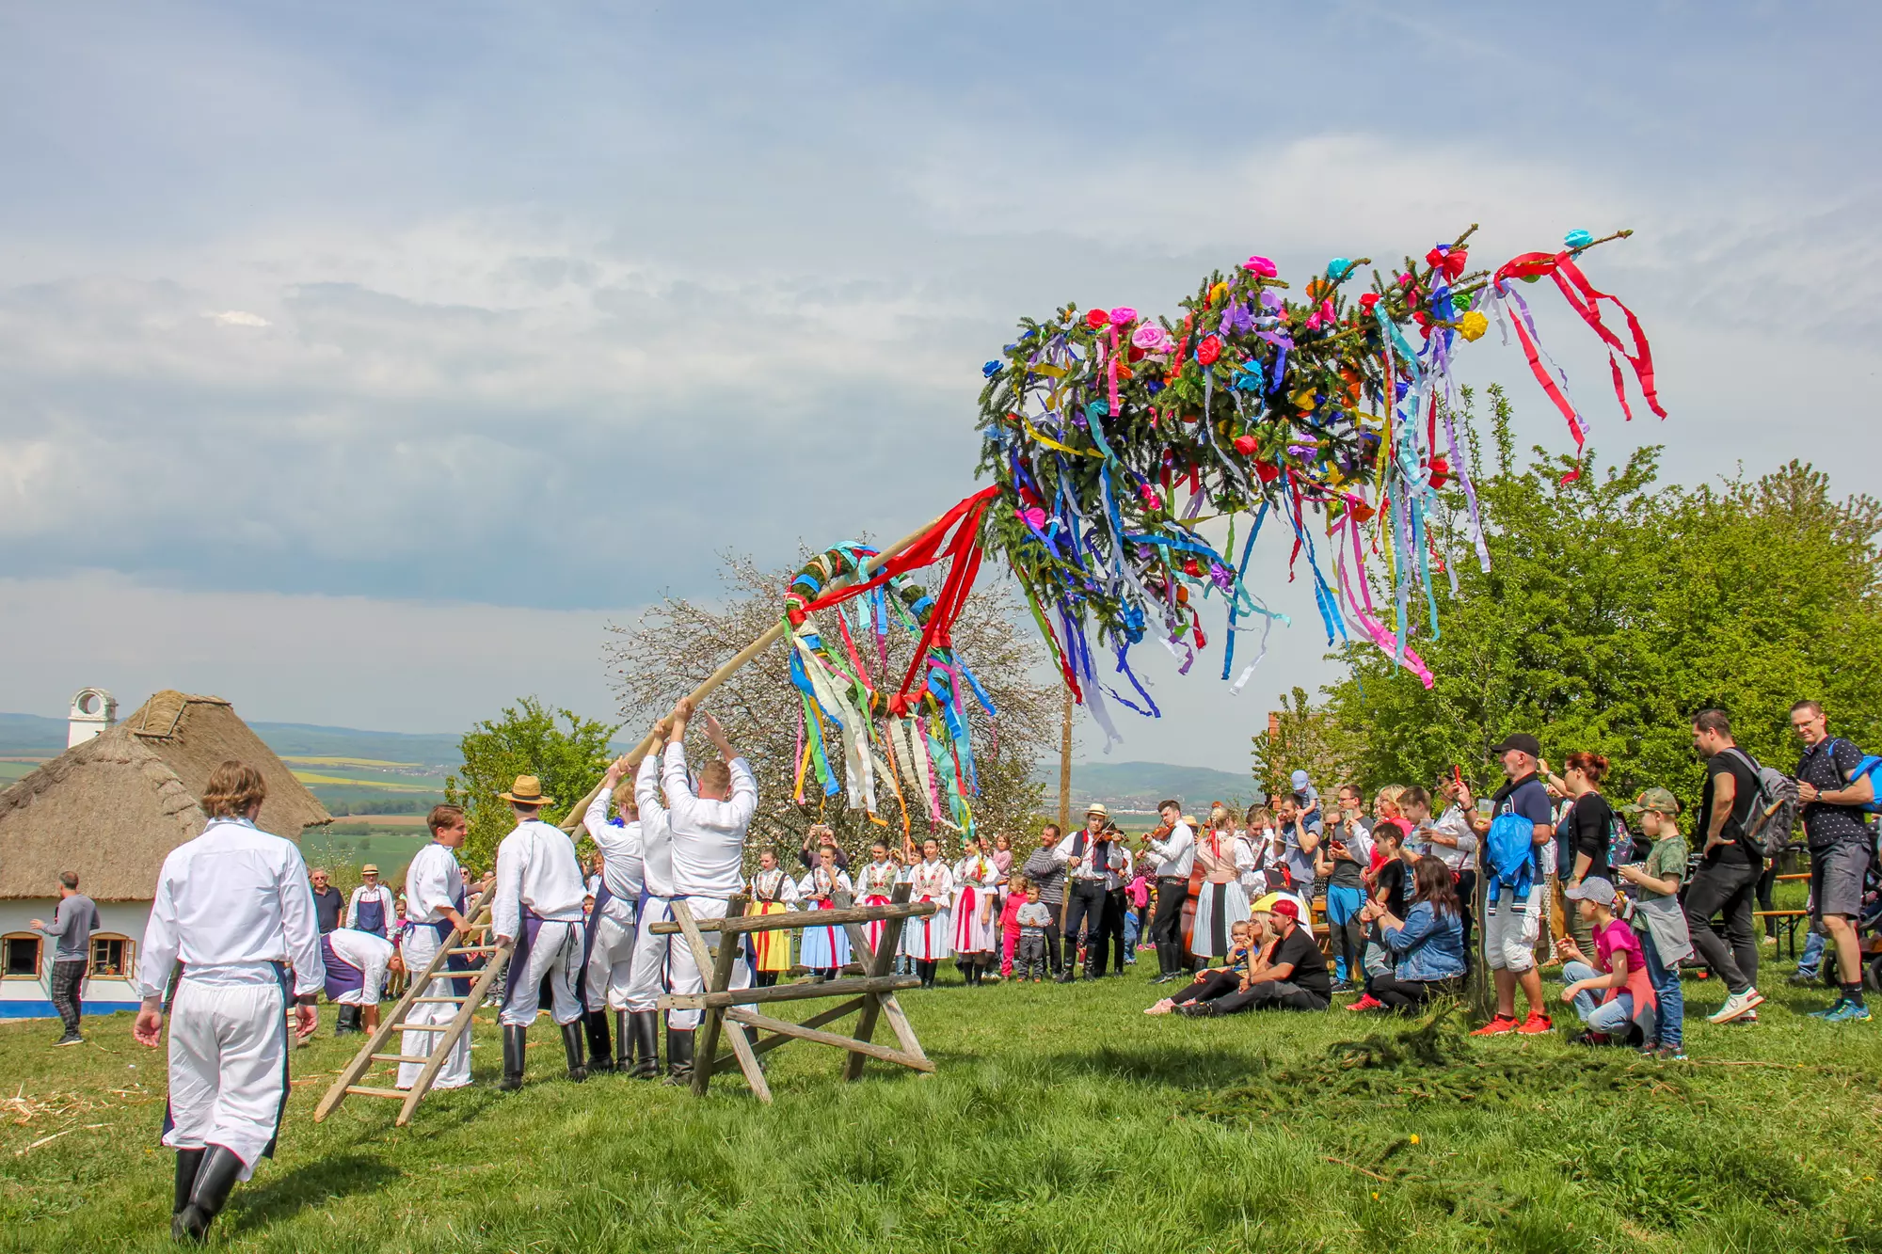
https://www.kudyznudy.cz/akce/otevirani-pastvin-a-staveni-maje-ve-skanzenu-rochu

Slide 17
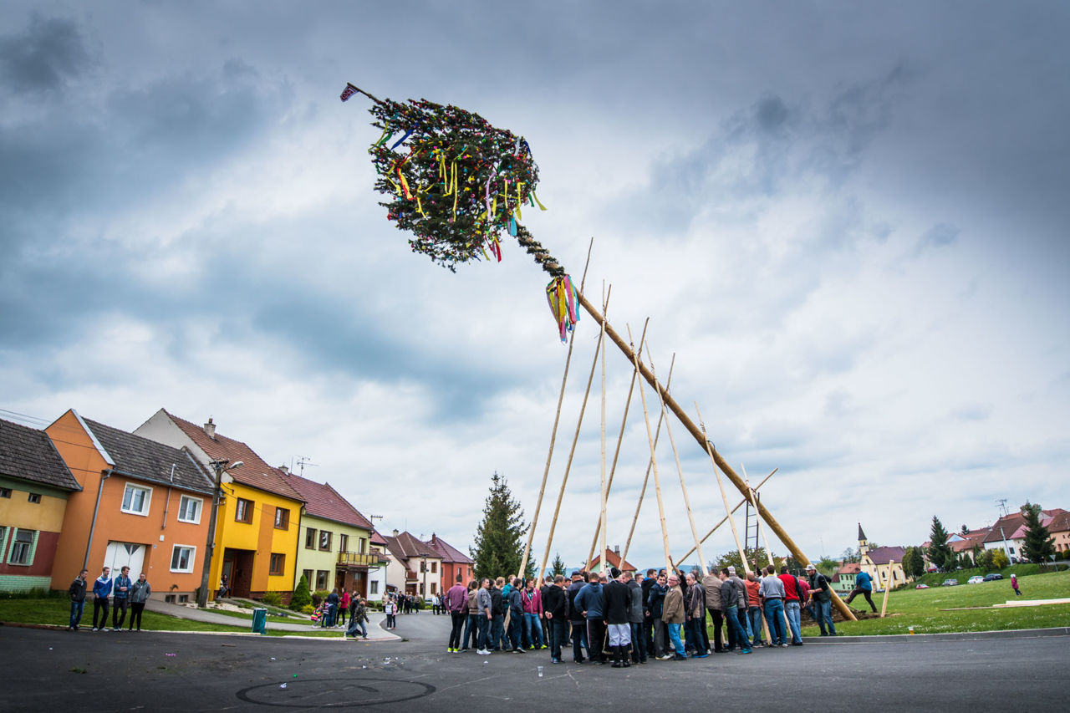
https://www.folklorni-akademie.cz/lidova-tradice/rucni-staveni-maje

Slide 18
Summer solstice
In Slavic culture known as Kupala night
Celebrations of the summer beginning
Rituals associated with purifying power of natural elements
Jumping over a lit fire
Swimming naked in waters
Picking herbs for their magical powers
Turned into the St John’s Eve
https://authenticukraine.com.ua/en/blog/kupala

Slide 19
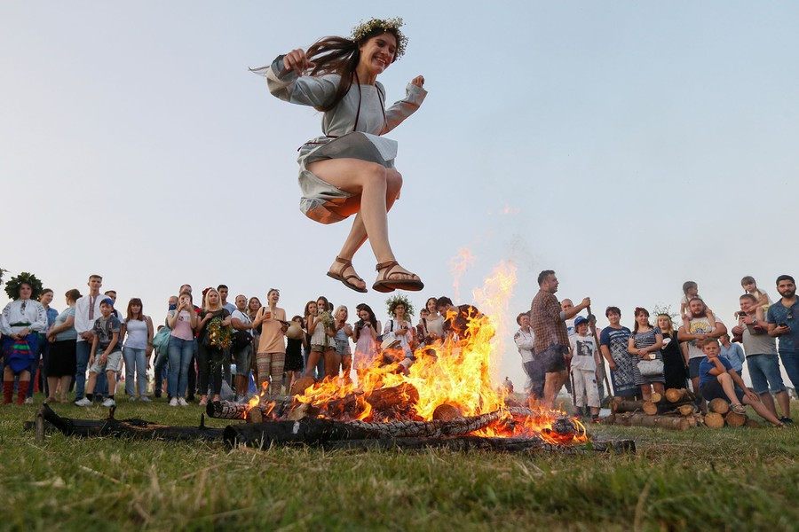
https://www.theatlantic.com/photo/2018/07/images-from-ivan-kupala-night/564818/

Slide 20
Harvest celebrations
Harvest = Season when crops are gathered from the fields:
Wheat
Hop
Wine
The celebrations have belonged to the most significant traditional feasts
During this thanks-giving feast, part of the harvest was offered to Slavic gods
Harvest wreath as a symbol of fertility, health and strength
https://www.kkuh.cz/10-mikovske-dozinky

Slide 21
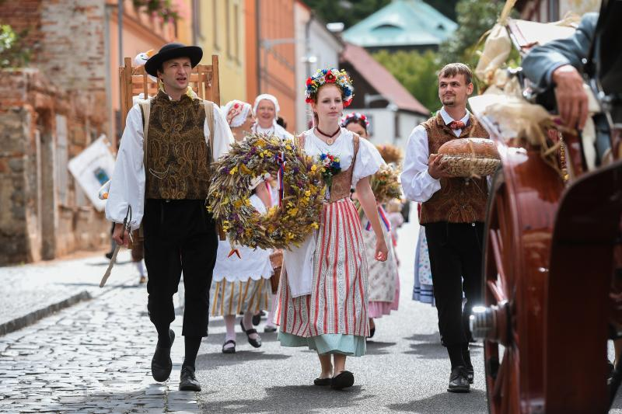
https://stredni-skola-frydlant.cz/frydlant-bude-zacatkem-zari-hostit-krajske-dozinky/

Slide 22
Village feasts
Biggest folk event between the end of summer and winter solstice
In ancient times, they were connected to harvest celebrations
In the Middle Ages, Christians converted them into feasts of the village’s saint patron
Chasa (group of youth) chooses their elders (leading couple)
https://www.facebook.com/zachytila/photos

Slide 23
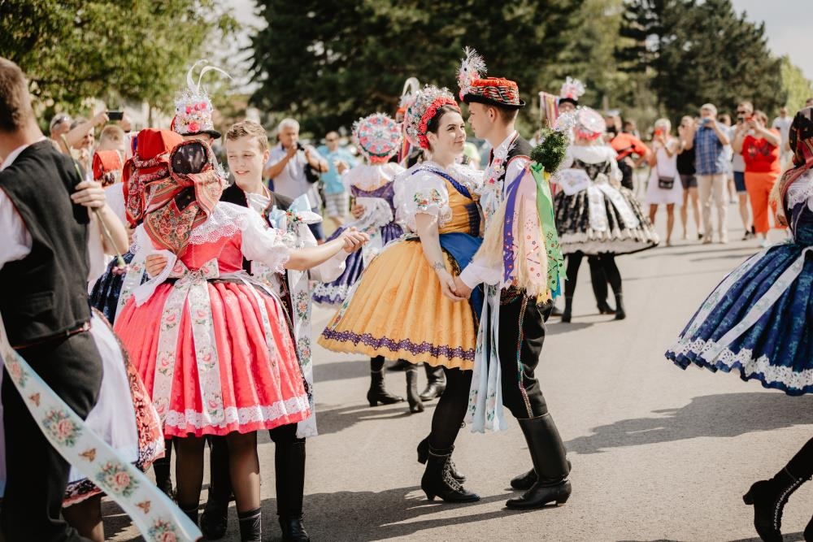
https://www.velke-pavlovice.cz/krojovane-hody-ve-fotografiich-ludmily-esterkove

Slide 24
Winter solstice
Arrival of Morana, goddess of death and winter
People did activities for which there was no time left over the year
Figure of St Nicholas
Accompanied by an angel and devil brings gifts to children
Figure of St Lucia
Dressed in white walks silently through the village with a goose wig and flour in her hands, making marks on the houses
https://www.facebook.com/media/set/?set=a.5603648416387249&type=3

Slide 25
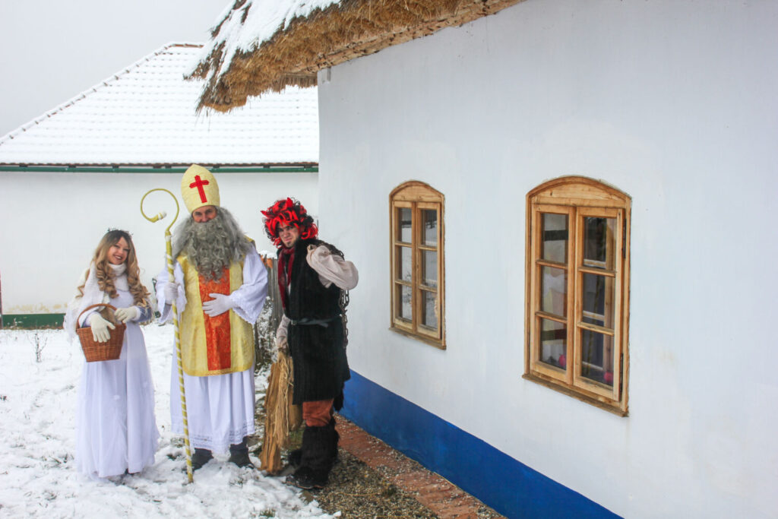
https://skanzenrochus.cz/radostny-cas-prozijeme-zas-ve-skanzenu-rochus/

Slide 26
https://www.facebook.com/media/set/?set=a.1170994369652698&type=3

Slide 27
Christmas
Ancient pagan customs during “Christmas” period were associated with the new year and cult of the dead
Some of the customs persist
Cutting apples to foretell health
Floating nut shells with tiny candles to see who will get farthest from home
Czech handmade glass-blown Christmas decorations – UNESCO
https://skanzenrochus.cz/fotogalerie/

Slide 28
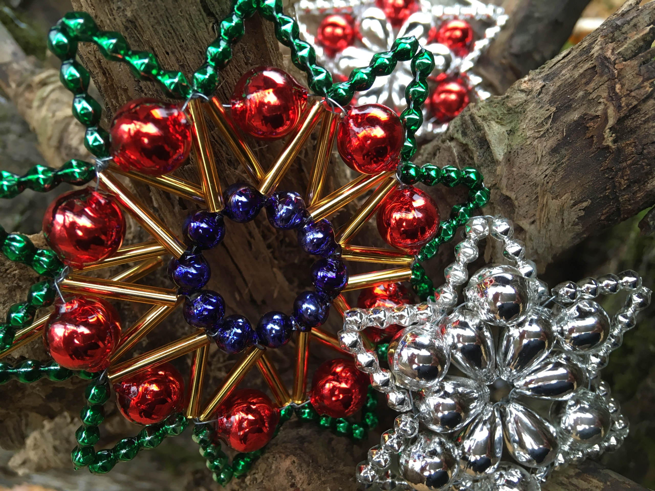
https://www.nulk.cz/2020/12/18/rucni-vyroba-ozdob-z-foukanych-sklenenych-perli-pro-vanocni-stromek-2/

Slide 29
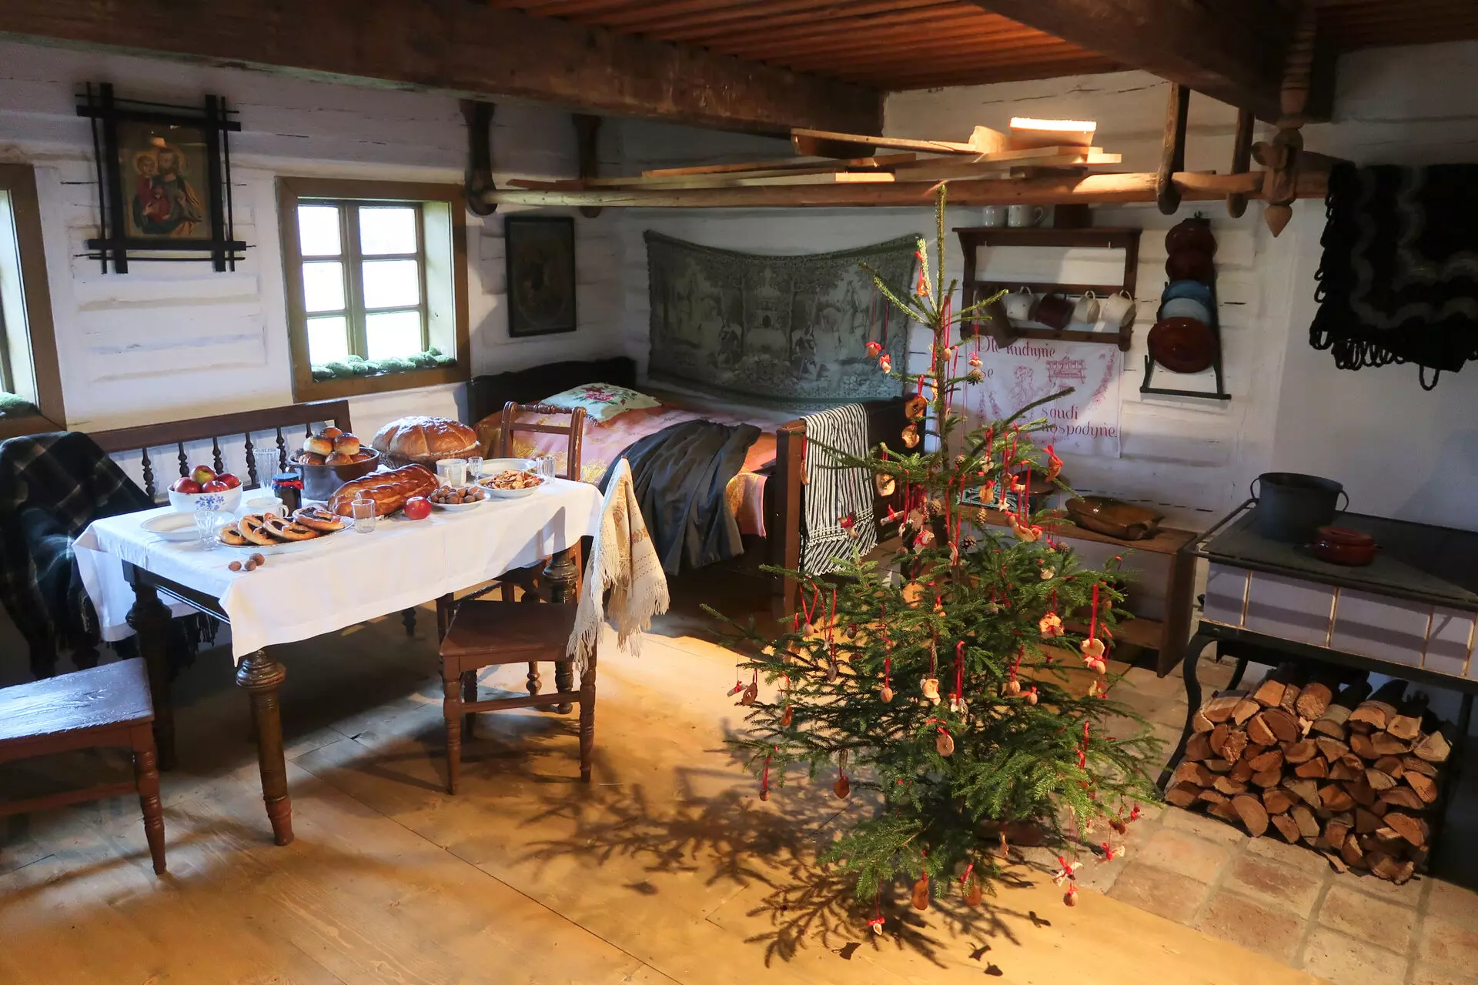
https://www.kudyznudy.cz/aktuality/muzea-v-prirode-zahajuji-o-vikendu-adventni-a-vano

Slide 30
Family customs
Associated with human’s life cycle
Customs concerning:
Birth
Wedding
Death and burial

Slide 31
Visits to mother and baby
Known as bringing gifts to the corner
For six weeks after giving birth, mother laid with her baby on the bed in the corner, separated from other family members by a piece of cloth
The cloth was supposed to protect mother and baby from evil forces or diseases
Friends and relatives brought gifts, especially food and drinks
https://www.esbirky.cz/

Slide 32
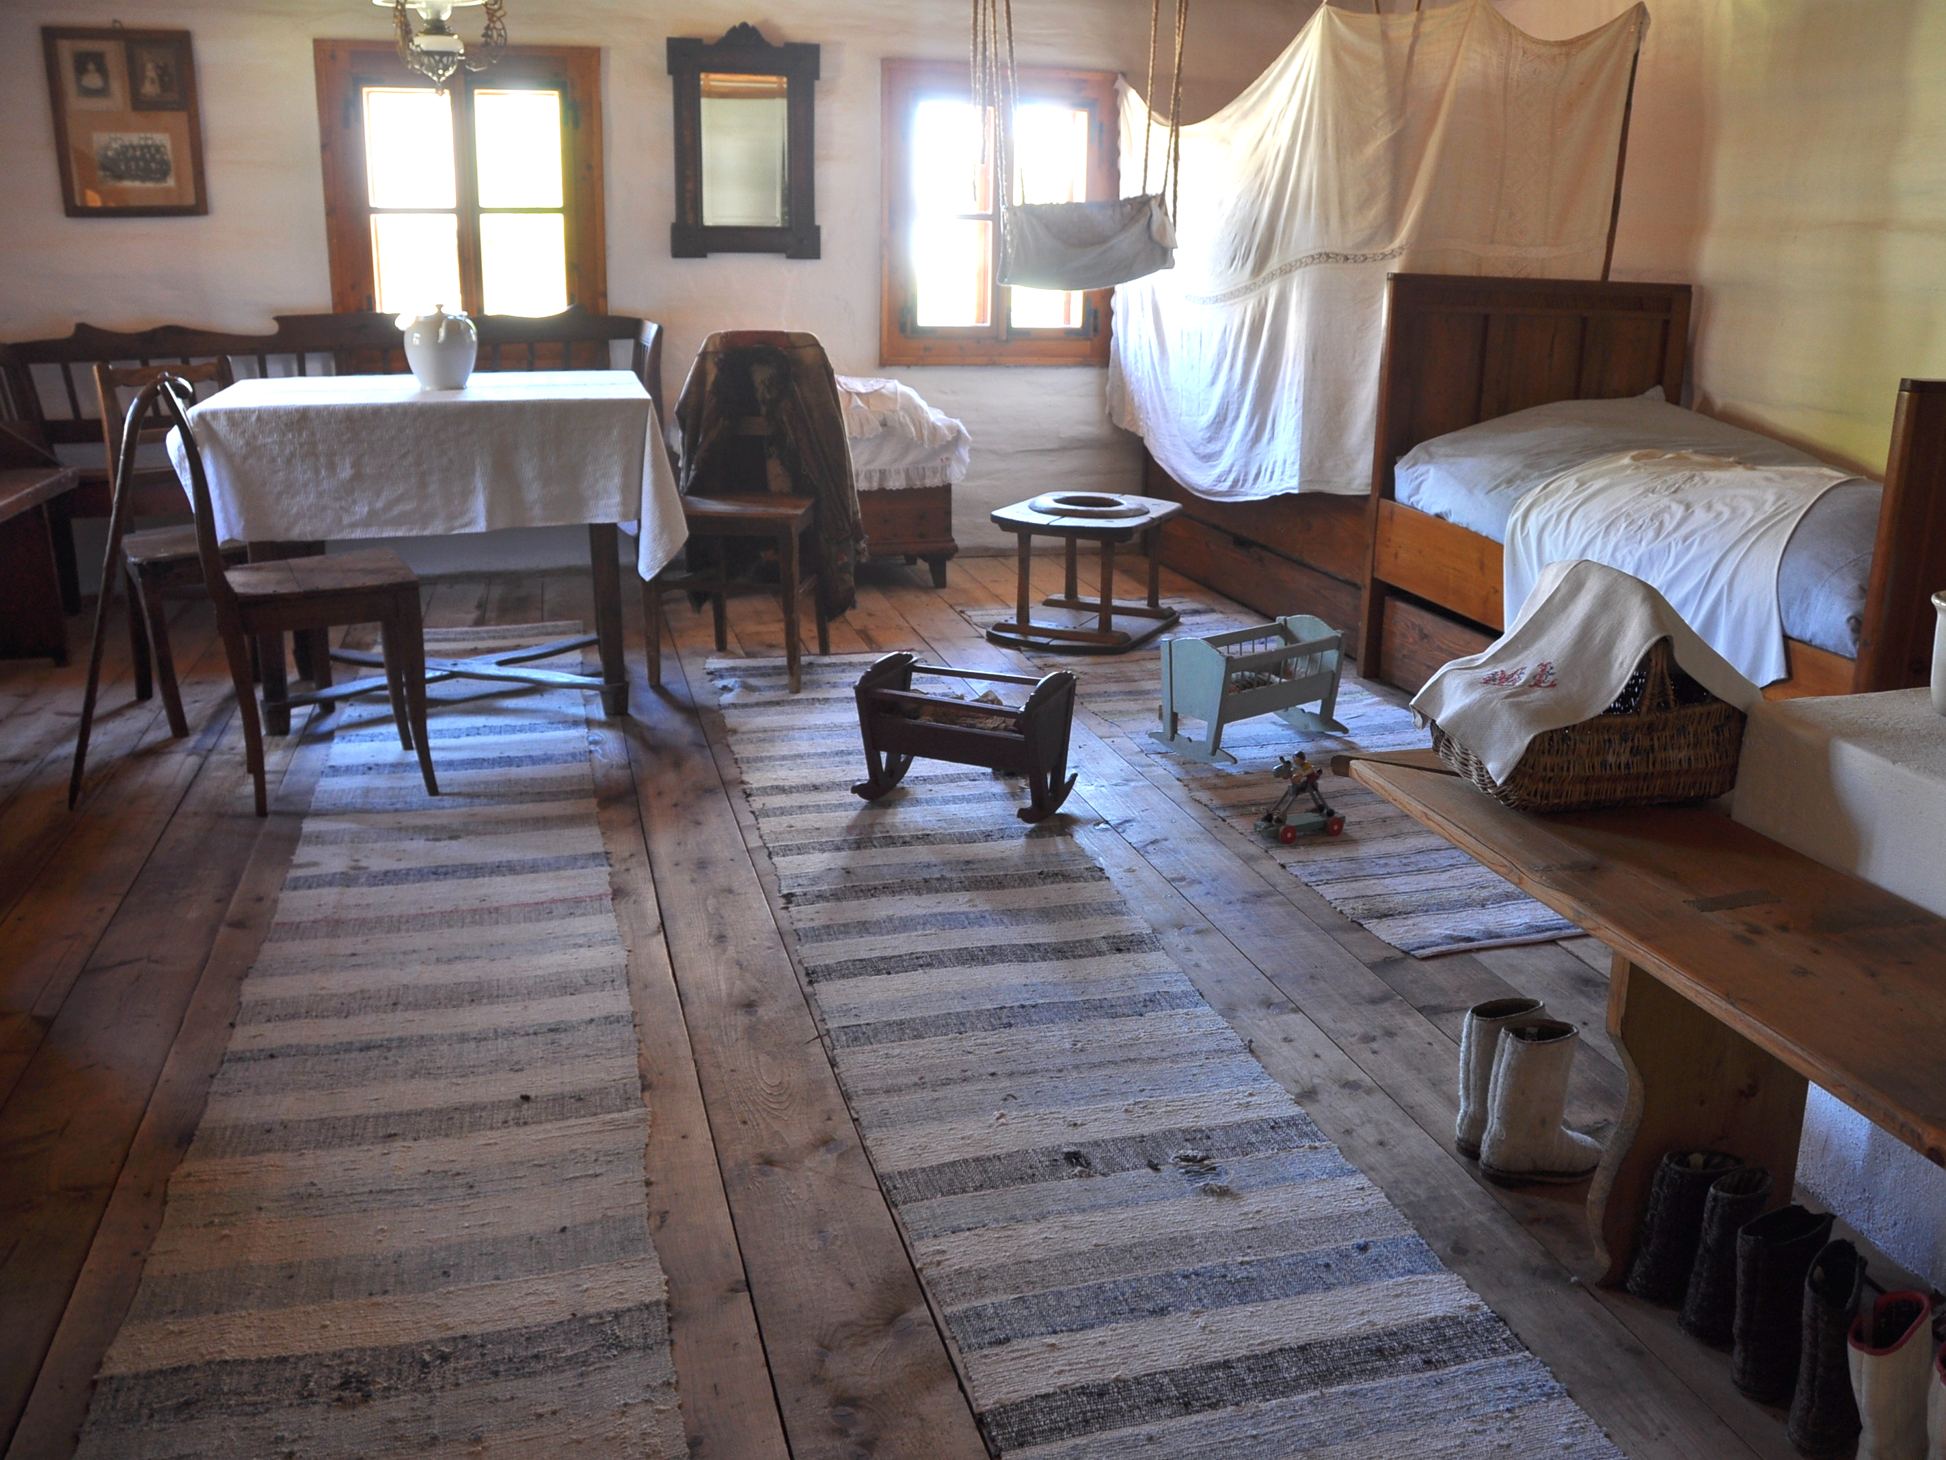
https://cs.wikipedia.org/wiki/Koutn%C3%AD_plachta

Slide 33
Baptising
In the past usually two or three days after birth (fear of health complications)
Mother was too weak to participate
Important role of Godparents who are responsible for their godchildren if they become orphans
Today, children are baptized after half a year of life
https://www.facebook.com/Tradicevobrazech/photos/a.101374475560944/197534929278231/?type=3

Slide 34
Welcoming to motherhood
Six weeks after baby’s birth, woman was introduced to society in her new role as mother
She held child in her arms, wrapped in ceremonial cloth called úvodnice
It was believed in magical function of úvodnice; brides also wore it at their wedding day
https://cz.pinterest.com/pin/352617845805344324/

Slide 35
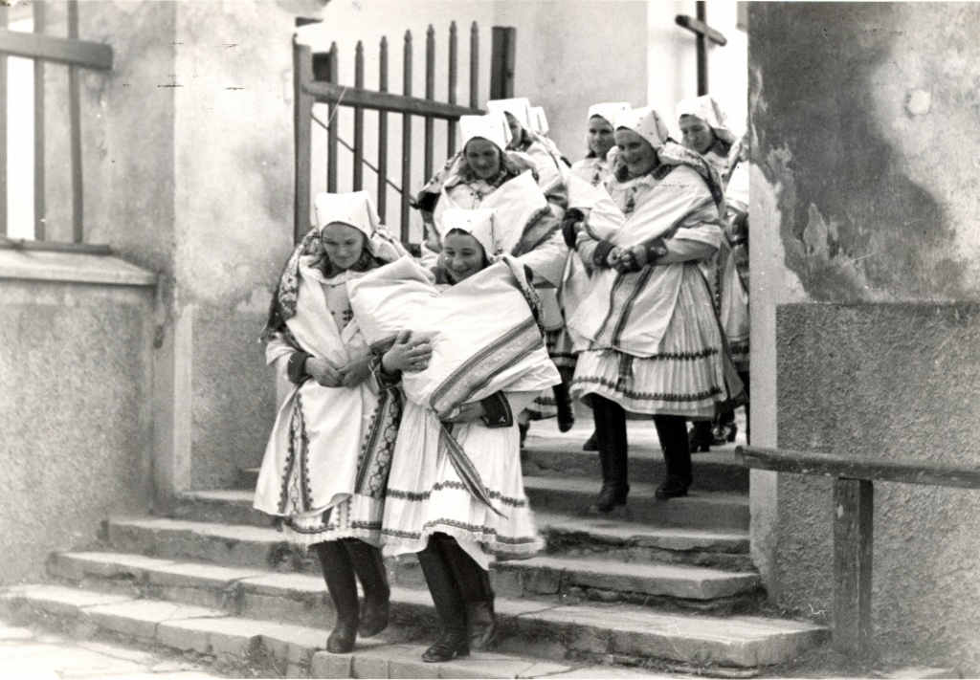
https://www.malovanykraj.cz/archiv/53-archiv/2015-6/453-kondrova-marta-judr-alexander-tobek-neznamy-fotograf-slovacka

Slide 36
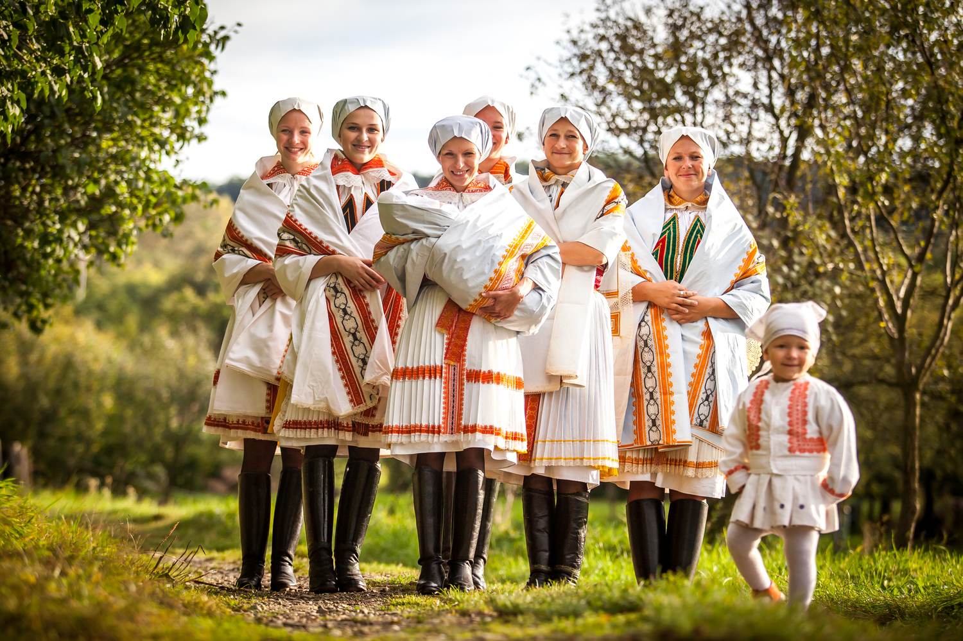
https://ohlednuti.uh.cz/autor/petr-pavlinec/uvodnice

Slide 37
Bride capping
Ancient wedding ceremony symbolizes transition from virginity to womanhood
Wreath as a symbol of freedom was replaced by a cap
Matrons of the village accepted the bride into the ranks of married women
http://www.yna.cz/english-vivat-gracie/

Slide 38
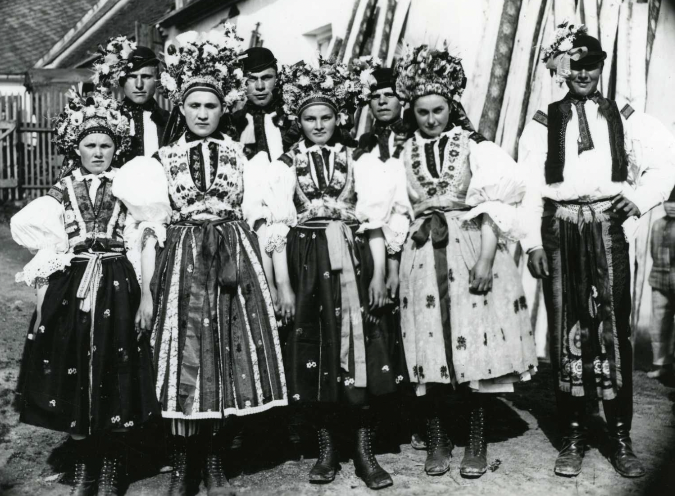
https://www.folklornamapa.sk/p/uherskohradistske-dolnacko-ludovy-odev/

Slide 39
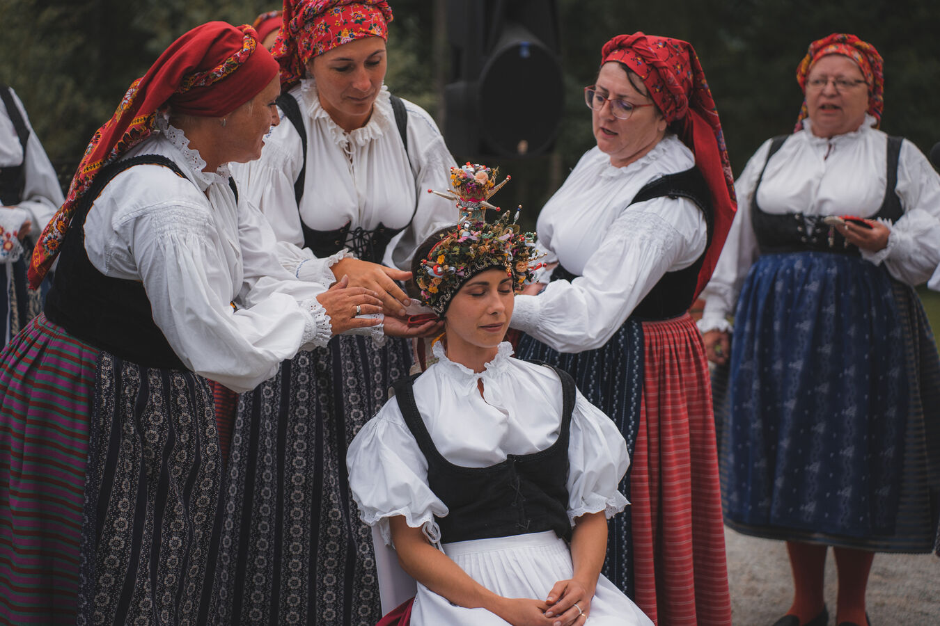
https://www.megapixel.cz/foto/616162

