Slide 1
Insights into Czech Music Culture (HV070)
Michaela Šilhavíková
447933@mail.muni.cz

Slide 2
Moravian customs and traditions
In ethnology usually covered by the terms custom tradition, ceremonial culture or annual customs
Expressions related to:
Particular calendar dates = annual customs
Events in human life = family customs
Many of them have their origins in the old pagan Slavic culture
After Christianization, some of them changed their original meaning

Slide 3
Family customs
Associated with human’s life cycle
Customs concerning:
Birth
Wedding
Death and burial

Slide 4
Visits to mother and baby
Known as bringing gifts to the corner
For six weeks after giving birth, mother laid with her baby on the bed in the corner, separated from other family members by a piece of cloth
The cloth was supposed to protect mother and baby from evil forces or diseases
Friends and relatives brought gifts, especially food and drinks
https://www.esbirky.cz/

Slide 5
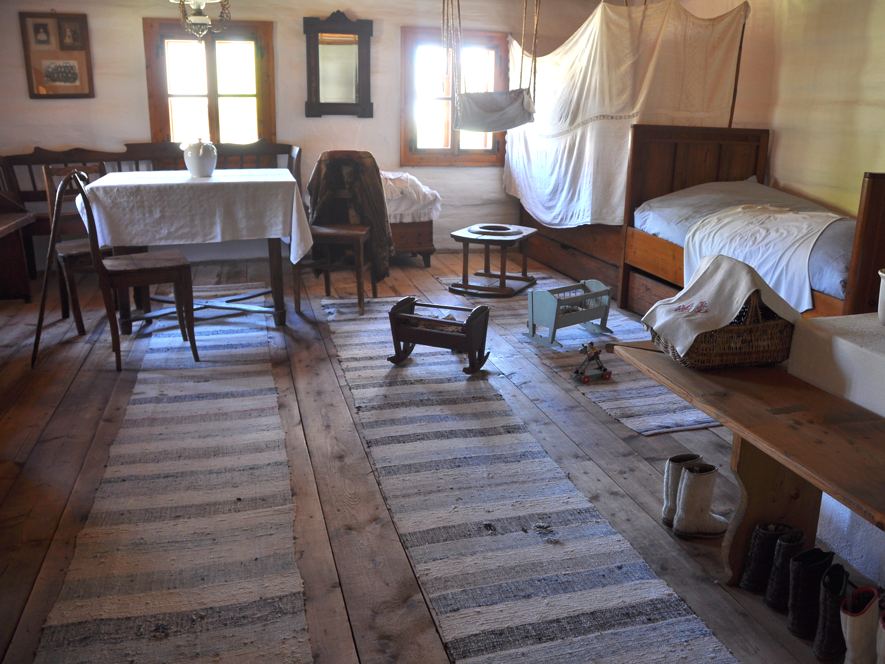
https://cs.wikipedia.org/wiki/Koutn%C3%AD_plachta

Slide 6
Baptising
In the past usually two or three days after birth (fear of health complications)
Mother was too weak to participate
Important role of Godparents who are responsible for their godchildren if they become orphans
Today, children are baptized after half a year of life
https://www.facebook.com/Tradicevobrazech/photos/a.101374475560944/197534929278231/?type=3

Slide 7
Welcoming to motherhood
Six weeks after baby’s birth, woman was introduced to society in her new role as mother
She held child in her arms, wrapped in ceremonial cloth called úvodnice
It was believed in magical function of úvodnice; brides also wore it at their wedding day
https://cz.pinterest.com/pin/352617845805344324/

Slide 8
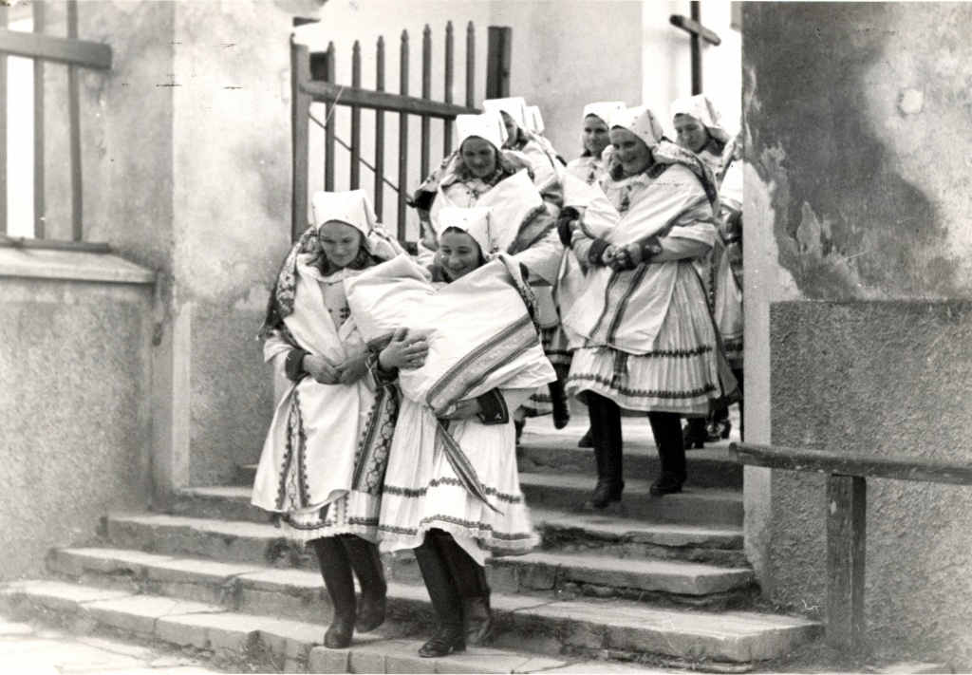
https://www.malovanykraj.cz/archiv/53-archiv/2015-6/453-kondrova-marta-judr-alexander-tobek-neznamy-fotograf-slovacka

Slide 9
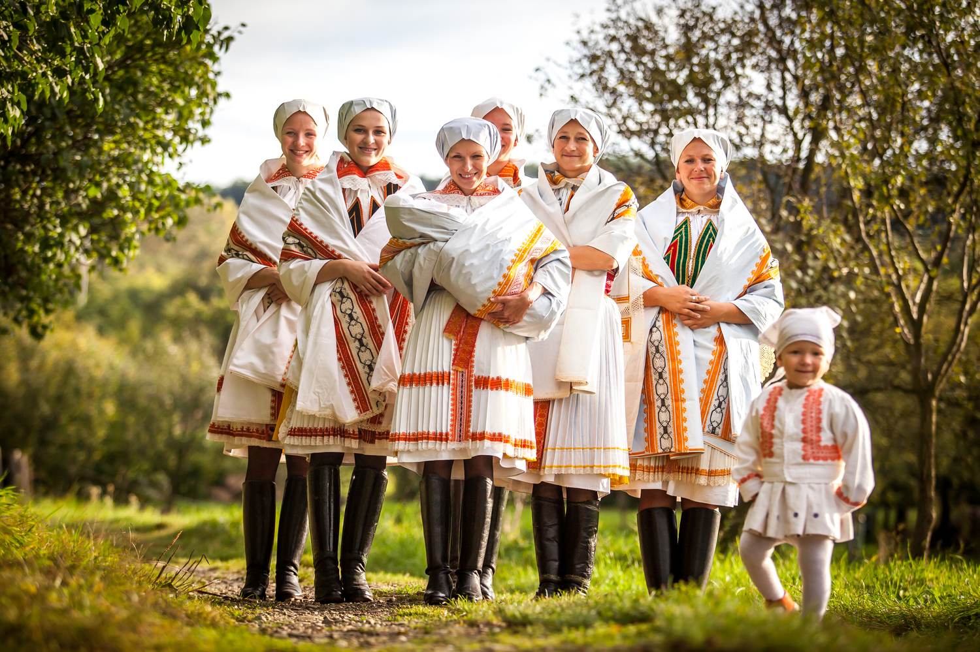
https://ohlednuti.uh.cz/autor/petr-pavlinec/uvodnice

Slide 10
Bride capping
Ancient wedding ceremony symbolizes transition from virginity to womanhood
Wreath as a symbol of freedom was replaced by a cap
Matrons of the village accepted the bride into the ranks of married women
http://www.yna.cz/english-vivat-gracie/

Slide 11
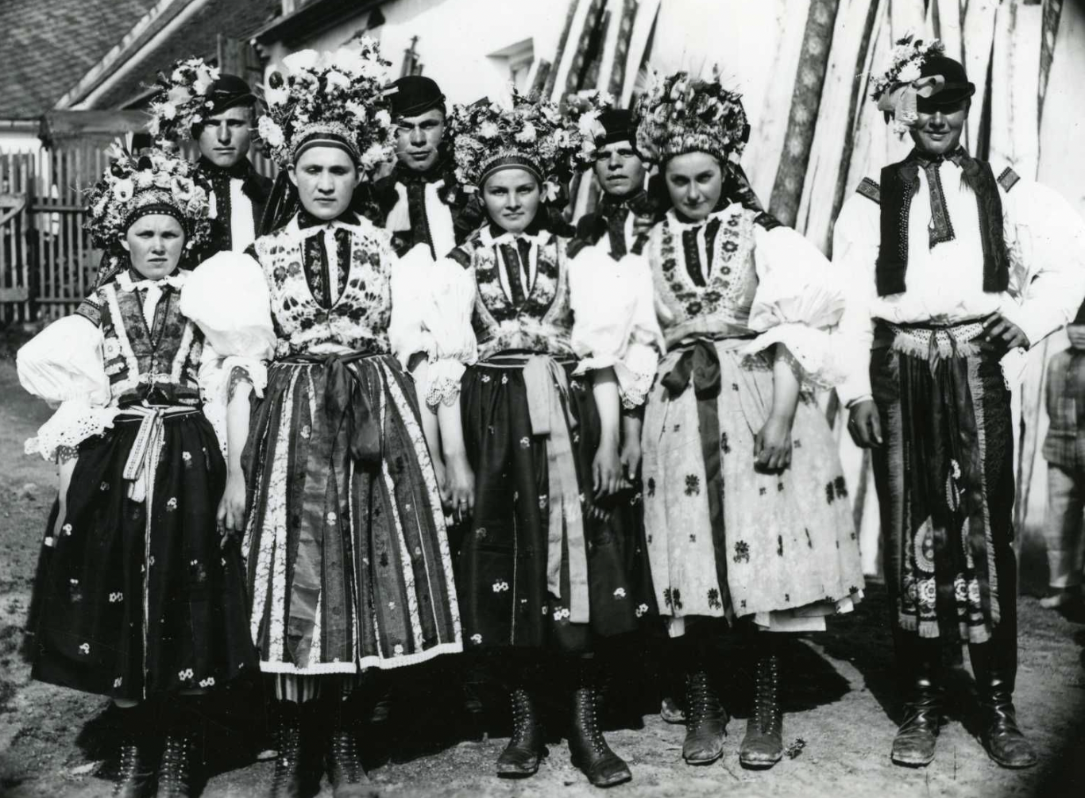
https://www.folklornamapa.sk/p/uherskohradistske-dolnacko-ludovy-odev/

Slide 12
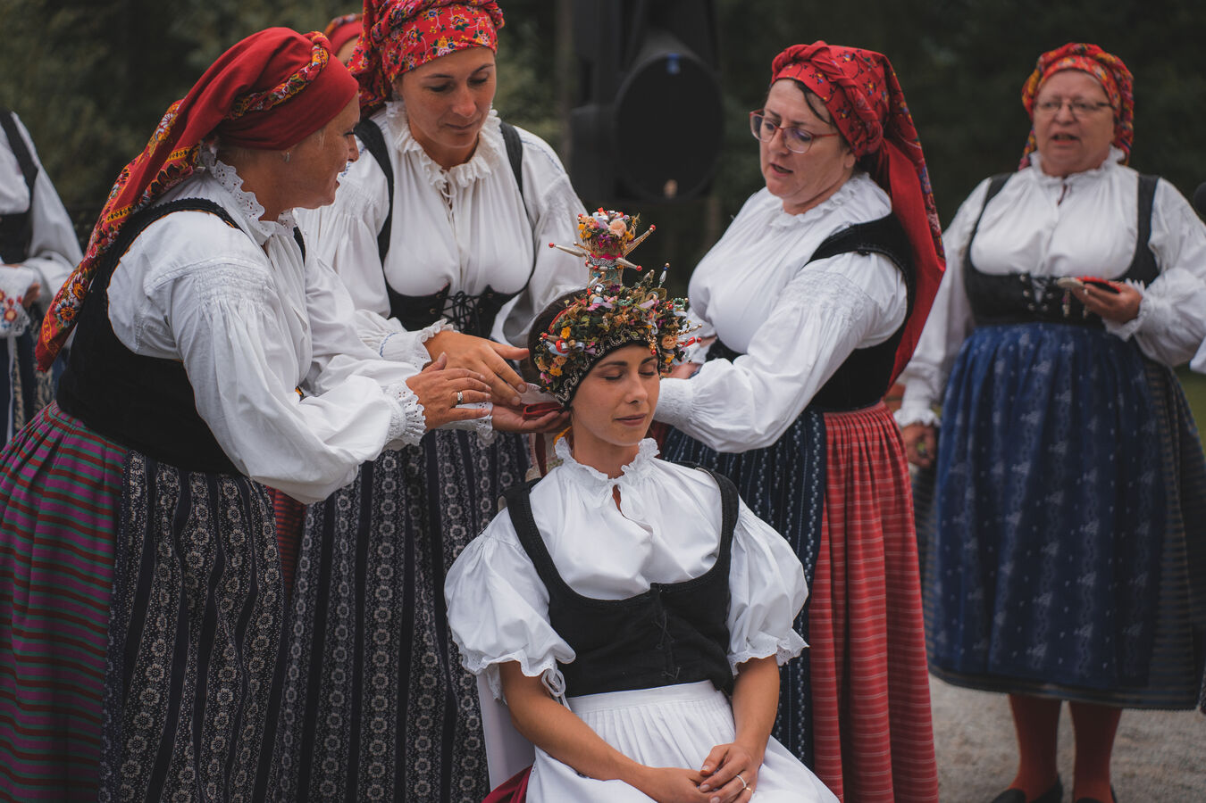
https://www.megapixel.cz/foto/616162

