Slide 1
Phonetics revision

Slide 2
Task 1 Vowel sounds
In each line, find the words with a different vowel sound.

Slide 3
Task 1 Answer key
In each line, find the words with a different vowel/diphtong sound.

Slide 4
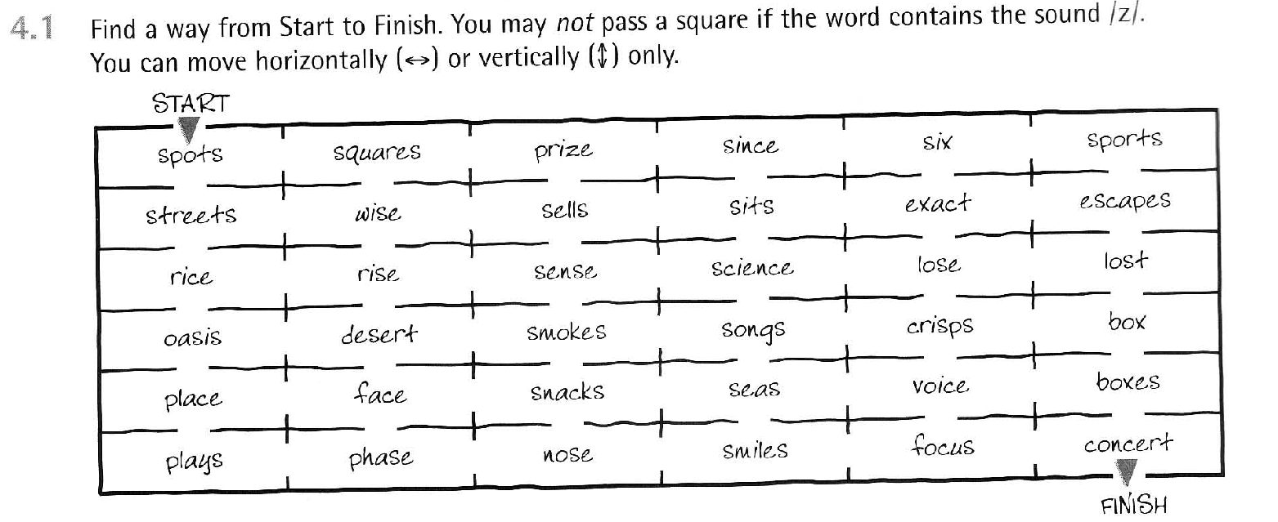
Task 2 S x Z

Slide 5
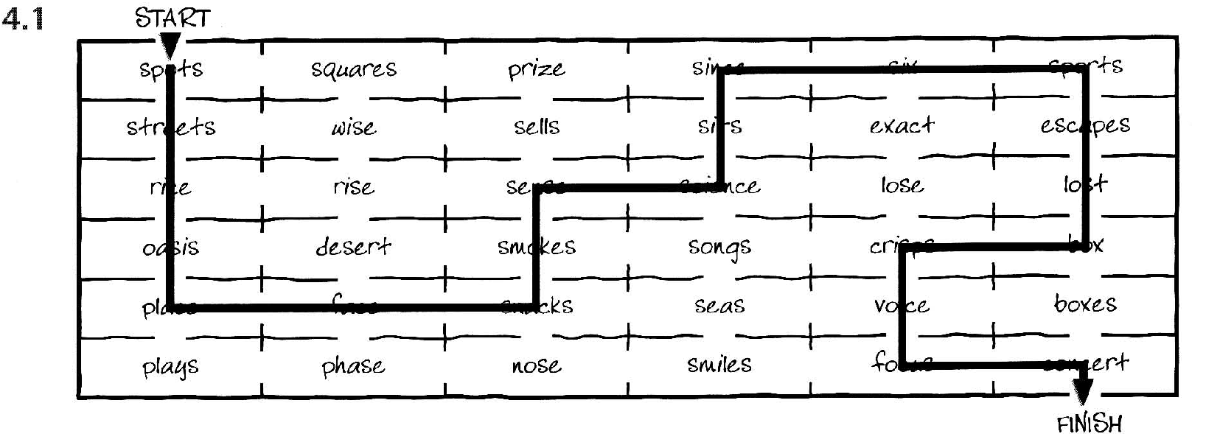
Task 2 Answer key

Slide 6
Task 3 S x Z

Slide 7
Task 3 Answer key

Slide 8
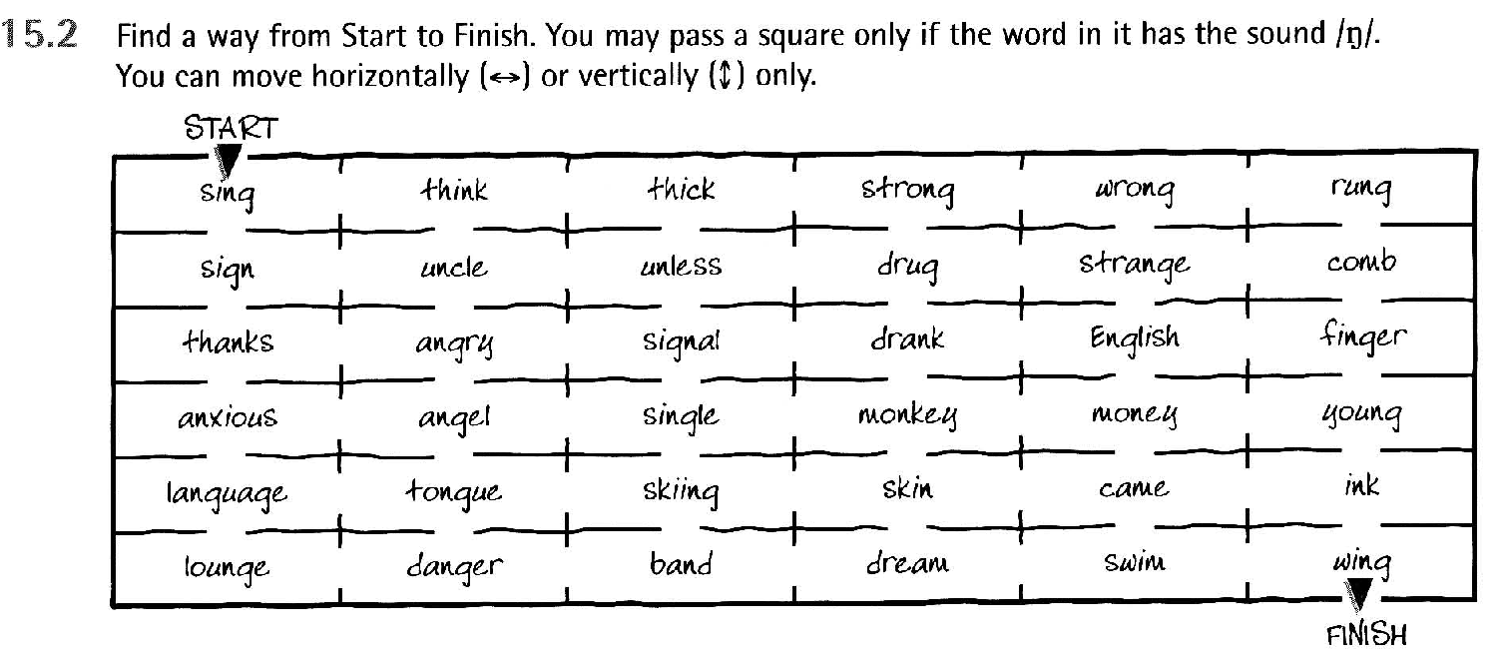
Task 4

Slide 9
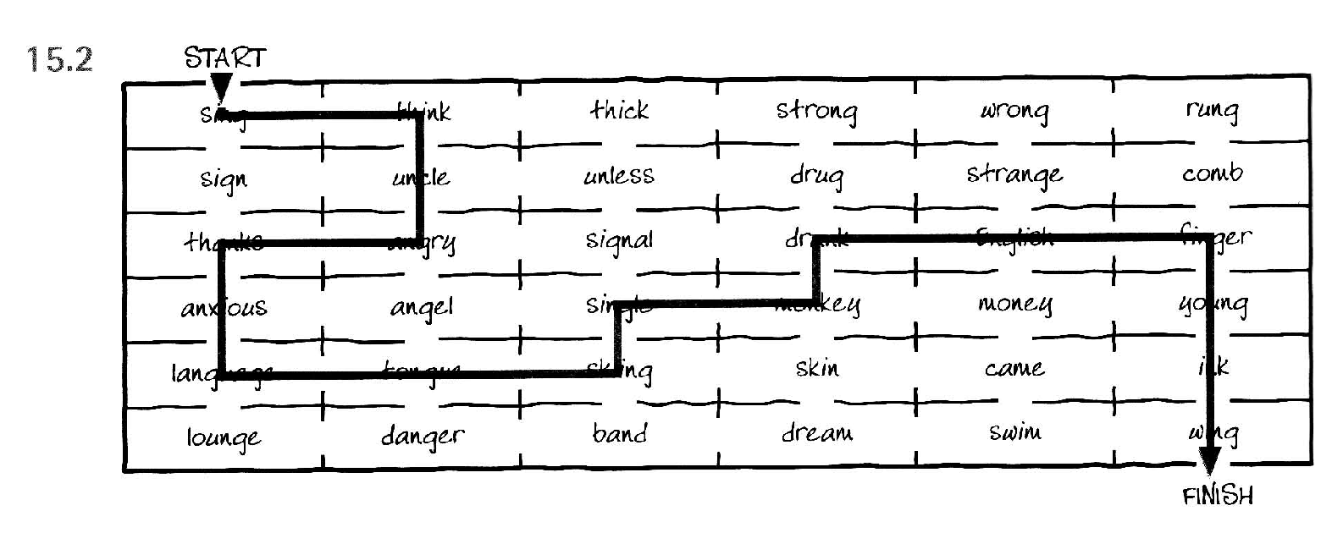
Task 4 Answer key

Slide 10
Task 5 Reading
Identify difficult words
Words with th
Wods with –s ending
Voiced consonant endings
Regular past tenses
Anything else?
In the light of the moon a little egg lay on a leaf.
On Sunday morning the warm sun came up and – pop!
– out of the egg came a tiny and very hungry caterpillar.
He started to look for some food:
On Monday he ate through one apple, but he was still hungry.
On Tuesday he ate through two pears, but he was still hungry.
On Wednesday he ate through three plums, but he was still hungry.
On Thursday he ate through four strawberries, but he was still hungry.
On Friday he ate through five oranges, but he was still hungry.
On Saturday he ate through:
One piece of chocolate cake, one ice-cream cone, one pickle, one slice of Swiss cheese,
One slice of salami, one lollipop, one piece of cherry pie, one sausage, one cupcake,
And one slice of watermelon.
That night he had a stomach-ache.
The next day was Sunday again. The caterpillar ate through one nice green leaf,
And after that he felt much better.
Now he wasn´t hungry anymore – and he wasn´t a little caterpillar anymore.
He was a big, fat caterpillar.
He built a small house, called the cocoon, around himself.
He stayed inside for more than two weeks.
Then he nibbled a hole in the cocoon, pushed his way out and…
He was a beautiful butterfly!

Slide 11
Task 5 Answer key
You can listen to the story read and see if you find any other difficulties.

Slide 12
Task 6
δ
θ
Read out all the words. Pay attention to the difference between the sound pairs.
Student A chooses five words from the list and dictates them to student B. Student B writes them down in normal writing and in phonetic transcription. Check (with a dictionary).
Swap roles.

Slide 13
Task 6
Baker, Ann. Ship or Sheep? Book and Audio CD Pack: An Intermediate Pronunciation Course. Cambridge University Press, 2006.

Slide 14
Task 7 -s endings
Choose all the 3rd person singular present simple verbs and all plural nouns from the Winnie story https://agora.xtec.cat/escolasuris/wp-content/uploads/usu1882/2021/11/Winnie-THE-WITCH-NEW.pdf .
Divide them into three groups according to their pronunciation (/s/, /z/, /iz/

Slide 15
Task 8
Practice saying these words.
Play left hand/right hand.
Bonus: more on the ng sound

Slide 16
Feedback
What was your favourite activity and why?
How did you feel about station learning? Was it useful for you? Why (not)?
Now to the course:
What do you enjoy about the course?
What do you not enjoy? What changes would you suggest?
What do you need to learn as best as you can in this course?

