Slide 1
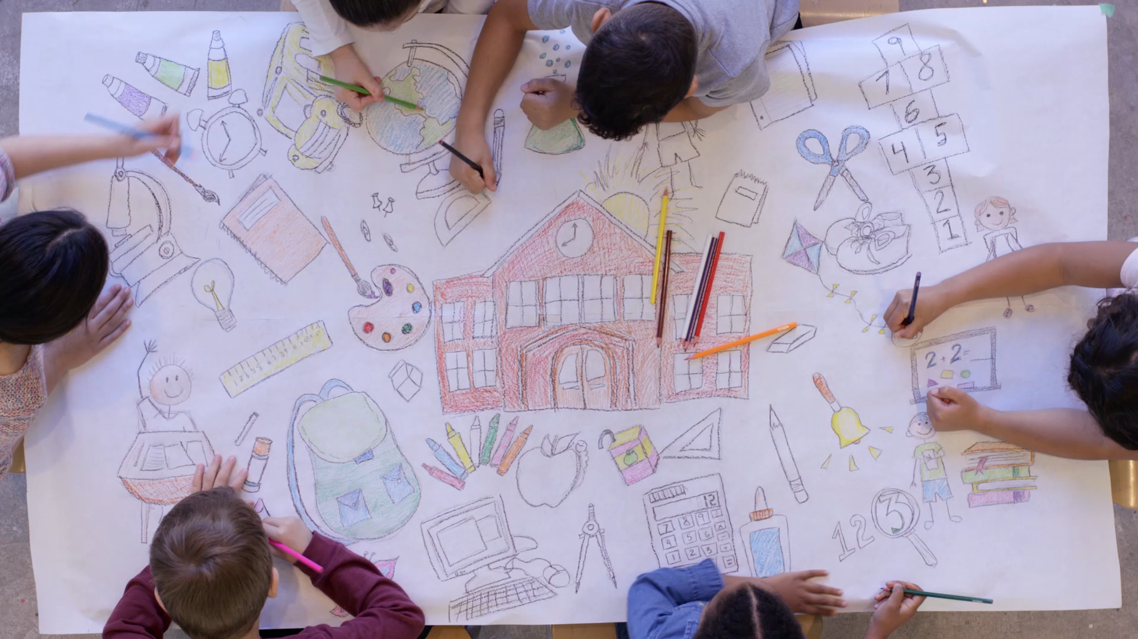
Classroom management in primary english lessons
Mgr. Petra Pašalov

Slide 2
Entering the classroom
Children pick which way they want to be welcome by the teacher
High 5
Hug
Pinkie shake
Elbow hello
Dance
Smile hello
Enter the classroom in a role!
Mice
Robots
Tigers
Soldiers …

Slide 3
Learn their names
Name tags hanging on their necks
Labels
Name games GTK

Slide 4
Classroom layout
Cushions or chairs in horseshoe shape
Just on a carpet
Switch seats (attention grabber)

Slide 5
Consistency – establish the rules
Visual pictures with the certain rules
Using gestures (gists with thumbs up e.g.)
Clear short instructions

Slide 6
Give them roles
Music switcher
Books/folders passer
Puppet carer
Storybook page turner
Prompts carrier

Slide 7
Attention Grabbers
Alligator chump
Hocus Pocus
To infinity
1, 2, 3 eyes on me
Peanut, peanut butter
Zip, Zip, Zap
We will, we will

Slide 8
Practical activities for children
Rolling arms
Pose
Snap, clap, click
Who stole the cookie?
Hicklety picklety bumblebee
Jack in the box
Willoughby Wallaby Wooo
Who is missing ? Peek-a-boo.
2-4-6-8 who do we appreciate?

Slide 9
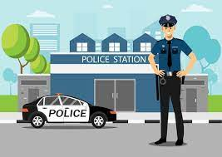
Reward system
Police car aiming to the police station (good behavior, misbehavior)
Possible rewards (stamps, singing their favourite songs)

Slide 10
Plan, plan, plan!
Get your aids ready
Flashcards in order, music prepared, puppet, prompts, etc.
Use transition chants
Lesson structure
Welcome + attendance record
Warm Up
Lead In
Vocabulary building
TPR game
Workbook
Calm down
Feedback
Bye bye song

Slide 11
Variety of activities
Multiple Intelligence
Activities connected by the main theme
Short and clear instructions
Appropriate level

Slide 12
Puppet
It´s a really powerfull tool
It might be a mediator and helper
Never leave it on the floor

Slide 13
Feedback
Always ask for feedback
Make it at the same part of your lesson (the final is the best)
Support their answers in English

Slide 14
Play
Make yourself comfortable (wear comfy clothes)
Get down on a carpet
Be at their level
Exaggerate
Be confident

Slide 15
Thank you for your attention!

