Slide 1
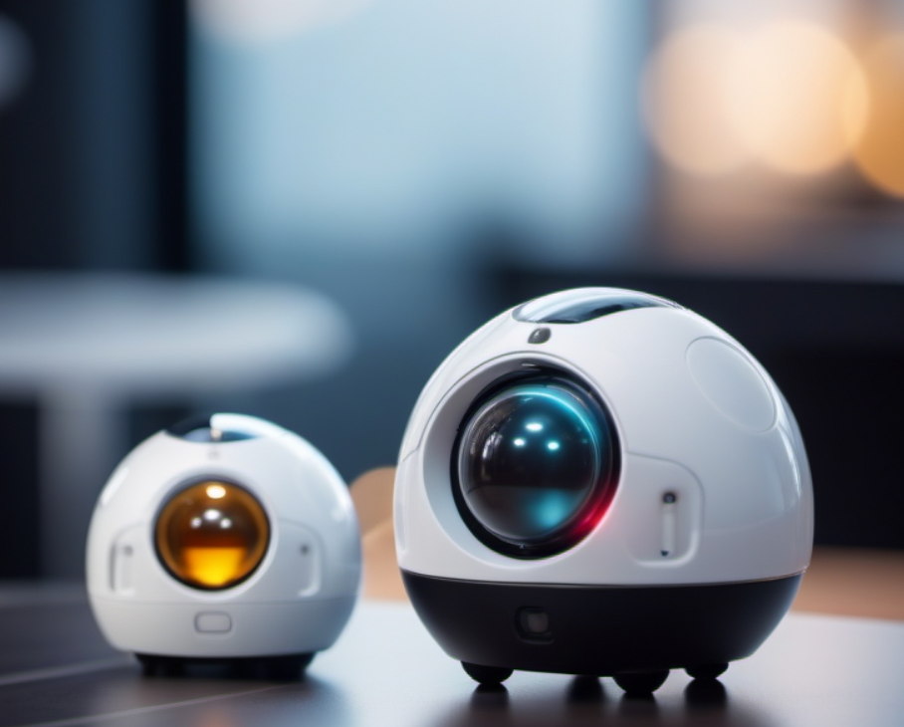
Robotics in STEM EDU in Czech Curriculum
Mgr. Karel Picka, Ph.D.
Department of Technical and Information Education
Faculty of Education
Masaryk University

Slide 2
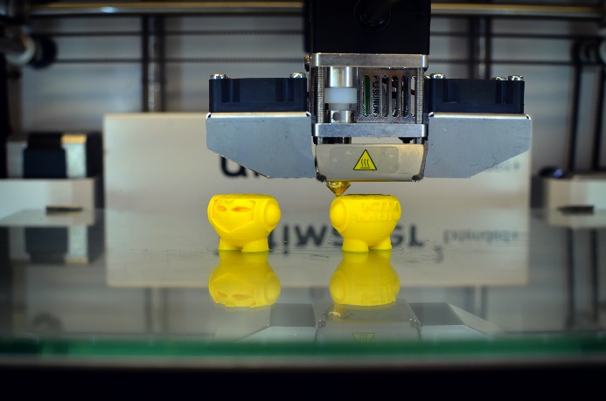
There was big change in ICT education i our country in last couple of years
After years of stagnation, the national informatics/ICT curriculum (compulsory for all elemtary schools) has changed
shift from simple user skills to algorithmic thinking, programming, robotics…
in development since 2018, mandatory for all elementary schools from 4.9. 2023
However, some schools have been implementing changes for a year or two

Slide 3
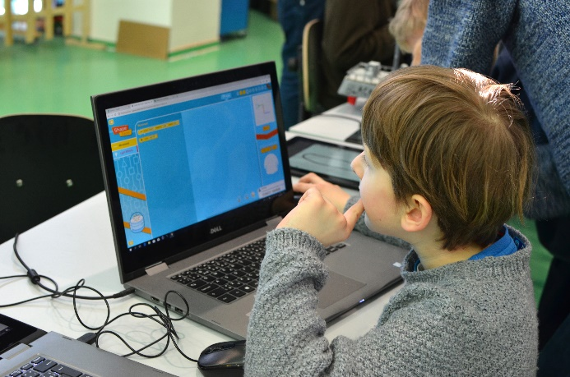
There was big change in ICT education i our country in last couple of years
Informatics as a subject in primary schools has also gained more hours in the hourly allocation
Instead of one hour per week, pupils will now encounter 2 to 3 hours per week (depending on whether it is the lower or higher level of elemtary school*)
*Lower: 6 – 10 years of age, Higher: 11 – 15 years of age

Slide 4
What was drop out of the curriculum?
Lower Elementary
Computer basics (concepts, hardware, OS, file formats, multimedia, troubleshooting and maintenance, safety and prevention)
Information retrieval and communication (information flow, communication methods, information retrieval)
Information processing and application (word processing, graphical editor)
Higher elementary
Information retrieval and communication (ict developments, information verification and value, internet)
Information processing and use (graphics, spreadsheets, presentations, law and intellectual property)

Slide 5
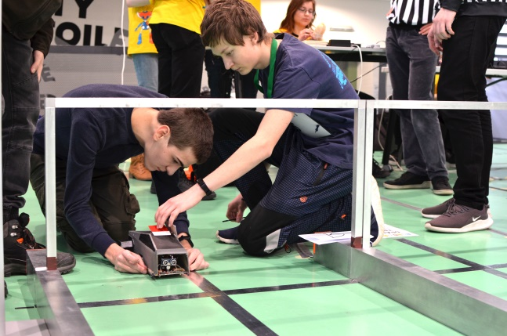
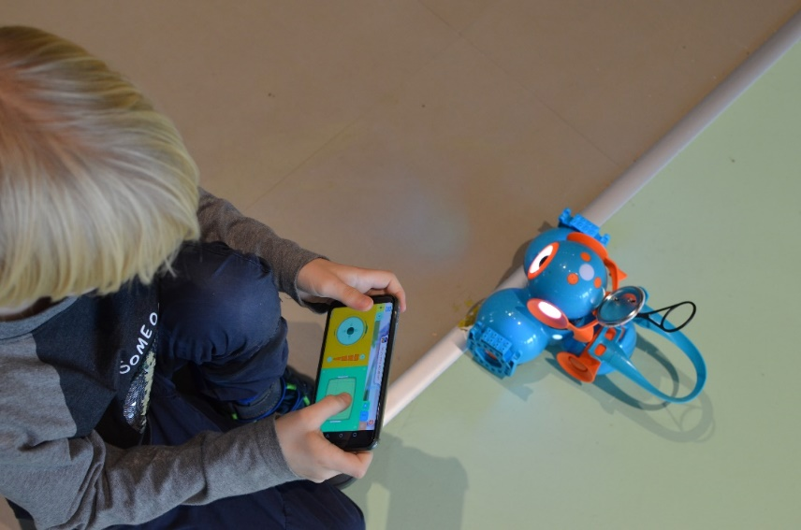
So, what´s new?

Slide 6
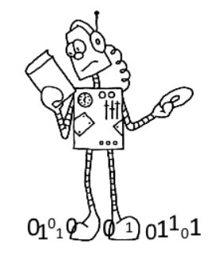
New curriculum
New sections of curriculum:
1) DATA, INFORMATION AND (data) MODELLING
2) ALGORITHMISATION AND PROGRAMMING
3) INFORMATION SYSTEMS
4) DIGITAL TECHNOLOGIES

Slide 7
New curriculum
All of these categories are taught at different levels of difficulty across the lower and upper primary levels
For example:
2) ALGORITHMISATION AND PROGRAMMING
At the lower elementary level, pupils will meet the very basics of programming in Scratch, step robots (Bee-bot, Vex), etc.
At the upper elementary level, pupils will encounter more demanding programming in Scratch, but also, for example, the development of programmable robots or microcontrollers such as Ozobot, Micro:bit or Arduino

Slide 8
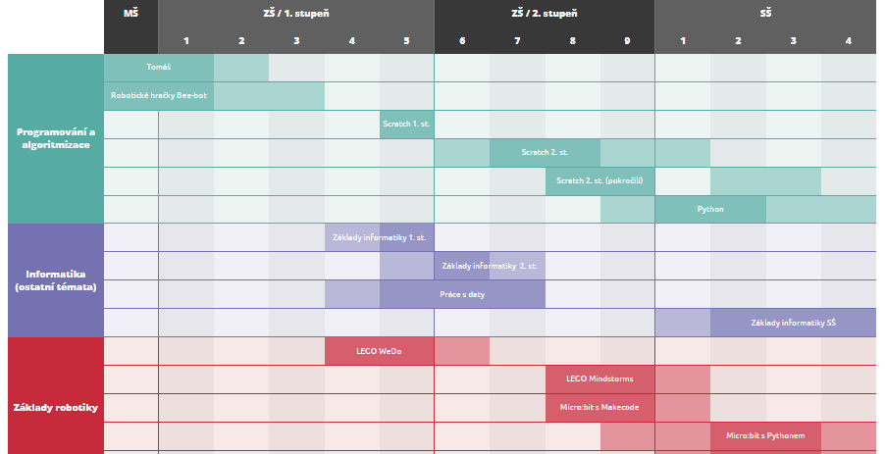
New Textbooks for Primary/Secondary Schools
https://imysleni.cz/ucebnice

Slide 9
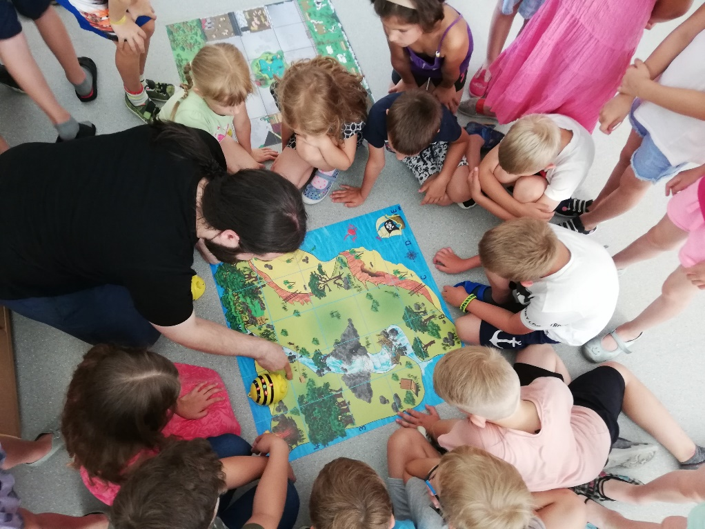
What can our students encounter?
Lower Elementary
Examples of robotics

Slide 10
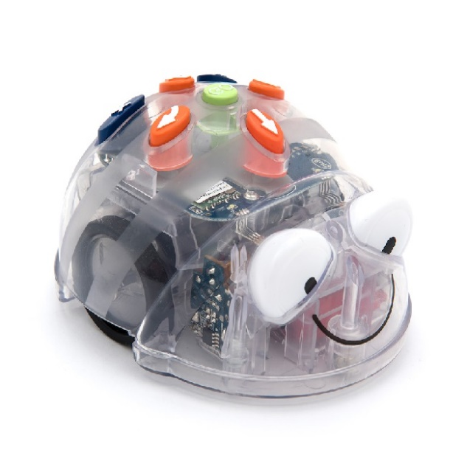
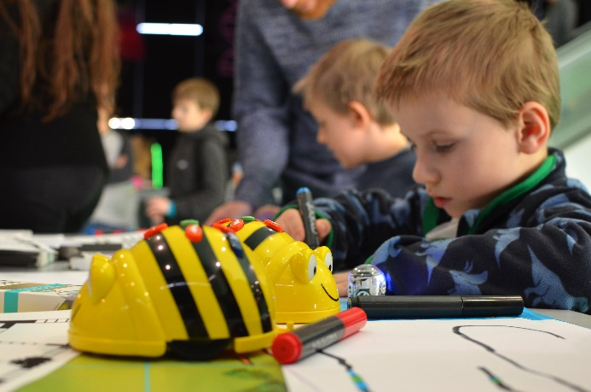
Bee bot/Blue bot
Step robot
Very easy to handle for younger kids
No need for computer or tablet/smartphone
Can help teach basic algoritmisation even for very young kids
Lot of materials

Slide 11
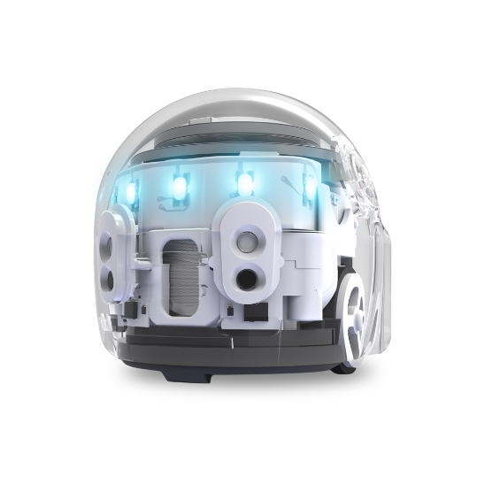
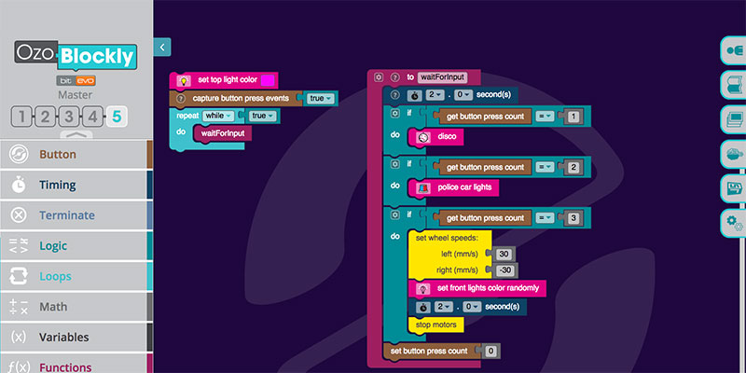
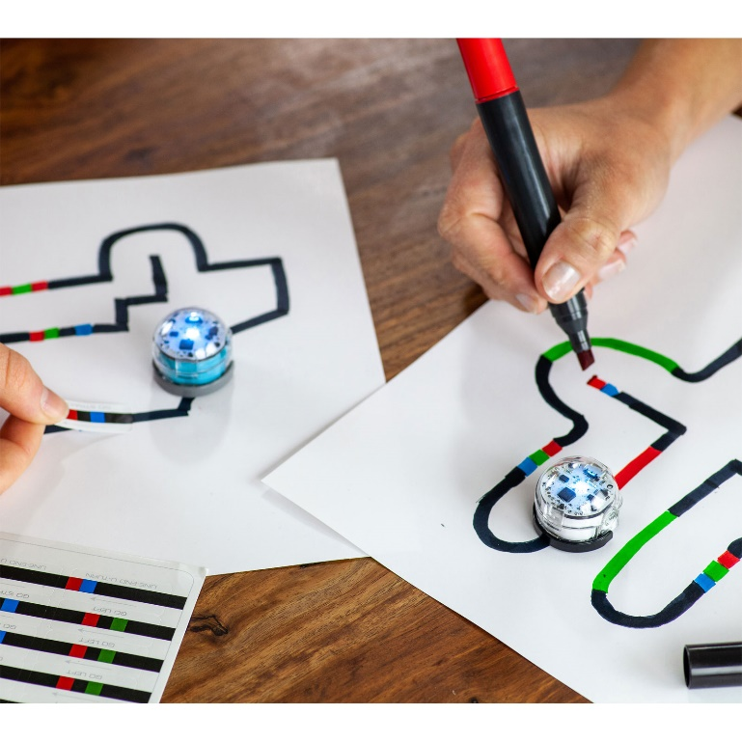
Ozobot
Can be programmed on paper or via computer/tablet
Can read codes made by colour markers on paper
Can be programed by visual programming language based on Blockly

Slide 12
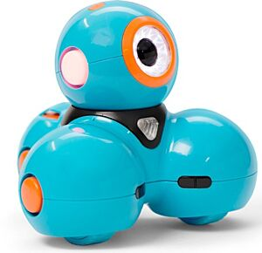
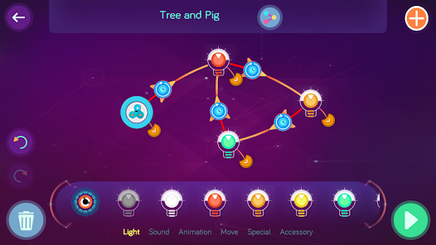
Dash & Dot
Programmable via several tablet/phone apps
Uses block programming but also its own interesting visual programming language

Slide 13
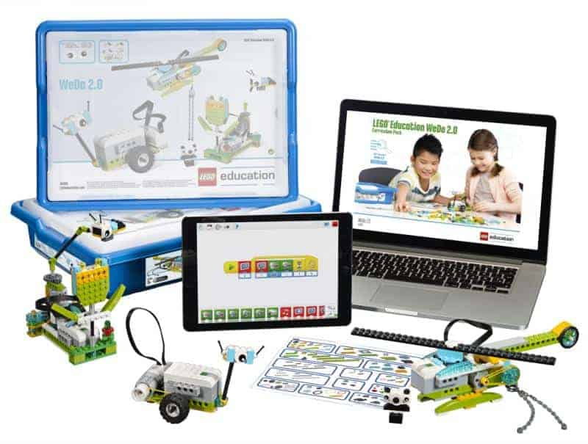
LEGO
LEGO WeDo has established itself for lower primary schools
Today, it is being replaced by other programmable Lego, but an official textbook accredited by the Ministry of Education has been created for the popular WeDo in past two or so years

Slide 14
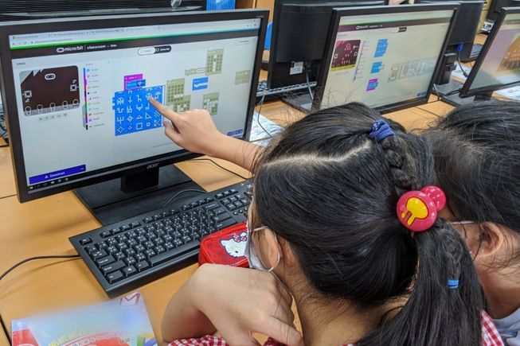
What can our students encounter?
Upper Elementary
Examples of robotics

Slide 15
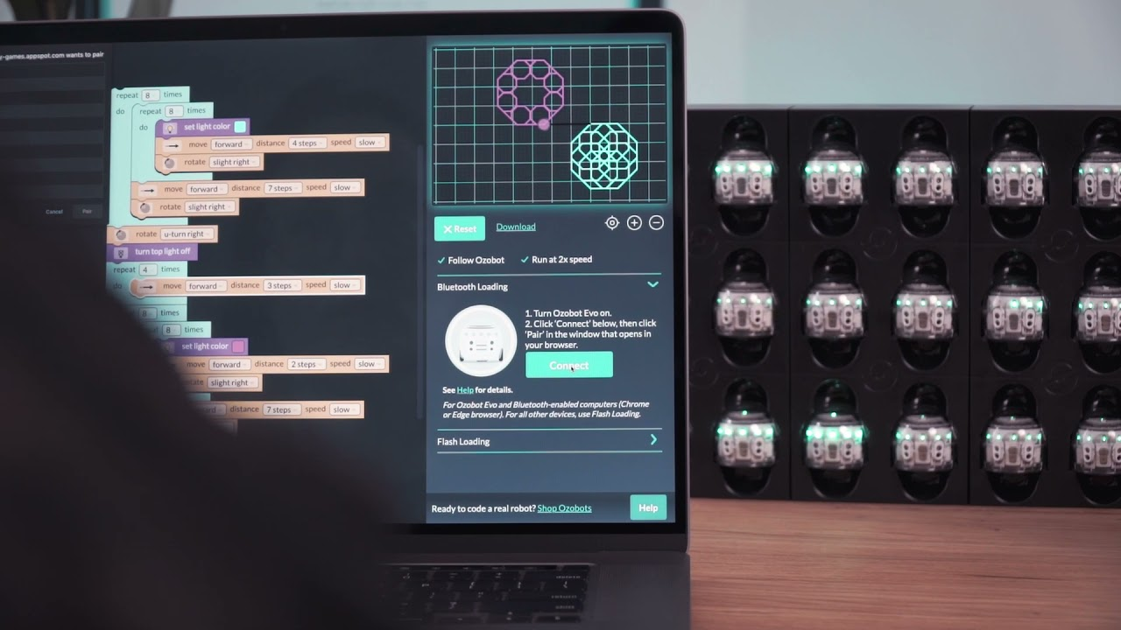
Ozobot
Same as above, but with more focus on programming with higher levels of visual coding and not so much on the paper with markers

Slide 16
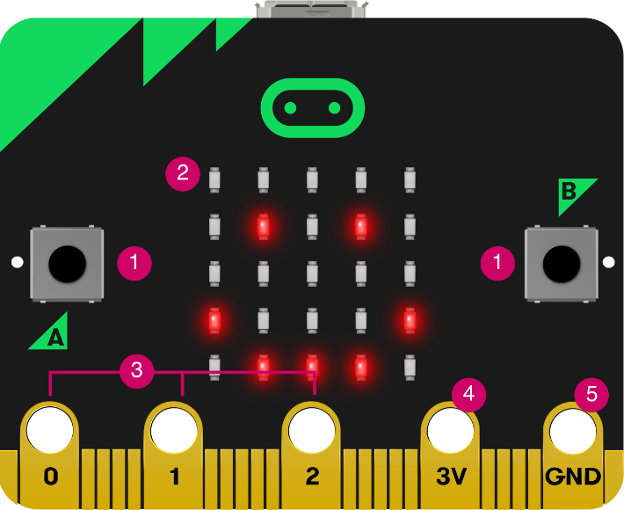
Micro:bit
small single-board computer for programming and electronics education
includes various sensors, such as an accelerometer, magnetometer, and LED display
Programmable: Micro:bit can be programmed in various programming languages, including Blockly, JavaScript, and Python, making it versatile for use in education at different levels.

Slide 17
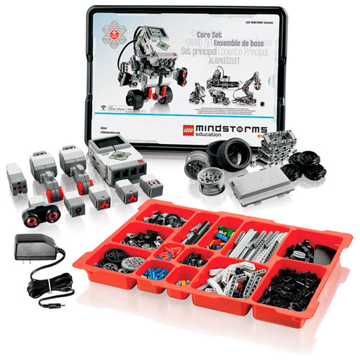
LEGO Mindstorms
educational robotics platform that combines hardware, such as programmable bricks and sensors, with a user-friendly programming environment (mostly visual block based)
Mindstorms allows students to engage in hands-on learning, teaching them programming, engineering, and problem-solving skills while building and coding their own robots.

Slide 18
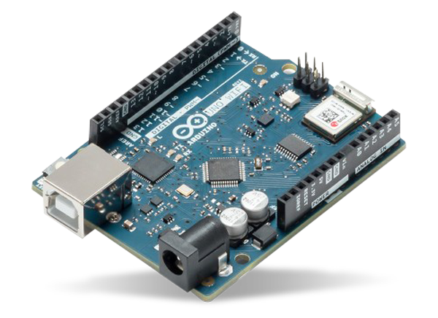
Arduino
open-source microcontroller platform that introduces students to the world of electronics and programming
„More challanging“ then Micro:bit
Can be use as a good vessel to transfer from visual programming languages to text based (C, C++, MicroPython, Java,…)
Can connect to various hardware and be used to virtually any project the teacher or student can handle

Slide 19
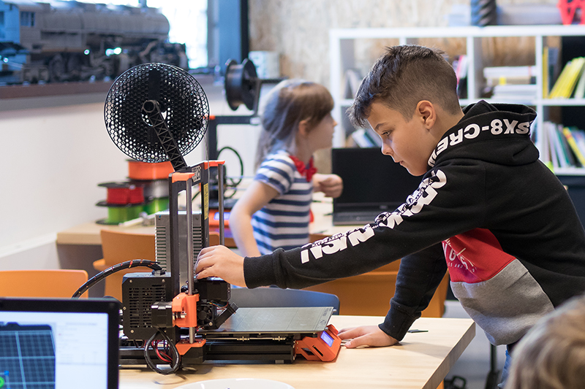
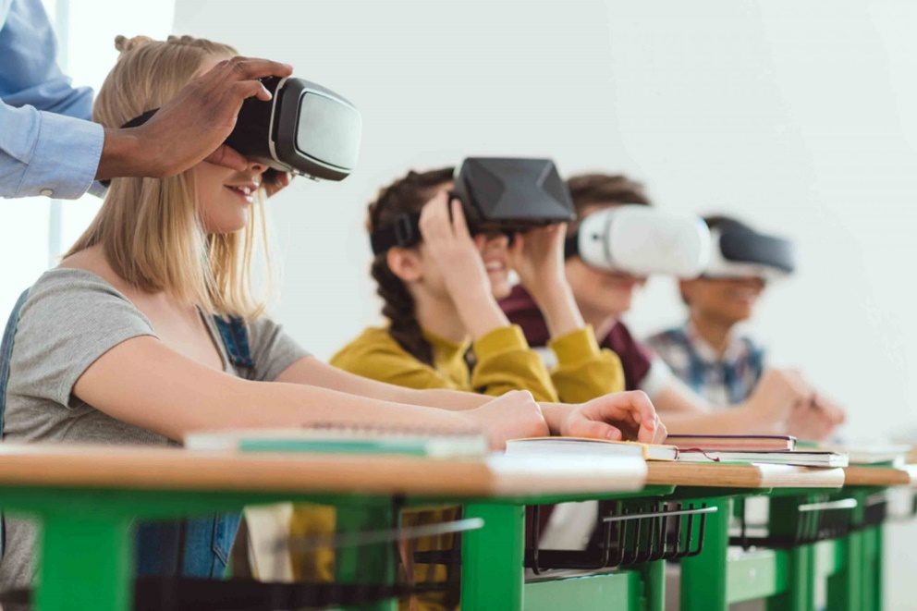
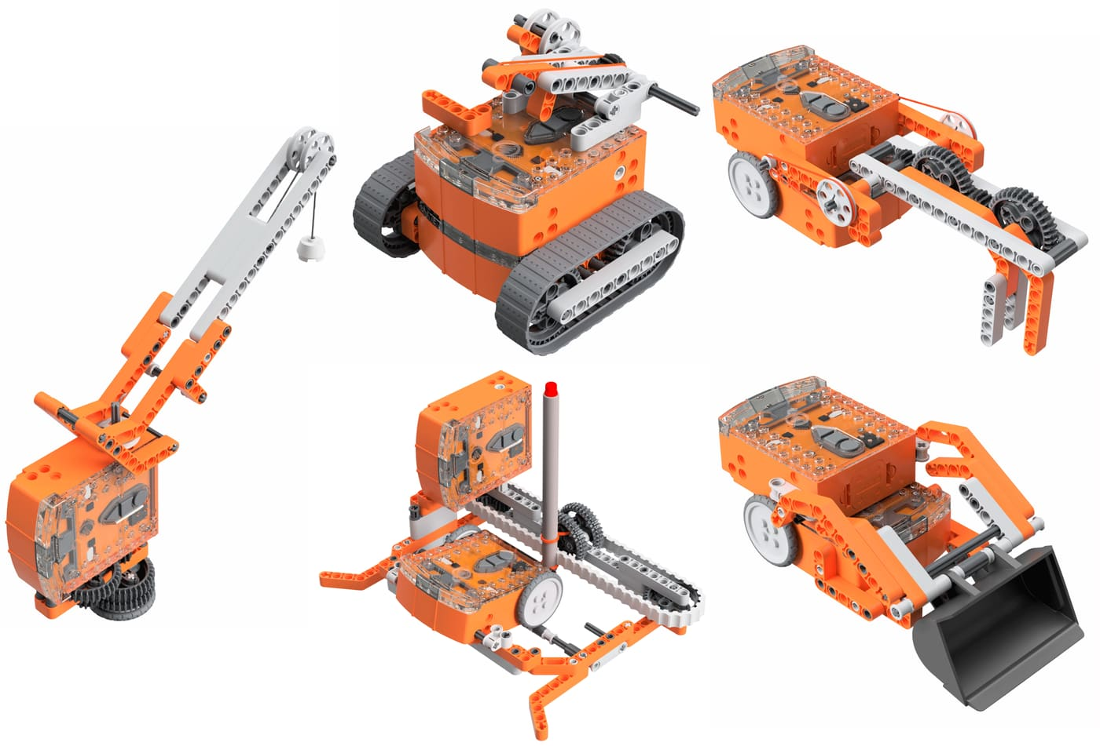
And much more…

Slide 20

Thanks for your attention!
Mgr. Karel Picka, Ph.D.
Assistant Professor
Masaryk University | Faculty of Education
Department of Technical and Information Education
A: Poříčí 31 | Brno
E: picka@ped.muni.cz

