Slide 1

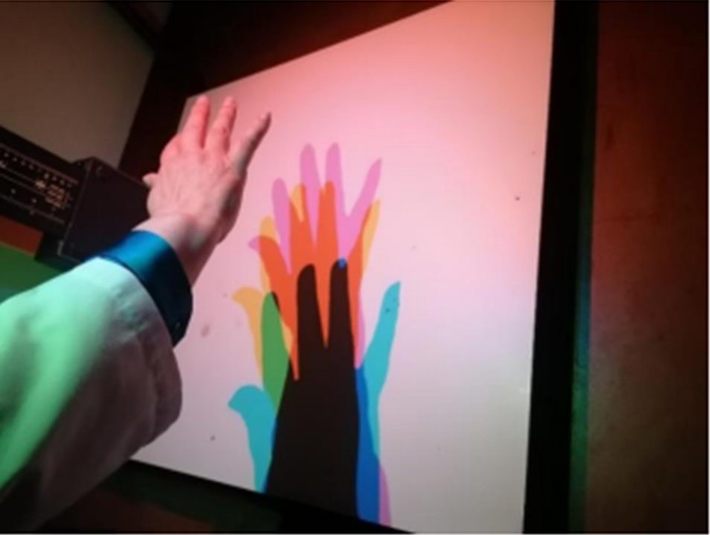

STEAM approach in building automatons: wheels and axles
Ana Peixoto
anapeixoto@ese.ipvc.pt
STEM Education in Brno, Faculty of Education, Masaryk University
10 september, 2024

Slide 2
STEM /STEAM
In Portugal, STEM and STEAM approach focuses on active learning, defended by different authors over decades.
What is active learning? This is when students are actively involved with their hands, minds and hearts (hands-on; minds-on and hearts-on).
STEM and STEAM, more or less adopted in teacher training, have been presented as essential in the teaching of science, technology and, for a longer time, engineering and mathematics (STEM).
The 2030 goals point to the need for more and more schools, whether primary, secondary or higher education, to opt for any of these perspectives, clearly pointing to the STEM curriculum.
STEM Education in Brno, Faculty of Education, Masaryk University
10 September, 2024

Slide 3
STEM /STEAM
STEM Education in Brno, Faculty of Education, Masaryk University
10 September, 2024

Slide 4
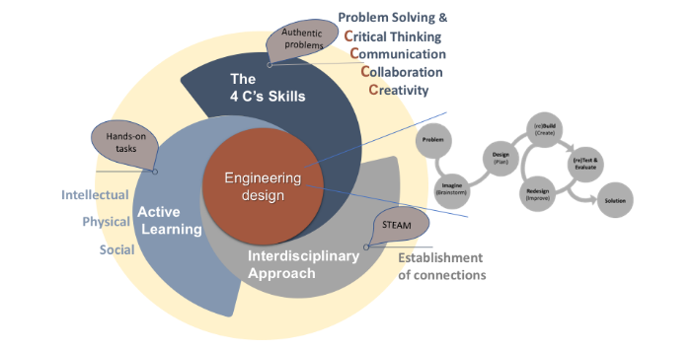
Theoretical framework
STEM Education in Brno, Faculty of Education, Masaryk University
10 September, 2024

Slide 5
STEAM approach
Focused on solving problems… how to solve them? (engineering) … the science and mathematics involved in the solving process … the art
The 5 steps (cycle) Question… Imagine… Plan… Create… Improve… or…
(Schull, 2019)
Create/
Build
Identify
the
problem
(Schul, 2019)
Plan/
Design
Test &
Evaluate
Imagine
Improve/
Redesign
Share
Solution(s)
Vale e Barbosa, (2020 adapted from Cunningham & Hester, 2007); Eddleman, 2016; Enderson et al., 2013; English et al., 2015; Stoner et al., 2013; WORKS, 2021)
STEM Education in Brno, Faculty of Education, Masaryk University
10 September, 2024

Slide 6
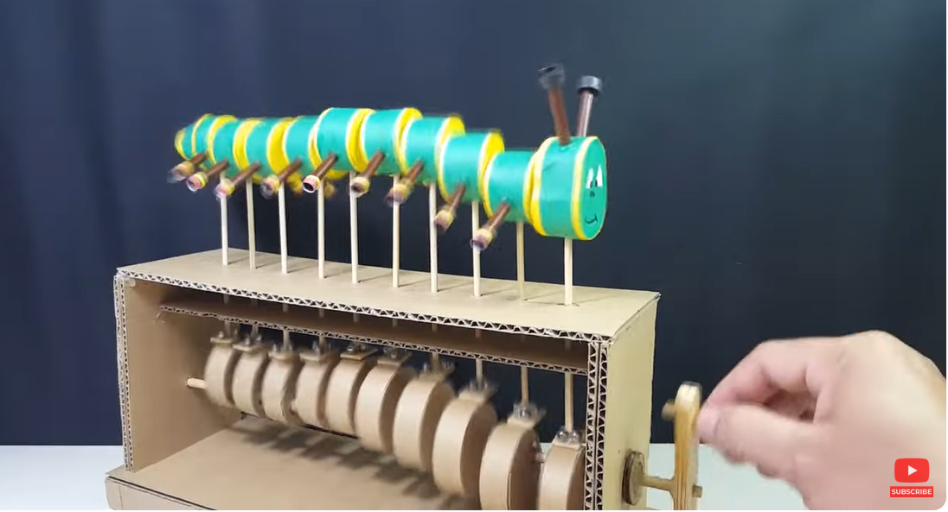
The challenge
Resu
lta
d
os
As a group, try to build the artifact present. To do this, they must follow the engineers’ process.
https://www.youtube.com/watch?v=_eKhOqsT898&t=10s
3 de novembro, 2023
Cabo Verde, Ilha de Santiago

Slide 7
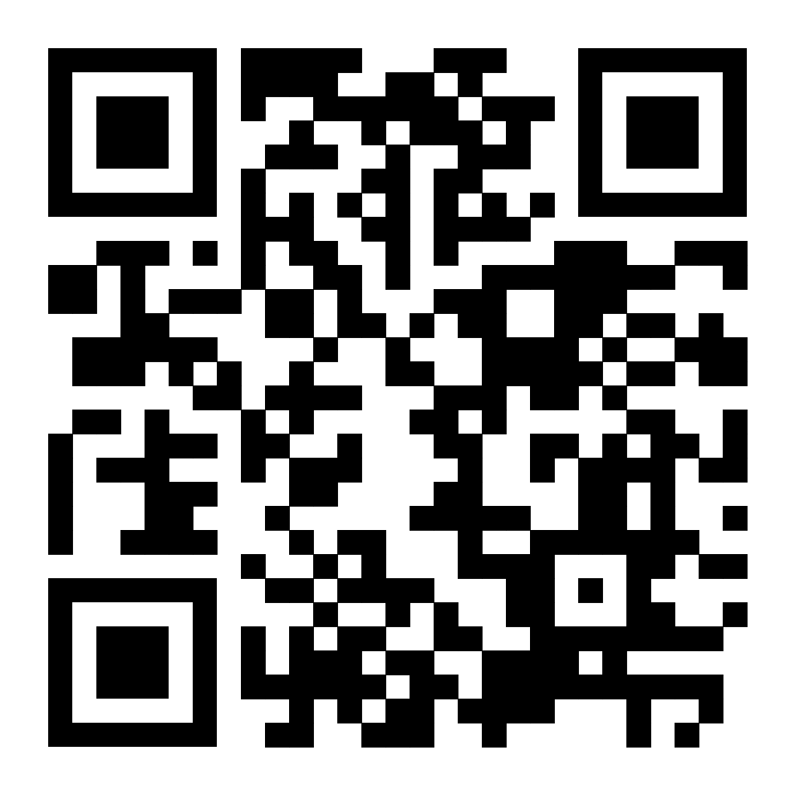
The challenge
Resu
lta
d
os
As a group, try to build the artifact present. To do this, they must follow the engineers’ process.
https://www.youtube.com/watch?v=_eKhOqsT898&t=10s
3 de novembro, 2023
Cabo Verde, Ilha de Santiago

Slide 8
References
Coutinho, C. P. (2014). Metodologia de investigação em ciência sociais e humanas: Teoria e Prática (2ª Ed.). Coimbra: Edições Almedina.
Cunningham, C. M., & Hester, K. (2007). Engineering is Elementary: An Engineering and Technology Curriculum for Children. Paper presented at ASSE Annual Conference and Exposition, Honolulu, HI. Retrieved from http://www.eie.org/sites/default/files/research_article/research_file/ac2007full8.pdf
Lopes, J. B., Viegas, C., & Pinto, A. (2018). Melhorar Práticas de Ensino de Ciências e Tecnologia – Registar e Investigar com Narrações Multimodais. Lisboa: Edições Sílabo.
Flinn, E., & Mulligan, A. (2022). Ideas STEM para Primaria. NARCEA, S. A. DE EDICIONES.
Osborne, J (2002). The Challenges for Science. Education for the Twenty-First Century Pontifical Academy of Sciences, Scripta Varia 104, Vatican City 2002. Acedido em 10 de janeiro, 2020, www.pas.va/content/dam/accademia/pdf/sv104/sv104-osborne.pdf
Peixoto, A. (2007a). As ciências físicas e as actividades laboratoriais na Educação Pré-Escolar: diagnóstico e avaliação do impacto de um programa de formação de Educadores de Infância (Tese de doutoramento em Educação não publicada). Braga: Universidade do Minho.
Peixoto, A. (2007b). Formação de Educadores de Infância no domínio das ciências físicas com recurso a actividades laboratoriais: um programa de formação. In J. B. Lopes, & J. P. Cravino (Eds.), Atas XII Encontro Nacional de Educação em Ciências (pp. 272-275). Vila Real: Universidade de Trás-os-Montes e Alto Douro.
Peixoto, A., & Ramalho, S. (2010). As ciências físicas na licenciatura de Educação Básica: uma análise das alterações introduzidas por Bolonha. In Actas da 17ª Conferência Nacional de Física, 20º Encontro Ibérico para o Ensino da Física (pp. 357-358). Vila Real: Universidade de Trás-os-Montes e Alto Douro.
Peixoto, A., & Ramalho, S. (2011). Autonomia e aprendizagem: As ciências físicas na formação inicial de professores e educadores. In Atas Silva, J. et al. (Orgs.), Congresso Ibérico Pedagogia para a autonomia (pp. 277-284). Braga: Universidade do Minho, CD-ROM.
Perignat, E., & Katz-Buonincontro, J. “STEAM in practice and research: An integrative literature review,” Thinking Skills and Creativity, 31, 20194, pp. 31–43.
Schull, C. (2019). Awesome engineering activities for kids. California: ROCKRIDGE PRESS.

Slide 9
Thank you all for your attention!
STEM Education in Brno, Faculty of Education, Masaryk University
10 September, 2024

