Slide 1
Antiadrenergics
Tomáš Goněc
2023

Slide 2
Antiadrenergics
direct – competitive inhibitors on NA binding site
indirect – inhibitors of release/uptake of NA
blocking of adrenergic receptor causes:
vasodilation and blood pressure decrease
bradycardia (heart-rate decrease)
increase of uterus tonicity
prolactin release inhibition
decrease of intraocular pressure

Slide 3
Antiadrenergics
Antiadrenergics are used in therapy as:
antihypertensives
vasodilators (angina pectoris, myocardial infarction)
antiarrhythmics
migraine prophylaxis
uterotonics
glaucoma therapy

Slide 4
α-blockers (non-selective)
Natural drugs – ergot alkaloids

Slide 5
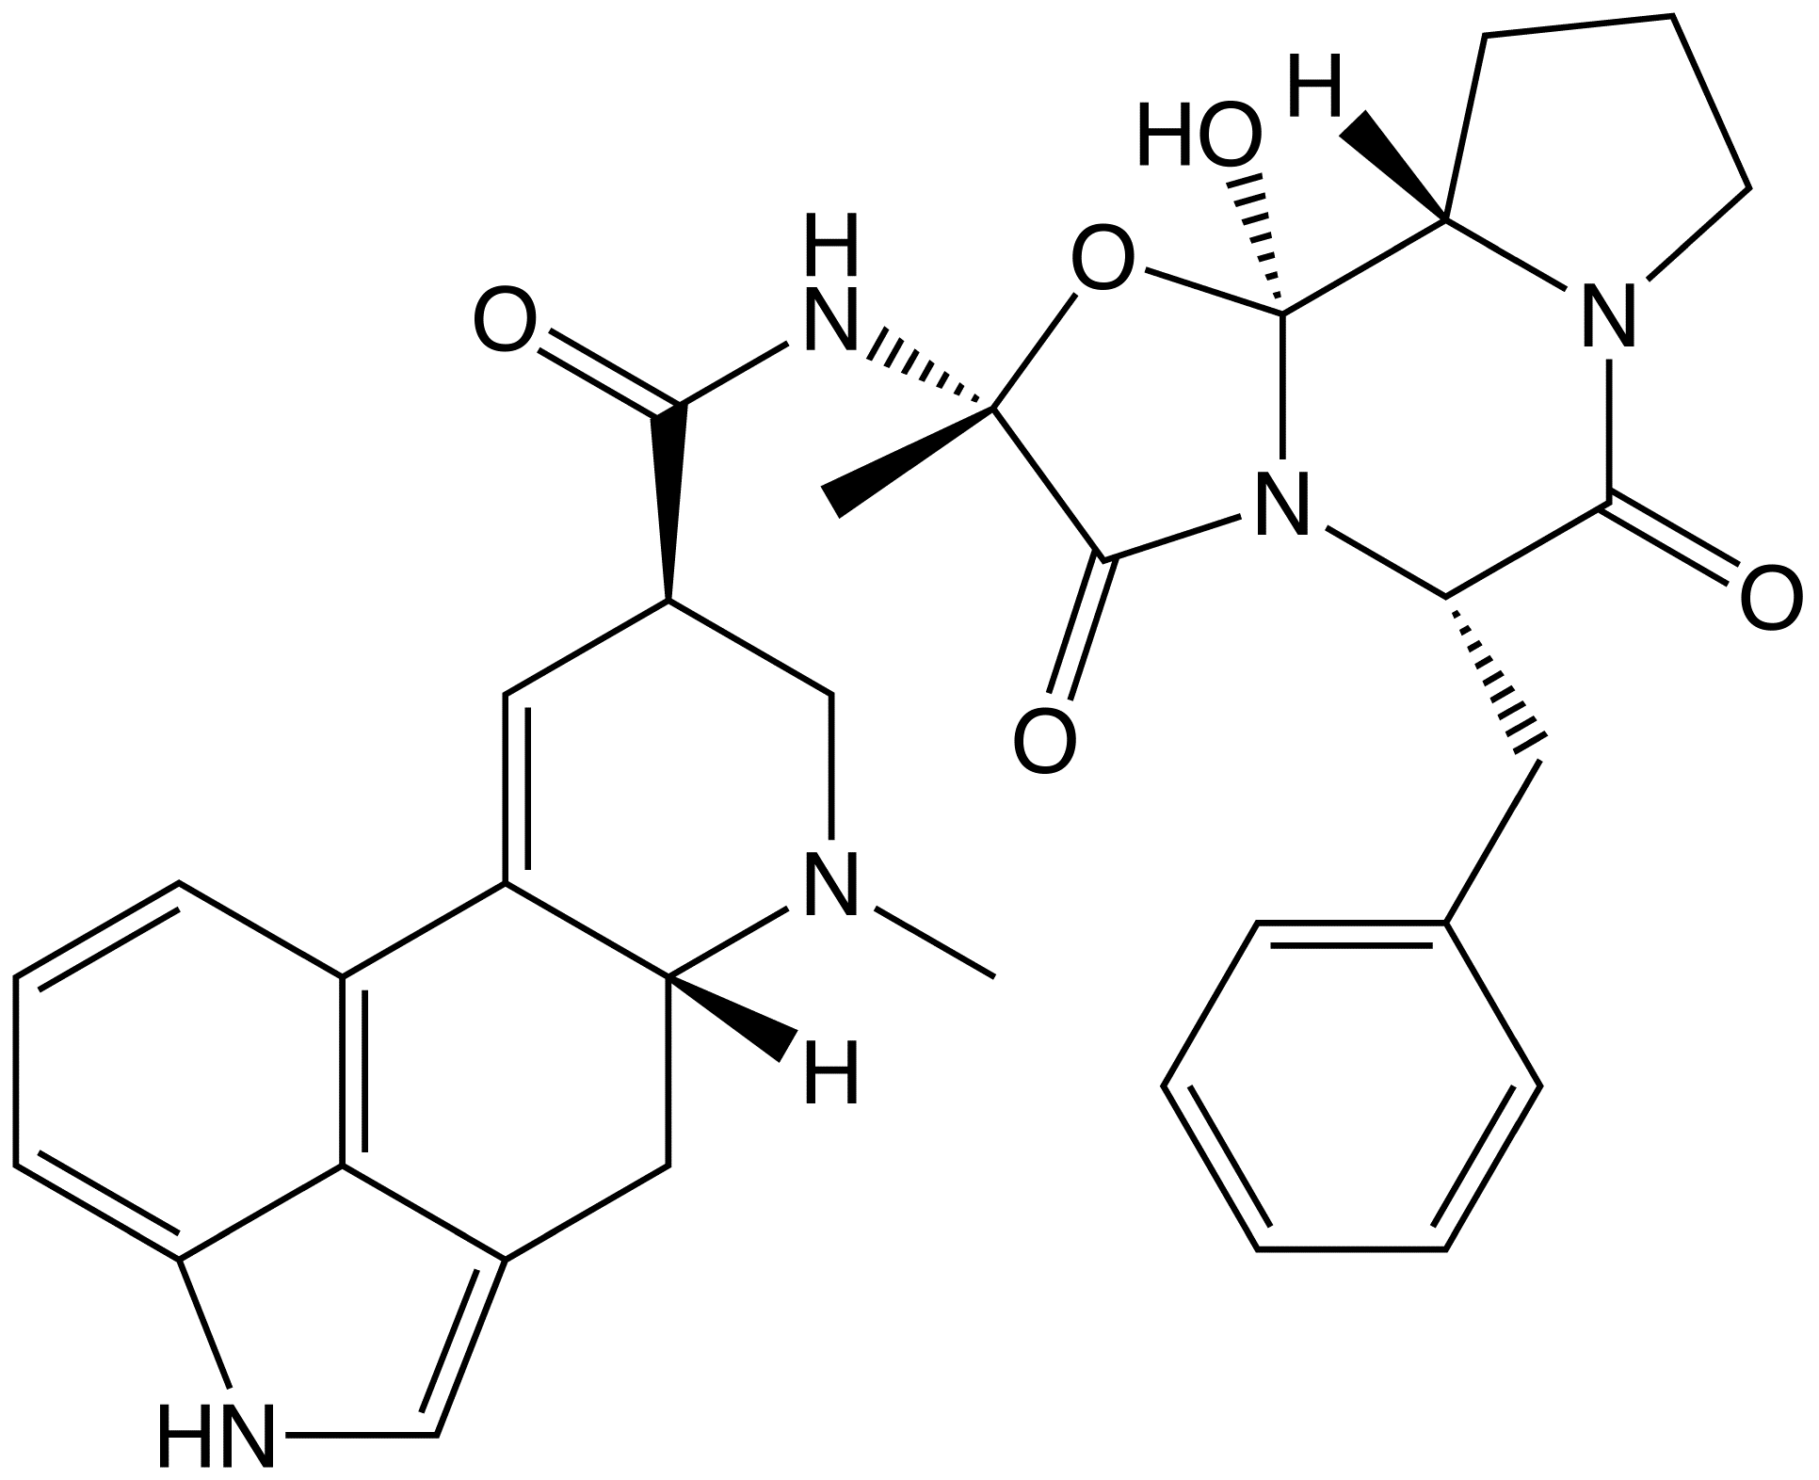
α-blockers (non-selective)
Ergotamine, dihydroergotamine
α antagonistic, 5HT, D agonistic effect
strong vasoconstriction
therapy of migraine attack
nasal administration

Slide 6
α-blockers (non-selective)
Dihydroergotoxine
α₁, 5HT antagonistic, D agonistic effect
strong vasodilator
mixture of alkaloids:
dihydroergocristine
dihydroergocryptine
dihydroergocornine
therapy of insufficient limbs perfusion, insufficient CNS perfusion, insufficient internal ear perfusion, Menier disease

Slide 7
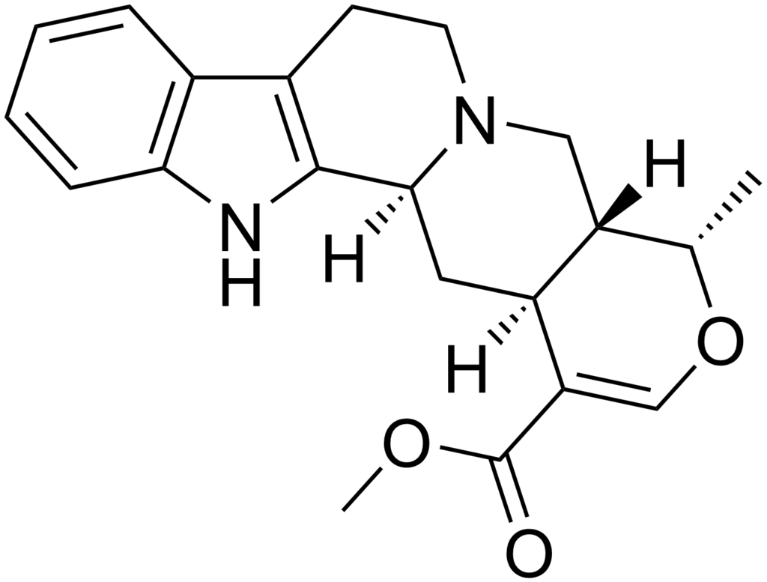
α-blockers (non-selective)
Ajmalicine
structurally related to Yohimbine
antihypertensive effect - α₁ - antagonist, α₂ - agonist

Slide 8
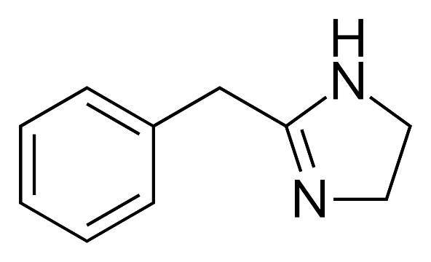
α-blockers (non-selective)
Tolazoline
α antagonist, H₂ agonist
vasodilation in lungs
therapy of neonatal pulmonar hypertension
peripheral vasodilator – treatment of acrocyanosis – spasm of peripheral veins

Slide 9
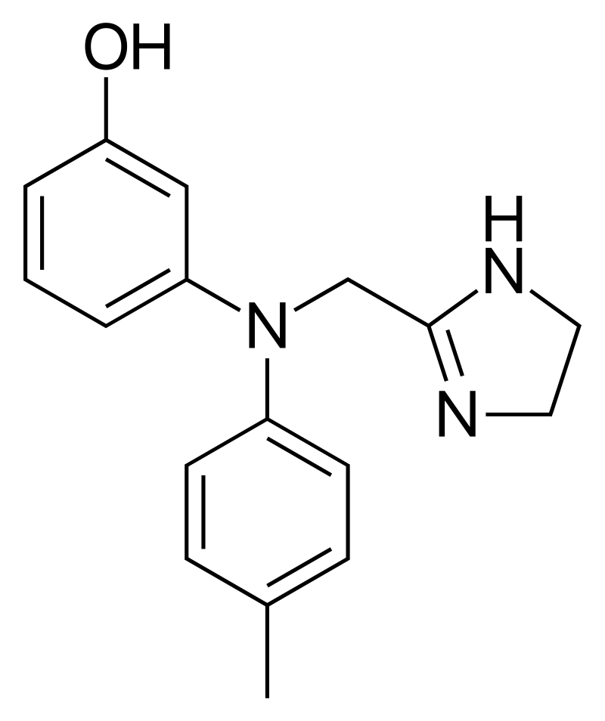
α-blockers (non-selective)
Phentolamine
dominantly α₁ antagonist - vasodilator
antihypertensive agent
limited use (hypertension crisis)
risk of reflexive tachycardia

Slide 10
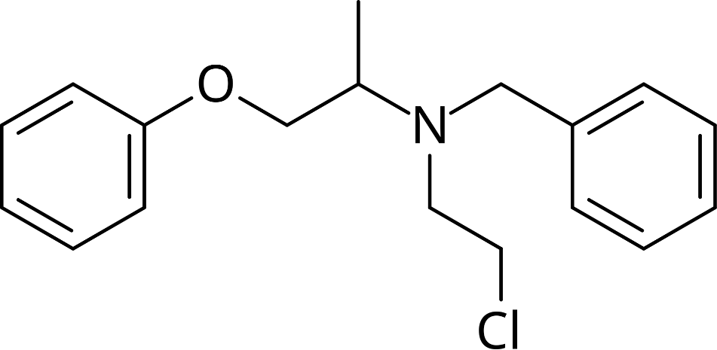
α-blockers (non-selective)
Phenoxybenzamine
irreversible alpha blocker
therapy of severe hypertension caused by pheochromocytoma

Slide 11
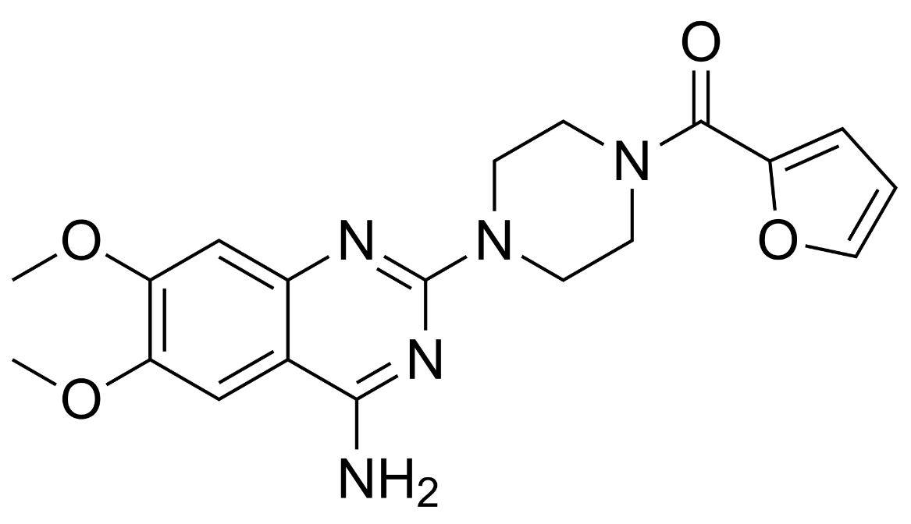
selective α₁-blockers
Prazosin
oral antihypertensive agent
enlarged prostate therapy
night-mares related to post-traumatic stress disorder
worse side effects compared to other derivatives

Slide 12
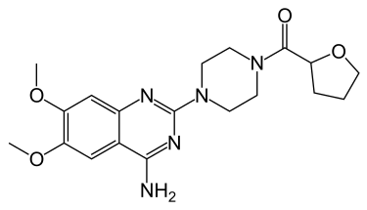
selective α₁-blockers
Terazosin
oral antihypertensive agent
enlarged prostate therapy

Slide 13
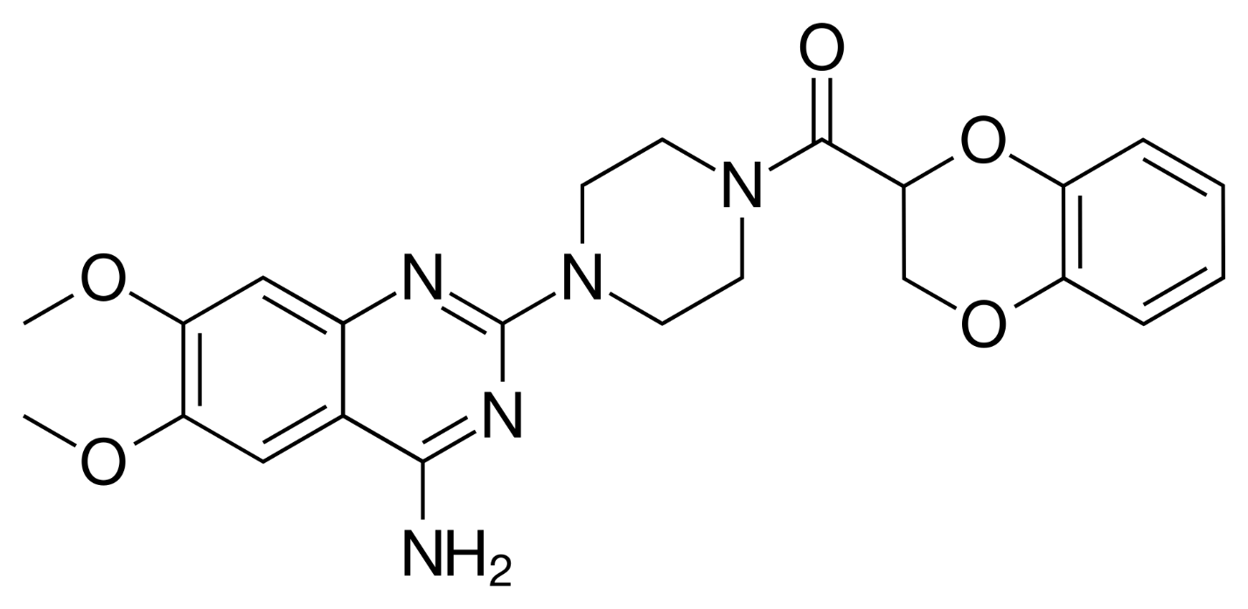
selective α₁-blockers
Doxazosin
oral antihypertensive agent
enlarged prostate therapy

Slide 14
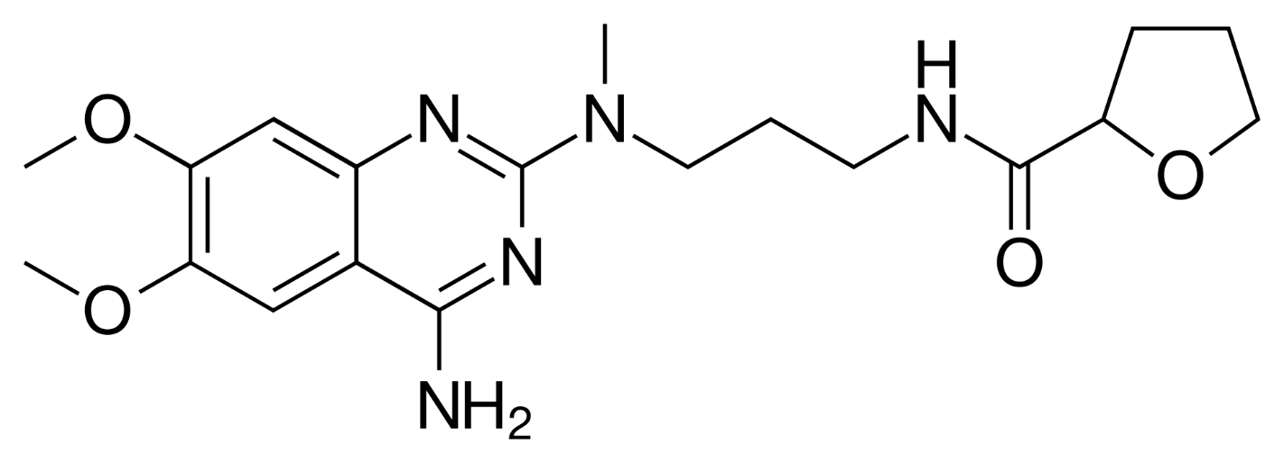
selective α₁-blockers
Alfuzosin
enlarged prostate therapy – decrease of urethral and prostatic tonus

Slide 15
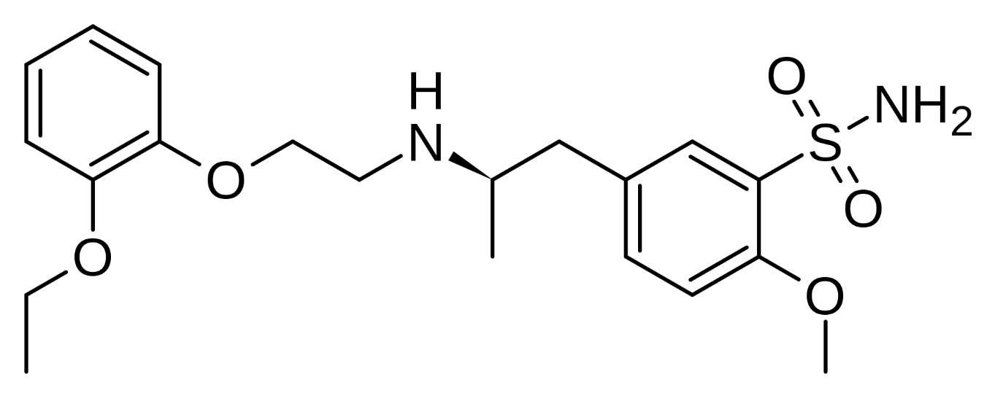
selective α₁-blockers
Tamsulosin
enlarged prostate therapy – decrease of urethral and prostatic tonus
helps with the passage of kidney stones

Slide 16
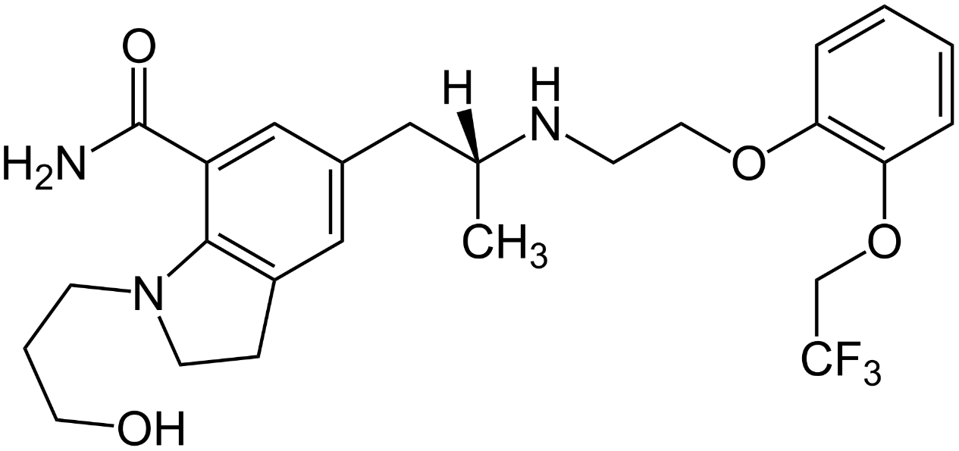
selective α₁-blockers
Silodosin
enlarged prostate therapy – decrease of urethral and prostatic tonus

Slide 17
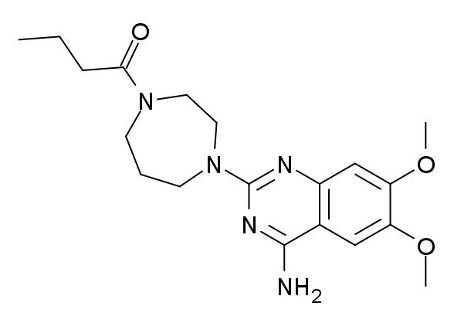
selective α₁-blockers
Bunazosin
topic application
glaucoma therapy
approved in Japan

Slide 18
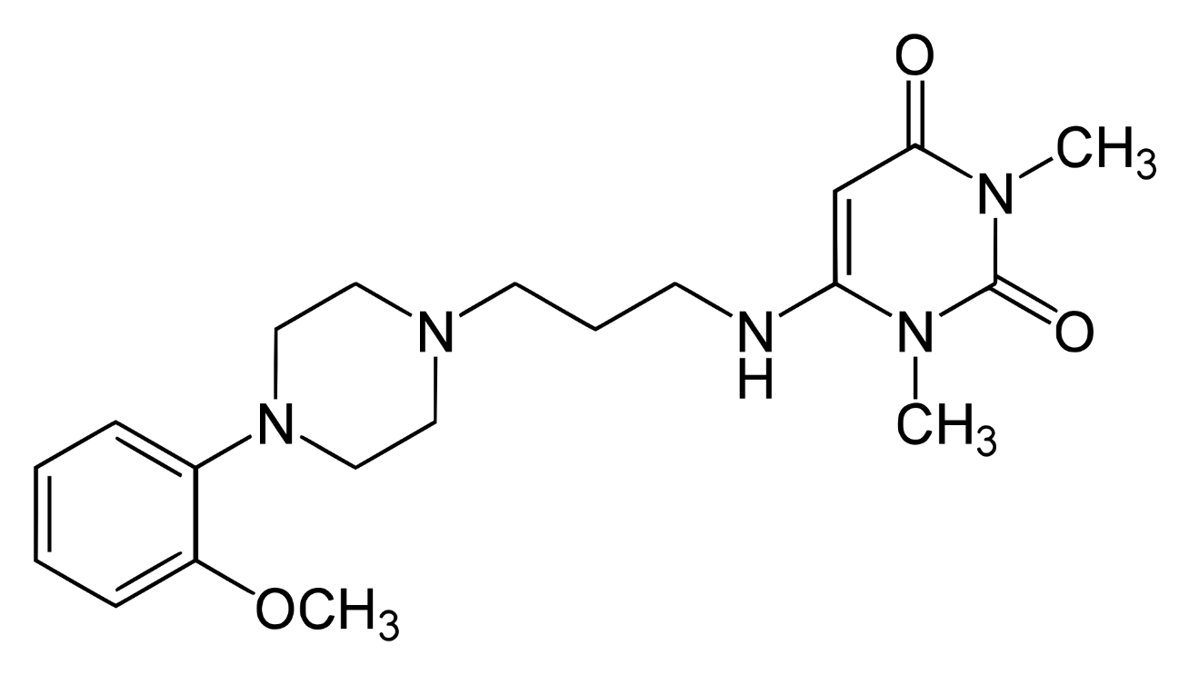
selective α₁-blockers
Urapidil
is also 5HT1A agonist – combined peripheral and central antihypertensive effect
arterial hypertension

Slide 19
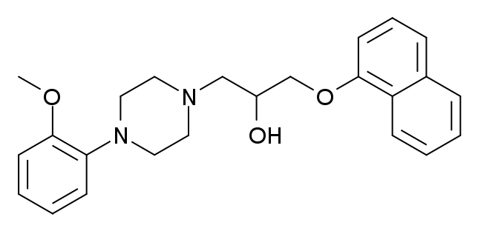
selective α₁-blockers
Naftopidil
enlarged prostate therapy – decrease of urethral and prostatic tonus

Slide 20
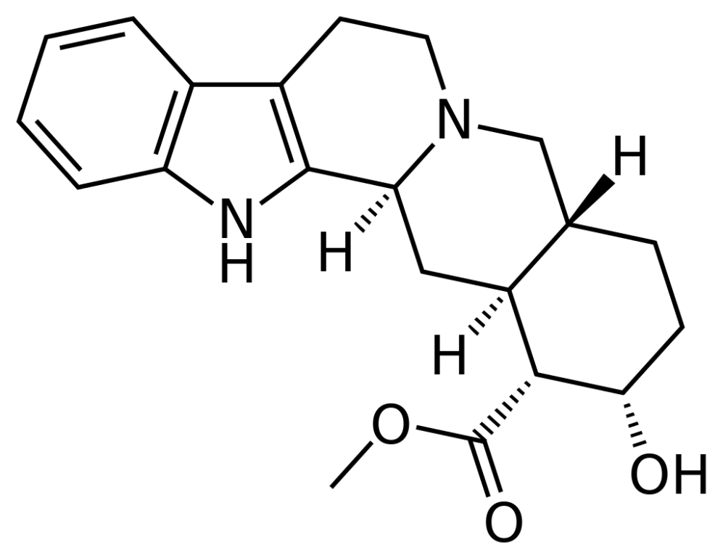
selective α₂-blockers
Yohimbine
specific increase of pelvic perfusion
therapy of erectile dysfunction
overcome by PDE V inhibitors

Slide 21
β-blockers
Current Use
Treatment
･Angina pectoris (chest pain associated with lack of oxygen to the heart)
･Arrhythmias (irregular heart rhythms)
･Heart attack
･Heart failure
･Hypertension (high blood pressure)
･Glaucoma
･Migraine

Slide 22
β-blockers
Current Use
Prevention
･Protects the heart in people who have coronary artery disease
･Reduces risk of stroke
･Prevents second myocardial infarction
･Protective prior to non-cardiac surgery in persons at high risk of complications
･Migraine prevention

Slide 23
β-blockers
SAR
Aryloxypropanolamines Arylethanolamines
(-propoxy-) spacer -O- can be replaced by isosteric
-COO-; -NHCOO- or =C=N- group
R1: isopropyl-, tertbutyl- or arylalkyl-
R2: various substituents
o-substitution or another ring = non-selective
p-substitution = cardio-selective

Slide 24
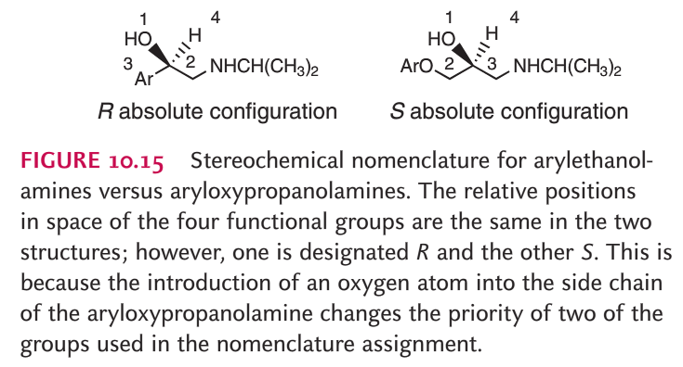
β-blockers
Absolute configuration

Slide 25
β-blockers
effect variation:
intrinsic sympatomimetic activity (ISA)
compounds with ISA partially stimulates adrenergic receptor,
but response is hundred times weaker
membrane stabilizing activity (MSA)
compounds with MSA acts like Na⁺ channel blockers (like local anesthetics) and such activity is useful for arrhythmia therapy
cardioselectivity
cardio-selective compounds prefer myocardial β₁-adrenergic
receptors and has reduced affinity to bronchial β₂-adrenergic receptors (no bronchial side-effects)

Slide 26
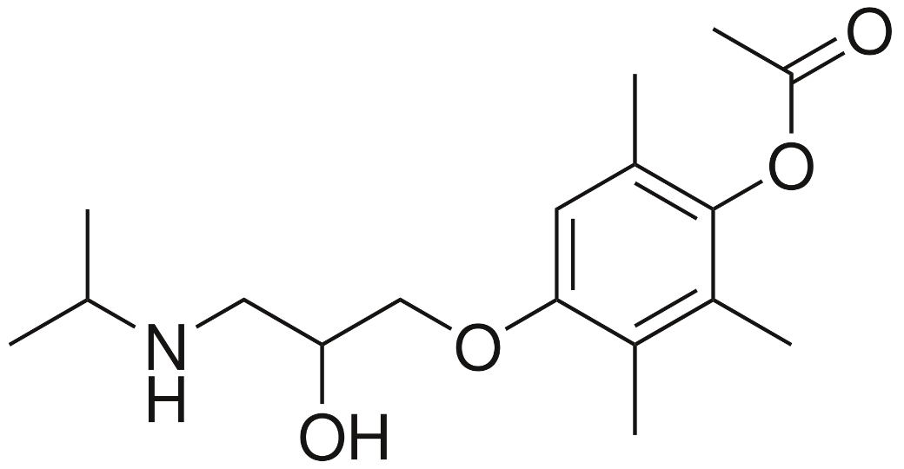
non-selective β-blockers without ISA, MSA
Metipranolol
in cardiology obsolent
glaucoma therapy

Slide 27
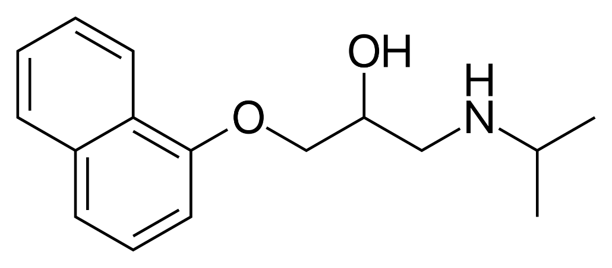
non-selective β-blockers without ISA, MSA
Propranolol
hypertension
angina pectoris
migraine prevention
arrhythmias

Slide 28
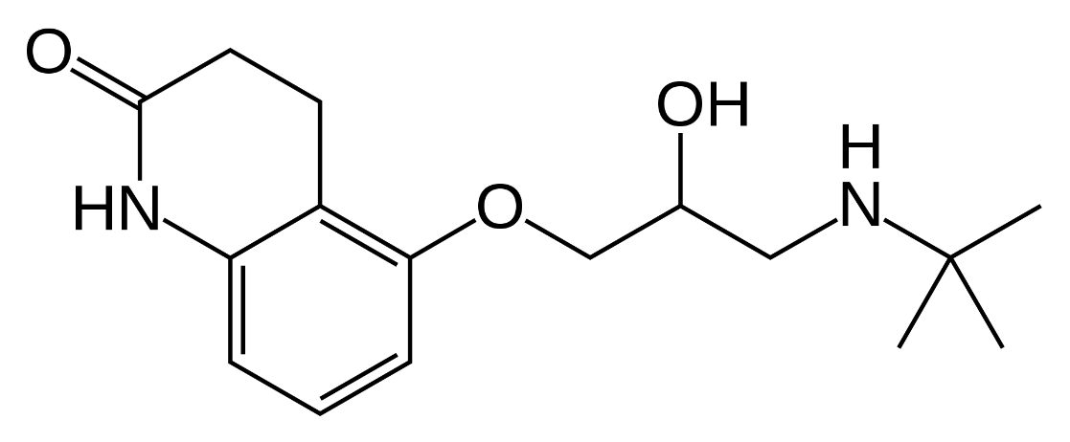
non-selective β-blockers without ISA, MSA
Carteolol
glaucoma

Slide 29
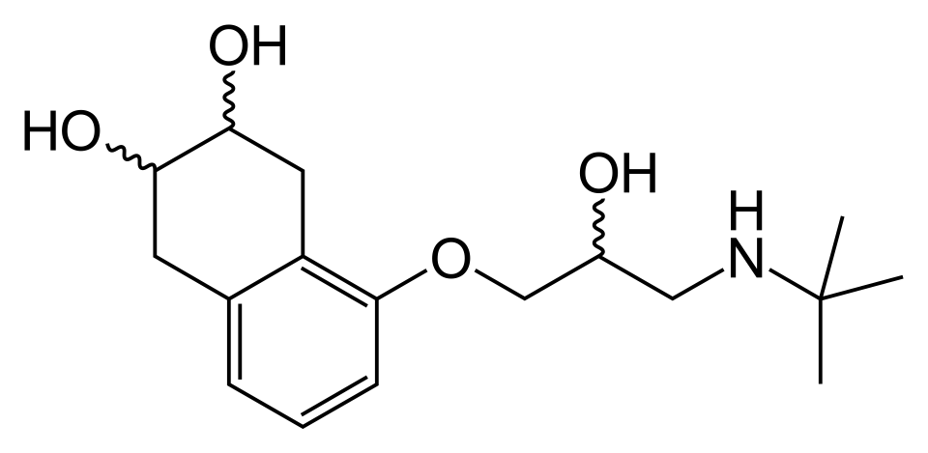
non-selective β-blockers without ISA, MSA
Nadolol
hypertension
arrhythmias
migraine
angina pectoris
used as racemic mixture

Slide 30
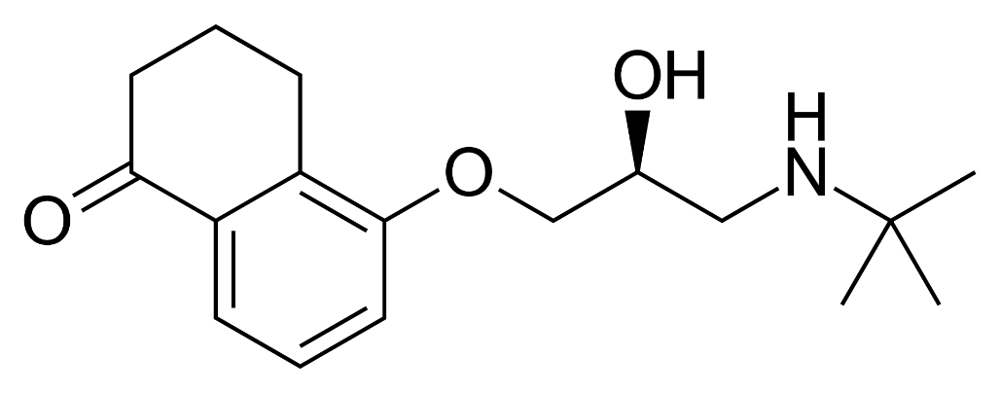
non-selective β-blockers without ISA, MSA
Levobunolol
glaucoma
pure L-bunolol

Slide 31
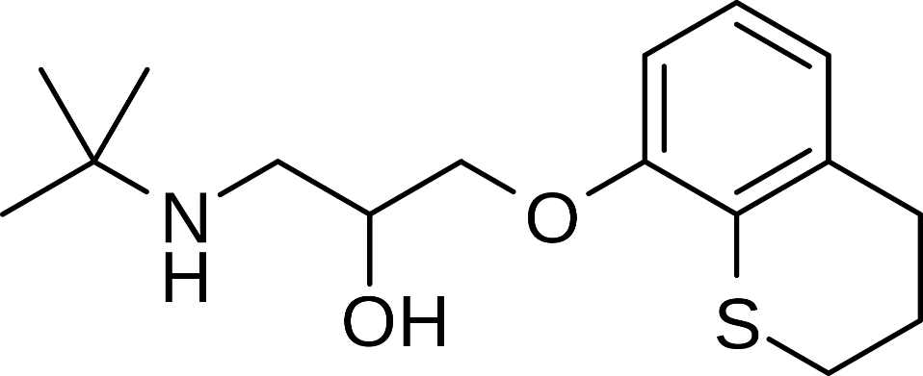
non-selective β-blockers without ISA, MSA
Tertatolol
antihypertensive

Slide 32
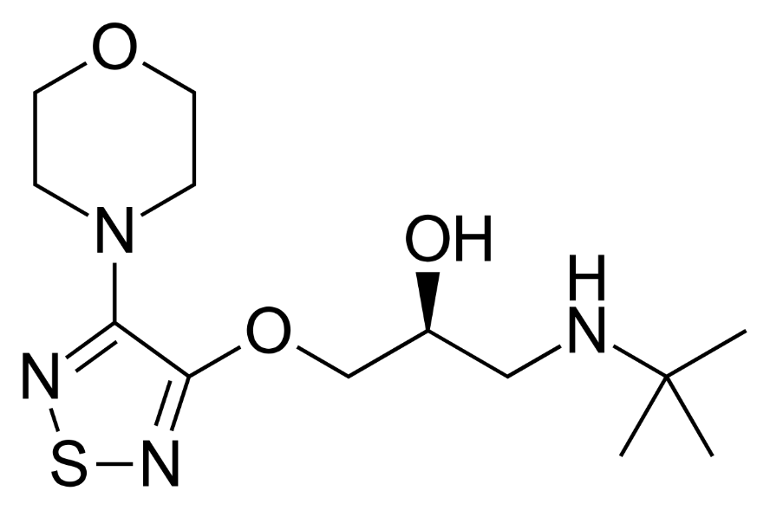
non-selective β-blockers without ISA, MSA
Timolol
antihypertensive
angina pectoris
migraine
glaucoma

Slide 33
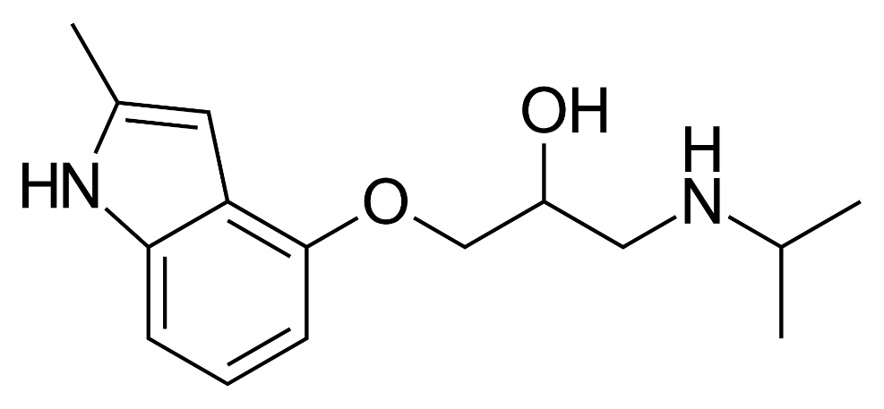
non-selective β-blockers without ISA, MSA
Mepindolol
glaucoma
not on the market

Slide 34
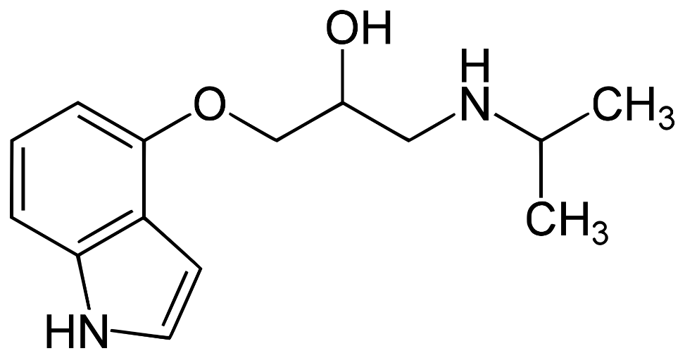
non-selective β-blockers with ISA
Pindolol
hypertension
arrhythmias
angina pectoris
combined with 5-HT1A inhibition

Slide 35
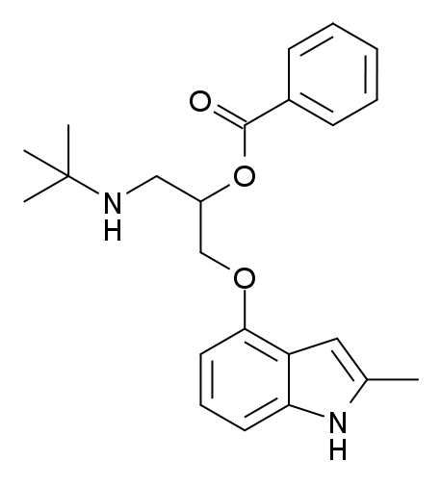
non-selective β-blockers with ISA
Bopindolol
hypertension
arrhythmias
angina pectoris
prodrug of dimethylpindolol

Slide 36
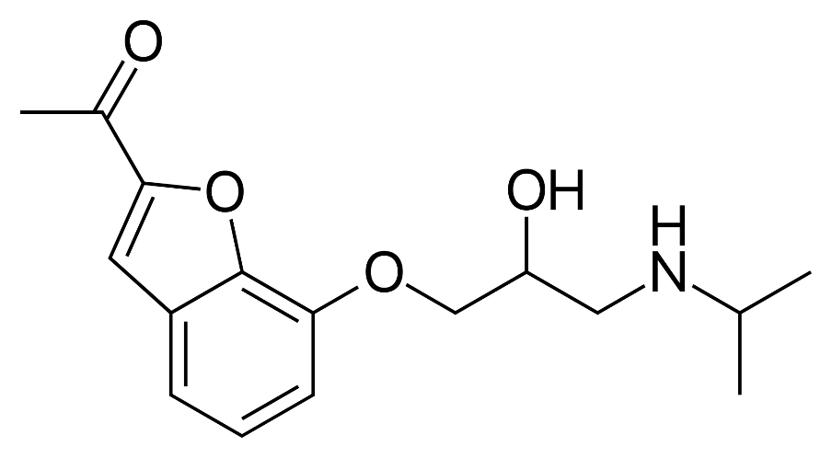
non-selective β-blockers with ISA
Befunolol
glaucoma
marketed in Japan

Slide 37
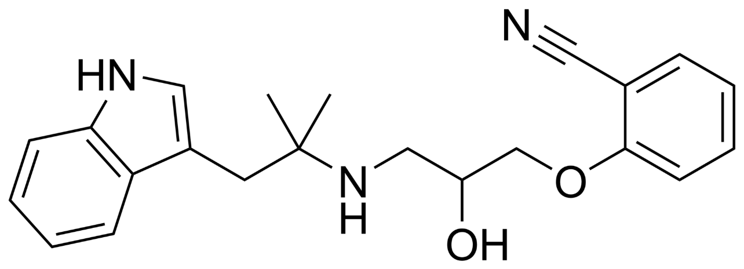
non-selective β-blockers with ISA
Bucindolol
phase III clinical trials
arrhythmias
combined effect on α₁ receptors

Slide 38
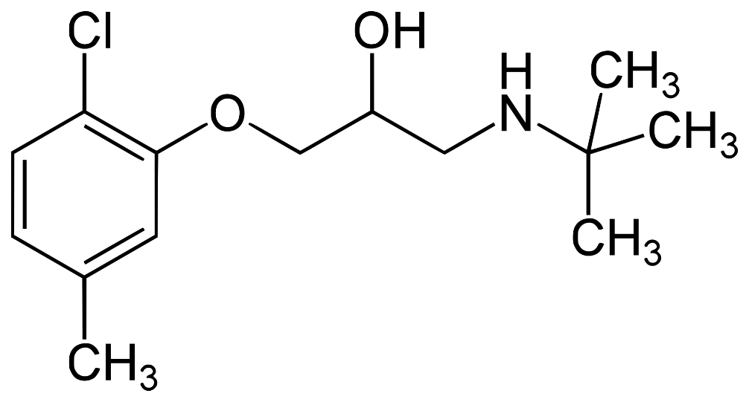
non-selective β-blockers with MSA
Bupranolol
hypertension
tachycardia
glaucoma

Slide 39
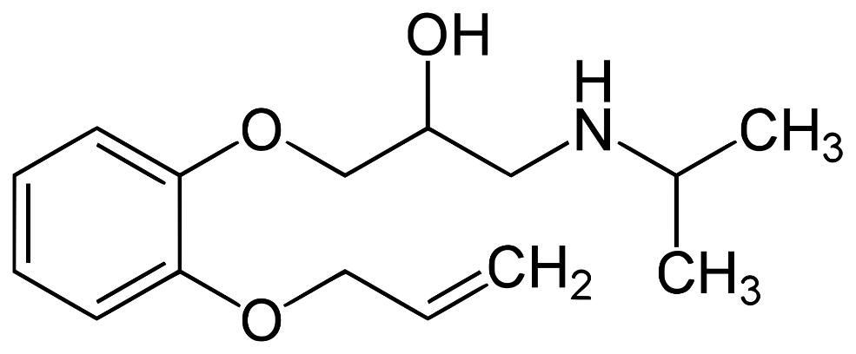
non-selective β-blockers with MSA
Oxprenolol
hypertension
tachycardia
angina pectoris

Slide 40
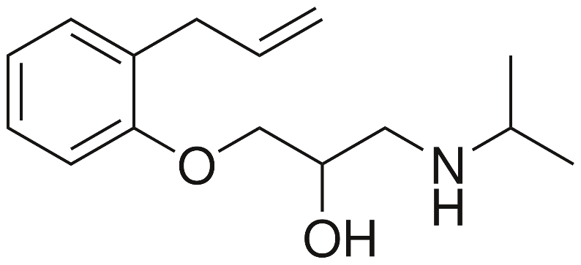
non-selective β-blockers with MSA, ISA
Alprenolol
angina pectoris
5HT1A + 5HT1B antagonist

Slide 41
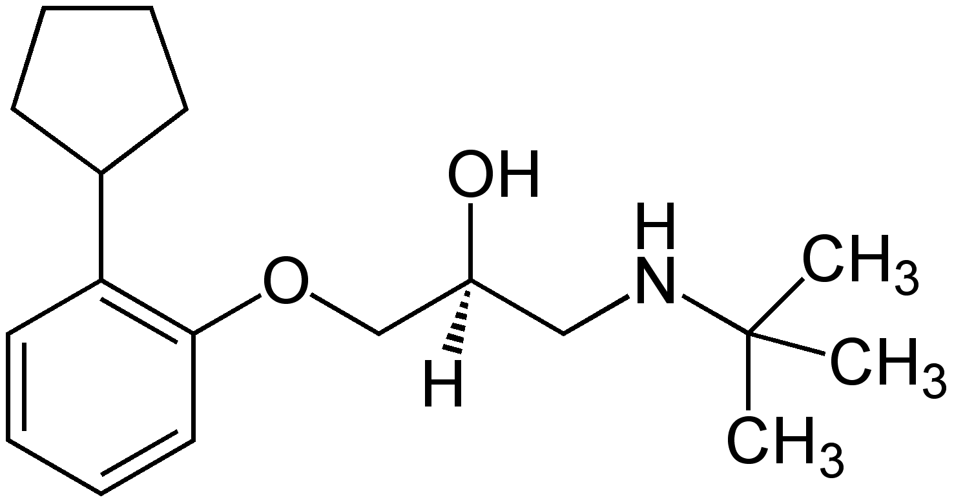
non-selective β-blockers with MSA, ISA
Penbutolol
hypertension
heart failure

Slide 42
selective β₁-blockers without ISA and MSA
Atenolol
hypertension
angina pectoris
migraine prevention
arrhythmias

Slide 43
selective β₁-blockers without ISA and MSA
Metoprolol
hypertension
angina pectoris
migraine prevention
arrhythmias
myocardial infarction

Slide 44
selective β₁-blockers without ISA and MSA
Betaxolol, Levobetaxolol
hypertension
glaucoma - levobetoxalol

Slide 45
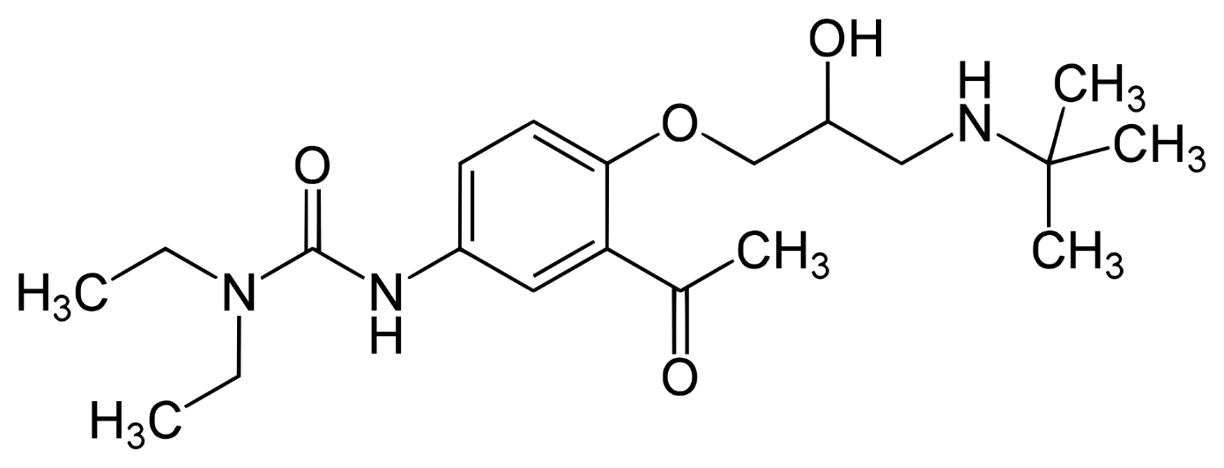
selective β₁-blockers without ISA and MSA
Celiprolol
β₂ agonist, α₂ antagonist
hypertension

Slide 46
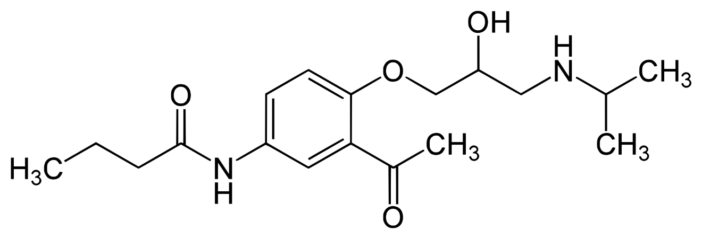
selective β₁-blockers without ISA and MSA
Acebutolol
hypertension
arrhythmias

Slide 47
selective β₁-blockers without ISA and MSA
Nebivolol
hypertension
heart failure

Slide 48
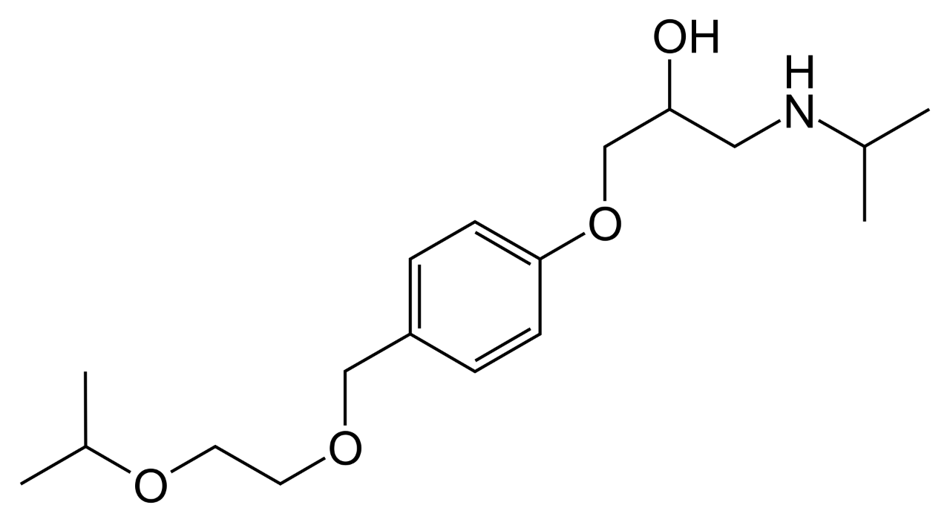
selective β₁-blockers with MSA
Bisoprolol
hypertension
heart failure
angina pectoris
arrhythmias

Slide 49
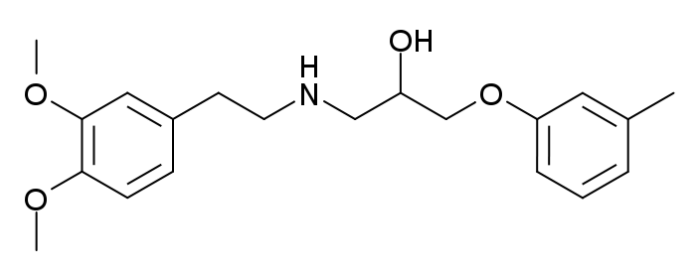
selective β₁-blockers with MSA
Bevantolol
hypertension
Ca²⁺ channel blocking activity
no longer on the market

Slide 50
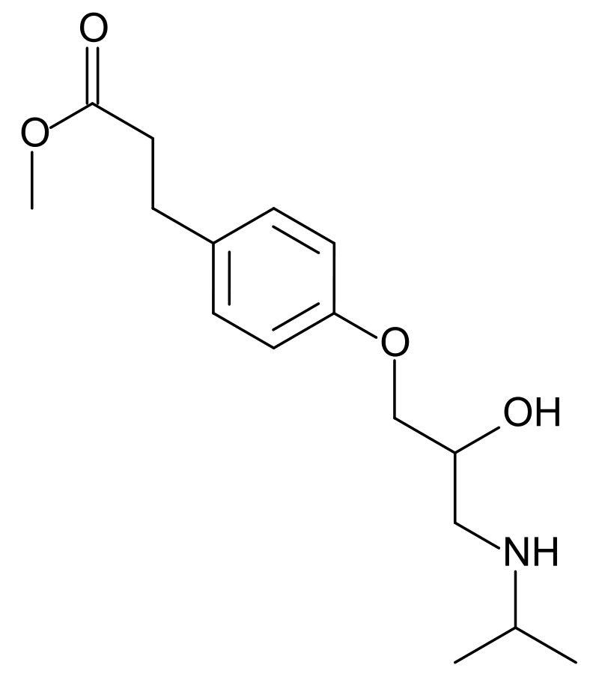
ultra-short-acting β-blockers
Esmolol
myocardial infarction
arrhythmias
half-time 9 min
intravenous application

Slide 51
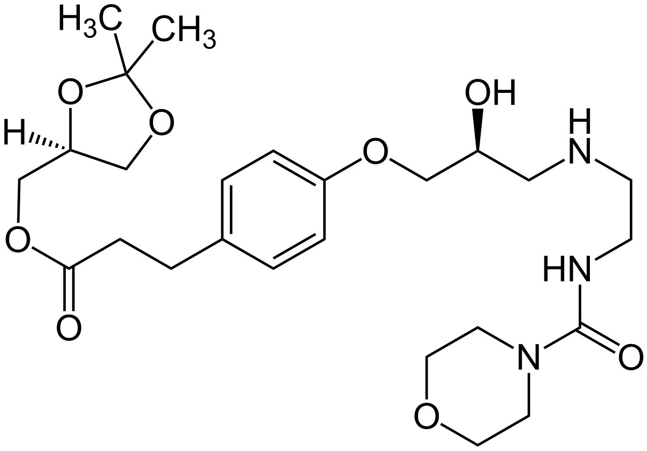
ultra-short-acting β-blockers
Landiolol
myocardial infarction
arrhythmias
half-time 3-4 min
intravenous application

Slide 52
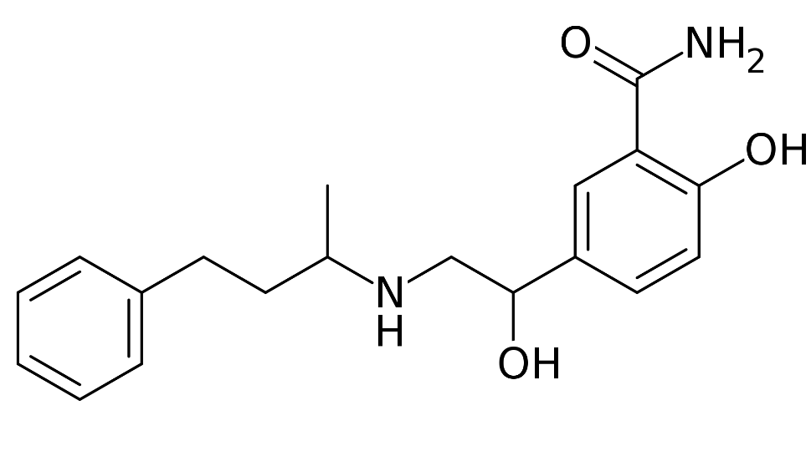
combined α- and β-blockers
Labetalol
hypertension
pregnancy-induced hypertension

Slide 53
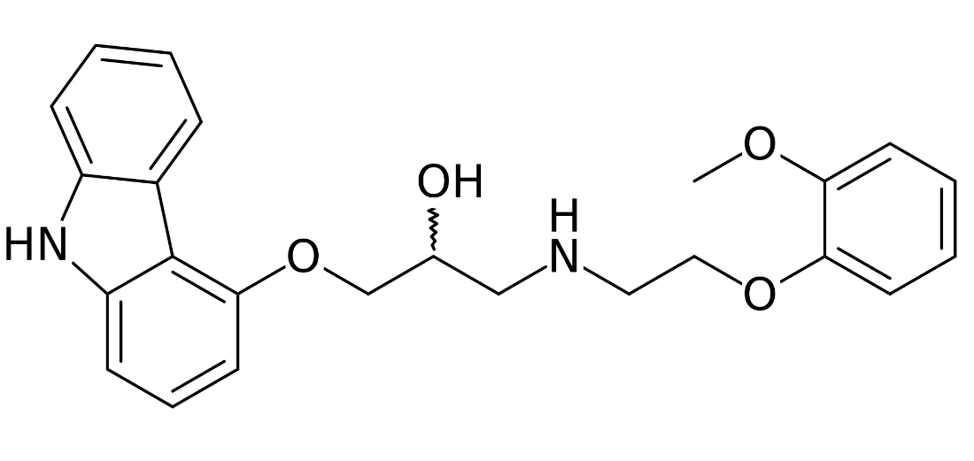
combined α- and β-blockers
Carvedilol
hypertension
heart failure

Slide 54
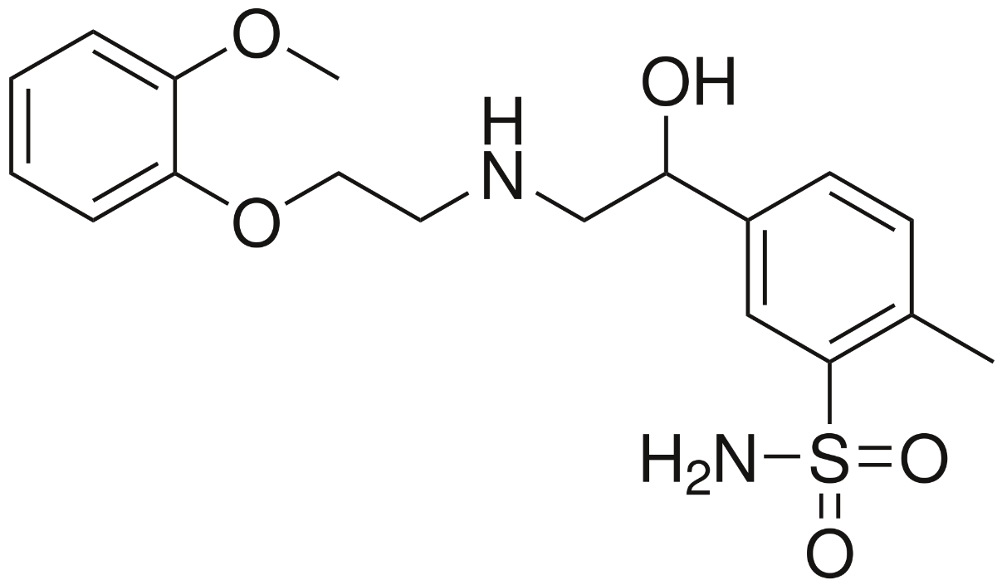
combined α- and β-blockers
Amosulalol
hypertension
more active on α₁ receptors, less on β receptors
marketed in Japan and Korea

Slide 55
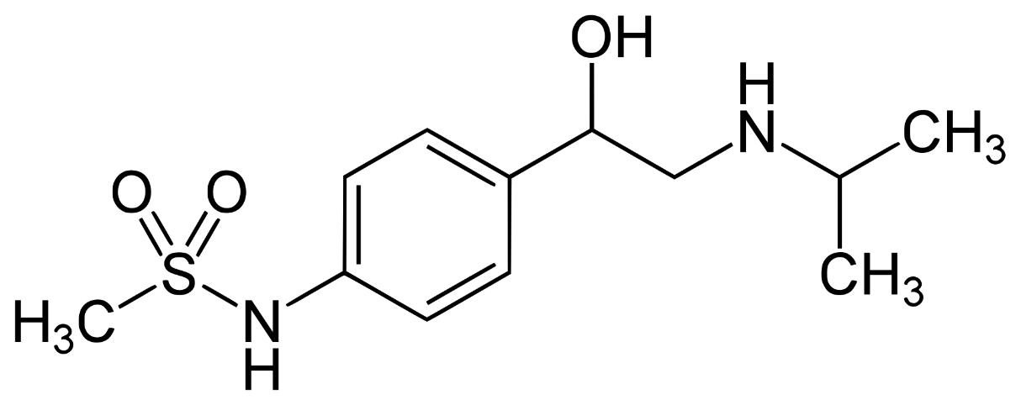
β-blockers with K⁺channel blocking activity
Sotalol
arrhythmias

Slide 56
Thank You for Your attention

