Slide 1
Adrenergic receptor antagonists
Seminar
Tomáš Goněc 2020

Slide 2
Synthesis of selected compounds
Tolazoline synthesis

Slide 3
Synthesis of selected compounds
Prazosin synthesis

Slide 4
Synthesis of selected compounds
Propranolol synthesis – two general methods used in other
betablockers synthesis as well

Slide 5
Synthesis of selected compounds
Metoprolol synthesis

Slide 6
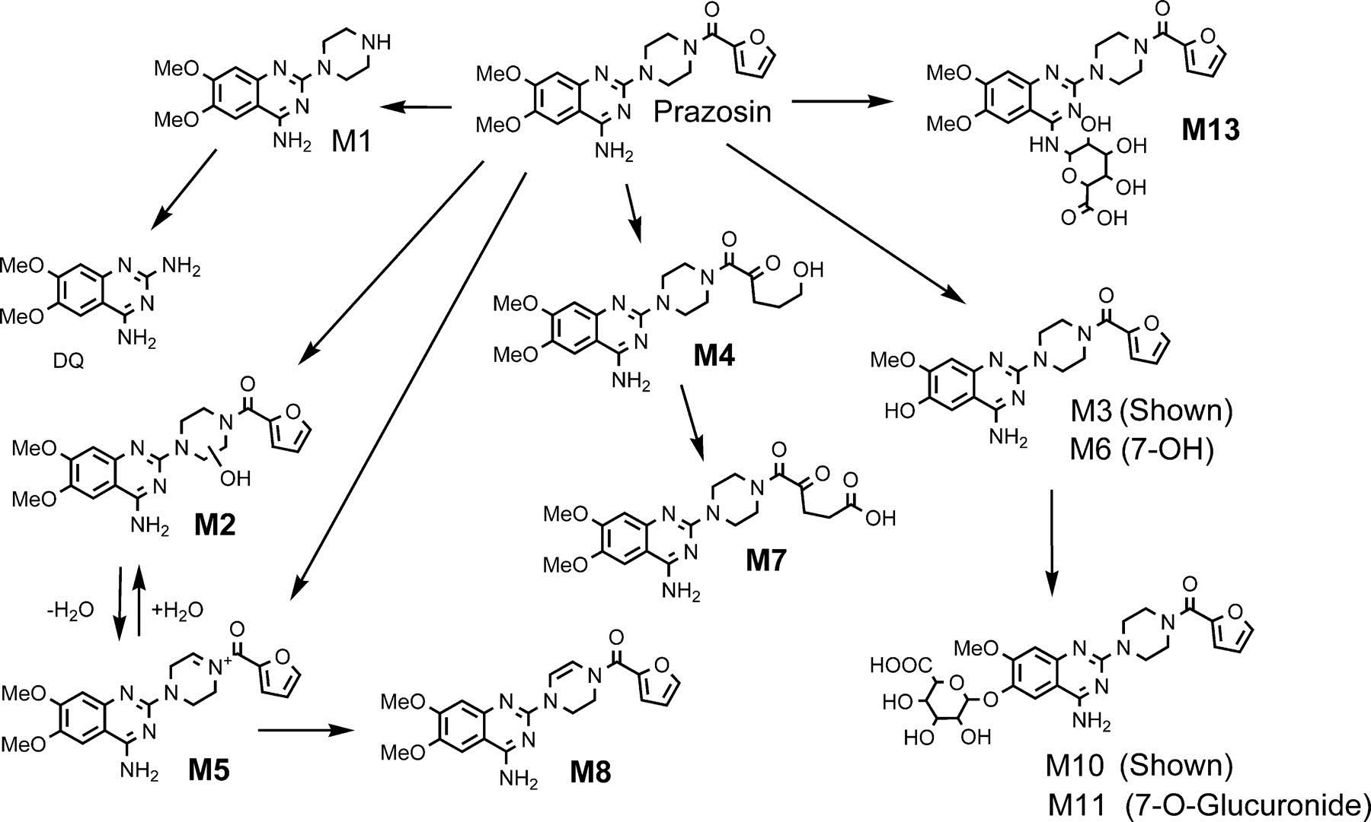
Metabolism of Prazosin

Slide 7
Metabolism of Urapidil

Slide 8
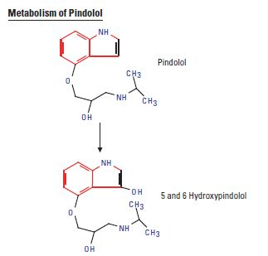
Metabolism of Pindolol

Slide 9
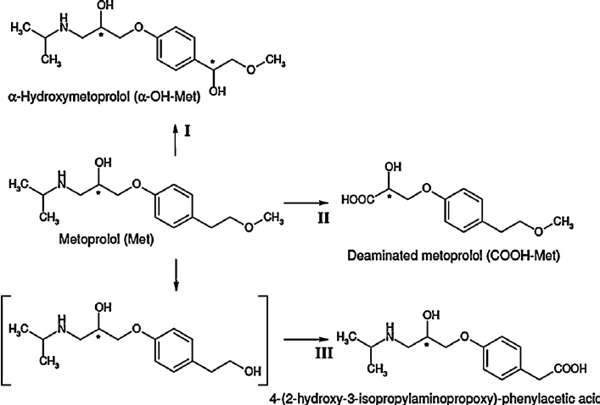
Metabolism of Metoprolol

Slide 10
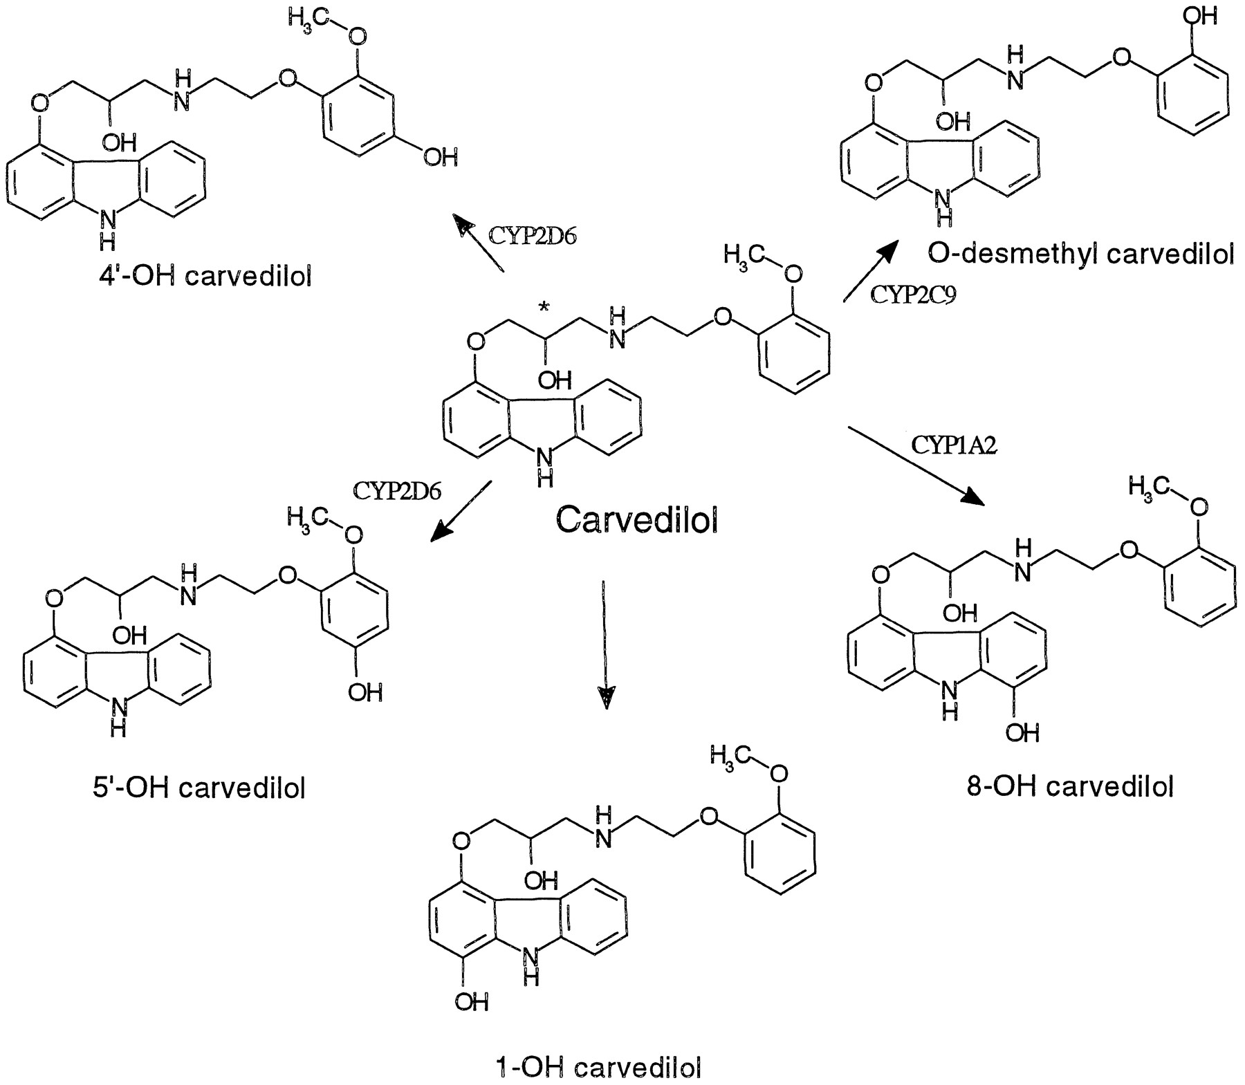
Metabolism of Carvedilol

