Slide 1
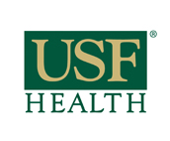
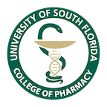
Nano based value care solutions for Oncology practices with focus on herbal and nutraceuticals
Yashwant V Pathak
M Pharm, Executive MBA, MSCM, PhD, FAAAS
Professor and Associate Dean for Faculty Affairs,
USF Health Taneja College of Pharmacy, University of South Florida, 12901 Bruce B Downs Blvd, MDC 030 , Tampa FL 33612, USA
What’s app/ Cell Tel: 713-302-3765
E mail: ypathak1@usf.edu
All the figures are taken from various web sources just to explain the ideas and concepts not to be used for sale or any other purpose except teaching

Slide 2
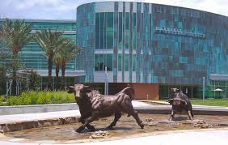
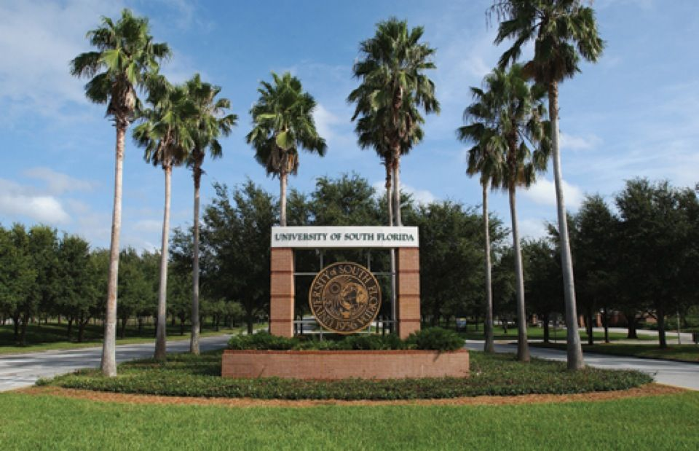
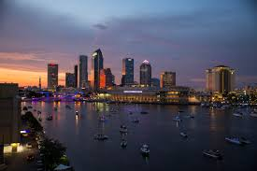
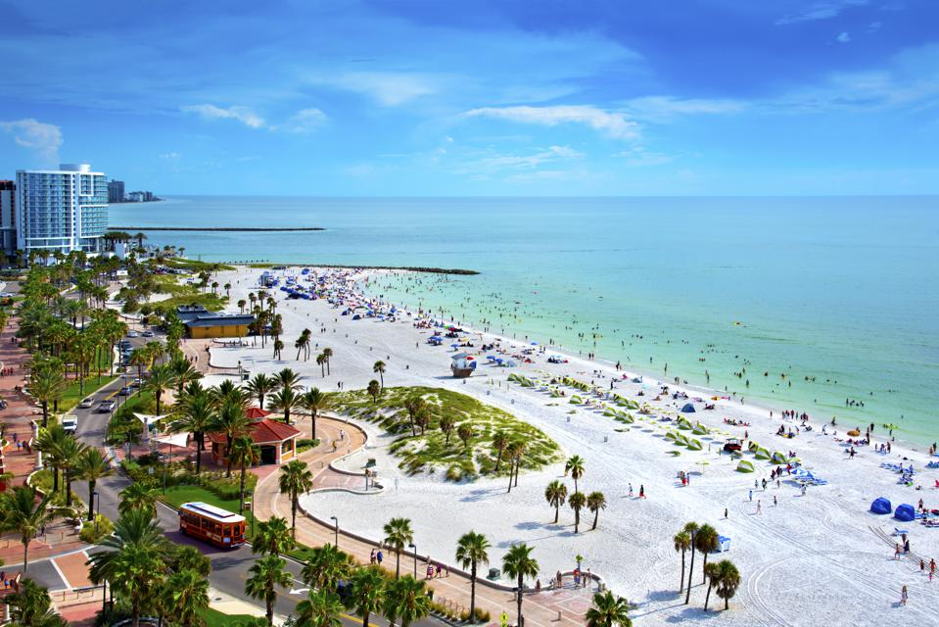
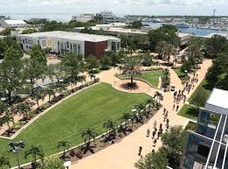

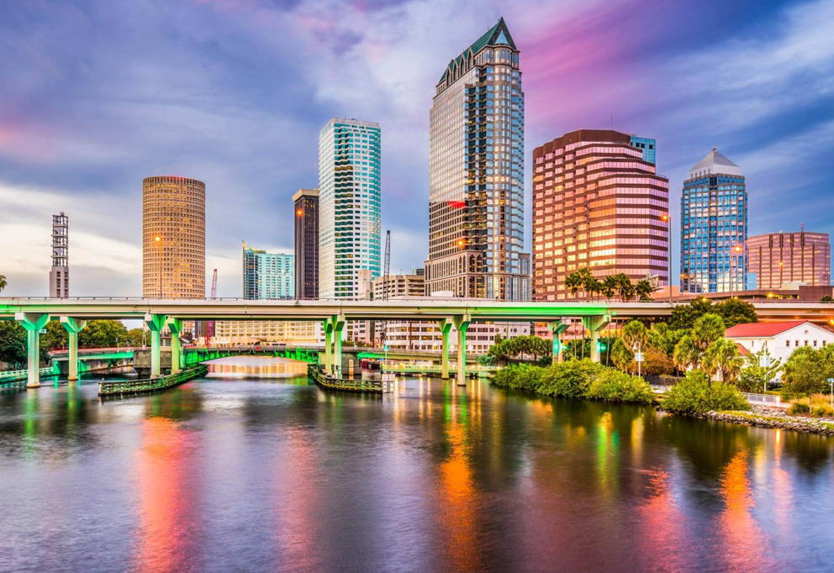

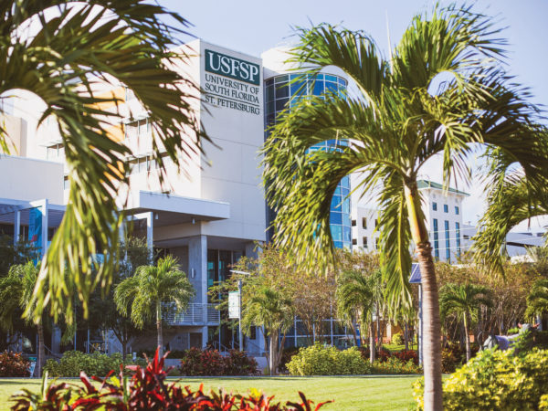
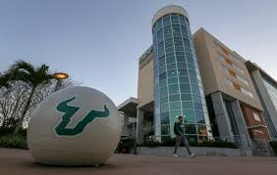
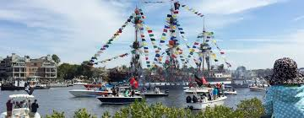
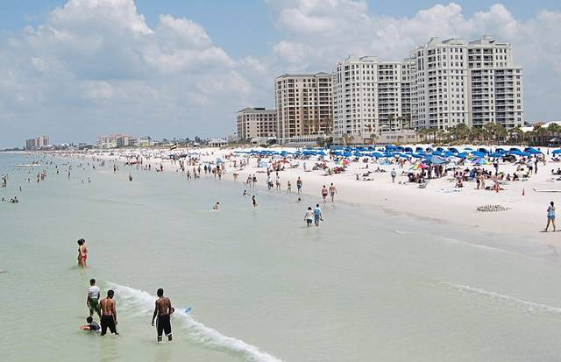
Greetings from USF , Tampa, Florida, USA

Slide 3
Nano based value care solutions for Oncology practices with focus on herbal and nutraceuticals
My Presentation is divided in three subheadings:
1. Value based Oncology care
2. Nanomedicine in Cancer Treatment: Recent Developments and Future Trend
3. Herbal and Nutraceuticals for value-based Oncology care (helping patients and reducing costs for cancer care )

Slide 4
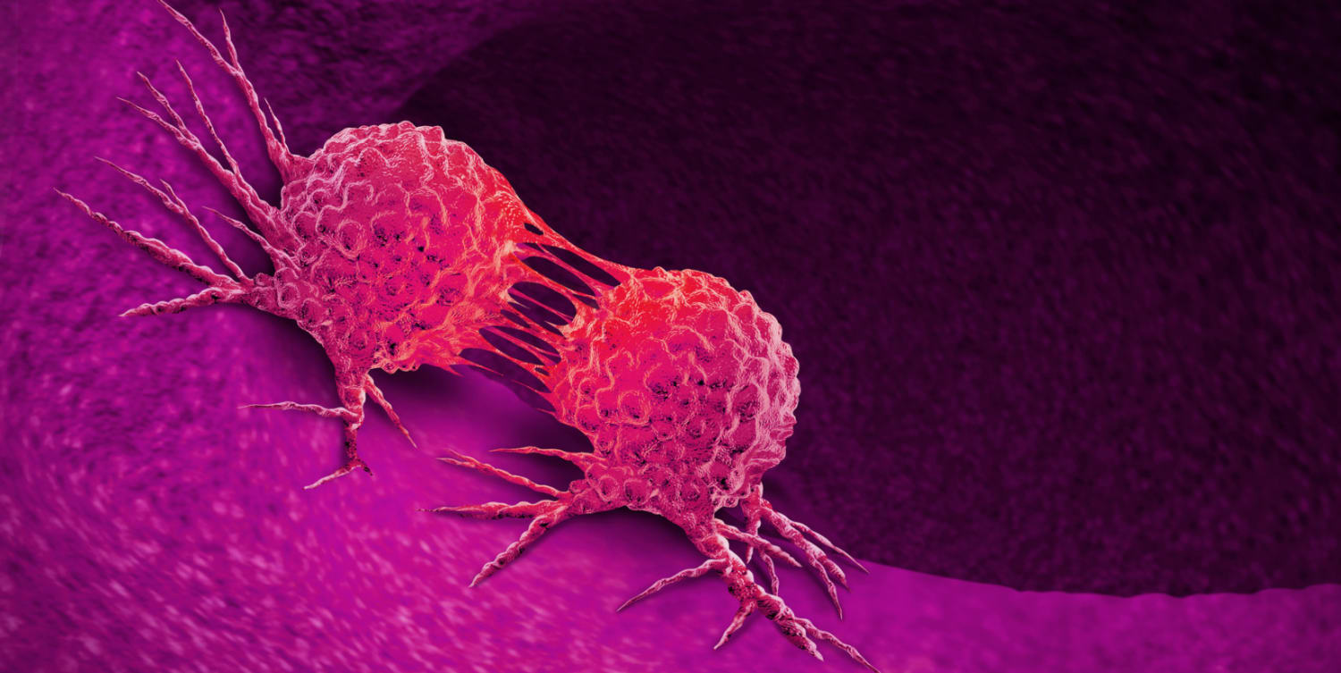
Value based Oncology care
Oncology practices are facing new challenges in an evolving healthcare landscape including the transition to value-based care, policy and reimbursement changes and increasing financial pressure.
Under value-based payment models, such as the Oncology Care Model (OCM), oncology practices are challenged to manage costs while continuing to deliver high-quality care.
Practices participating in OCM or preparing for the Oncology Care First (OCF) model are seeking new solutions that can help them optimize their practice and succeed in value-based reimbursement models.
Figure taken from
https://www.everydayhealth.com/cancer/guide/

Slide 5
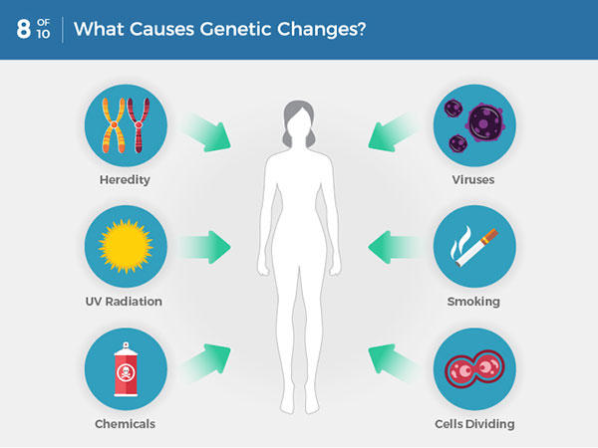
Understanding cancer in simple words
Cancer is a broad term used to describe many different diseases. In general, cancer happens when abnormal cells in your body grow out of control and crowd out normal cells.
It can start almost anywhere. Cancer can stay in one spot, or it can metastasize — spread throughout your body. Some cancers grow slowly, while others grow quickly.
Most cancers are named for where they start in the body. For instance, “breast cancer” begins in your breast tissue.
Many cancers form solid tumors, which are growths of tissue. But blood cancers, such as leukemia, don’t generally grow as tumors; they stay in the form of individual cells. Tumors can be either malignant (cancerous) or benign (noncancerous).
Taken from https://www.everydayhealth.com/cancer/guide/

Slide 6
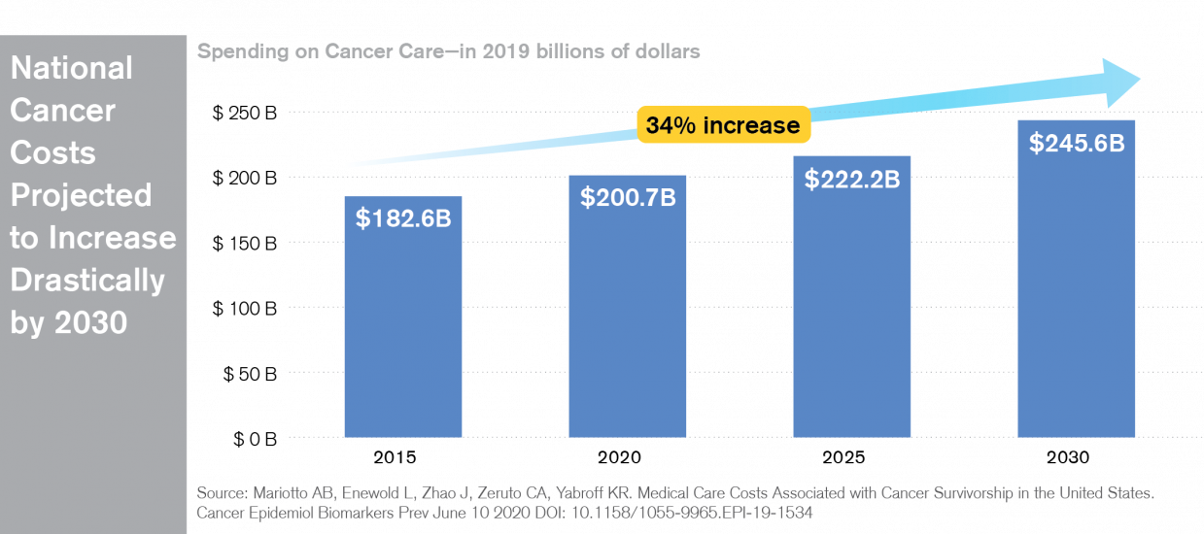
Rising costs of Oncology practices

Slide 7
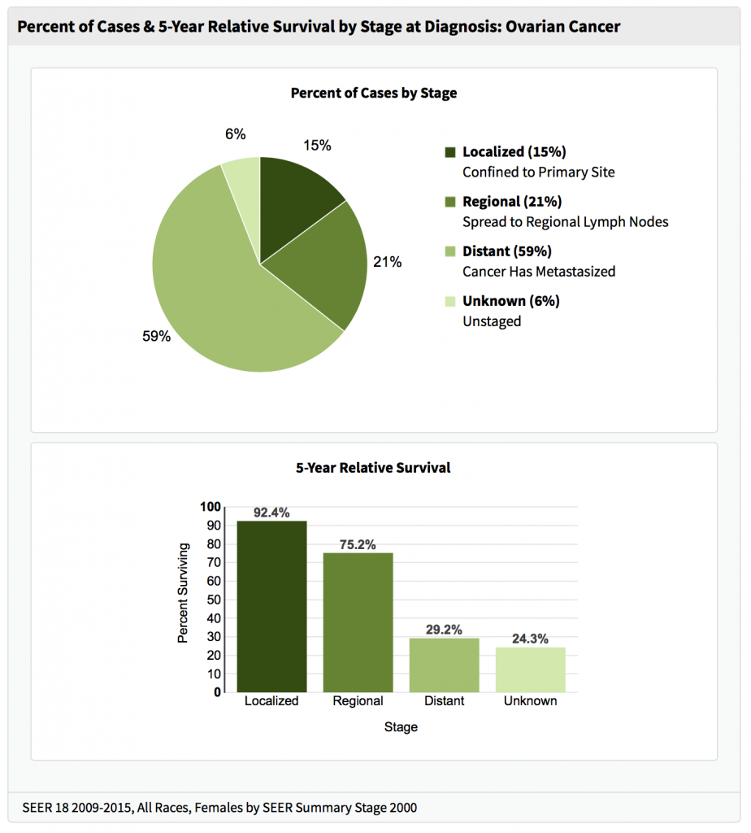
Cancer survival rates are improving
As cancer survival rates rise, so do the price tags of life-saving treatments. Monthly drugs costs may reach $100,000, causing many Americans to struggle with the physical and emotional effects of high out-of-pocket medical costs. Even worse, others are completely priced out of the hope for a cure.

Slide 8
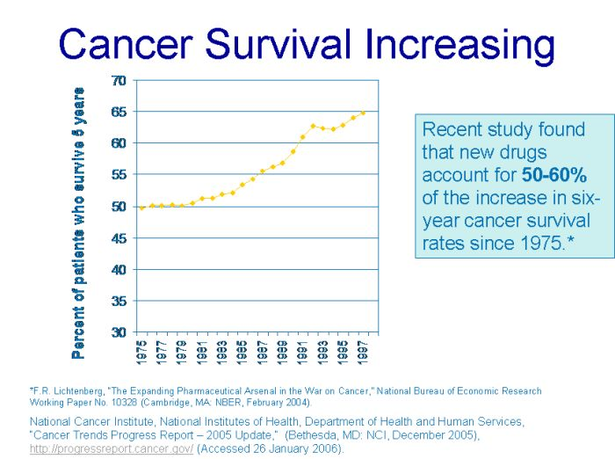
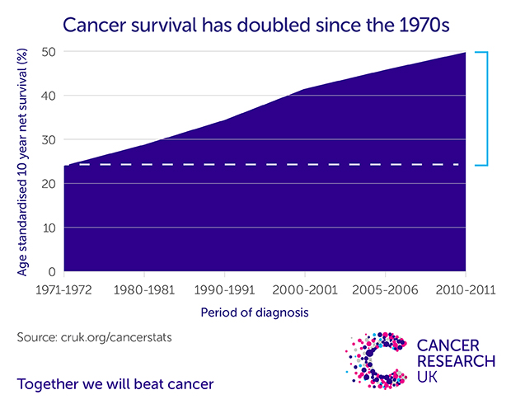
Cancer survival rates are improving
According to a 2019 survey conducted by The Mesothelioma Center at Asbestos.com, the nation's most trusted mesothelioma resource, 63% of cancer patients and loved ones reported financial struggles following a cancer diagnosis.
Source: The Mesothelioma Center at Asbestos.com, 2019

Slide 9
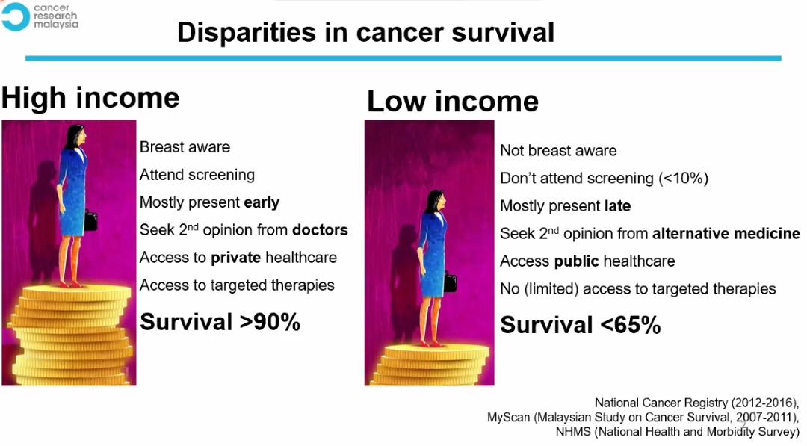
Cancer survival rates are improving
Low-income families, Americans who are uninsured or underinsured, and blue-collar workers who face medical bills more than four times their annual salaries cannot afford the rising costs of cancer treatments.
Taken from https://www.asbestos.com/featured-stories/high-cost-of-cancer-treatment/

Slide 10
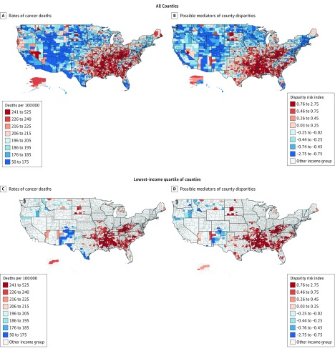
Income disparity and cancer
They found significant variation in cancer death rates across income groups, with a mean (SD) rate of 229.7 (32.9) deaths per 100 000 person-years in low-income counties vs 204.9 (26.3) (difference, 24.8; 95% CI, 22.4-27.4) and 185.9 (24.4) (difference, 43.8; 95% CI, 41.0-46.7) per 100 000 person-years in medium- and high-income counties, respectively (P < .001 for all pairwise comparisons).
They found geographic clusters, or hot spots, with the highest cancer death rates in the South, including the Mississippi River Delta, in addition to Appalachia (n = 507 counties in hot spots at a threshold of P < .05) Many of these hot spots were constituted with low-income counties
Taken from https://www.ncbi.nlm.nih.gov/pmc/articles/PMC6324449/#:~:text=We%20found%20significant%20variation%20in,person%2Dyears%20in%20medium%2D%20and

Slide 11
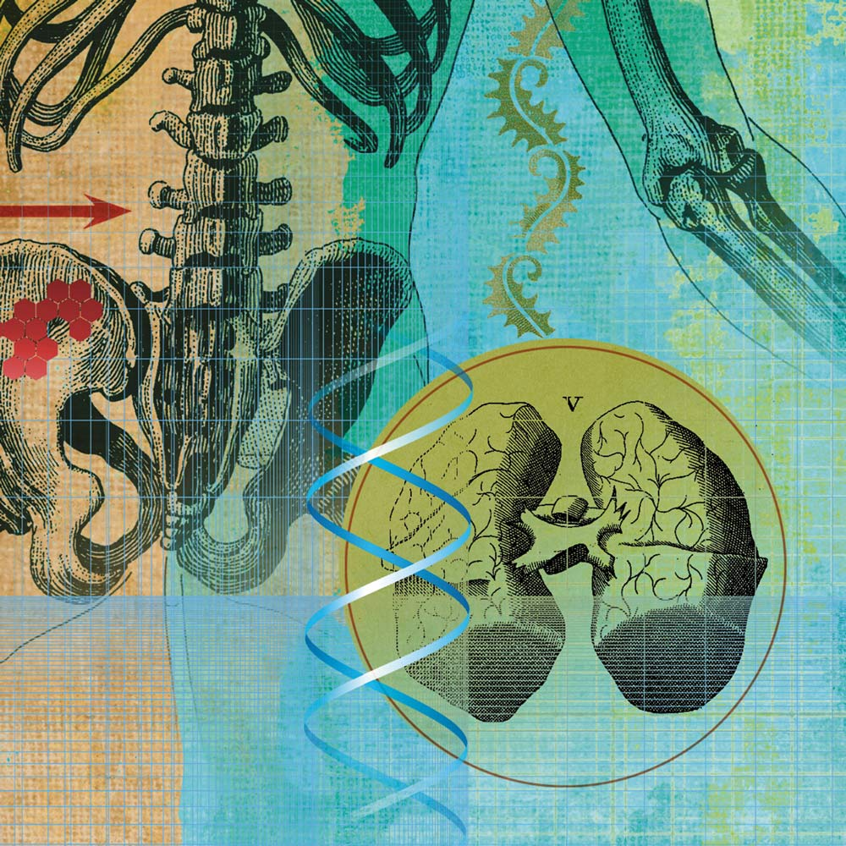
US cancer Epidemic at a glance
1,806,590
estimated new cancer cases will be diagnosed in 2020.
Source: American Cancer Society, 2020
606,520
are expected to die from cancer in 2020.
Source: American Cancer Society, 2020
40.1%
probability men in U.S. will face an invasive cancer diagnosis in their lifetime.
Source: American Cancer Society, 2020

Slide 12
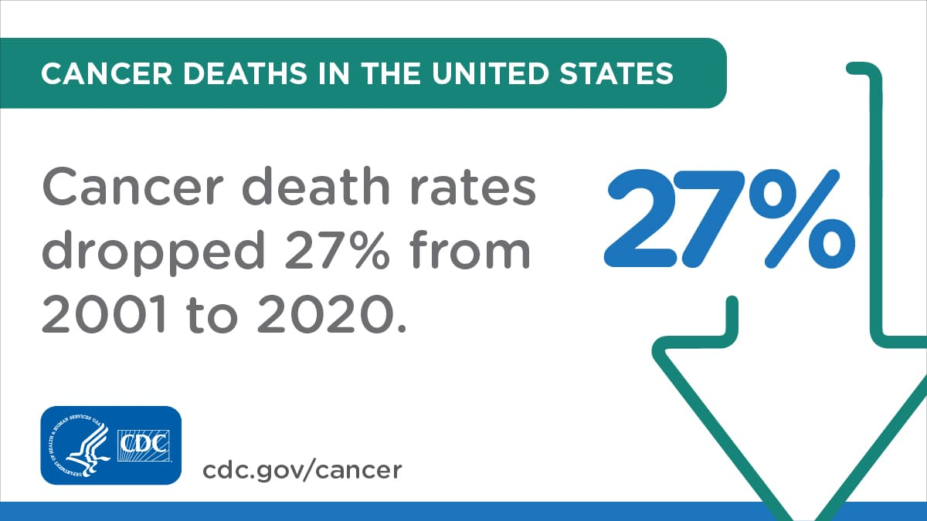


US cancer Epidemic at a glance
60%
of cancer patients
are 65 and older.
Source: American Society of Clinical Oncology
2nd
leading cause of death in US is cancer behind heart disease.
Source: Centers for Disease Control and Prevention
$150.8 billion
were spent nationally for cancer care in 2018.
Source: National Cancer Institute, 2019

Slide 13

Post operative cost
"People often only think up to surgery, but post-operative care is where the higher costs are. Dealing with complications and covering costs of scans, home care and follow-up treatments such as chemotherapy is when it gets really expensive."
Missy Miller
Medical Outreach Director at The Mesothelioma Center
Taken from https://www.asbestos.com/featured-stories/high-cost-of-cancer-treatment

Slide 14
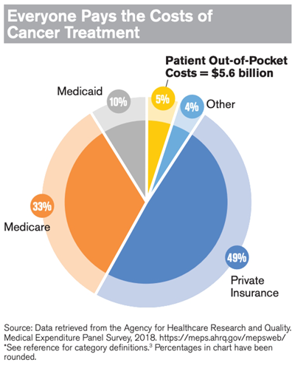
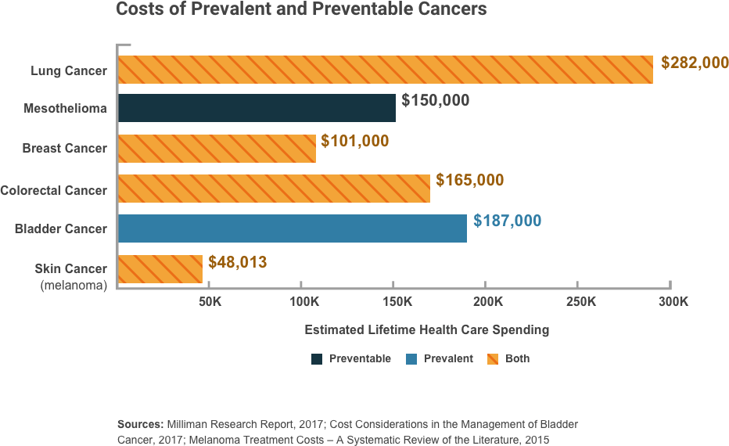
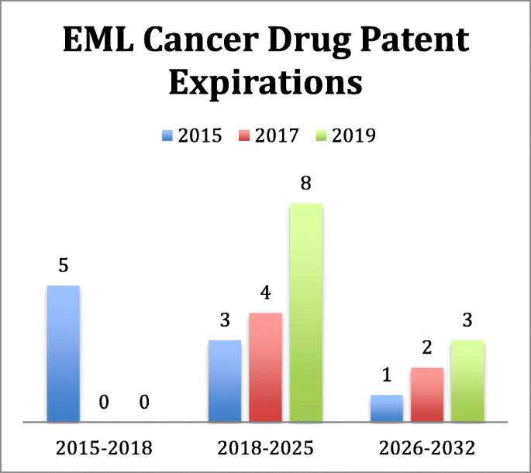
Cancer and costs involved

Slide 15
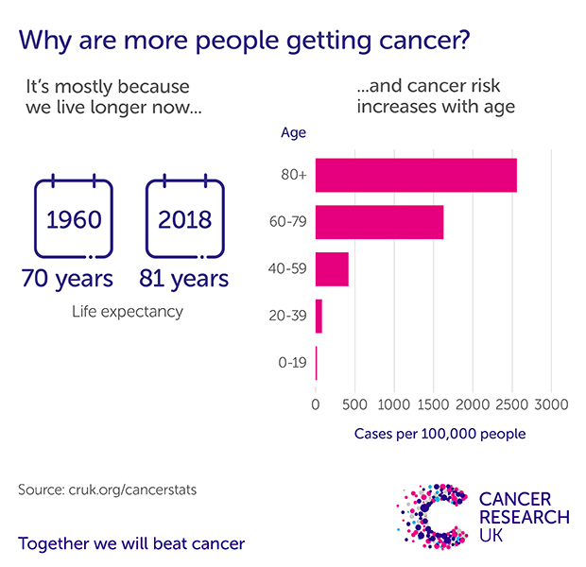
Figure taken from https://news.cancerresearchuk.org/2015/02/04/why-are-cancer-rates-increasing/

Slide 16
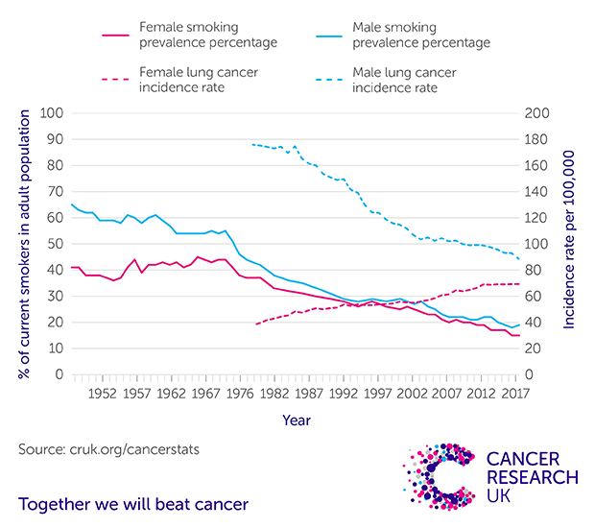
Figure taken from https://news.cancerresearchuk.org/2015/02/04/why-are-cancer-rates-increasing

Slide 17
Value of cancer care
As cancer survival rates rise, so do the price tags of life-saving treatments. Monthly drugs costs may reach $100,000, causing many Americans to struggle with the physical and emotional effects of high out-of-pocket medical costs. Even worse, others are completely priced out of the hope for a cure.

Slide 18

Income and cancer expenses
According to a 2019 survey conducted by The Mesothelioma Center at Asbestos.com, the nation's most trusted mesothelioma resource, 63% of cancer patients and loved ones reported financial struggles following a cancer diagnosis.
Source: The Mesothelioma Center at Asbestos.com, 2019
Average monthly cost of cancer treatments
Chemotherapy
$ 1000-12000
Radiation
$ 9000
Immunotherapy
$ 10,000-20,000
Average Monthly income Pretax
$ 3600

Slide 19
Nanomedicine in Cancer Treatment: Recent Developments and Future Trend

Slide 20
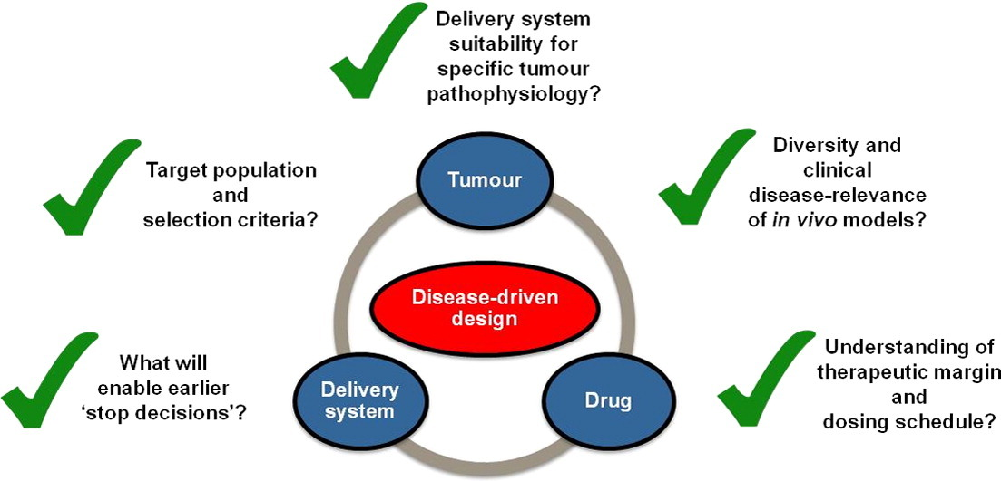
Anticancer nano medicine development
Challenges and strategies in anti-cancer nano-medicine development: An industry perspective,
JI Hare et al, Advanced Drug Delivery reviews , 208, 25-38, 2017

Slide 21

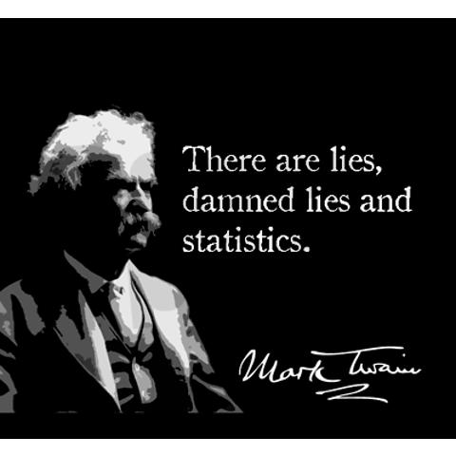
Statistical data

Slide 22
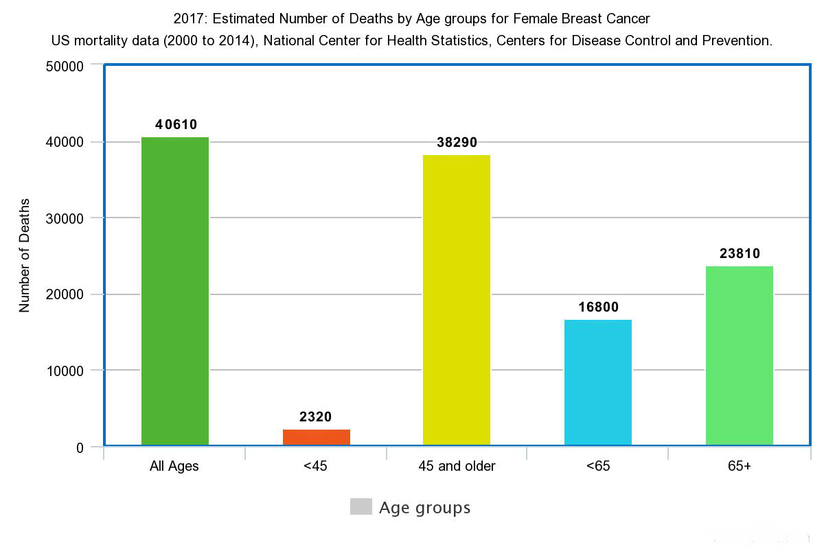
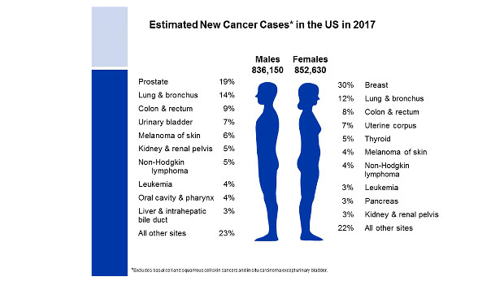

Slide 23
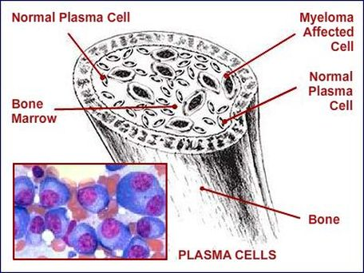
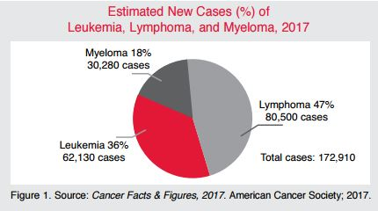
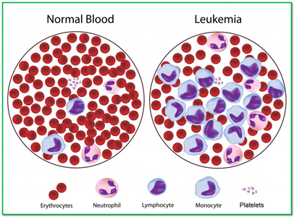
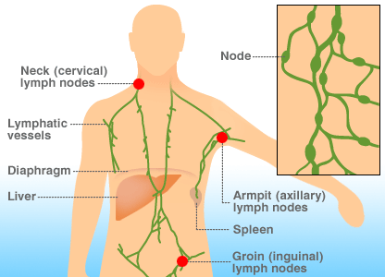

Slide 24
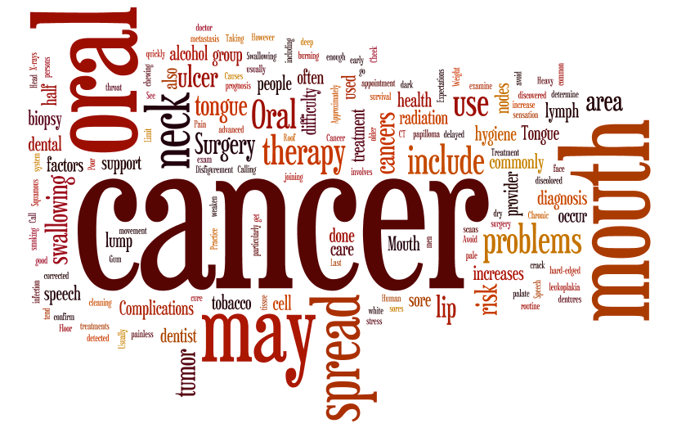
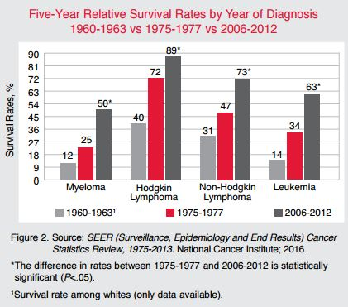
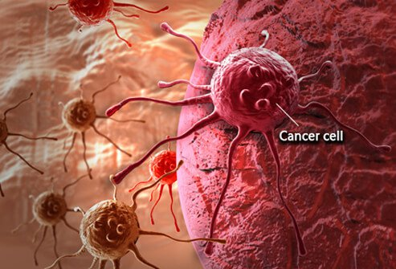
American Cancer society Statistics, 2017

Slide 25

Recent Developments: Nanomedicine and Cancer treatment
Figure taken from http://www.abaftconsultants.com/recent-developments.html with Thanks

Slide 26
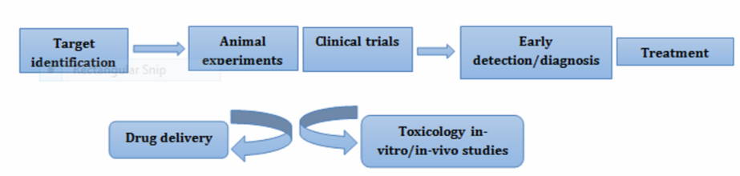
Nano applications in Cancer treatment
Taken from : Cancer Nanotechnology: The Recent Developments in the Cancer Therapy, GA Deshpande, Global Journal of Nanomedicine, Vol 1,1-6, 2016

Slide 27
FDA approved and products in Clinical trials for cancer treatment
Nanomedicine type | Drug | Product name/company | Indication | Phase
Liposomes | Doxorubicin | Myocet™/Teva UK | Metastatic breast cancer | Approved
 |  | Doxil™/Janssen | Kaposi's sarcoma, Ovarian cancer (post-first line failure) Multiple myeloma | Approved
 |  | ThermoDox™/Celsion | Primary hepatocellular carcinoma, Refractory chest wall breast cancer Colorectal liver metastases | Phase III
 |  | 2B3–101/2-BBB Medicines BV | Brain metastases Glioma | Phase II
 | Vincristine | Marqibo™/Spectrum Pharmaceuticals | Acute lymphoblastic leukaemia | Approved
 | Daunorubicin | DaunoXome™/Galen | HIV-related Kaposi's sarcoma | Approved
 | Cytarabine | Depocyt™/Pacira Pharmaceuticals | Lymphomatous meningitis | Approved
 | Irinotecan | Onivyde™/Merrimack Pharmaceuticals | Metastatic pancreatic cancer (2nd line), Gastric cancer | Approved Phase II

Slide 28
FDA approved and products in Clinical trials for cancer treatment
Cytarabine: daunorubicin 5:1 fixed ratio | CPX-351/Celator | Acute myeloid leukaemia | Phase III
Cisplatin | Lipoplatin/Regulon | Non-small cell lung cancer | Phase III
 | SPI-77/ALZA Pharmaceuticals | Ovarian cancer | Phase II
 | Aroplatin/Aronex Pharmaceuticals | Malignant mesothelioma | Phase II
Oxaliplatin | MBP-426/Mebiopharm | Gastrointestinal adenocarcinoma | Phase II
Paclitaxel | LEP—ETU/Insys | Breast cancer | Phase II
 | EndoTAG-1/MediGene | Breast cancer | Phase II
 | PNU-91934/MSKCC | Esophageal cancer | Phase II
SN-38 | LE-SN38/Neopharm | Metastatic colorectal cancer | Phase II
Irinotecan: Floxuridine 1:1 ratio | CPX-1/Celator | Colorectal cancer | Phase II

Slide 29
FDA approved and products in Clinical trials for cancer treatment
Polymeric conjugates | Camptothecin | CRLX101 (cyclodextrin adamantane)/Cerulean | Renal cancer Small cell lung cancer Ovarian cancer | Phase II
 | Asparaginase | Oncaspar™ (PEG)/Baxalta | Acute lymphoblastic leukaemia | Approved
 | Paclitaxel | Opaxio™ (Polyglycerol adipate)/CTI Biopharma | Ovarian cancer Non-small cell lung cancer (women) | Phase III maintenance Phase II
 | Irinotecan | NKTR102 (PEG)/Nektar | Metastatic breast cancer | Phase III
 | Camptothecin | CRLX101 (nanoparticle)/Cerulean | Renal cell carcinoma (3rd/4th line),Ovarian cancer (2nd/3rd line) | Phase II
 |  | XMT1001 (Fleximer™)/Mersana | Gastric cancer (2nd line),Non-small cell lung,cancer (2nd/3rd line) | Phase II
 | Diaminocyclohexane (DACH) Platinum | AP 5346 (Hydroxypropylmethacrylate)/ProLindac™ | Ovarian cancer | Phase II
 | Docetaxel | DEP™ (G5 PEG-Polylysine)/StarPharma | Advanced cancers | Phase I
 |  | CriPec™ docetaxel (nanoparticle)/Cristal Therapeutics | Solid tumours | Phase I

Slide 30
FDA approved and products in Clinical trials for cancer treatment
Polymeric nanoparticles | Docetaxel + Prostate-Specific Membrane Antigen (PSMA) | BIND-014 (Accurin™)/BIND Therapeutics | Cholangiocarcinoma,Cervical cancer,Bladder cancer Head and neck cancer, Non-small cell lung cancer subtypes | Phase II
 | AZD2811 (AZD1152 hydroxyquinazoline pyrazol anilide; Aurora-B Kinase Inhibitor) | AZD2811 (Accurin™) nanoparticle/AstraZeneca | Advanced solid tumours | Phase I
Polymeric micelles | Paclitaxel | Genexol-PM™/Samyang Biopharmaceuticals | Breast cancer, Non-small cell lung cancer, Ovarian cancer | Approved
 |  | NK105/NanoCarrier™ | Stomach cancer, Breast cancer | Phase III
 |  | NC-4016/NanoCarrier™ | Solid tumours | Phase I
 |  | Nanoxel™/Samyang Biopharmaceuticals | Advanced breast cancer | Phase I
 | DACH-platin | NC-6004 Nanoplatin™/NanoCarrier™ | Pancreatic cancer, Head and neck cancer, Non-small cell lung cancer, Bladder cancer | Phase III
Other | Irinotecan | HA-irinotecan HyACT™/Alchemia | Colorectal cancer Lung cancer | Phase II Phase III
 | Tumour Necrosis Factor (TNF) | CYT-6091/CytImmune | Non-small cell lung cancer | Phase II
 | Paclitaxel | Abraxane ™/Celgene | Advanced breast cancer Advanced non-small cell lung cancer Advanced pancreatic cancer | Appr

Slide 31
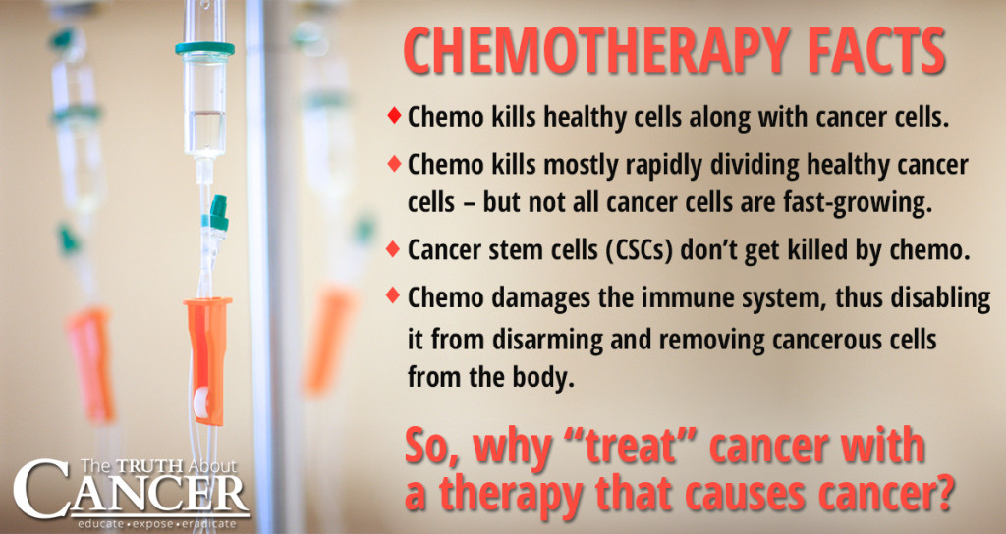
Traditional approach to treat cancer
The traditional mainline approaches to treating cancer have been chemotherapy, radiation therapy and surgery, sometimes characterized as: poison, burn and slash.
Both chemotherapy and radiation therapy have from the onset been focused on killing cancer cells, in one case by using highly toxic chemicals and in the other case by using focused radiation.
Sometimes these approaches have worked and have saved lives. In many instances, however, they have not worked, worked badly, have led to cancer relapses or have contributed to killing patients due to their side effects.
Figure taken from https://thetruthaboutcancer.com/questions-before-chemotherapy-treatment/ with Thanks

Slide 32
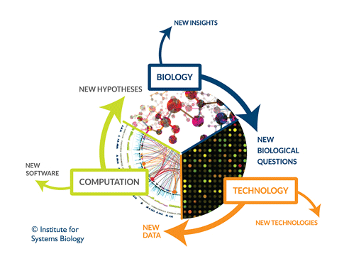
Systems Biology approach towards cancer
The systems biology approach to understanding diseases is founded on the simple, profound belief that diseases are systemic disorders that emerge from the dysfunction of one or more networks that subsequently change the levels of the molecules controlled by these “disease-perturbed” networks.
The cause of these network dysfunctions can be genetic and/or environmental, and as the disease progresses, the dynamics of the changing levels of the affected proteins should explain the biological mechanisms of the disease.
As the changes caused by these disease-perturbed networks percolate throughout the system, they inevitably lead to the systemic dysfunction of multiple other organs.
Taken from https://www.systemsbiology.org/news/2014/05/12/cancer-detection-a-systems-biology-approach/ with Thanks

Slide 33
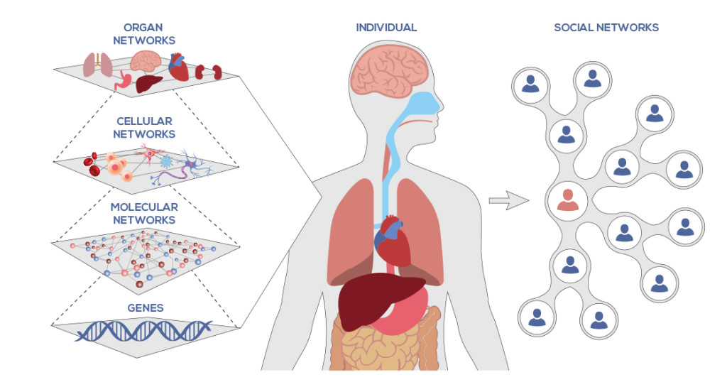
Networks of Network in Human Body
Figure taken from https://www.systemsbiology.org/about/what-is-systems-biology/ with Thanks

Slide 34
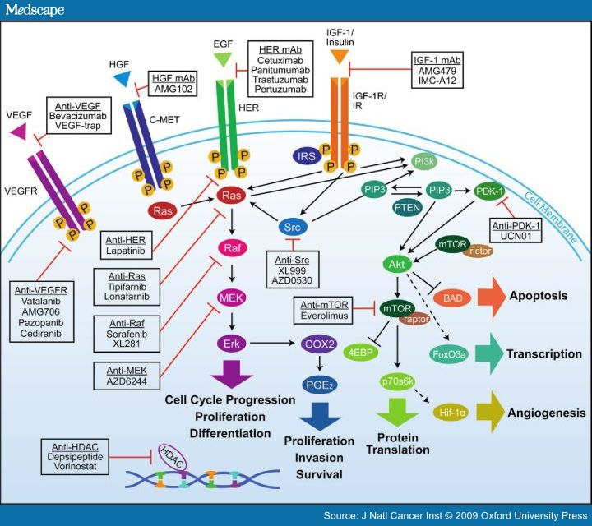
Signaling pathways: Lead to new drug discovery and treatment options
There are several signaling pathways that play an essential role in the cellular decisions between proliferation, differentiation and death.
Alterations in these signaling pathways and connected gene regulatory networks can change cellular decisions and thereby trigger the onset of tumor formation.
Even though there are multiple pathway components studied in detail in many cancer types, it remains unresolved how information is processed and how cells decide whether to respond with proliferation or differentiation or survival.

Slide 35
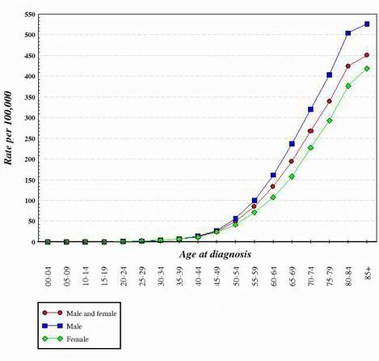
Incidence of cancer is heavily correlated with aging
For almost all types of cancer studied to date, it seems as if the transition from a normal, healthy cell to a cancer cell is step-wise progression that requires genetic changes in several different oncogenes and tumor suppressors.
This is one reason why cancer is much more prevalent in older individuals. In order to generate a cancer cell, a series of mutations must occur in the same cell.
Since the likelihood of any gene becoming mutated is very low, it stands to reason that the chance of several different mutations occurring in the same cell is truly very unlikely.
For this reason, the cells in a 70 year old body have had more time to accumulate the changes needed to form cancer cells but those in a child are much less likely to have acquired the requisite genetic changes.
Of course, some children do get cancer but it is much more common in older individuals. The graph below shows colon cancer rates in the United States as a function of age. The graph was obtained from the National Cancer Institute
Figure taken from http://www.anti-agingfirewalls.com/2012/03/29/new-emerging-and-potential-treatments-for-cancers-part-2-%E2%80%93-focus-on-anti-cancer-interventions-that-simultaneously-address-multiple-growth-pathways/

Slide 36
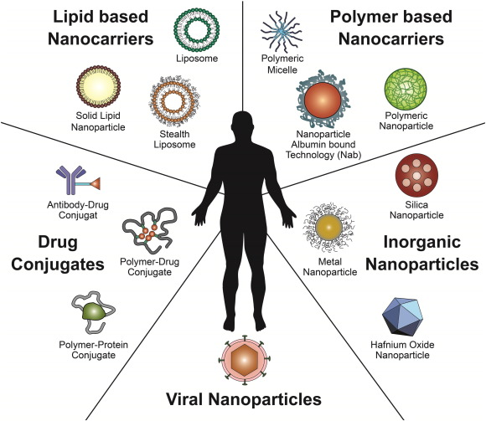
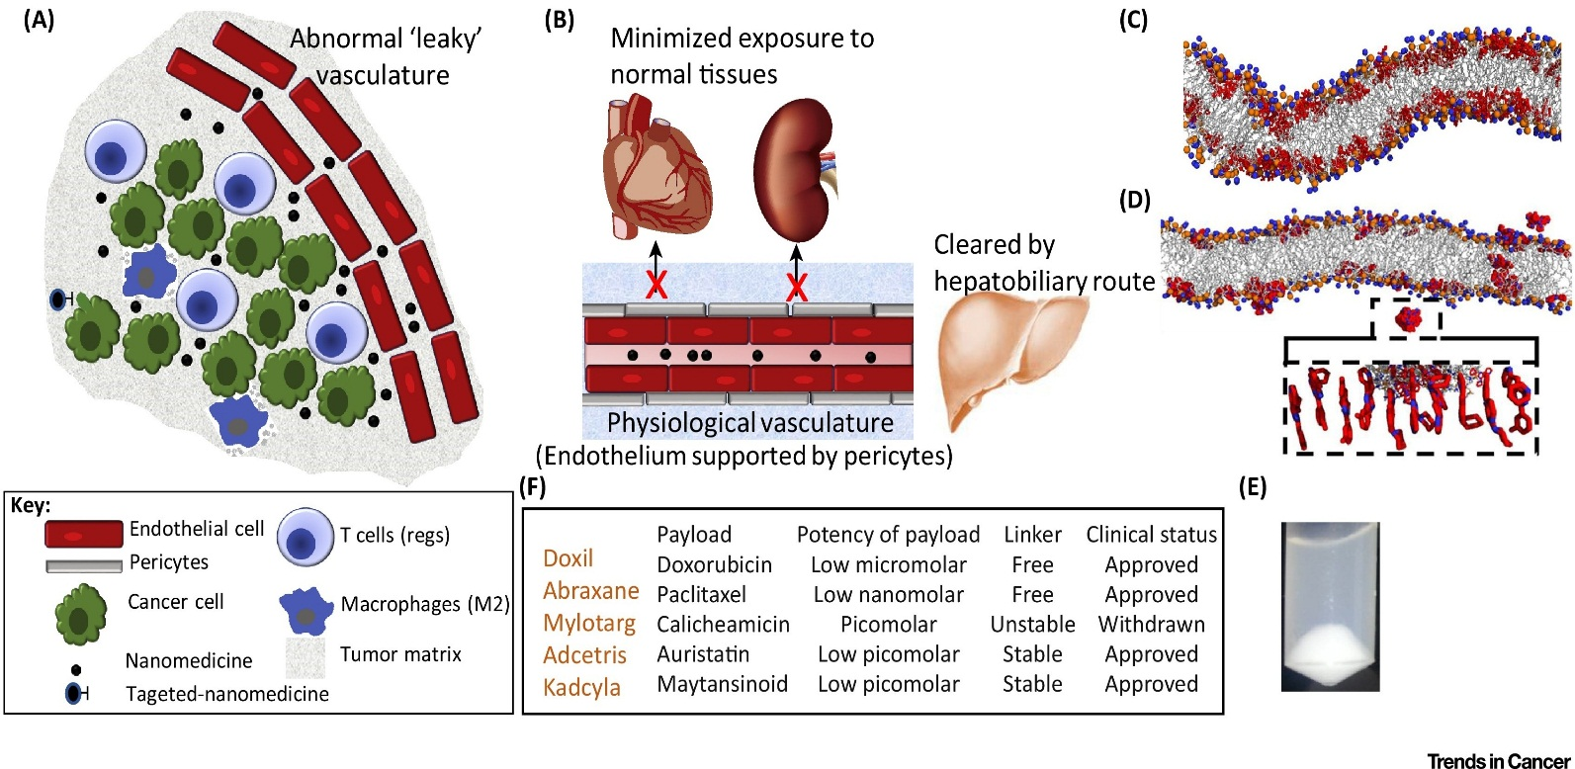
Challenge of understanding the correlations between patient biology and nano medicine behavior
1) Building the understanding of the interaction between tumor pathophysiology and nano medicine behavior in tumors, to enable the optimization of tumor accumulation, intra-tumoral distribution, and retention of distinct nano medicines
2) Transitioning from formulation-driven research to disease-driven rational development
3) Developing and exploiting more clinically relevant animal models to optimize nano medicine properties, dosing schedules, and treatment combinations with a clinical line of sight to the target disease as it develops in patients
4) Pre-selecting patients likely to respond to nano medicine-based therapy
Figure taken from Cancer Nanomedicine: Lessons for Immuno-Oncology, 2017, http://www.cell.com/trends/cancer/fulltext/S2405-8033(17)30123-1
Nanomedicine in cancer therapy: Challenges, opportunities, and clinical applications
Journal of Controlled release, 200,138-157, 2015

Slide 37
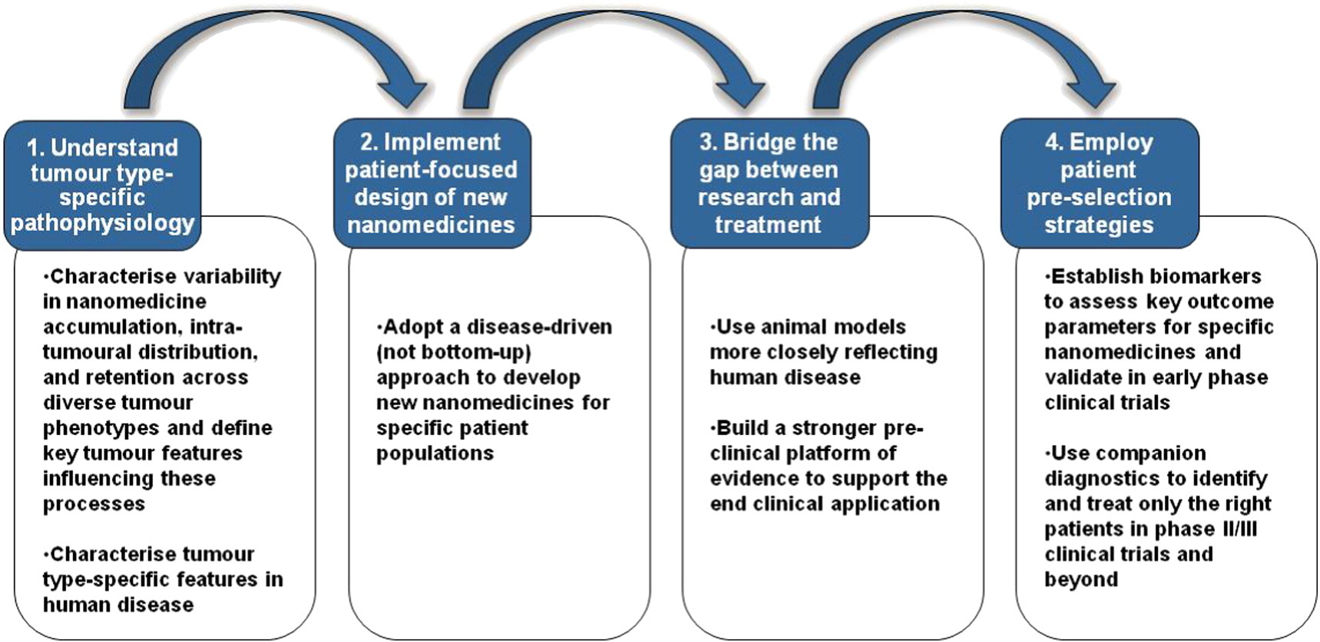
Improving the successful clinical translation of nano medicines
Challenges and strategies in anti-cancer nano-medicine development: An industry perspective,
JI Hare et al, Advanced Drug Delivery reviews , 208, 25-38, 2017

Slide 38
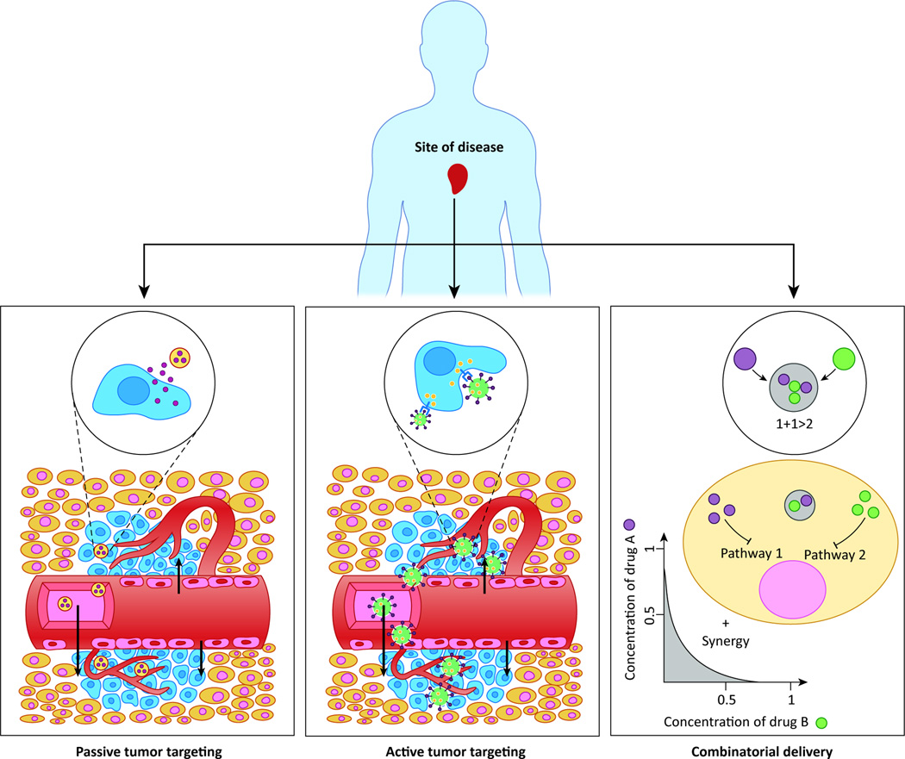
Possible approaches for drug delivery to the tumors
Schematic representation of Passive targeting, active targeting, and combinatorial delivery
Cancer Nanomedicine: From Targeted Delivery to Combination Therapy, Xiaoyang Xu, William Ho, Xueqing Zhang, Nicolas Bertrandand Omid Farokhzad, Trends Mol Med. 2015 Apr; 21(4): 223–232

Slide 39
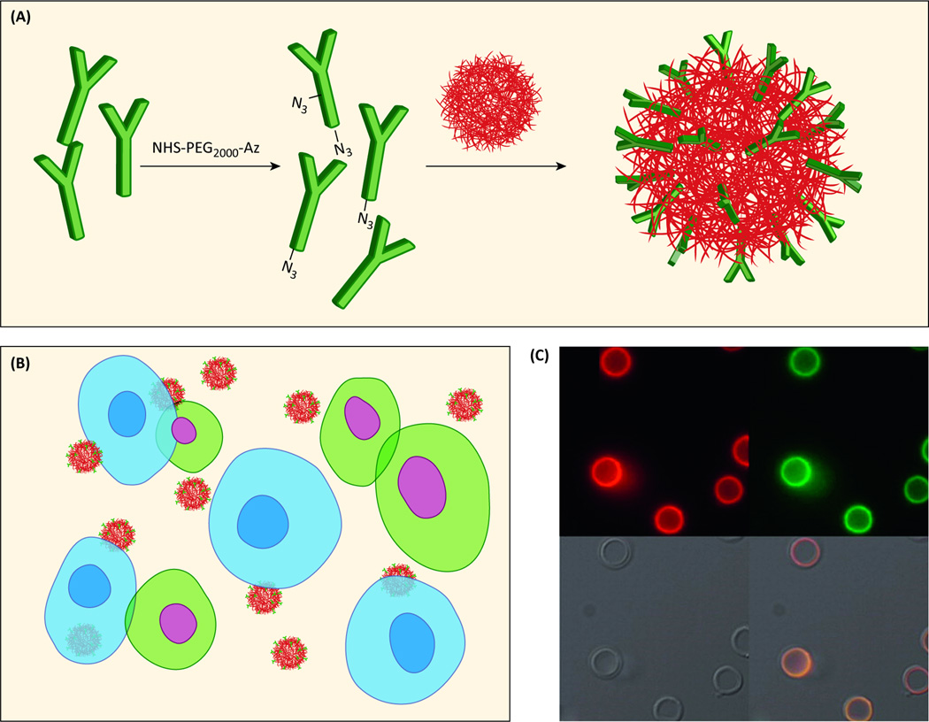
Antibody functionalization and visualization
(a) Antibodies conjugated to the NP surface through “click” chemistry.
(b) Cells that express the complementary antigen are blue and show Ab-facilitated binding of targeted NPs. Cells that do not express the complementary antigen are green with no NP binding.
(c) Fluorescence microscopy images of huA33 mAbAz functionalized nanocapsules with
(i) the antibody labeled with AF647 (red), or (ii) antibody labeled with AF488 (green),
(iii) bright field, and
(iv) overlay images. Adapted with permission from
Cancer Nanomedicine: From Targeted Delivery to Combination Therapy, Xiaoyang Xu, William Ho, Xueqing Zhang, Nicolas Bertrandand Omid Farokhzad, Trends Mol Med. 2015 Apr; 21(4): 223–232

Slide 40
Recent trends in Cancer Therapy
Applications | Without use of Nanotechnology | With use of Nanotechnology
Diagnosis | FNAC, biopsy, FISH, immune histo chemistry used for diagnosis. Early detection is not possible Only in vitro detection is possible Real time detection is not possible | Quantum dots and raman probe can be used for diagnosis Early detection is possible In vitro and in vivo detection is possible Real time detection is also possible
Imaging | X-ray, CT scan, MRI,PET scan, isotopes can is used Ultrasonography is used | Quantum dots can be used UCM ultrasonography can be used Very early detection of neo vascularization is possible Imaging, targeting, delivering and monitoring is possible
Early detection of cancer | Cytology, FNAC and biopsy is used | Vital optical imaging is possible Inexpensive mass screening is possible
Drug delivery | Oral, intramuscular ,intra vinous, intra- arterial drug delivery is possible | Targeted delivery is possible Possible to deliver small dose Low systemic toxicity Batter and faster responses
Taken from : Cancer Nanotechnology: The Recent Developments in the Cancer Therapy, GA Deshpande, Global Journal of Nanomedicine, Vol 1,1-6, 2016

Slide 41
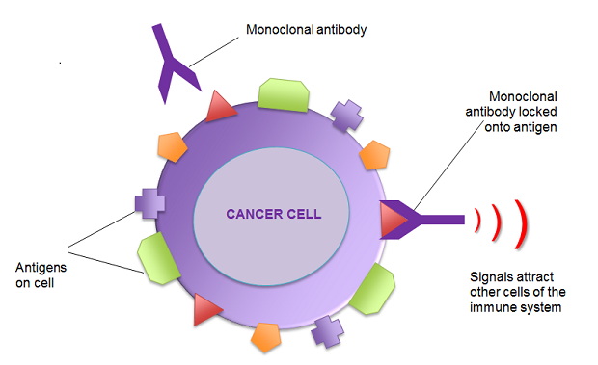

Interesting approaches based on systems biology of cancer
Monoclonal antibody cancer therapies that block HER proteins: These are monoclonal antibodies that bind selectively to HER proteins and compromise the functionality of those proteins.
While HER-blocking monoclonal antibody therapies are useful, sometimes they are only weakly effective or won’t work at all as single therapies.
A major problem with cancer therapies based in inhibiting the HER pathway is Grb7 upregulation which promotes cancer cell survival and migration. Drug inhibition of Akt signaling is the culprit.
Another limitation of EGFR-HER2 inhibition using lapatinib is that insufficient inhibition of PI3K-survivin signaling leads to only a limited pro-apoptotic effect of lapatinib in HER2 amplification-positive cells with a PIK3CA mutation.
The combination of trastuzumab and lapatinib may help overcome drug resistance in HER2-positive breast cancers.
The resistance to trastuzumab and lapatinib of breast cancers may be overcome by down-regulating mTOR expression.
However, blocking the mTOR pathway via using a P13K inhibitor may be ineffective as a single therapy for breast cancer because of feedback upregulation of HER3.
Histone deacetylase inhibition (HDACi) is another very important emerging approach to cancer therapy, again most-frequently in combination with other pharma approaches
Figures taken from http://pharmacologycorner.com/overview-on-monoclonal-antibody-therapy-ppt-images-and-videos/ with thanks

Slide 42


Interesting approaches based on systems biology of cancer
Another new angle for treating certain cancers is to combine an HER/EGFR inhibitor with a histone deacetylase (HDAC) inhibitor like panobinostat.
Combining an mTOR inhibitor and a HDAC inhibitor appears to be an effective way to kill pancreatic cancer cells.
Multiple-pathway cancer treatments are being examined in a large number of clinical trials.
Another cancer therapy that may well be coming into practice is monoclonal antibody blocking of the protein CD47.
Another approach is using Nutlin-3 to de-inhibit P53 expression in cancers.
Minocycline might be an anti-cancer therapy.
Integrative medicine using herbal antioxidants and other natural products in combination with anticancer drugs
Figures taken from https://pharmaceuticalintelligence.com/2015/10/14/32589/ with thanks

Slide 43

Personalized cancer therapy

Slide 44

The need for combining cancer therapies addressing multiple pathways is reflected in the large number of clinical trials of such combined therapies.
A Safety Study of LBH589 (Panobinostat) and RAD001 (Everolimus) to Stabilize Kidney Cancer
A Dose Finding Study With I.V. Panobinostat (LBH589), Docetaxel, and Prednisone in Patients With Hormone Refractory Prostate Cancer
Panobinostat Plus Ifosfamide, Carboplatin, and Etoposide (ICE) Compared With ICE For Relapsed Hodgkin Lymphoma
A Phase II Study of Oral Panobinostat (LBH589) and Rituximab to Treat Diffuse Large B Cell Lymphoma
Panobinostat (LBH589) Plus Everolimus (RAD001) in Patients With Relapsed and Refractory Lymphoma
Treatment of Resistant Metastatic Melanoma Using Decitabine, Temozolomide and Panobinostat
Study of Cisplatin and Pemetrexed in Combination With Panobinostat in Solid Tumors
Study of Bortezomib and Panobinostat in Treating Patients With Relapsed/Refractory Peripheral T-cell Lymphoma or NK/T-cell Lymphoma

Slide 45

The need for combining cancer therapies addressing multiple pathways: large number of clinical trials of such combined therapies.
Panobinostat or Placebo With Bortezomib and Dexamethasone in Patients With Relapsed Multiple Myeloma
Panobinostat in Combination With Idarubicin and Cytarabine in Patients Aged 65 Years or Older With Newly Diagnosed Acute Myeloblastic Leukaemia (AML)
Safety and Efficacy Studies of Panobinostat and Bicalutamide in Patients With
Recurrent Prostate Cancer After Castration
A Trial l of Panobinostat Given in Combination With Trastuzumab and Paclitaxel in Adult Female Patients With HER2 Positive Metastatic Breast Cancer
Panobinostat With Rituximab for Relapsed/Refractory Diffuse Large B Cell Lymphoma
Carfilzomib Plus Panobinostat in Relapsed/Refractory Multiple Myeloma (MM)
A Phase II Trial of Panobinostat and Lenalidomide in Patients With Relapsed or
Refractory Hodgkin’s Lymphoma
Study of the Combination of Panobinostat and Carfilzomib in Patients With
Relapsed/Refractory Multiple Myeloma
Phase I Dose Finding and Proof-of-concept Study of Panobinostat With Standard Dose Cytarabine and Daunorubicin for Untreated Acute Myeloid Leukemia or Advanced Myelodysplastic Syndrome
Panobinostat/Velcade in Multiple Myeloma
Figure taken from https://www.cancer.gov/multimedia/infographics with Thanks

Slide 46
Herbal and Nutraceuticals for value based Oncology care
(helping patients and reducing costs for cancer care )

Slide 47

WHO Definition of herbal Medicines
From the World Health Organization (WHO)’s definition, herbal medicines include herbs, herbal materials, herbal preparations and finished herbal products that contain as active ingredients parts of plants, or other plant materials, or combinations.
Figure taken from Herbal interactions on absorption of drugs: Mechanisms of action and clinical risk assessment, Pharmacol.res., 62,207-227, 2010

Slide 48



Using herbal compounds and extracts
According to Guidelines for the Regulation of Herbal Medicines in the South-East Asia Region organized by WHO regional office for South East Asia 2003 [13], herbal drugs have been categorized into four groups, including:
  Indigenous herbal medicines. They are defined as well-known medicines in terms of their composition, treatment and dosage due to their age old use in a local community
  Herbal medicines in systems. These medicines in this group have been in use for a long time and therefore, for local use assessments of efficacy are not required
  Modified herbal medicines. They have got the modification of the form of indigenous herbal medicine or herbal medicine in systems (either in shape or dosage form, mode of administration, herbal medicinal ingredients, and methods of preparation and medical indications).
  Imported products with an herbal medicine base. This type includes raw materials and products) must be registered and marketed in the countries of origin.

Slide 49





Why Nano for Herbal Drugs
Nano is Too Big:
Nano particulate Drug Delivery Systems
Nanotechnology and nano science are widely seen as having a great potential to bring benefits to many areas of research and applications.
The prefix nano is derived from the Greek word meaning “Dwarf”. One nanometer is one billionth of a meter or 10 -9 m.
The term Nanotechnology was first used in 1974, when Norio Taniguichi a scientist at University of Tokyo, Japan used to refer the size of materials in nanometers.

Slide 50

Understanding the nano size concept
Taken from Nanoparticulate Drug Delivery Systems: D Thassu, M Deleers and YV pathak, Informa Health Care, 2007

Slide 51
Nanofabrication

Slide 52
Nanocharacterization
Analytical techniques used to characterize nano systems
Laser diffraction
Photon correlation spectroscopy
Wide angle X-ray scattering
Differential scanning colorimetry
Proton nuclear magnetic resonance spectroscopy
Electron spin resonance
Transmission electron spectroscopy (TEM)
Sedimentation velocity analysis and electron microscopy
Dynamic light scattering (DLS) and TEM
DLS and cryo- transmission electron microscopy
Flow cytometry and Elisa method
Fluorometry
Fluorescence and TEM

Slide 53

Challenges with Herbal Medicines
High dose levels
Characterization/Solubility problems and Formulation challenges
Consistency
Reproducibility
Clinical efficiency
Manufacturing on large scale as a source of medicine for large number of people
Disagreement between the practioners and needs for standardization
Patient compliance

Slide 54

Nanotechnology Applications in herbal Drugs
Nanotechnology can help in
Reducing the dose levels of the Herbal medicines
Providing better stability to the product
Ease in formulations and characterizations
Better patient acceptability
It will help in reproducibility of the therapeutic effectiveness

Slide 55
Herbal drugs and their efficacy in the treatment of diseases in clinical trials
Herbal drug | Scientific name | Treatment
St. John's wort | Hypericum perforatum | Peptic ulcer and chronic gastritis
 |  | Major depressive disorder
Ginkgo | Ginkgo biloba | Peripheral arterial insufficiency
 |  | Raynaud's disease
 |  | Dementia with neuropsychiatric features
Ginger | Zingiber officinale | Pregnancy-induced nausea
 |  | Osteoarthritis (OA) of the knee
Ginseng | Panax quinquefolius or American ginseng | Reduces postprandial glycemia
 |  | Improve cancer-related fatigue
Curcumin | Curcuma longa | Healing of peptic ulcer
Echinacea | Echinacea purpurea | Common cold
Chamomile | Matricaria recutita | Generalized anxiety disorder
Kava | Piper methysticum | Anxiolytic and antidepressant activity
Valerian | Valeriana officinalis | Coronary heart disease
Garlic | Allium sativum | Hepatopulmonary syndrome
Saw palmetto | Serenoa repens | Chronic abacterial prostatitis
Milk thistle | Silybum marianum | Type II diabete

Slide 56
Types of nano carriers and nanomaterials used to deliver herbal drugs
Type of Nanocarrier | Definition | Nanomaterial used
Liposomes | Vesicles composed of one or more bilayers of amphiphatic lipid molecules enclosing one or more aqueous compartments. | Phosphatidylcholine Phosphatidylglycerol, Phosphatidylethanolamine Phosphatidylserine
Polymeric micelles | Self-assembling nanosized colloidal particles with a hydrophobic core and hydrophilic shell currently used for the solubilazation of various poorly soluble pharmaceuticals. | Poly(ethylene oxide)-poly ( benzyl-Laspartate) Poly(N-sopropylacrylamide)- polystyrene
Dendrimers | Polymer in which the atoms are arranged in many branches and sub-branches along a central backbone of carbon atoms. | Polyamidoamine (PAMAM) Polypropyleneimine Polyaryl ether
Polymeric nanoparticles | colloidal solid particles with a size range of 10 to 1000nm 1 and they can be spherical, branched or shell structures | Poly-(ε-caprolactone) (PCL) Poly (lactide-coglycolide) (PLGA) Chitosan Alginate Albumin Gelatin
Solid-lipid nanoparticles | nanostructures made from solid lipids | Glyceryl behenate Stearic triglyceride Cetyl palmitate Glycerol tripalmitate

Slide 57

Common materials of nano carriers
Sources | Materials
Natural | gelatin, albumin, alginate, collagen, chitosan
Synthetic | poly(lactide) (PLA), poly(lactideco-glycolide) (PLGA), poly-ε-caprolactone (PCL), Polymethyl metha acrylate, (PMMA), poly alkyl cyano acrylate (PACA), Poly methyl cyano acrylate (PMCA), polyarylamide, ethyl cellulose, eudragit
Metallic | iron oxide, gold, silver, gadolinium and nickel
Ceramic | silica, alumina and titani

Slide 58

Methods used for formulating nanostructures
Nanostructure | Method
Liposomes | Sonication Electroformation Extrusion from diluted lamellar dispersions High-shear homogenization Reverse-phase evaporation Gel exclusion chromatography Freeze lyophilization Calcium-induced fusion Detergent dialysis Ultracentrifugation
Polymeric micelles | Dialysis Solution-casting Direct dissolution
Dendrimers | Tomalia’s divergent growth approach Convergent growth approach Orthogonal coupling strategy
Polymeric nanoparticles | Ionic gelation Coacervation Solvent evaporation Spontaneous emulsification/solvent diffusion Salting out/emulsification-diffusion Supercritical fluid technology Polymerization.
Solid-lipid nanoparticles | High shear homogenization Ultrasound dispersion technique High pressure homogenization Solvent emulsification/evaporation microemulsion and solvent diffusion
Nanocapsules | Microemulsion Miniemulsion polymerization and interfacial polymerization
Ceramic nanoparticles | Template synthesis Hot pressing technique Controlled hydrolysis in micellar medium
Metallic nanoparticles | Gas phase deposition Electron beam lithography.
Nanoemulsions | Spontaneous emulsification High pressure Ultrasonic homogenization

Slide 59










Table 5. Chemical structures of herbal compounds
Compounds | Chemical structure
Curcumin |  | Curcuma longa
Lycopene |  | Gac fruit (Momordica cochinchinensis
Tetrandrine |  | Stephania tetrandra
Tanshinone |  | Salvia miltiorrhiza
Silibinin |  | Silybum marianum

Slide 60
Table 6. Nanotechnology techniques for herbal extracts
Herbal extracts | Method | Result
Tripterygium wilfordii | Liposomes prepared by thin-film dispersion method | Particle size: 30 nm to 50 nm. The optimum entrapment efficiency of - tripterine :98.10% - total alkaloids : 88.63%
Cuscuta chinensis | Nanoparticles of C.chinensis (CN) prepared by nanosuspension method and compared with ethanolic extract (CE) on acetaminophen-induced hepatotoxicity in rats. | Nanoparticles system has been suggested to be applied to overcome other water poorly soluble herbal medicines and furthermore to decrease the treatment dosage.
Yizhihao | Chitosan (CS)-compound Yizhihao-nanoparticles (NP) were formed by the method of ion-cross-linking to incorporate CS with Na₃ PO₄. | CS-compound Yizhihao-nanoparticles have obvious antibacterial activity to the Staphylococcus aureus, Pneumococcus, and beta-hemolytic Streptococcus
Silibinin and tetrandrine | The model traditional Chinese medicines, silibinin (SIL) and tetrandrine (TET), were incorporated into solid lipid nanoparticles (SLN ) separately by high-pressure homogenization. | High-pressure homogenization is feasible for preparing SLN loaded with traditional Chinese medicines.
Tanshinone II(A)- | To optimize formulation of tanshinone II(A)-loaded PLGA nanoparticles and compare the difference of two methods in preparation and quality of nanoparticles. The two methods were nanoprecipitation method and emulsion-evaporation method. | Nanoprecipitation method was better than emulsion-evaporation method for preparation of tanshinone II(A)-loaded PLGA nanoparticles

Slide 61
Some interesting developments in cancer treatment using different therapies
PEMF (Pulse Electromagnetic Fields)
Oxygen/Ozone Therapy
Ultraviolet Blood Irradiation
Oxygen Therapy
Cold Laser Therapy
Bemer
Hyperthermia (Whole Body/Local)
ARPwave Therapy
HALO (Biophotonic Therapy)
Liver Flush
Low-Dose Chemotherapy
Brio Strategy for Cancer treatment
When possible mitigate pain without prescription medication
Provide proper “after-clinic” assistance
Detoxify the body
Restore the body’s natural immune response
Eliminate tumors
Brio-Medical is a natural holistic treatment center in Arizona, USA
Taken from https://apply.brio-medical.com/treatments/?utm_source=google&utm_medium=ppc&utm_campaign=Quality-Campaign&utm_term=natural_BwE

Slide 62


Some interesting developments in cancer treatment using different therapies
Hercules Multilaser Therapy
Curcumim
IPT
Mind/Body Spirit Meditation
Poly MVA
Healy
25+ IV Therapies
Frequency Therapy
Prescription & Supplemental Therapy
Lymphatic Therapy
Lymphatic Therapy
Taken from https://apply.brio-medical.com/treatments/?utm_source=google&utm_medium=ppc&utm_campaign=Quality-Campaign&utm_term=natural_BwE

Slide 63


Some interesting developments in cancer treatment using different therapies
Ultrasound Screen
Acupuncture
Massage Therapy
Cupping
Nebulizer
Curcumin
Prolotherapy
Laser Therapy
Nutrition Therapy
Labs
Taken from https://apply.brio medical.com/treatments/?utm_source=google&utm_medium=ppc&utm_campaign=Quality-Campaign&utm_term=natural_BwE

Slide 64

Nano-Drug Delivery Systems Entrapping Natural Bioactive Compounds for Cancer: Recent Progress and Future Challenges
Traditional medicines hold a significant role in many healthcare systems around the world.
● According to a World Health Organization (WHO) assessment, conventional medicine meets and/or supplements the fundamental health needs of around 80% of the community in underdeveloped nations.
● Plant-derived anticancer medicines are highly sought after because they are effective inhibitors of cancer cells.
● Although the development of nano drugs is fraught with uncertainty, and the development of potent bioactive chemicals from natural origin is not a popular alternative today, improving the effectiveness of known natural bioactive substances using nanotechnology has become a typical aspect.
● Different drug delivery systems entrapping natural bioactive compounds for cancer treatment are summarized.
● Application of Nano drug-delivery systems for natural anticancer agents can improve bioavailability, biodistribution, therapeutic activity, drug targetting, and stability.
Taken from Nano-Drug Delivery Systems Entrapping Natural Bioactive Compounds for Cancer: Recent Progress and Future Challenges- Front. Oncol., 29 March 2022 |
https://doi.org/10.3389/fonc.2022.867655

Slide 65


Slide 66

Nano drug delivery platforms

Slide 67
Recent patents on herbal drugs
Patent Number | Title | Description of patent | Compound /herbal plant | Treatment of cancer
IN202241000705 (2022) | Lung cancer treatment using astragalus, cisplatin and vinorelbine | It describes the novel drug formulations of astragalus, cisplatin and vinorelbine for treating lung cancer | Astragalus, cisplatin and vinorelbine | Lung cancer and non -small cell carcinoma [NSCLC]
IN202111049427 (2021) | A novel herbal composition for anticancer activity | This invention relates to the herbal composition for cancer treatment where cinnamon zeylanticum J.presl., is utilized | Cinnamomum zeylanicum J.presl. | Used in different cancer treatments
IN202141046188 (2021) | Enhanced anticancer activity of quercetin-loaded TPGS (Tocopherol polyethylene glycol succinate) nanosuspension for drug imperious MCF-7(Michigan cancer foundation -7) human breast cancer cells | This study provides a novel insight into the mechanism of action of quercetin-induced apoptosis in human breast cancer cells | Quercetin | Human breast cancer
IN202021048696 (2020) | Cytotoxic herbal silver nanoparticles as a remedy for mammary carcinoma | The present invention is herbal extract mediated silver nanoparticles acting as a cytotoxic agent to mammary carcinomatous cells by showing G2/M-phase cycle arrest | Brassica oleracea L. | Mammary carcinoma, cervical cancer, hepatocarcinoma cell

Slide 68
Recent patents on herbal drugs
Patent Number | Title | Description of patent | Compound /herbal plant | Treatment of cancer
US20170258929 (2017) | The method uses and combination composition in cancer treatment | The conjugate of GnRH and curcumin give along or in combination with 2’,2’-difluoro-2’-deoxycytidine in pancreatic cancer treatment | Curcumin and its analog | Pancreatic cancer
EP3144006 (2017) | The combination of chemotherapeutic agent and curcumin analog used in the treatment of glioblastoma | Liposomes containing curcumin eliminate the QT- prolongation to treat glioblastoma | Curcumin | Glioblastoma
US20170035701 (2017) | Preparation method and uses of stabilized high drug load of nanocarrier | Formation of the micellar core of active compound by encapsulating the active compound by nanocarrier of lipid shell | Curcumin, reservatrol, honokiol, and magnolol | Brain cancer, liver cancer, and skin cancer
US20170035701 (2017) | Preparation method and uses of stabilized high drug load of nanocarrier | Formation of the micellar core of active compound by encapsulating the active compound by nanocarrier of lipid shell | Curcumin, reservatrol, honokiol, and magnolol | Brain cancer, liver cancer, and skin cancer

Slide 69
Recent patents on herbal drugs
Patent Number | Title | Description of patent | Compound /herbal plant | Treatment of cancer
US20170224636 (2017) | Curcumin-sophorolipid complex. | The present invention relates to a curcumin acidic sophorolipid complex is enhances the bioavailability of curcumin and nano- encapsulated in acidic sophorolipid | Curcumin | Specifically for breast cancer
EP3144006 (2017) | The combination of chemotherapeutic agent and curcumin analog used in the treatment of glioblastoma | Liposomes containing curcumin eliminate the QT- prolongation to treat glioblastoma | Curcumin | Glioblastoma
US20170035701 (2017) | Preparation method and uses of stabilized high drug load of nanocarrier | Formation of the micellar core of active compound by encapsulating the active compound by nanocarrier of lipid shell | Curcumin, reservatrol, honokiol, and magnolol | Brain cancer, liver cancer, and skin cancer
US20160263221 (2016) | Information of pharmaceutical formulation of controlled drug targeted delivery system | It provides a container having at least one herbal drug and adapted to release herbal compounds inside the cancer cell | Curcumin | Lung, breast, prostate, and colon cancer

Slide 70
Recent patents on herbal drugs
Patent Number | Title | Description of patent | Compound /herbal plant | Treatment of cancer
US20160287533 (2016) | Bioavailability enhancing curcumin composition, method, and uses | The formulation which increasing the curcumin properties and treats the uncontrolled cellular growth in the human cell | It included at least one curcumin, resveratrol, catching derivative | Cervical cancer and precancerous cervical lesion
US20160287706 (2016) | Left helical 3D cage-like structure of DNA drug carrier nanocage | L-DNA (left helical structure of DNA) nanocage (3D cage) has high efficiency of cellular delivery so it is very suitable to deliver an active herbal drug into the cell | Genistein | Various cancer
US20140369938 (2016) | Curcumin-coated magnetic nanoparticles for biomedical application | Curcumin and its derivatives are coated with ultra-small superparamagnetic nanoparticles of iron oxide directly without losing the therapeutic properties of curcumin | Curcumin | Breast cancer, lung cancer, pancreatic cancer
US20150314006 (2015) | Particulate drug delivery methods. | It provides preparation of drugpolymer or oligomer conjugate which is useful in in-vivo drug delivery for therapeutic application | Genistein-like species which having one hydroxyl group and a thiol group | Prostate cancer

Slide 71

Nano based value care solutions for Oncology practices
Conventional cancer therapies are sometimes restricted due to their low specificity, which can result in significant side effects toxicity, and likely creation of MDR phenotype
As a corollary, the necessity to precisely destroy cancer cells, overcome MDR, and boost the specificity of a medication using spatial, temporal, and dosage regulation of its release is driving the hunt for more effective anticancer therapy. The cost of cancer is very high beyond the reach of common person
Phytochemicals at lower doses initiate adaptive response but as one increases the dose it produces acute autophagic response and apoptosis.
There are several types of drug carriers available today, each with distinct and varied qualities that make them suitable for the treatment of cancers.

Slide 72

Nano based value care solutions for Oncology practices
The cost of cancer is very high beyond the reach of common person
Natural products are a key source for the development of innovative anti-cancer medicines that may be used both preventively and therapeutically.
These will be very cost effective and reduce the cost of cancer treatment
After appropriate studies, it is now possible to create multipurpose nano carriers that permit the slow and selective release of various drugs at specific tumor locations.
In vitro and preclinical research have shown that NPs transporting and delivering both chemotherapeutic drugs and natural ingredients are extremely efficient for both curative and chemosensitizing reasons.
The importance of herbal medicines may increase in the future via such a nano-drug delivery system. Further research is requisite to address the safety issues related to these systems.

Slide 73

A lot to learn : A lot to be done

Slide 74




USF: Taneja College of Pharmacy
Yashwant V Pathak
M Pharm, Executive MBA, MSCM, PhD
Professor and Associate Dean for Faculty Affairs,
USF Health Taneja College of Pharmacy, University of South Florida
12901 Bruce B Downs Blvd, MDC 030
Tampa FL 33612, USA
Tel: 01-813-974-1026
E mail: ypathak1@usf.edu
We offer
Pharm D (4 years)
Residency and Fellowships in many different areas of specializations
Masters in Pharmaceutical nanotechnology
PhD in Nano Sciences/ Medical Sciences
(to be implemented by July 2021)
Welcome to Beautiful Tampa, Florida House of Taneja College of Pharmacy

Slide 75





Areas of research
Nano particulate drug delivery systems
Impact of microgravity on Drug delivery systems (with PUCRS)
Applications of nanotechnology in various areas including Agriculture, herbal drugs and west water management
Course coordinator: Risk management and nanotechnology
Published over 250 research papers, reviews, chapters in books
Edited over 45 books in the field of nanotechnology, Nutraceuticals and Drug delivery systems and conflict management and cultural studies
Published by Elsevier, Springer, Taylor and Francis, CRC Press, John Wiley and sons, Inform healthcare, Dr Gruyter (Germany)
Two volume book edited with PUCRS faculty Prof Marlise Araujo dos Santos

Slide 76













Books in Nano Sciences
Forthcoming books:
Nano carriers for nasal drug delivery systems (2022)

Slide 77











Books in Drug Delivery Systems

Slide 78













Books in Nutraceuticals

Slide 79







migwe'c (megwitch)
Thank You (Native American Language)
Ma-salama
Minnetdaram
Mochas Gracias
Obrigado
תודה רבה
(todá rabá, “thank you very much”).
Thanks
Diversity is soul of humanity

