Slide 1
Recapitulation

Slide 2
EUnetHTA Core Model
The Model attempts to adhere to the definitions of HTA that emphasize the multidisciplinary nature of assessments​
1. Health problem and current use of technology (CUR) ​
2. Description and technical characteristics of technology (TEC) ​
3. Safety (SAF) ​
4. Clinical effectiveness (EFF) ​
5. Costs and economic evaluation (ECO) ​
6. Ethical analysis (ETH) ​
7. Organizational aspects (ORG) ​
8. Patients and Social aspects (SOC) ​
9. Legal aspects (LEG)

Slide 3
Health Policy Analysis
The purpose of health policy
More healthy people mean a stronger economy​
We need investment in health, but it must be cost-effective investment ​
Efficacy vs. Effectiveness (and Efficiency)
Value for money
Quality​, Solidarity and Sustainability
Retrospective vs. Prospective analysis

Slide 4
RCTs and RWD
EBM Pyramid
Interventional vs. Pbservational CT
Prospective vs. Retrospective trials
Systematic reviews and meta-analysis
Randomized Clinical Trials (RCTs)
Masking
Types of Clinical trials Designs
Clinical trials phases
Real world data and evidence

Slide 5
Economic Analysis
PharmDr. Dominik Grega, PhD.

Slide 6
What is meant by economic analysis?
is concerned with describing and analyzing the cost and impact of interventions and their impact on the individual, the healthcare system and society

Slide 7
Basic parameters for economic analysis
Defining the problem
Determining the study´s perspective
Determining the alternatives and outcomes
Selecting the apropriate pharmacoeconomic method
Placing monetary values on the outcomes
Identifying study resources
Establishing the probabilities of the outcomes
Applying decision analysis
Discounting costs or performing a sensitivity or incremental cost analysis
Presenting the results

Slide 8
1. Defining the problem
intention to solve any health problem (by any intervention: surgical, prevention programme, drugs, health devices etc.)
Discussed at the first seminar

Slide 9
2. Determining the study´s perspective
Payer's Perspective (Health Insurance Company)
Perspective of the patient
Social Perspective

Slide 10
3. Determining the alternatives and outcomes
Current most used treatment/s
The intervention/s which a new one should replace
Therapeutic mix
The selection of the comparator should be adequately described and justified. At the same time, it is necessary to state and explain all the aspects that led to the selection of the given comparator.

Slide 11
4. Selecting the apropriate pharmacoeconomic method
Cost-minimization analysis
Cost-effectiveness analysis
Cost-utility analysis
Cost-benefit-analysis

Slide 12
Cost-minimization-analysis
The difference in effectiveness and safety must be a statistically non-significant
Based on a meta-analysis, network meta-analysis or study of non-inferiority, alternatively equivalence.

Slide 13
Cost-effectiveness/utility analysis
The purpose is to investigate incremental cost-effectiveness/utility ratio (ICER/ICUR)
ICER = $\frac{{Cost}_{new interv.}−{Cost}_{comparator} }{{Outcomes}_{new interv.}−{Outcomes}_{comparator}}$
ICUR = $\frac{{Cost}_{new interv.}−{Cost}_{comparator} }{{QALY}_{new interv.}−{QALY}_{comparator}}$

Slide 14
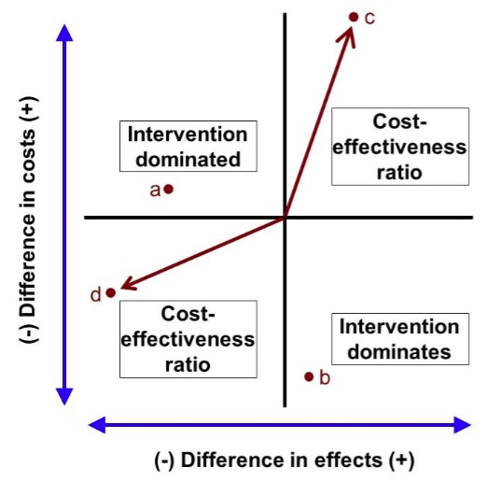
Cost effectiveness analysis graph
Notes:
In the literature, we can often encounter graphical depictions of cost-effectiveness analysis. The x and y coordinate axes are used for display. Their center indicates point 0, which also represents the procedure against which we compare the new procedure. The x-axis is the cost limit, above the axis is all that has a cost difference greater than 0, and what is below it has costs less than 0. The y-axis is the efficiency limit, what is on the right has an efficiency difference greater than 0 and what is on the left, has a difference less than 0. At the same time, we could place a line in quadrant I that would determine the threshold of willingness to pay, to see more precisely to what extent the increased cost for a certain benefit is acceptable to the state.

Slide 15
Cost-benefit analysis
It is the only which compares both costs and benefits in monetary units
Net monetary benefit = (Outcomes * CET) – Costs (should be more than 0)
Benefit to cost ratio = $\frac{Outcomes(Benefits)}{Costs} (should be more than 1)$

Slide 16
5. Placing monetary values on the outcomes
Calculate the costs:
Direct healthcare costs (HC, Nursing care, Technology costs, side efects treatment, medical education...)
Direct non-healthcare costs (social benefits and services, out-of pocket payments for non-medical items)
Indirect costs (Loss of productivity – absenteeism, presenteeism)
Intangible costs

Slide 17
6. Identifying study resources
Searching for clinical trials, meta-analyses, network meta-analyses, observational studies, patient registries, etc.

Slide 18
7. Establishing the probabilities of the outcomes
What is the probability that patients will be in one of the defined health states?
How will the patients move from one health state to another, and with which probability?

Slide 19
8. Applying decision analysis
How will the patients move from one health state to another, and with which probability?

Slide 20
9. Discounting costs or performing a sensitivity or incremental cost analysis
If costs and benefits are presented over a period of more than one year, future costs and benefits need to be discounted. Discounting is a method of converting future costs or revenues to their present value. The conversion of future values to their present value is performed as follows: $\frac{{value}_{t}}{{(1+r)}^{t}}$
t – time period, r – discount rate

Slide 21
9. Discounting costs or performing a sensitivity or incremental cost analysis
One-way SA
Two-way SA
Multivariant SA
Best case/worst case analysis
Probabilistic SA

Slide 22
10. Presenting the results
Use the ISPOR guidelines (CHEERS)

Slide 23
Budget impact analysis
The inputs
Perspective
Time horizon
Discounting
Population
Number of patients eligible for treatment
Market penetration
Current treatment schedule
Costing
Outcomes of BIA
Sensitivity analysis

Slide 24
Budget impact analysis

Slide 25
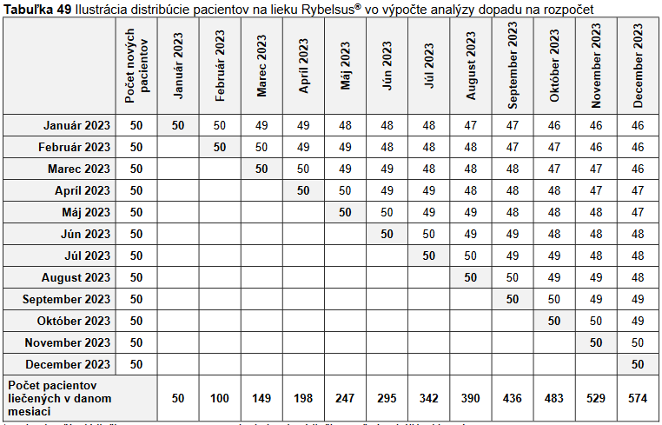
Budget impact analysis

Slide 26
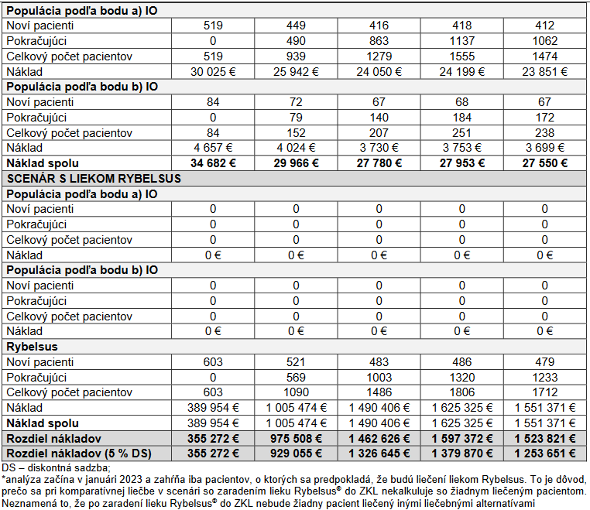

Slide 27
Thank you for your attention

