Slide 1
Drug transporters
2018

Slide 2
Transporters
membrane proteins able to facilitate flux of molecules into and out of cells
primary function is to transport nutrients (sugars, aminoacids, nucleotides, vitamines) inside or to efflux endogenous and exogenous toxines outside the cell
drugs bearing similar parts to natural substrates can be carried too – problems with bioavailability, efficiacy and toxicity (substrate competition)

Slide 3
Transporters
Passive transporters (facilitated transporters):
move molecules down their electrochemical gradient
Active transporters works against electrochemical gradients
Primary transporters – move molecules consumpting ATP
Secondary transporters – use energy of facilitated transport (e.g. of ions)
-co-transporters (in same way)
-exchangers (in opposite way)

Slide 4
Transporters
Most transporters are expressed om barrier cells:
- liver
- kidney
- intestine
- placenta
- brain
Different transporters on inner and outer part of cells

Slide 5
Transporters classification
cellular level:
influx tr.
efflux tr.
pharmacological level:
absorptive tr. (absorption into bloodstream)
secretory tr. (transport from bloodstream into urine,
bile or gut lumen)
conventionally, transporters enhancing absorption into brain and fetus are absorptive

Slide 6
Substrate classification
Organic cation transporter (OCT)
Organic cation/carnitine transporter (OCTN)
Organic anion transporter (OAT)
Organic anion transporter polypeptides (OATP)
Peptide transporter (PEPT)
Monocarboxylate transporter (MCT, SMCT)
Nucleoside transporter (CNT, ENT)
Bile acid transporter (NTCP, ASBT, BSEP, OST)
Multidrug resistance protein (MDR)
Multidrug resistance associated protein (MRP)
Breast cancer resistance protein (BCRP)

Slide 7
Mechanistical classification
presence of ATP consumption
ABC (ATP-binding casette) – e.g. MDR, MRP, BCRP)
SLC (Solute carrier) – most of transporters

Slide 8
Organic cation transporters (OCT)
OCT 1, OCT 2, OCT 3
similar transmembrane topology
shared group of substrates
common transport mechanism

Slide 9
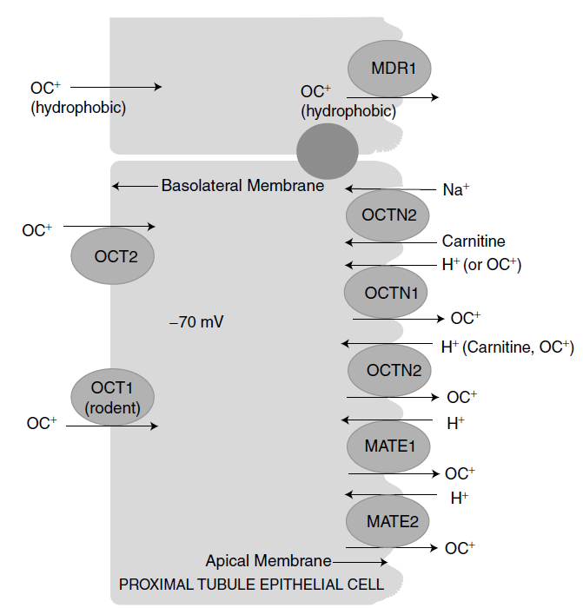

Slide 10
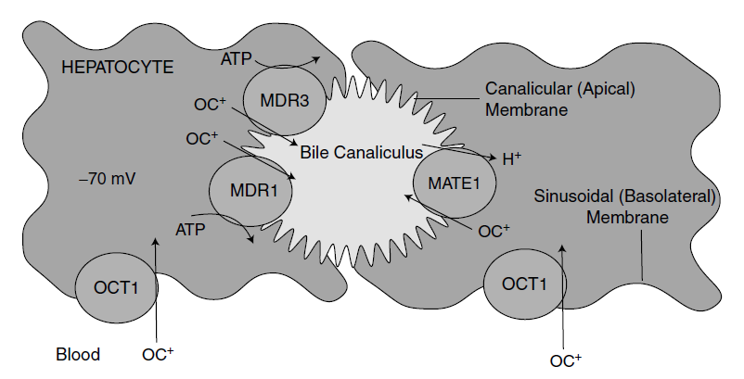
Organic cation transporter (OCT)

Slide 11
Organic cation transporter (OCT)
common substrates
generally low molecular weight
relativelly hydrophilic
organic cation
(positive charge not necessary:
anions – prostaglandines
neutral – beta estradiol)

Slide 12
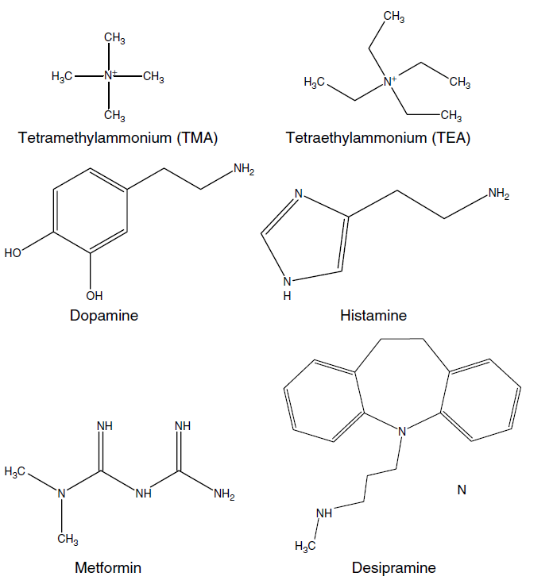
Organic cation transporter (OCT)

Slide 13
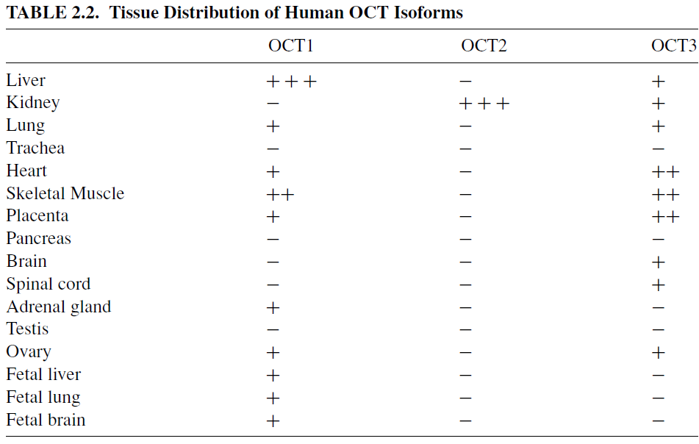
Organic cation transporter (OCT)

Slide 14
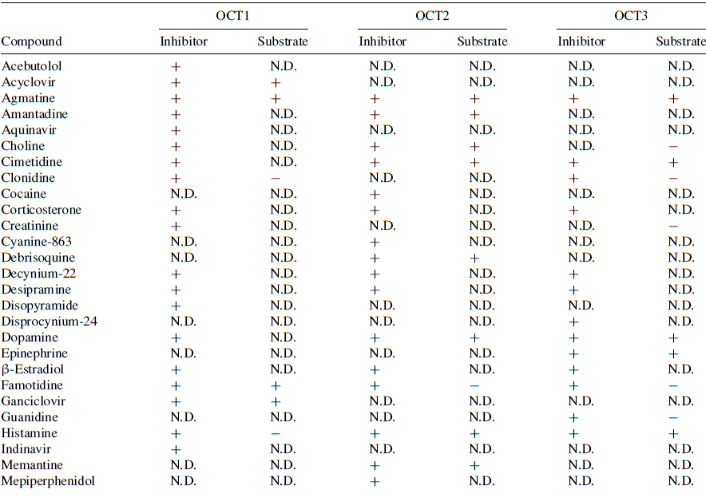
Organic cation transporter (OCT)

Slide 15
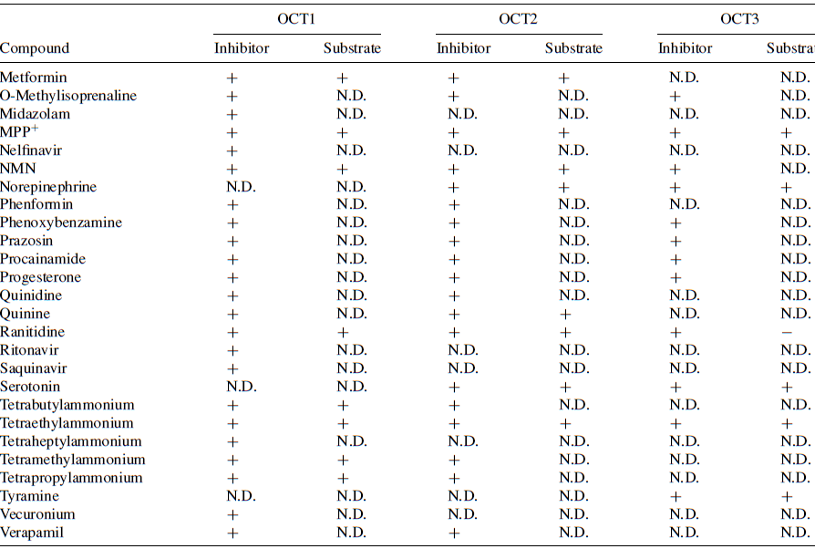
Organic cation transporter (OCT)

Slide 16
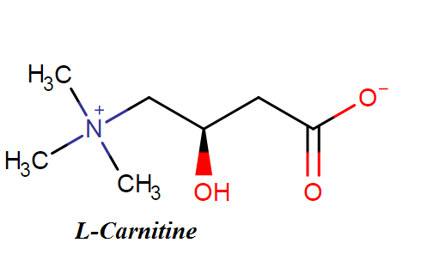
Organic cation/carnitine transporters (OCTN)
Carnitine
zwitterion
essencial cofactor in the lipid metabolism
involvement in beta-oxidation
absorbed from diet by OCTN
reabsorbed in distal tubulus by OCTN

Slide 17
Organic cation/carnitine transporters (OCTN)
OCTN 1
H⁺ antiporter
OCTN 2
Na⁺ cotransporter or cation uniporter
substrates:
quinidine, verapamil, small compounds with quarternary N
s. are competetive inhibitors and causes secondary carnitine deficiency

Slide 18
Organic anion transporters (OAT)
organic acids secretory system – excretion of acidic metabolites into urine
utilizes electrochemical gradient of substrate itself or another solute
mechanism of action:
organic anion – dicarboxylate exchange
organic anion – urate exchange

Slide 19
Organic anion transporters (OAT)
OAT is mainly expressed in kidney
multispecific transporters binds very vast array of substrates
specifity based on general physicochemical properties:
charge
hydrophobicity
hydrogen bonding ability

Slide 20
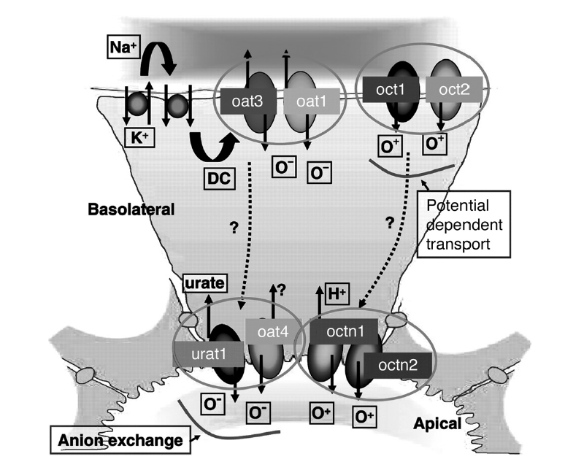
Organic anion transporters (OAT)
Mechanism coupled with ion exchange:

Slide 21
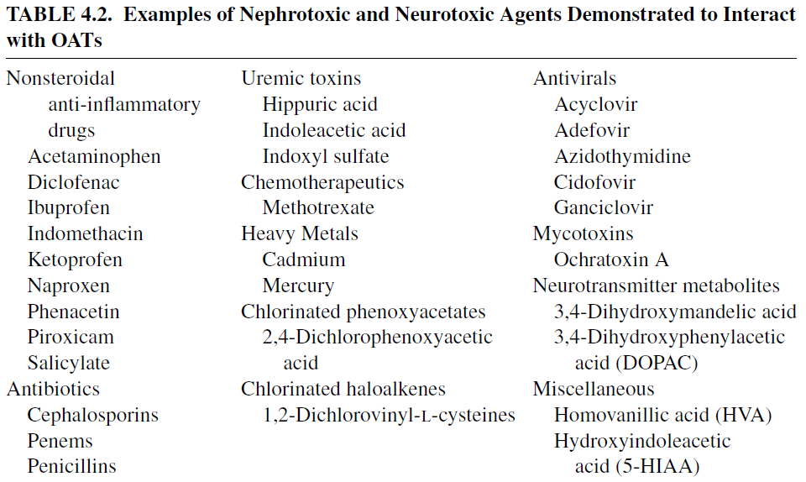
Organic anion transporters (OAT)
Mechanism coupled with ion exchange:

Slide 22
Organic anion transporting polypeptides (OATP)
Mechanisms are diverse
all posesses rocker-switch type of mechanism, exchanging different co-substrates
Substrates are relatively large (from benzylpenicilin 334 to cholecystokinin octapeptide 1143)
In general, substrates are steroid or cyclic peptide compounds, often negativelly charged

Slide 23
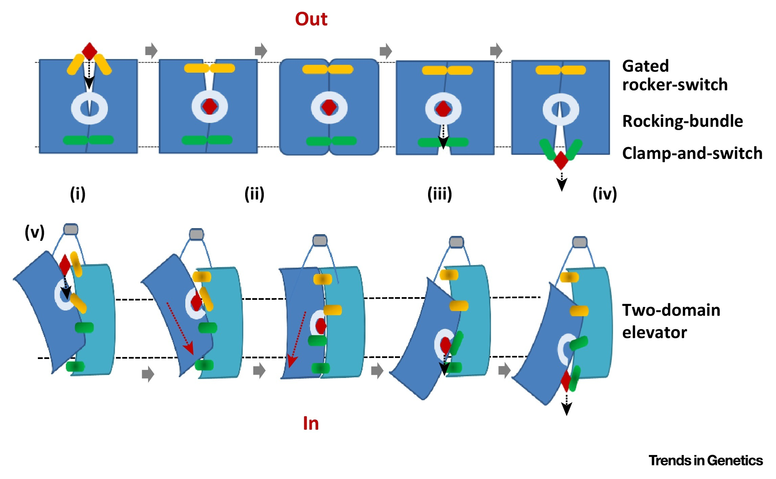

Slide 24
Organic anion transporting polypeptides (OATP)
Endogenous substrates are:
thyroid hormones
bile acids
steroid hormones
bilirubin
prostaglandines
Whole drug families are substrates:
Statins
Sartans
ACE inhibitors (Prils)
Cardiac glycosides

Slide 25
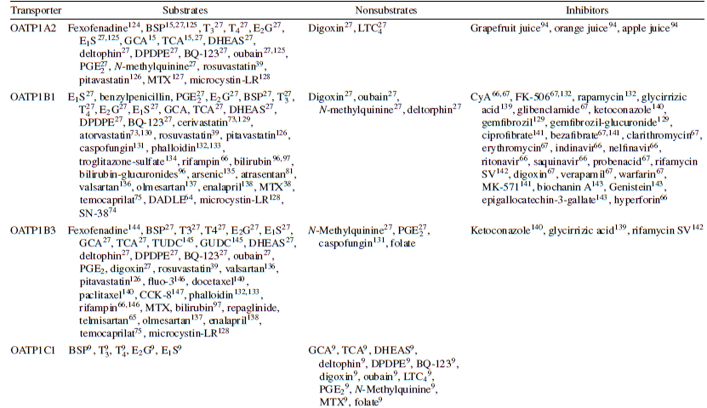
Organic anion transporting polypeptides (OATP)

Slide 26
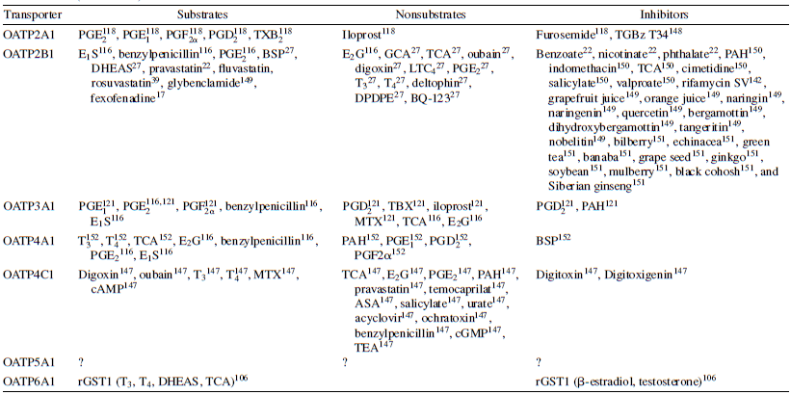
Organic anion transporting polypeptides (OATP)

Slide 27
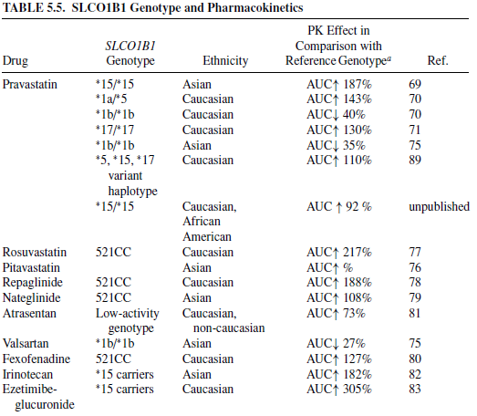
Organic anion transporting polypeptides (OATP)
pharmacogenetics is very important

Slide 28
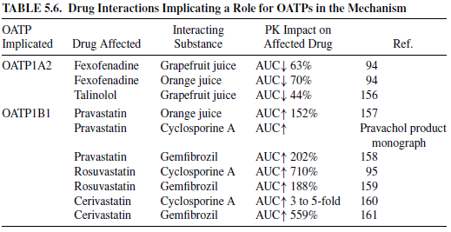
Organic anion transporting polypeptides (OATP)
drug interactions very common
facilitating of fexofenidate excretion
suppresion of statins first-pass effect

Slide 29
Mammalian oligopeptide transporters (PEPT)
Aminoacids are mainly absorbed from the intestine
in the form of di- and tri-peptides.
These are cleavaged by cytosolic peptidases and free
aminoacids are transported into bloodstream
(by other transporters).
4 isoforms:
PEPT1, PEPT2
PHT1, PHT2 (peptide-histidine transporters)

Slide 30
Mammalian oligopeptide transporters (PEPT)
Mechanism of action:
utilizating H⁺ membrane gradient
- neutral and anionic peptides requires H⁺ cotransport
- cationic peptides do not need H⁺

Slide 31
Mammalian oligopeptide transporters (PEPT)
Molecular requirements for substrate molecules:
PEPT1: L-aminoacid
acid or hydrophobic moiety at C terminus
weakly basic group in α position of N terminus
ketomethylene / peptidic bond
PEPT2: as PEPT1
aminocarbonyl group in α or β position
PHT: not elucidaded yet
Endogenous substrates:
all aminoacid di- and tri-peptides

Slide 32
Mammalian oligopeptide transporters (PEPT)
Exogenous substrates:
β-lactam antibiotics, ACE inhibitors,
L-DOPA prodrugs, valacyclovir, valgancyclovir,
aminoacid prodrugs of bisphosphonates,
peptide analogs (e.g. linezolid)
Activity and expression of PEPTs are dependent on
diet volume and composition
insulin / leptin regulation involved

Slide 33
Monocarboxylate transporters (MCT, SMCT)
MCT1-14 isoforms
MCT1-4 transports metabolic monocarboxylates
(e.g. lactate, pyruvate, butyrate, acetoacetate)
other MCTs involved in aminoacids transport
MCT8 transports T3 and T4 thyroid hormones
Mechanism of action: H⁺ cotransporters
Sodium-dependent monocarboxylate transporters
(SMCT)
Mechanism of action: Na⁺ cotransporters
Exogenous substrates: acidic β-lactams, statins,
valproic acid crossing blood-brain barrier

Slide 34
Nucleoside transporters (CNT, ENT)
Nucleosides are hydrophilic and has low membrane
permeability
two classes of transporters:
Concentrative nucleoside transporters (CNT)
Equilibrative nucleoside transporters (ENT)
Many therapeutic nucleoside analogues rely
on these transporters to enter or exit cells

Slide 35
Concentrative nucleoside transporters (CNT)
mechanism of action: Na⁺ cotransporter
3 isoforms:
CNT1, CNT2, CNT3
CNT1
typically found in epitelium of intestine, kidney
and liver
mainly pyrimidine nucleosides, limited transport
of adenosine
anticancer gemcitabine, cytarabine, capecitabine
antivirotic zidovudine, lamivudine, zalcitabine
cotransport nucleoside : Na⁺ (1 : 1)

Slide 36
Concentrative nucleoside transporters (CNT)
CNT2
widely distributed in organism
purine nucleosides, limited transport of uridine
ribavirin, 5-fluorouridine
cotransport nucleoside : Na⁺ (1 : 1)
CNT3
widely distributed in organism
purine and pyrimidine nucleosides
many nucleoside analogs are substrates too
cotransport nucleoside : Na⁺ (1 : 2)

Slide 37
Equilibrative nucleoside transporters (ENT)
mechanism of action:
concentration-dependent facilitated transport
ENT1
ubiquitous distribution in organism
both purine and pyrimidine nucleosides
gemcitabine, fludarabine, cytarabine, ribavirin
dipyridamol is potent ENT1 inhibitor
ENT2
most abundant in muscle, but present in other tissues
lower afinity for guanosine and cytidine
transports also free nucleotide bases

Slide 38
Equilibrative nucleoside transporters (ENT)
ENT3
broadly selective for all nucleosides
and their analogues
located on lysozomal membrane
ENT4
in fact OCT, transports selectively adenosin

Slide 39
Bile acid transporters
primary bile acids: cholic acid
chenodeoxycholic acid
secondary bile acids: deoxycholic acid
lithocholic acid
produced from primary acids by intestinal microflora
amphipatic detergents crucial for lipid absorption
hepatobiliary circulation – one molecule of bile acid
is secreted and reabsorbed approximately 12X a day

Slide 40
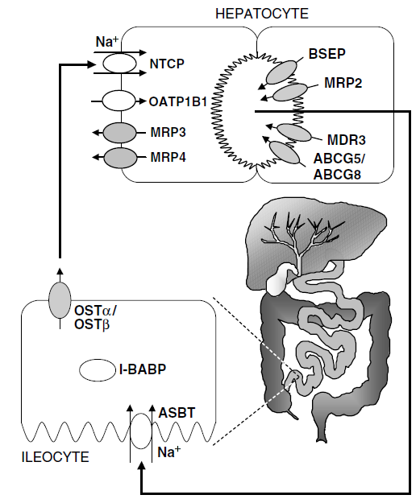
Bile acid transporters

Slide 41
Bile acid transporters
Bile salt export pump (BSEP)
secretes monovalent bile acid salts into bile
ATP binding casette transporter
Multidrug resistance protein 2 (MDR2)
secretes divalent and glucuronated bile acids,
glucuronated and sulfatated drug metabolites,
chemotherapeutics and antibiotics
ATP binding casette transporter
Multidrug resistance protein 3 (MDR3)
secretes phospholipids

Slide 42
Bile acid transporters
Apical sodium-dependent bile acid transporter
(ASBT)
absorbs bile acid from ileum to enterocyte
Na⁺ cotransporter
Organic solute transporter (OSTα/OSTβ)
transports bile acids from enterocyte to blood stream
Sodium-taurocholate cotransporting polypeptide
(NTCP)
transports bile acids into hepatocytes
Na⁺ cotransporter
Organic anion transporters (OATPs)
transports bile acids as well

Slide 43
Multidrug resistance protein (P-glycoprotein)
two main human isoforms: MDR1, MDR2
present in all tissues, predominantly in secretory
organs
ATP binding casette transporters
systems are saturable
MDR1
transports broad spectrum of xenobiotics
substrates generally nonpolar, weakly amphipathic
MDR2
transports acetylcholin and other fosfolipids into bile

Slide 44
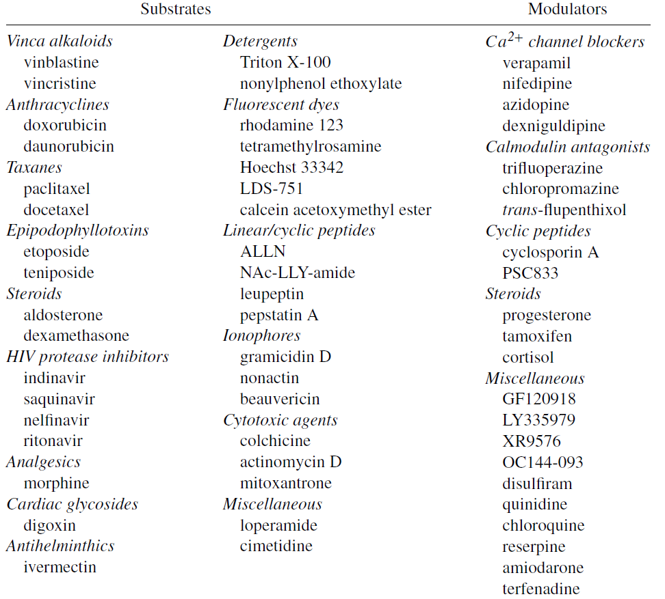
Multidrug resistance protein (P-glycoprotein)

Slide 45
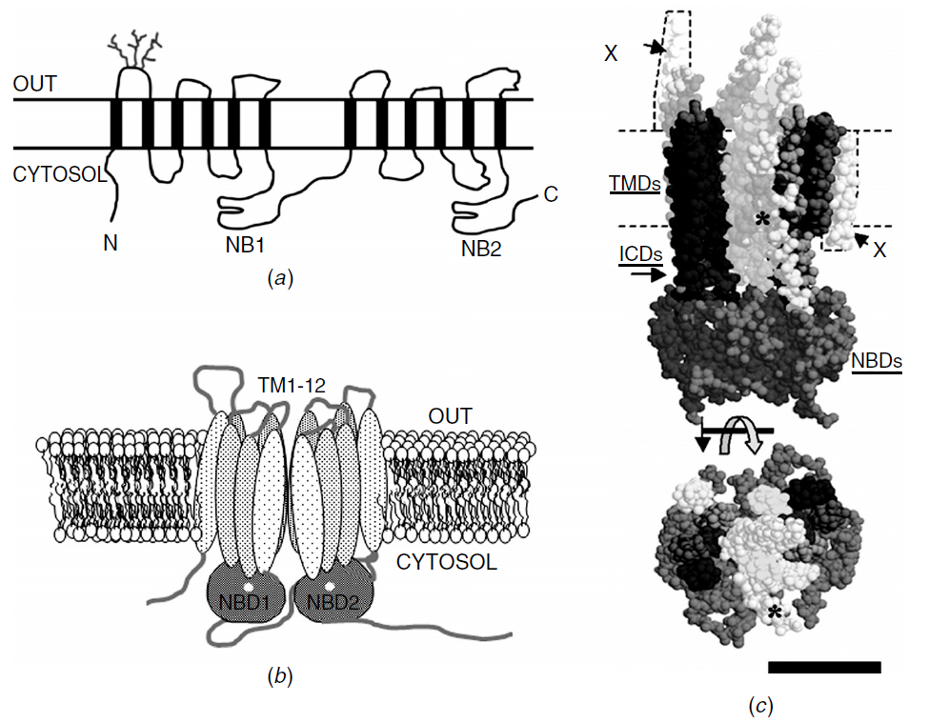
Multidrug resistance protein (P-glycoprotein)

Slide 46
Multidrug resistance proteins (MRP)
12 isoforms
MRP1-9
cystic fibrosis transmembrane conductance regulator
(CFTR)
sulfonylurea receptors (SUR1, SUR2)
- all ATP binding casette proteins
- effluxes many endogenous and xenobiotic
lipophilic organic anions
predominant localization in renal epithelia,
hepatocytes and blood-tissue barriers

Slide 47
Multidrug resistance proteins (MRP)
MRP1
ubiquitous transporter
substrates:
glucuronates of leucotriens, estradiol, bilirubin,
cholic acid, methotrexate
MRP2
main hepatocytar transporter
similar substrates as MRP1
MRP3
hepatocytar transporter
similar substrates as MRP1 and MRP2

Slide 48
Multidrug resistance proteins (MRP)
MRP4
ubiquitous transporter
substrates as MRP1, additionally prostanoids, urate,
topotecan
MRP5
urogenital tract and vascular system epitelium
substrates: cAMP, cGMP, fluorouracil, methotrexate
MRP6
kidney, liver
low affinity, same substrates as MRP1

Slide 49
Multidrug resistance proteins (MRP)
MRP7, MRP9
little known
MRP8
predominant in periferal neurons
substrates similar to MRP1,
additionally cAMP and cGMP

Slide 50
Breast cancer resistance protein (BCRP)
ATP binding casette protein
located in GIT, genitals, placenta, liver
and blood-brain barrier
overexpressed in some carcinoma cells
substrates:
anticancers: mitoxantron, etoposide, topotecan,
irinotecan, methotrexate
tyrosin kinase inhibitors: gefitinib, imatinib
photodynamic therapeutics: porfyrins, chlorins
steroids, antivirals, HMG-CoA reductase inhibitors,
antibacterial quinolones, macrolides, nitrofurantoin

