Slide 1
Metabolism and drug design
2018

Slide 2
ADME - Metabolism
Organisms posesses a large set of enzymes able to modificate xenobiotics
Original issue is to protect internal environment from toxic agents
Compounds are generally made more hyrophilic to enhance renal or hepatobiliar excretion

Slide 3
ADME - Metabolism
Knowledge of metabolic pathways is crucial
By metabolization, drug can be
deactivated (most metabolites)
made more potent (prodrugs)
converted to reactive form (toxicity)

Slide 4
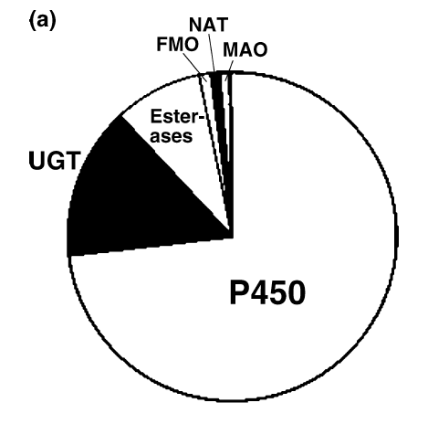
Enzyme set ready for metabolisation
Fraction of drugs metabolized by various systems

Slide 5
Oxidation enzymes
Cytochrome P450 (CYP, P450)
often occures rearrangements in structure after primary oxidation
FeO³⁺ involved in mechanism

Slide 6
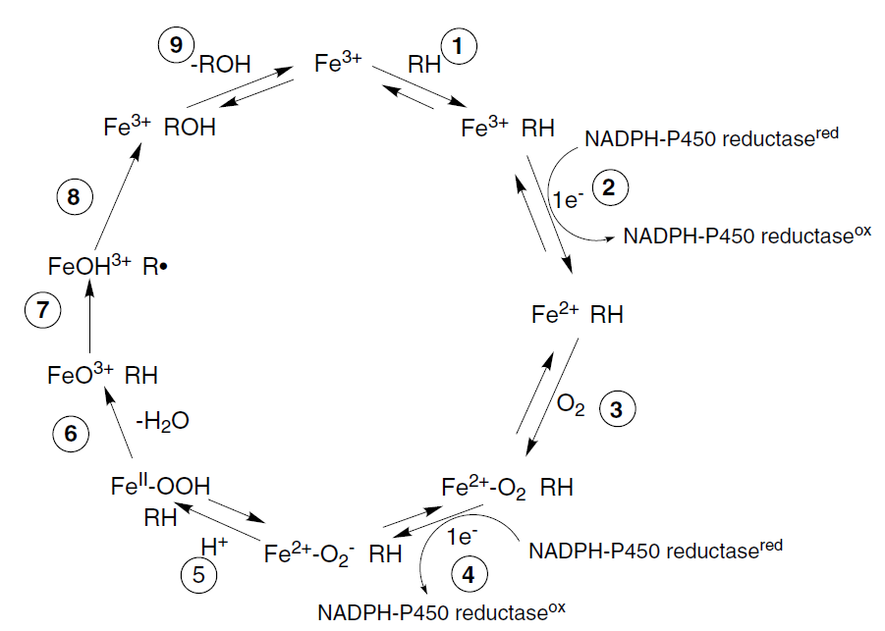
Oxidation enzymes
Cytochrome P450 (CYP, P450)

Slide 7
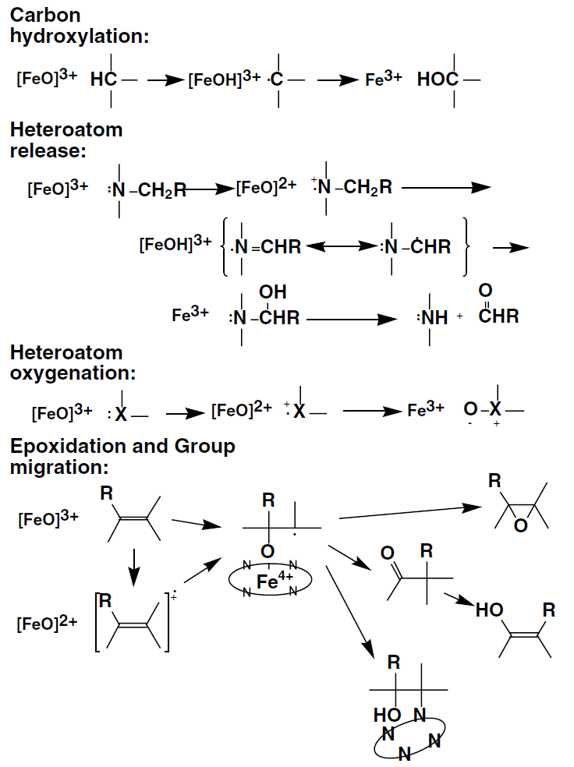

Slide 8
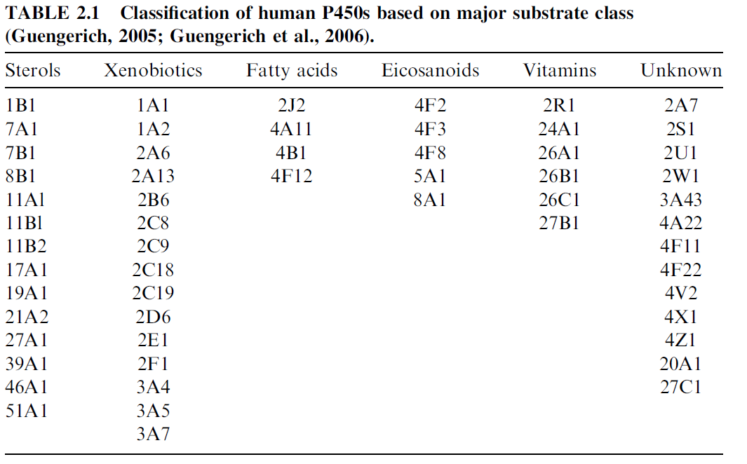
Oxidation enzymes
Cytochrome P450 (CYP, P450)
human genome has 57 P450 genes

Slide 9
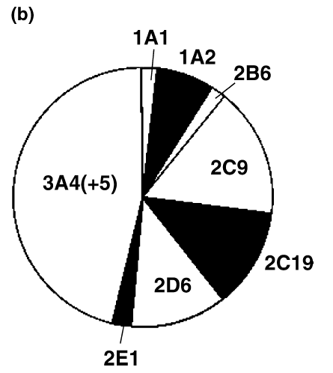
Oxidation enzymes
Cytochrome P450 (CYP, P450)
only few are of high importance

Slide 10
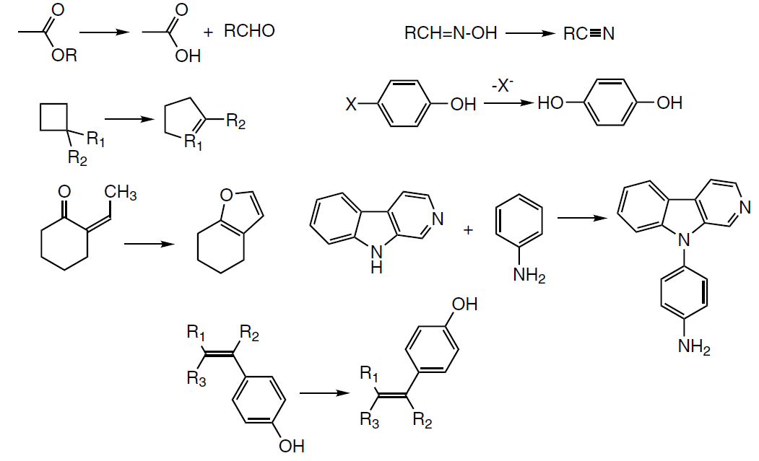
Oxidation enzymes
Cytochrome P450 (CYP, P450)
some uncommon reactions

Slide 11
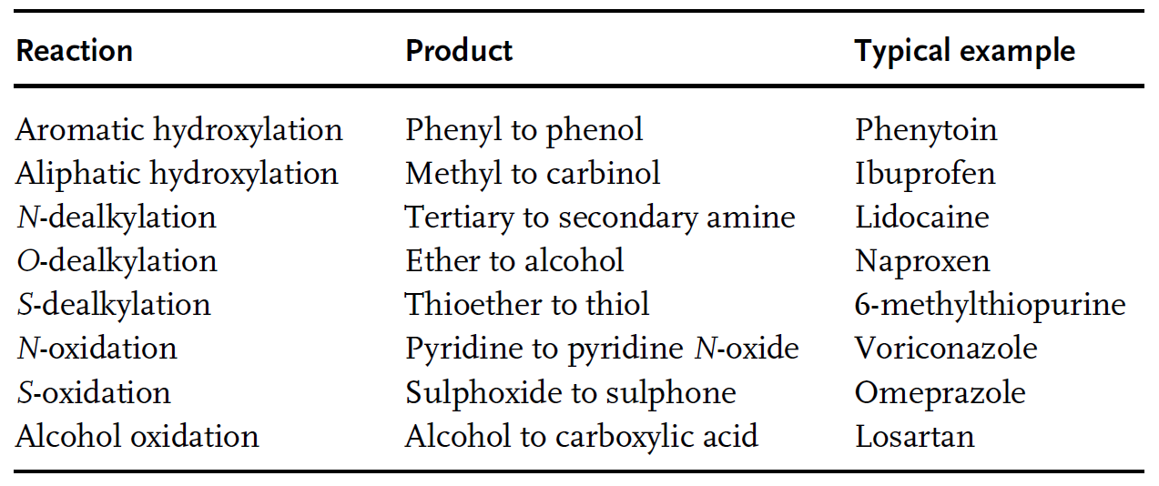
Oxidation enzymes
Cytochrome P450 (CYP, P450)

Slide 12
Oxidation enzymes
Flavin-containing Monooxygenase (FMO)
7 forms of FMO, located in endoplasmatic reticulum
distincly from CYP P450, only soft nucleophiles are substrates (N, S, P in phosphines)

Slide 13
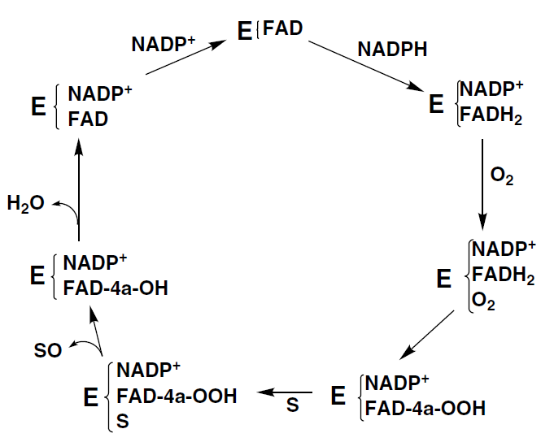
Oxidation enzymes
Flavin-containing Monooxygenase (FMO)

Slide 14
Oxidation enzymes
Monoamine Oxidase (MAO)
two forms – MAO A and MAO B
present in mitochondrial membrane of hepatocytes and neurons
flavoprotein oxidase protein as FMO, but with different mechanism releasing ammonia and hydrogen peroxide

Slide 15
Oxidation enzymes
Aldehyde Oxidase
Xanthine Dehydrogenase
contains molbdenum and iron in active center
present in cytosol, mainly in hepatocytes
electron can be transferred to an oxidized pyridine nucleoside or to oxygen forming H₂O₂
substrates are: various aldehydes
heterocycles containing N
(purines are substrate for both enzymes)

Slide 16
Oxidation enzymes
Peroxidases
similar mechanism with CYP system involving FeO
generating of radical
radical further undergoes propagation, dimer formation or dealkylation

Slide 17
Oxidation enzymes
Alcohol Dehydrogenases (ADH)
concentrated in liver, specifity for primary and some secondary alcohols
reaction is generally reversible
at least 7 different genes for ADHs

Slide 18
Oxidation enzymes
Aldehyde Dehydrogenases (ALDH)
concentrated in liver, mainly in mitochondria
at least 19 genes for ALDHs are known

Slide 19
Reduction enzymes
CYP P450, ADH
both can catalyze reductions of aldehydes and imines
these reverse reactions occures in environments with low O₂ tension (e.g. venous section of liver)

Slide 20
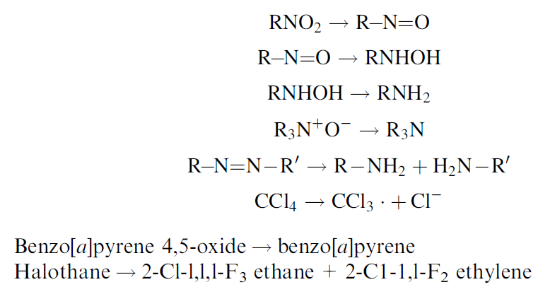
Reduction enzymes
CYP P450, ADH

Slide 21
Reduction enzymes
NADPH-P450 Reductase
main function is to restore P450 system, but has enzymatic activity to some P450 substrates as well

Slide 22
Reduction enzymes
Aldo-Keto Reductase (AKR)
substrates are mainly sugar aldehydes, steroids, prostaglandines

Slide 23
Reduction enzymes
Quinone Reductase (NQO)
present in cytosol, substrates are quinones (both ortho- and para-), iminoquinones, nitro- and azo- compounds

Slide 24
Reduction enzymes
Glutathione Peroxidase (GPX)
reduces hydroperoxides including H₂O₂
six different enzymes, most of them contains selenocystein in the active site
restored by GSH reductase
overall reaction can be written as

Slide 25
Hydrolysis enzymes
Epoxide Hydrolase (GPX)
located in microsomes and endoplasmic reticulum
catalyses simple addition of water to epoxide:

Slide 26
Hydrolysis enzymes
Esterases and Amidases
heterogenous group of enzymes with similar basic mechanism of action
present in all environments in the organism
most important:
lipases
acetylcholin esterase (ACHE)
butylcholin esterase

Slide 27
Conjugation enzymes
UDP-Glucuronosyl Transferases (UGT)
conjugation of glucuronic acid to various functional groups:
alcohols, phenols, amines, heterocyclic nitrogens, amides thiols, acids
conjugates are:
more polar
ionized at physiological pH
have increased Mr
are actively excreted by carriers in liver and kidney

Slide 28
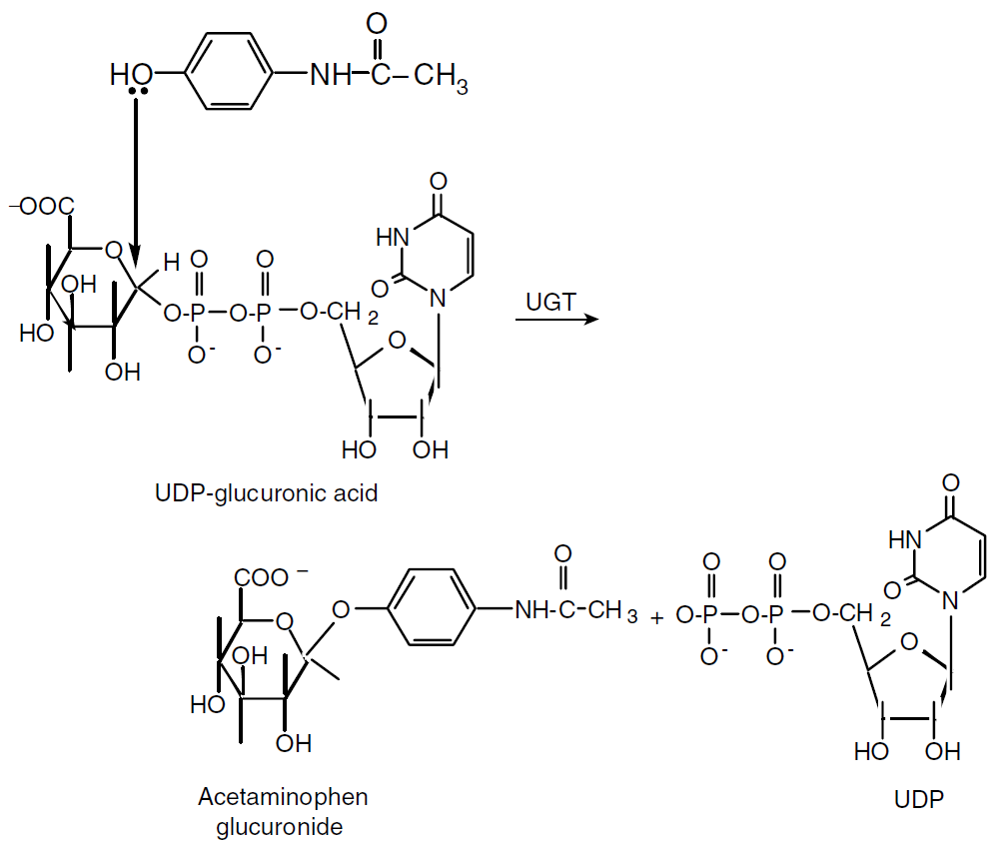
Conjugation enzymes
UDP-Glucuronosyl Transferases (UGT)

Slide 29
Conjugation enzymes
UDP-Glucuronosyl Transferases (UGT)
endogenous substrates:
bilirubin, steroids, lipids, leucotrienes, thyroid hormones, vitamines A, D
three major gene families:

Slide 30
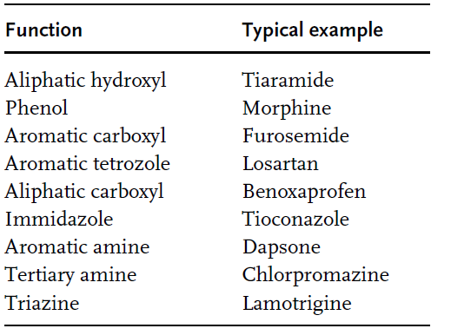
Conjugation enzymes
UDP-Glucuronosyl Transferases (UGT)

Slide 31
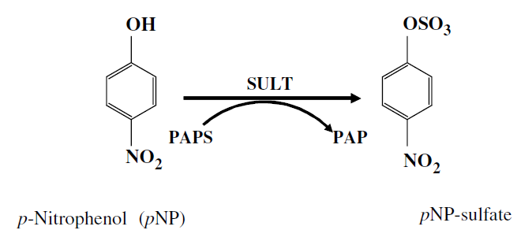
Conjugation enzymes
Cytosolic Sulfotransferases (SULT)
works with cosubstrate PAPS (3-phosphoadenosin-5-phosphosulfate)
both O-sulfates and N-sulfates can be formed

Slide 32
Conjugation enzymes
Cytosolic Sulfotransferases (SULT)
works with cosubstrate PAPS (3-phosphoadenosin-5-phosphosulfate)

Slide 33
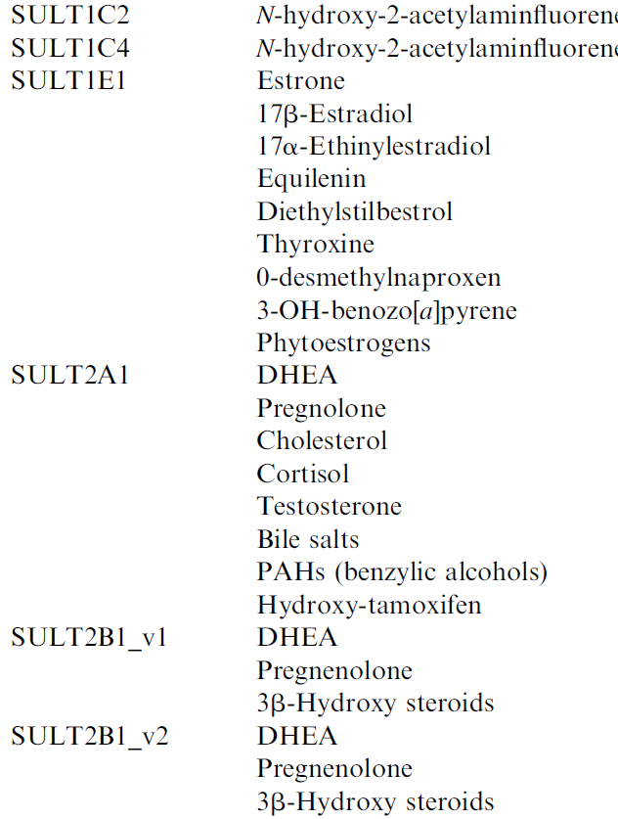
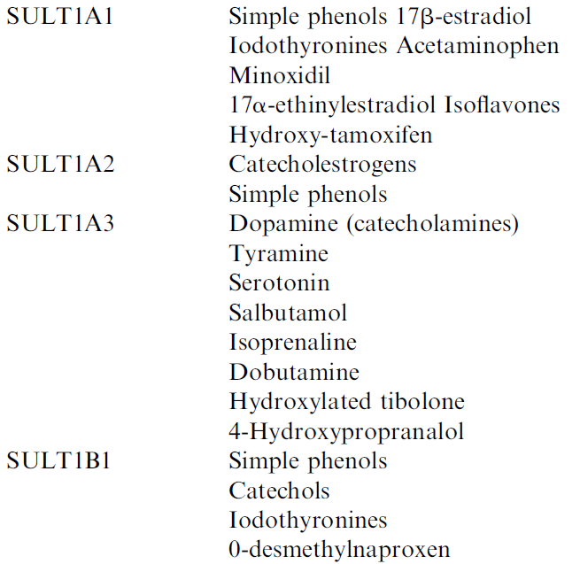
Conjugation enzymes
Cytosolic Sulfotransferases (SULT)

Slide 34
Conjugation enzymes
Glutathione-S-Transferases (GTS)
- glutathione is endogenous nucleiophile
- attacs electrophilic molecules
- glutathione conjugates are excreted by transporters into bile
- six major classes if GTS

Slide 35
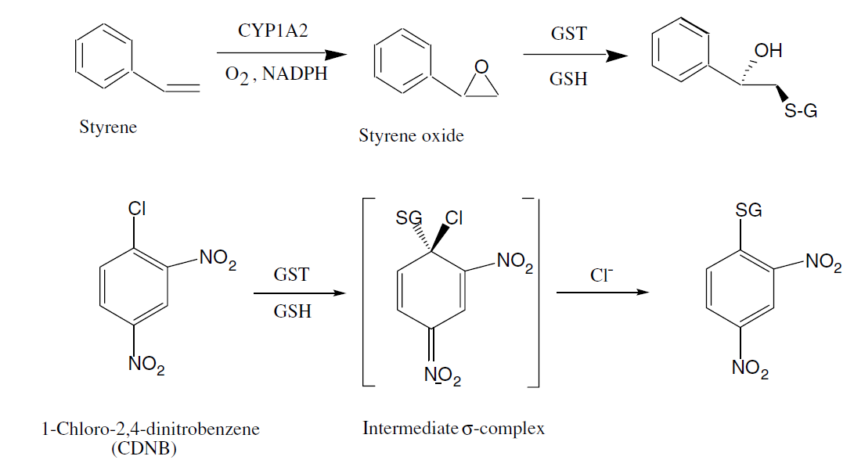
Conjugation enzymes
Glutathione-S-Transferases (GTS)

Slide 36
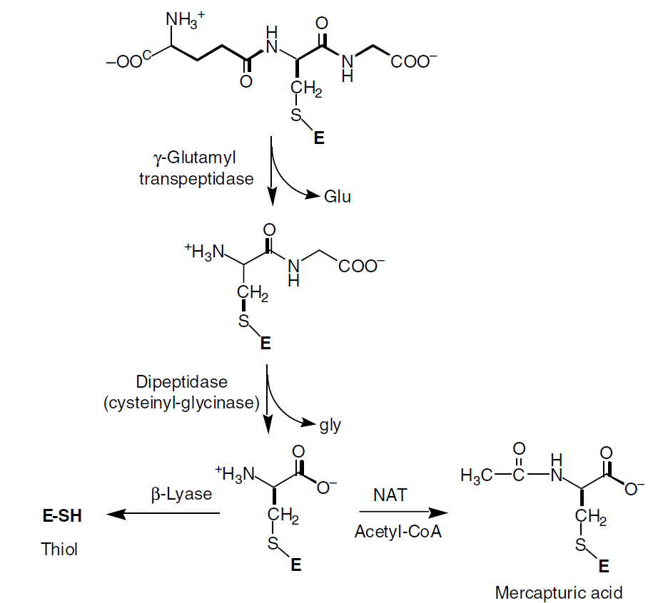
Conjugation enzymes
Glutathione-S-Transferases (GTS)
conjugates may
be further converted
to N-acetylcystein,
mercaptouric
or thiol derivatives
and excreted
by urine

Slide 37
Metabolism-induced toxicity
Part of molecule is altered by oxidation, reduction or conjugation to form a reactive electrophile
Electrophiles reacts with internal nucleophiles (proteins, nucleic acids, small peptides)
Alkylation of such structures may cause organ toxicity and cancerogenity.

Slide 38
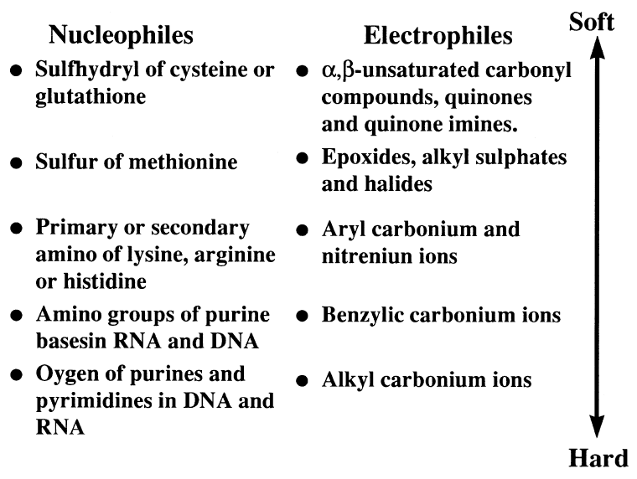
Metabolism-induced toxicity

Slide 39
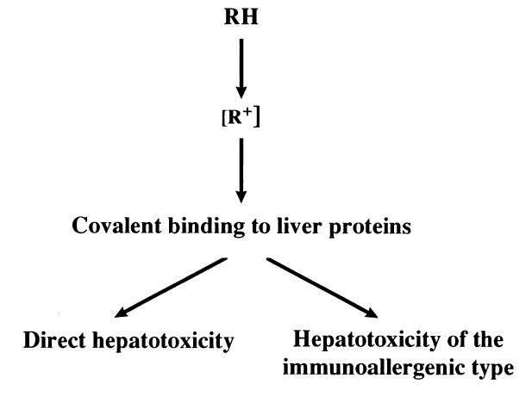
Metabolism-induced toxicity
two kinds of toxicity – altering protein functions
- triggering immunity reaction

Slide 40
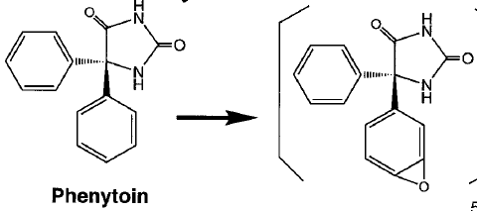
Toxicophores
Epoxides
phenytoin is metabolized by P450 to epoxide metabolite causing hepatic necrosis and aplastic anaemia

Slide 41
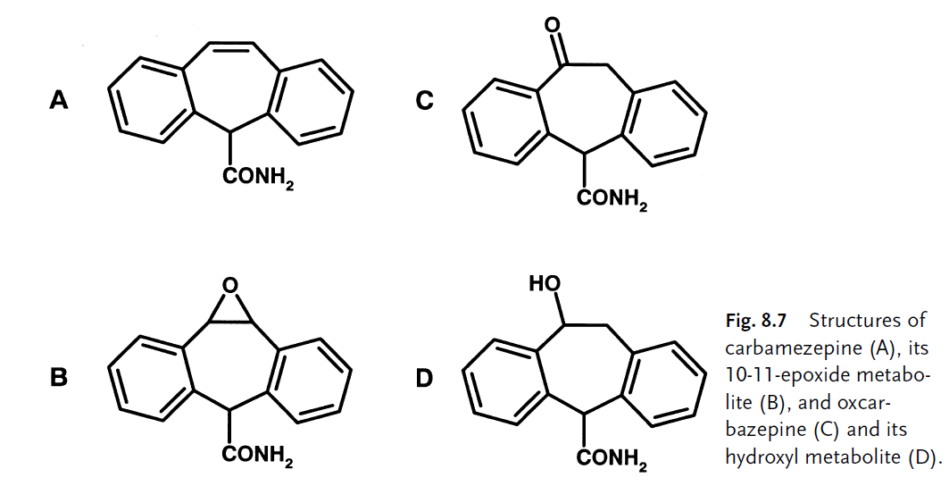
Toxicophores
Epoxides
carbamazepine epoxide causes teratogenicity and skin rash
oxcarbamazepine is much less toxic

Slide 42
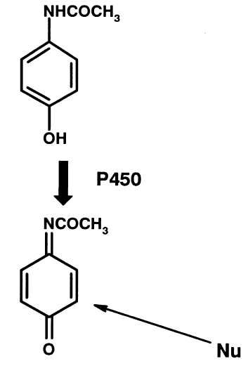
Toxicophores
Quinone Imines
phenacetin is oxidated by P450 and causes cellular hepatotoxicity

Slide 43
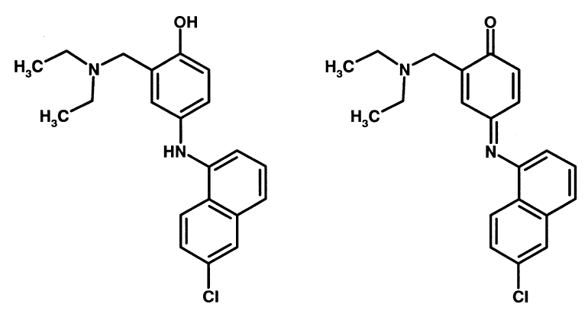
Toxicophores
Quinone Imines
Antimalaric agent amodiaquine causes hepatotoxicity

Slide 44
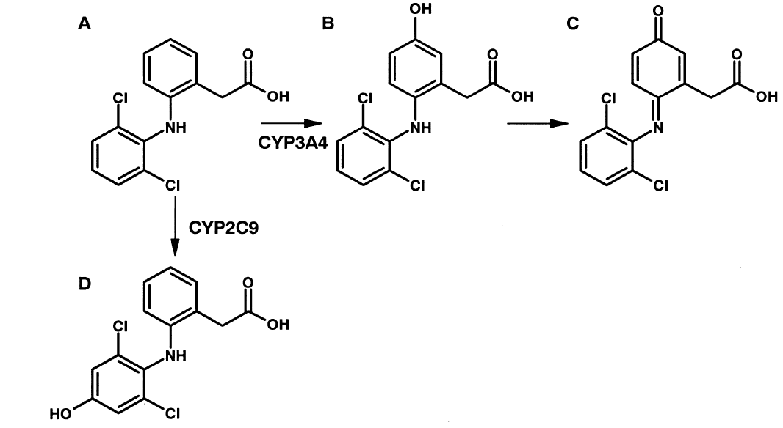
Toxicophores
Quinone Imines
One pathway for diclofenac causes hepatotoxicity

Slide 45
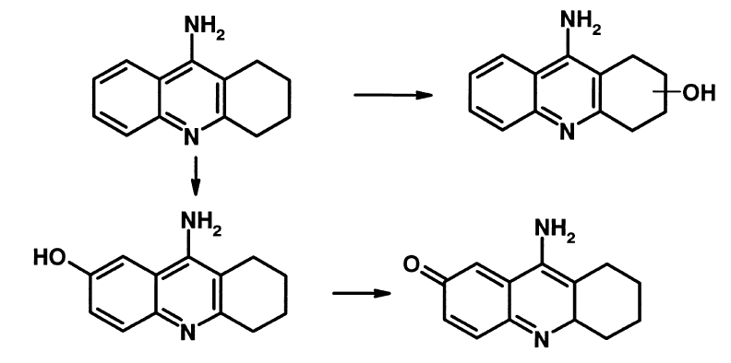
Toxicophores
Quinone Imines
ACHE inhibitor tacrine causes hepatotoxicity

Slide 46
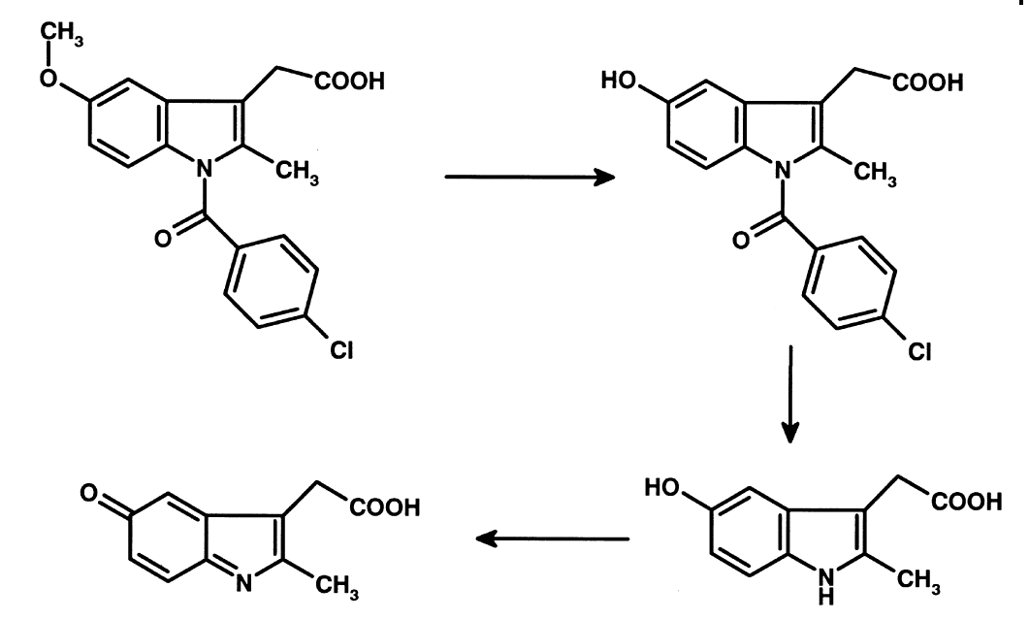
Toxicophores
Quinone Imines
Indomethacin caused agranulocytosis

Slide 47
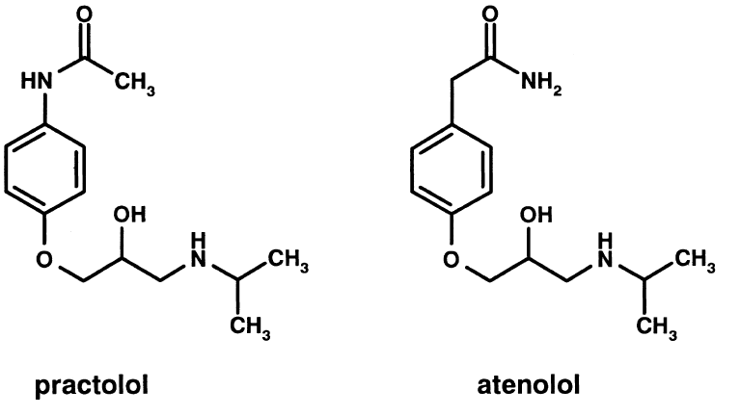
Toxicophores
Quinone Imines
Practolol had to be withdrawn from the market due to skin and eye lesions
Atenolol have not toxic acetanilide moiety

Slide 48
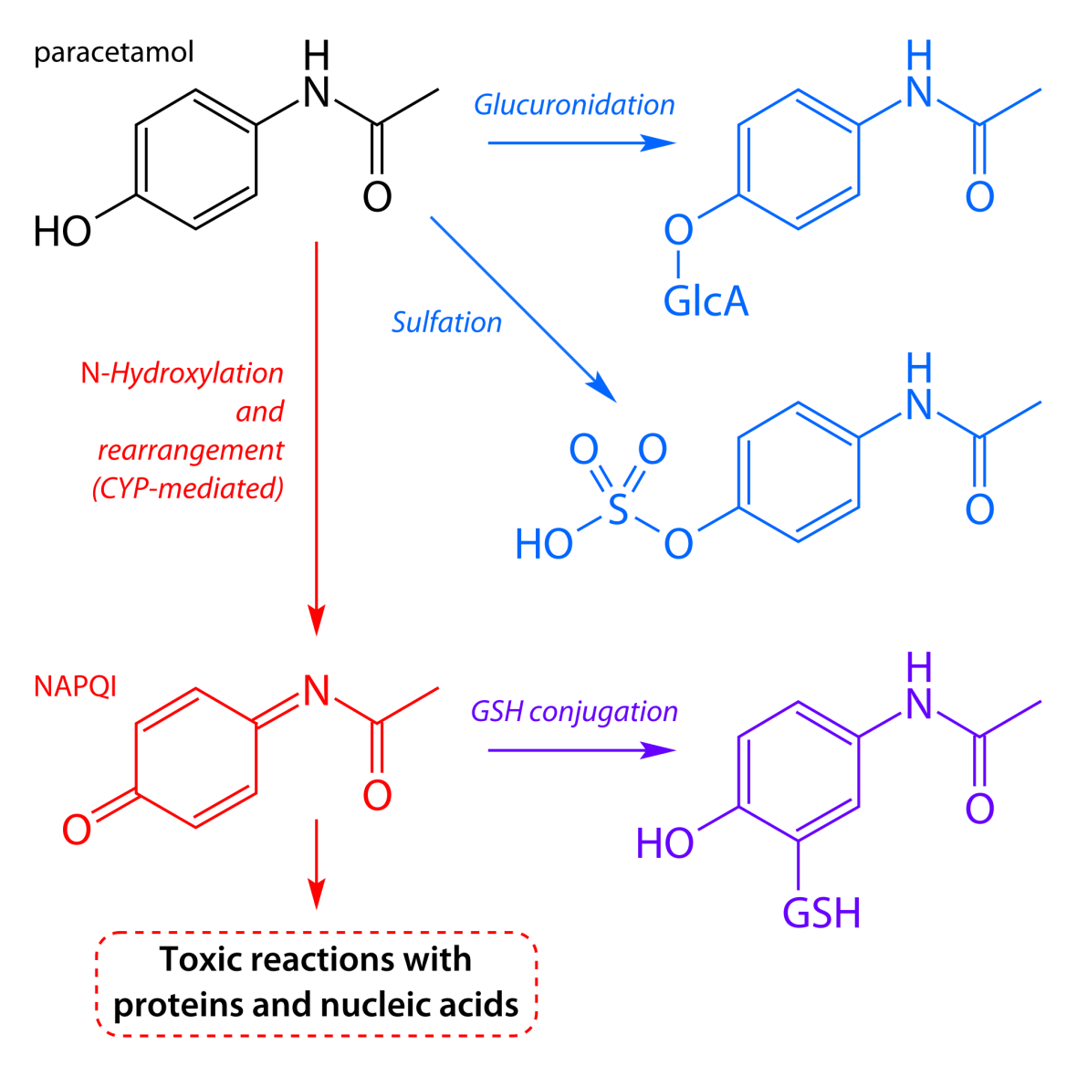
Toxicophores
Quinone Imines
Paracetamol has the same toxicologic issue

Slide 49
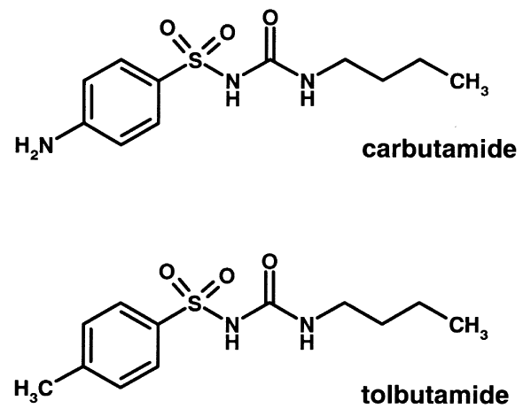
Toxicophores
Quinone Imines
Carbutamid caused bone marrow toxicity and was withdrawn
Tolbutamid have not this problem

Slide 50
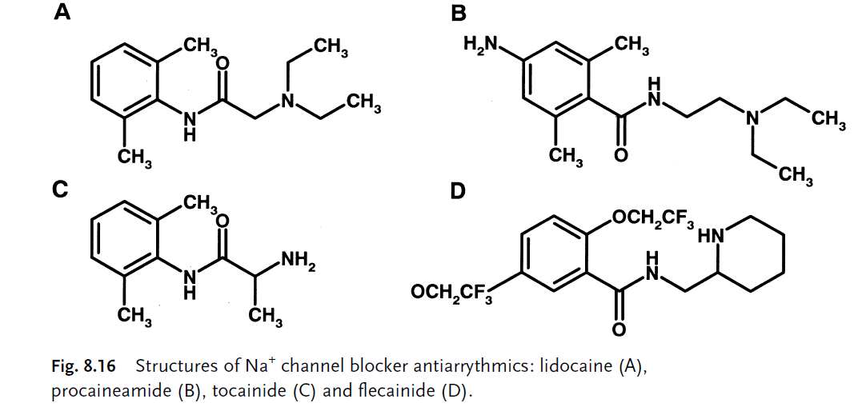
Toxicophores
Quinone Imines
Lidocain as antiarrhytmic has short biological half-time.
Longer acting analogues procainamide and tocainide are toxic, flecainid do not so.

Slide 51
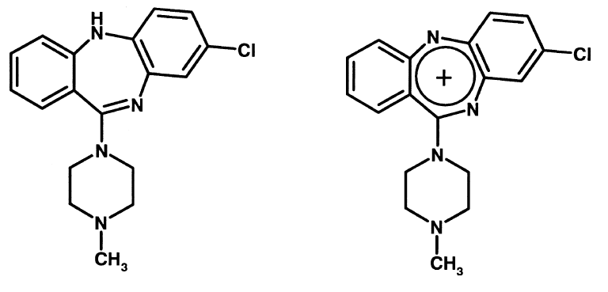
Toxicophores
Nitrenium Ions
Clozapine forms reactive nitrenium ions causing agranulocytosis

Slide 52
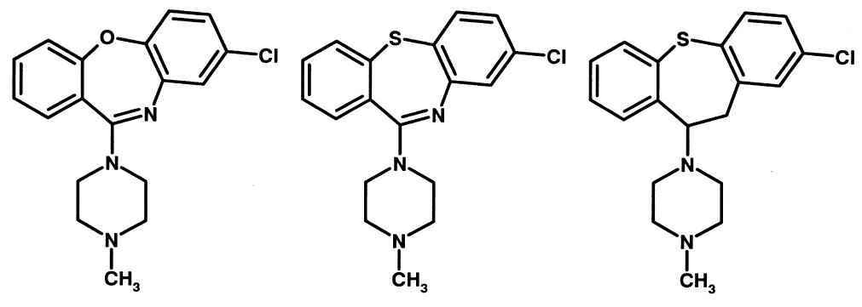
Toxicophores
Nitrenium Ions
Modification of circle brought non-toxic analogues

Slide 53
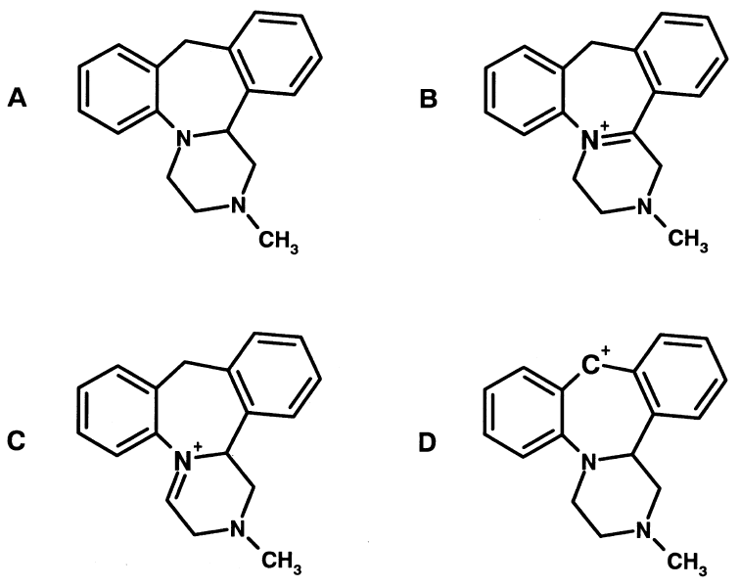
Toxicophores
Iminium Ions
Antidepressant mianserin causes agranulocytosis

Slide 54
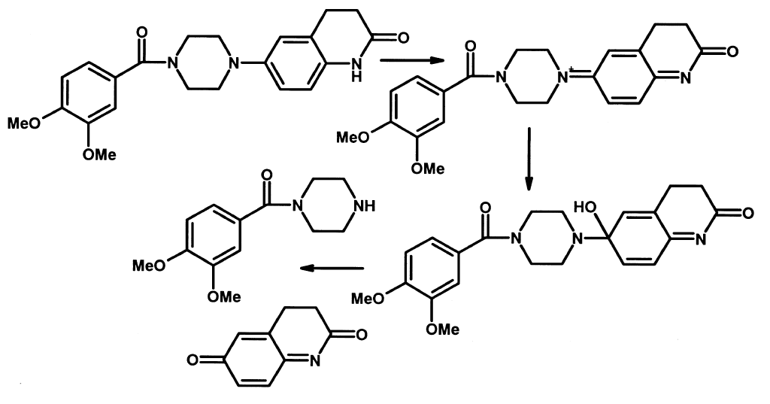
Toxicophores
Iminium Ions
Cardiotonic vesnarinon causes agranulocytosis both due to iminium and quinone imine formation

Slide 55
Toxicophores
Hydroxylamines
hydroxylamines are further metabolized to reactive nitroso derivatives
Sulphonamides and dapson are metabolized that way - causes agranulocytosis and skin hypersensitivity

Slide 56
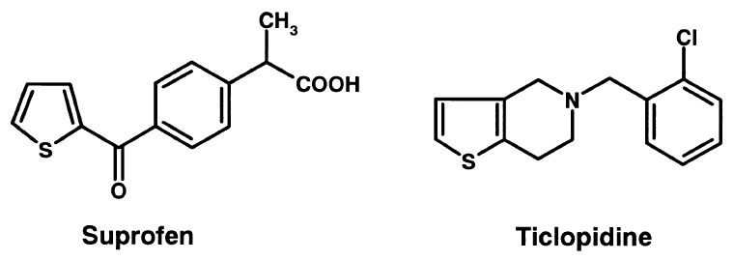
Toxicophores
Thiophene ring
thiophene S-oxides and S-chlorides causes covalent protein bonding
agranulocytosis by ticlopidine (platelet inhibitor)
nephrotoxicity of suprofen (NSA, withdrawn)

Slide 57
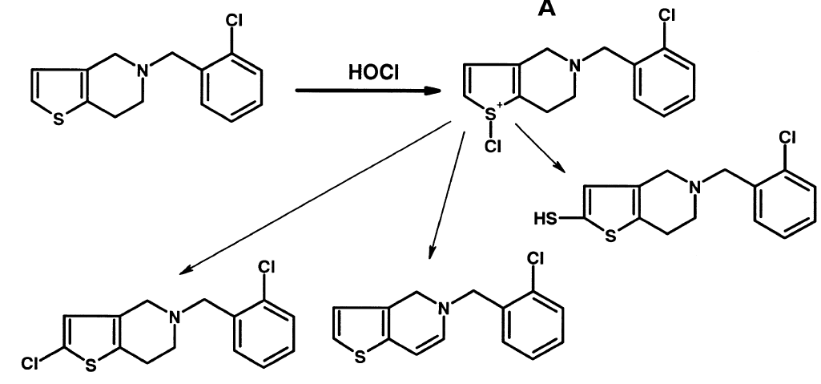
Toxicophores
Thiophene ring
ticlopidine metabolism in white blood cells

Slide 58
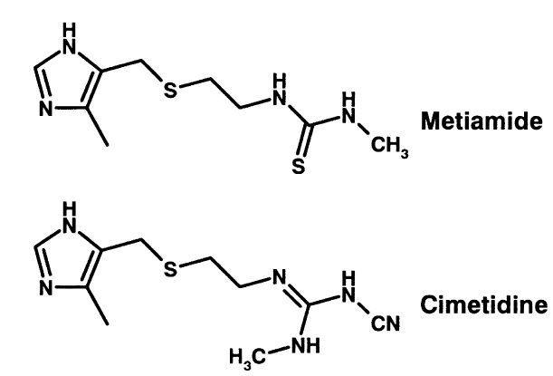
Toxicophores
Thioureas
thioureas are metabolized to sulfon acids
Metiomid was withdrawn due to blood dyscrasias
Cimetidine not shows this problem

