Slide 1
Physicochemical properties
MPDD 14.3.2024

Slide 2
LIPOPHILICITY
LogP depends on:
Molecular volume
Dipolarity
Hydrogen bond acidity
Hydrogen bond basicity

Slide 3
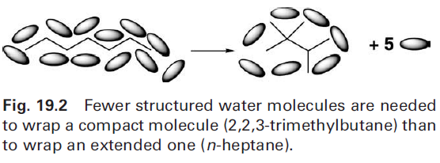
LIPOPHILICITY
LogP depends on:
Molecular volume
-related to molecular weight and affects the overall size of the cavity that must be formed in the solvent

Slide 4
LIPOPHILICITY
LogP depends on:
Molecular volume
Dipolarity
-affects the polar alignment of the molecule with polar solvent (dipole-dipole interaction with molecules of water)
Hydrogen bond acidity
Hydrogen bond basicity

Slide 5
LIPOPHILICITY
LogP depends on:
Molecular volume
Dipolarity
Hydrogen bond acidity
-hydrogen bond donation – hydrogens with polar bonds (OH, NH₂, NH)
Hydrogen bond basicity
-hydrogen bond acceptance (O, N, F atoms)
Both affects the hydrogen bonding rate with environment

Slide 6
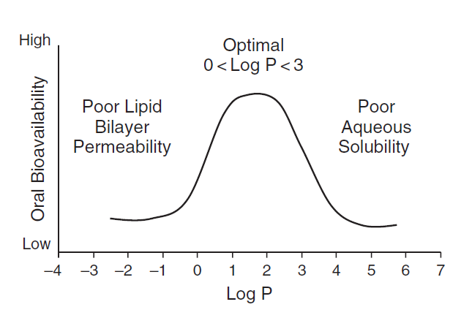
LIPOPHILICITY

Slide 7
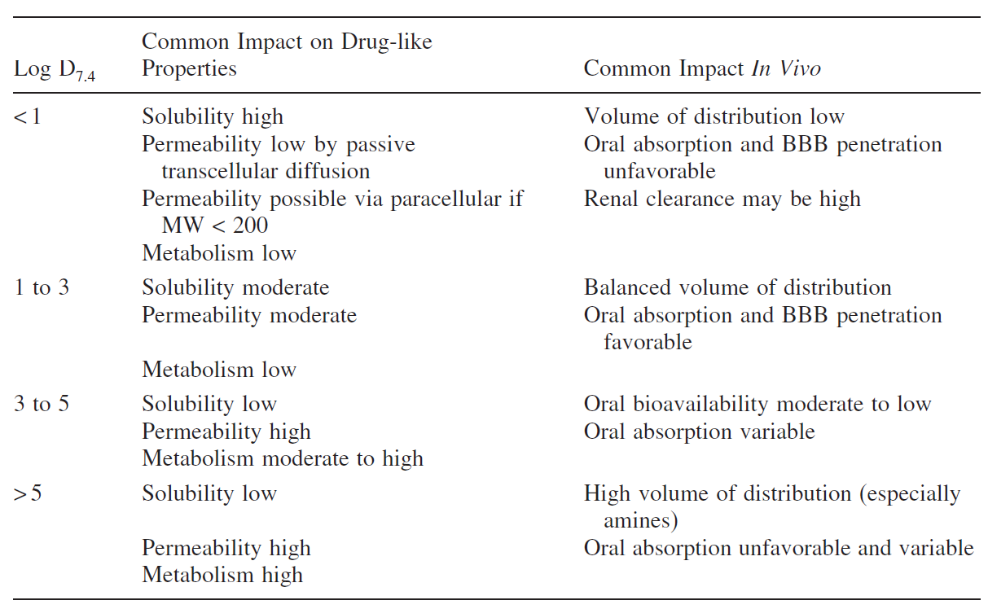
LIPOPHILICITY

Slide 8
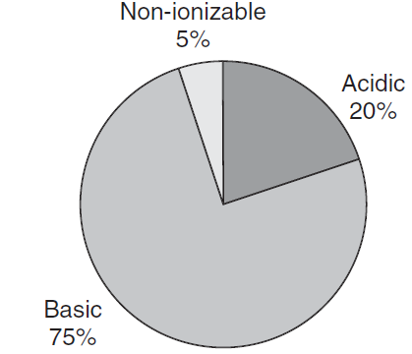
pK_{A}
Most of drugs are ionizable
Most of drugs are basic

Slide 9
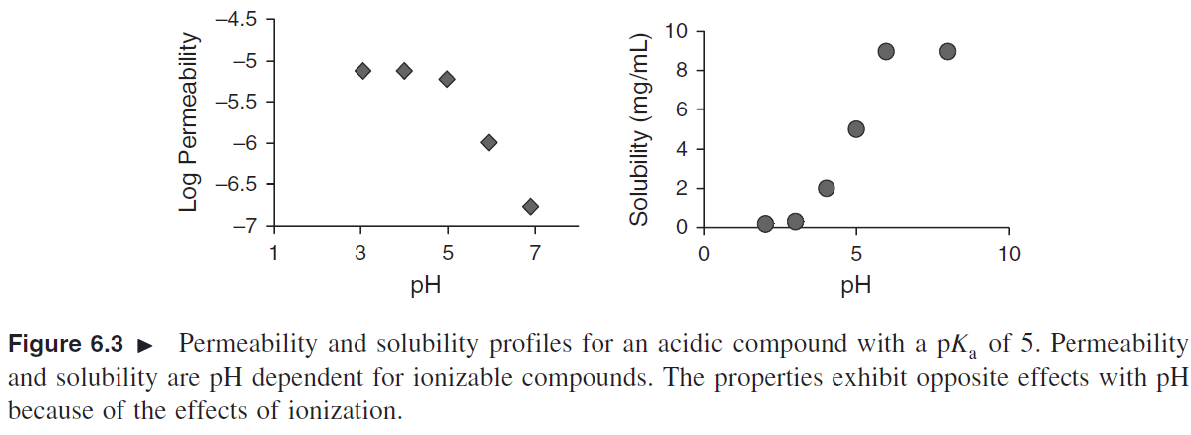
pK_{A}
pKa determines the degree of ionization and affects both solubility and permeability, but in opposite way

Slide 10
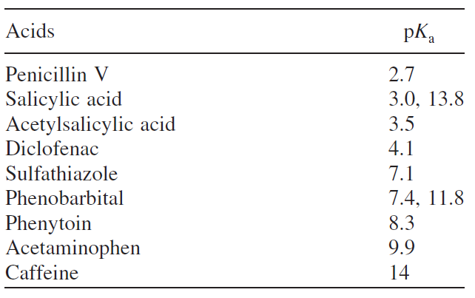
pK_{A}

Slide 11
pK_{A}

Slide 12
pK_{A}
Effect of mesomeric effect on sulfonamide activity :
most acidic compounds are most potent
almost linear dependence

Slide 13
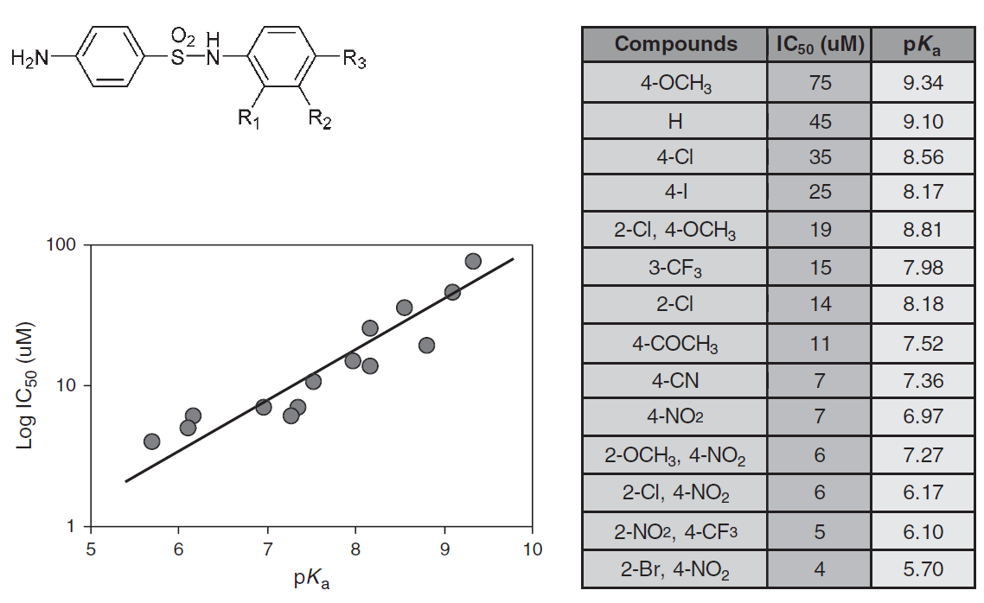
pK_{A}
Effect of mesomeric effect on sulfonamide activity : most acidic are most potent

Slide 14
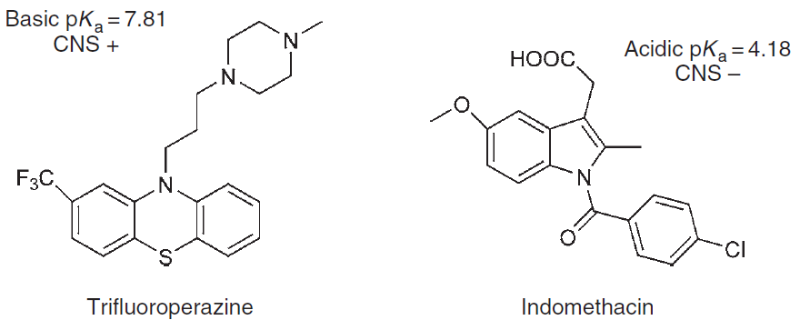
pK_{A}
basic drugs permeates blood-brain barrier,
acidic do not so

Slide 15
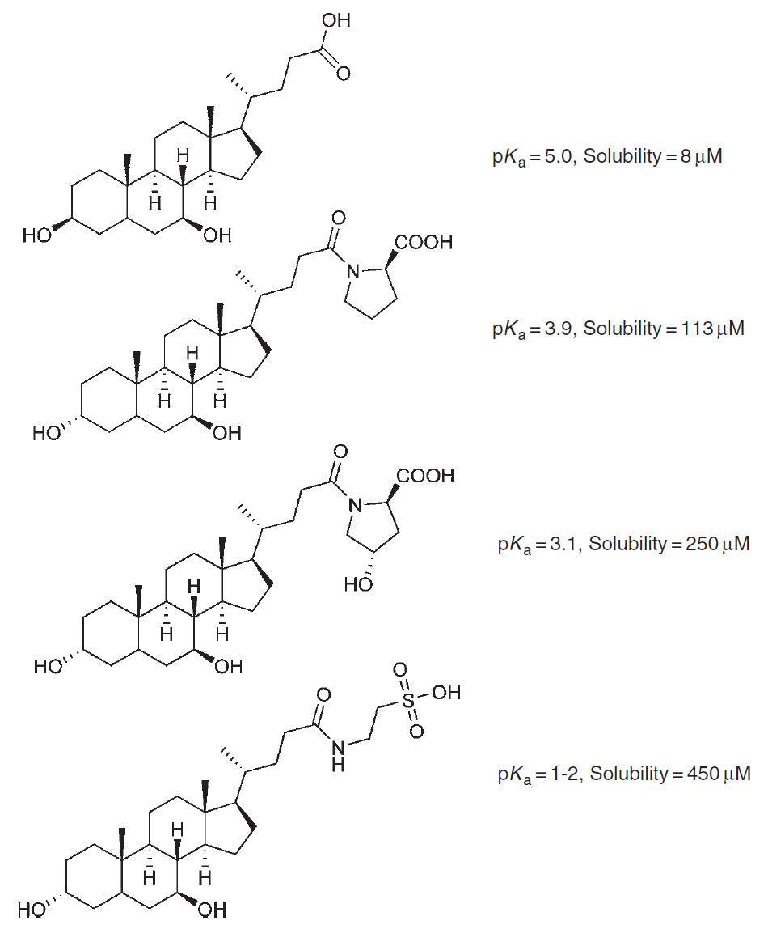
pK_{A}
pKa effect on
water solubility of
bile acids:

Slide 16
pK_{A}
The strength of acid can be increased by electron withdrawing group on α carbon (halogen, carboxy, cyano, nitro...)
The strength of base can be decreased by adding conjugated double bond system close to nitrogen (nitrogen lone electron pair is delocalized)
Basicity of aniline can be increased by -OCH₃
and decreased by -NO₂ substitution

Slide 17
SOLUBILITY
Solubility is a determinant of intestinal absorption and oral bioavailability
Solubility is increased by adding ionizable groups or reducing logP and MW
Salt formation increase dissolution rate

Slide 18
SOLUBILITY
Problems of low-soluble compounds:
design problem:
-lipophilic groups are often added to enhance target binding
-most active compounds are often poor soluble

Slide 19
SOLUBILITY
Structural properties affecting solubility:

Slide 20
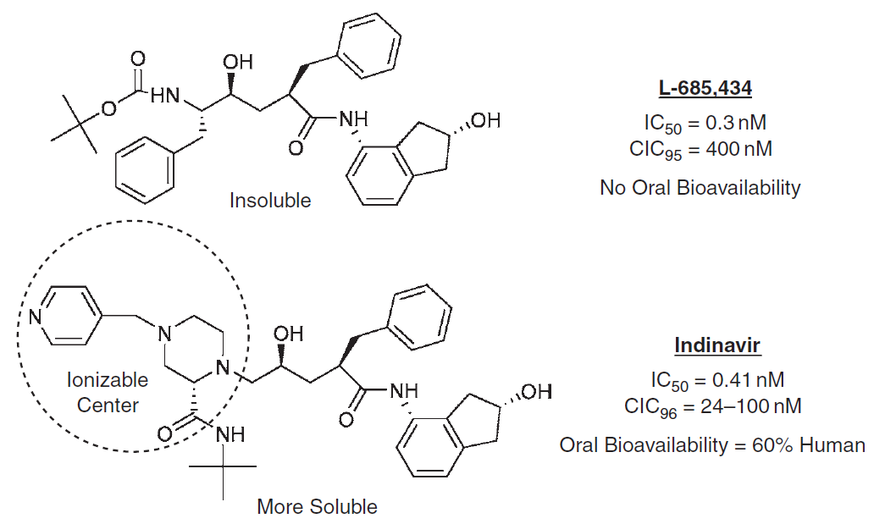
SOLUBILITY
Effect of solubility on oral bioavailability:

Slide 21
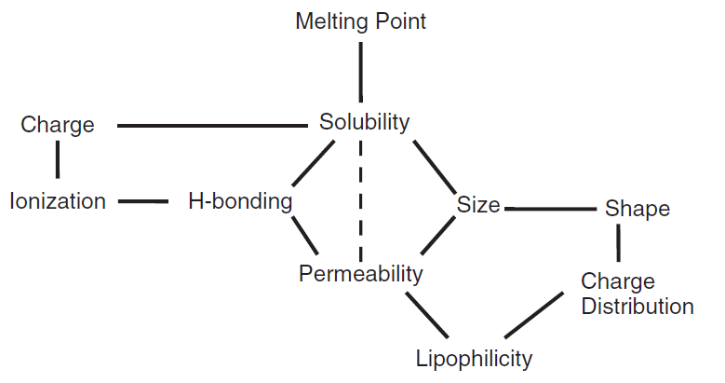
SOLUBILITY
Changing one property affect other properties:

Slide 22
SOLUBILITY
Permeability tends to vary over a more narrow range than does solubility.
The difference between a high-permeability and low-permeability compound can be 50-fold (0.001-0.05 min⁻¹)
The difference between a high-solubility and low-solubility compound can be million-fold
(0.1 µg/mL-100mg/mL)
Therefore, if a structural modification improves solubility by 1000-fold while reduces permeability by 10-fold, there will be still 100-fold improvement of absorption

Slide 23
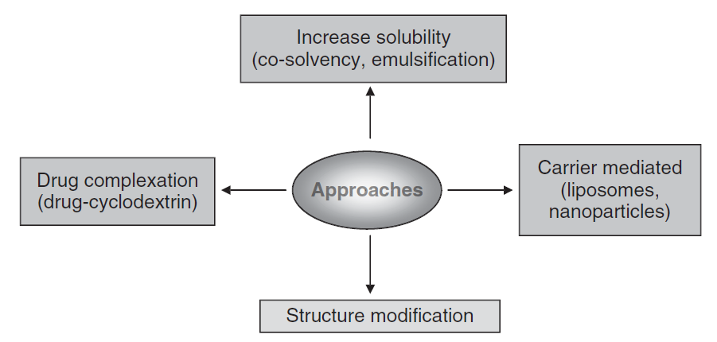
SOLUBILITY
Approaches to improve solubility
– structure modification is the first choice

Slide 24
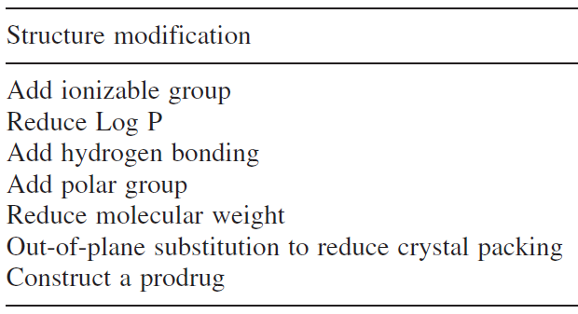
SOLUBILITY
Structure modification strategies for solubility improvement:

Slide 25
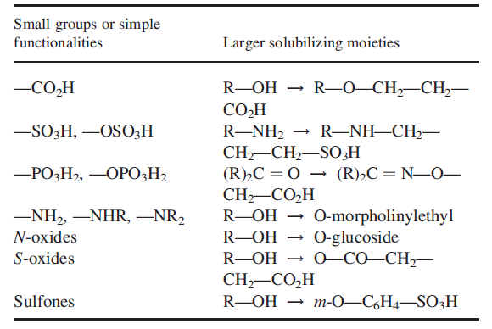
SOLUBILITY
Addition of ionizable groups
typically basic amine or carboxylic group is added

Slide 26
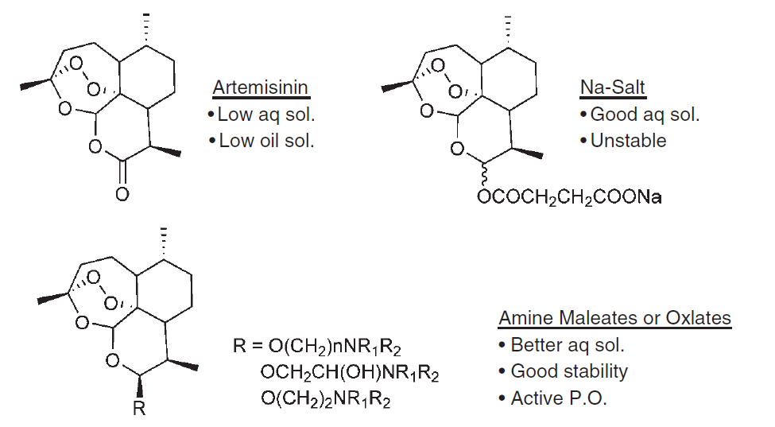
SOLUBILITY
Addition of ionizable groups
typically basic amine or carboxylic group is added

Slide 27
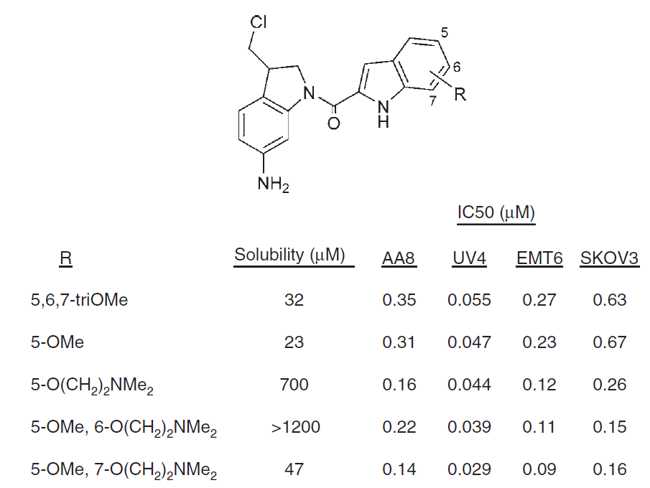
SOLUBILITY
Addition of ionizable groups

Slide 28
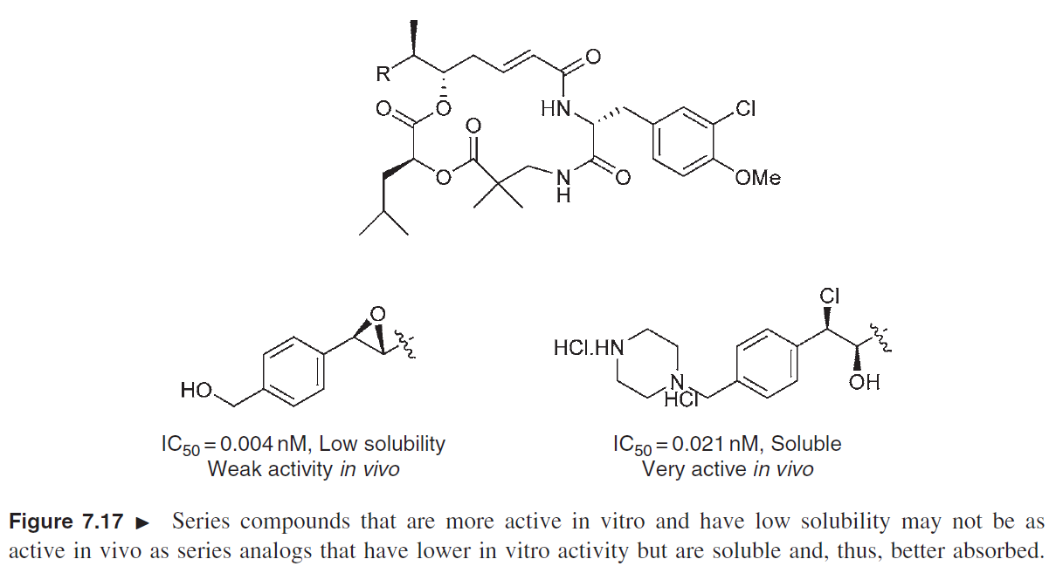
SOLUBILITY
Addition of ionizable groups

Slide 29
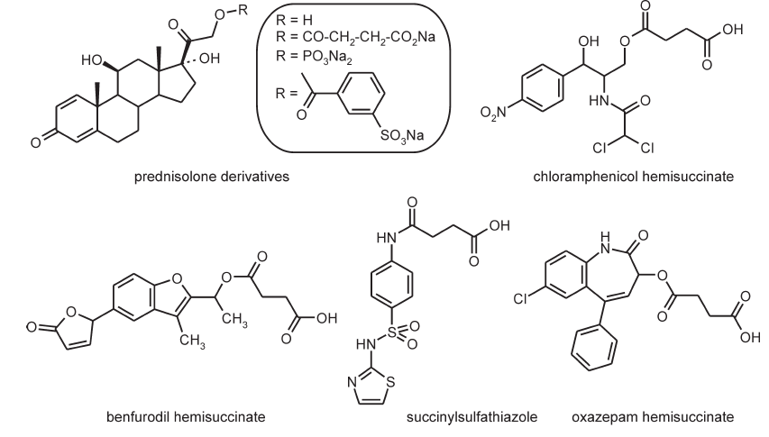
SOLUBILITY
Addition of ionizable groups - acids

Slide 30
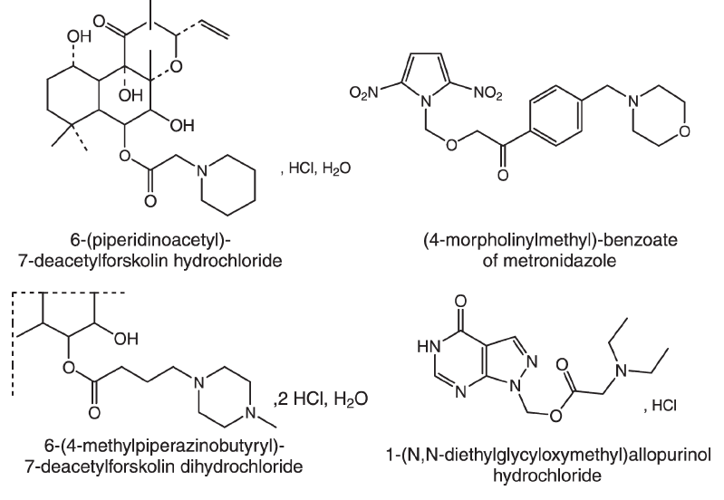
SOLUBILITY
Addition of ionizable groups - base

Slide 31
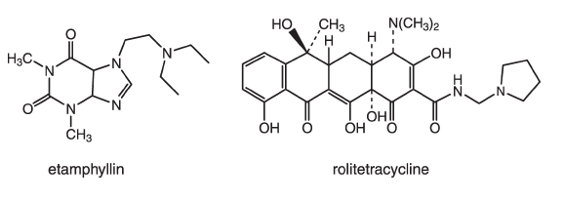
SOLUBILITY
Addition of ionizable groups - base

Slide 32
SOLUBILITY
The most active compound in vitro is not necessarily the most active in vivo
A successful drug candidate possesses balanced potency and suitable physical-chemical properties

Slide 33
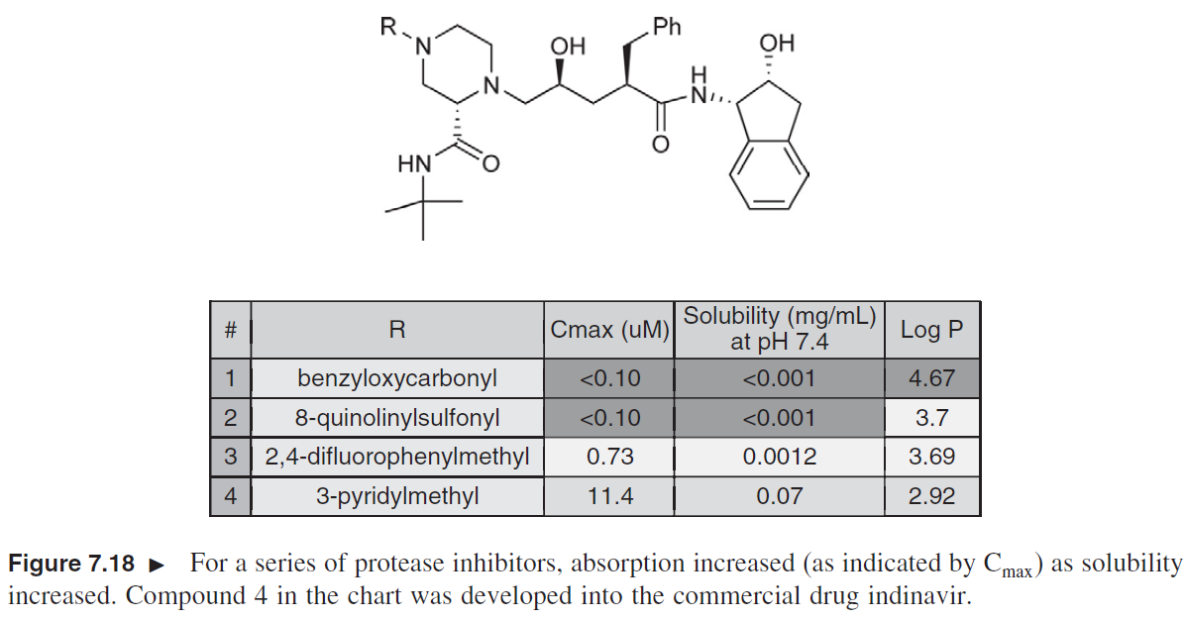
SOLUBILITY
2. Reduction of logP

Slide 34
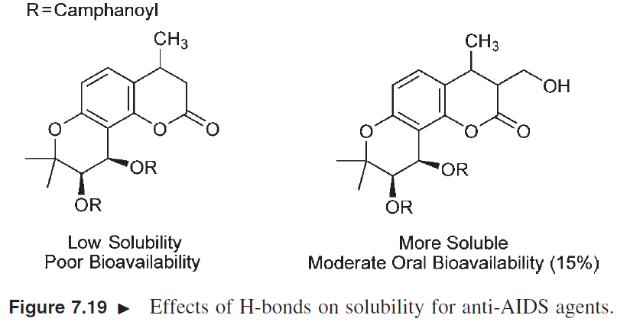
SOLUBILITY
3. Increasing hydrogen bonding properties

Slide 35
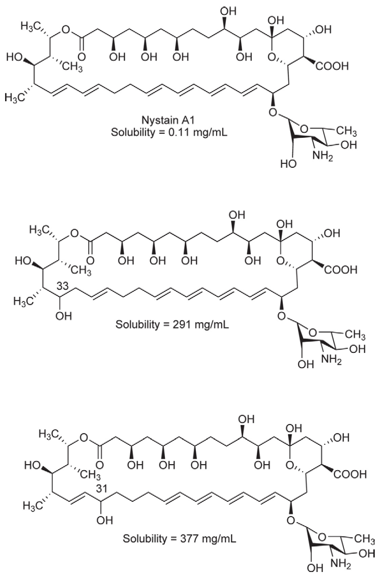
SOLUBILITY
3. Increasing hydrogen
bonding properties
rapid increase
of solubility due to
disruption of aggregate
formation

Slide 36
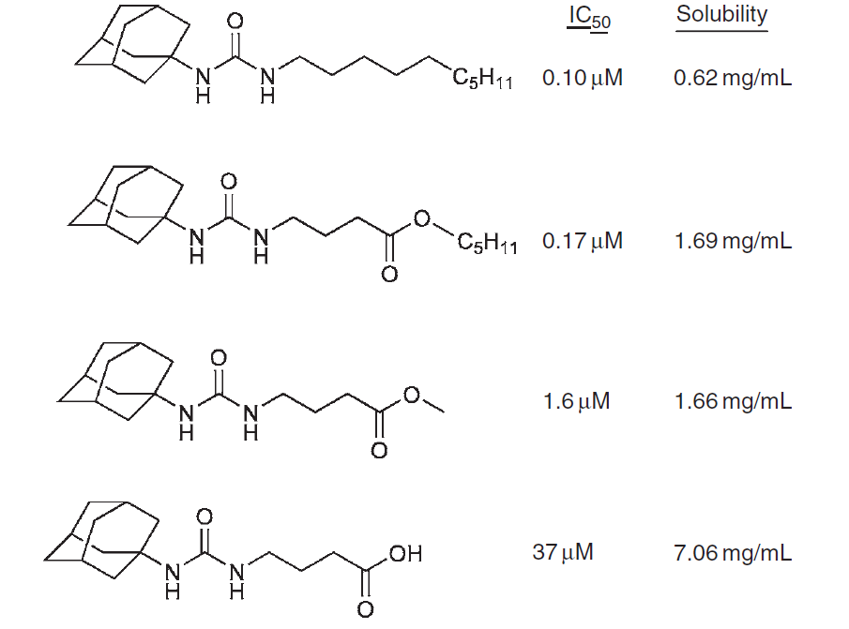
SOLUBILITY
4. Addition of polar group
ester or
carboxylic
group
(epoxide
hydrolase
inhibitors)

Slide 37
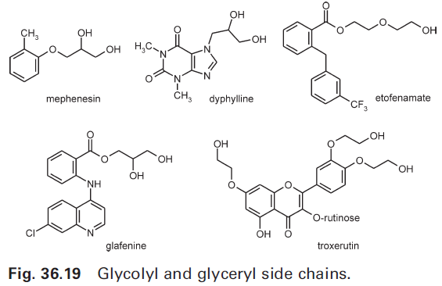
SOLUBILITY
4. Addition of polar group

Slide 38
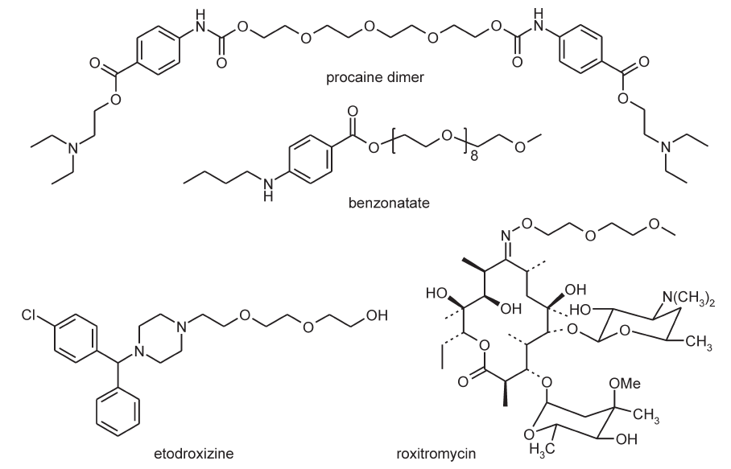
SOLUBILITY
4. Addition of polar group
polyethylene glycol

Slide 39
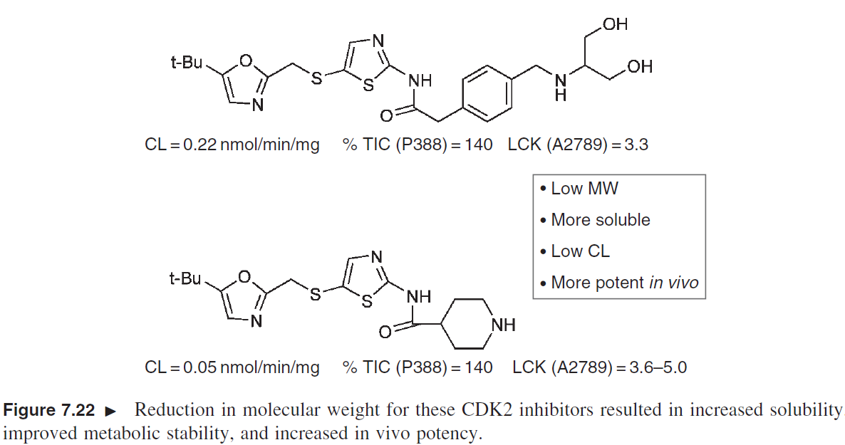
SOLUBILITY
5. Reduction of the molecular weight

Slide 40
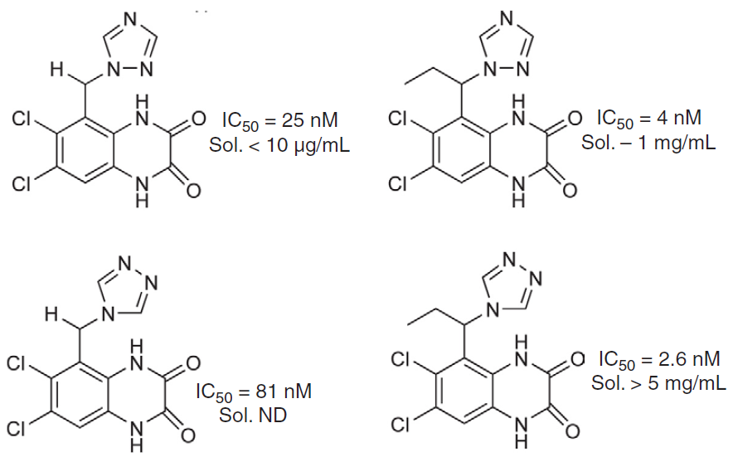
SOLUBILITY
6. Out-of-plane substitution
planar molecules forms tight crystal lattice and aggregates in water solutions

Slide 41
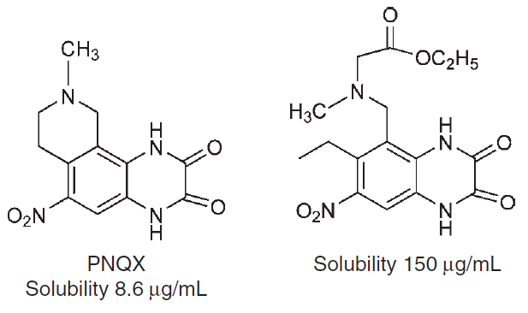
SOLUBILITY
6. Out-of-plane substitution

Slide 42
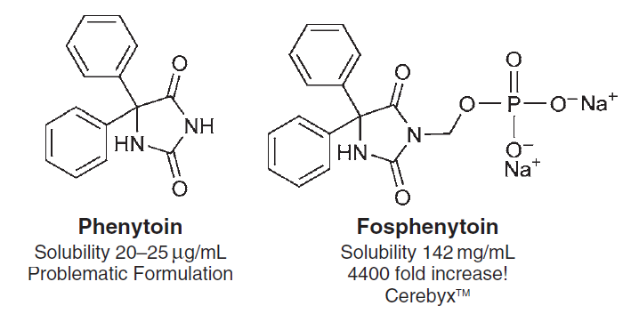
SOLUBILITY
7. Prodrug construction
addition of charged or polar groups

Slide 43
SOLUBILITY
8. Salt formation
Solubility of salts are generally higher than of free acid or base
After dissolving, free acid or base may crystallize due to pH of environment. However, compound may stay at supersaturated solution and do not precipitate immediately
Salt increases bioavailability due to increasing dissolution rate

Slide 44
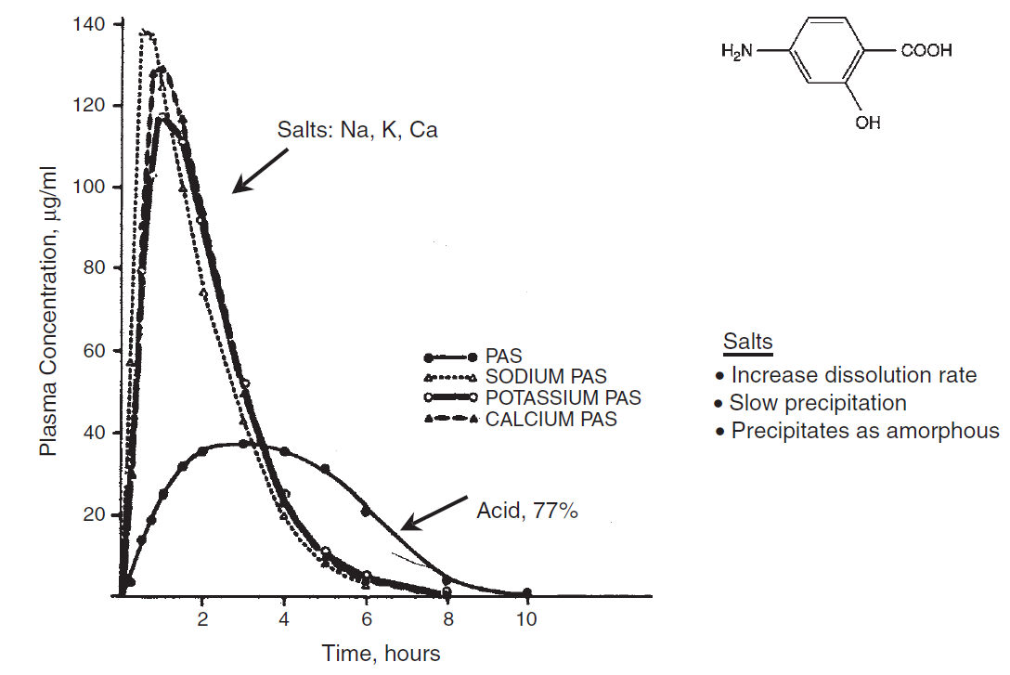
SOLUBILITY
8. Salt formation

Slide 45
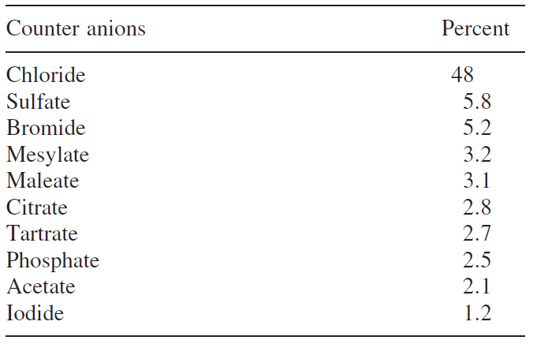
SOLUBILITY
8. Salt formation

Slide 46
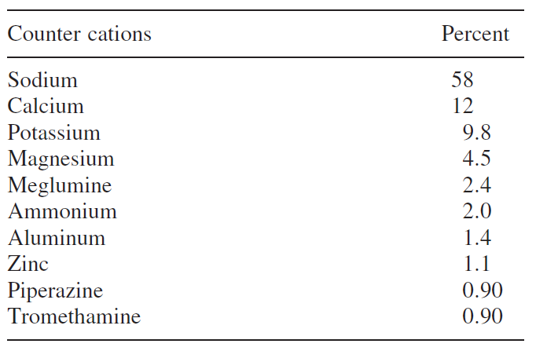
SOLUBILITY
8. Salt formation

Slide 47
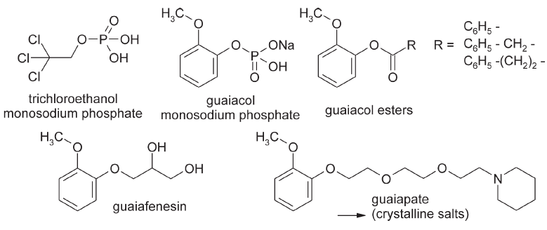
SOLUBILITY
9. Crystalline solid formation
structure modification gains crystalline derivatives of liquid active compounds or increases low m.p.

Slide 48
PERMEABILITY
95% of drugs permeates by passive diffusion
generally, uncharged molecules are able to permeate
but small part of ionized molecules are able to permeate too, while forming neutral pairs with suitable counterions

Slide 49
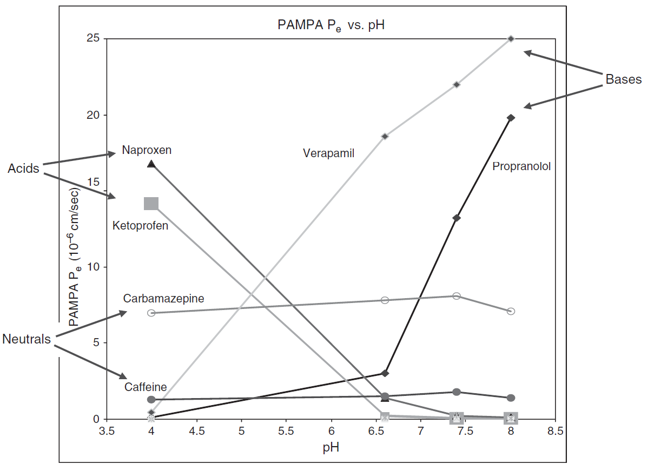
PERMEABILITY

Slide 50
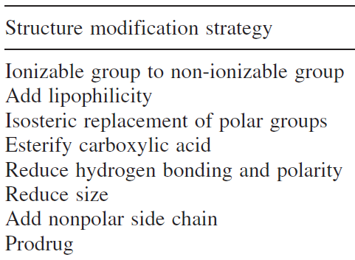
PERMEABILITY
The only way to improve permeability is structure modification
Formulations are not effective in fixing
poor permeability

Slide 51
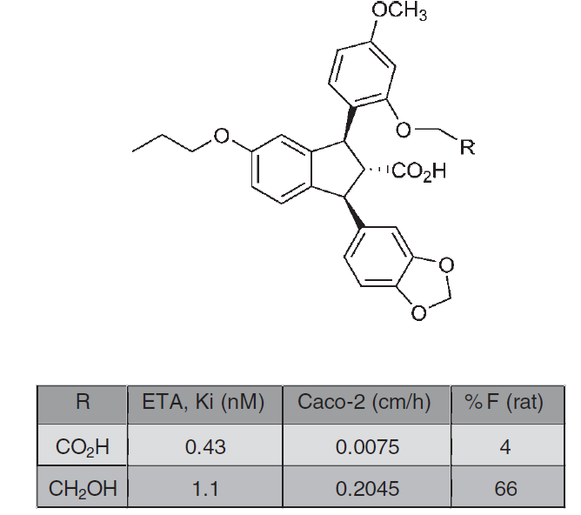
PERMEABILITY
1. Reducing ionizable groups

Slide 52
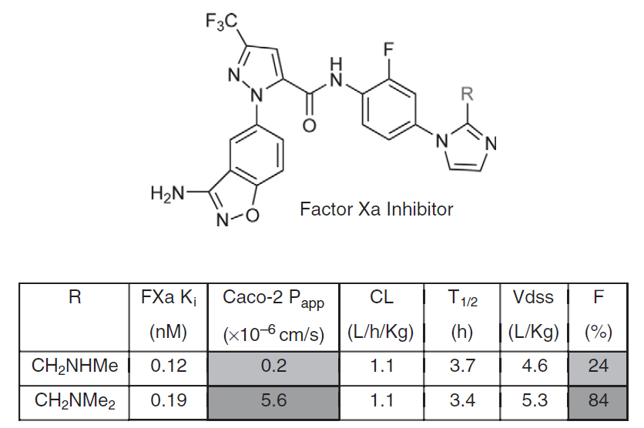
PERMEABILITY
2. Increasing lipophilicity

Slide 53
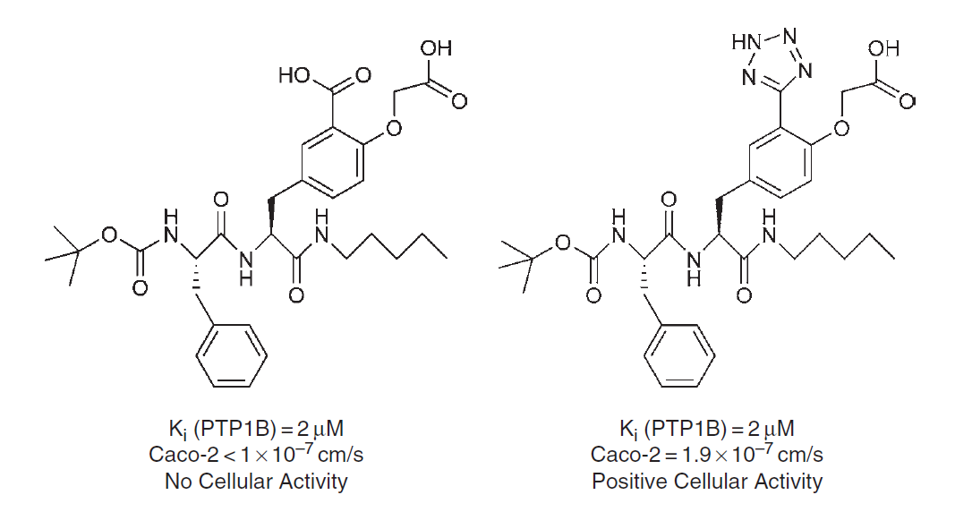
PERMEABILITY
3. Isosteric replacement of polar groups
tetrazole for carboxylic group

Slide 54
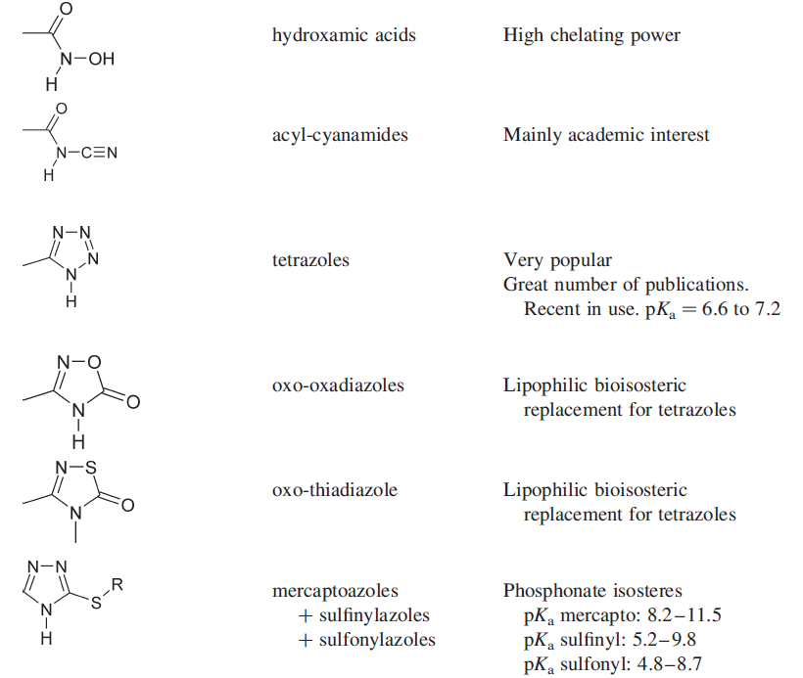
PERMEABILITY
3. Isosteric replacement of polar groups
isosteres
of carboxylic
group

Slide 55
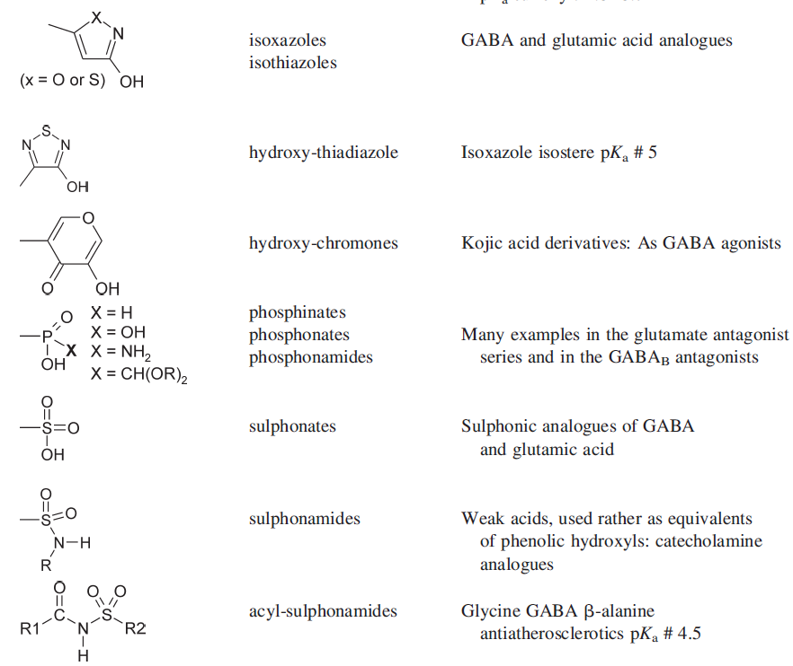
PERMEABILITY
3. Isosteric replacement of polar groups
isosteres
of carboxylic
group

Slide 56
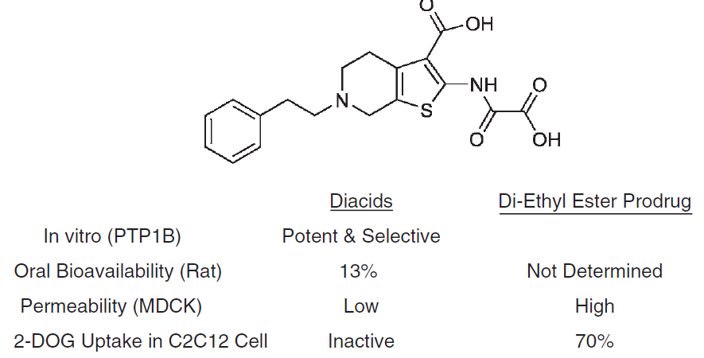
PERMEABILITY
4. Esterification of craboxylic groups

Slide 57
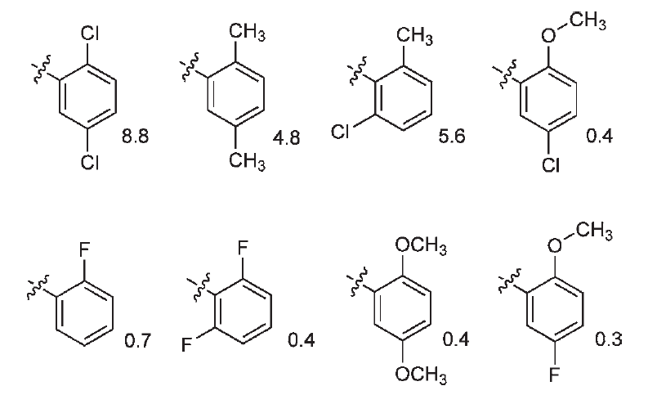
PERMEABILITY
5. Reduction of hydrogen bonding and polarity

Slide 58
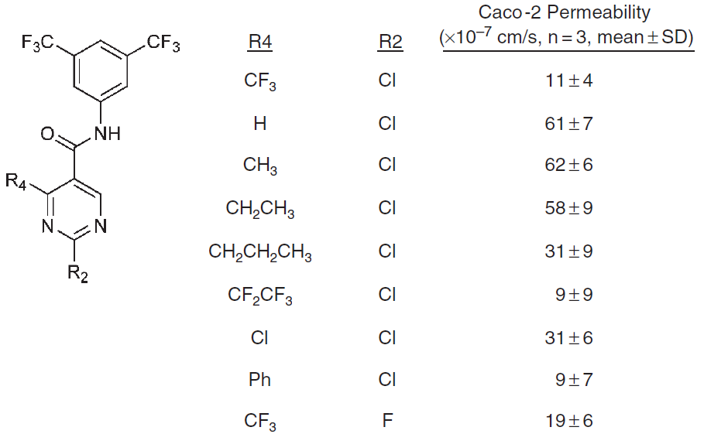
PERMEABILITY
6. Reduction of size

Slide 59
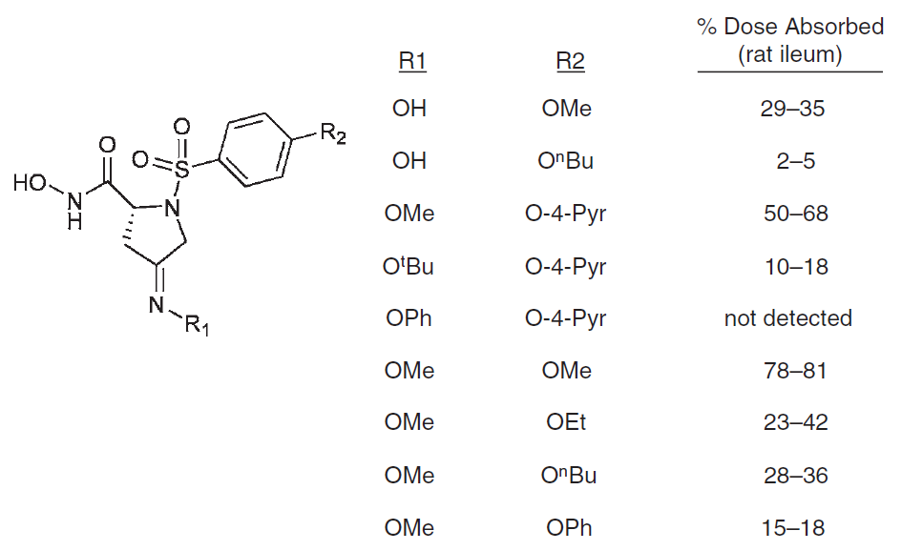
PERMEABILITY
6. Reduction of size

Slide 60
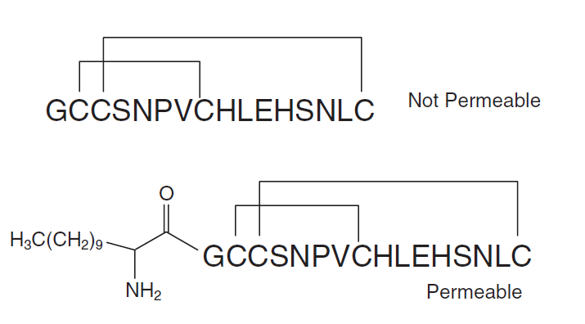
PERMEABILITY
7. Addition of non-polar side chain
increasing membrane affinity by long saturated chain
cyclic peptide:

Slide 61
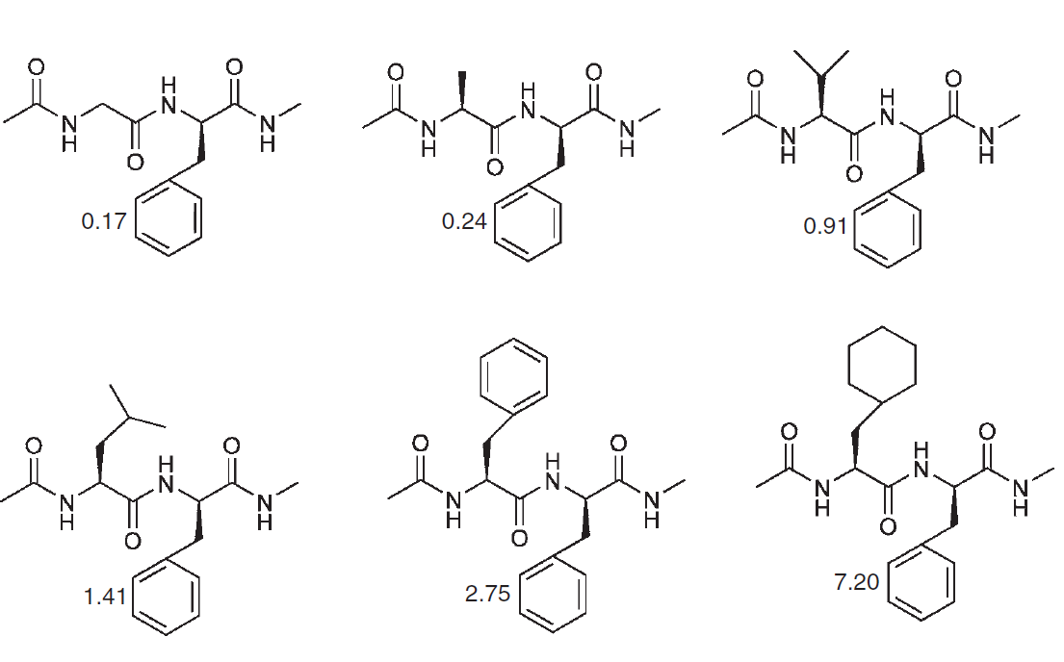
PERMEABILITY
7. Addition of non-polar side chain

Slide 62
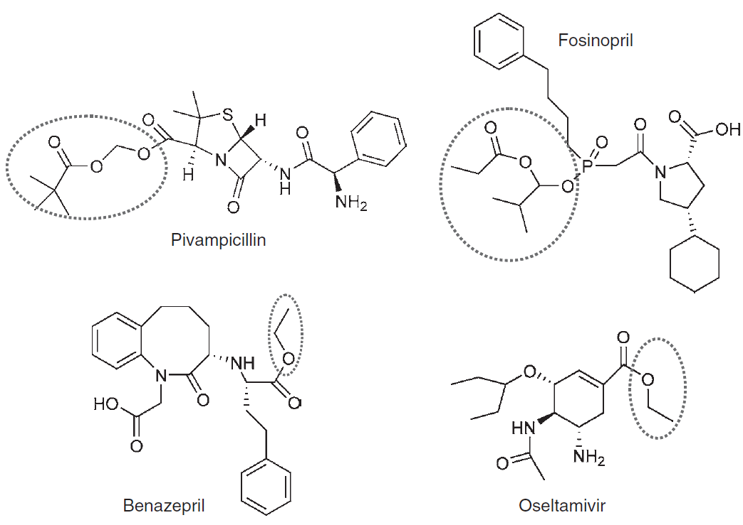
PERMEABILITY
8. Prodrug construction
example of modifications increasing lipophilicity/reducing number of ionizable groups

