Slide 1
ETHICS AND LEGAL FRAMEWORK IN THE USE OF MEDICAL MARIJUANA

Slide 2
INTRODUCTION
Cannabis is the illicit drug which is used the most worldwide.
Widespread debate: Should cannabis be legalized?
Difference between medical and recreational use

Slide 3
INDEX
Background and origins
Ethical implications
Medical uses
Risks associated
Legal framework in US
Legal framework in EU

Slide 4
BACKGROUND
Cannabis sativa is an angiosperm that is able to grow in many different climates an ecosystems.
Original from Asia but spread all over the world nowadays

Slide 5
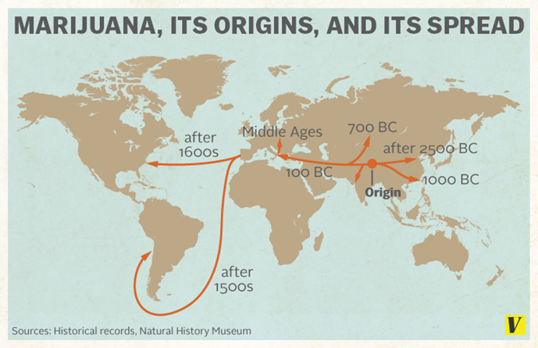

Slide 6
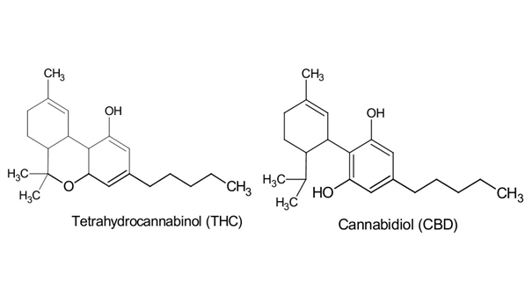
BACKGROUND
More than 400 components identified: 60 % belong to the group cannabinoids:
- THC and cannabidiol as more representatives

Slide 7
BACKGROUND
How they affect organism?
- Interaction with multifunctional membrane receptors CB1 and CB2.
- CB1: brain, spinal cord and sensitive areas
- CB2: peripheral tissues. Immunity and inflammation procedures

Slide 8
ETHICAL ISSUES
Main question
“Does potential benefits of medical marijuana exceed potential risks?”
Other ethical implications
“How does this affect to Patient-Doctor relationship?”
“How much autonomy should patient have in its administration?”

Slide 9
POTENTIAL BENEFITS
Used in treatment for:
-Chronic pain associated with cancer
- Neuropathic pain
- Potentiate opioid activity: analgesic
-Inhibition of muscle spasticity: Multiple sclerosis.
-Glioblastoma therapy
-Glaucoma
-Reduce nausea and vomiting associated with chemotherapy

Slide 10
POTENTIAL RISKS
- Tolerance and dependance
- Affect to social relationships
- Nervous system: exacerbate pre-exisiting psychotic disorders
- Respiratory system: Inflammation of airways. Chronic bronchitis
- CVS system: vasodilation, tachycardia, mild hypertension
- Fetal development: Malformations, lower weight at birth
- Teratogenic and mutagenic effects: associated to some types of cancer
- Marijuana as a link to more dangerous drugs.

Slide 11

DOCTOR - PATIENT RELATIONSHIP
Doctor is sometimes acting illegally if they recommend the use of a drug that it is NOT fully approved by FDA or other Drug administrations
Some doctors may refuse to prescribe it even if it is legal in their country or state
Existence of “specialized”
marijuana-prescribing doctors

Slide 12
AUTONOMY
Difficult to perform clinical trials to determine exact doses for marijuana treatment
Possibility of abusing of its use by patient
- Not every patient is the same: age, sex, mental conditions and many other factors play a role

Slide 13
LEGAL FRAMEWORK
Although cannabis remains a prohibited substance worldwide, nowadays there are some exceptions according to its medicinal and therapeutical use (regulatory regimes)
However, not all regulatory regimes are equal worldwide, a consensus hasn’t been reached yet.
Here there are some examples:

Slide 14
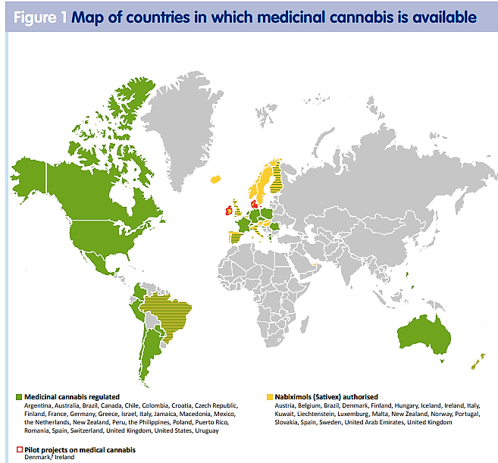

Slide 15
LATIN AMERICA
Especially Latin american and the Caribbean countries are following this trend, enacting policies that enable patients to access certain types of preparations to alleviate symptoms, reduce pain or improve their quality of life (policies allowing access to cannabis for therapeutic use).
For example, Uruguay is the first country in the world to completely legalise the cannabis market for medical and scientific purposes, as well as for industrial and recreational use.

Slide 16
USA
A total of 33 states, the District of Columbia, Guam and Puerto Rico have approved a comprehensive public medical marijuana/cannabis programs.
California (1996)
13 states→allowed the usage of "low THC, high cannabidiol (CBD)" products for medical reasons in limited situations or as a legal defense.
Only in 4 states→no public marijuana access program (Kansas, Nebraska, South Dakota and Idaho)

Slide 17
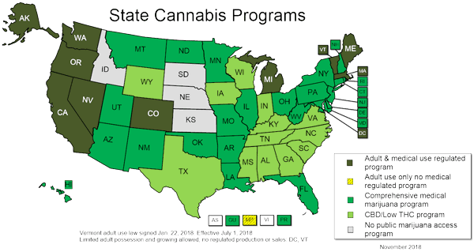

Slide 18
COMPREHENSIVE PROGRAMS (33 STATES)
Protection from criminal penalties.
Access to marijuana through home cultivation, dispensaries or some other system.
It allows a variety of strains, including those more than "low THC”.
It allows either smoking or vaporization.

Slide 19
SPECIAL CONDITIONS ACCORDING TO STATE (US)
-For example, in states like New York, West Virginia and Puerto Rico, it may not or cannot be smoked.
- In the case of Vermont (adult-use legalization legislation) adults 21 years or older are allowed to possess up to one ounce of marijuana and to grow two mature plants. Public consumption and selling of marijuana remains illegal.

Slide 20
SPECIAL CONDITIONS ACCORDING TO STATE (US)
-Majority of the states do not recognize patients from other states, and if they do, they often cannot purchase through dispensaries.
- In those states who have LIMITED ACCESS MARIJUANA PRODUCT LAWS (LOW THC), the legality of the usage or prescription depends on the medical condition that the patient suffers from, mostly related to intractable epilepsy, seizure disorders, cancer or ALS.

Slide 21
FEDERAL ISSUES (US)
However, at a federal level marijuana is still considered to have a high potential for dependency and no accepted medical use, making distribution of marijuana a federal offense (medical marijuana "prescriptions" are more often called "recommendations" or "referrals”)
States with medical marijuana laws generally have some form of patient registry, which may provide some protection against arrest for possession up to a certain amount of marijuana for personal medicinal use.

Slide 22
EU
-Netherlands: Best example of well-established medicinal cannabis model (Medicinal canabbis agency) in pharmacies for a number of pathologies in possession of a medical prescription. Cannabis cultivation is legal.
-Germany: medicinal cannabis must be covered by both private insurers and public health services. Seriously ill patients can buy cannabis by prescription. The permission is granted for a maximum of three days.
-Czech Republic: medical cannabis is legalized since 2013, but it is not usually covered by the health insurance system. Only may be authorized under special conditions e.g. Oncology treatments
-United Kingdom: the government only permits the use of Sativex for patients with multiple sclerosis, under medical prescription, and every patient must pay for his or her medication (about 500 euros a month).

Slide 23
EU
Some other examples:
-Poland: medicinal cannabis could be sold in registered pharmacies. Patients need a special permission from a regional pharmaceutical inspector and a physician accredited by the Ministry of Health. No domestic production or self-cultivation.
-Greece: patients can access medicinal cannabis products, in recognition of their benefits for specific illnesses (chronic pain, glaucoma and multiple sclerosis for example). It also proposes that individuals can cultivate cannabis for medicinal use. The bill has not come into force yet.

Slide 24
EU
In other countries, medicinal cannabis is limited to pilot projects:
-Denmark, Ireland: cannabis for therapeutic purposes is still illegal, but a pilot programme will begin this year (in the case of Denmark) for a limited number of patients with specific health problems (i.e. multiple sclerosis, chronic pain, back injury, nausea and effects of chemotherapy).
-Some other countries in which medical use of cannabis is legal: Austria, Finland, France, Italy, Norway, Portugal, Spain and Sweden

Slide 25
REFERENCES
http://www.ncsl.org/research/health/state-medical-marijuana-laws.aspx
http://www.medicalmarijuana.eu/
The American Society of Addiction Medicine. The role of the physician in "medical" marijuana. 2010.
http://fileserver.idpc.net/library/Medicinal%20cannabis%20briefing_ENG_FINAL.PDF

