Slide 1
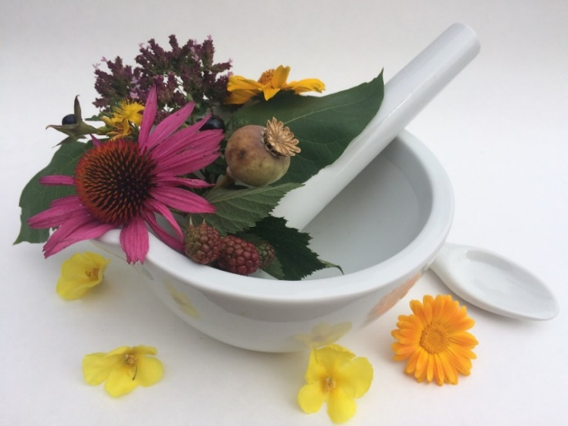
Pharmacognosy lab exercise 1
What is Pharmacognosy?
What is a drug?
How can we identify drugs?
How to prepare microscopic preparations?

Slide 2
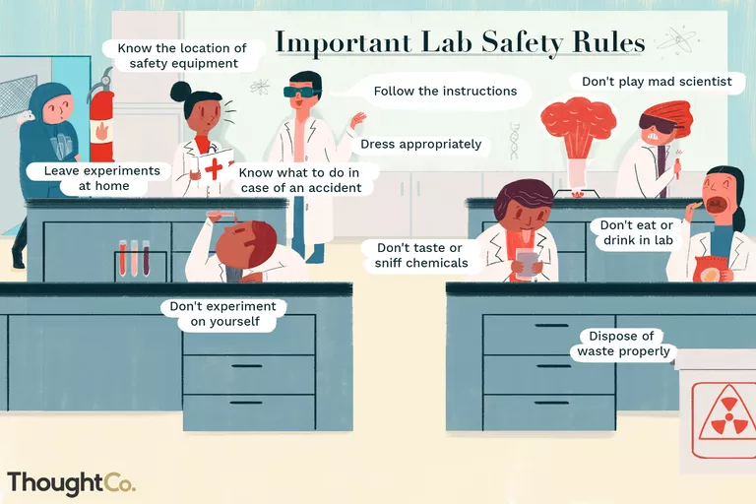

Slide 3
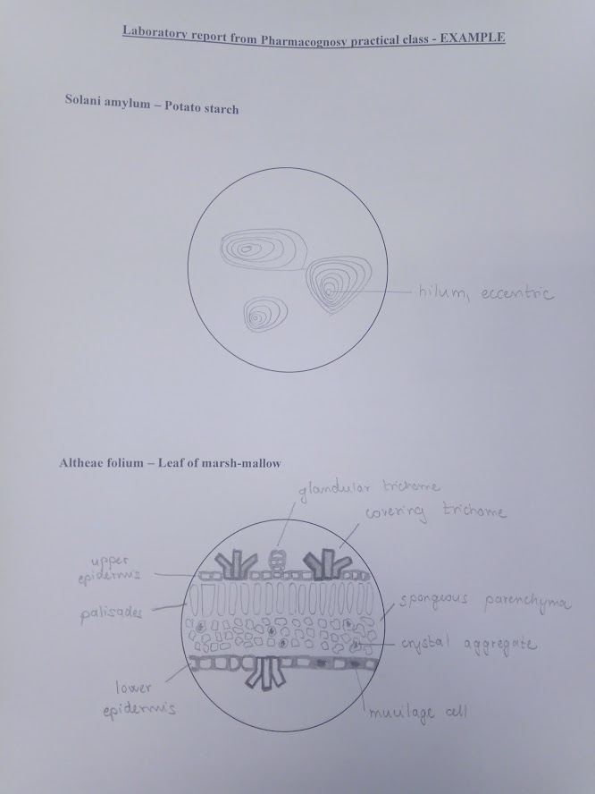
How to obtain course credits
100% participation in practical lessons – in case of one-time absence you will write a short paper on a given topic (2-3 standard pages)
At least 60% of two tests (12 points of 20 max.)
Test 1 – 6th week of semester
Test 2 – 10th week of semester
Reports from lab exercises – sketches of microscopic preparations, with designations of typical structures, possibly denote the magnification used for observation, sketches are made during the practical class and are handed in at the end of the that class

Slide 4
Pharmacognosy
Science about drugs of natural origin – plant, animal, microbial, which are used for treatment, prevention of diseases, and diagnostics and affection of physiological functions
Pharmacognosy relates to other pharmaceutical disciplines (pharmacology, medicinal chemistry, galenic pharmacy)
Starting material for isolation of natural medicinal products are drugs
Notes:
Drug usually means a medicine, an active compound. In pharmacognosy, the word drug has another meaning

Slide 5
Drug
Word origin: droog waere (flemish word for dry spices and herbs)
Modified or non-modified preserved plants or their parts; animals or their parts; or products of metabolism of plants, animals, or microbials (starch, mucilage, honey)
Drugs according to structure:
with organized body structure (cellular structure, Malvae flos)
  amorphous (products of metabolism, Balsamum peruvianum)
Drugs according to origin: plant-derived
animal-derived (whole animal – Cantharis, animal organs – glands, products – waxes, hormones, enzymes)
Conservation stops the decomposition of plant material after it has been removed from the mother plant
- freezing, freeze-drying
- preferred way of conservation – drying
Notes:
Historically, drugs were used directly for treatment or preparation of healing tinctures and extracts. Nowadays, drugs are merely a raw material for isolation of their active compounds, which are then used for treatment.
Drugs according to usage: drugs for treatment, drugs for isolation of active compounds
Amorphous drugs can be physiological products – natural products of plant/animal body; or pathological products – these are produced after an external intervention, for example an injury such as cutting the bark of a tree.
Mother plant ( mother organism) – plant (organism), from which the drug is derived

Slide 6
Drying
direct sunlight is unsuitable
in shade and well-ventilated rooms
properly dried plant material contains most of its original constituents in the same amounts as before drying
drying temperature, duration and method of drying depend on the constituents of the dried plant – plants containing volatile essential oils up to 40°C,
– easily hydrolysed constituents (glycosides) – fast drying with a higher temp. (enzyme inactivation) and then drying with usual drying temp. 60-70°C
Change of colour during the drying process:
Plants with neutral cellular fluid – almost no colour change
Plants with acidic cellular fluid get dark
Flowers with anthocyans content change colour from pinkish or red to purple or blue
We need to know:
Drying temperature
Way of drying
Length of drying
Storage parameters (no direct sunlight, 5-15°C)
Right labelling
Notes:
Drying speed depends on the temperature and the relative air humidity – it occurs faster in higher temp. and with better air circulation above the dried material.
When the drying process is finished, the material has to cool down prior to packaging (residual water vapor).
In some drugs, the desired compounds are synthesized even after harvest. This is known as post-mortal biosynthesis (Digitalis – foxglove).
Other drugs have to undergo fermentation, during which desired compounds are enzymatically created (black tea).
Drugs with stark effects (Opium) should be kept separately, also those with sharp smell.

Slide 7
Systematic classification of drugs
Pharmaco-botanical – according to the phylogenetic development of mother plants
Pharmaco-chemical – according to the chemical structure of content compounds
Pharmacological – according to the therapeutic effect of content compounds
Biogenetic – according to the biosynthetic origin of content compounds
Notes:
Pharmacochemical system: drugs with content of alkaloids, phenolic glycosides, essential oils
Pharmacological system: drugs with effect on the digestive system

Slide 8
Nomenclature of Drugs
Binomic – first part of name expresses mother plant (genus or species), second part expresses name of corresponding plant organ
Lini semen, Belladonnae radix, Conii fructus
One name - Lycopodium, Mel
Exceptions - Liquiritiae radix, Cynosbati fructus
It is necessary to state the mother plant and family each time
Notes:
Mother plant (organism) – plant (organism), from which the drug is derived
Glycyrrhiza glabra = liquorice
Rosa canina = dog rose

Slide 9
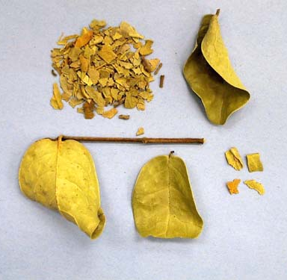
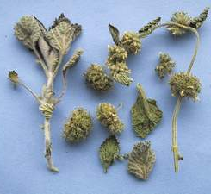
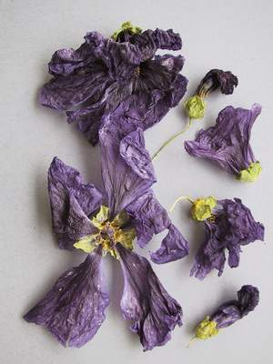
Drugs from aerial plant parts
Folium (leaf) – plant leaves
Herba (herb) – whole aerial plant part
Flos (flower) - whole flowers or their parts
(floral leaf petals), or whole inflorescence

Slide 10
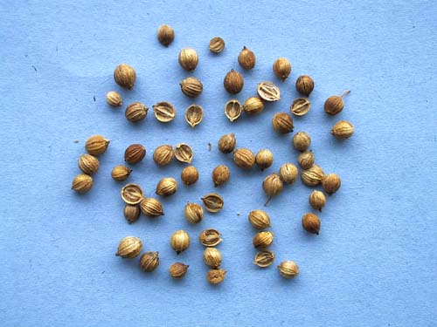
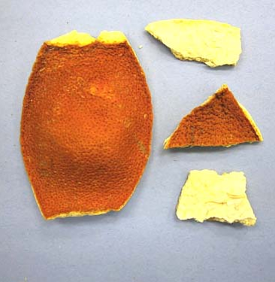
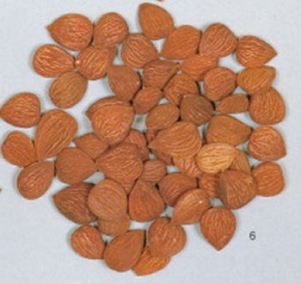
Drugs from aerial plant parts
Fructus (fruit) – whole fruit or infructescence,
or fruit imitations
Pericarpium – pericarps of Rutacae family
Semen (seed) – seed or its part (germ)

Slide 11
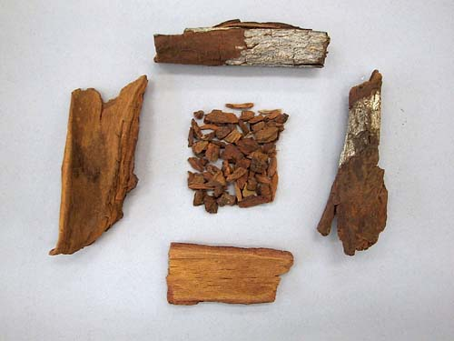
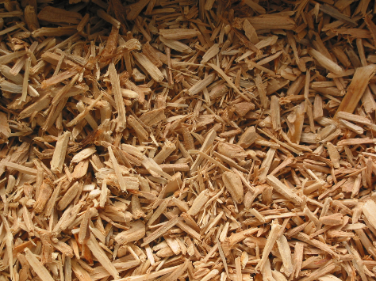
Drugs from aerial plant parts
Cortex (bark) – all kinds of plant tissues
upon the cambium
Lignum (wood) – woody parts of plant
only (xylem)

Slide 12
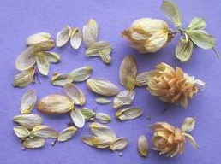
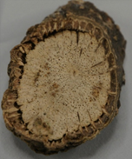
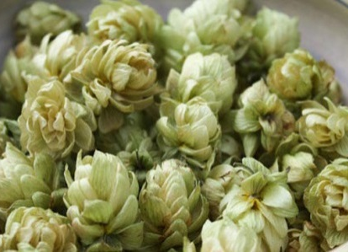
Drugs from aerial plant parts
Stipes – drug contains peduncle only
Gemma - drug contains eye only
Sporae – drug contains spores only
Glandulae - drug contains glands only
Caulis - drug contains footstalk (stem) only
Strobilus - drug contains strobiles only
Notes:
Less frequent drugs
Peduncle - a stalk supporting an inflorescence
Strobiles – seed cones (hops flowers)

Slide 13
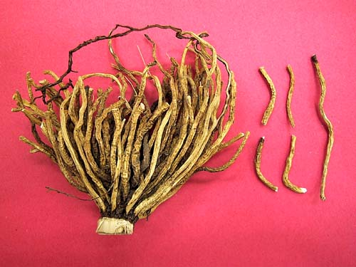
Drugs derived from underground plant organs
Radix – used for drug made of rhizomes, roots, bulbs and tubers

Slide 14
Nomenclature of plant products and most often used adjectives
Amylum - starch
Balsamum - balm
Resina – resin/oleoresin
Gummi - mucilage
Gummiresina – gum resin
(bdellium)
Cera - wax
Oleum - oil, volatile oil
naturalis - natural
pulvis - powdered
mundata - peeled
maturus - ripened
imaturus - unripened
amari - bitter
dulcis - sweet

Slide 15
Review of traditional pharmacological effects of drugs
astringent (adstringent)
amarum
anabolic
analgesic
anthelmintic
antianemic
antiarrhytmic
antiasthmatic
antidiabetic
antidiarrhoic
antidysmenoreic
antiphlogistic
antihemoroidal
antihydrotic
antirheumatic
antisclerotic
aromatic
balneologic
Notes:
Adstringent – shrinks or constricts body tissues
Amarum – contains bitter substances that promote secretion of digestive juices
Anabolic – promotes the synthesis of compounds
Anthelmintic - expels parasitic worms (helminths) and other internal parasites from the body
Antiasthmatic – eases respiratory distress in asthma
Antidiabetic – lowers glycaemia
Antidysmenoreic – against painful menstruation
Antihemoroidal - Th of piles
Antihydrotic – lowers the secretion of sweat glands and lowers perspiration
Antirheumatic – acts anti-inflammatory
Antisclerotic – against atherosclerosis
Aromatic - drug containing aromatic substances, which positively influences the fragrance of the herbal preparation
Balneologic – additive substance to bath

Slide 16
Review of traditional pharmacological effects of drugs
cardioactive
cardiotonic
carminative
cholagogue
cholekinetic
choleretic
corigens
cytostatic
derivans
dermatic
desinficiens
diaphoretic
diuretic
emenagogue
emetic
expectorant
gargarism
gynecologic
hypotensive
Notes:
Cardioactive – acts on myocard
Cardiotonic - enhances contractions of myocard and thus boosts heart function
Carminative – against meteorism, flatulence
Cholagogue – increases the secretion of bile into small intestine
Cholekinetic - boosts the contractions of gallbladder
Choleretic – increases the production of bile
Corigens – modifies the unpleasant taste, smell or look
Cytostatic – stops the growth and multiplication of tumor cells
Derivans – locally increases the amount of blood flowing through the skin, making it red and warm, also increases inflammation development and edema absorption
Dermatic – for treatment of skin diseases
Desinficiens – destroys germs
Diaphoretic – promotes sweating
Diuretic – promotes urine production
Emenagogue – for irregular menstruation
Emetic – causes vomiting
Expectorant – eases coughing up of sputum or mucus
Gargarism – used for gargling
Hypotensive – lowers blood pressure

Slide 17
Review of traditional pharmacological effects of drugs
lactagogue
laxative
metabolic
nervine
roborans
sedative
spasmolytic
stimulans
stomachic
urologic
venotonic
Notes:
Lactagogue – stimulates production and secretion of mother´s milk
Laxative – against constipation
Metabolic – stimulates metabolism
Nervine – soothes the nervous system, calms ruffled nerves
Roborans – strengthens the organism
Sedative – lowers CNS activity
Spasmolytic – acts against painful contractions of smooth muscles
Stimulans – stimulating effect, enhances psychological and physiological functions for a short period of time
Stomachic – stimulates metabolism, enhances appetite
Urologic – used in treatment uf urinary tract diseases
Venotonic – enhances the tension of veins, lowers edema formation

Slide 18
Drug analysis
Using the demands of pharmacopaeia or other mandatory rules
Identification
Purity checking
Content determination
Important – sample collection and preparation

Slide 19
Identification
Sensoric (organoleptic) assays – using our natural sensors
  Smell
  Taste
  Vision
  Touch
Microscopic identification – directed on characteristic signs (shape of skin cells, presence of typical structures/organelles containing essential oils, mucilages, starch grains, vascular bundles)
Physico-chemical methods – microsublimation, fluorescence, simple chemical reaction or thin layer chromatography
Notes:
Smell can point to deterioration of plant material or to a plant rich in volatile essential oil.
Taste can point to characteristically tasting compounds such as bitter substances, mucilages, tannins.
Using vision we macroscopically characterize the plant, shape of its leaves, shape of leaves' edges, and thickness of petiole, amount of trichomes and their shape.
Chemical reactions are carried out after extraction of constituents from the drug. Usually the extraction is done by water, or by an organic solvent such as methanol, ethanol. We use two types of reactions: color reactions = result is a change of color, and precipitation reaction = precipitate forms

Slide 20
Purity checking
Foreign matter, impurities
Loss on drying
Determination of total ash
Determination of HCl-insoluble ash
Optical rotatory power
Index of refraction
Notes:
Foreign matter can be sand, other plant parts.
Loss on drying does not ​qual the loss of water. A drug dried at high temperatures such as 105•C loses also volatile substances such as essential oils.
Determination of HCl-insoluble ash gives information about different minerals present.

Slide 21
Content determination
Direct / indirect determination of compounds
Colorimetric methods
Gravimetric methods
Titration methods
Biological methods
HPLC, GC
Notes:
Biological methods are used when the amount of constituents measured by chemical methods does not match the effect of the drug (tannins and their adstringent effect)

Slide 22
Division of plant metabolites
primary metabolites - saccharides, amino acids, low-molecular carboxylic acids – mevalonate, pyruvic acid, shikimic acid
secondary metabolites - polysaccharides, alkaloids, terpenoids, phenolic glycosides, flavonoids, coumarines, anthocyanins, tannins, anthraglycosides…
Notes:
Primary metabolites are simple and universal substances which occur in all organisms. They have several precursors.
Secondary metabolites are synthesized from primary metabolites by specific, genetically controlled and enzymatically catalyzed reactions. Secondary metabolites are usually referred to as natural drugs.

Slide 23
Preparation of microscopic slides
Temporary microscopic slides
Permanent microscopic slides
Surface specimens - leaves, flowers
Cuts - barks, wood, root
  transversal
  tangential
  radial

Slide 24
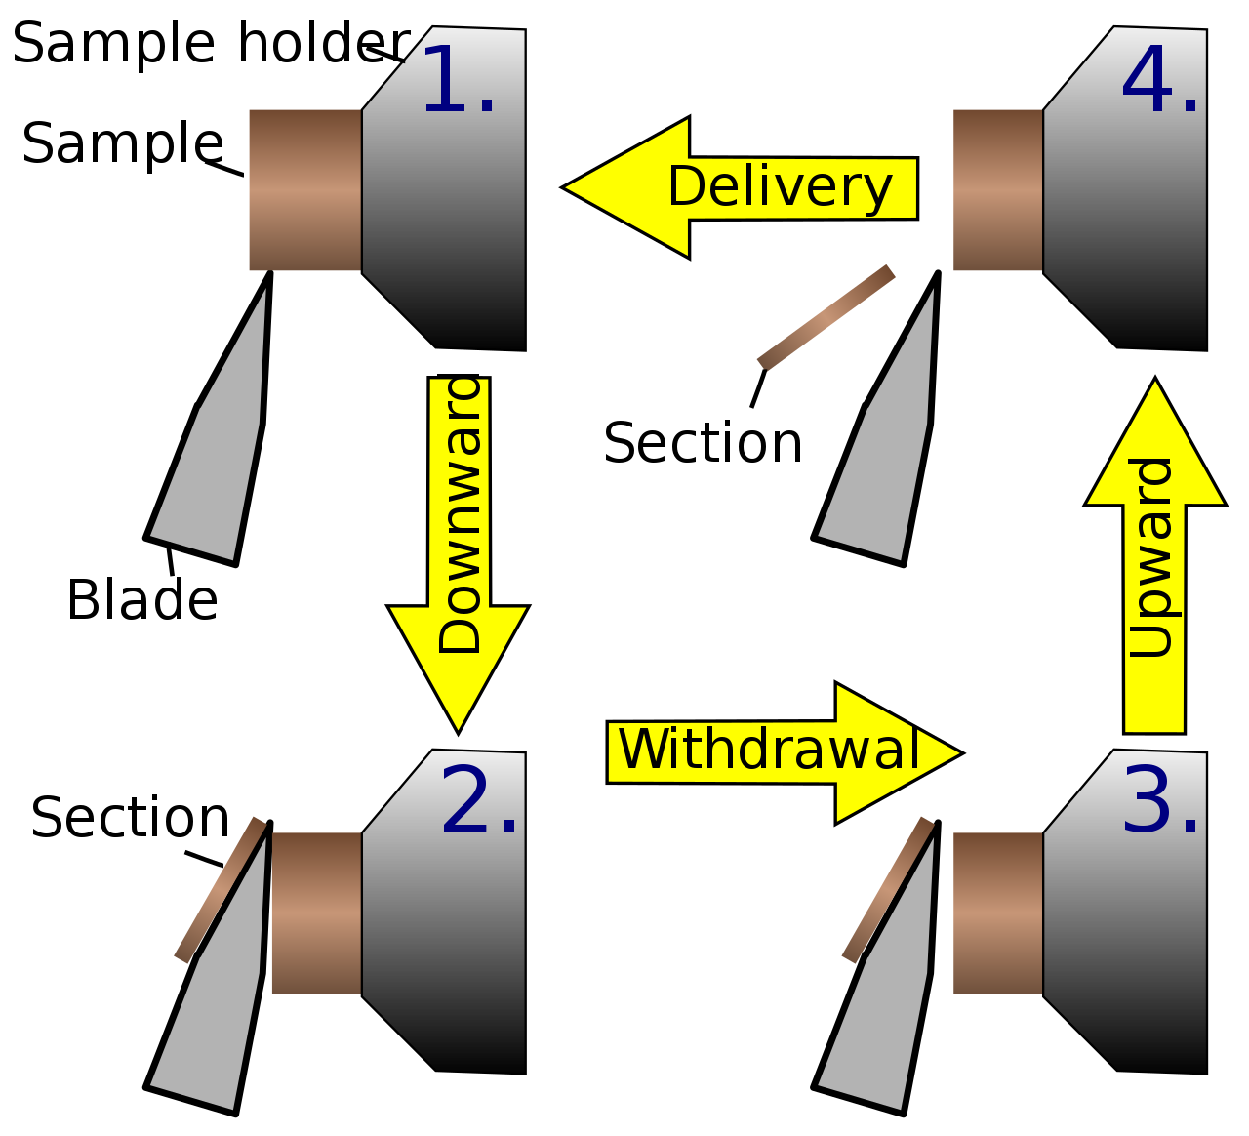
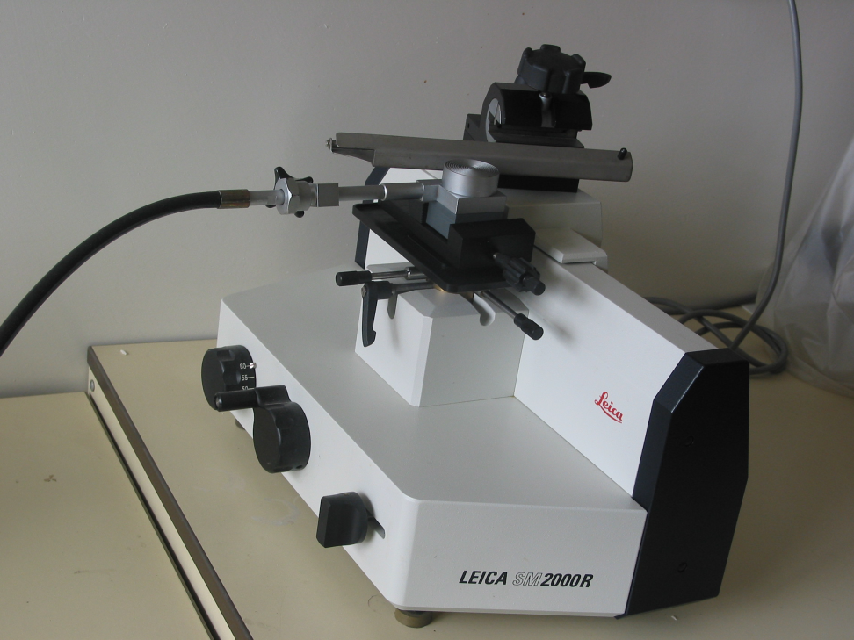
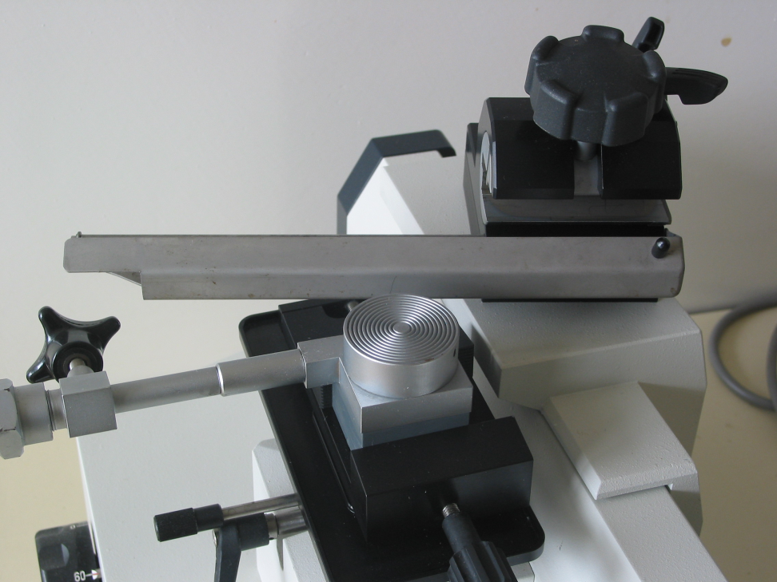
Ways of cutting
  manual
  microtome cut thickness: 50 nm- 100 μm
    Sledge-type microtome
    Rotary microtome
    Cryomicrotome
    Laser microtome contact free slicing

Slide 25
Procedure of permanent slide preparation
Softening and conservation
  Alcohol-glycerol mixture, chlorine dioxide in acetic acid, formaldehyde
Fixation
  Immediate termination of biochemical reactions
  Fixation mixtures – FAA (formaldehyde/acetic acid/alcohol), chromic acid
Clearing
  Chloral hydrate, hydrogen peroxide, glycerol

Slide 26
Fastening of object
  Encapsulation into paraffin
    it is necessary to remove water by treatment with ethanol (ethanol series)
  Encapsulation into gelatin
  Freezing
Cutting and adhesion
  Mixture of albumin and glycerol 1:1
Staining
  Before using stains paraffin must be removed by hydration with alcohol series

Slide 27
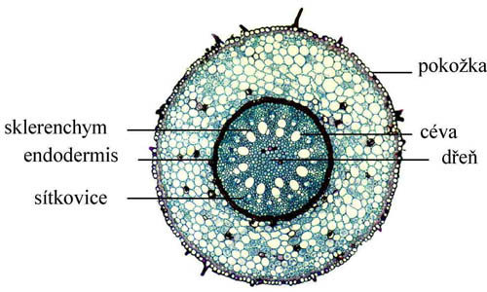
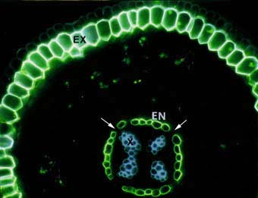
  Staining according to the procedure
    progressive, regressive, succedaneous, simultaneous
  Staining according to the result
    diffusive, differentiative
  phloroglucine, picric acid, iodine solution, saphranine, fuchsine, ferric chloride, congo red
Notes:
Progressive staining – up to a certain hue
Regressive staining – we apply a dye and then we remove the color to the desired hue
Succedaneous – uses different dyes, one after another
Simultaneous – uses different dyes combined in one solution
Diffusive staining – all parts of tissue are dyed with the same color
Differentiative – different dyes to highlight certain structures

Slide 28
Mounting
  Necessary to dehydrate
  Canada balsam, resins, liquid paraffin
Enframement
  lanoline-colophony glue, albumin, colorless nail polish

Slide 29
The most important information sources about natural products
Text books for Pharmacognosy
  Bruneton J.: Pharmacognosy, phytochemistry
  Evans W.C.: Pharmacognosy
  Dewick: Natural products
  Wichtl M.: Herbal drugs and phytopharmaceuticals
  European Pharmacopoeia

Slide 30
internet
  Web of Science
  Science Direct
  Belstein Crossfire
  American Chemical Society
  SciFinder

