Slide 1
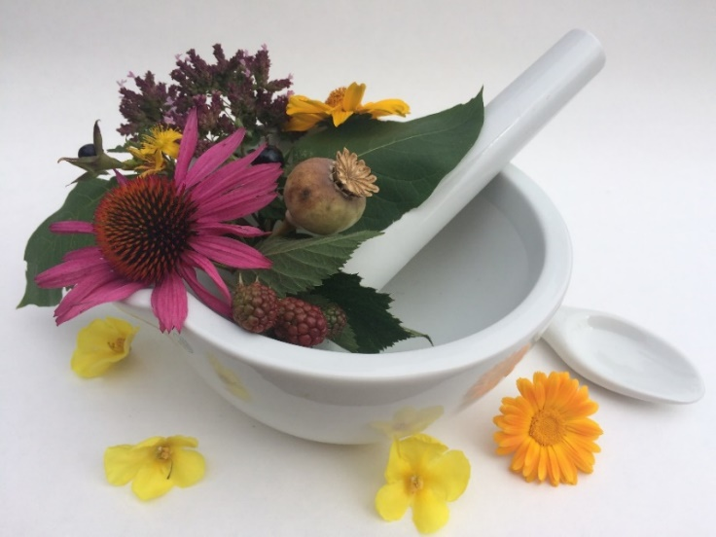
Pharmacognosy lab exercise 4
Roots and rhizomes
of dicotyledonous plants

Slide 2
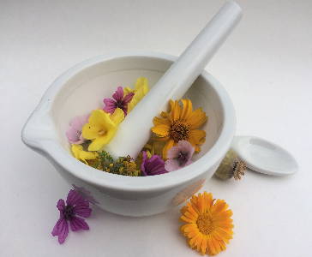
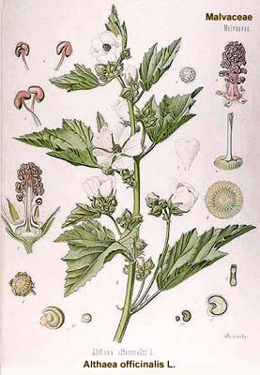
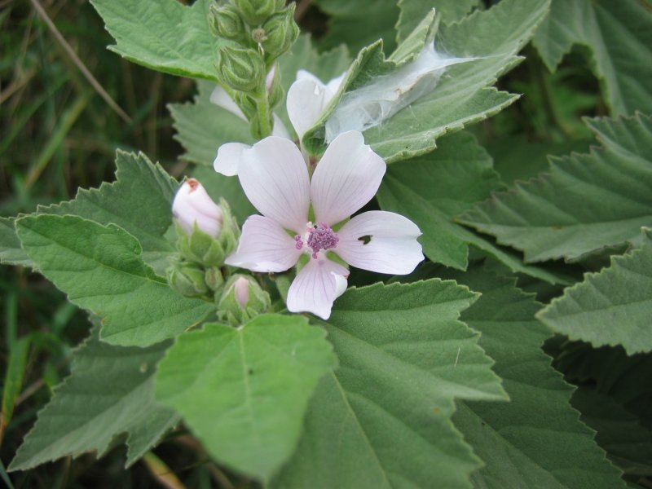
Althaeae radix CzPh 2017
Mother plant: Althaea officinalis, Malvaceae (marsh-mallow)
Althaeae syrup CzPh 2017
https://commons.wikimedia.org/wiki/File:Althaea_officinalis.jpeg

Slide 3
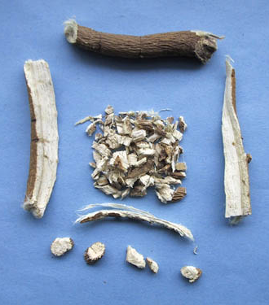
Althaeae radix CzPh 2017
Macroscopy: moderately twisted root, with many scarifications after side roots, on a surface often projected white fibers of sclerenchyma, weak odour, floury mucous taste
Content compounds: mucilage, starch, glucose, pectin, mineral compounds, flavonoids
Usage: mucilaginose, antitussic, antiphlogistic

Slide 4
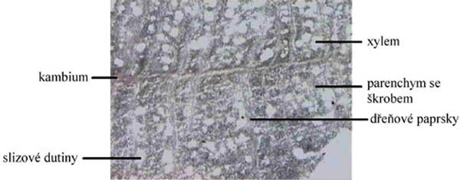
Althaeae radix CzPh 2017
Microscopy: in secondary bark phloem fibres, medullar rays, vessels with libriform, phloem sieve tubes, cells with mucilage and cells with starch
xylem
cambium
parenychyma
with starch
medullar rays
cavities
with mucilage

Slide 5
Althaeae radix CzPh 2017
Microscopy:
medullar rays
phloem fibers
sieve tubes
cambium
vessel
aggregated crystals
of oxalate
libriform
cell with mucilage

Slide 6
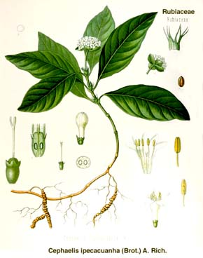
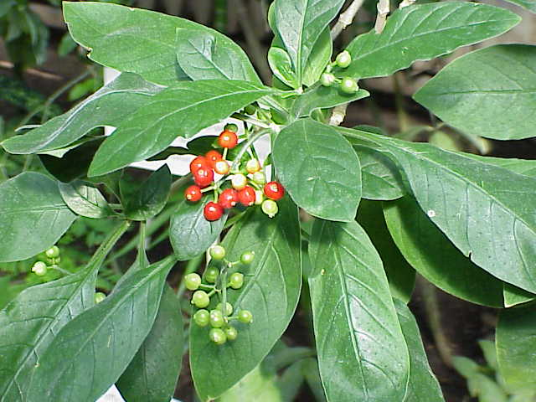
Ipecacuanhae radix CzPh 2017
Mother plant: Cephaelis ipecacuanha, Cephaelis acuminata Rubiaceae, Ipecacuanha (ipecacuanha)
Ipecacuanhae extractum fluidum normatum CzPh 2017
Ipecacuanhae pulvis normatus CzPh 2017
https://commons.wikimedia.org/wiki/File:Cephaelis_acuminata5.jpg

Slide 7
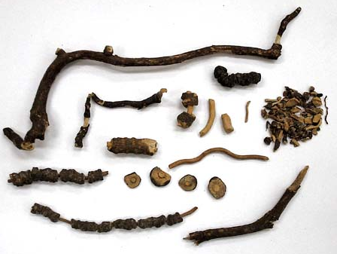
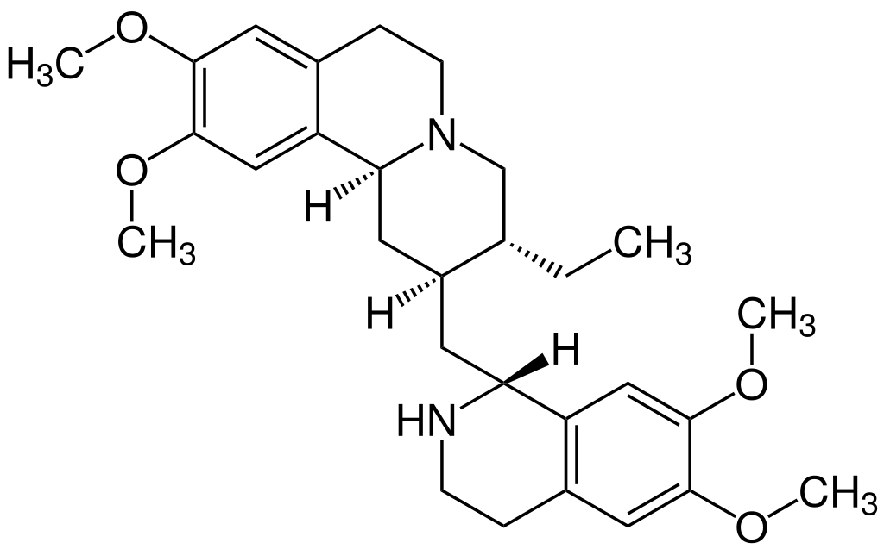
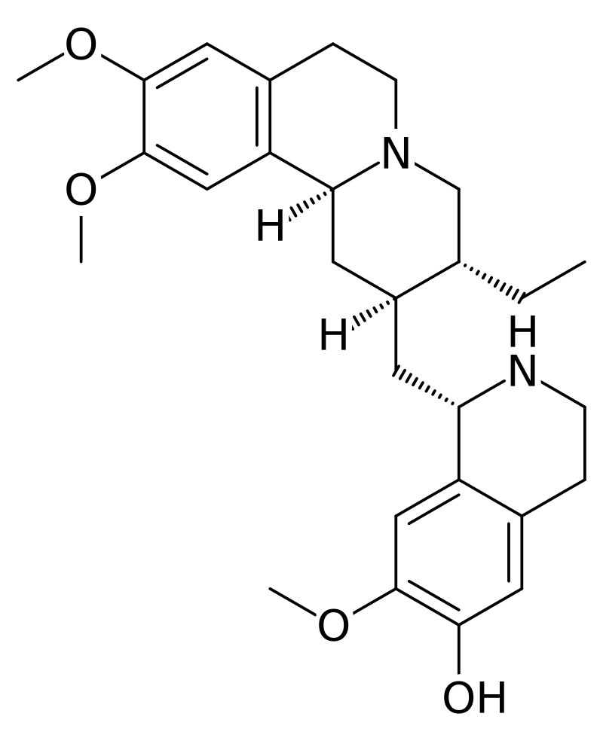
Ipecacuanhae radix CzPh 2017
Macroscopy: annular roots, with red-brown surface, broad bark, which can be easily peeled off from yellow wood, undistinguished odour, sharp bitter taste
Content compounds: alkaloids - emetine, cephaeline, saponins
Usage: expectorant, emetic, chemotherapeutic to threat amoeba dysentery
emetine
cephaeline

Slide 8
Ipecacuanhae radix CzPh 2017
Microscopy: disproportion between width of bark and wood (4:1), secondary bark with starch cells and rafides of calcium oxalate, sieve tubes, wood with vessels, libriform, parenchyma of wood with starch

Slide 9
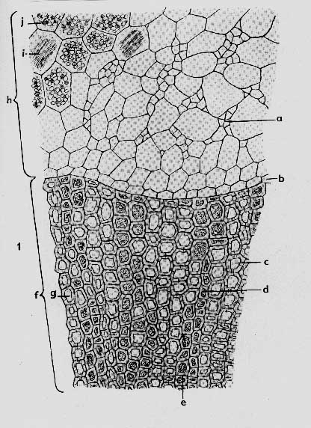
Ipecacuanhae radix CzPh 2017
Microscopy:
rafides
starch
sieve-tubes
cambium
vessels with libriform

Slide 10
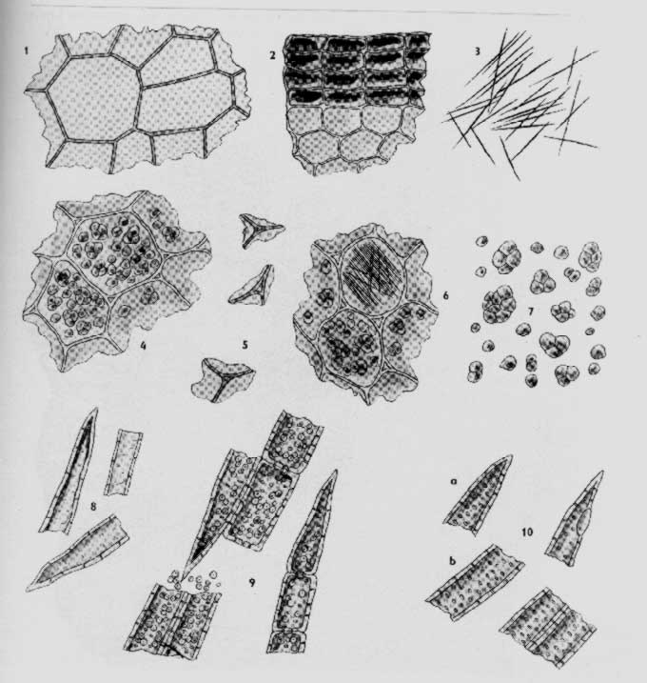
Ipecacuanhae radix CzPh 2017
Ipecacuanhae pulvis normatus CzPh 2017
In powder can be observed: pices of cork, parenchym, rafides, starch grains, pieces of libriform and vessels

Slide 11
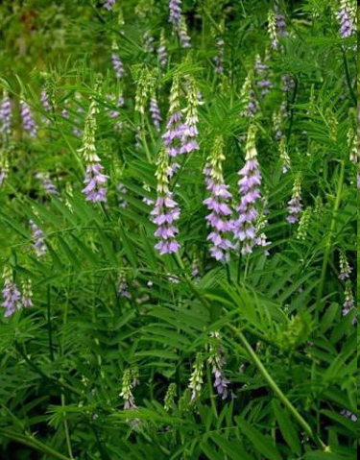
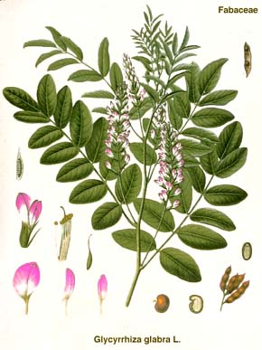
Liquiritiae radix CzPh 2017
Mother plant: Glycyrrhiza glabra, G. inflata, G. uralensis Fabaceae (liquorice)
Liquiritiae extractum fluidum ethanolicum normatum CzPh 2009
Liquiritiae extractum siccum ad saporandum CzPh 2017

Slide 12
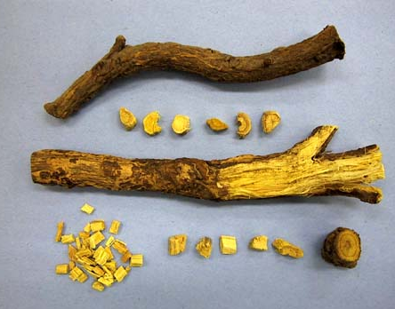
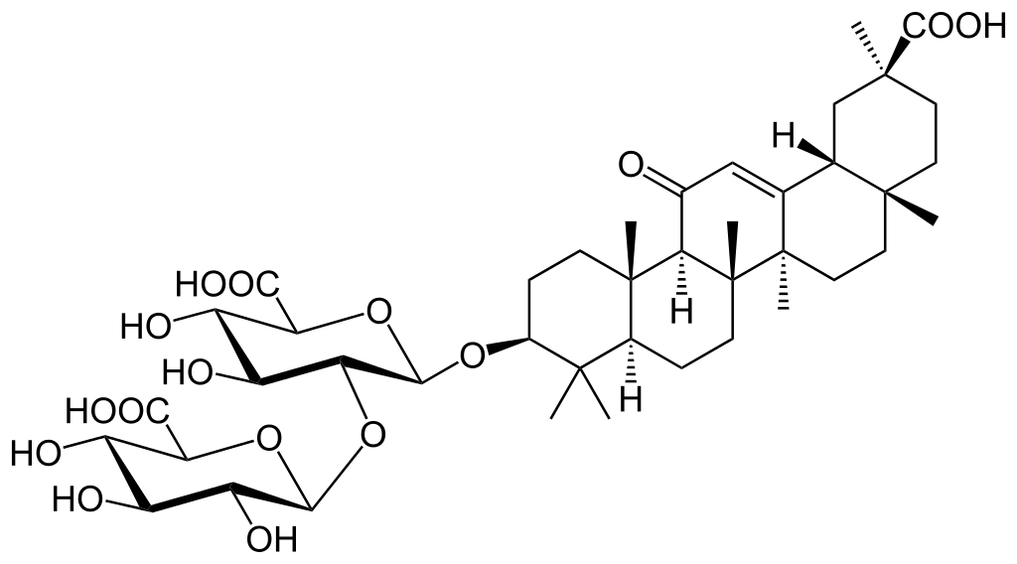
Liquiritiae radix CzPh 2017
Macroscopy:non-branched capitate (spindle-shaped) root, from outside rugged, grey-white, on the section yellow, sweetish odour, unpleasant sweet taste
Content compounds: saponins (glycyrrhizin), flavonoids, estrogen-like compounds, starch, sugars
Usage: expectorant, bacteriostatic effect, (not) diuretic, antiulcerotic, spasmolytic
glycyrrhizin

Slide 13
Liquiritiae radix CzPh 2017
Microscopy: cork, crystals of calcium oxalate, medullar rays, cambium, vessels with libriform and with cellular cells, sieve-tubes, typical keratenchyma, phloem fibers, wood parenchyma with starch

Slide 14
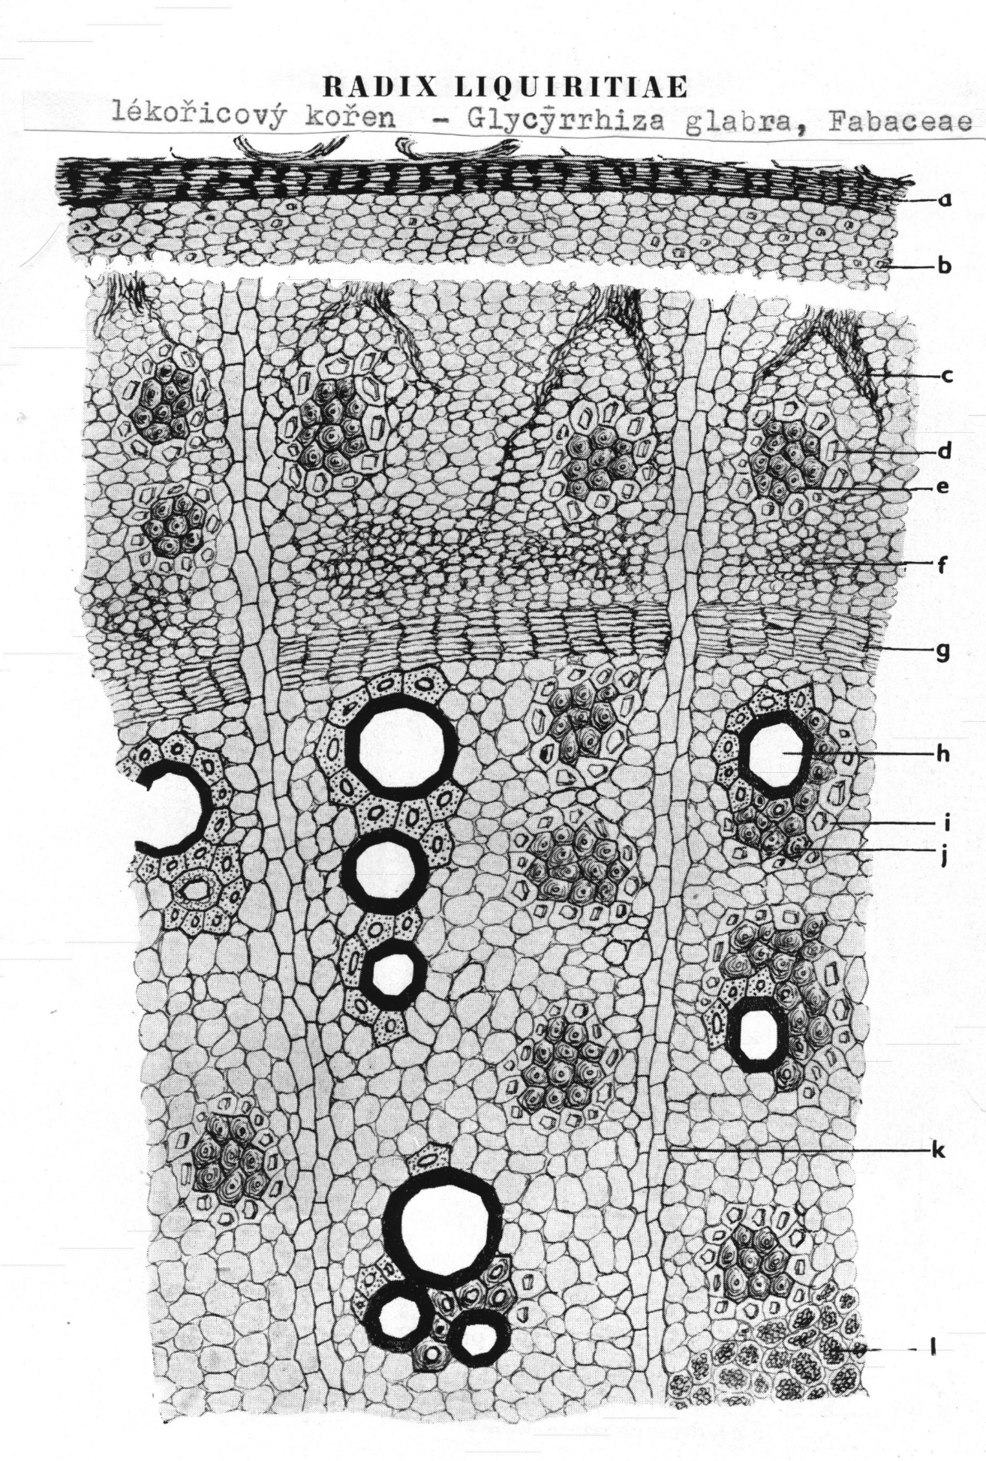
Liquiritiae radix CzPh 2017
Microscopy:
cork
keratenchyma
phloem fibers
sieve-tubes
kambium
vessels
libriform
starch

Slide 15
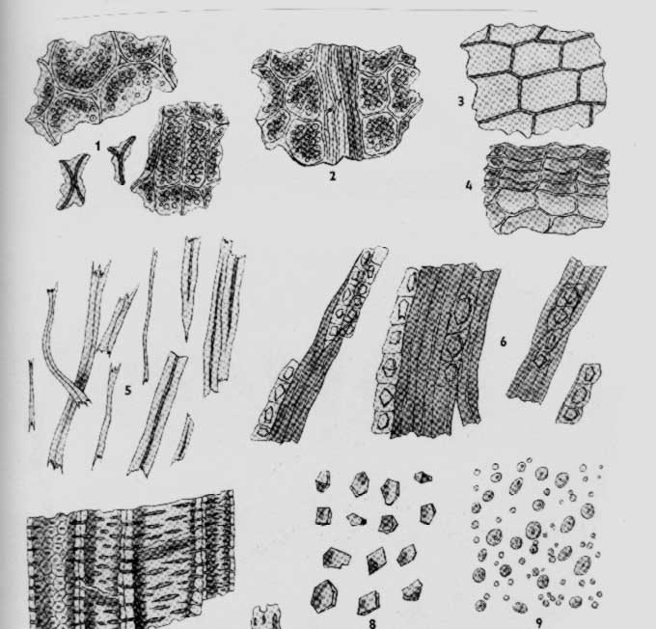
Liquiritiae radix CzPh 2017
Liquiritiae radicis pulvis
Can be observed: pieces of cork, bark with keratenchyma, pieces of parenchyma and sclerenchyma, cellular fibres, vessels, crystals of calcium oxalate, starch grains

Slide 16
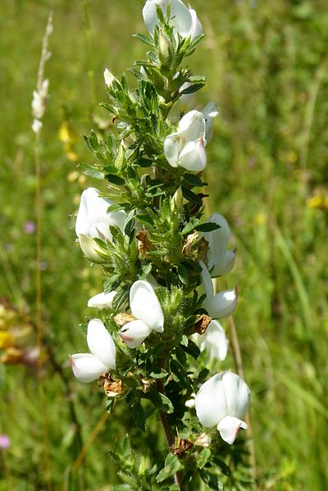
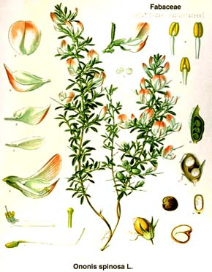
Ononidis radix CzPh 2017
Mother plant: Ononis spinosa, Fabaceae (spiny restharrow)
https://commons.wikimedia.org/wiki/File:Ononis_spinosa_white_01.jpg

Slide 17
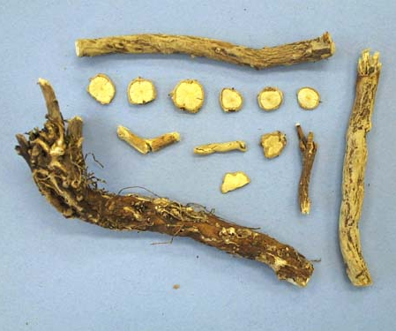
Ononidis radix CzPh 2017
Macroscopy: long twisted root, non-branched, rugged, grey-brown, on the section yellow, drug without odour, acidish tart taste
Content compounds: flavonoids (ononin), essential oil, tannins, mineral compounds, organic acids
Usage: diuretic, stomachic, metabolic, antiphlogistic, antirheumatic

Slide 18
Ononidis radix CzPh 2017
Microscopy: cork, primary cortex, secondary cortex, cells with crystals of calcium oxalate, phloem fibers, cambium, sieve-tubes, libriform, cellular fibers, visible medullar rays, rosette of primary vessels

Slide 19
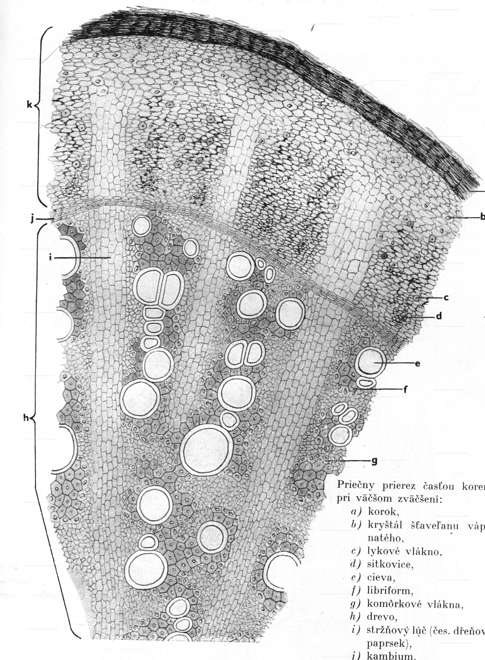
Ononidis radix CzPh 2017
Microscopy:
cork
crystals
sieve-tubes
kambium
vessels
libriform
medullar rays

Slide 20
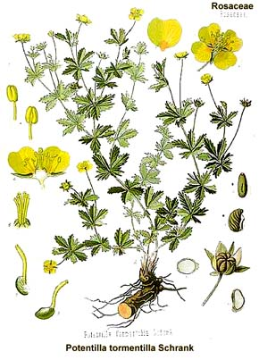
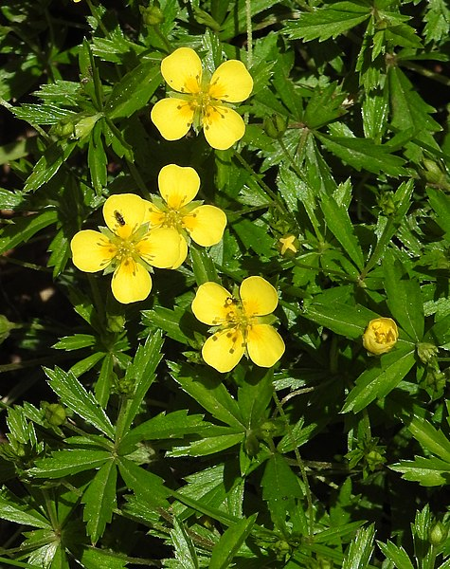
Tormentillae radix (rhizoma) CzPh 2017
Mother plant: Potentilla tormentilla syn. P. erecta, Rosaceae
(common tormentil)
Tormentillae tinctura CzPh 2017
https://commons.wikimedia.org/wiki/File:Potentilla_erecta_RF.jpg

Slide 21
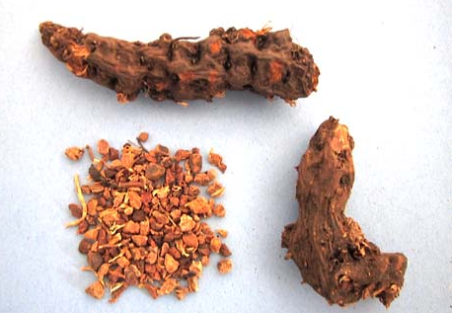
Tormentillae radix (rhizoma) CzPh 2017
Macroscopy: very hard cylindric rhizome, spindle-shaped, dark red with scarification after side roots, on the section brighter, weaved with sclerenchymatic fibers, odour indistinctive, very constricting taste
Content compounds: catechine tannins, organic acids, waxes, traces of volatiles
Usage: strong astringent, antidiarrhoic, antiphlogistic, haemostyptic

Slide 22
Tormentillae radix (rhizoma) CzPh 2017
Microscopy: cork, feloderm, cortical parenchyma, cambium, sieve-tubes, vessels with libriform, cells with aggregates of calcium oxalate and starch

Slide 23
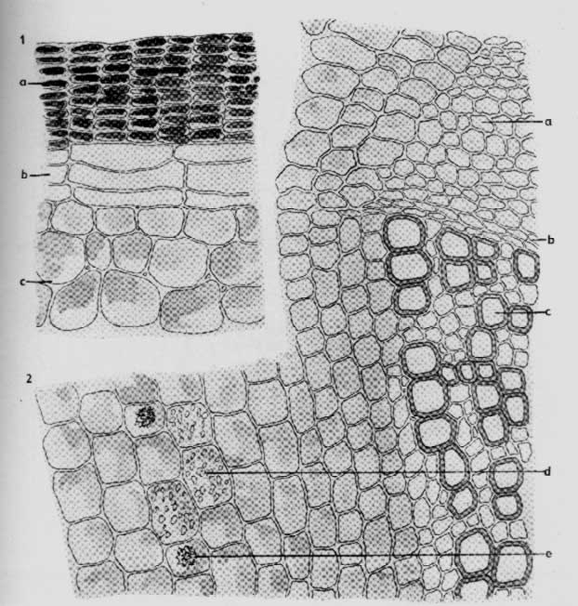
Tormentillae radix (rhizoma) CzPh 2017
Microscopy:
cork
feloderm sieve-tubes
cambium
parenchyma
vessels
starch
oxalate aggregate

Slide 24
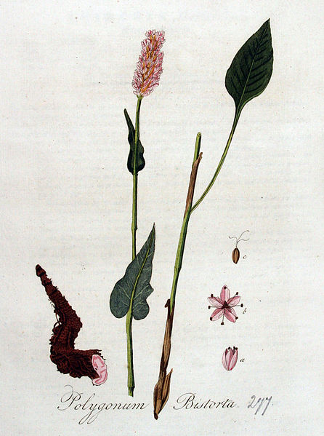
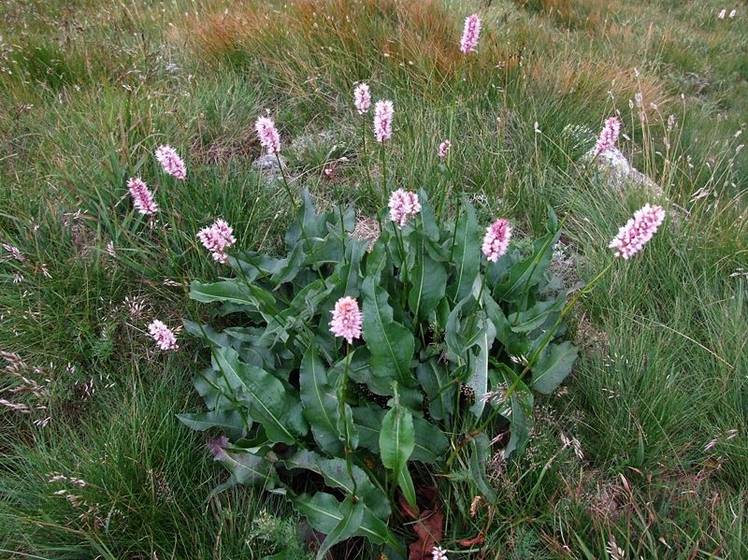
Bistortae radix (rhizoma) CzPh 2017
Mother plant: Polygonum bistorta syn. Persicaria bistorta (Bistorta major), Polygonaceae (Bistort)
https://upload.wikimedia.org/wikipedia/commons/f/f8/Polygonum_bistorta_a3.jpg

Slide 25
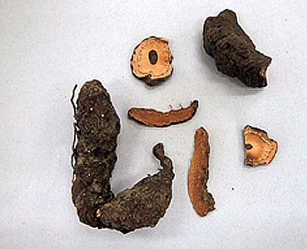
Bistortae radix (rhizoma) CzPh 2017
Macroscopy: flat, twisted, dark brown rhizome, on the section red-brown, without odour, constricting taste
Content compounds: catechin tannins, pigment – bistort red, higher amount of starch
Usage: astringent, haemostyptic, externally on inflamed mucous membrane and edema, antidote for intoxications

Slide 26
Bistortae radix (rhizoma) CzPh 2017
Microscopy: cork, flobaphene cells, cells with aggregates of calcium oxalate, sieve-tubes with phloem fibers, cambium, vessels with libriform, parenchyma with starch

Slide 27
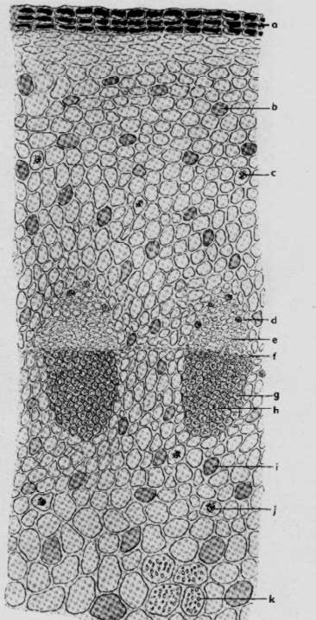
Bistortae radix (rhizoma) CzPh 2017
Microscopy:
cork
flobaphene cells
oxalate aggregates
sieve-tubes
kambium
vessels with labriform
starch

Slide 28
MACROSCOPY

Slide 29
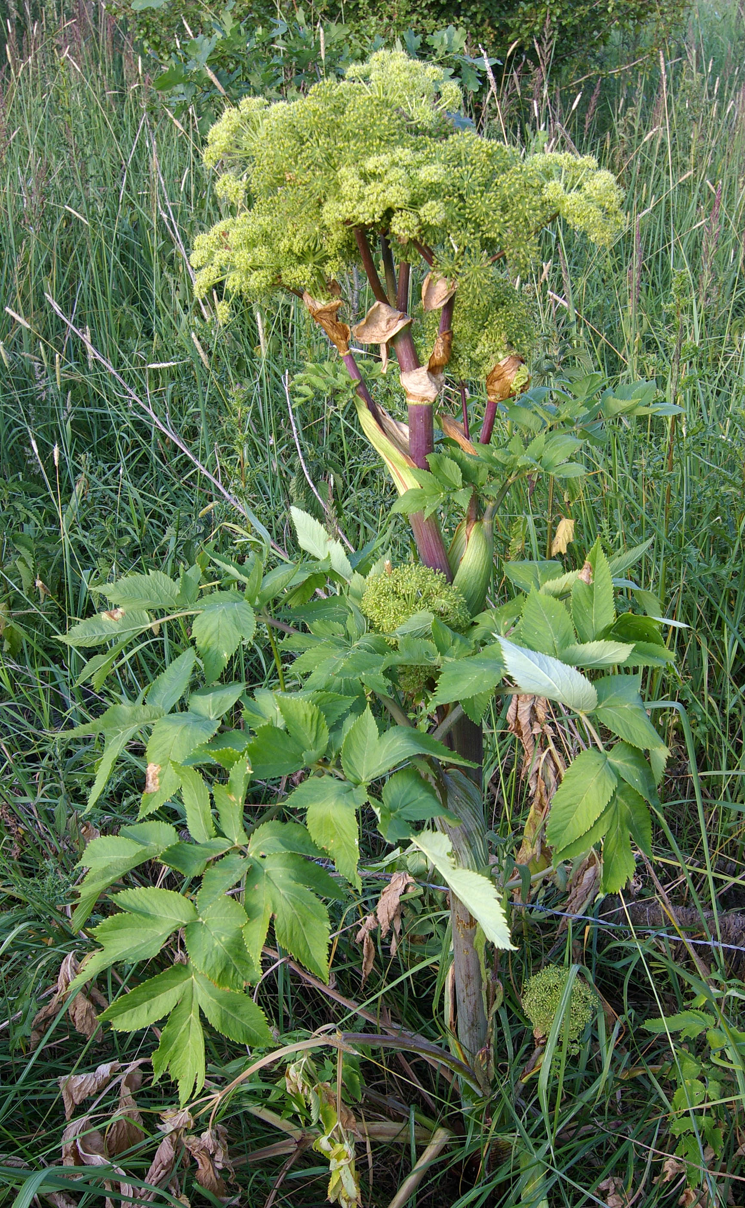
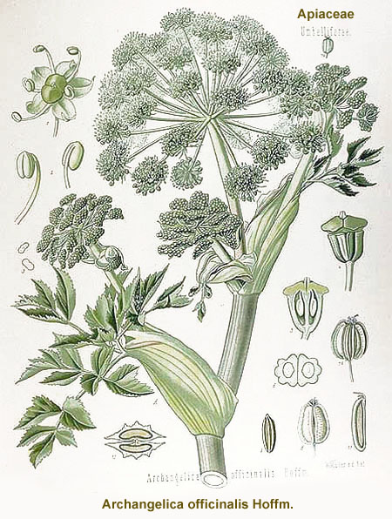
Angeliceae radix CzPh 2017
Mother plant: Archangelica archangelica, syn. Archangelica officinalis, Apiaceae, (angelica)
https://commons.wikimedia.org/wiki/File:AngelicaArchangelica1.jpg

Slide 30
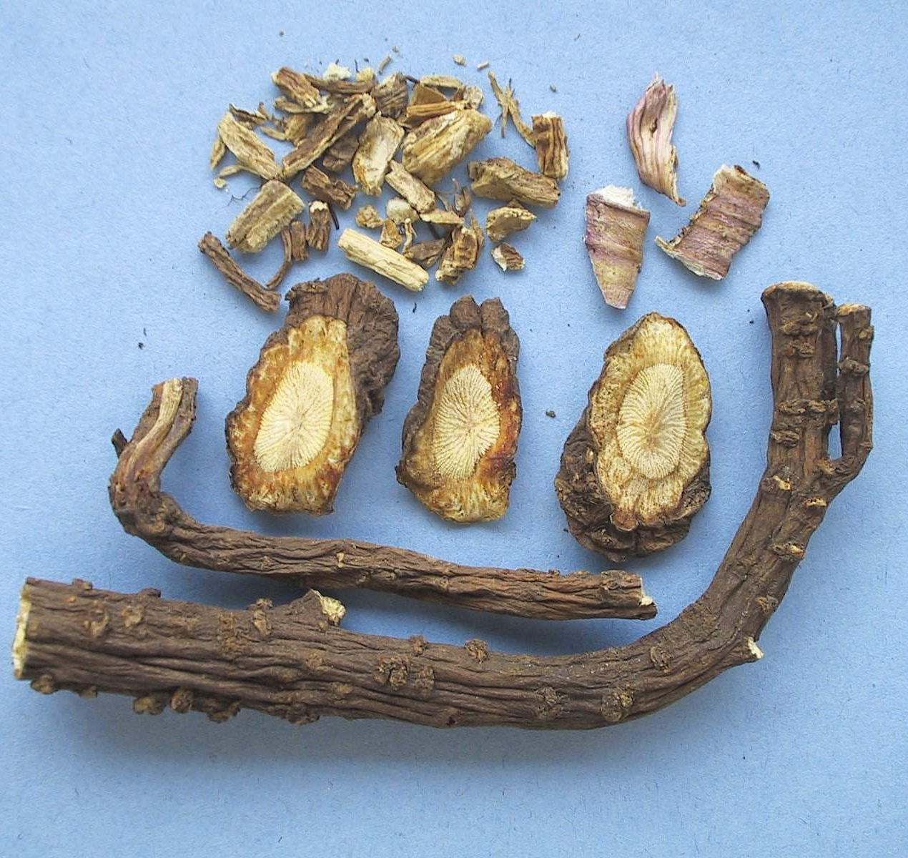
Angeliceae radix CzPh 2017
Macroscopy: short rhizoma, transversally stripped with roots scarification, grey-brown to red-brown colour, on the section grey-yellow wood, spicy odour, taste sharp spicy
Content compounds: volatile oils (pinen), coumarins (angelicin), bitter compounds
Usage: amare, stomachic, spasmolytic, carminative, sedative

Slide 31
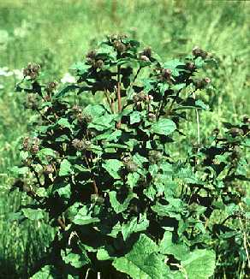
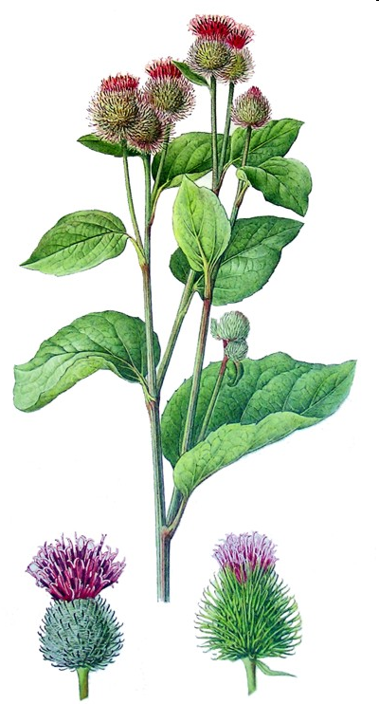
Bardanae radix
Mother plant: Arctium tomentosum, A. lappa, A. minus, Asteraceae (downy burdock )

Slide 32
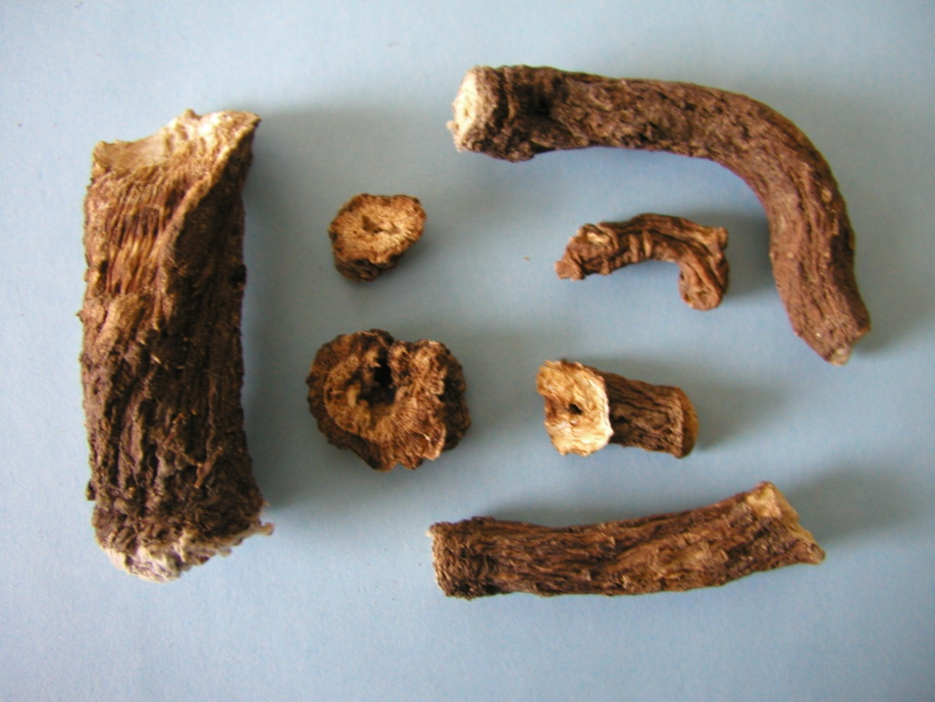
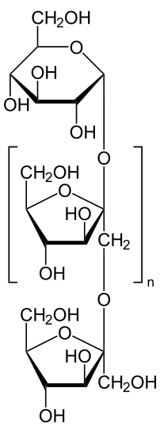
Bardanae radix
Macroscopy: roots of grey-brown colour, on the section whitish, without odour, bitter taste
Content compounds: inulin, polyacetylenes, mucilage, tannins, essential oil, bitter compounds
Usage: dietetic, diagnostic, diuretic, bacteriostatic and mycostatic effects

Slide 33
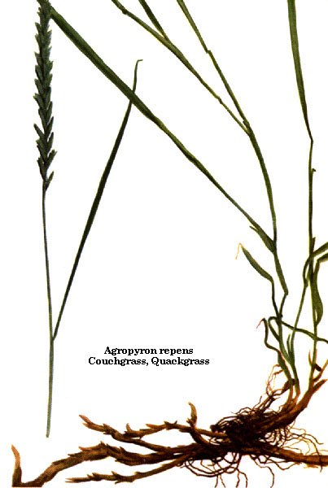
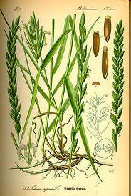
Graminis radix (rhizoma) CzPh 2017
Mother plant: Elymus repens (Agropyron repens, Elytrigia repens), Poaceae, twitch, quick grass, quitch grass

Slide 34
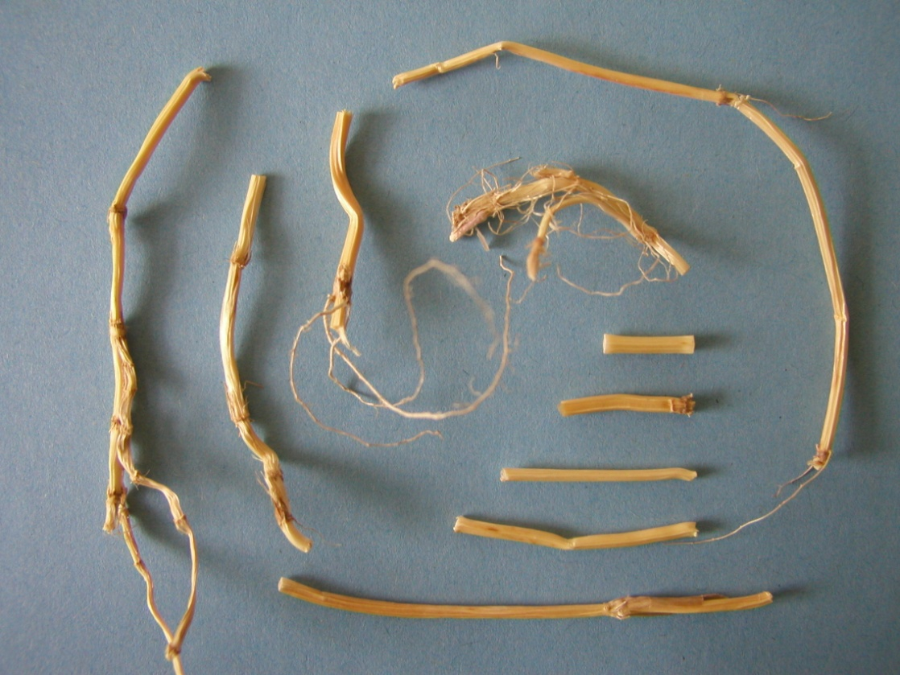
Graminis radix (rhizoma) CzPh 2017
Macroscopy: yellow peaces of rhizome – articulate and hollow, only in nodes full, without side roots, without odour, sweetish taste
Content compounds: sugars, inuline, mucilage, inositol, saponins, silicic acid, volatiles
Usage: diuretic, metabolic

Slide 35
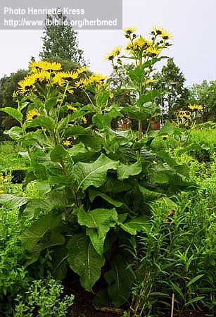
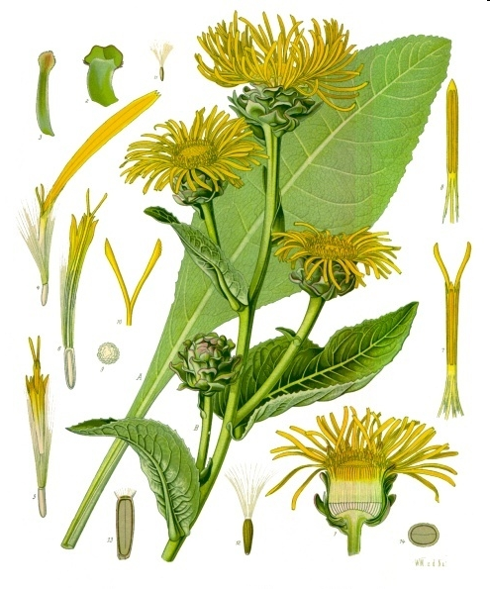
Inulae radix
Mother plant: Inula helenium, Asteraceae, (Elecampane, also called Horse-heal)

Slide 36
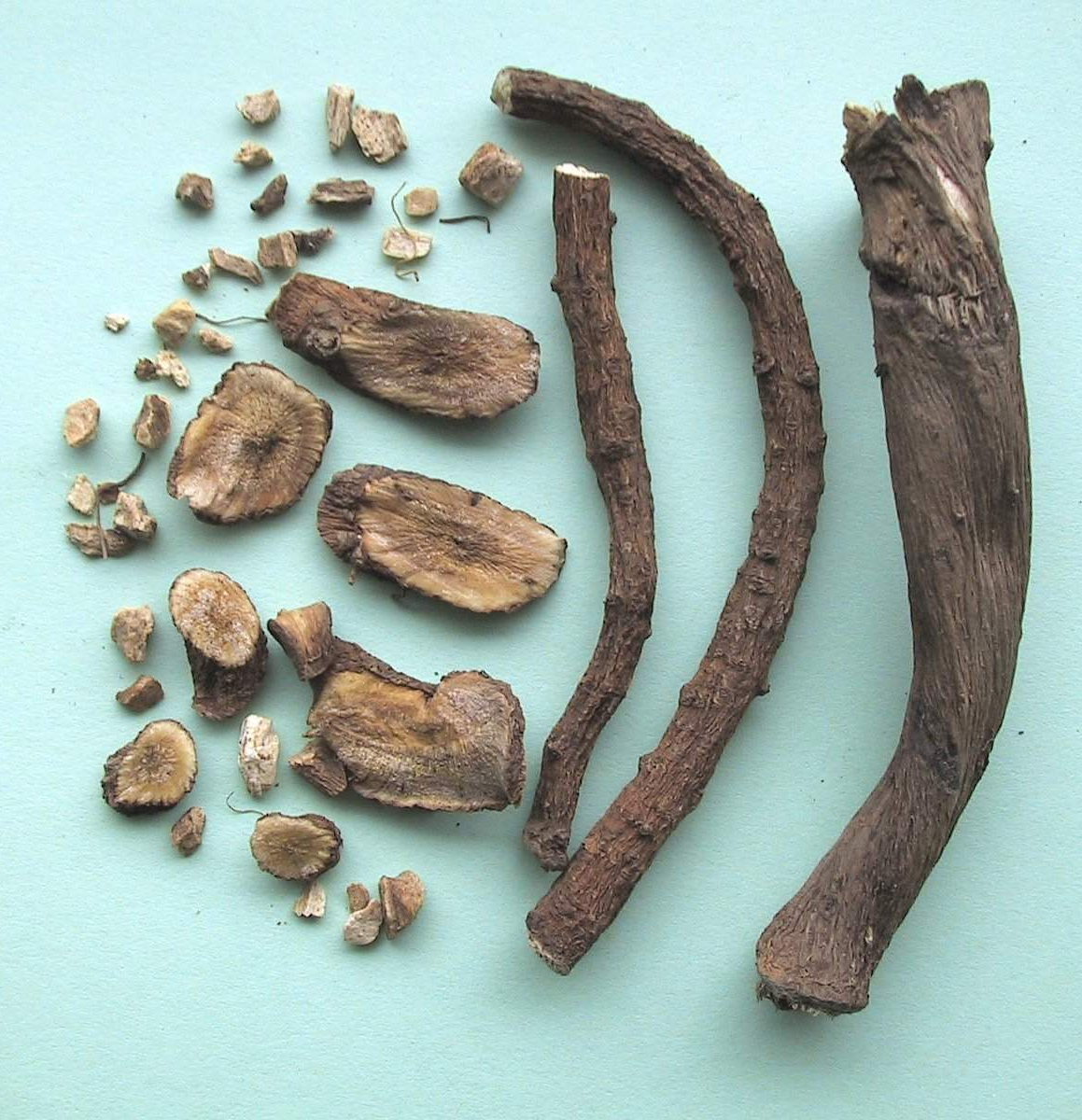
Inulae radix
Macroscopy: side roots - cylindrical, from outside yellow to grey-brown, inside brown, rhizomes – grey-brown, wrinkled, aromatic odour, spicy bitter taste
Content compounds: essential oil, inulin, bitter compounds, sugars
Usage: expectorant, spasmolytic, diuretic

Slide 37
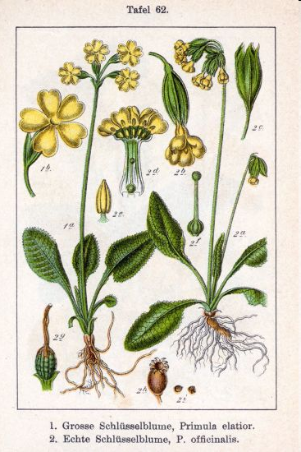
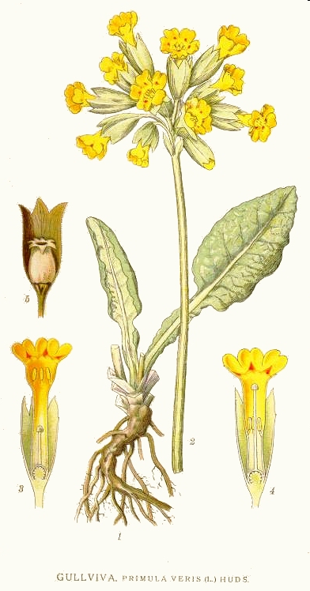
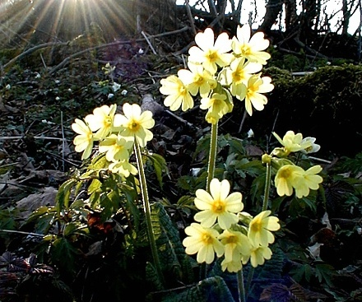
Primulae radix CzPh 2017
Mother plant: Primula veris, Primula elatior, Primulaceae
(primrose)

Slide 38
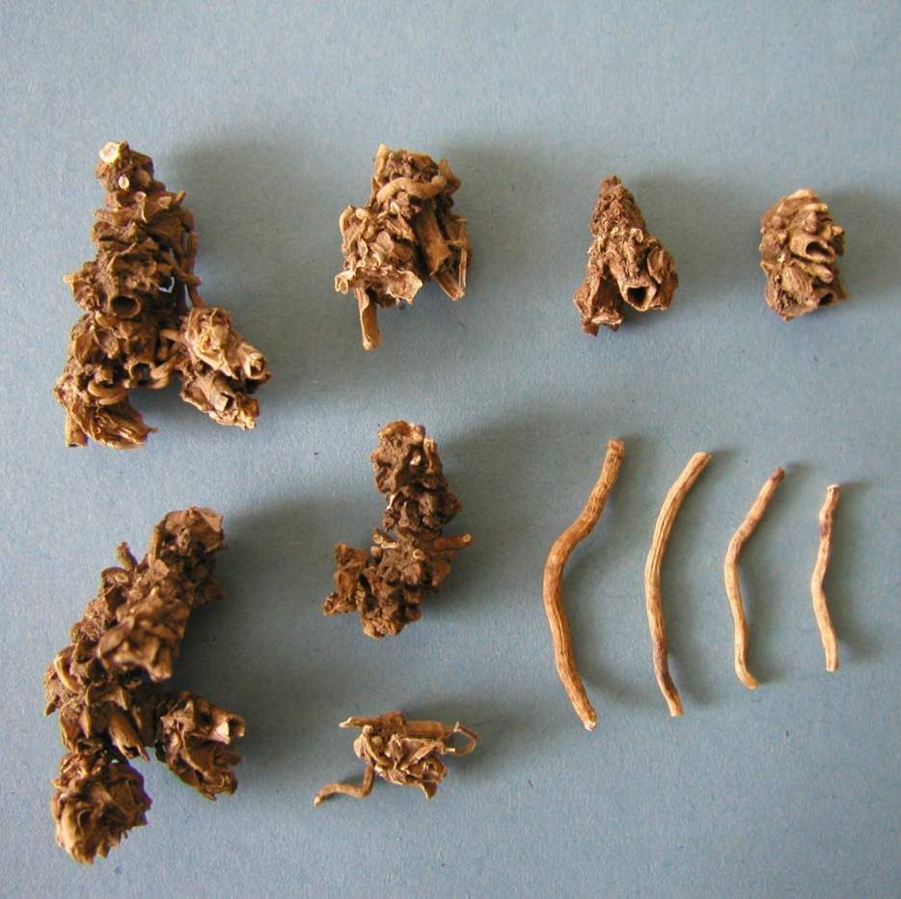
Primulae radix CzPh 2017
Macroscopy:irregular, twisted root, P. veris – roots break-able, bright yellow, P. elatior - brown to brown-red, acidish taste, weak odour
Content compounds: saponins (primulic acid), phenolic glycosides (primulaverine), flavonoids, essential oil
Usage: expectorant, diuretic

Slide 39
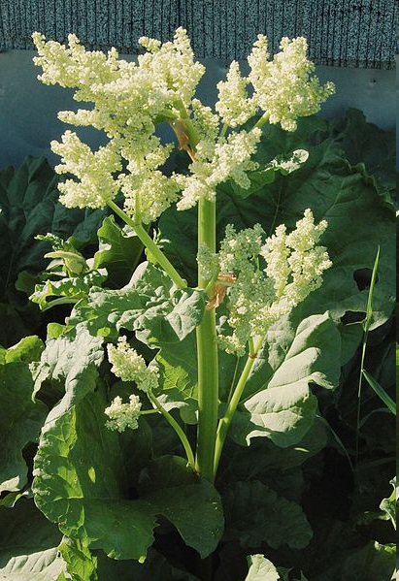
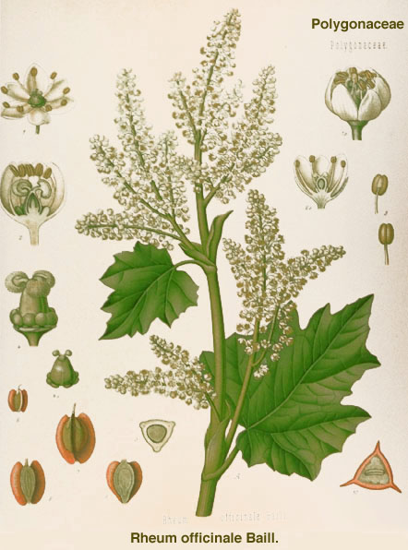
Rhei radix CzPh 2017
Mother plant: Rheum palmatum, Rheum officinale or their hybrids, Polygonaceae, (rhubarb)

Slide 40
Rhei radix CzPh 2017
Macroscopy:round or cylindric rhizomes, peeled off, yellow-brown – marble-like, characteristic unpleasant odour, spicy acrid taste
Content compounds:
anthraquinone glycosides (aloe-emodin), tannins, rutin, pectine, calcium oxalate
Usage: laxative, stomachic, astringent
aloeemodin

Slide 41
Saponariae radix
Mother plant: Saponaria officinalis, Caryophyllaceae,
(Soapwort)

Slide 42
Saponariae radix
Macroscopy: red-brown cylindrical roots, longitudinally wrinkled, white cortex an yellow wood on the section, taste at the beginning sweet, than bitter and soapy
Content compounds: saponins, sugars
Usage: expectorant, diuretic, antiphlogistic

Slide 43
Valerianae radix CzPh 2017
Mother plant: Valeriana officinalis, Valerianaceae (valerian)
Valerianae extractum siccum CzPh 2017
Valerianae tinctura CzPh 2017

Slide 44
Valerianae radix CzPh 2017
Macroscopy: obovate rhizome with small roots, red-brown to grey-brown, strong characteristic odour, sweet spicy taste
Content compounds: essential oil, valepotriates, pyridine alkaloids, valerenic acid, flavonoids
Usage: sedative, spasmolytic, antiemetic
valerenic acid

