Slide 1
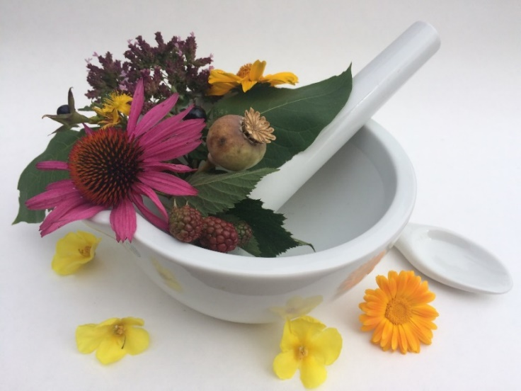
Pharmacognosy lab exercise 5
Roots, rhizomes and leaves of dicotyledonous plants

Slide 2
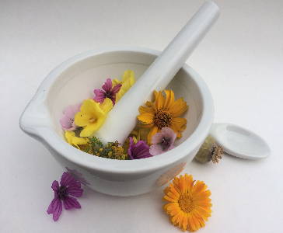
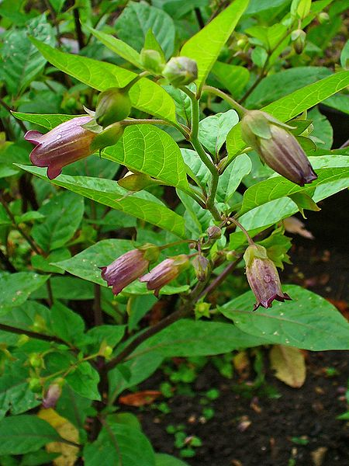
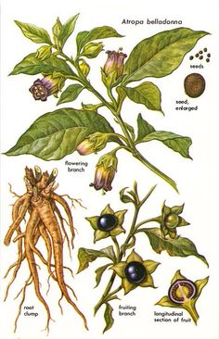
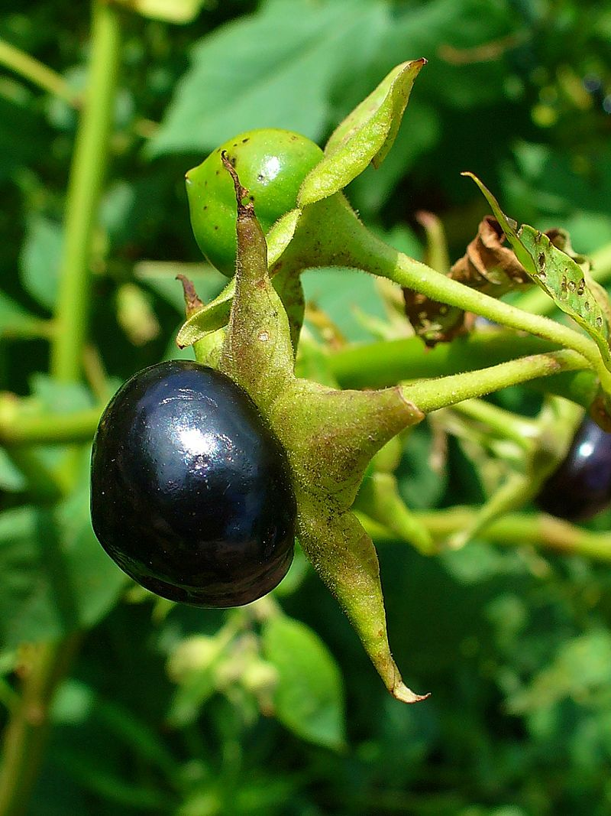
Belladonnae radix
Mother plant: Atropa belladonna, Solanaceae
(deadly nightshade)
https://commons.wikimedia.org/wiki/File:Atropa_belladonna_004.JPG
https://commons.wikimedia.org/wiki/File:Atropa_belladonna_001.JPG
Notes:
Bella Donna – beautiful lady

Slide 3
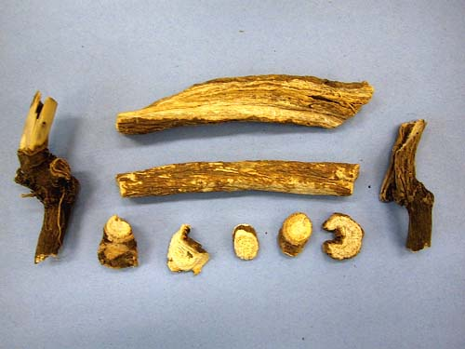
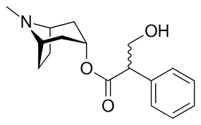
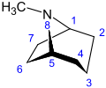
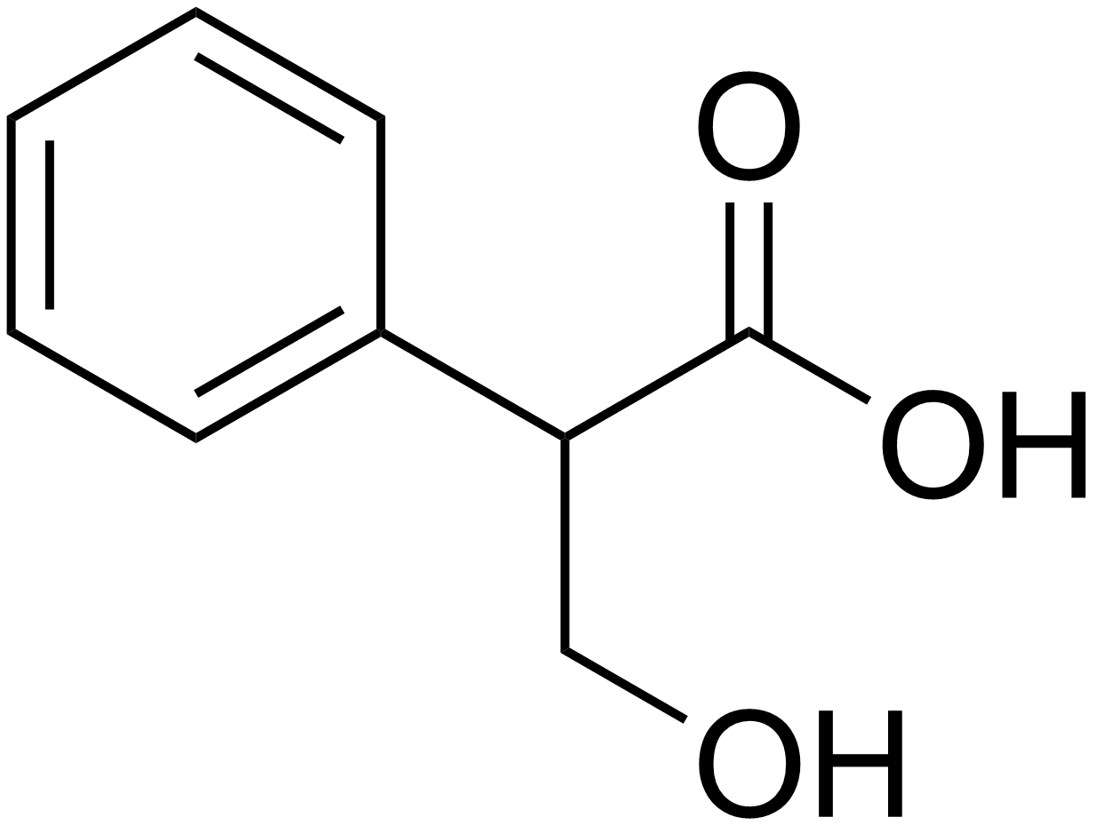
Belladonnae radix
Macroscopy: roots of different size, bright grey, longitudinally banded, wide wood and narrow cortex, on the section whitish, on the section raising dust (presence of starch), without odour, taste firstly sweet, then bitter
Content compounds: 0.45-0.85 % tropane alkaloids: atropine, scopolamine, apoatropine, belladonine, cuscohygrine, starch
Atropin is a racemic mixture of (+)- and (-) - hyoscyamine (the latter is the main alkaloid)
Usage: isolation of alkaloids, parasympatolytic
atropine
scopolamine
tropane
tropic acid

Slide 4
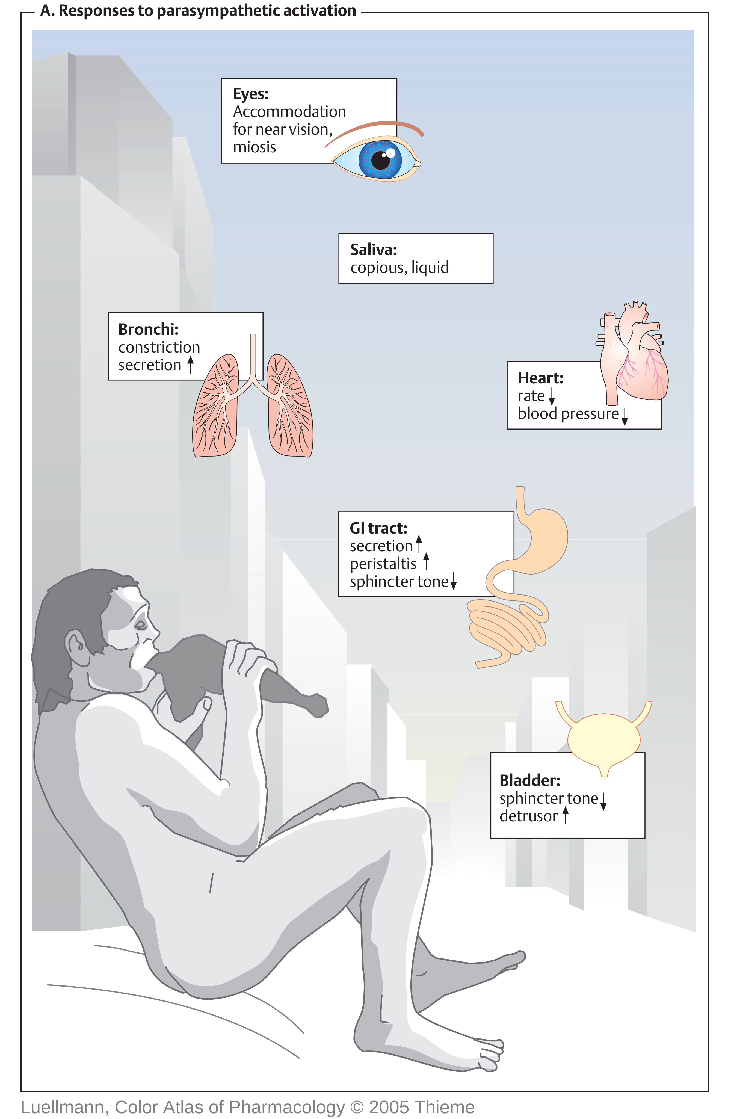
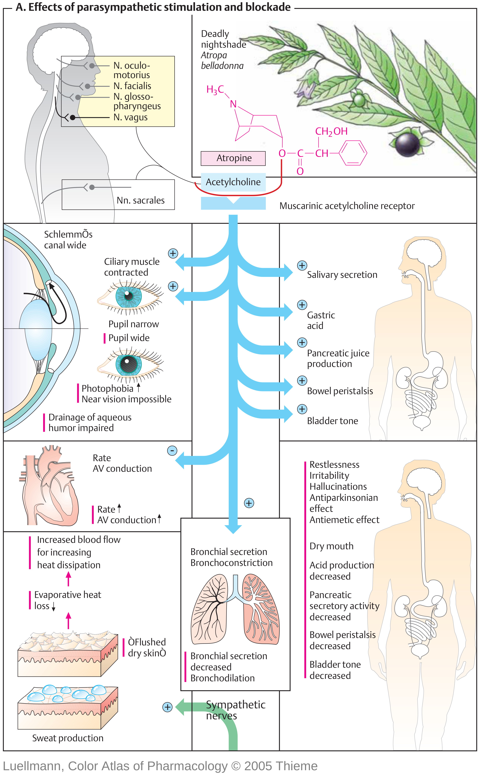

Slide 5
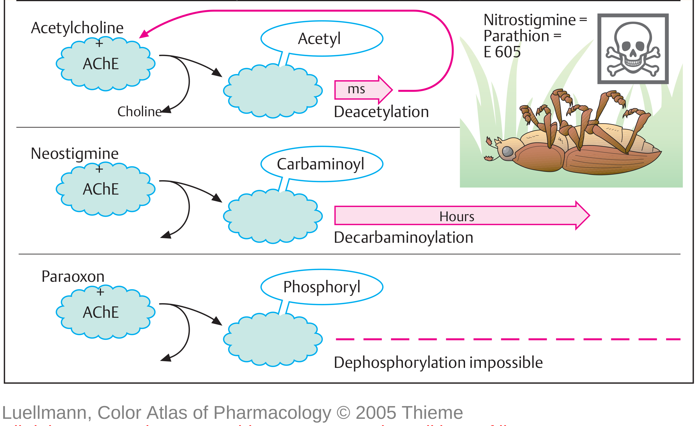
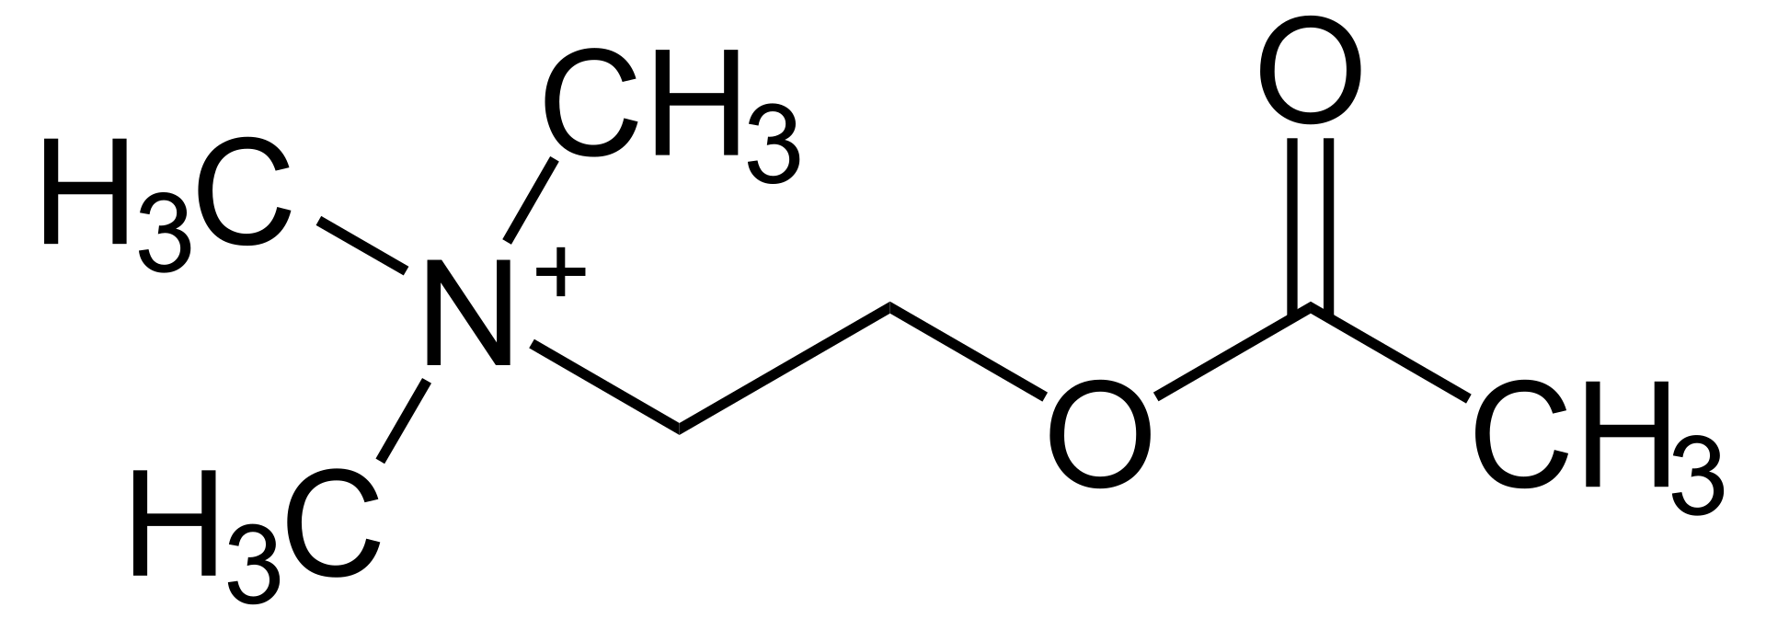
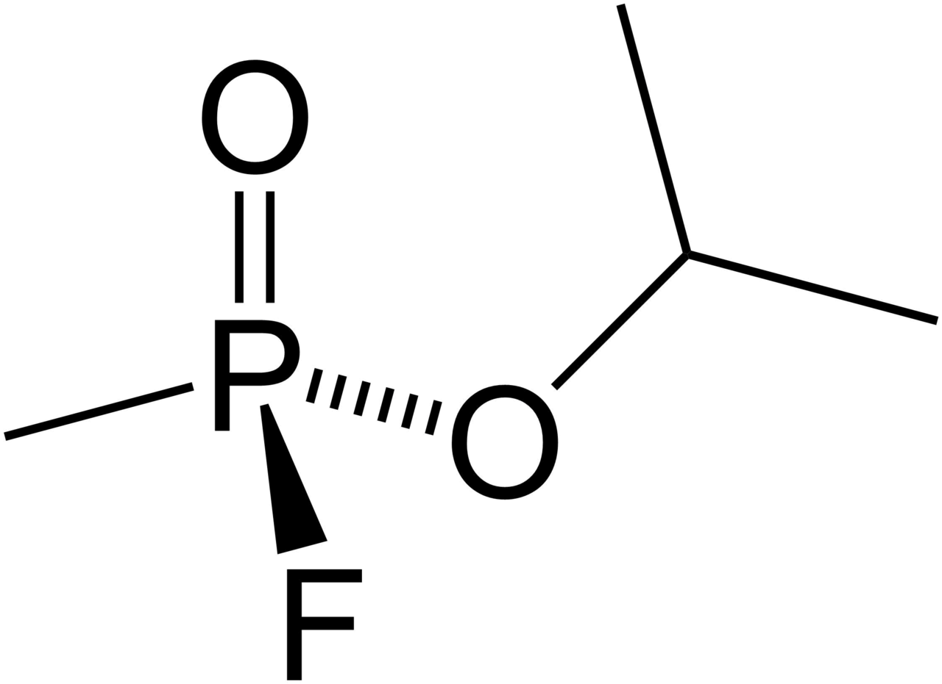
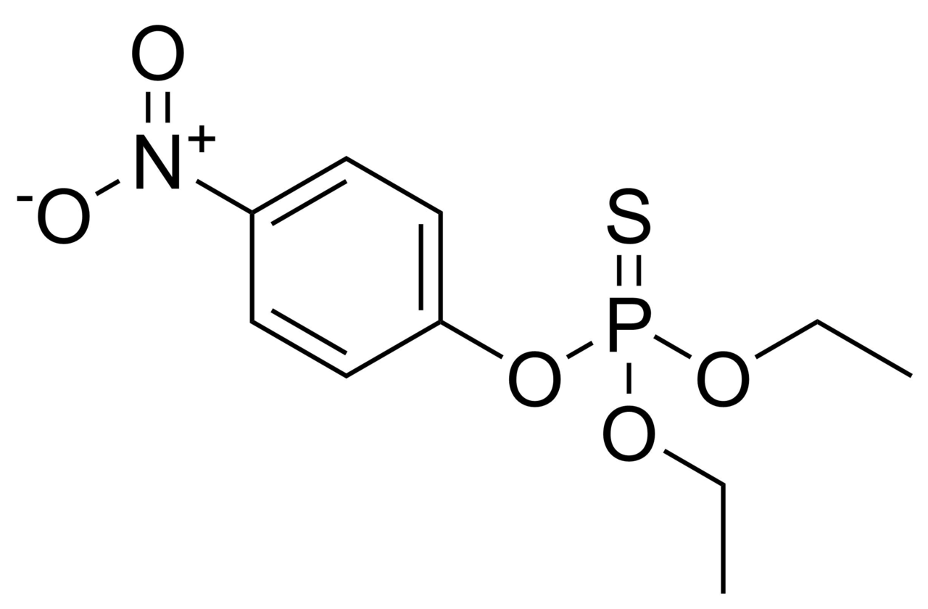
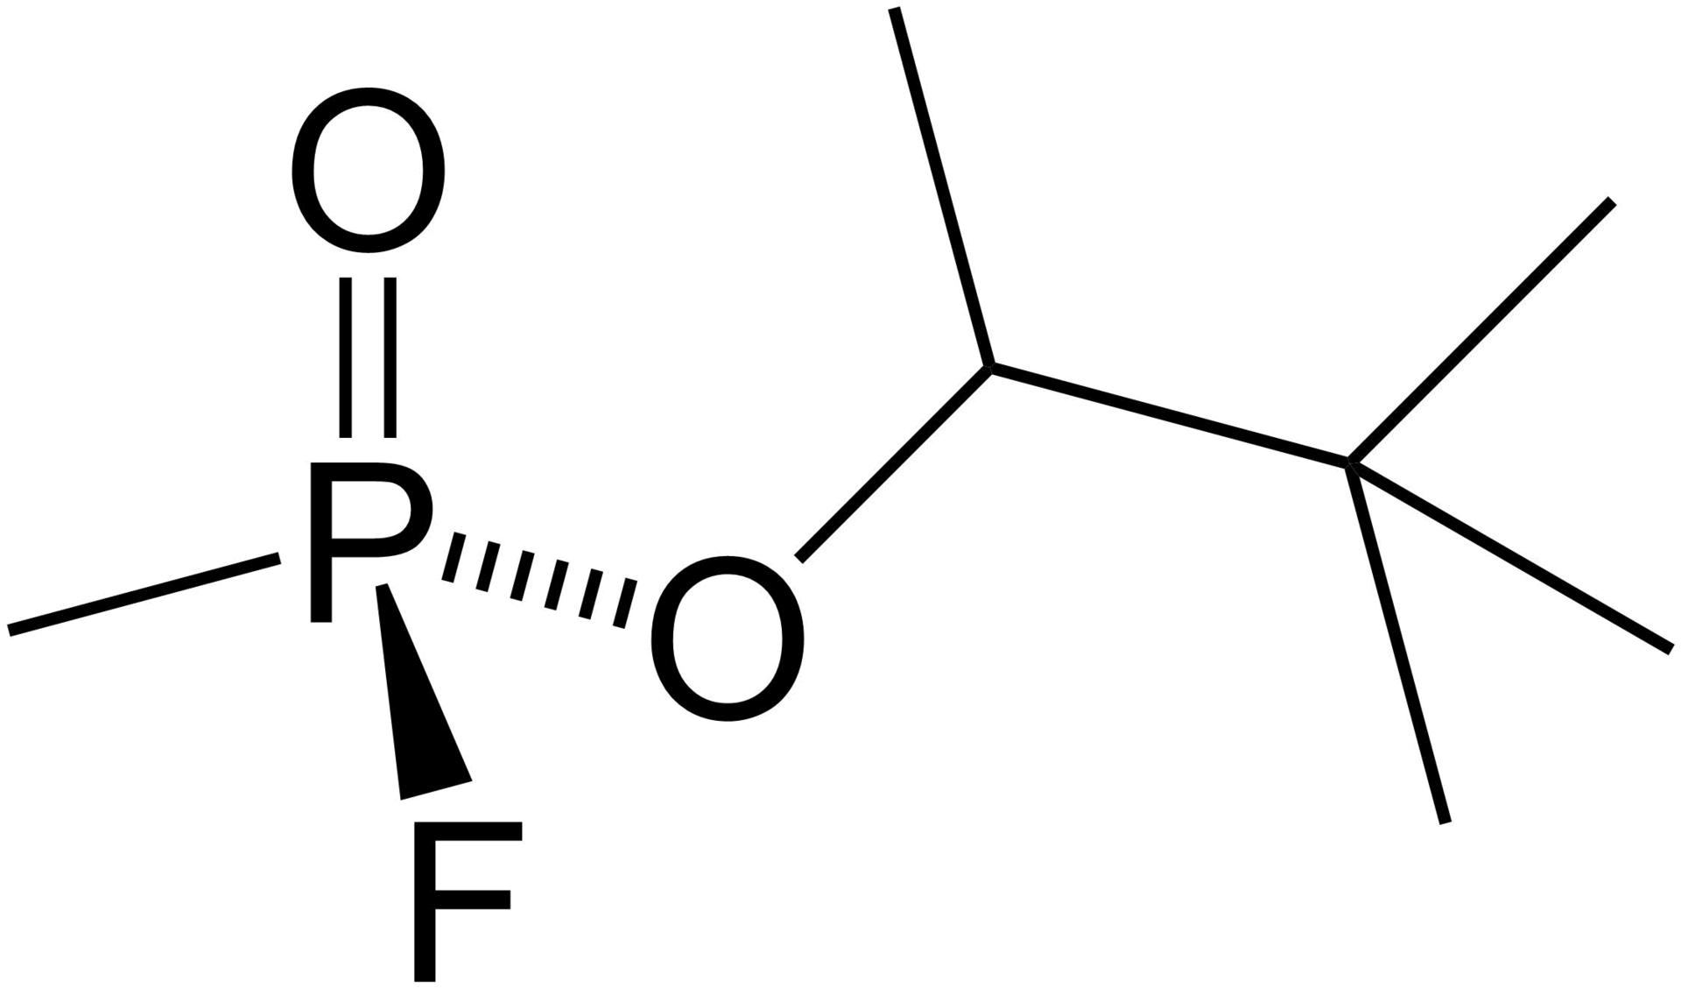
Belladonnae radix
Atropine intoxication: mydriasis, mouth dryness, hallucinations, terminal state- delirium and coma, death due to paralysis of vital centres
Atropine – mydriatic, antiemetic, antiparkinsonic, premedication to general anesthesia, antidotum for intoxication with parasympatomimetics (organophosphates – insecticides, chemical weapons)
Scopolamine – sedates the CNS, spasmolytic
acetylcholine
sarine
soman
parathion

Slide 6
Belladonnae radix
Microscopy: cork with tangentially prolonged cells, secondary cortex with parenchyma, starch and sand cells (calcium oxalate), visible cambium, upon cambium sieve-tubes, under cambium vessels with libriform, sand cells and parenchyma with starch, typical sign – in wood disseminated sieve-tubes: interxylar phloem, bicollateral vascular bundles

Slide 7
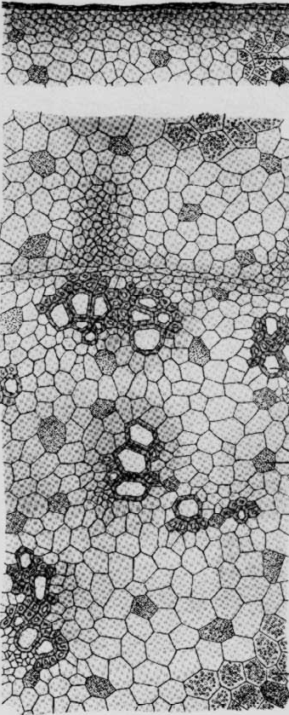
Belladonnae radix
Microscopy:
cork
parenchyma with starch
sand cell
sieve-tubes
cambium
interxylar phloem
vessels with libriform
sand cell

Slide 8
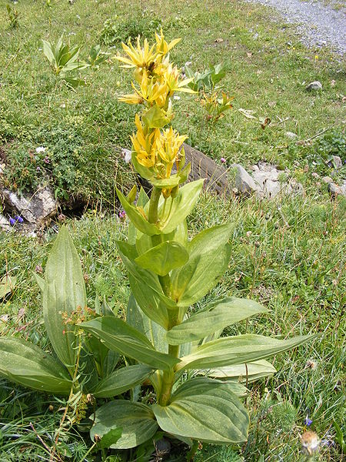
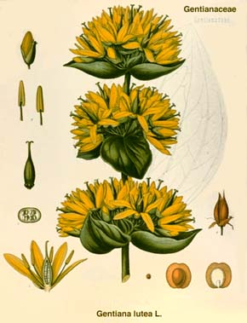
Gentianae radix CzPh 2017
Mother plant: Gentiana lutea, Gentianaceae (great yellow gentian)
Gentianae tinctura CzPh 2017
https://cs.wikipedia.org/wiki/Soubor:Gentiana_lutea_DSCF1579.JPG

Slide 9
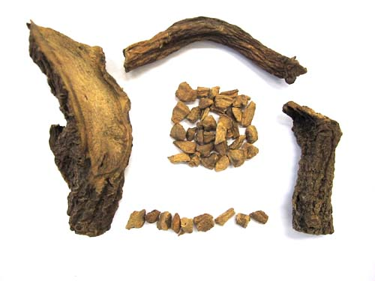
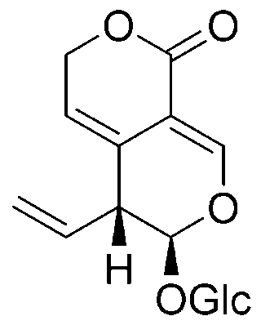
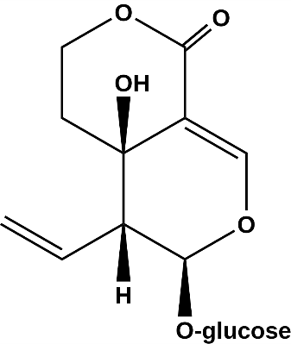
Gentianae radix CzPh 2017
Macroscopy: cylindrical root, poorly branched, on the surface brown-grey, on the section yellow-brown-red-yellow, longitudinally wrinkled, scarification after side-roots, weak odour (dried figs), taste firstly sweetish than bitter
Content compounds: bitter substances (gentiopicrin, amarogentin, swertiamarin), yellow pigment gentisin, no starch
Usage: amare-stomachic
gentiopicrin
swertiamarin

Slide 10
Gentianae radix CzPh 2017
Microscopy: 4-6 lines of thin-wall cork, thin-wall bark parenchyma, vessels separated and isolated or creating groups, no sclerenchyma (libriform), no starch (or only low amount), possible microcrystalline calcium oxalate. No well differentiated parenchyma rays.

Slide 11
Gentianae radix CzPh 2017
Microscopy:
parenchyma
sieve-tubes
cambium
vessels
interxylar phloem

Slide 12
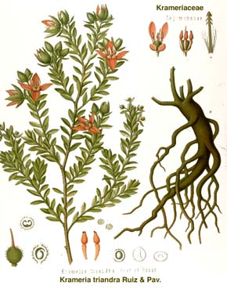
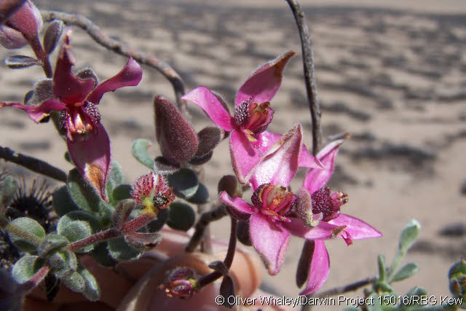
Ratanhiae radix CzPh 2017
Mother plant: Krameria triandra, Krameriaceae (Rhatany)
Ratanhiae tinctura CzPh 2017

Slide 13
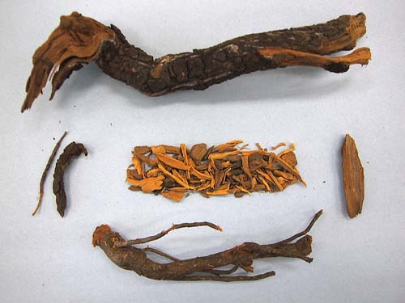
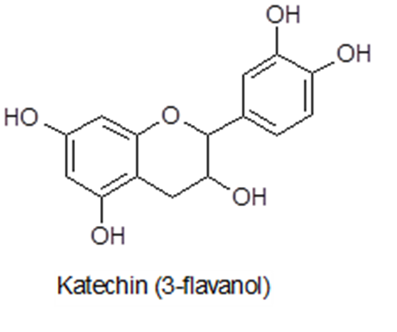
Ratanhiae radix CzPh 2017
Macroscopy: long non-branched roots, very hard, red-brown colour, bark of old roots is squamously ruptured, bark of young roots smooth with sharp transversal rifts, easily separated from wood, fracture in bark shortly wavy, in wood fragmentized, drug without odour, astringent taste
Content compounds: catechine tannins, starch, sugars
Usage: astringent, antidiarrhoic
Notes:
Flobafen – rhatany red

Slide 14
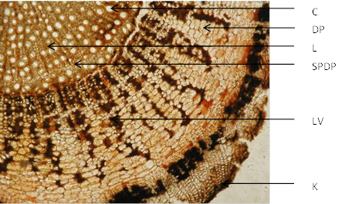
Ratanhiae radix CzPh 2017
Microscopy: characteristic wide cork with cells close to each other, simple parenchyma rays, in cortex part seen funnel-shaped broadening, in secondary cortex aggregates of phloem fibers and starch cells, upon cambium sieve-tubes, under cambium vessels with libriform, connecting strips of wood parenchyma (for intake of water and nutrients in time of dry weather)
vessel
parenchyma rays
libriform
xylem
phloem fibers
cork

Slide 15
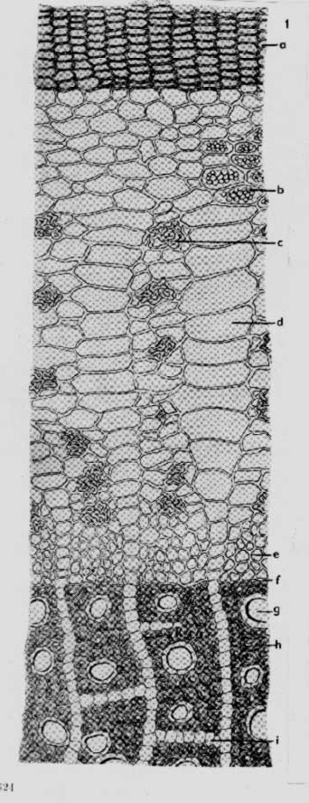
Ratanhiae radix CzPh 2017
Microscopy:
cork
starch
phloem fibers
medullar rays
sieve-tubes
cambium
vessel with libriform
connecting strips of wood parenchyma

Slide 16
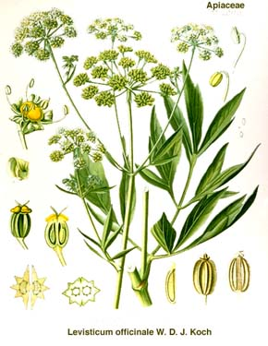
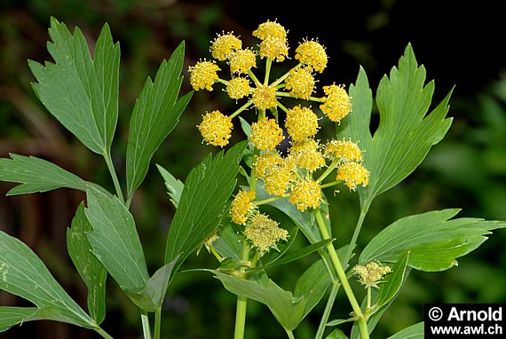
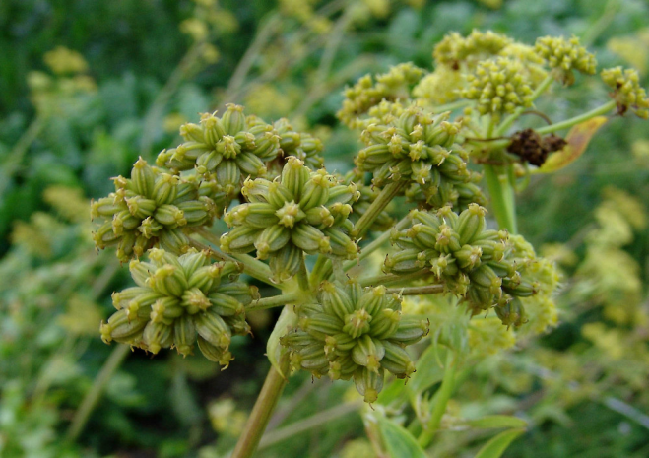
Levistici radix CzPh 2017
Mother plant: Levisticum officinale, Apiaceae (lovage)

Slide 17
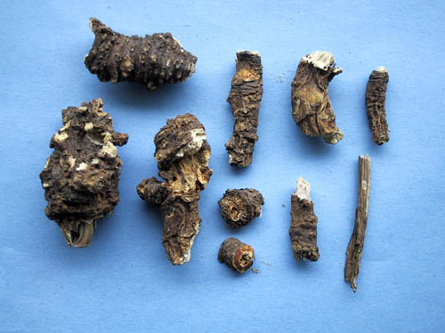
Levistici radix CzPh 2017
Macroscopy: stronger roots, bright grey-brown to yellow-brown colour, section usually smooth with visible wide yellow-white bark and narrow bright yellow wood, spicy odour, sharp spicy taste
Content compounds: essential oil, furanocoumarines, organic acids
Usage: diuretic, carminative, stomachic
psoralen
bergapten

Slide 18
Levistici radix CzPh 2017
Microscopy: transversal section: cork – several layers, under air bubbles (elasticity of root), cortex – channels with volatiles, medullar rays, sieve-tubes, cambium, vessels, parenchyma

Slide 19
Levistici radix CzPh 2017
Microscopy:

Slide 20
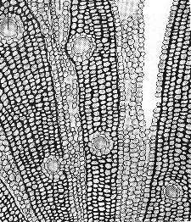
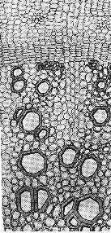
Levistici radix CzPh 2017
Microscopy:
sieve-tubes
cambium
vessels
air bubble
medullar ray
channel with volatiles

Slide 21
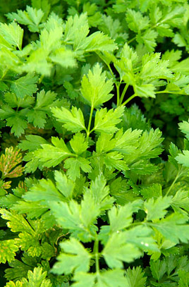
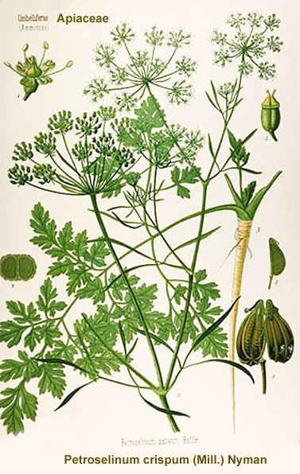
Petroselini radix CzPh 2017
Mother plant: Petroselinum crispum,Apiaceae (parsley)

Slide 22
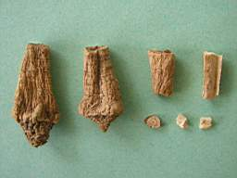
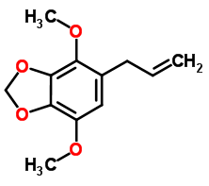
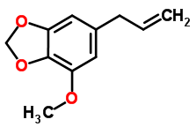
Petroselini radix CzPh 2017
Macroscopy: simple spindle-like root, externally yellow-white, longitudinally wrinkled, transversally ringed, section not clear, bark white-yellowish, wood yellow, characteristic aromatic odour, sweet taste, weakly spicy.
Content compounds: essential oil (phenylpropanoids), flavonoids, mucilage and sugars
Usage: diuretic, carminative, stomachic, antiseptic
apiol
myristicin

Slide 23
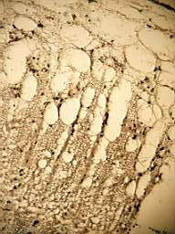
Petroselini radix CzPh 2017
Microscopy: cork, in cortex pat channels with volatiles, medullar rays, sieve-tubes, cambium, vessels, wood parenchyma
cork
channel
sieve-tubes
cambium
vessels
medullar ray

Slide 24
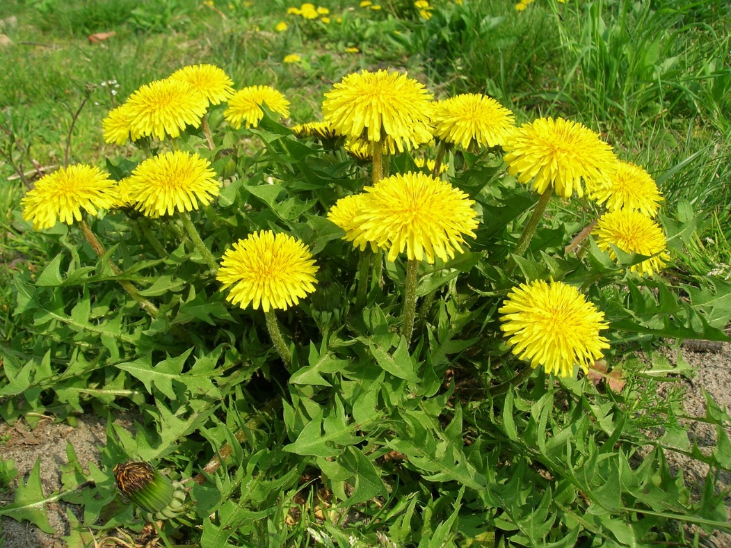
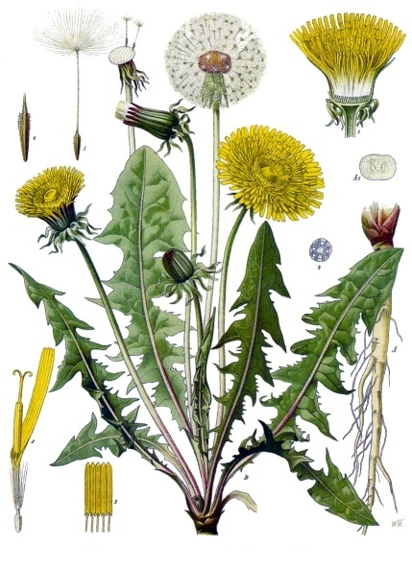
Taraxaci radix cum herba CzPh 2017
Mother plant: Taraxacum officinale, Asteraceae (dandelion)

Slide 25
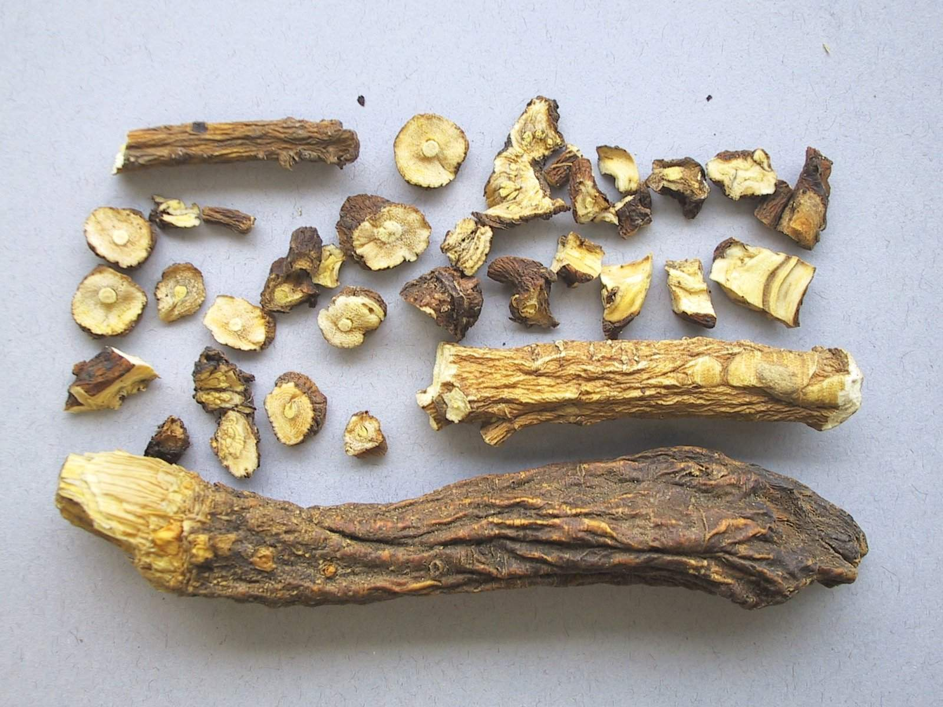
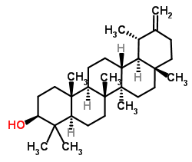
Taraxaci radix cum herba CzPh 2017
Macroscopy: post-like roots, hardly wrinkled, poorly branched, on the surface grey-brown to red-brown, fragile, on the section whitish bark and dark lactifers and lemon-like yellow wood without rays, drug must not smell, bitter taste
Content compounds: bitter compounds, mucilage, sugars, inuline, mineral compounds
Usage: amare, cholagogue, diuretic, metabolic, antidiabetic (insulin secretagogue activity in vitro; in vivo decreased serum glucose concentrations)
taraxasterol

Slide 26
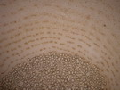
Taraxaci radix cum herba CzPh 2017
Microscopy: narrow multi-layer cork, wide bark with strips of lactifers in concentric rings accompanied by sieve-tubes, cambium, vessels, medullar parenchyma

Slide 27
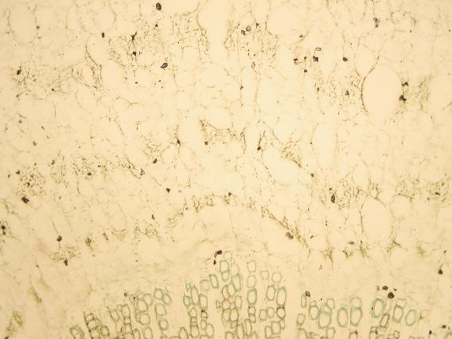
Taraxaci radix cum herba CzPh 2017
Microscopy:
Sieve-tubes and lactifers
Cambium
Vessels

Slide 28
MACROSCOPY

Slide 29
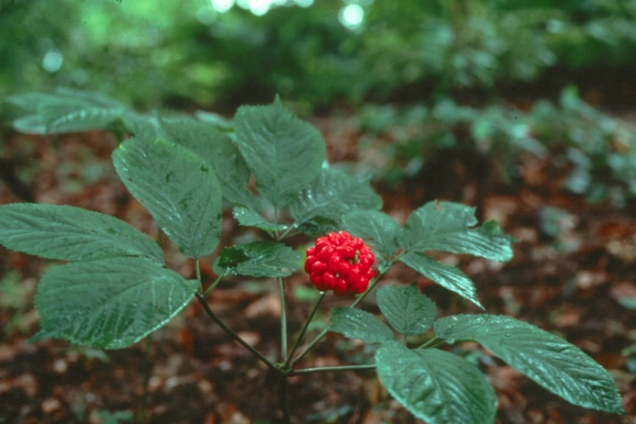
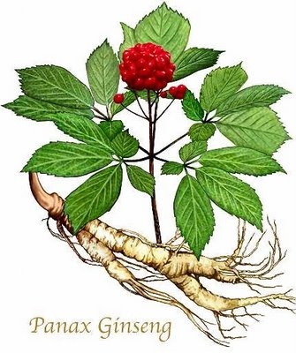
Ginseng radix CzPh 2017
Mother plant: Panax ginseng, Araliaceae (ginseng)
Ginseng extractum siccum CzPh 2017
Notoginseng radix CzPh 2017
Mother plant: Panax pseudoginseng, Araliaceae

Slide 30
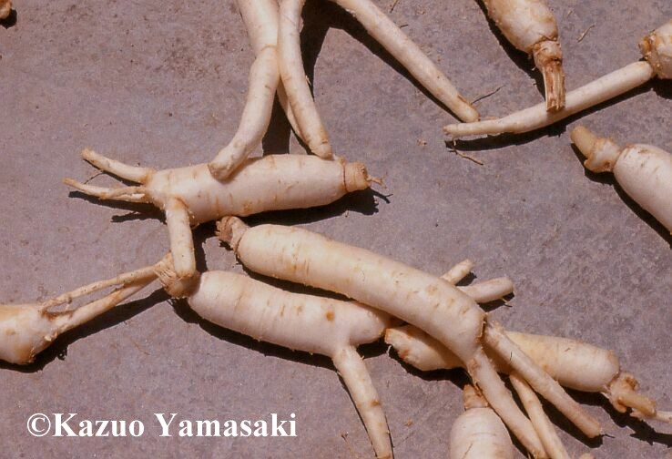
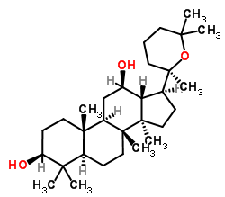
Ginseng radix CzPh 2017
Macroscopy: branched, spindle-like, externally bright brown-yellow to yellow-white, longitudinally wrinkled roots, in upper part ring-like strangled, hard and fragile, on the section grainy, yellow-white, flour-like dusted with brown-yellow cambial ring, specific odour, firstly sweet taste, later very bitter
Content compounds: saponine glycosides - ginsenosides, starch, sugars, vitamines B
Usage: adaptogene, tonic, geriatric
panaxadiol
panaxatriol

Slide 31
Rhaponticae radix CzPh 2017
Mother plant: Leuzea carthamoides (syn. Rhaponticum carthamoides), Asteraceae (Maral Root )

Slide 32
Rhaponticae radix CzPh 2017
Macroscopy: large part of small roots with central rhizome, black-brown colour, on the section yellowish, characteristic weak odour, taste slightly sweetish, resinous
Content compounds: steroids -phytoecdyzones
Usage: adaptogene, tonic, psychostimulant
fytoecdyzone

Slide 33
Betulae folium CzPh 2017
Mother plant: Betula pendula, B. pubescens, Betulaceae (birch tree)

Slide 34
Betulae folium CzPh 2017
Macroscopy: leaves lengthily stalked, 3-edged, double serrated margins, on the face dark green, on the reversed side brighter, characteristic netting veins, veins light brown to white, without odour, weak bitter taste
Content compounds: flavonoids (hyperoside, quercetin), essential oil, organic acids, betulinic acid
Usage: diuretic (saluretic)
hyperoside

Slide 35
Digitalis purpureae folium CzPh 2017
Mother plant: Digitalis purpurea, Plantaginaceae (Purple foxglove)

Slide 36
Digitalis purpureae folium CzPh 2017
Macroscopy: leaf blade from oval lanceolate to broad oval, upper side bright green, lower side gray felt-like, margin irregular notched, toothed or serrated, veins pinnated, on the lower side protruded, without odour, unpleasant bitter taste
Content compounds: cardioactive glycosides: primary glycosides (purpureaglycosides A, B), secondary glycosides (digitoxin)
Usage: cardiotonic, isolation of glycosides
digitoxin

Slide 37
Digitalis lanatae folium CzPh 2017
Mother plant: Digitalis lanata, Plantaginaceae (Grecian foxglove)

Slide 38
Digitalis lanatae foliumCzPh 2017
Macroscopy: leaves sharpened, local hairy, without odour, bitter taste
Content compounds: cardioactive glycosides: lanatosides A, B,C, E; digitoxin, digoxin
Usage: cardiotonic, isolation of glycosides
digoxin

Slide 39
Cardioactives – mechanism of action and toxicity
https://www.cvpharmacology.com/cardiostimulatory/digitalis
https://www.memorangapp.com/flashcards/229226/8%2F30+Inotropes/
Intoxication signs:
Cardiac arrhytmia
Altered color vision (red-yellow)
Toxicity is increased by:
Low K+ = hypokaliemia (!diuretics!)
High Ca2+ = hypercalcemia
Interactions with many medicines

Slide 40
Farfarae folium CzPh 2017
Mother plant: Tussilago farfara, Asteraceae (Coltsfoot )

Slide 41
Farfarae folium CzPh 2017
Macroscopy: leaves palm-like, lobular, toothed, upper side yellow-green, lower side white felt-like, trichomes aggregated, without odour, weak bitter mucilage taste
Content compounds: mucilage, inulin, tannins, pyrrolizidine alkaloids (tusilagin, senkirkin)
Usage: mucilaginose, expectorant, antitussic
tusilagin
senkirkin

Slide 42
Fragariae folium
Mother plant: Fragaria vesca, Rosaceae (Wild strawberry )

Slide 43
Fragariae folium
Macroscopy: lengthily leafstalked trifoliate leaves, sharply serrated, it tooths are visible pinkish hydatodes, upper side light green, lower side silverish hairy, withour odour bitterish mucilaginous taste
Content compounds: condensed tannins, flavonoids, volatiles, organic acids
Usage: astringent, diuretic

Slide 44
Rubi fruticosi folium
Mother plant: Rubus fruticosus, Rosaceae (blackberry)

Slide 45
Rubi fruticosi folium
Macroscopy: 3-5 foliate oval leaves with sharply serrated margin, upper side dark green, lower brighter, poorly hairy, leafstalk and vein with back curved thorns, without odour, astringent taste
Content compounds: hydrolysable tannins, flavonoids, organic acids
Usage: astringent, antidiarrhoic
gallic acid
ellagic acid

Slide 46
Rubi idaei folium
Mother plant: Rubus idaeus, Rosaceae (raspberry)

Slide 47
Rubi idaei folium
Macroscopy: 3-5 foliate leaves oval shaped, shortly sharpened with serrated margins, upper side dark green, lower side densely felt-like hairy, protruded viens, leafstalk and main vein with smooth thorns, without odour, mild astringent taste
Content compounds: tannins, organic acids, mineral compounds, flavonoids
Usage: mild astringent, spasmolytic, cholagogue, diuretic
gallic acid
ellagic acid

Slide 48
Hamamelidis folium CzPh 2017
Mother plant: Hamamelis virginiana, Hamamelidaceae (Witch Hazel)

Slide 49
Hamamelidis folium CzPh 2017
Macroscopy: leatherlike soft leaf with short stalk, leaf blade broad oval, at the base oblique, asymmetric, at the end sharpened, brownish-green, blade margin serrated or toothed, veins pinnated, protruding on the lower side, with trichomes, without odour, astringent taste
Content compounds: elagic tannins - hamamelitanins, flavonoids, saponins, essential oil
Usage: astringent, antidiarrhoic, haemostyptic
hamamelose

Slide 50
Malvae folium CzPh 2017
Mother plant: Malva mauritiana, Malva neglecta, Malva sylvestris, Malvaceae (High mallow, Marshmallow)

Slide 51
Malvae folium CzPh 2017
Macroscopy: without odour, mucilaginous taste
M. mauritiana – big oval leaves, rounded, blade 5 sectioned, blunt lobes, toothed
M. neglecta - 5-7-lobular leaves, from reniform to rounded, blunt lobes, notched toothed, upper side bald, lower hairy.
M. sylvestris – rounded leaves, blade palm-like 3-7 lobular, lobes from triangular to elongated, notched, width bigger than length

Slide 52
Malvae folium CzPh 2017
Content compounds: membrane mucilage, tannins, essential oil, phytosterols
Usage: mucilaginose, emoliens, antiphlogistic, mild astringent
galacturonic acid

Slide 53
Zingiberis radix (rhizoma) CzPh 2017
Mother plant: Zingiber officinale, Zingiberaceae (ginger)
https://commons.wikimedia.org/wiki/File:Althaea_officinalis.jpeg

Slide 54
Zingiberis radix (rhizoma) CzPh 2017
Macroscopy: rhizome on the surface grey, poorly wrinkled, longitudinally stripped, aromatic typical odour, taste warm spicy and pungent
Content compounds: volatiles (zingiberene), resins (gingerols, gingerdiols), phenylalkanoles, phenylalkanones
Usage: tonic, stomachic, diaphoretic, spice
zingiberen

