Slide 1
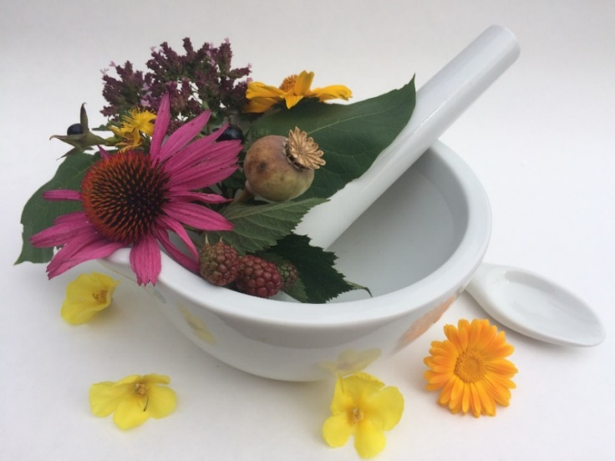
Pharmacognosy lab exercise 7
Drugs – leaves, herbs

Slide 2
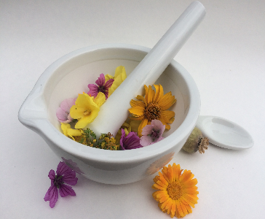
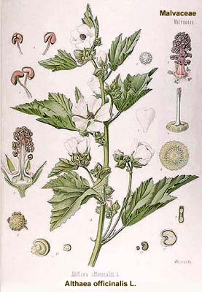
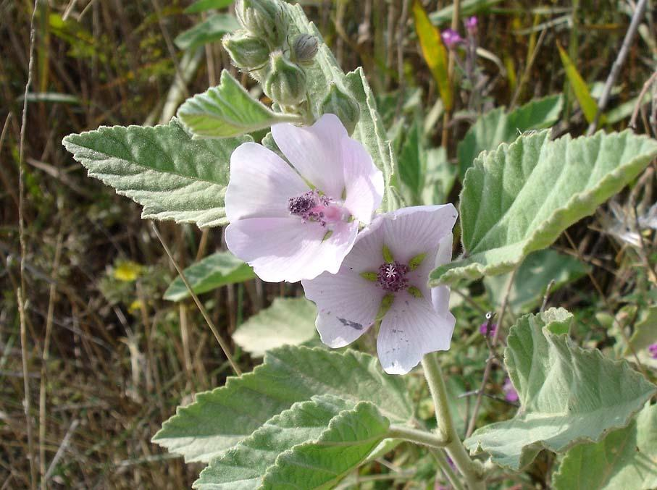
Althaeae folium CzPh 2017
Mother plant: Althaea officinalis, Malvaceae (marsh-mallow)

Slide 3
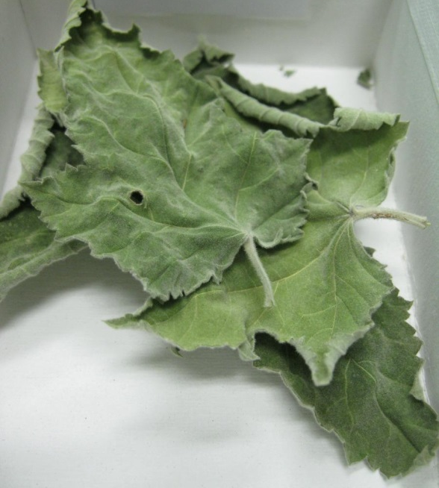
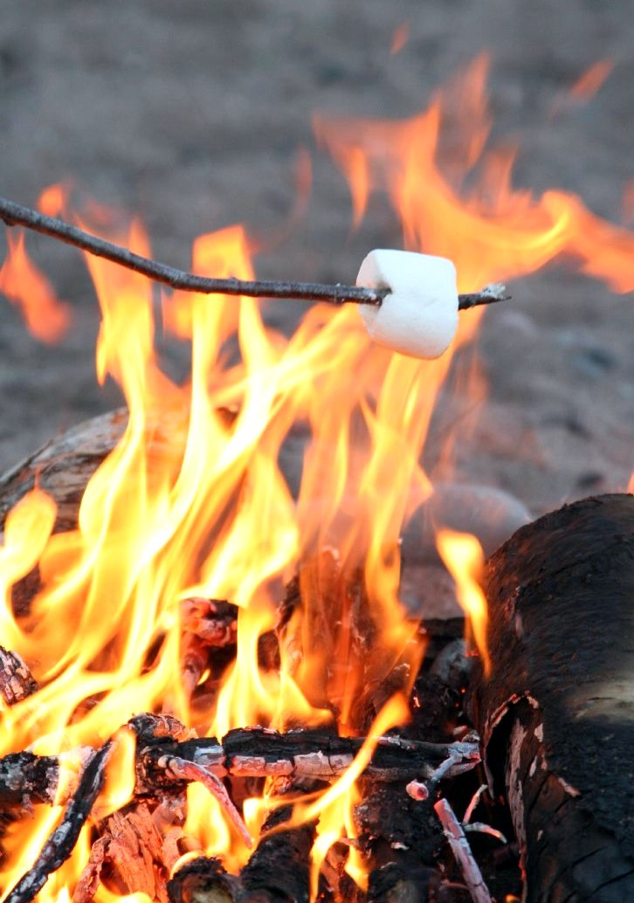
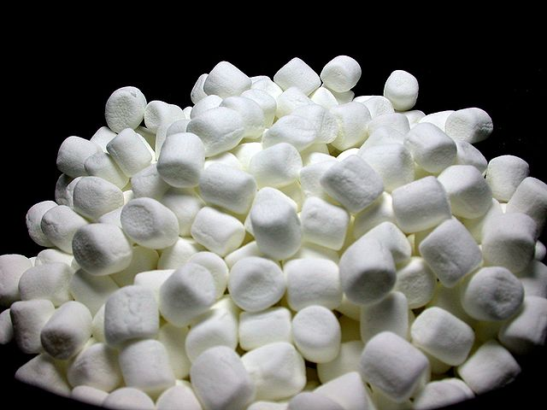
Althaeae folium CzPh 2017
Macroscopy: leaf grey-green, shortly leafstalked, oval to triangular cordate, 3–5 lobular, toothed, both sides densely grey and trichomous (tomentose), veins on lower side distinguished, without odour, mucilage taste
Content compounds: mucilage, pectin, flavonoids
Usage: mucilaginose, antitussic, antiphlogistic
No marsh-mallow in these marshmallows!
To roast or not to roast?
https://upload.wikimedia.org/wikipedia/commons/thumb/4/43/Mini_marshmallows_in_bowl.JPG/640px-Mini_marshmallows_in_bowl.JPG https://en.wikipedia.org/wiki/Marshmallow#/media/File:RoastingMarshmallow.jpg
Notes:
Leaf of marshmallow contains less mucilages than root. Mucilage can alter the pharmacocinetics of other medicines which are administered in the same time (may delay their absorption).

Slide 4
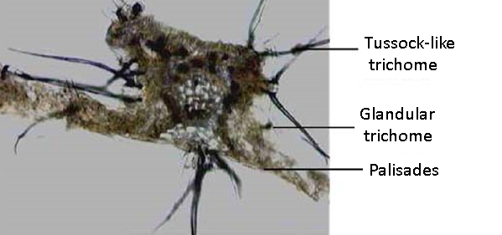
Althaeae folium CzPh 2017
Microscopy: bifacial leaf, between epidermis cells are mucilage cells, palisade parenchyma, spongeous parenchyma with crystal aggregates and large mucilage cells, collateral vascular bundle, both skin layers with one-cell trichomes grouped in clusters/tussocks and scarce club-shaped glandular trichomes

Slide 5
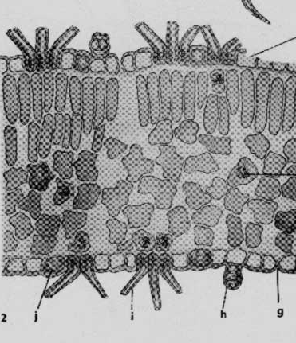
Althaeae folium CzPh 2017
Microscopy:
covering trichome
upper epidermis
palisades
spongeous parenchyma
crystal aggregate
mucilage cell
glandular trichome
collateral vascular bundle
Notes:
Mucilage cells can be in the epidermis too.

Slide 6
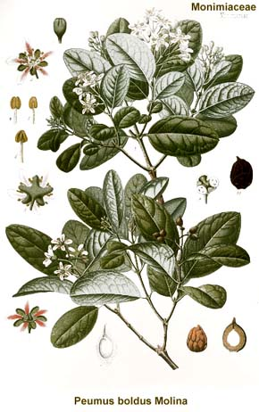
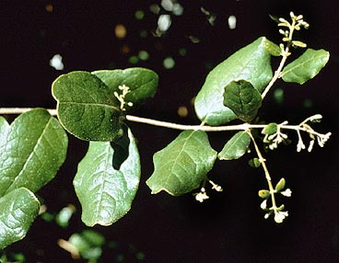
Boldo folium CzPh 2017
Mother plant: Peumus boldus, Monimiaceae (boldo)
Boldi folii extractum siccum CzPh 2017

Slide 7
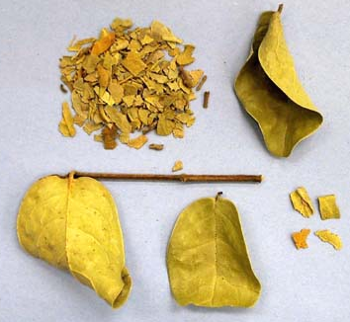
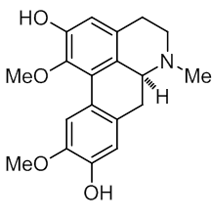
Boldo folium CzPh 2017
Macroscopy: shortly leafstalked leaf, oval, fragile, tough, leather like, on the margin under winded, green-grey, upper side covered with small bumps, bottom side less bumpy, camphor-like odour, taste bitter and spicy
Content compounds: alkaloids (boldine, sparteine), essential oil (ascaridole), flavonoids
Usage: cholagogue, choleretic, diuretic
boldine

Slide 8
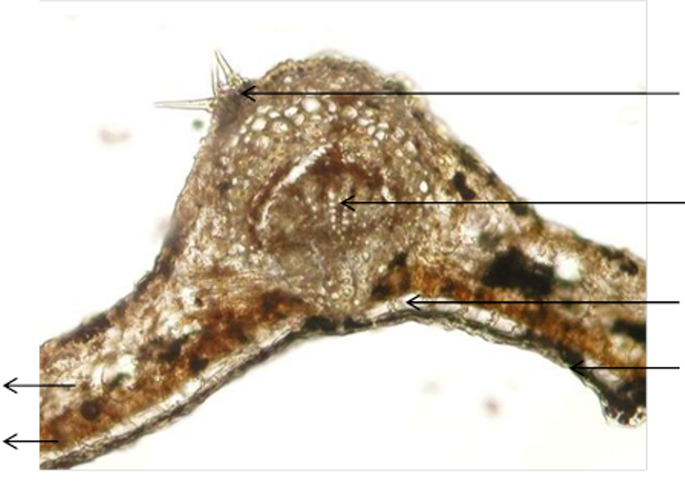
Boldo folium CzPh 2017
Microscopy: bifacial leaf, thick cuticle layer, bundles of covering trichomes, under epidermis hypodermal cells with mucilage in one row, reinforcing collenchyma, palisades, spongeous parenchyma with cells containing essential oil, collateral vascular bundle with sclerenchyma
covering trichomes
collenchyma
vascular bundle
hypodermal cells
spongeous parenchyma
cuticle
palisade parenchyma

Slide 9
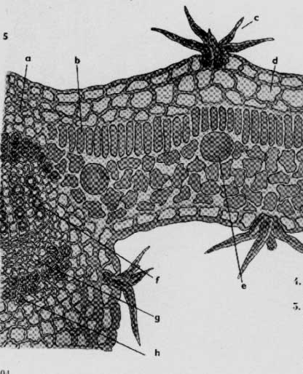
Boldo folium CzPh 2017
Microscopy:
covering trichome
hypodermal cells
palisades
cell with essential oil
xylem
Phloem
collateral vascular bundle
epidermis
spongeous parenchyma
collenchyma

Slide 10
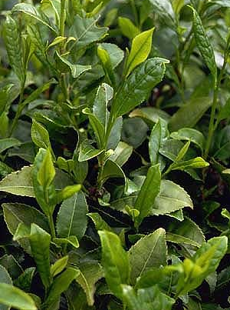
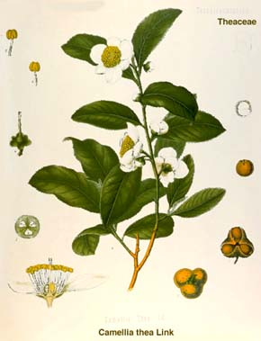
Theae folium
Mother plant: Thea sinensis syn. Camellia sinensis, Theaceae
(tea plant, tea-tree (do not confuse with Melaleuca alternifolia, the source of tea tree oil))

Slide 11
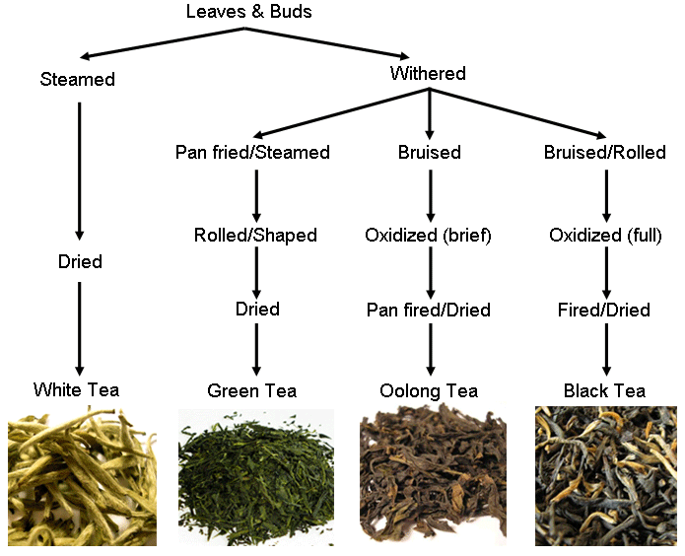
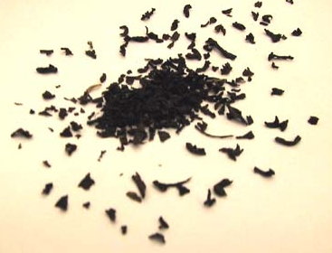
Theae folium
Macroscopy: fresh leaves are leaf stalked, green, shiny, from lanceolate to oval shape with serrate margin, leaves of black tea are tubularly curled, black, aromatic odour, aromatic taste, astringent
Red tea = rooibos, Aspalathus linearis, (Fabaceae), also called bushtea
Notes:
Green tea is made from fresh dried leaves.
Black tea is made from fermented leaves. The fermentation process is wrongly called fermentation – no fermentation occurs, only oxidation by an enzyme polyphenol oxidase. During this oxidation, constituents in the leaf are changed, so the resulting leaves contain also tea pigments theaflavine and thearubigine.
White tea is made from buds and very young leaves (minimally processed).
Yellow tea is made similarly as green tea, but it is oxidized for a short time. This produces more mellow taste and it removes the grassy smell of green tea.
Red tea refers to rooibos tea, which is made from Aspalathus linearis.

Slide 12
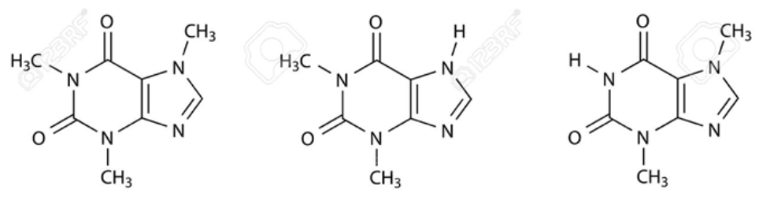
Theae folium
Content compounds: purine alkaloids (caffeine 1-5%), tannins, essential oils
Usage: refreshing beverages, diuretic, obstipative, stimulans
Interactions: influence on iron absorption
caffeine theobromine theophylline
Notes:
Caffeine is one of the least addictive drugs. However, excessive consumption of caffeine can lead to addiction. Withdrawal symptoms are: irritability, fatigue and dysphoria. They usually last for 2-3 days. The lethal dose of caffeine is approx. 10 grams (100 cups of coffee). 3 cups of coffee (300 mg of caffeine) are considered a relatively safe dose.
Caffeine stimulates medullary, vasomotor and respiratory centres, which leads to bradycardia, vasoconstriction and increased respiratory rate. In larger
doses caffeine has diuretic effect.
Mechanism of action: caffeine is an antagonist of adenosine on adenosine receptors. By blocking these receptors, caffeine accelerates nerve signaling, increases wakefulness and constricts the blood vessels in the brain. Blockade of this receptor in the heart leads to the accelerated „pounding“ of the heart after intake of caffeine (heart palpitations).

Slide 13
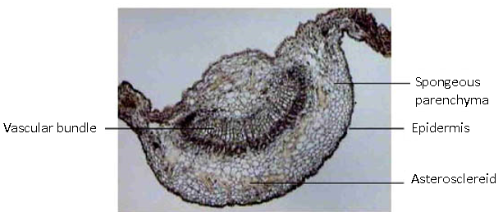
Theae folium
Microscopy: bifacial leaf, upper epidermis, palisade parenchyma, spongeous parenchyma with crystal aggregates and asterosclereids (star-shaped sclerenchymatic cells), collateral vascular bundle with sclerenchyma sheath, lower epidermis with covering trichomes

Slide 14
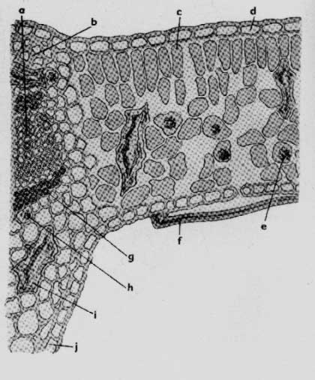
Theae folium
Microscopy:
epidermis
palisades
spongeous parenchyma
crystal aggregate
trichome
asterosclereid cell
collateral vascular bundle

Slide 15
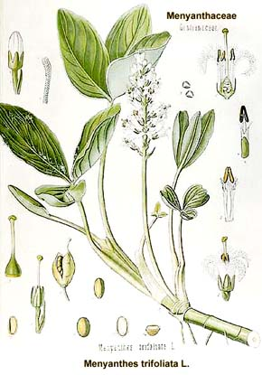
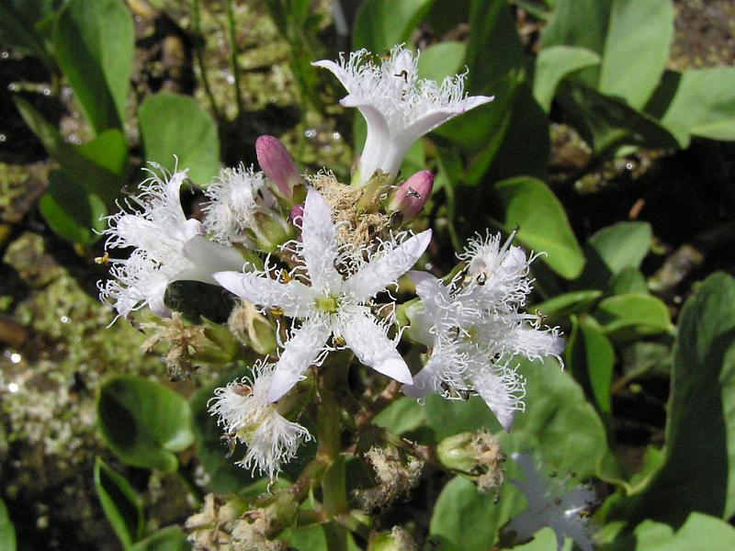
Trifolii fibrini folium
CzPh 2017
Mother plant: Menyanthes trifoliata, Menyanthaceae
bog-bean, buckbean

Slide 16
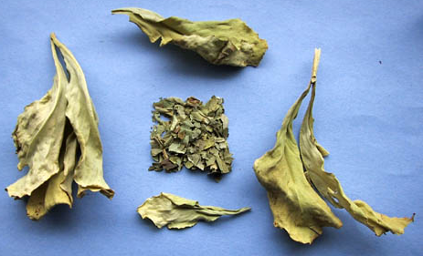
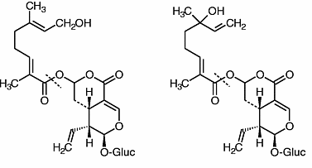
Trifolii fibrini folium
CzPh 2017
Macroscopy: leaves trifoliate, lengthily leaf stalked, integerrimum or slightly toothed, upper side richly green, lower side lighter with a broad main vein, without odour, very bitter taste
Content compounds: glycosidic bitter substances, tannins, flavonoids
Usage: amare, stomachic, mild cholagogue
foliamentin mentiafolin

Slide 17
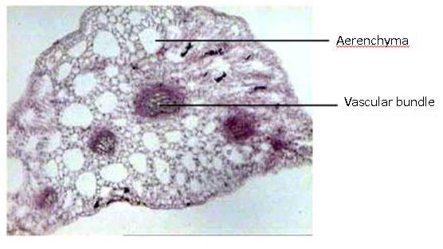
Trifolii fibrini folium
CzPh 2017
Microscopy: thin cuticle, palisade parenchyma, typical spongeous parenchyma (aerenchyma - cells in a chain-like manner), vascular bundle collateral with sclerenchymatic fibers

Slide 18
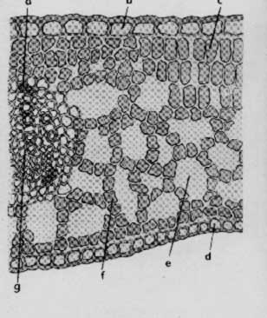
Trifolii fibrini folium
CzPh 2017
Microscopy:
epidermis
palisades
xylem
phloem
aerenchyma
collateral vascular bundle

Slide 19
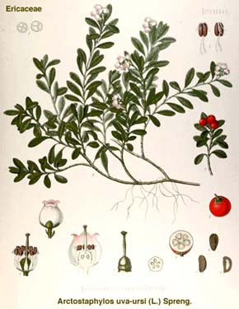
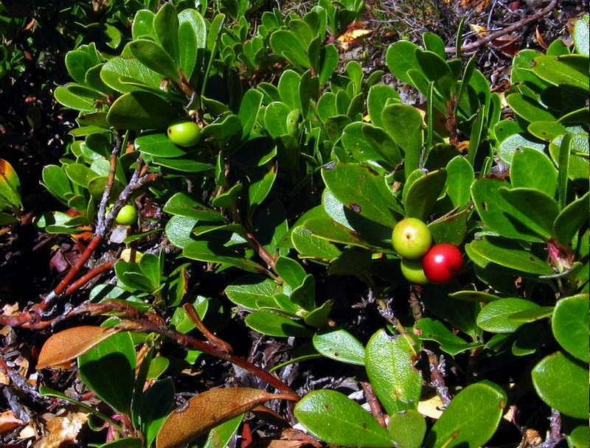
Uvae ursi folium CzPh 2017
Mother plant: Arctostaphylos uva-ursi, Ericaceae
Kinnikinnick, Pinemat manzanita, Bearberry

Slide 20
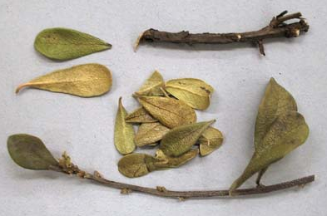
Uvae ursi folium CzPh 2017
Macroscopy: leaf shiny, leather like, opposite oval, integerrimum (whole) with smooth underwinded blade, dark-green, on the reversed side brighter, netting veins, without odour, bitter taste – astringent – later sweetish
Content compounds: phenolic glycosides (arbutine, methylarbutine), tannins, flavonoids
Usage: desinficiens of urinary tract
arbutin
Notes:
Mechanism of action: arbutin hydrolysis to hydroquinone, which has antiseptic properties. Uvae ursi folium should not be taken for longer periods of time. High doses of hydroquinone are toxic.

Slide 21
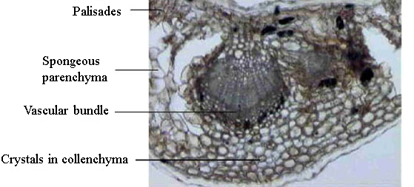
Uvae ursi folium CzPh 2017
Microscopy: upper epidermis with anomocytic stomata (air ducts), thick cuticle, palisades, spongeous parenchyma, crystals of calcium oxalate, lower epidermis with stomata, collateral vascular bundle with collenchyma

Slide 22
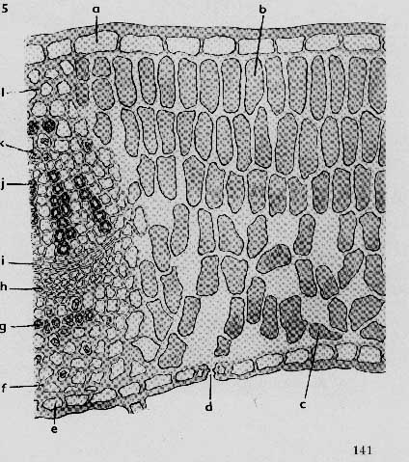
Uvae ursi folium CzPh 2017
Microscopy:
epidermis
palisades
vessels
sieve tubes
spongeous parenchyma
crystals
Collateral vascular bundle

Slide 23
MACROSCOPY

Slide 24
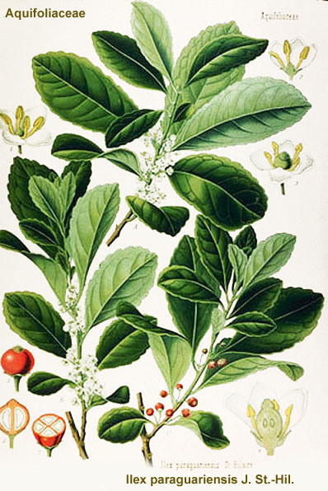
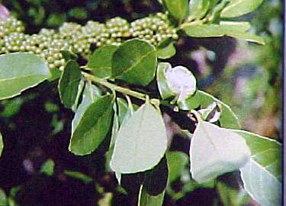
Mate folium
Mother plant: Ilex paraguariensis, Aquifoliaceae
leaves and tops of branches treated by smoke of fire (Yerba maté)
Notes:
Treatment with smoke inactivates the enzymes, which could otherwise cause unwanted blackening of the drug.

Slide 25
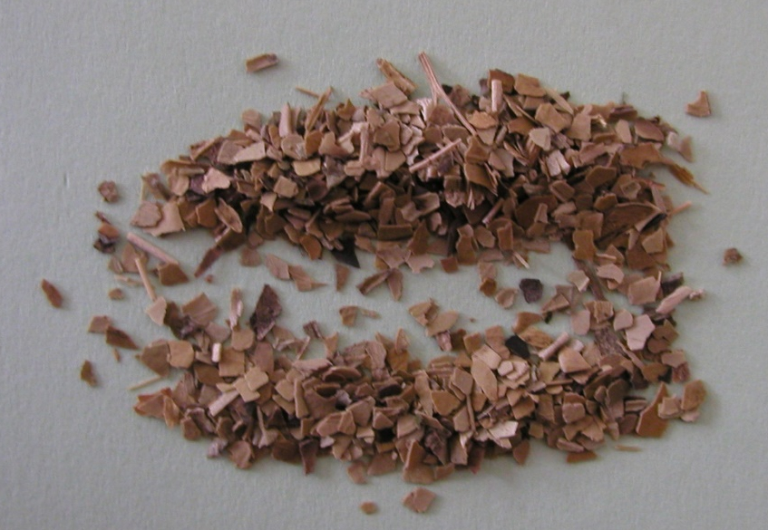
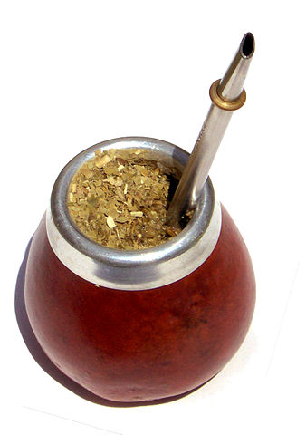
Mate folium
Macroscopy: fresh leaves oval-lanceolate, leatherlike, shiny, with numerous glandules, characteristic smoke odour, astringent taste
Content compounds: purine alkaloids (caffeine 0.5-2.1%), tannins
Usage: refreshing beverages, stimulans
caffeine
Mate in a traditional calabash gourd
https://commons.wikimedia.org/wiki/File:Mate_en_calabaza.jpg

Slide 26
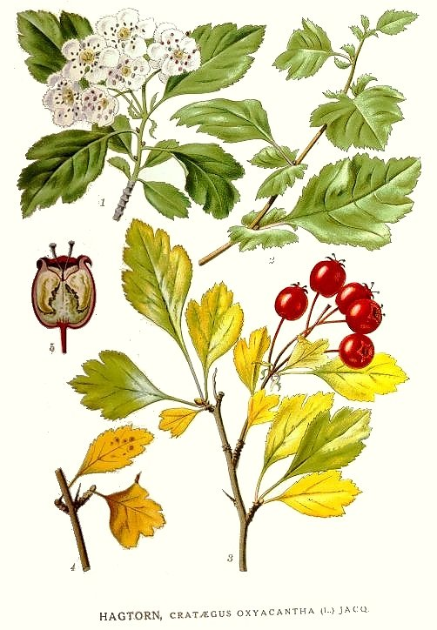
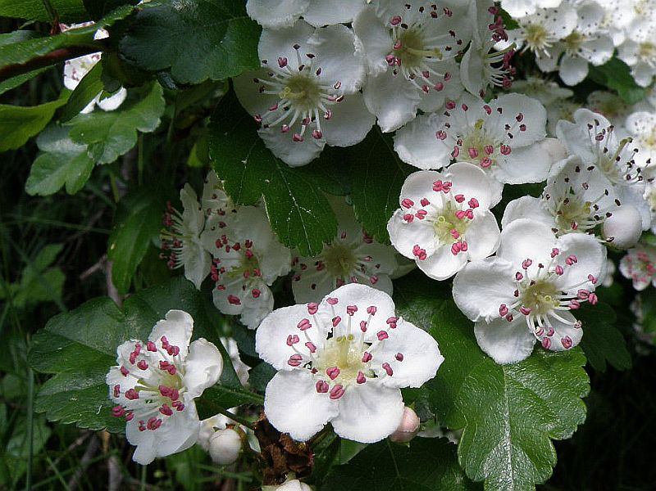
Crataegi folium cum flore CzPh 2017
Mother plant: Crataegus monogyna, Crataegus laevigata (C. oxyacanthoides), Rosaceae (Common Hawthorn )
Crataegi folii cum flore extractum fluidum quantificatum CzPh 2017
Crataegi folii cum flore extractum siccum CzPh 2017

Slide 27
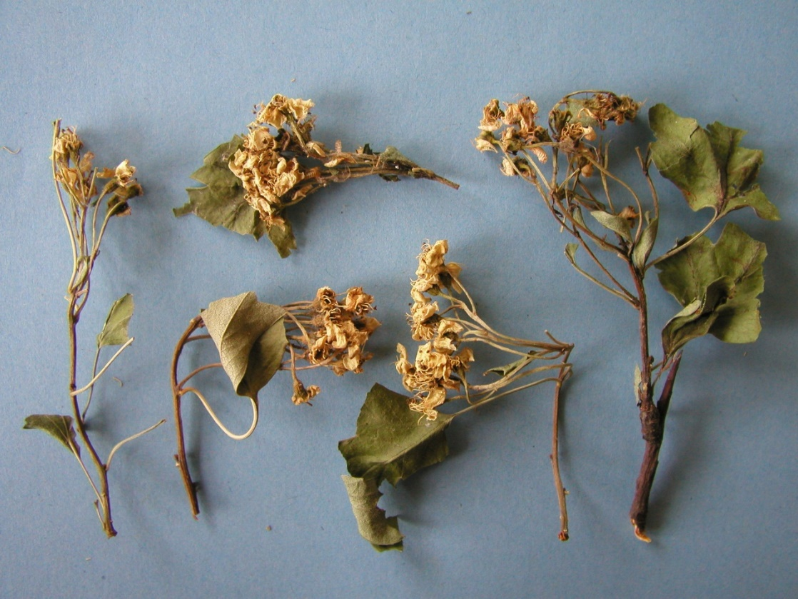
Crataegi folium cum flore CzPh 2017
Macroscopy: both species leaves on the face dark green, on the reversed side brighter with evident veins, bald or sporadically hairy, pleasant odour, weakly bitter taste
C. oxyacanthoides – leaf oval,
3-5 lobular, narrowing to stalk,
bluntly to notched toothed
C. monogyna – obovate and
deeply lobed, sometimes almost
to the midrib, with the lobes
spreading at a wide angle

Slide 28
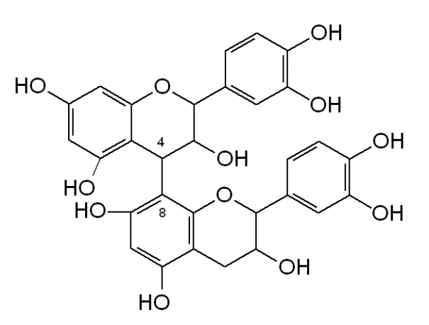
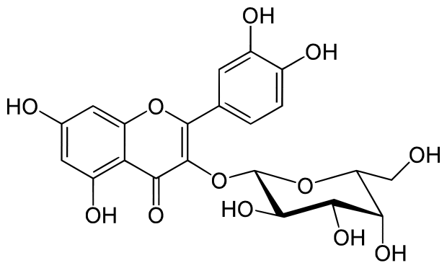
Crataegi folium cum flore CzPh 2017
Content compounds: flavonoids (hyperoside, rutin, vitexine) proanthocyanidins, triterpene acids, purine bases
Usage: hypotonic, spasmolytic, antisclerotic, sedative tea mixtures
hyperoside
dimeric procyanidine B2
Notes:
Type and content of flavonoids are different in flowers, in leaves, and between species. Flowers of C. monogyna and laevigata contain mainly hyperoside. Leaves of C. monogyna contain vitexin-rhamnoside and acetylated derivatives. Leaves of C. laevigata contain nonacetylated derivatives.

Slide 29
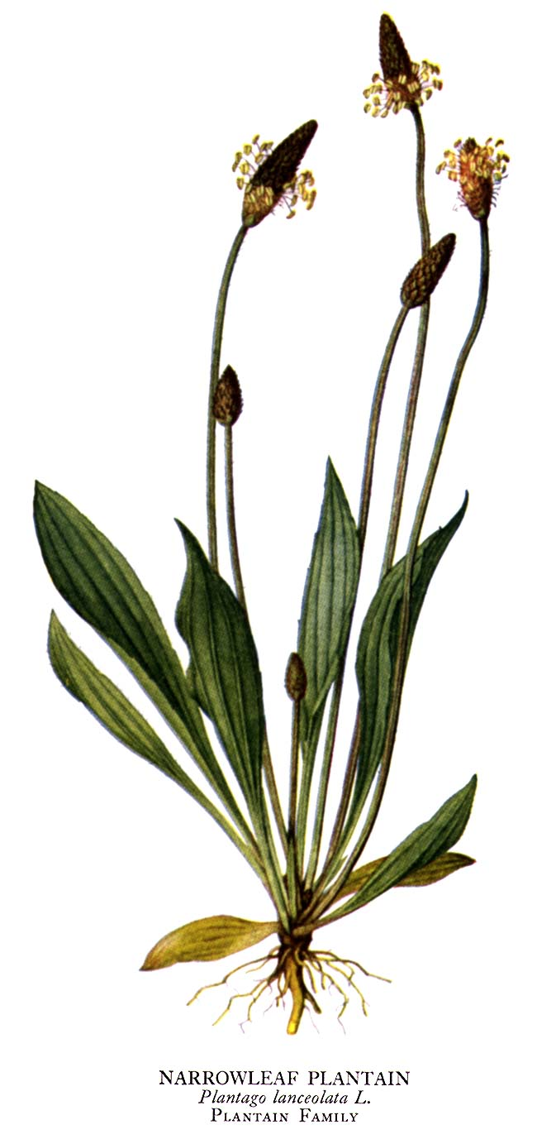
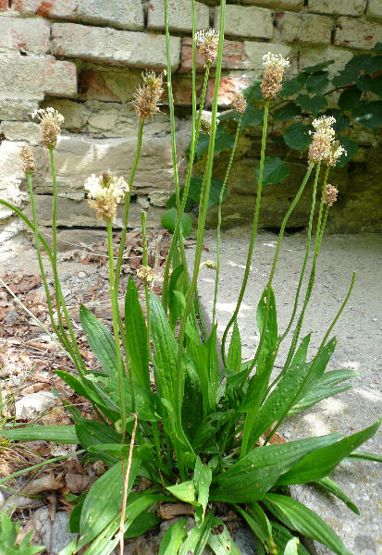
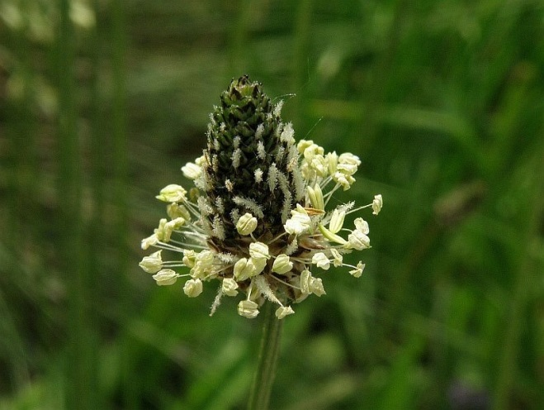
Plantaginis folium CzPh 2017
Mother plant: Plantago lanceolata, Plantaginaceae (narrowleaf plantain)
Plantaginis sirupus CzPh 2009
Plantaginis extractum fluidum CzPh 2009

Slide 30
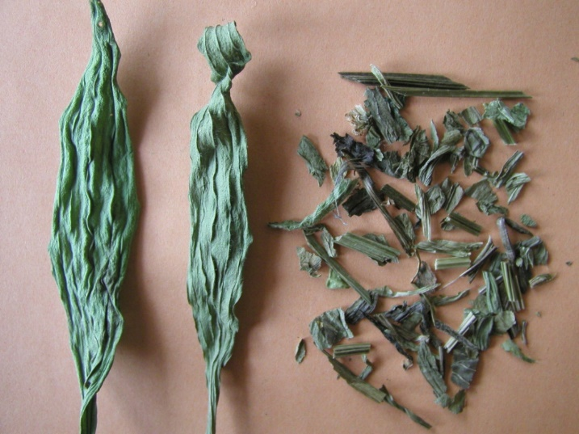
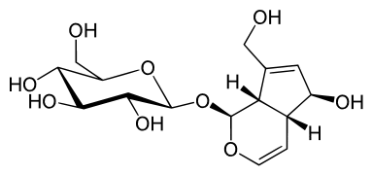
Plantaginis folium CzPh 2017
Macroscopy: leaf lanceolate, narrowing to stalk, integerrimum, brown-green or grey-green, bald, veins parallel with 3-7 down located prominent veins, without odour, mucilaginous taste, bitter-salty
Content compounds: iridoid glycoside aucubin, flavonoids, mucilage
Usage: mucilaginose, expectorans, antiphlogistic
aucubin
Notes:
When the drug is stored improperly, aucubine hydrolyses and forms brown and black pigments. These can cause brown or black colour of the stored drug.

Slide 31
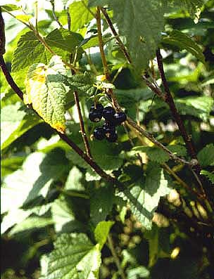
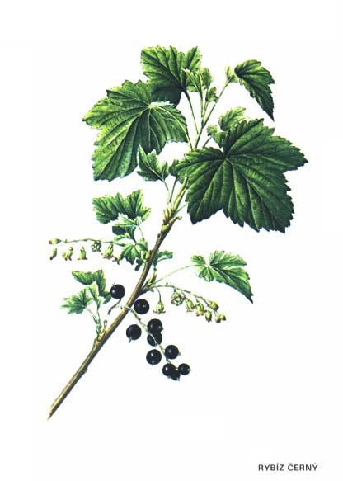
Ribes nigri folium CzPh 2017
Mother plant: Ribes nigrum, Grossulariaceae (blackcurrant)

Slide 32
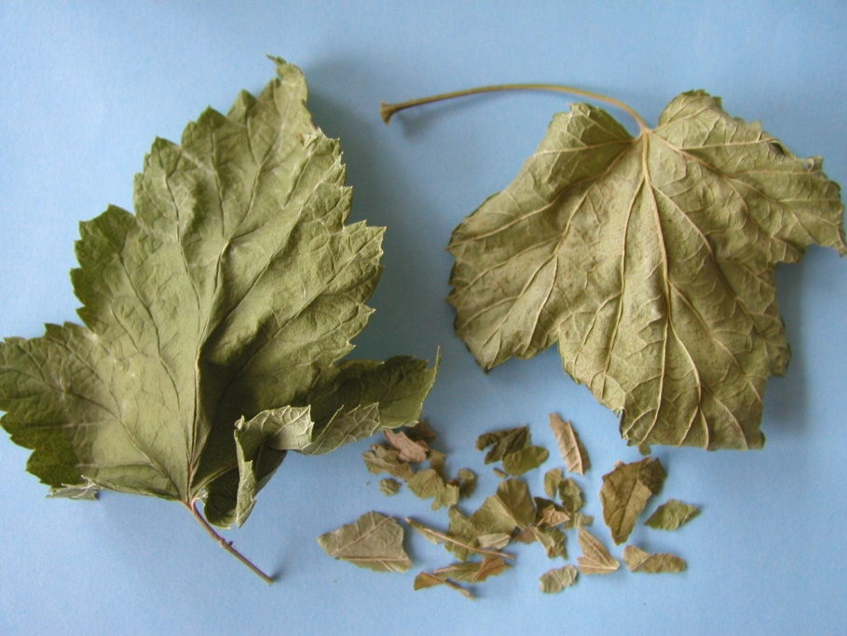
Ribes nigri folium CzPh 2017
Macroscopy: leaf stalked, palm-like, 3-5 lobular, serrated on the margin, dark-green, distinct characteristic odour, acidish mild astringent taste
Content compounds: flavonoids, essential oil, tannins, vitamin C
Usage: diuretic, diaphoretic, metabolic

Slide 33
Herbs
Drugs consist of stem, leaves and flowers

Slide 34


Adonidis herba
Mother plant: Adonis vernalis, Ranunculaceae (Pheasant's Eye)

Slide 35


Adonidis herba
Macroscopy: rounded, grooved stem with sitting, smooth leaves and big shiny yellow flowers, without odour, bitter taste
Content compounds: cardioactive glycosides (adonitoxin, cymarin = k-strophantidin + D-cymarose), flavonoids, saponins
Usage: cardiotonic, diuretic, !poisonous plant!
Bekhterev's infusion- mixture of the plant extracts with sodium bromide or codeine to treat heart diseases, panic disorder, dystonia and mild forms of epilepsy.
adonitoxin
Notes:
These cardenolides do not accumulate in the organism, they metabolize faster.

Slide 36


Agrimoniae herba CzPh 2017
Mother plant: Agrimonia eupatoria, Rosaceae (Common Agrimony)

Slide 37

Agrimoniae herba CzPh 2017
Macroscopy: branched stem, rounded, roughly hairy, green, leaves imparipinnate with serrated margin, on the face dark green, on the reversed side brighter, felt-like, flowers 5-membered, petals prolongated, gold-yellow, weak aromatic odour, taste slightly bitter, spicy, astringent
Content compounds: catechine tannins, silicic acid, essential oil
Usage: antiphlogistic, cholagogue, astringens (poorly healing wounds)

Slide 38


Alchemillae herba CzPh 2017
Mother plant: Alchemilla vulgaris, Rosaceae (lady's mantle)

Slide 39

Alchemillae herba CzPh 2017
Macroscopy: stems and leaves richly green, hairy, leaves 7-9 palm-like lobular, without odour, bitter astringent taste
Content compounds: mixed tannins, bitter substances
Usage: astringent, stomachic, dermatic, haemostyptic, gynecologic (folk medicine)
Notes:
Astringent for diarrhea with blood. Dermatic for septic cutaneous defects, ulcers.

Slide 40


Centaurii herba CzPh 2017
Mother plant: Centaurium erythraea, C. majus, C. suffruticosum,
C. umbellatum, C. minus Gentianaceae (Centaury)

Slide 41



Centaurii herba CzPh 2017
Macroscopy: hollow stem, on the top branched, bald, green to brown, lanceolate leaves, integerrimum, dark green, flowers in cime-like dichasium, pinkish, without odour, very bitter taste
Dichasium – type of determinate inflorescence, the development of the flower at the apex is followed by two new flower axes developing from buds opposite one another
Simple dichasium
https://upload.wikimedia.org/wikipedia/commons/thumb/8/80/Simple_dichasium.png/638px-Simple_dichasium.png
Dichasium
https://commons.wikimedia.org/wiki/File:Dichasium_(inflorescence).PNG
Notes:
Dichasium - A cymose inflorescence with all branches below the terminal flower in regular opposite pairs.

Slide 42


Centaurii herba CzPh 2017
Content compounds: bitter substances (swertiamarin, sweroside, genciopicrine), flavonoids, essential oil
Usage: amare, stomachic, digestive, tonic
swertiamarin
genciopicrine
Notes:
Centaurii herba has similar use as Gentianae radix – to stimulate appetite

Slide 43


Herniariae herba
Mother plant: Herniaria glabra, Herniaria hirsuta, Caryophylaceae (Rupturewort)

Slide 44



Herniariae herba
Macroscopy: filamentous, richly branched stems, integerrimum leaves oval shaped, small flowers in underarms of leaves, characteristic odour, weak bitter taste
Content compounds: acidic saponins, flavonoids, tannins, coumarins (umbelliferone, methylumbelliferone = herniarin)
Usage: diuretic, spasmolytic, urodesinficient
umbelliferone
herniarin
Notes:
Saponins have haemolytic properties.

Slide 45


Hyperici herba CzPh 2017
Mother plant: Hypericum perforatum, Hypericaceae (St. John´s Wort)
Hyperici herbae extractum siccum quantificatum CzPh 2017

Slide 46

Hyperici herba CzPh 2017
Macroscopy: round stem with two longitudinal narrow slats, on the top branched, leaves oval, integerrimum, blade of leaves pointed, 5-membered flowers in cime-like dichasium, yellow, balsamic odour, bitter astringent taste

Slide 47


Hyperici herba CzPh 2017
Content compounds: dianthrone derivatives (hypericin), acylphloroglucinols (hyperforin), flavonoids, essential oil, tannins
Usage: antidepressive, astringent, stomachic, cholagogue, sedative
!not a laxative! (although contains dianthrones)
Interactions: induction of CYP450 isoenzymes => faster metabolization of medicines (p.o. contraceptives, antidepressants) => they can be ineffective
Phototoxicity! (urticary can develop)
Czechia – stomachic herbal teas (Species stomachicae) often contain Hyperici herba
hypericin
Notes:
Diantrones in Hyperici herba do not have laxative effect.
Hyperforin is a prenylated derivative of phloroglucinol.
Antidepressant effect usually needs 2-4 weeks of therapy to become observable.
Phototoxicity after exposure to sunlight or UV radiation when using Hyperici herba.

Slide 48


Hyssopi herba
Mother plant: Hyssopus officinalis, Lamiaceae (Hyssop)

Slide 49

Hyssopi herba
Macroscopy: branched stem with narrow sitting lanceolate leaves, integerrimum, blue-purple flowers in verticiles in underarms of leaves, typical odour of camphora, sharp spicy taste
Content compounds: essential oil (pinens, ketone pinocamphone), tannins, flavonoids
Usage: amare, carminative, expectorant, stomachic, diuretic
Notes:
The essential oil is neurotoxic. Neurotoxicity could be linked to the inhibitory action of ketones on cell respiration.

