Slide 1
AntiulcerAgents
Tomáš Goněc 24. 10. 2022

Slide 2
Peptic ulceration
Mucose degradation

Slide 3
Mechanism of acid secretion

Slide 4
Peptic ulceration
multifactorial disease:
increased acid production and enzyme activity
decreased acid production and enzyme activity
Helicobacter pylori infection
long-term NSAID medication
leads to damage of mucose protective layer and ulcer formation

Slide 5
Helicobacter pylori infection

Slide 6
Long-term NSAID administration

Slide 7
Therapy
acids and digestives
direct antacids
indirect antacids
mucoprotective drugs
drugs for Helicobacter pylori eradication

Slide 8
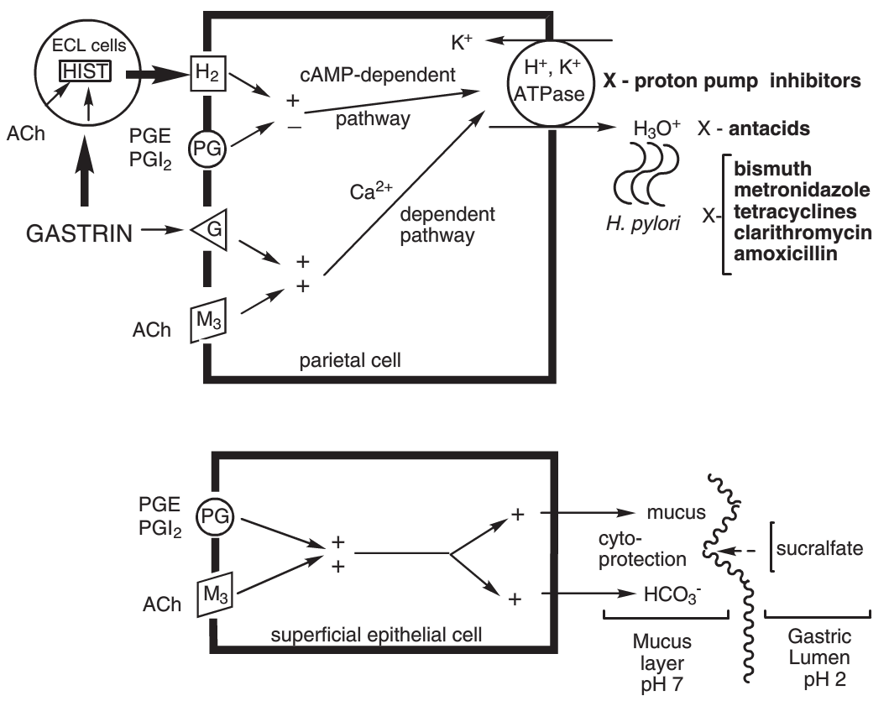
Mechanism of action

Slide 9
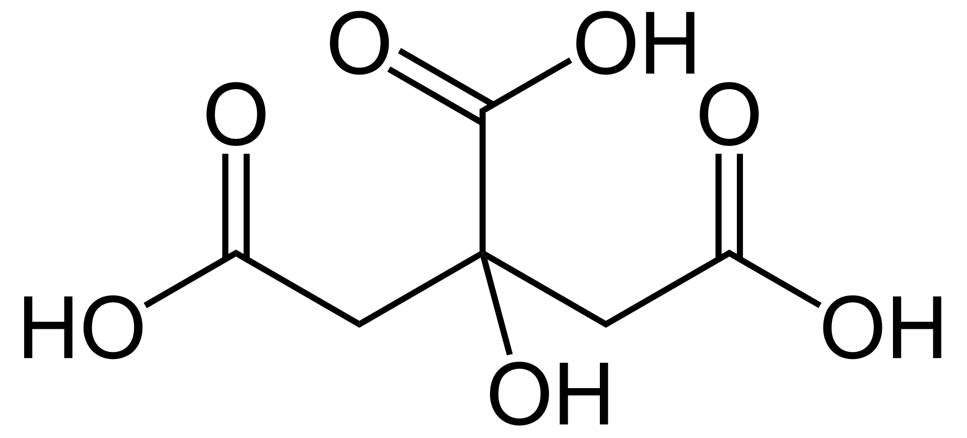
Acids
achlorhydria – low or no HCl secretion
increased pH damages mucosa
HCl
Citric acid

Slide 10
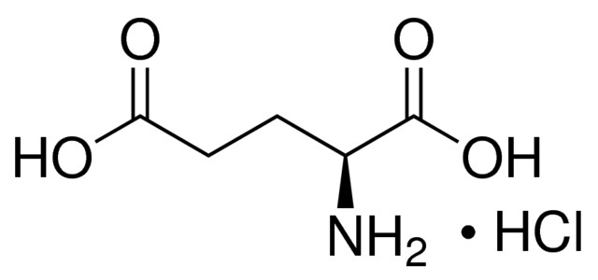
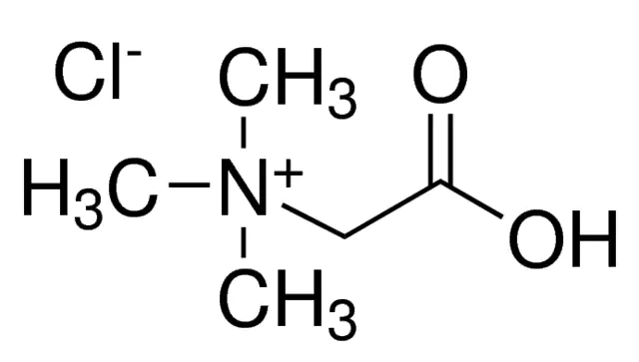
Acids
Glutamic acid hydrochloride
Betaine hydrochloride

Slide 11
Digestives
insufficient digestion – longer pass through of food – gastritis, ulceration risk
recombinant enzymes:
Amylase
Lipase
Pepsine
Tilactase (galactosidase for digesting milk products)
Pancreatine – mixture of pancreatic enzymes (lipase, amylase and protease) isolated from pig pancreas

Slide 12
Direct antacids
Carbonates:
NaHCO₃
CaCO₃
MgCO₃
quick pH increase may lead to increased gastrine levels and excessive HCl secretion
absorbtion of Mg²⁺, Ca²⁺ and Na⁺ leads to ion dysballance

Slide 13
Direct antacids
Magnesium compounds:
MgO
MgO₂
Mg(OH)₂
MgSiO₃
forming MgCl₂ has laxative effect
Calcium compounds:
CaSiO₃

Slide 14
Direct antacids
Aluminium compounds:
both antacide and protective effect
long-term administration of aluminium salts may cause obstipation
AlPO₄
Al(OH)₃ (algeldrate)
NaAl(OH)₂CO₃

Slide 15
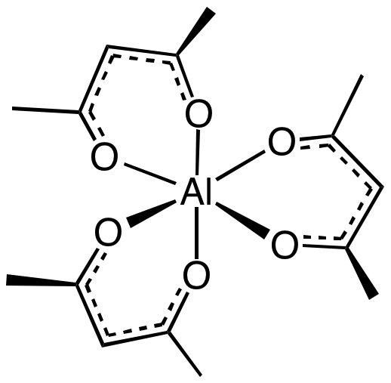
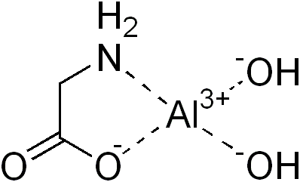
Direct antacids
Aluminium compounds:
Aluminium acetylacetonate
Aloglutamol
Dihydroxyaluminium aminoacetate
(= Aluminium glycinate)

Slide 16
Direct antacids
Polycationic complex salts:
Magaldrate
AlMg₂(OH)₇ · H₂O
Almagate
Al₂Mg₆(OH)₁₄(CO₃)₂ · 4H₂O
Hydrotalcite
Mg₆Al₂CO₃(OH)₁₆ · 4H₂O
Almasilate
MgAl₂(H₂SiO₃) · H₂O

Slide 17
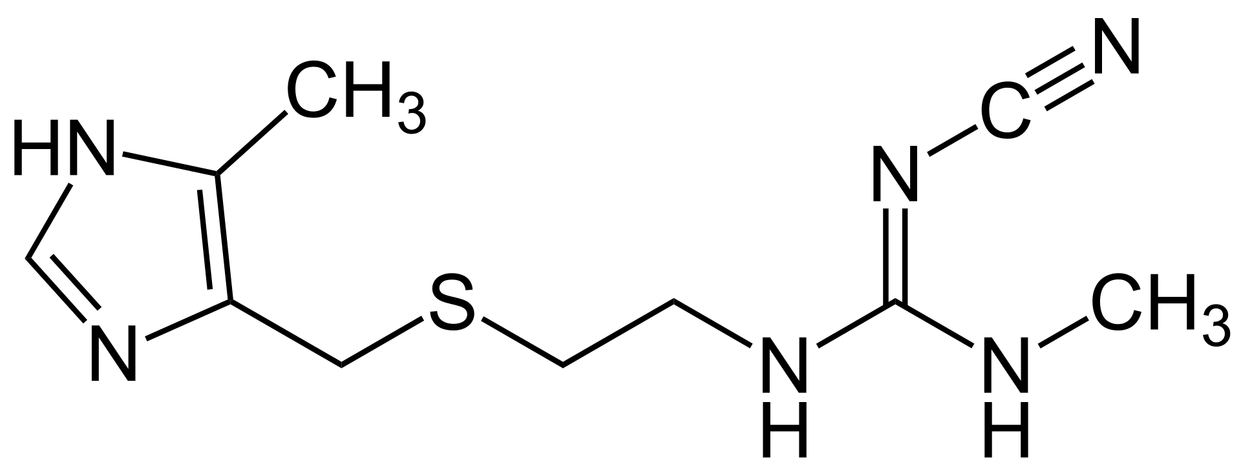
Selective H₂ histamine receptor antagonists
SAR of H₂ antagonists:
cimetidine first on the market 1978

Slide 18
Selective H₂ histamine receptor antagonists
Cimetidine
first on the market
cytochrome P450 inhibitor – numerous drug interactions
duration of action 4-8 hr

Slide 19
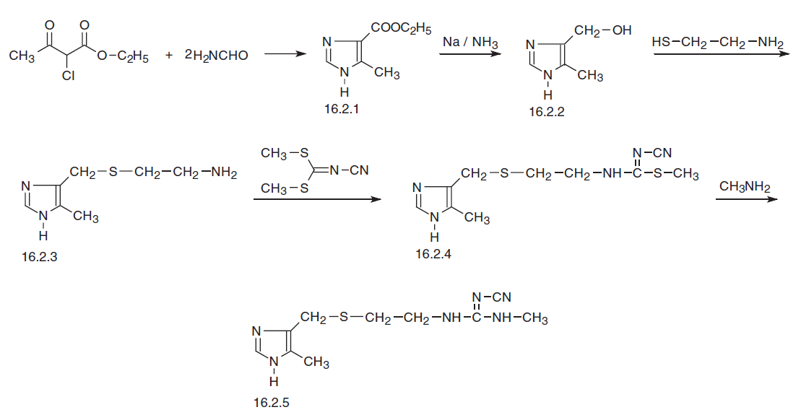
Selective H₂ histamine receptor antagonists

Slide 20
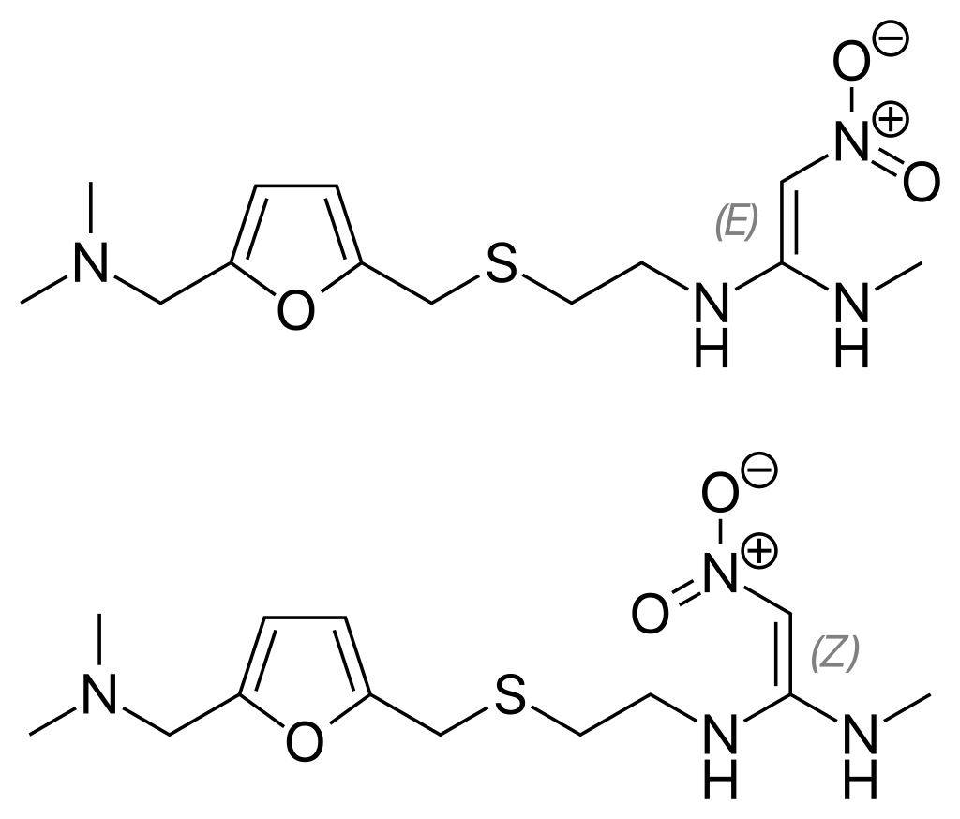
Selective H₂ histamine receptor antagonists
Ranitidine
better safety profile
2019-2020 withdrawn due to cancer-causing impurities

Slide 21
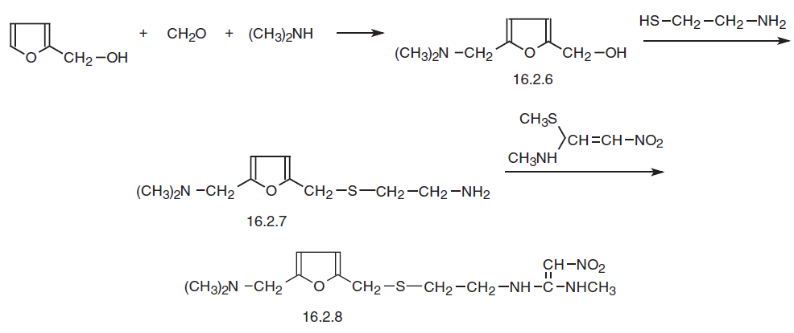
Selective H₂ histamine receptor antagonists

Slide 22
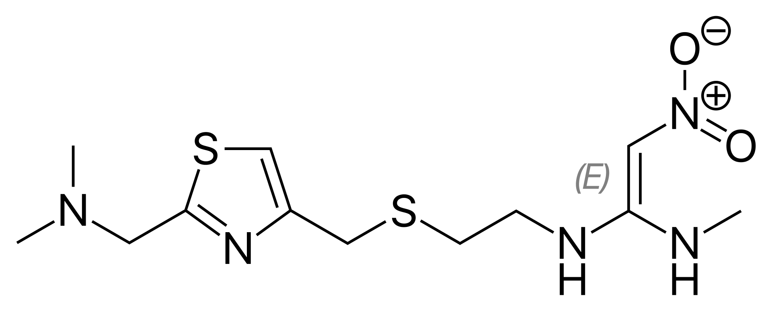
Selective H₂ histamine receptor antagonists
Nizatidine
1988 on the market, better safety profile

Slide 23
Selective H₂ histamine receptor antagonists

Slide 24
Selective H₂ histamine receptor antagonists
Famotidine
1985 on the market, no effect on cytochrome P450

Slide 25
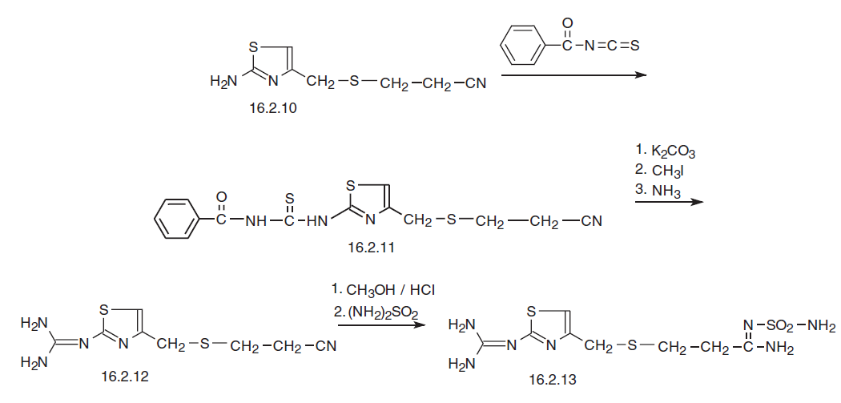
Selective H₂ histamine receptor antagonists

Slide 26
Selective H₂ histamine receptor antagonists
Roxatidine acetate
1986 on the market, once a day

Slide 27
Selective H₂ histamine receptor antagonists
Lafutidine
second generation, since 2005
Japan, Korea, India
additional mechanisms of (NO stimulation, somatostatin activation, antiinflammatory efect)

Slide 28
Proton pump inhibitors
irreversible H⁺/K⁺ ATPase inhibitors
Omeprazol first on market (1988)
1st generation have superseded H2 antagonists and and direct antacids during 90ties
2nd generation Esomeprazol since 2001
3rd generation – reversible proton pump inhibitors Revaprazan 2005

Slide 29
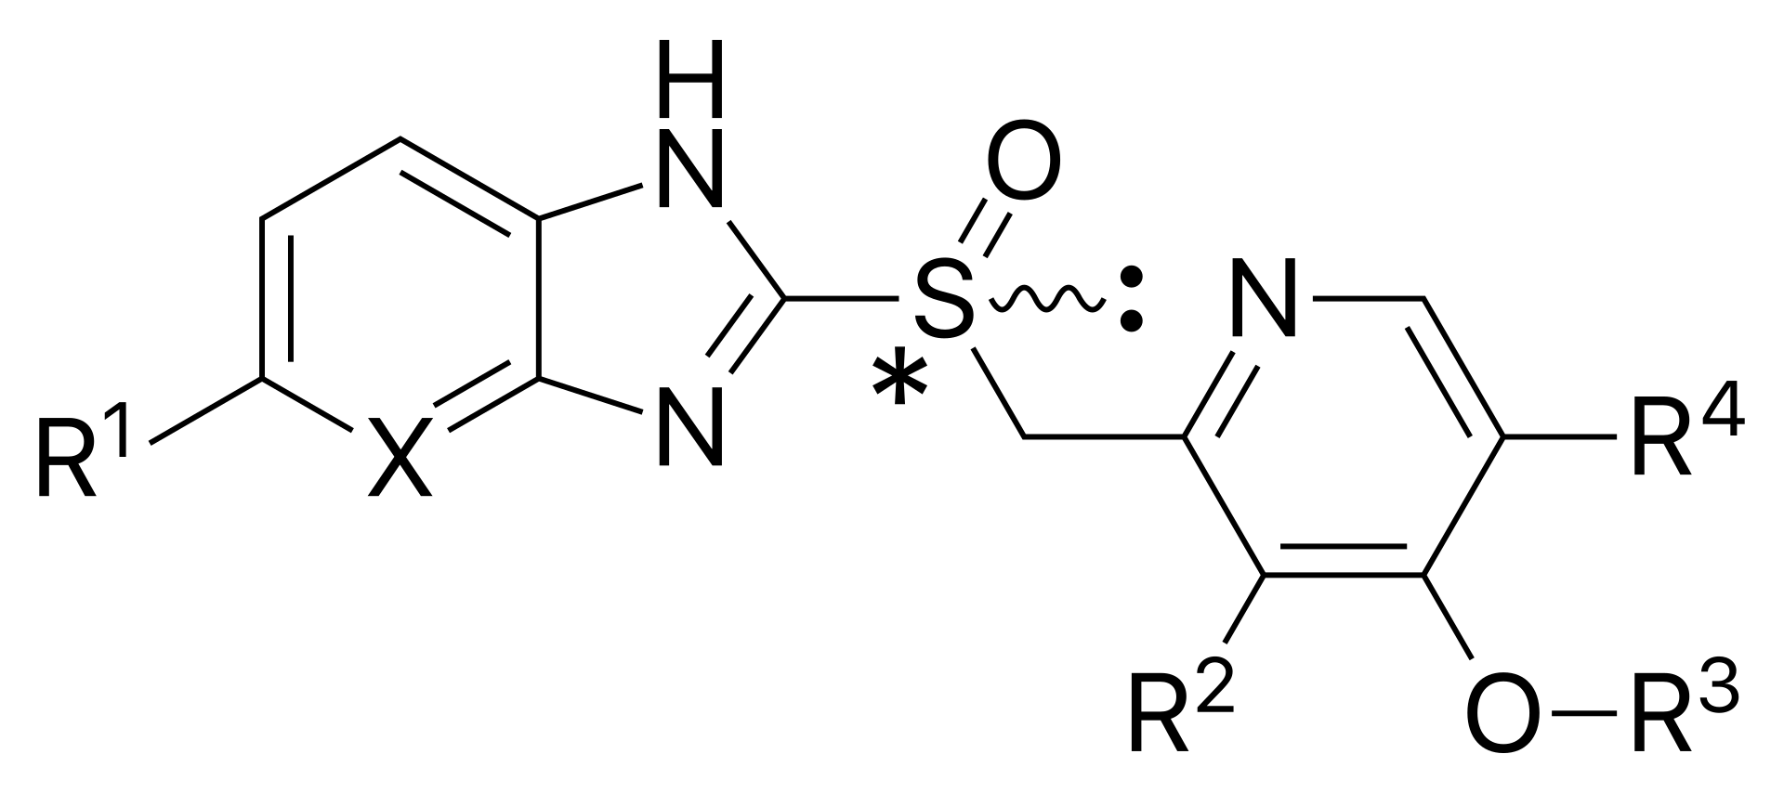
Proton pump inhibitors
irreversible H⁺/K⁺ ATPase inhibitors
general formula:

Slide 30
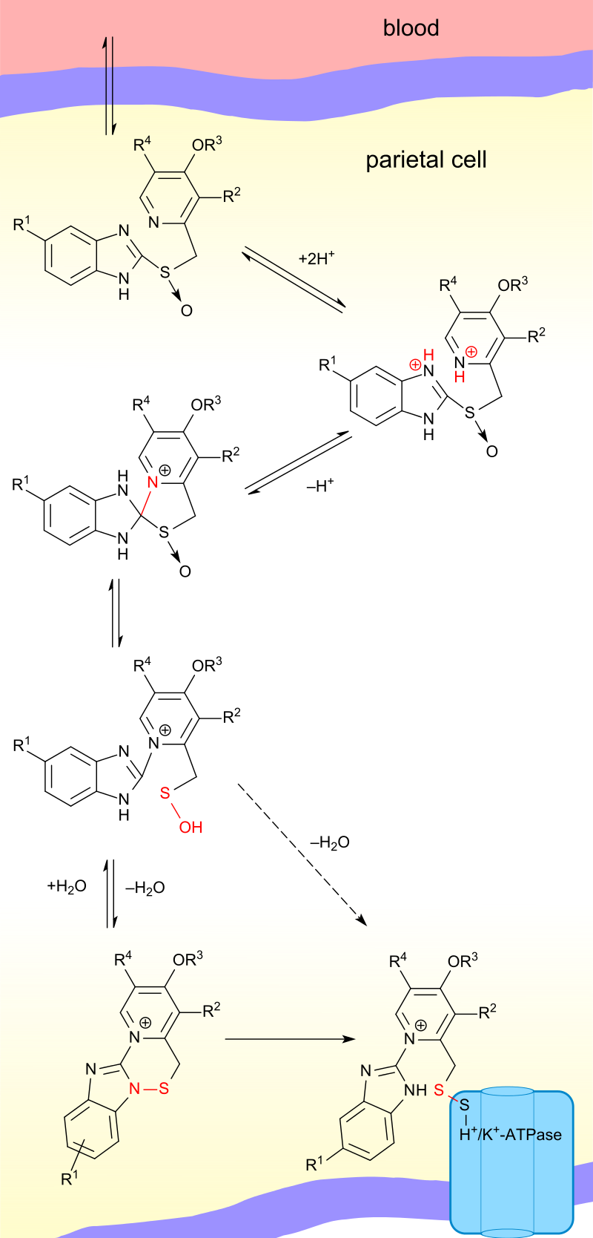
Proton pump inhibitors
mechanism of action:

Slide 31
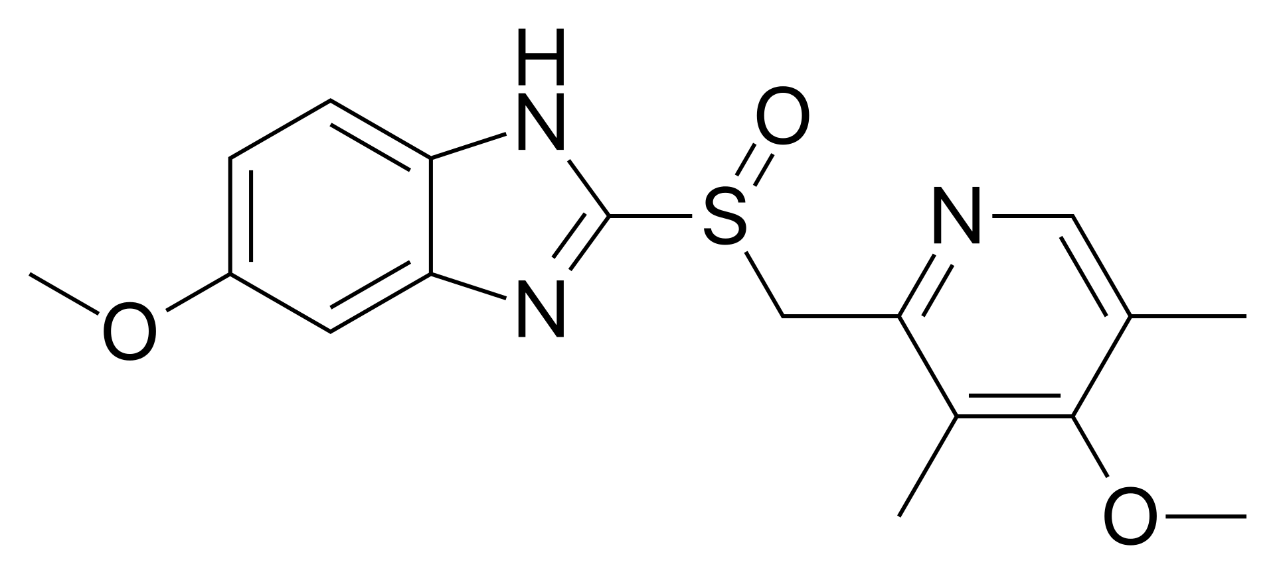
Proton pump inhibitors
Omeprazole
1988

Slide 32
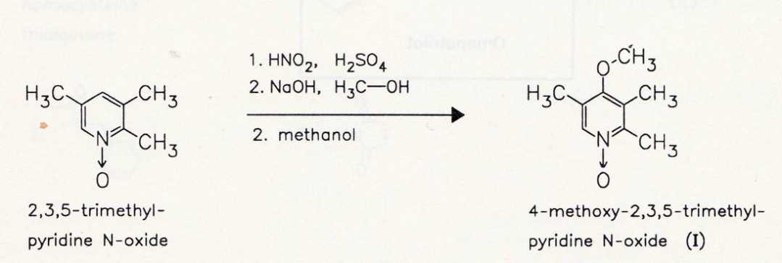
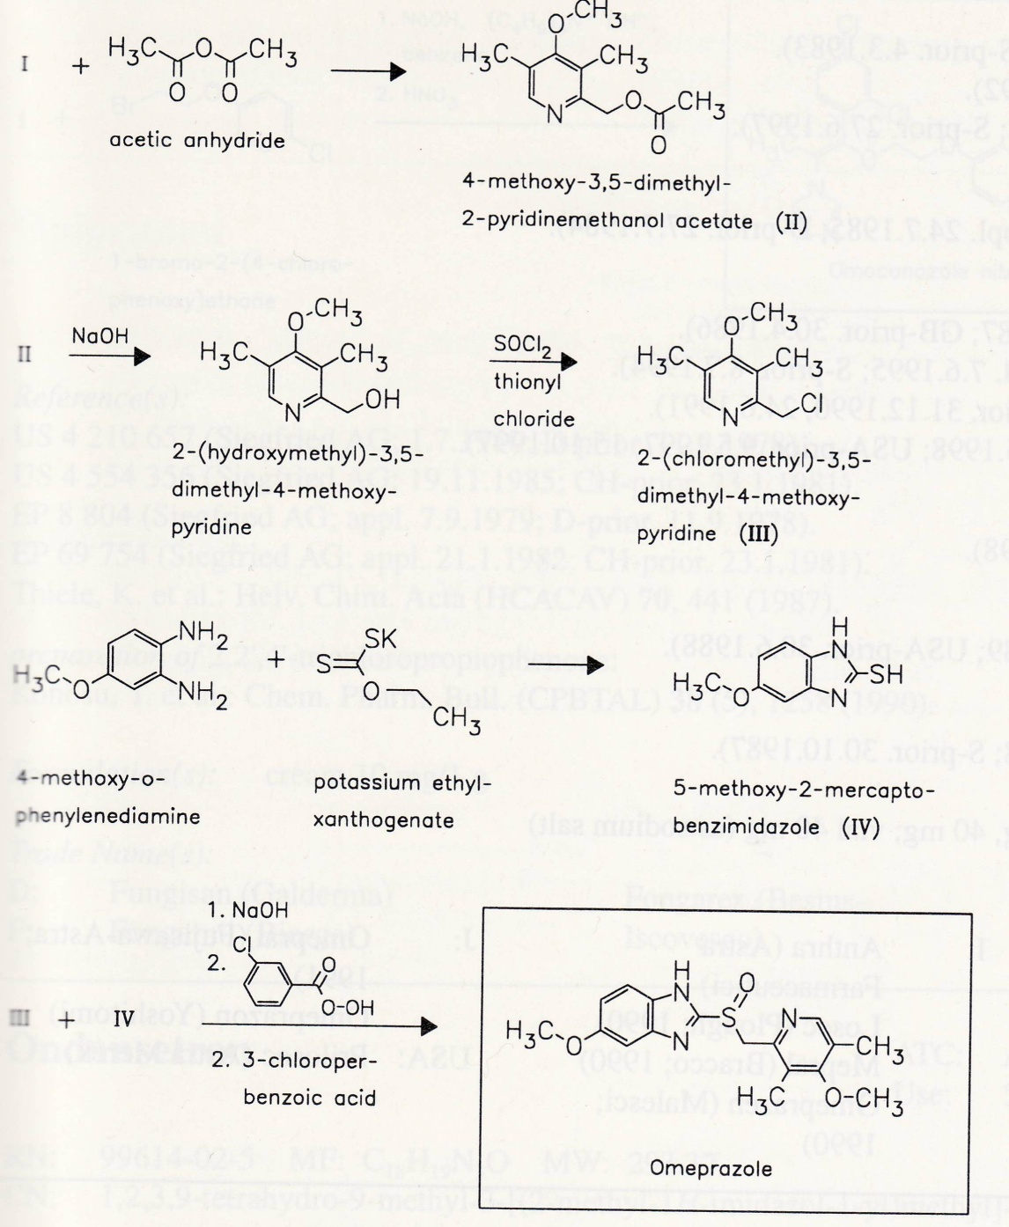
Proton pump inhibitors

Slide 33
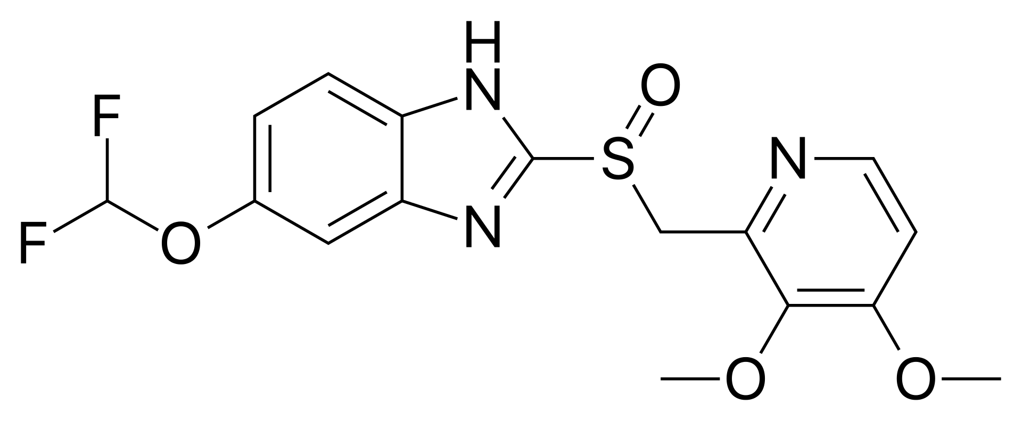
Proton pump inhibitors
Pantoprazole
1994

Slide 34
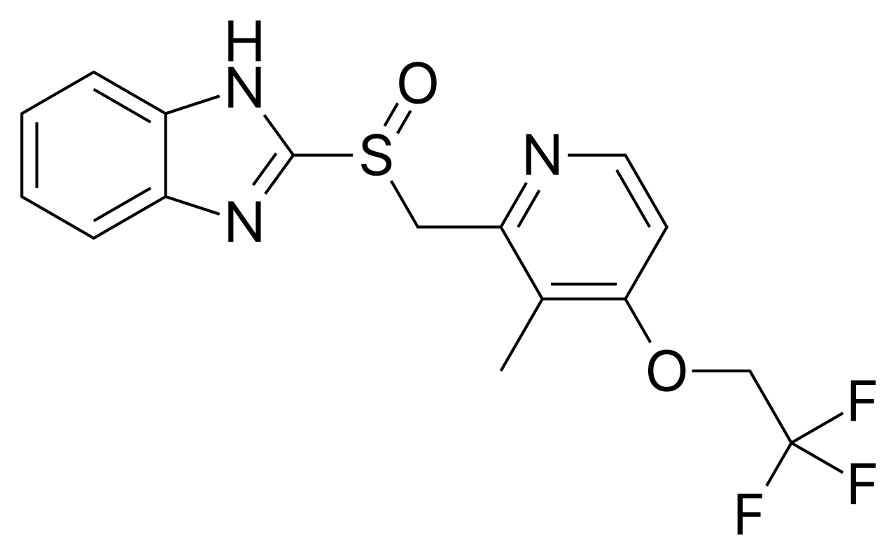
Proton pump inhibitors
Lansoprazole
1992

Slide 35
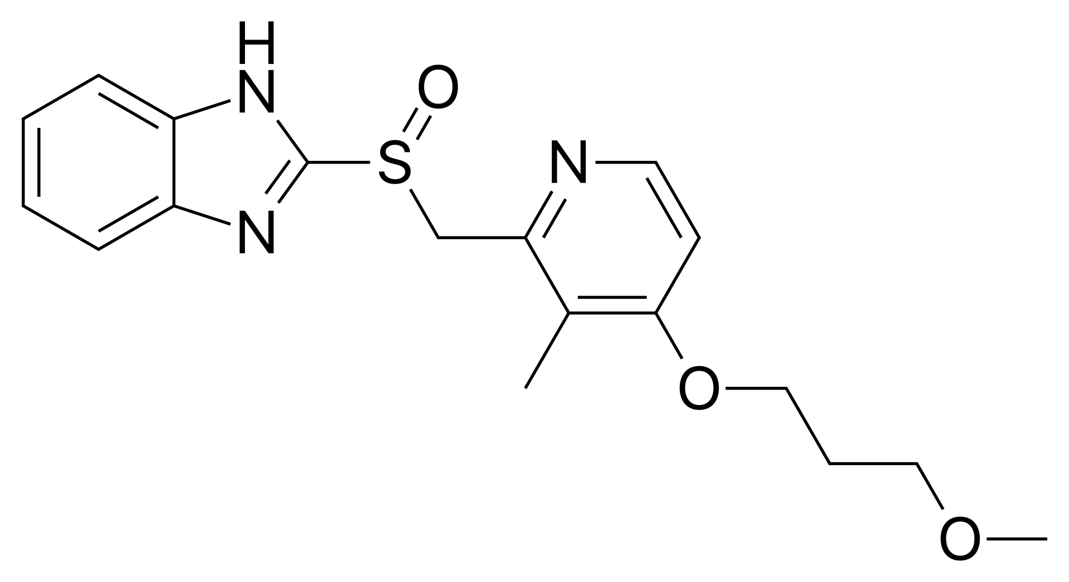
Proton pump inhibitors
Rabeprazole
1997

Slide 36
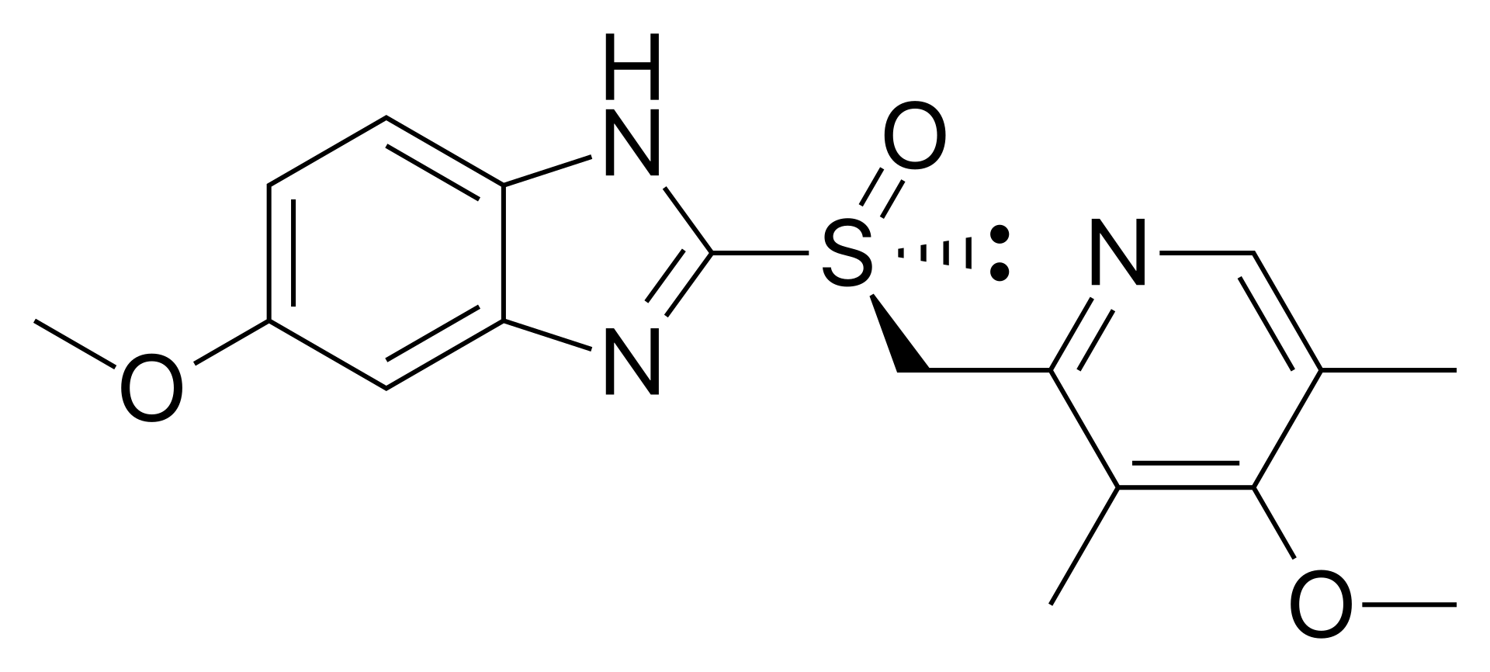
Proton pump inhibitors
Esomeprazole
2001

Slide 37
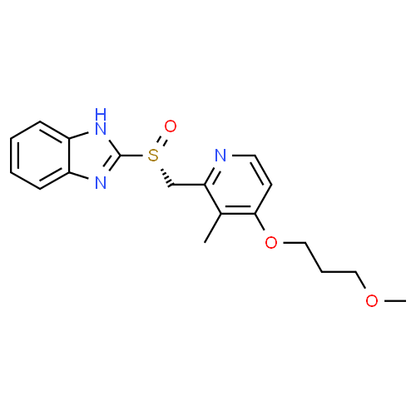
Proton pump inhibitors
Dexrabeprazole
2007 India

Slide 38
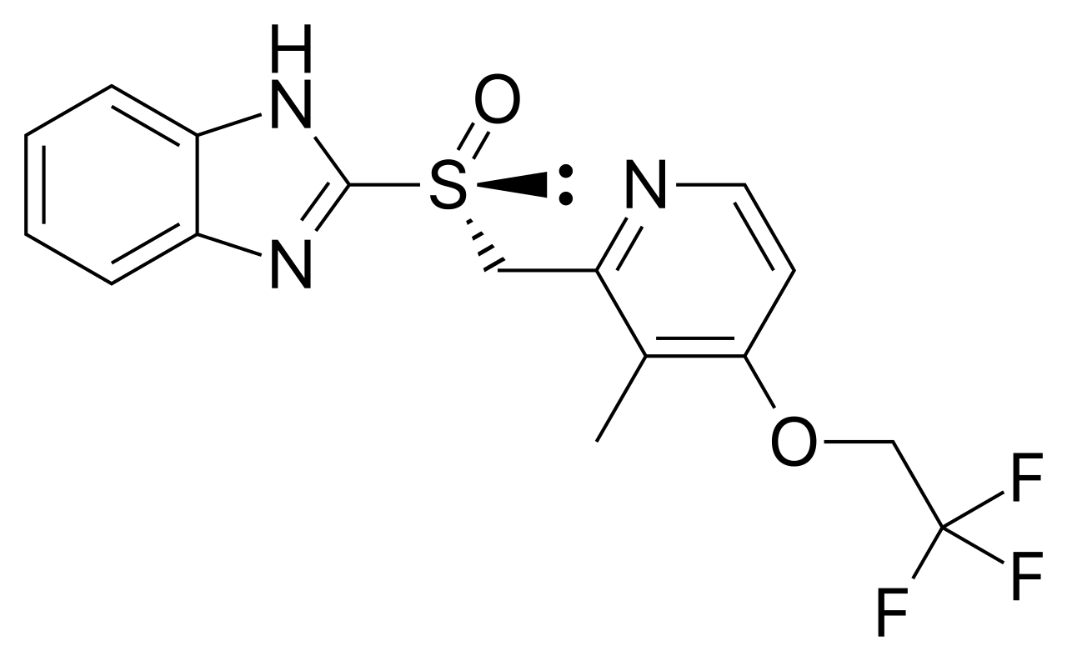
Proton pump inhibitors
Dexlansoprazole
2009

Slide 39
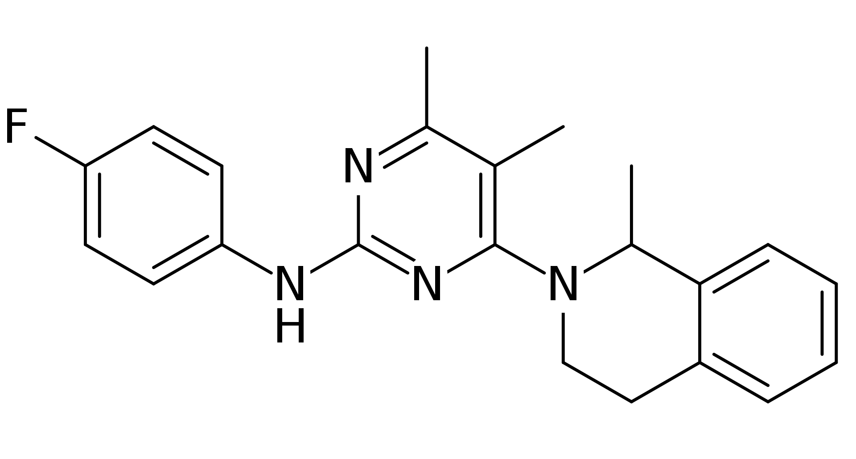
Reversible proton pump inhibitors
Revaprazan
first on the market 2005, Korea only

Slide 40
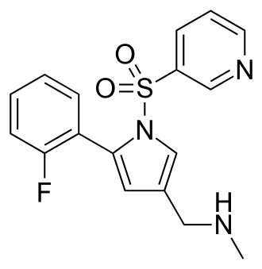
Reversible proton pump inhibitors
Vonoprazan
2015 Japan, 2022/2023 USA

Slide 41
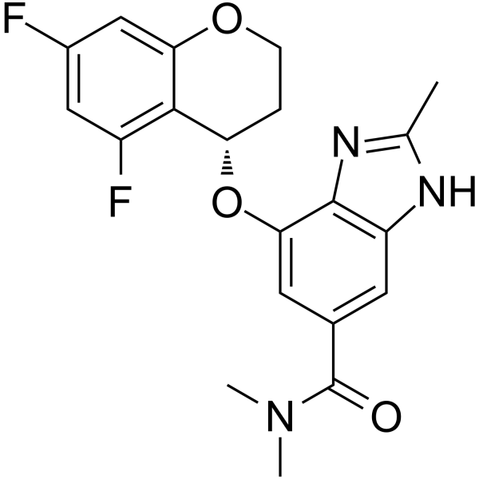
Reversible proton pump inhibitors
Tegoprazan
2019 China, 2020 Korea, FDA under consideration

Slide 42
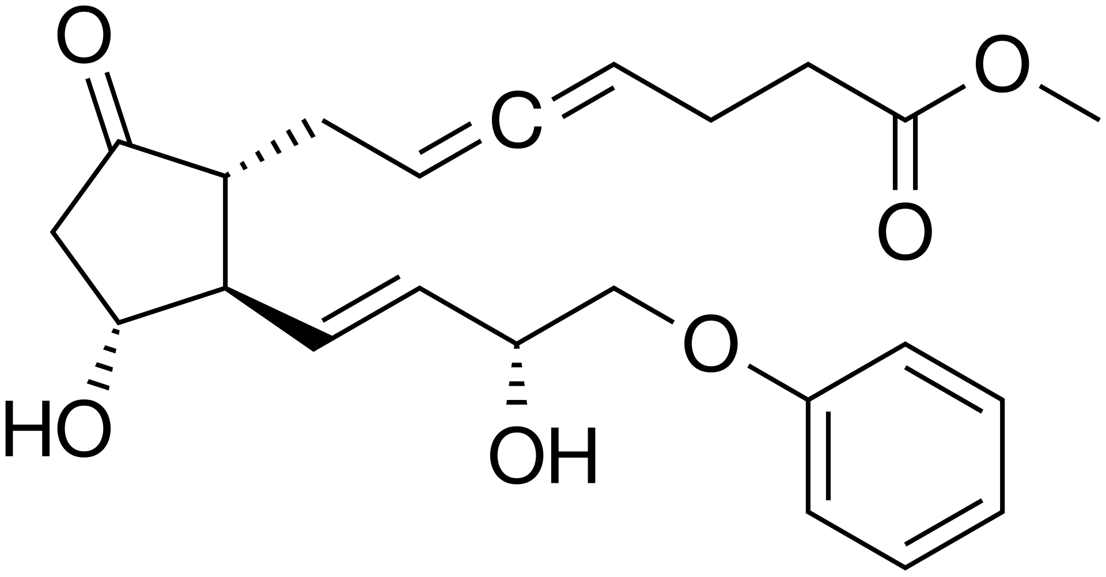
Prostaglandines
EP3 receptor agonists
Misoprostol
Enprostil

Slide 43
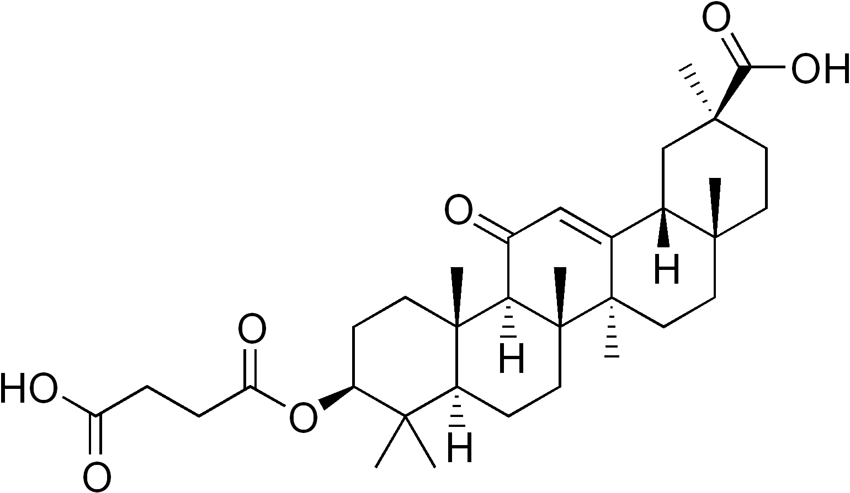
Cortisol synthesis inhibitors
Carbenoxolone
gycyrhettinic acid derivative

Slide 44
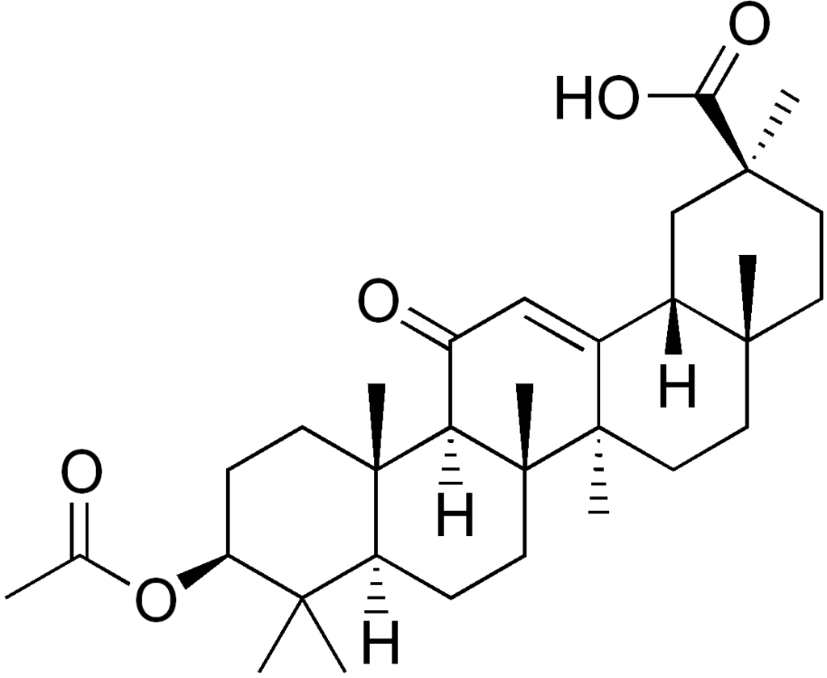
Cortisol synthesis inhibitors
Acetoxolone
gycyrhettinic acid derivative

Slide 45
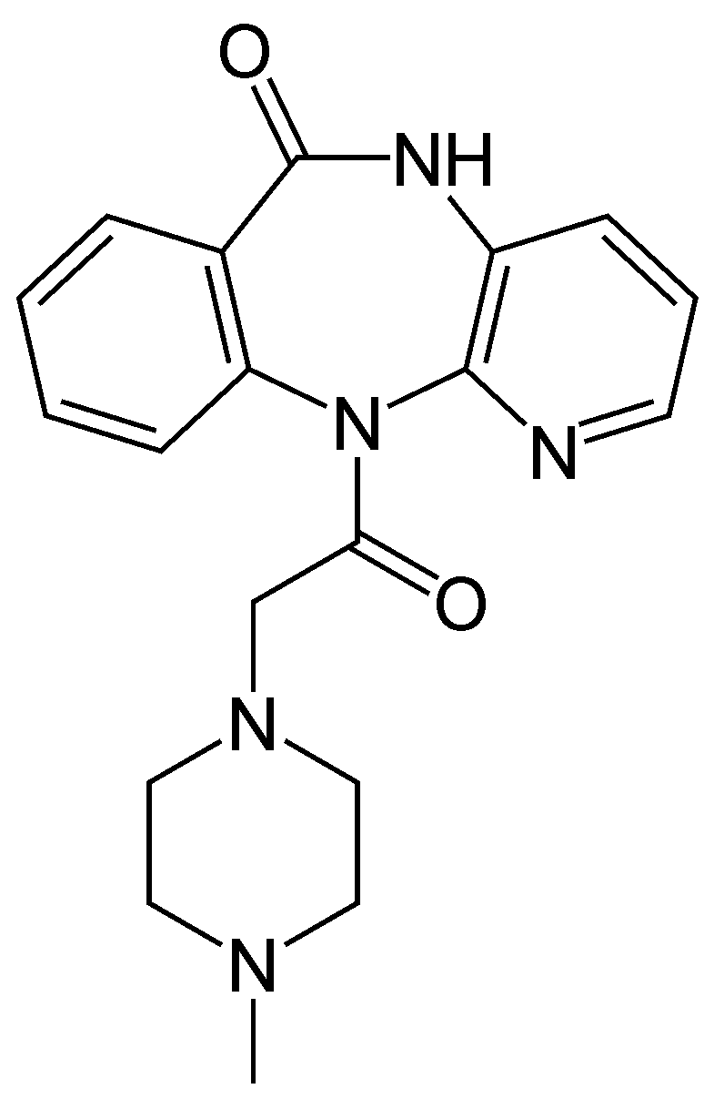
Muscarinic M1 inhibitors
Pirenzepine
cannot diffuse through blood-brain barrier
reduces acid secretion
reduces muscle spasm

Slide 46
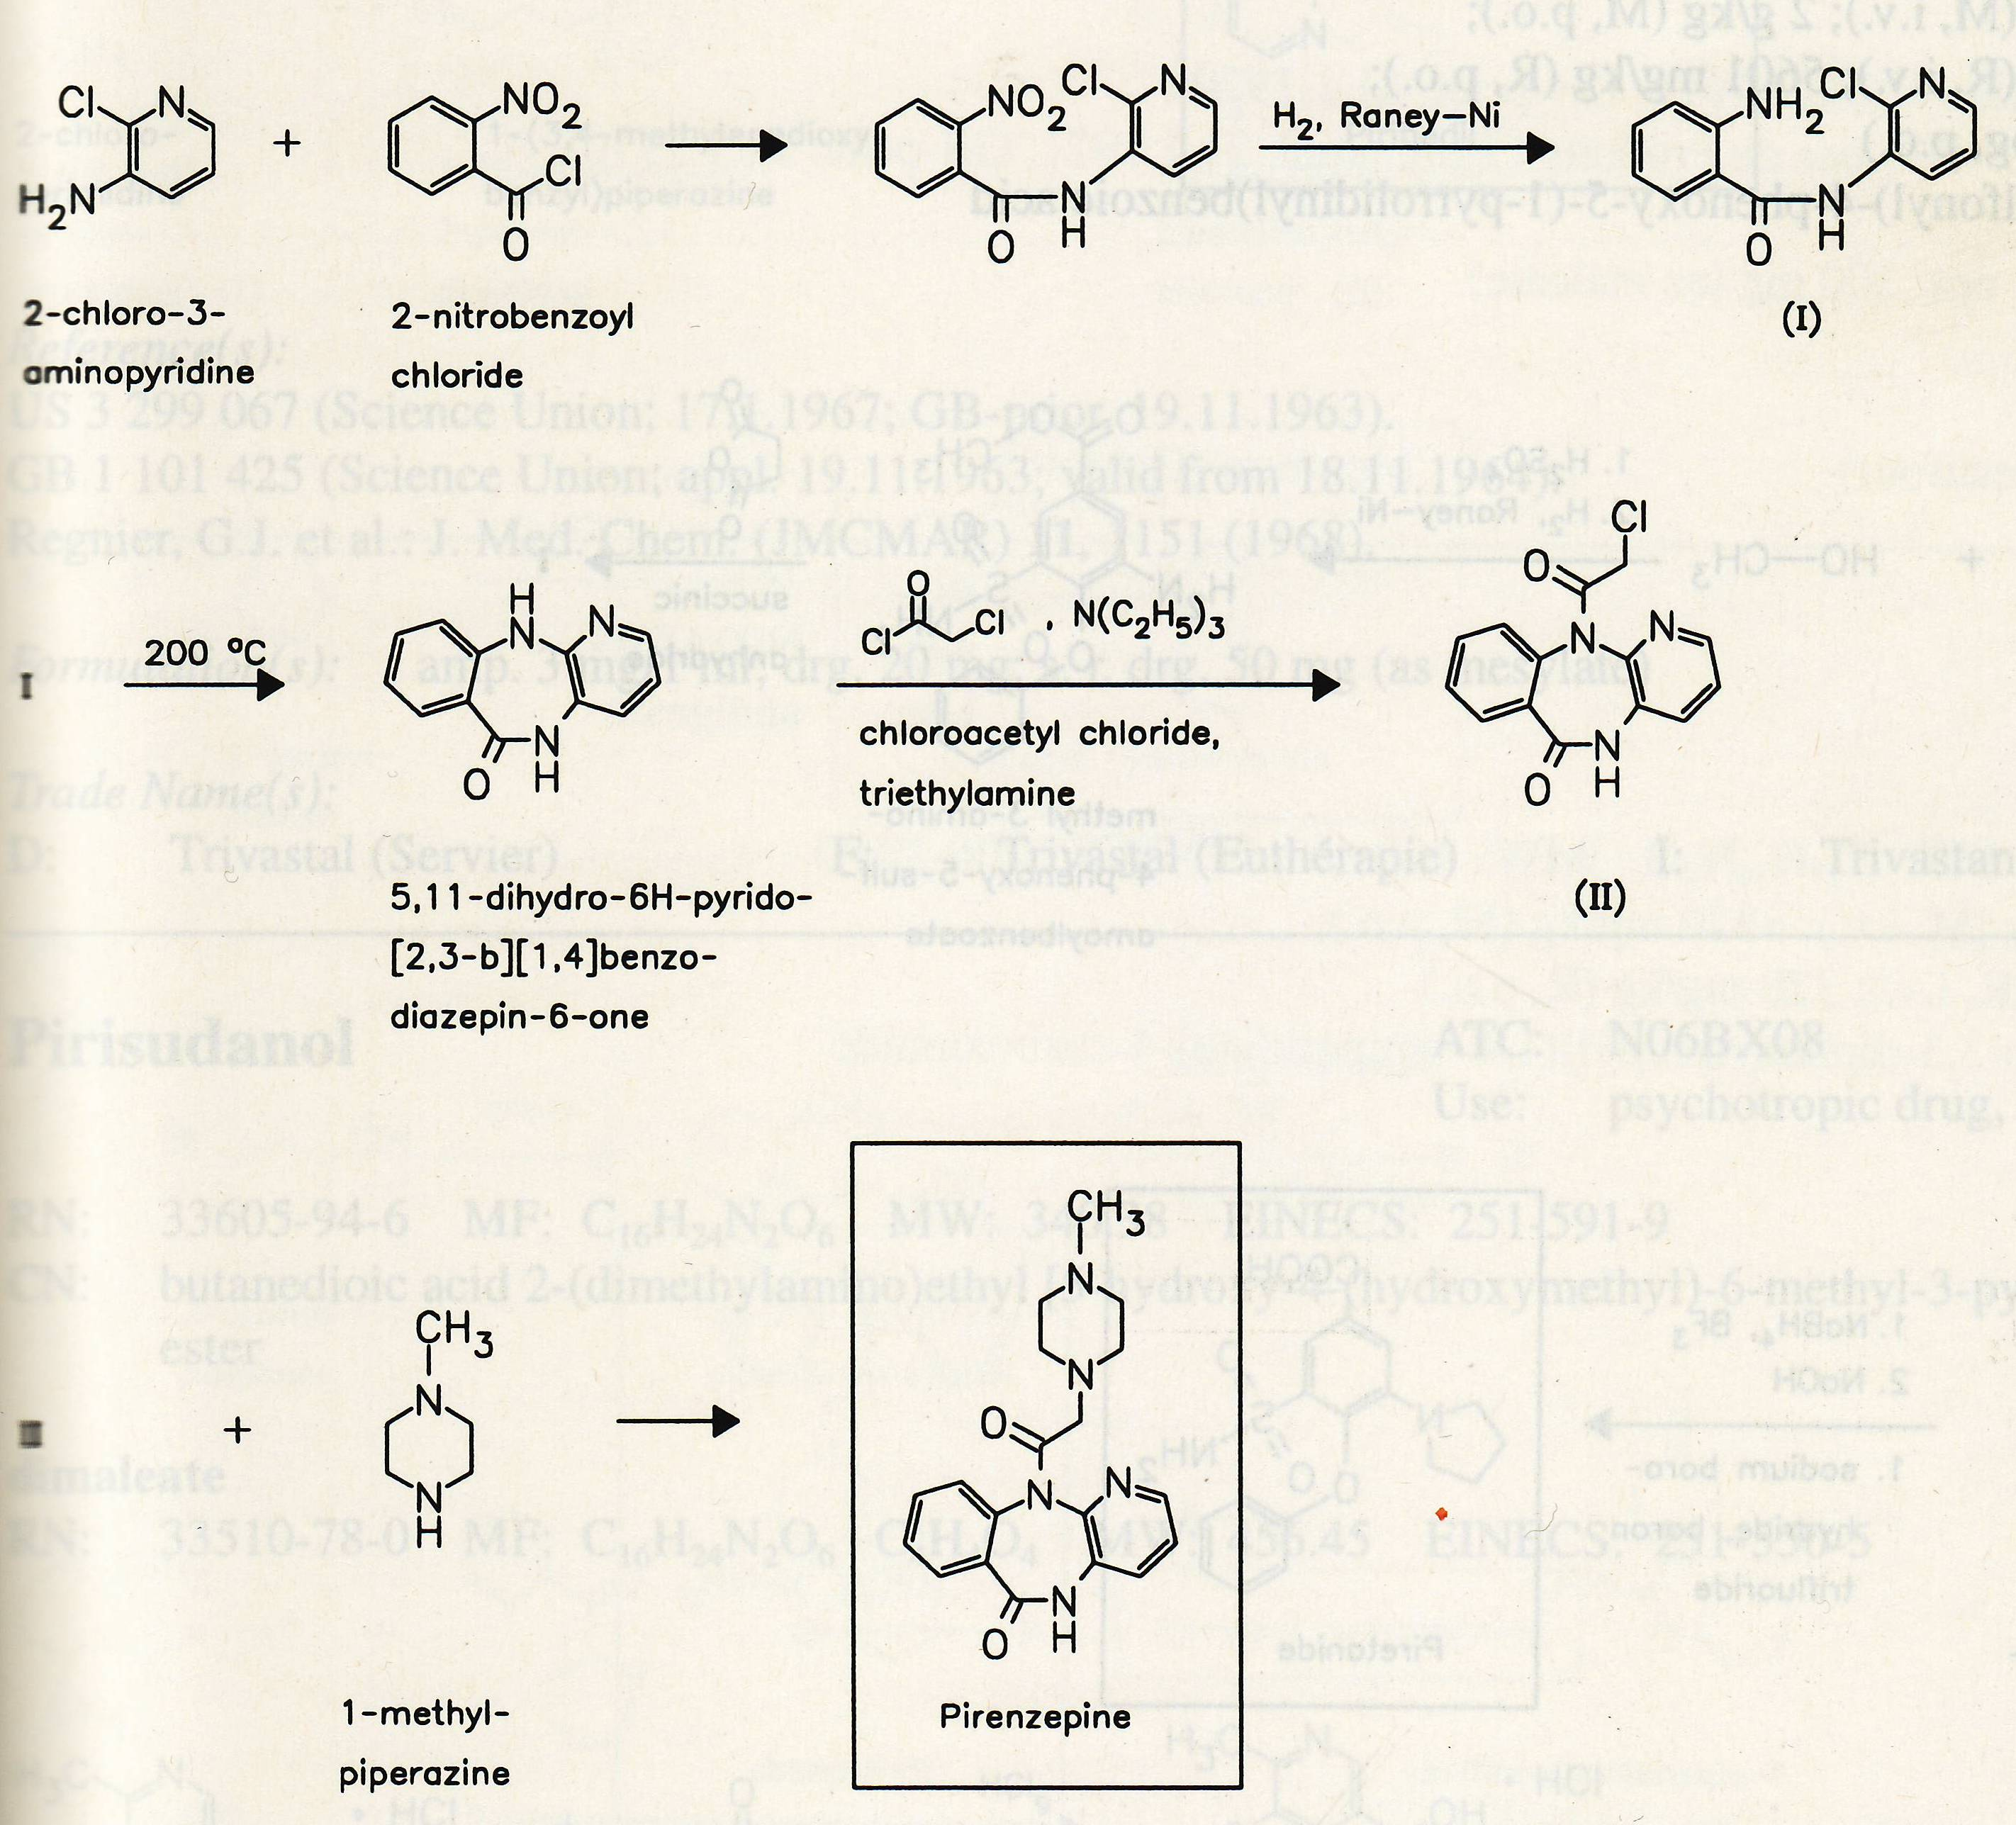
Muscarinic M1 inhibitors
Pirenzepine synthesis

Slide 47
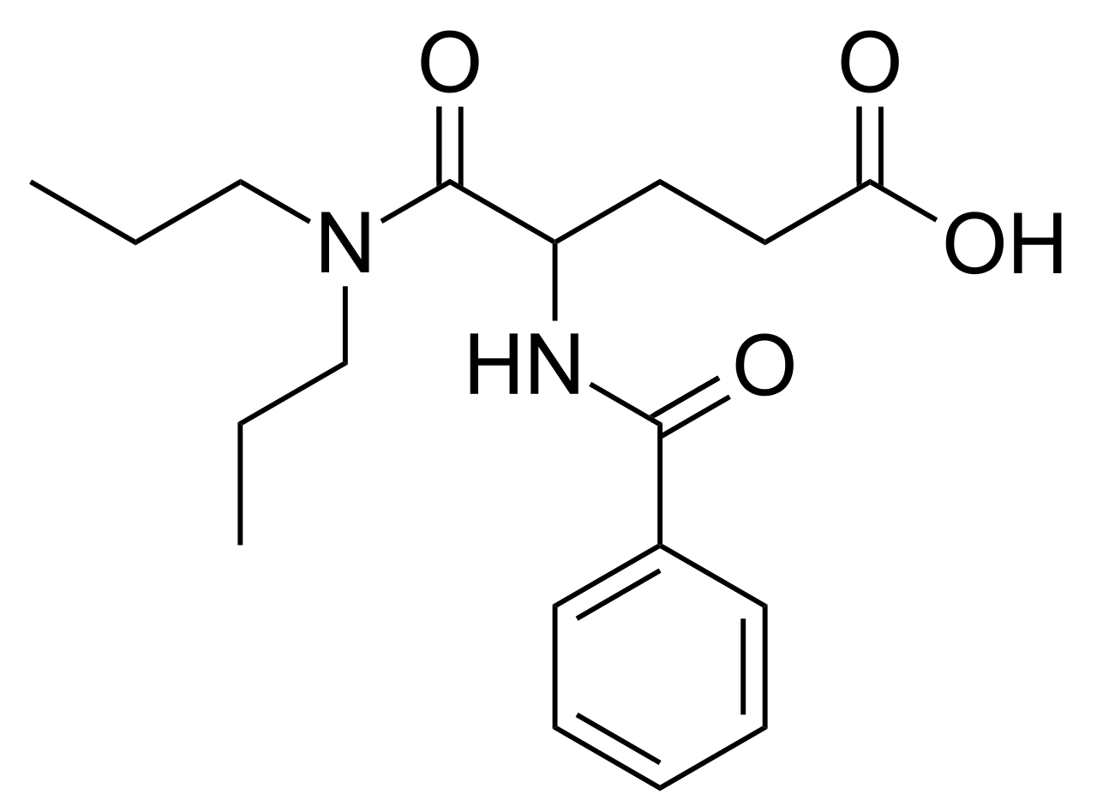
Cholecystokinin antagonists
Proglutimide
partial δ-opioid receptor agonist – prevent development of tolerance in opioid therapy

Slide 48
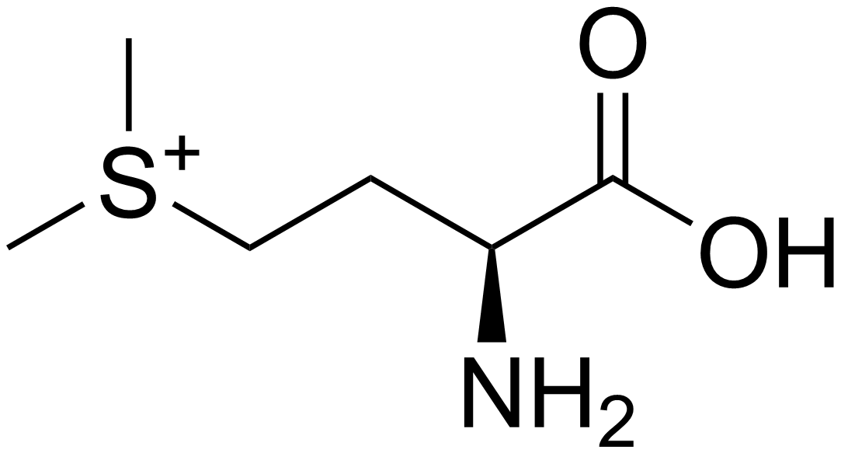
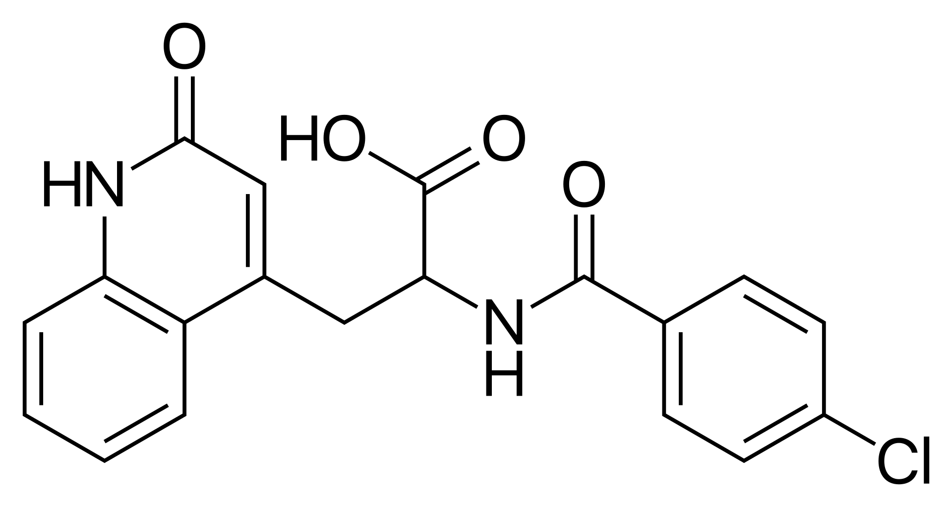
Antioxidants
Methylmethionine sulfonium chloride
mucoprotective effect
decreases acid secretion
Rebamipide
mucoprotective effect
antiimlammatory effect
asian countries

Slide 49
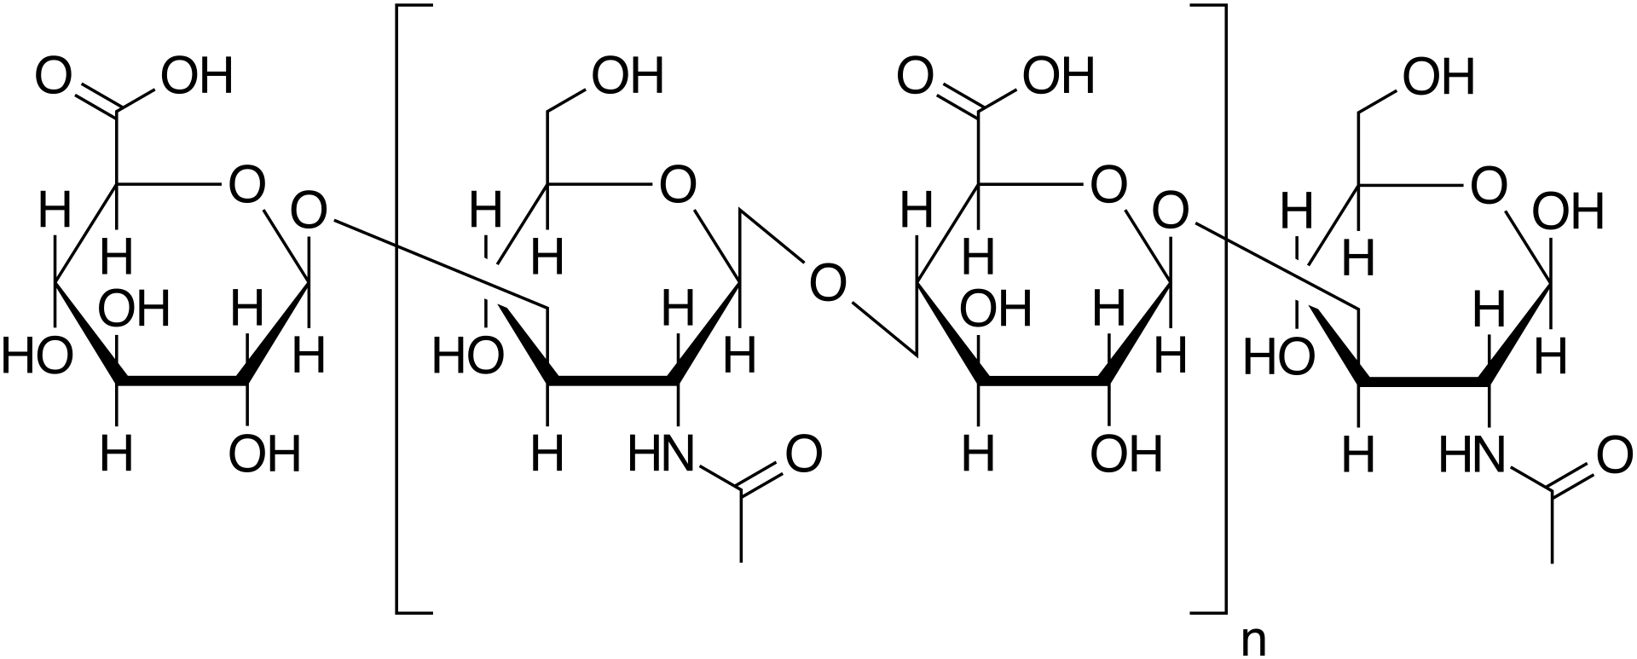
Mucoprotective agents
Gefarnate
insoluble terpene fatty acid
Sulgicotide
isolate from pig duodenum mucosa

Slide 50
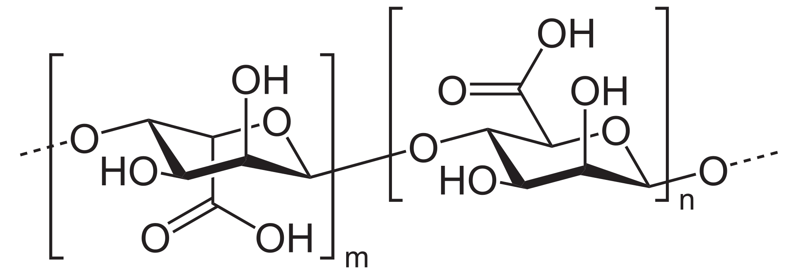
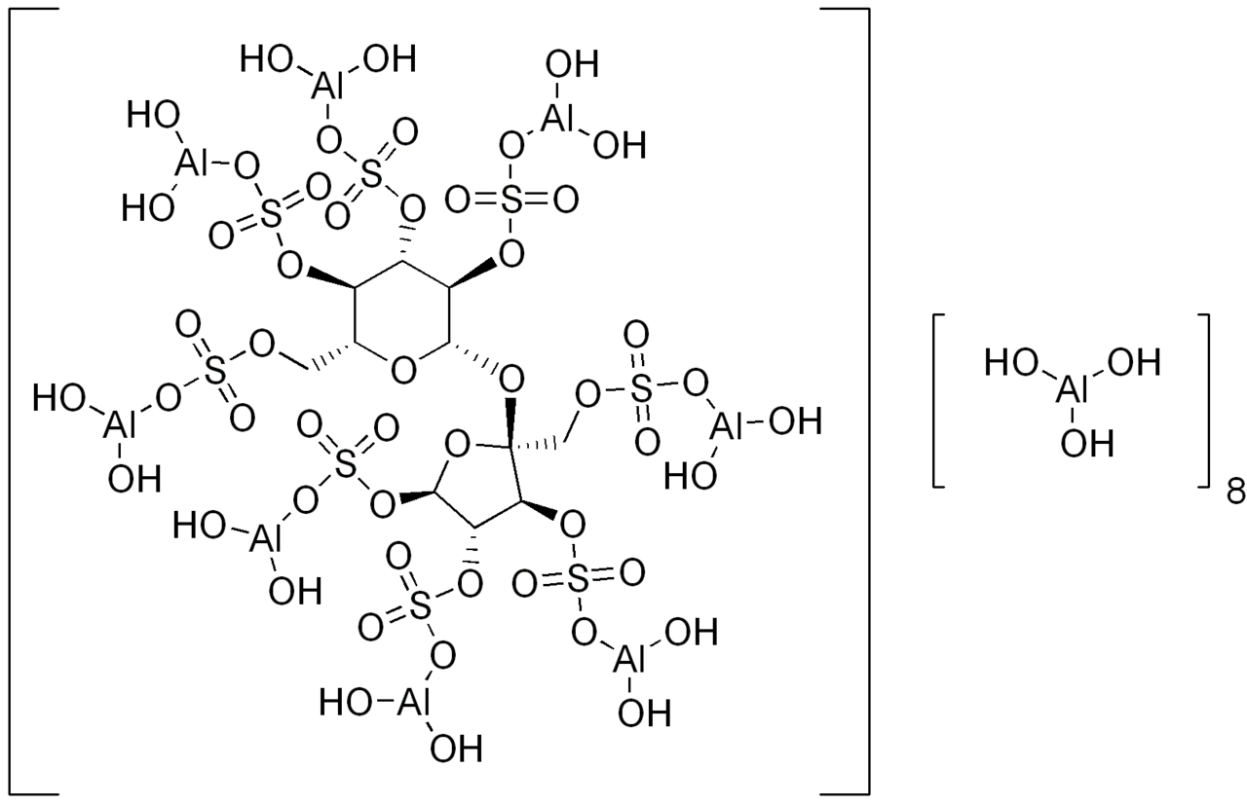
Mucoprotective agents
Alginic acid
brown seaweeds
polysaccharide
Sucralfate
with HCl forms
pasta-like material
prostaglandine
stimulation

Slide 51
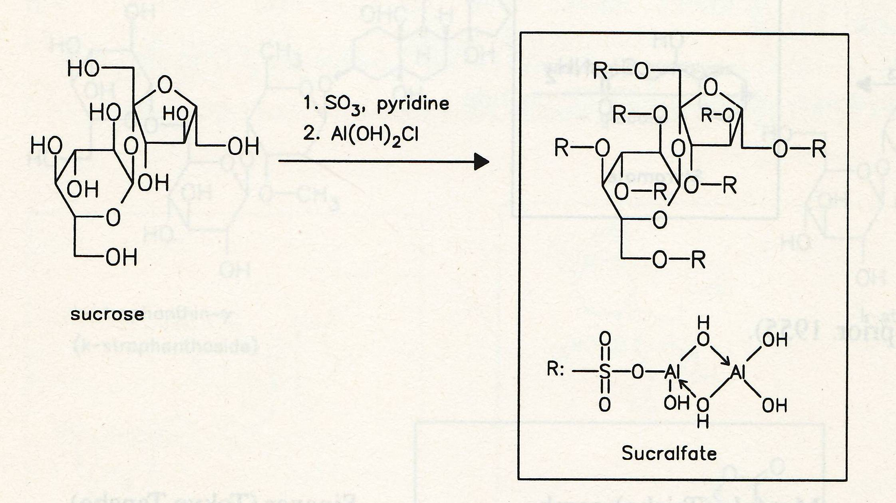
Sucralfate synthesis

Slide 52
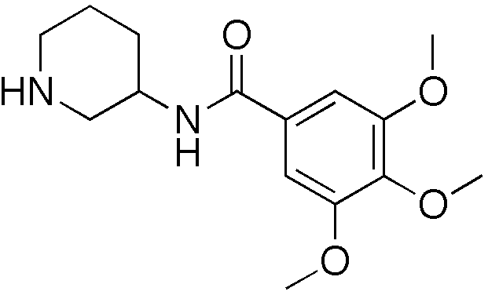
Mucoprotective agents
Troxipide
multifactorial mucoprotective effect:
increase of glukosamine content in mucus
prostaglandine stimulation
antiinflammatory effect
Japan, Korea, China, India

Slide 53
Drugs for Helicobacter pylori eradication
Combination of proton pump inhibitor + two antimicrobials
Antimicrobials:
Metronidazole, Tinidazole
Azithromycin, Clarithromycin
Amoxicillin
Tetracycline
Levofloxacin
Rifabutin

Slide 54
Drugs for Helicobacter pylori eradication
antimicrobial bismuth salts:
Bismuth subnitrate (bismuth oxynitrate)
Bi₅O(OH)₉(NO₃)₄
Bismuth subcitrate (bismuth potassium citrate)
K₅Bi(C₆H₄O₇)₂· 3H₂O

