Slide 1
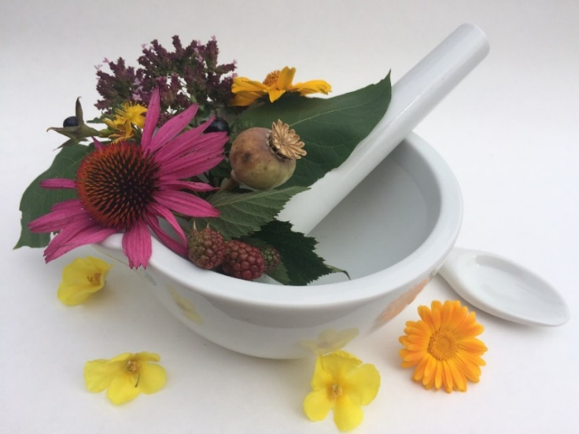
Pharmacognosy lab exercise 6
Drugs – cortex, wood, leaves

Slide 2
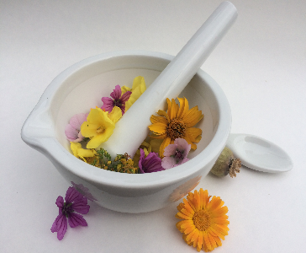
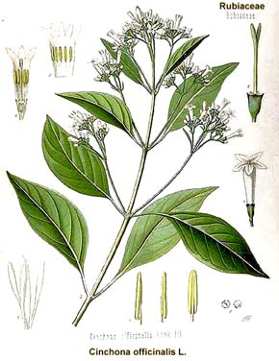
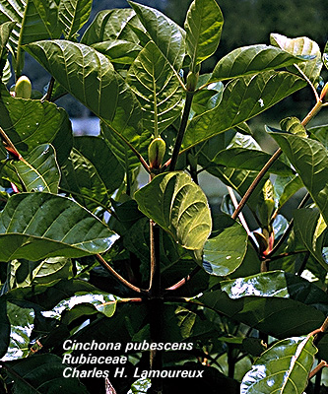
Cinchonae cortex CzPh 2017
Mother plant: Cinchona pubescens (C. succirubra), C. calisaya, C. ledgeriana Rubiaceae , (Cinchona)
Cinchonae extractum fluidum normatum CzPh 2017

Slide 3
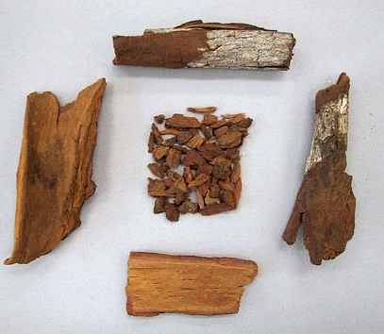
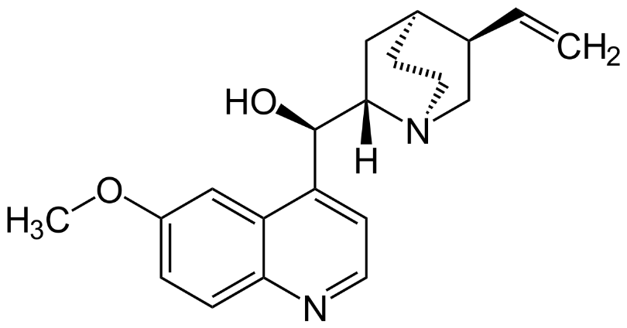
Cinchonae cortex CzPh 2017
Macroscopy: tubularly curled bark, externally grey-brown to brown, wrinkled and cracked, internal side brown-red, fracture from inner side is fibrous, outer side clean and smooth, aromatic odour, very bitter taste
Content compounds: around 30 alkaloids, mainly quinine, quinidine, minor: cinchonine, cinchonidine
Usage: isolation of alkaloids
  quinine – direct effect on CNS - antipyretic, analgesic, antimalarial
  quinidine - antiarrhythmic
quinine
Notes:
Quinine increases the sensitivity of uterus to oxytocine – it should not be administered to pregnant women because it can induce abortion.
Quinine is used as a standard for bitterness.

Slide 4
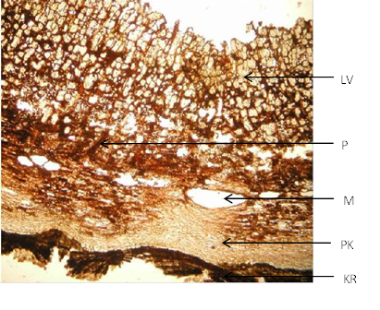
Cinchonae cortex CzPh 2017
Microscopy: surface cork, in cortex secretory cells (cellulae lactiferae), calcium oxalate sand cells, cells with starch, phloem fibers (with ruptures (infundibuliform pits)), medullar rays, sieve-tubes
phloem fibers
sand cell
lactifer
phloem fiber
feloderm
cork

Slide 5
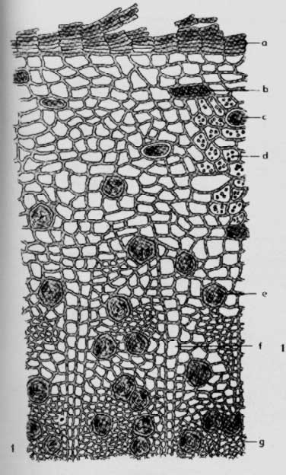
Cinchonae cortex CzPh 2017
Microscopy:
cork
phelloderm
sand cell
secretory cell
starch
phloem fiber
medullar rays
sieve-tubes

Slide 6
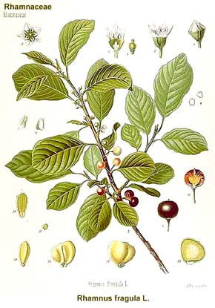
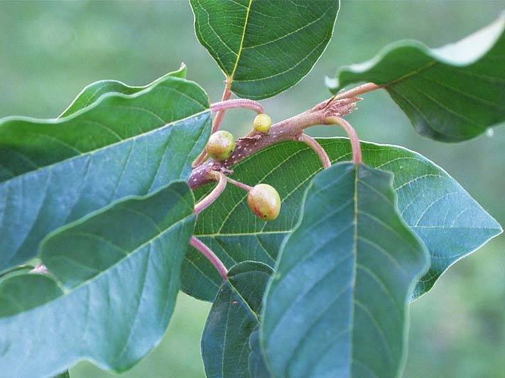
Frangulae cortex CzPh 2017
Mother plant: Rhamnus frangula (Frangula alnus), Rhamnaceae, (Buckthorn)

Slide 7
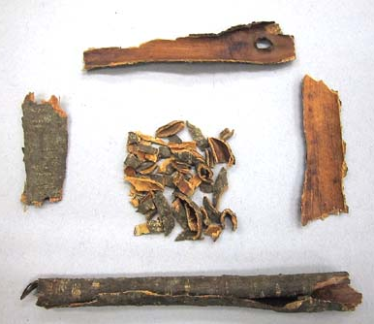
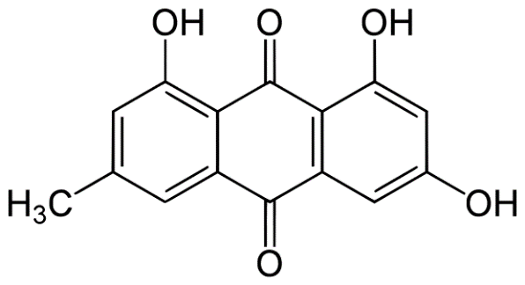
Frangulae cortex CzPh 2017
Macroscopy: tubularly rolled, externally grey-brown, grayish transversal elongated lenticels, inner side smooth reddish brown, fibrous fracture, without odour, bitter-sweet taste
Content compounds:
anthraquinone derivatives
glucofrangulins A, B frangulins
glycosides
Usage: laxative
frangula-emodin
(aglycone)
Notes:
Interactions: risk of hypokalemia when on digoxin medication, or diuretic medication
Laxatives can cause loss of minerals such as kalium.

Slide 8
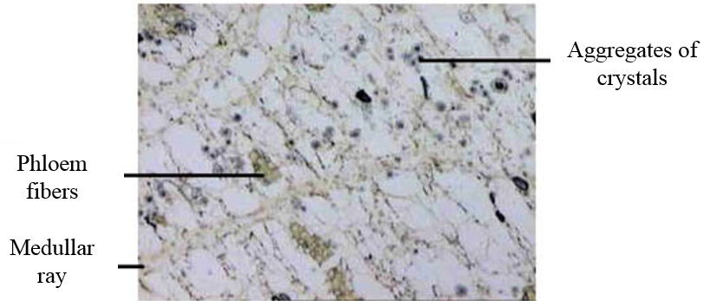
Frangulae cortex CzPh 2017
Microscopy: several layers of cork, under cork collenchyma (Absence of sclerified parenchyma), cells with starch, aggregates of calcium oxalate crystals, mucilage cavities (young bark), medullar rays, typical groups of thick phloem fibers, sieve -tubes

Slide 9
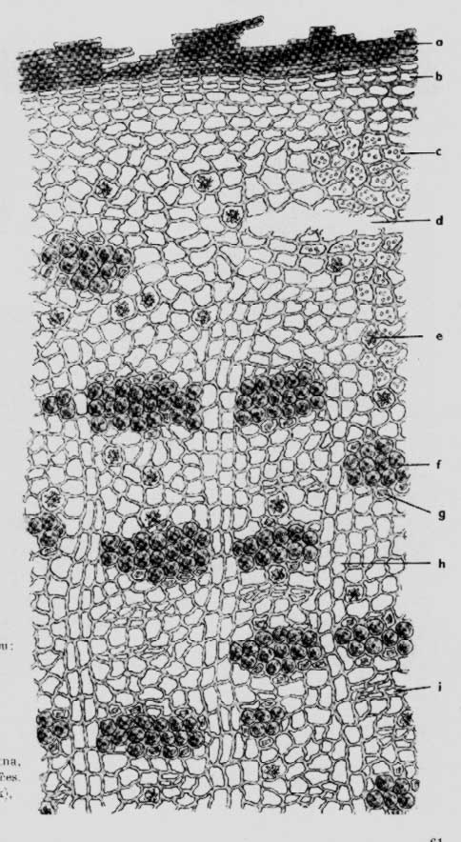
Frangulae cortex CzPh 2017
Microscopy:
cork
phelloderm
starch
mucilage cavity
druse
phloem fibers
medullar rays
sieve-tubes

Slide 10
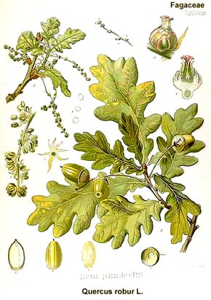
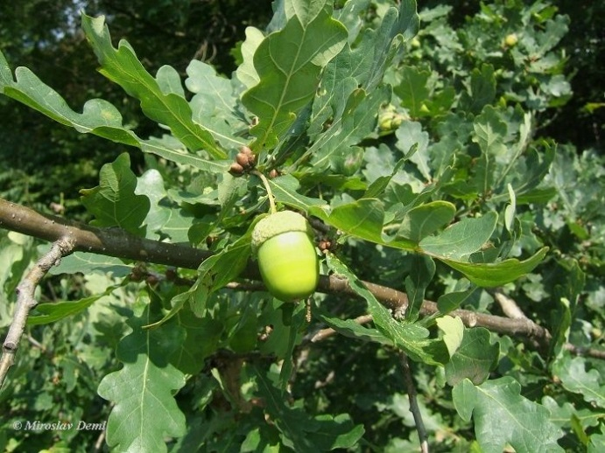
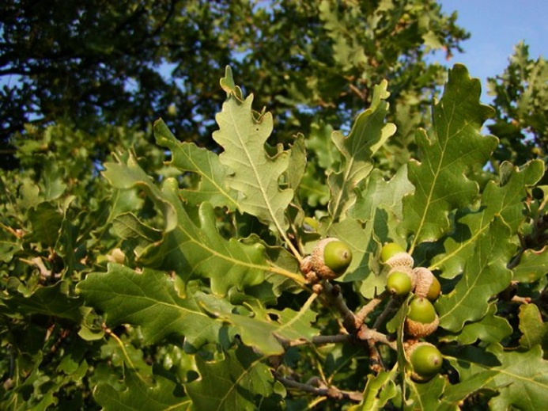
Quercus cortex CzPh 2017
Mother plant: Quercus robur, Q. petraea, Fagaceae, (oak)
Q. robur
Q. petraea

Slide 11
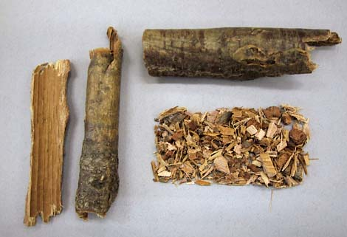
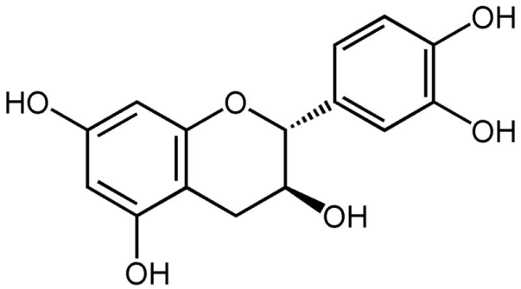
Quercus cortex CzPh 2017
Macroscopy: tubullar pieces of cortex, externally smooth, shiny, silver-gray, inner side bright brown to reddish, with sharp ridges, typical odour, bitter astringent taste
Content compounds: condensed tannins (catechins), phlobaphens, flavonoids
Usage: astringent, haemostyptic, antidiarrhoic
catechin
Notes:
Astringent compounds react with proteins in top layers of tissue, they form a membrane, which prevents the spread of infection and inflammation. Astringent compounds react also with proteins in the food, they form precipitates, if this happens in the bowels, such astringent compounds act antidiarrhoic (stool becomes less watery). Astringents also have vasoconstrictive effect.
Tannins can be converted into phlobaphens, red tannin pigments, which are insoluble in water. This conversion can happen by many ways: condensation, oxidation with air oxygen, heating, effects of acids and enzymes.
Quercus cortex is used mainly to prepare so called “sitting baths” for treating hemorrhoids.

Slide 12
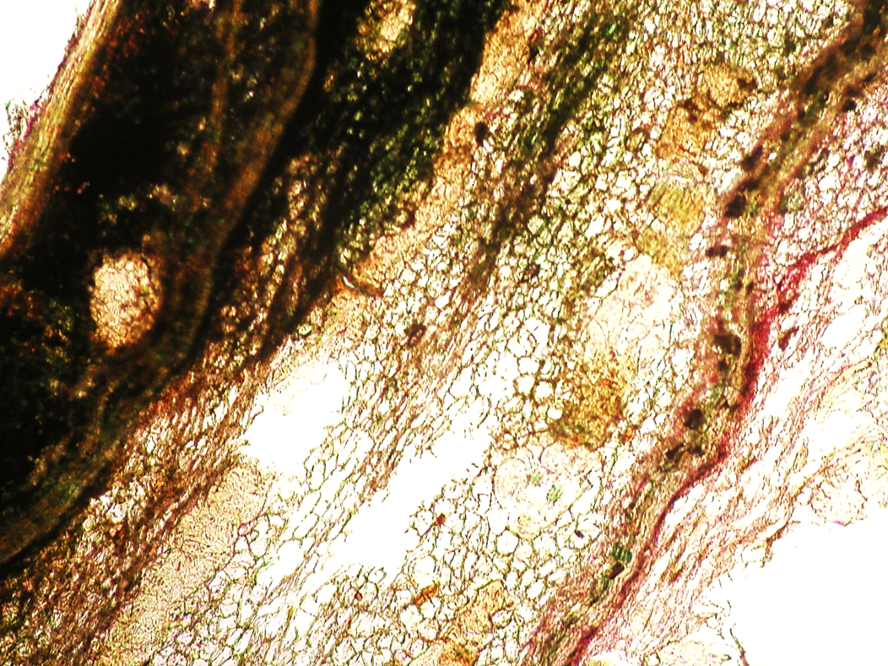
Quercus cortex CzPh 2017
Microscopy: cork, collenchyma, primary cortex separated from secondary by strip of sclereid cells, single sclereids (stone cells), phloem fibers, aggregates of calcium oxalate crystals, medullar rays, sieve-tubes, reinforcing slat from sclereids
strip of sclereid cells
cork
sclereids
reinforcing slat from sclereids

Slide 13
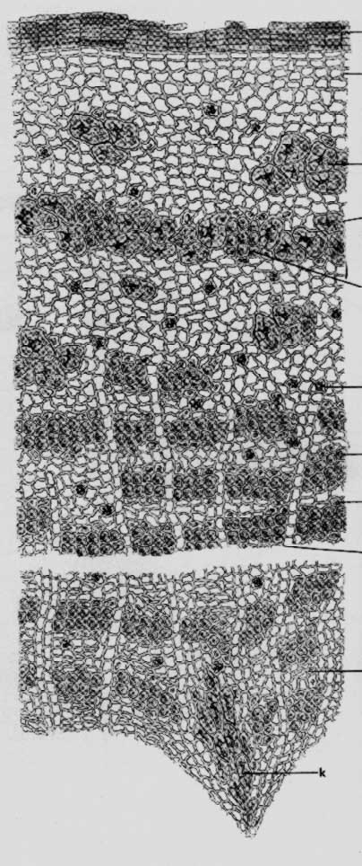
Quercus cortex CzPh 2017
Microscopy:
cork
collenchyma
stone cells
mechanical strip
druses
medullar rays
phloem fibers
reinforcing slat

Slide 14
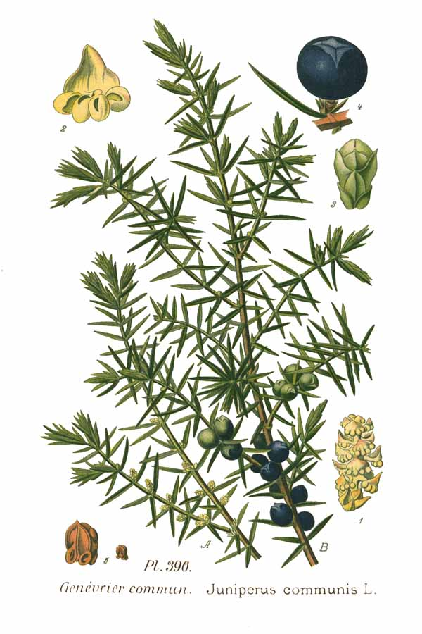
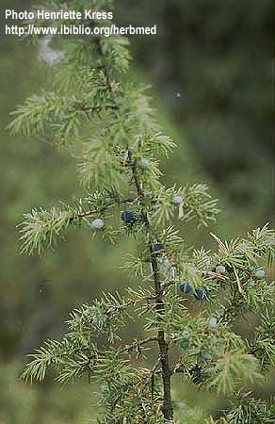
Juniperi lignum
Mother plant: Juniperus communis, Cupressaceae, (Juniper)

Slide 15
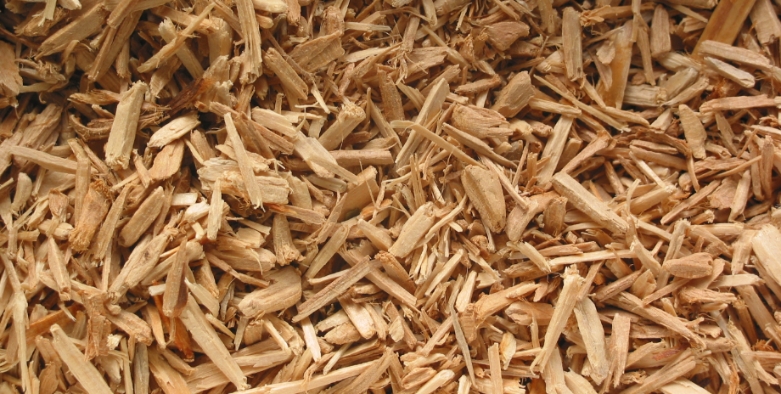
Juniperi lignum
Macroscopy: bright yellow to reddish wood, fibrous, aromatic odour and taste
Content compounds: essential oil (pinene, terpinene), resins
Usage: diuretic, diaphoretic, derivans (irritant)

Slide 16
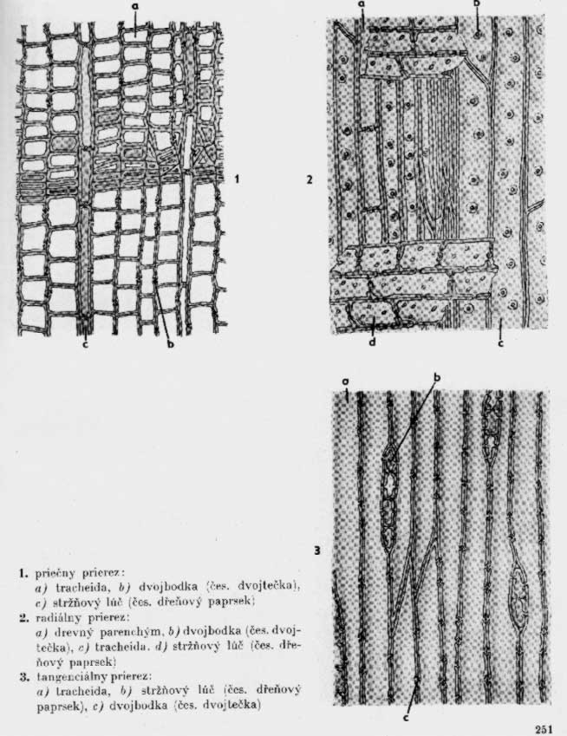
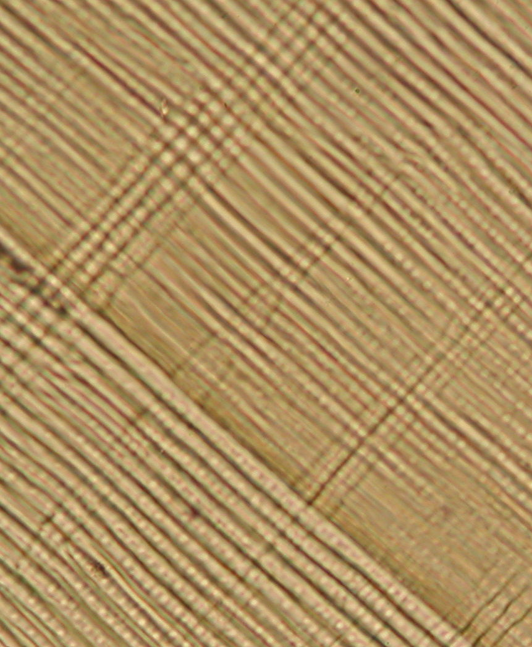
Juniperi lignum
Microscopy: parenchymatic cells (spring and summer wood), vessels with lenticels, vessels, medullar rays
Radial section
vessels
lenticells
medullar rays

Slide 17
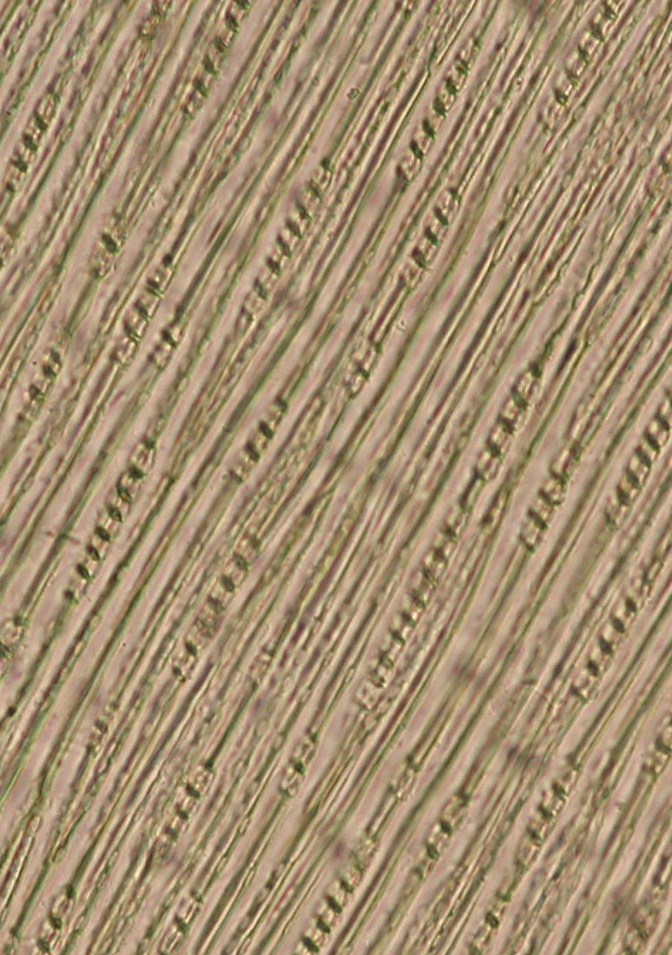
Juniperi lignum
Microscopy:
tangential section
vessels
medullar rays
Notes:
Spindle cells (storage)

Slide 18
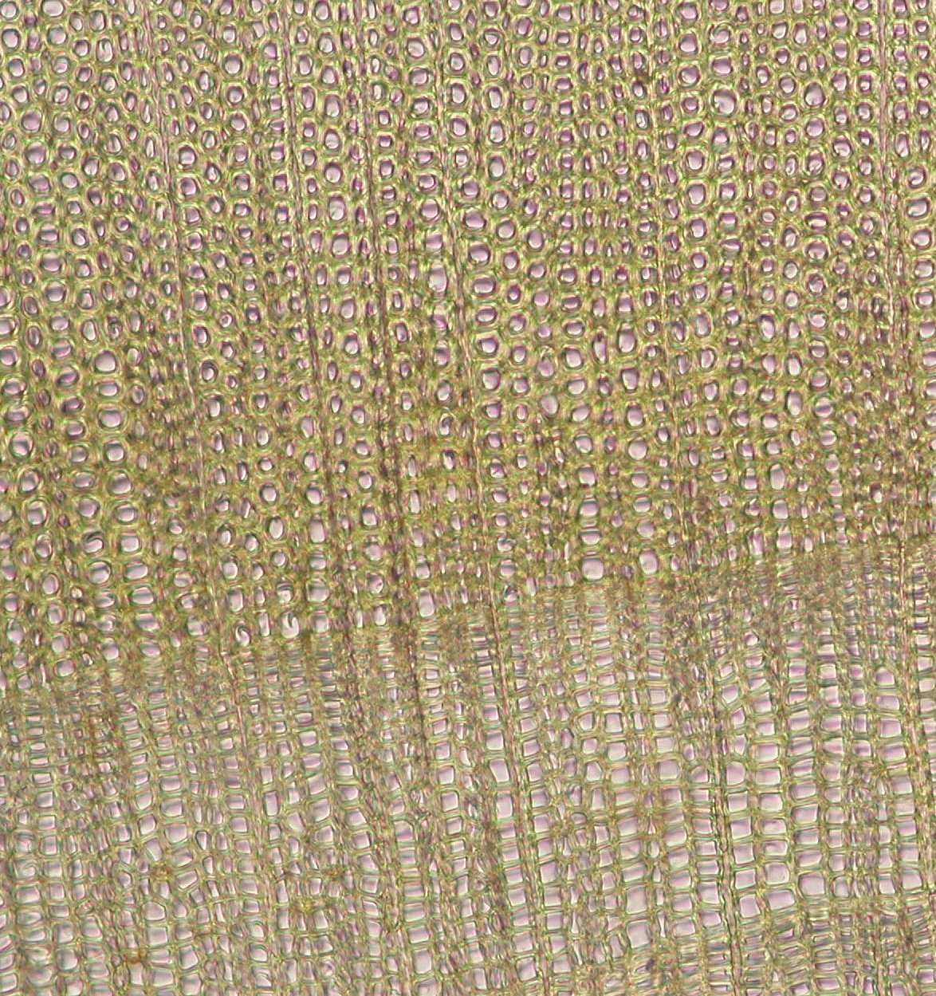
Juniperi lignum
Microscopy:
transversal section
vessels
summer wood
medullar
rays
spring
wood
Notes:
Alternation of summer and spring wood. Spring wood tracheids are bigger and have thinner walls. Tracheids of summer wood have thick walls and serve mechanical function.

Slide 19
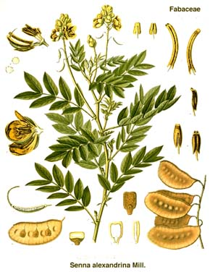
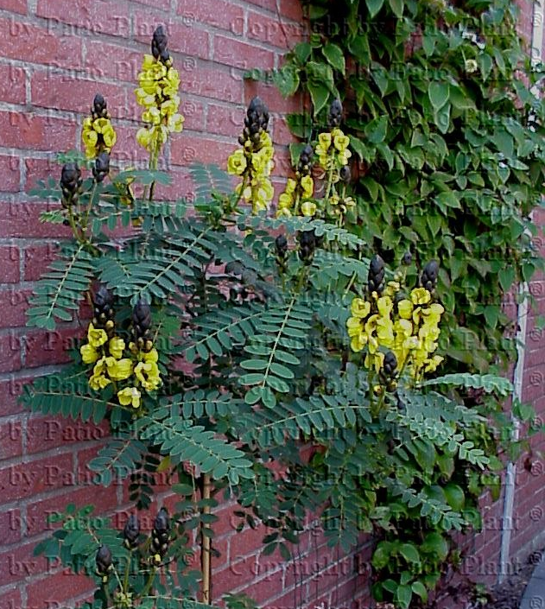
Sennae folium CzPh 2017
Mother plant: Cassia senna syn. C. acutifolia, C. angustifolia, Fabaceae (Caesalpinioideae), (Senna)
Sennae folii extractum siccum normatum CzPh 2017

Slide 20
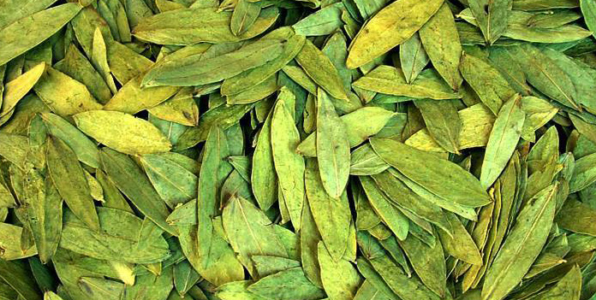
Sennae folium CzPh 2017
Macroscopy: weak odour, taste firstly sweetish, later mucilaginous, bitter
  C. angustifolia – narrow lanceolate leaves, sessile, notched, yellow-green to brown-green
  C. senna – wider, oval, integerrimum , finely pubescent, gray-green to brown green

Slide 21
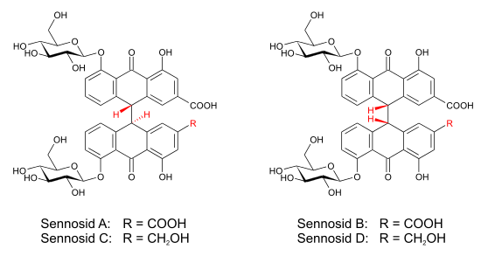
Sennae folium CzPh 2017
Content compounds: dianthrone glycosides, flavonoids, bitter compounds, mucilage, tannins
Usage: laxative
Interactions: risk of hypokalemia, treatment with digoxin, treatment with diuretics
Notes:
warnings: risk patients
How to prepare a macerate: use warm or lukewarm water. When boiling water is used, also other irritants macerate into the tea and this can cause heavy diarrhea with painful cramps, the stool may also contain blood.
The antraquinons act 8-12 hours after drinking the macerate (they need to pass to the large intestine). Advise patients to drink the tea in the evening, so the antraquinons act in the morning.

Slide 22
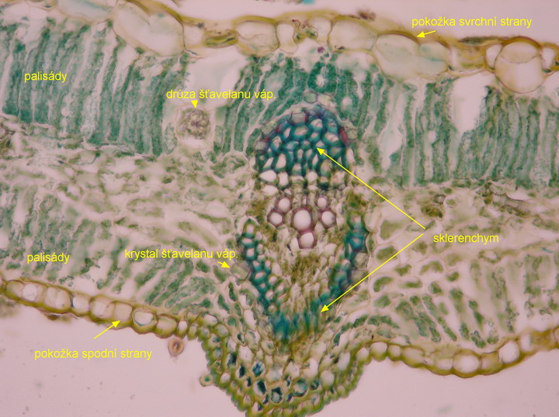
Sennae folium CzPh 2017
Microscopy: typical monofacial leaf with strong cuticle,
layer of epidermal cells, mucilage cells, covering trichomes, stomata, palisade parenchyma, spongeous parenchyma with aggregates of calcium oxalate, vascular bundle main and secondary with sclaerenchymatic cells

Slide 23
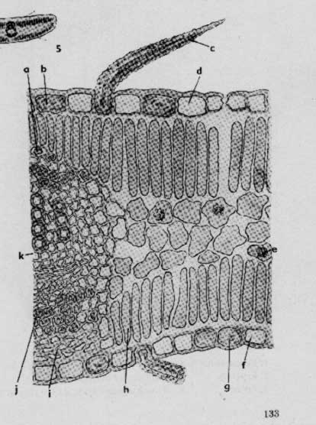
Sennae folium CzPh 2017
Microscopy:
covering trichome
epidermis with cuticle
mucilage cell
palisade
spongeous parenchyma
xylem
phloem
phloem fibers
palisades
epidermis
collateral vascular bundle

Slide 24
MACROSCOPY

Slide 25
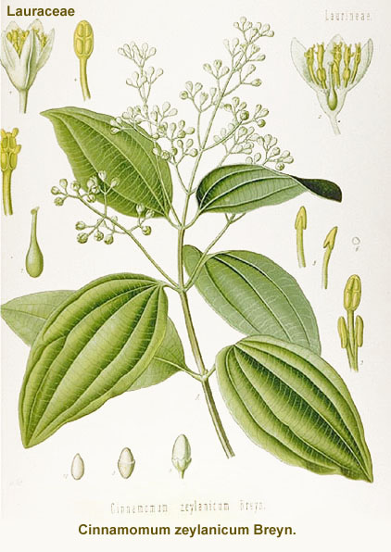
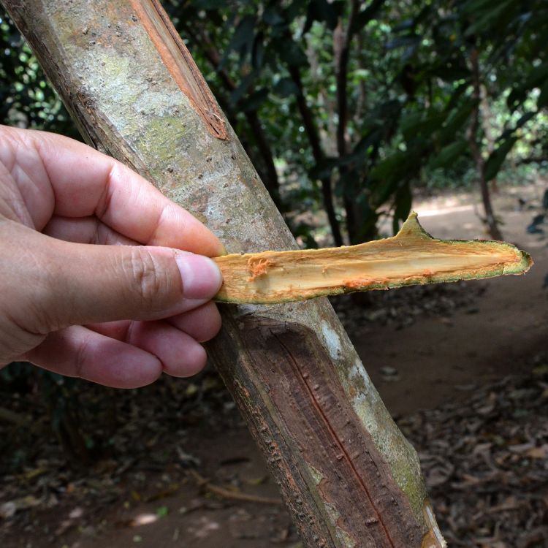
Cinnamomi cortex CzPh 2017
Mother plant: Cinnamomum zeylanicum syn. C. verum, Lauraceae, (Ceylon Cinnamon)
  Cinnamomi zeylanici corticis etheroleum CzPh 2017

Slide 26
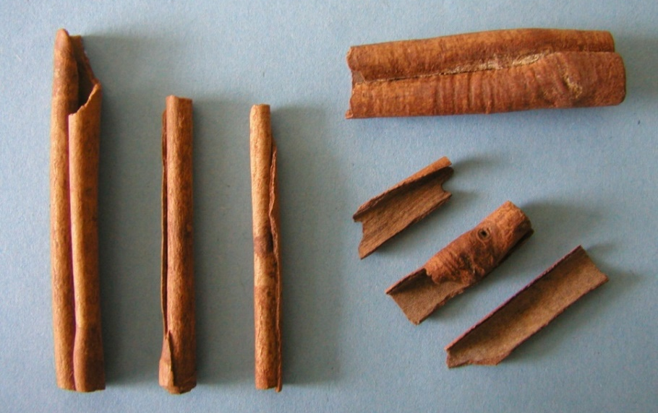
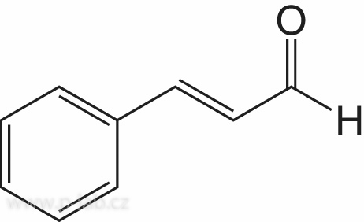
Cinnamomi cortex CzPh 2017
Macroscopy: pieces of cortex tubularly curled, on the surface smooth, finely striated, yellow- brown, inner side more dark, longitudinally wrinkled, characteristic odour, taste warm spicy and sweetish
Content compounds: essential oil (cinnamaldehyde up to 75%, eugenol), condensed tannins, diterpens, mucilage
Usage: stomachic, additive to correct taste and smell
cinnamaldehyde

Slide 27
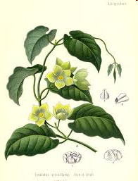
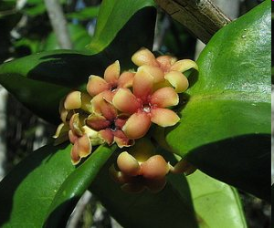
Condurango cortex
Mother plant: Marsdenia condurango Asclepiadaceae, (Condurango)

Slide 28
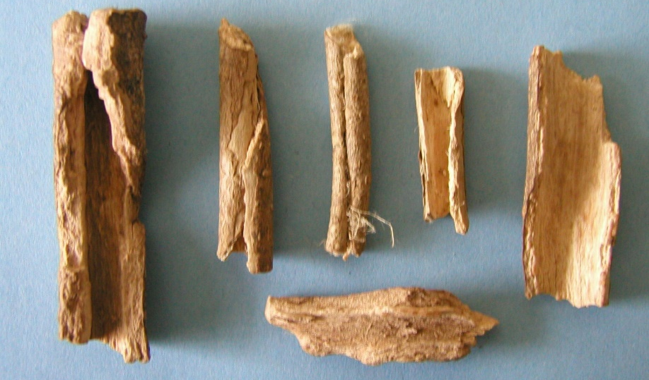
Condurango cortex
Macroscopy: tubularly curled bark, gray peridermis, inner side gray-brown, weakly bitter taste, a bit irritant, balsamic odour
Content compounds: bitter substances - condurango glycosides – ester glycosides of pregnane type (steroid)
Usage: amare, stomachic, appetite stimulant tonic

Slide 29
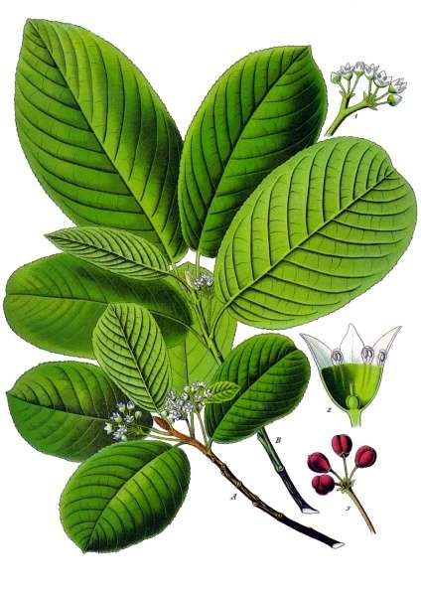
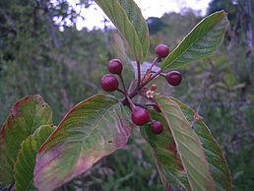
Rhammi purshianae cortex CzPh 2017
Mother plant: Rhamnus purshianus syn. Frangula purshiana, Rhammnaceae, (Cascara sagrada)
Rhamni purshianae extractum siccum normatum CzPh 2017

Slide 30
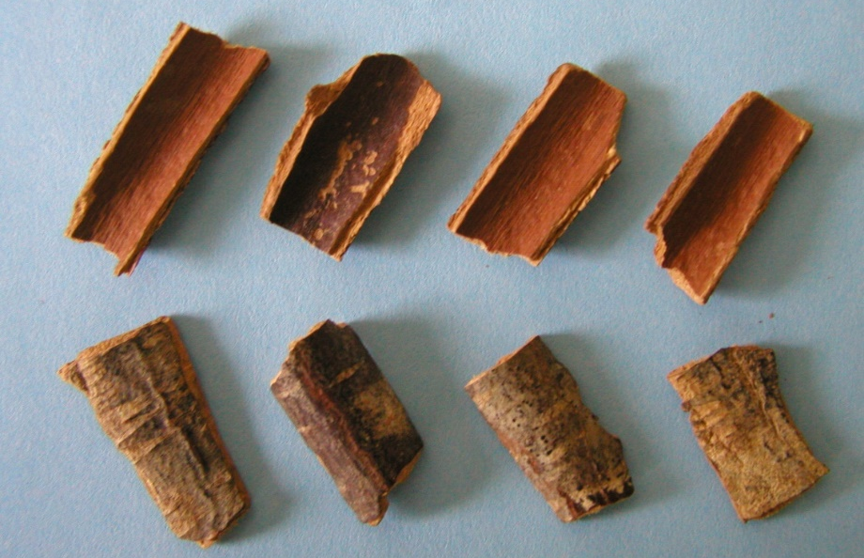
Rhammi purshianae cortex CzPh 2017
Macroscopy: pieces of bark, on the surface grey, often covered with mosses or lichens, inner side yellow-brown, without significant odour, bitter taste, irritating to vomit
Content compounds: hydroxyanthraquinone derivatives (cascarosides), flavonoids, bitter substances
Usage: laxative, mild cholagogue and choleretic
Notes:
Mechanismus účinku: stimulace motility, ovlivnění absorpce vody z lumen střeva a stimulace sekrece do lumen tračníku. Upozornění:způsob zpracování (dráždivé formy), režimová opatření,rizikové skupiny pacientů,nástup účinku

Slide 31
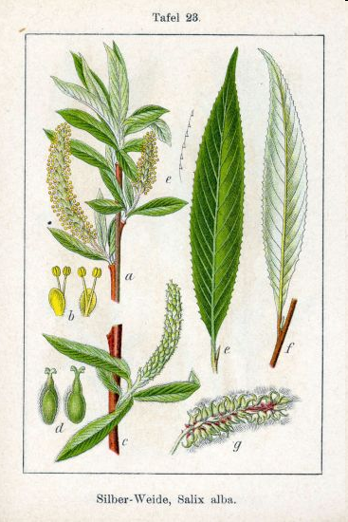
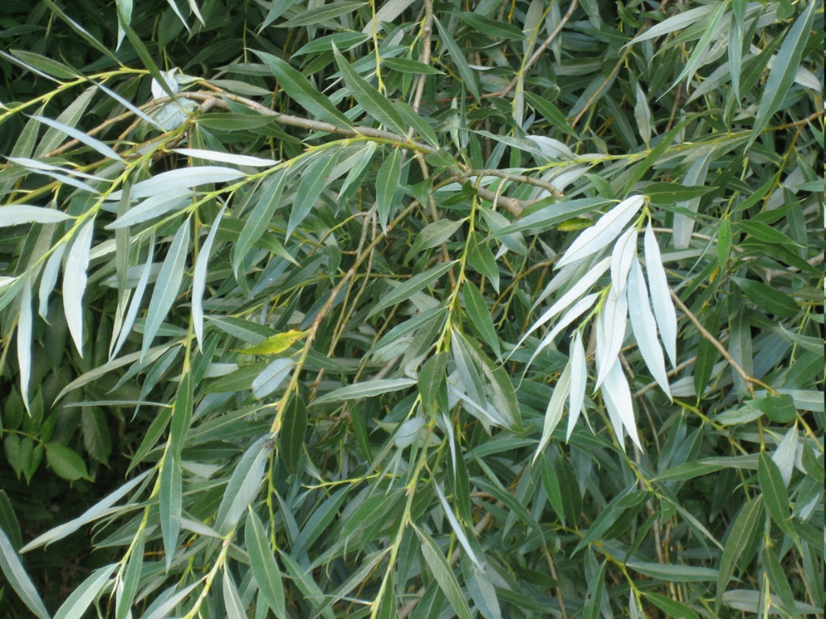
Salicis cortex CzPh 2017
Mother plant: Salix alba, Salicaceae, also other species of genus Salix, (Willow)
Salicis corticis extractum siccum CzPh 2017

Slide 32
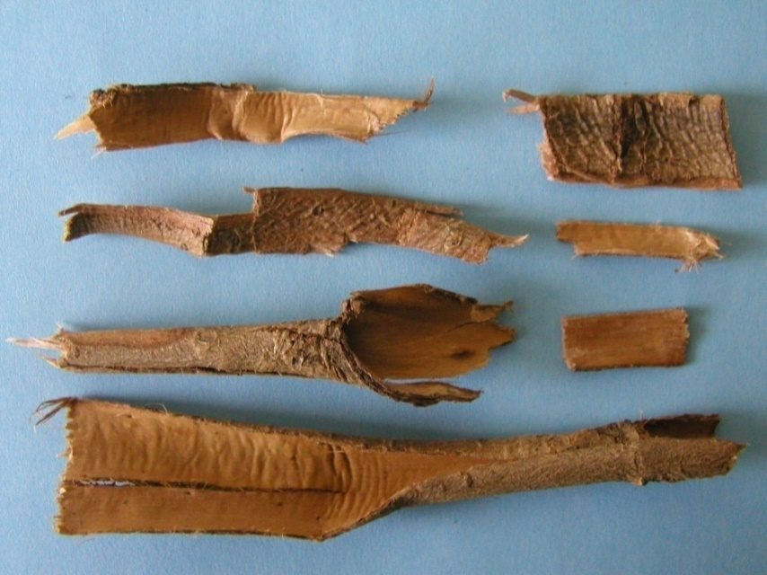
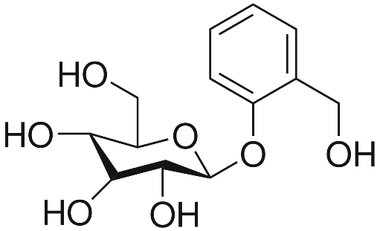
Salicis cortex CzPh 2017
Macroscopy: bark tubularly curled, elastic, surface smooth, shiny, without odour, bitter taste
Content compounds: phenolic glycosides (salicin up to 10%, fragiline, populine), flavonoids, tannins,
Usage: antipyretic, analgesic, antirheumatic, antiphlogistic
salicin

Slide 33
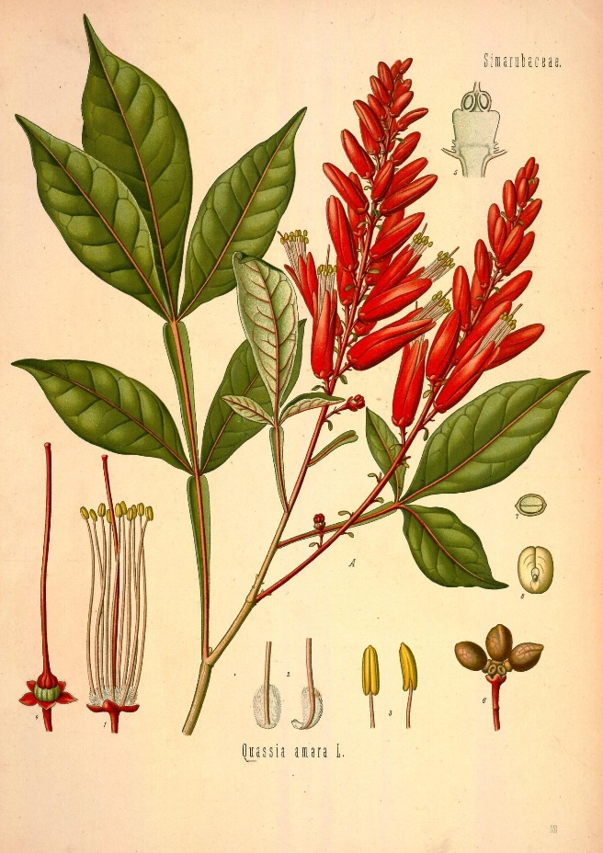
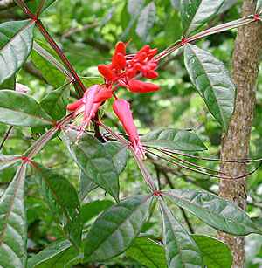
Quassiae lignum
Mother plant: Quassia amara, Simaroubaceae – Quassiae amarae lignum (Surinam quassia)
Picrasma excelsa, Simaroubaceae – Quassiae jamaycensae lignum (Jamaican quassia)

Slide 34

Quassiae lignum
Macroscopy: whitish or yellowish wood, light and soft, easy to cut, no annual rings, without odour, bitter taste
Content compounds: quassinoids (non-glycosidic bitter C20 or C25 compounds)
Usage: bitter aperitif, tonic, insecticides, antimalarial

Slide 35


Bucco folium
Mother plant: Barosma spp., Rutaceae, (Buchu)

Slide 36


Bucco folium
Macroscopy: leather-like, tough leaves, yellow-green colour, yellow-green colour, serrated, glandulary pointed, aromatic odour and taste
Folium bucco rotunda
B. betulina – oval leaves
Folium bucco longa
B. serratifolia – elipsoid longer leaves
A. Moolla, A.M. Viljoen / Journal of Ethnopharmacology 119 (2008) 413–419

Slide 37

Bucco folium
Content compounds: essential oil (diosfenol), flavonoids (diosmin)
Usage: urinary desinficient, diuretic
diosfenol

Slide 38


Juglandis folium
Mother plant: Juglans regia, Juglandaceae, (Walnut tree)

Slide 39


Juglandis folium
Macroscopy: leather-like, dark green, shiny, without stalk, integerrimus, pleasant odour, bitter and astringent taste
Content compounds:
gallo-tannins,, naphtoquinones (juglone), volatiles
Usage: astringent, haemostatic, externally to treat frostbite
juglone
Notes:
Brown pigment soluble in water is in roots, leaves and peel of walnuts. This pigment dyes skin to brown colour. Juglone is toxic to other plants (some plants are immune to it). It is detectable 8 m deep under the trunk of a walnut tree, or 27 meters away from it. Juglone has also fungicidal and antibiotic properties.

Slide 40


Myrtilli folium
Mother plant: Vaccinium myrtillus, Ericaceae (Vaccinioideae), (Blueberry)

Slide 41

Myrtilli folium
Macroscopy: egg-like leaves with serrated margin, non-shiny, bright green, without odour, astringent taste
Content compounds: catechin tannins, flavonoids, glucokinins, organic acids, trace amounts of phenolic glycosides
Usage: astringent, antiseptic, antidiabetic, diuretic
catechin

Slide 42


Lauri folium
Mother plant: Laurus nobilis, Lauraceae, (Laurel)

Slide 43


Lauri folium
Macroscopy: elongated, lanceolate, shiny, leather-like leaves, wavy margin, spicy odour, spicy bitterish taste
Content compounds:
essential oil (cineol), tannins, isoquinoline alkaloids
Usage: digestif, aromatic, spice
cineol

Slide 44


Vitis ideaei folium
Mother plant: Vaccinium vitis ideae, Vacciniaceae (bearberry)

Slide 45


Vitis ideaei folium
Macroscopy: leather-like leaves, opposite oval, integerrimus, on the face darker, without odour, bitter astringent taste
Content compounds: phenolic glycosides (arbutin), condensed tannins, flavonoids
Usage: astringent, urinary desinficient
arbutin

Slide 46


Olivae folium
Mother plant: Olea europea, Oleaceae, (Olive tree)

Slide 47


Olivae folium
Macroscopy: leather-like leaves, opposite, subsessile, entire, coriaceous, grayish-green upper side, whitish underside, bitter taste
Content compounds:
secoiridoides (oleuropein),
triterpenes, flavonoids
Usage: hypoglycemic, hypotensive, diuretic
oleuropein

