Slide 1
Persuasion in our society

Slide 2
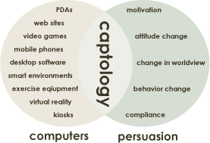
CAPTOLOGY
Captology is the study of computers as persuasive technologies.
CAPT (Computers as persuasive technologies)
Design, research, and program analysis of interactive computing products (web, mobile phones, other interactive devices) for the purpose of changing people’s attitudes and behavior

Slide 3
Current Captology projects
Persuasive online video
(Youtube – political campaign, advertising)
Psychology of Facebook
(how influence takes place inside a social network)
Peace Innovation & Technology
(Stanford researchers believe that, with the new digital tools, world peace is possible in 30 years)
Web Credibility Studies
(How to increase the credibility of your web presentation)

Slide 4
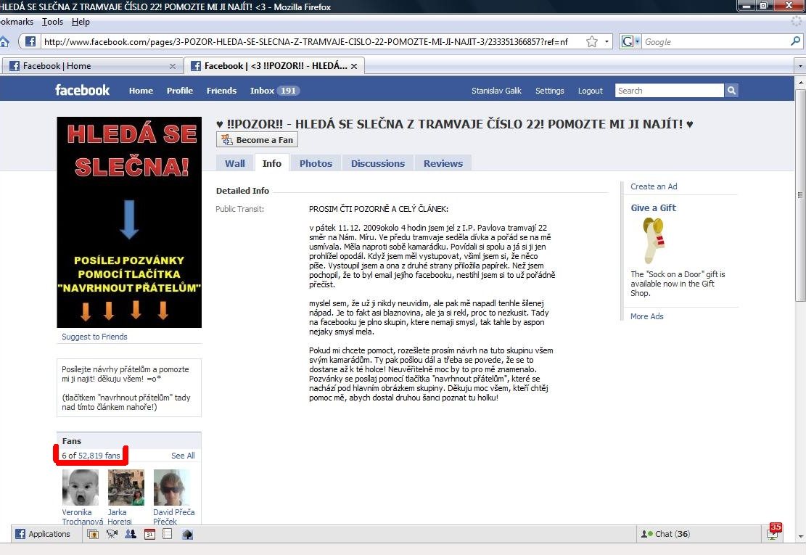

Slide 5
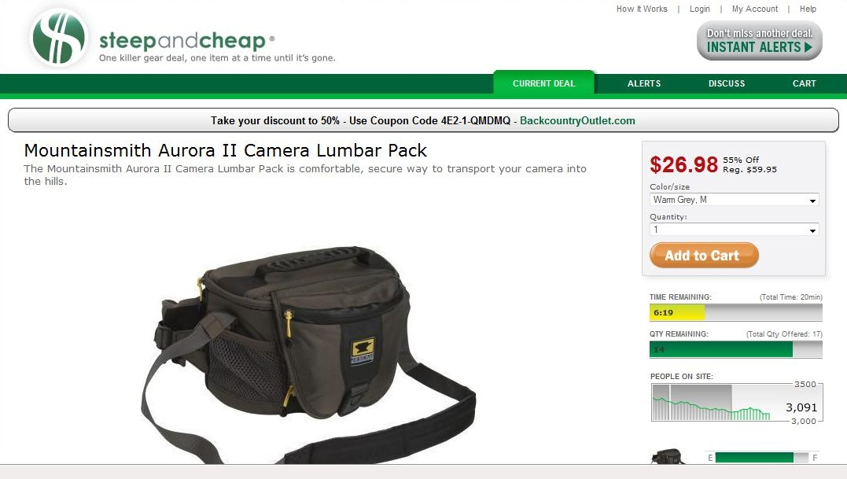
“Alarm clocking”
Watch this for better understanding: http://www.youtube.com/watch?v=SaKyjKvembQ&eurl=http%3A%2F%2Fwww.captology.tv%2F&feature=player_embedded

Slide 6
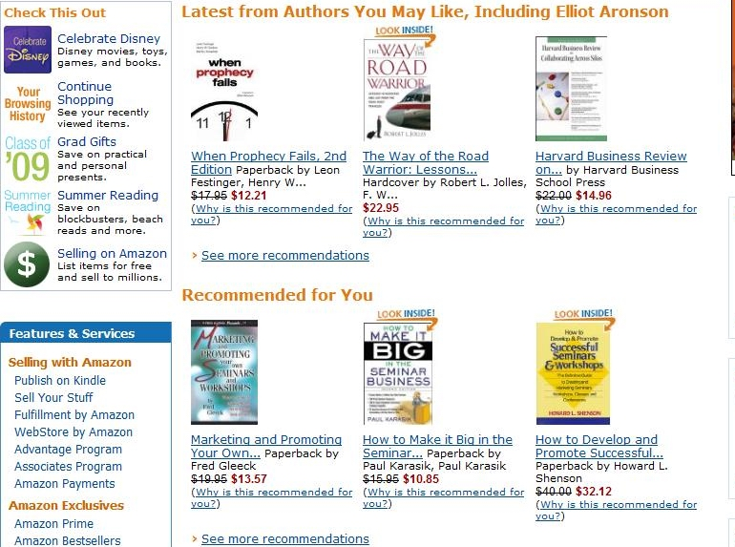
Captology

Slide 7
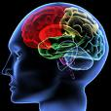

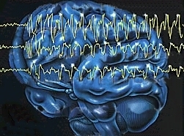
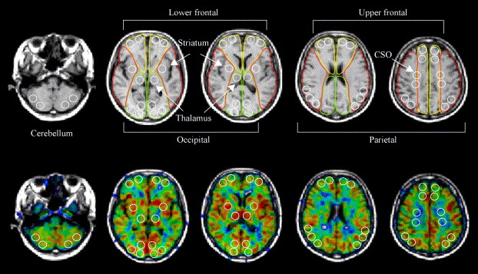
NEUROMARKETING
Neuroscience + Marketing = Neuromarketing
Study of consumer’s sensorimotor, cognitive, and affective responses to marketing stimuli by the means of brainscanning
  fMRI
  EEG

Slide 8

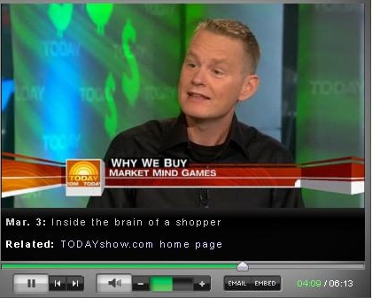
Neuromarketing
How do we react to in-store signs and promotions?
http://www.neurosciencemarketing.com/blog/articles/stores-shopping-cart.htm#more-431

Slide 9
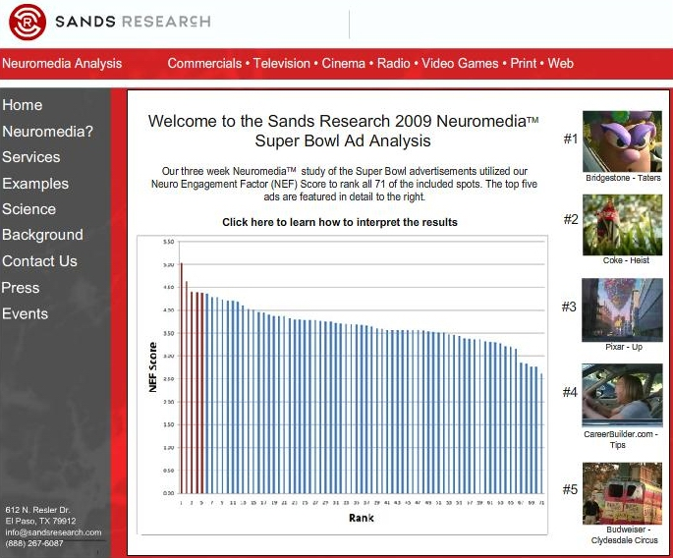
Neuromarketing research on Super Bowl Ads
Notes:
EEG and questionnaires

Slide 10


Pepsi vs. Coca Cola
Montague, 2003
Blind taste tests of Pepsi and Coke
  Results – neutral activity, both Pepsi and Coke had approximately 50% of preferences
Subjects were told the brand
  Results – 75% preferred Coke. WHAT’S MORE, Coke activated medial prefrontal cortex - a part of the brain that controls higher thinking.
  Possible explanation is that the brain was recalling images and ideas from commercials, and the brand was overriding the actual quality of the product.

Slide 11
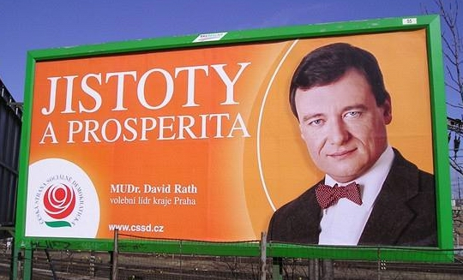
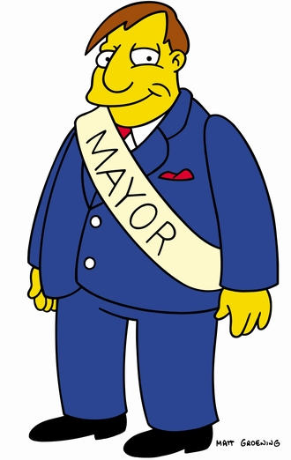
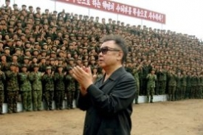
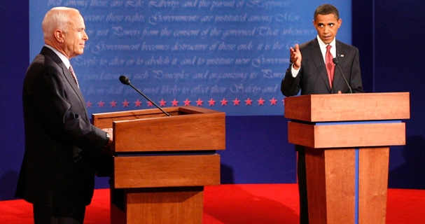
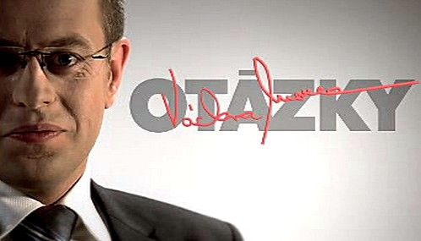
Political communication and persuasion
Political communication and persuasion is HIGHLY context dependent

Slide 12
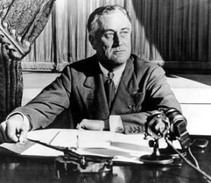
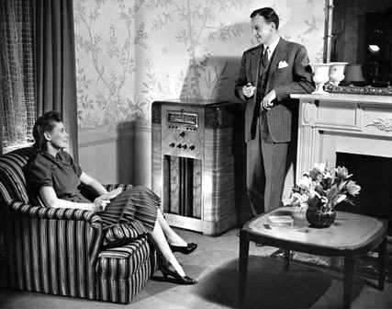
Technology and political communication
Franklin D. Roosevelt and his Fireside chats (1933 - 1944)

Slide 13
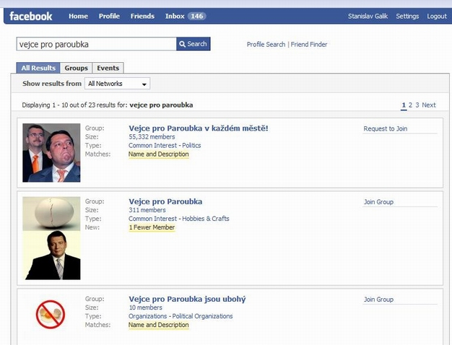
Technology and political communication

Slide 14
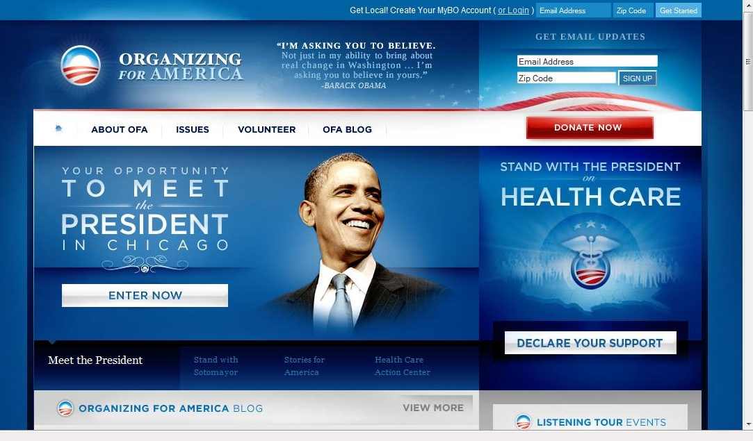
Technology and political communication

Slide 15
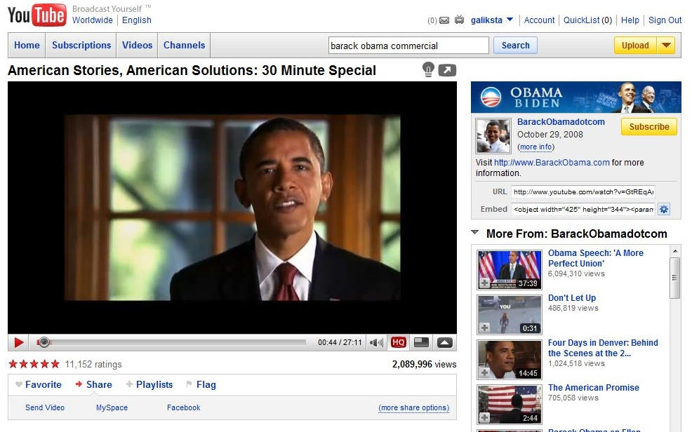
Technology and political communication

Slide 16
Political communication
Styles and strategies
Incumbency Style
  Symbolic Trapping of the Office
  (legitimacy, competency, charisma of the office)
  Creating pseudoevents to attract and control media attention
  Consulting or negotiating with world leaders
  Manipulating the economy or other important domestic issues
  Endorsements by party and other important leaders
DISADVANTAGES of Running as Incumbent:
Run on own record
Public may blame them for all problems
Besides campaigning they have to do the job they’ve been elected for
There are much bigger expectations from them than from opponents

Slide 17
Political communication
Styles and strategies
  Challenger style:
    Attacking the record of opponents
    Taking the offensive position on issues
    Calling for a change
    Emphasizing optimism for the future
    Speaking to traditional values rather than calling for value changes
Notes:
Taking the offensive position on issues Probing, questioning, challenging, attacking but never presenting concrete solutions for problems. It is the incumbent who has to defend. Challengers are not expected to solve the problem; they just have to say that they have got a plan.
Goldwater and McGovern did not understand the essential nature of the strategy and thus they lost. As they proposed specific proposals with details, they were subjected to intensive analysis, debated, refuted by opponents and media, and finally rejected as absurd.

Slide 18
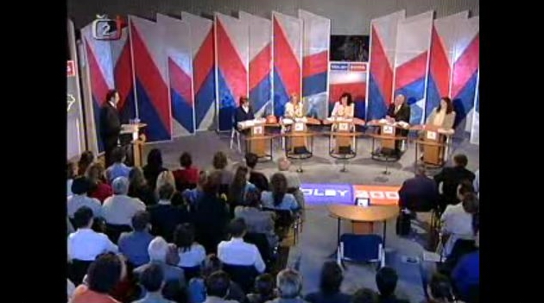
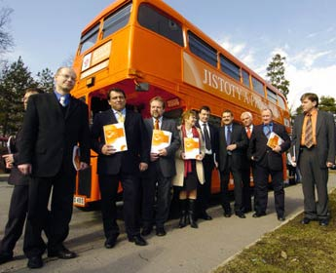

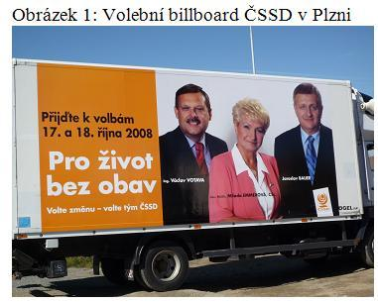
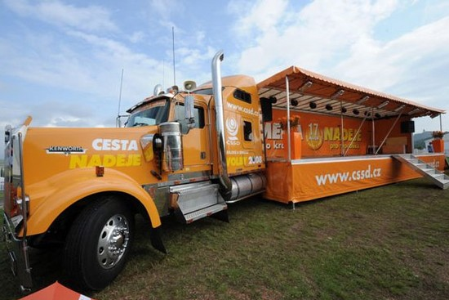
Importance of political advertising
Your campaign has to be seen!!!

Slide 19
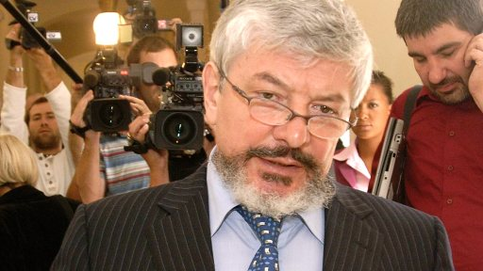

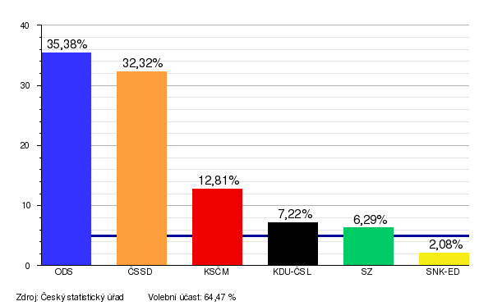
Importance of political advertising
Political parties participating in OVM
ODS
ČSSD
KSČM
KDU-ČSL
SZ

Slide 20
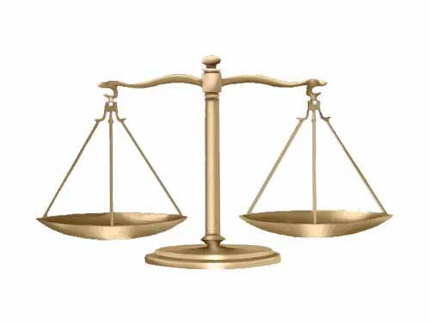
What is a political campaign about?
Political campaign is mostly about mobilizing your usual voters and gaining undecided voters

