Slide 1
PRESVEDČOVANIE

Slide 2
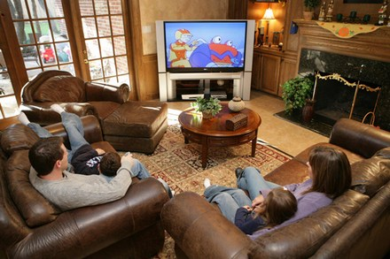
TV

Slide 3
Notes:
By understanding the real needs of their target segment (having less time washing the clothes by hands and desire for product that is gentle to clothes even in the washing machine) by the means of this campaign Woolite increased the sales by 300% and became the market leader and put Perwoll in the second place!

Slide 4
Notes:
Calls on Avon antibreastcancer line increased by 50%. More than 400% increase in preventive visits of their doctor (comparing 4 months before and 4m after the campaign)

Slide 5
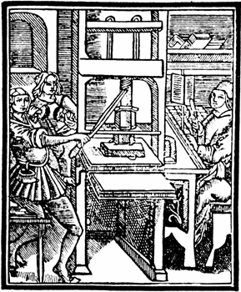
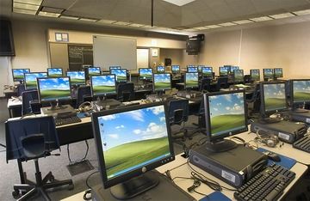
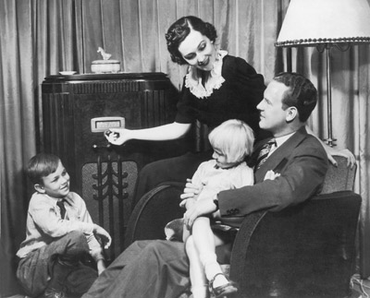
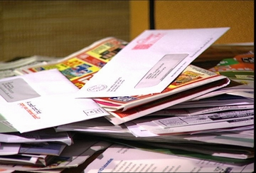
Masové média priniesli presvedčovanie do nových dimenzií
Notes:
Gutenberg printing press – 15th century
Mass newspapers and magazines in the late 19th century
Radio – 1930s
Television – 1950s
Directmail marketing and telemarketing in 1980s
WWW 1990s
We went from ancient persuasion based solely on interpersonal communication to persuasion where media are necessities.

Slide 6
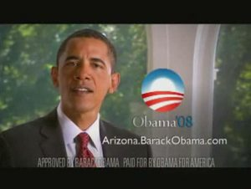
Notes:
With 6% of the world’s population, the USA consumes 57% of the world’s advertising. The money spent on advertising and product promotions corresponds to 2.2% of the US gross national product. (0.95% Japan, 0.9% Germany). That is more than $1000 per year per American.

Slide 7
Notes:
telemarketing

Slide 8
Notes:
religion

Slide 9
Notes:
At court

Slide 10
Notes:
In the family

Slide 11
Notes:
In the relationship

Slide 12
Notes:
The art of begging

Slide 14
Notes:
Physically more attractive people get better paid jobs

Slide 15
PRESVEDČIVÍ VYHRÁVAJÚ

