Slide 1
Elaboration Likelihood Model
(Petty, Cacioppo, 1986)

Slide 2
Elaboration Likelihood Model
  Elaboration – miera toho, ako veľmi človek premýšľa o argumentoch obsiahnutých v komunikácii
  Likelihood – pravdepodobnosť
Model nám hovorí, za akých podmienok je pravdepodobné, že človek bude alebo nebude o argumentoch hlbšie premýšľať
Low elaboration
High elaboration

Slide 3
Elaboration Likelihood Model
Dva spôsoby spracovávania informácií z persuazívnej komunikácie
  CENTRAL ROUTE - osoba dôkladne zvažuje argumenty, premýšľa nad dopadom prezentovaných myšlienok a porovnáva tvrdenia so svojimi vlastnými vedomosťami a hodnotami.
  PERIPHERAL ROUTE - osoba zvažuje obsah správy rýchlo a nerozvážne. Zameriava sa na jednoduché vodítka.

Slide 4
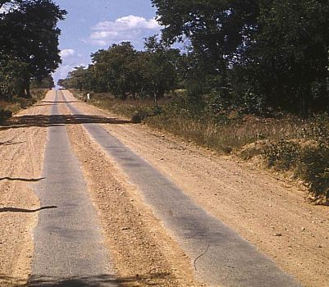
Evaluácia argumentov
⇨ mysliteľ
Heuristiky
(physical appeal, speaking style, music, etc)
⇨ cognitive miser

Slide 5
CENTRAL ROUTE
The central route involves message elaboration, defined as the extent to which a person carefully thinks about issue-relevant arguments contained in a persuasive communication

Slide 6
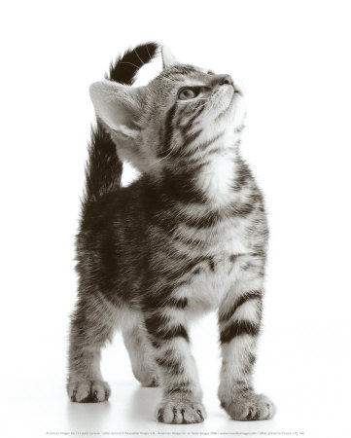

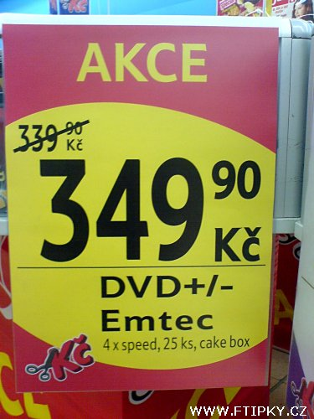




PERIPHERAL ROUTE

Slide 7
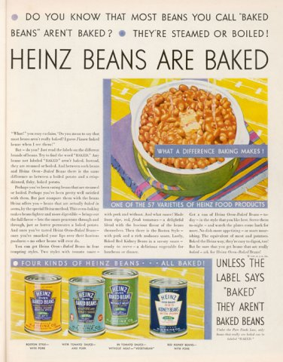
High elaboration (central route)

Slide 8

Low elaboration (peripheral route)

Slide 9
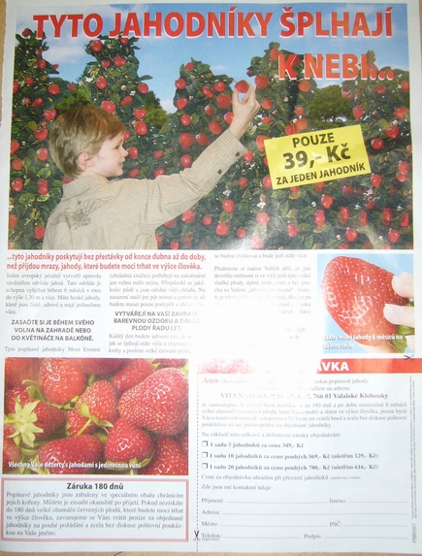
High elaboration (central route)

Slide 10

Low elaboration (peripheral route)

Slide 11

Ktorá cesta bude využitá?
Central route
Peripheral route
MOTIVÁCIA & SCHOPNOSŤ

Slide 12
Motivácia
Zainteresovanosť (involvement)
    Personally relevant issues are more likely to be processed on the central route; issues with little relevance take the peripheral route
    (High I – Central, Low I - Peripheral)
Need for cognition
    Personality characteristic – a need to understand the world and to employ thinking to accomplish this goal
    Certain individuals have a need for cognitive clarity, regardless of the issue; these people will work through many of the ideas and arguments they hear.

Slide 13
Involvement
People given the same information can process it differently.
  When personal relevance was high, people evaluated the merits of the presented information.
  When personal relevance was low, people counted the number of arguments presented and made a simple inference: “more is better”
“Comprehensive final exam” experiment
Personally relevant issue
Personally irrelevant issue
Variables:
Speaker’s expertise
Arguments strength
vs.

Slide 14
When you are highly involved you are likely NOT to care what source you have
Favorable attitude
Expert source
0.4
0
- 0.4
Non-expert source
Unfavorable attitude
Low involvement
High involvement
Favorable attitude
0.4
Strong arguments
0
Weak arguments
- 0.4
Unfavorable attitude
Low involvement
High involvement
When you are highly involved you care about the arguments

Slide 15
ABILITY
Distractions (disrupt elaboration)
Knowledge

Slide 16

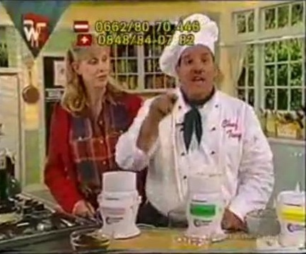
Peripheral route
Kredibilita
Celebrity endorsers
Krátkodobá postojová zmena

Slide 17
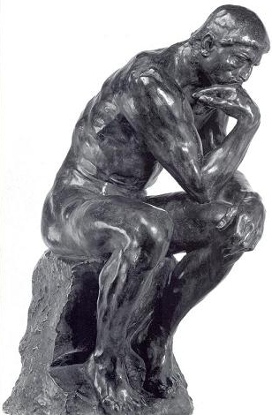
Elaboration continuum
Low personal relevance……………………………High personal relevance
High distraction……………………………….…………...…..Low distraction
Low accountability……………………………….……….High accountability
Low repetition………………………………………..………….High repetition
Low knowledge………………………………….……………..High knowledge
Low need for cognition……………………..………High need for cognition

Slide 18
Dôsledky
Stabilita postoja
Rezistencia
Konzistencia medzi postojom a správaním
Central route to persuasion | Peripheral route to persuasion
Dlhodobé | Krátkodobé
Ťažké zmeniť | Ľahké zmeniť
Vyššia konzistencia | Nižšia konzistencia

Slide 19
Praktické aplikácie
If listeners are motivated and able to elaborate a message, you should rely on factual arguments
If listeners are unable or unwilling to elaborate a message, you should rely on packaging rather than content
WHAT ARE FUTURE TRENDS???

Slide 20
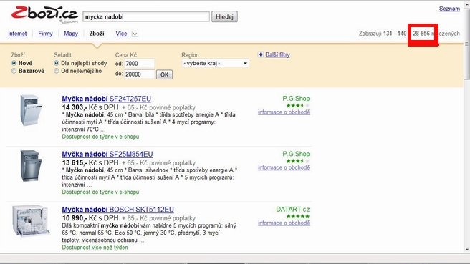

Future trends
Väčšie zameranie na periférne cesty
Zameranie na emócie
Rola kredibility, mentálnych skratiek ....

Slide 21
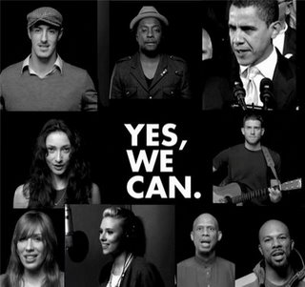
Celebrity endorsers + arguments
http://www.youtube.com/watch?v=jjXyqcx-mYY&feature=PlayList&p=D94F4A0FBC23F0F5&index=0&playnext=1
http://www.youtube.com/watch?v=ghSJsEVf0pU&feature=related

Slide 22
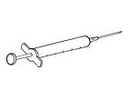


Inoculation theory (McGuire, 1961)
Rezistencia voči persuázii sa zvýši, keď je jedinec exponovaný malému množstvu protiargumentov, ktoré sú však oslabené ich bezprostredným znehodnotením

Slide 23
Inoculation theory
Forewarning
  Individuals generate a large number of counterarguments, strengthening their opposition to the advocated position

Slide 24
One-sided or two-sided arguments?
Two-sided is better…
…but never use it when you are not able to refuse it!

