Slide 1
Persuasion
The Art & The Science

Slide 2
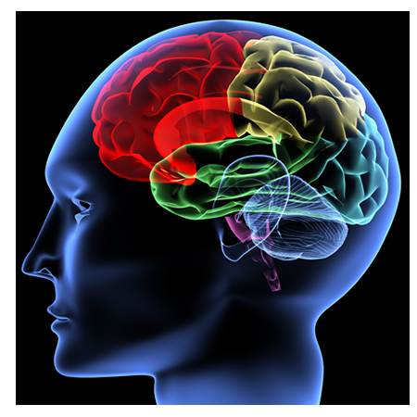
Persuasion

Slide 3

What does persuasion mean to you?
Can you think of times when the media or attractive communicator changed your mind about something?

Slide 4

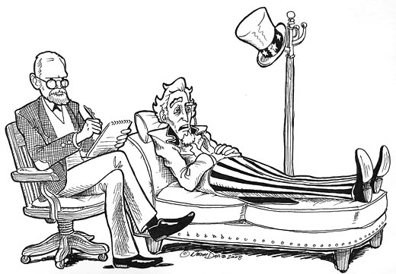


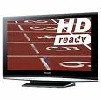
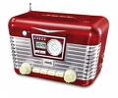



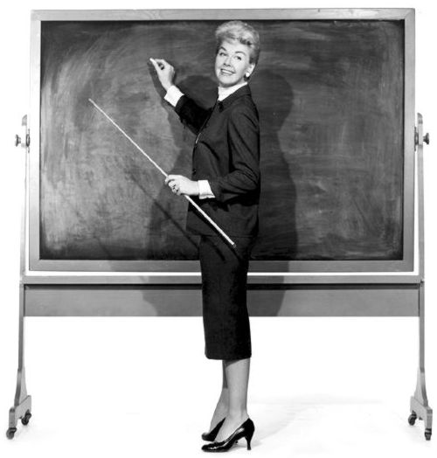

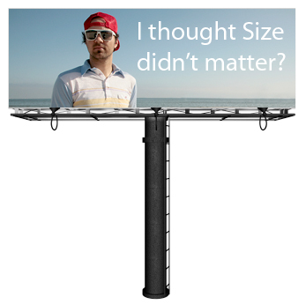

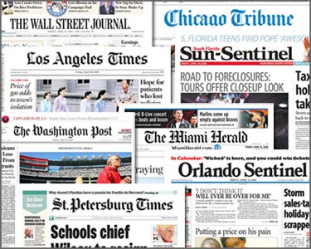
Persuasion is everywhere!

Slide 5
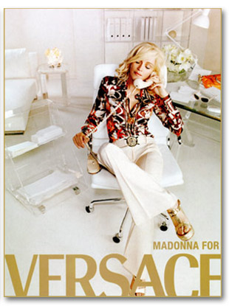
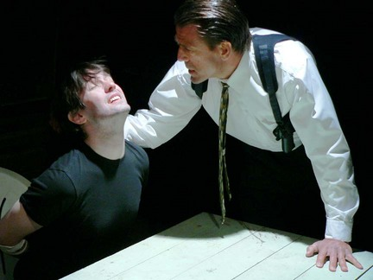
What is persuasion?
PERSUASION vs. COERCION

Slide 6


Persuasion
Persuasion: a symbolic process in which communicators try to convince other people to change their attitudes or behavior regarding an issue through transmission of a message, in an atmosphere of free choice.
(Perloff, 2008)

Slide 7
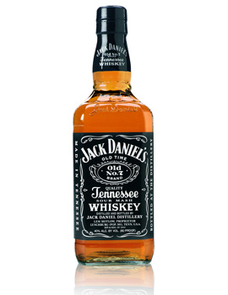
Persuasion definition summary
Persuasion is a symbolic process
Persuasion involves an attempt to influence
People persuade themselves
Persuasion involves the transmission of a message
Persuasion requires free choice

Slide 8

Coercion
Coercion: a technique for forcing people to act as the coercer wants them to act, and presumably contrary to their own preferences. It typically employs a threat of some horrible consequence if the person does not do what the coercer demands.
(Perloff, 2008)

Slide 9
Persuasion vs. Coercion
Persuasion:
Advertising
Loved one’s antidrug appeal
Health public service messages
Political campaigns
Sales and telemarketing
Friend’s attempt to influence another’s opinion of something
Coercion:
Threatening messages
Employer’s directives
Interrogation
Ban of smoking
Enforcement of seat belt laws
Communication in dangerously abusive relationship
Coercion and persuasion are not polar opposites. They are better viewed as lying along a continuum of social influence. They are overlapping concepts.
persuasion
coercion
Nature of psychological threat
Ability to do otherwise
Perception of free choice

Slide 10
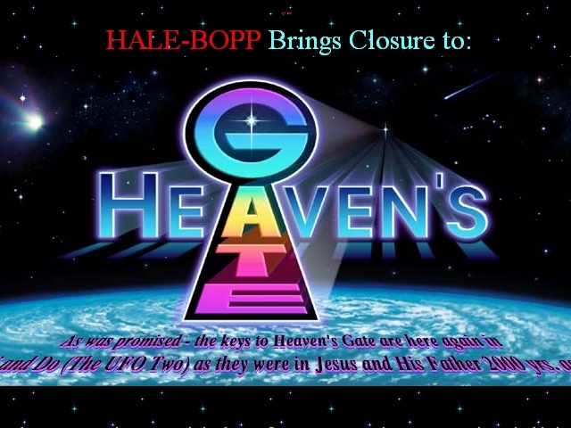
Persuasion – Coercion Continuum
persuasion
coercion
Nature of psychological threat
Ability to do otherwise
Perception of free choice
http://www.heavensgate.com/

Slide 11
Persuasive communication effects
Attitude SHAPING
  stimulating favorable impressions
    Unknown political candidates; new brand; new company; first date, etc.
Attitude REINFORCING
  making impressions more salient
    Political campaigns; reinforcing the image of the brand, etc.
Attitude CHANGING
  Change of “direction”
    Antismoking campaign, African-American Civil Rights Movement, etc.

Slide 12


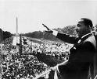
Historical perspective
“Those who don’t study history are doomed to repeat it."

Slide 13
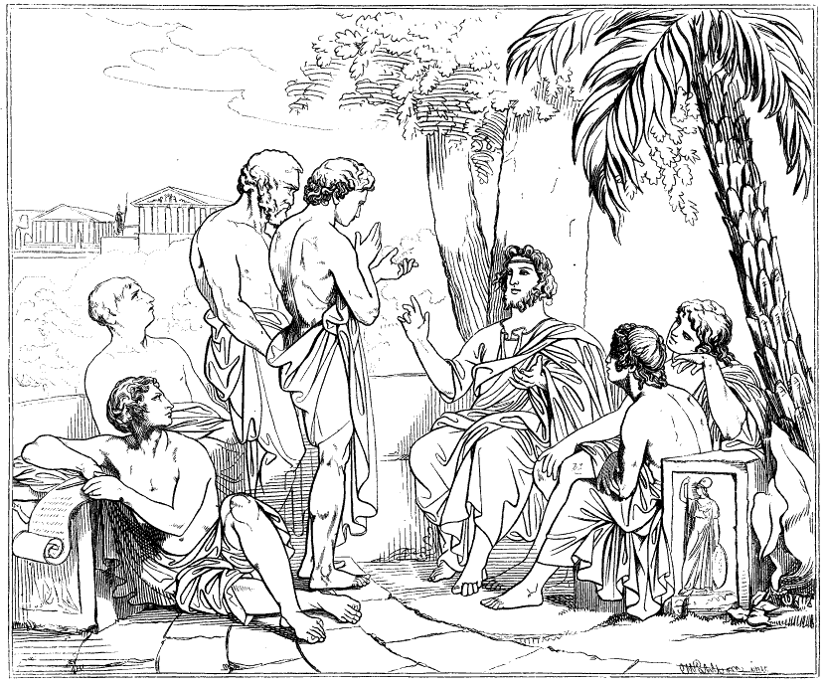
Sophists

Slide 14

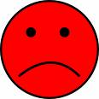

Plato

Slide 15
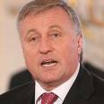

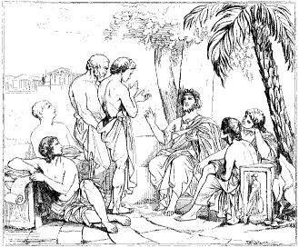

Plato vs. Sophists

Slide 16

Aristotle – The First Scientist
Argued that both had a point:
Plato - the truth is important.
Sophists - persuasive communication is a useful and important tool.
Ethos = the nature of communicator
Pathos = emotional state of audience
Logos = message arguments

Slide 17
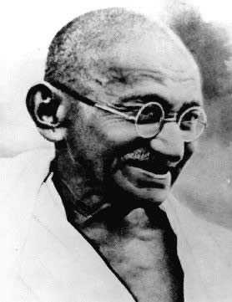


Persuasion in the Modern World

Slide 18
Ethics
WRITE DOWN:
What are the factors of ethical persuasion?
Write down three examples of ethical persuasive communication and unethical persuasive communication.

Slide 19


Ethics
Gandhi
Machiavelli
“evil means produce evil ends”
“the ends justify the means”
Kant – “treat other as ends, not as means“
Utilitarianism – actions should be judged based on whether they produce more good than evil.

Slide 20
Ethics
Persuasion is profoundly civilizing influence. Of course, persuasion is not always nice. It can be mean, ugly and untruthful.
BUT WE ARE RESPONSIBLE FOR DECISIONS WE MAKE!
EDUCATION

Slide 21
Attitude measurement tools
Likert scale
Semantic differential
Error choice technique

Slide 22
Likert Scale
An one-dimensional scale that consists of attitude-related statements and asks individuals to indicate their agreement/disagreement with each statement along a numerical scale
Stan is the best teacher in the world.
Strongly agree
Somewhat agree
Neutral
Somewhat disagree
Somewhat disagree

Slide 23
How to create the Likert scale?
Generate more questions than you need
Get a group of people to score the questionnaire
Sum the scores for all items
Calculate the intercorrelations between all pairs of items
Reject questions that have a low correlation with the overall score
For each item, calculate the t-value. Reject questions with lower t-values (higher t-values show questions with higher discrimination).

Slide 24
Semantic differential
Osgood, Suci, Tannenbaum (1957)
Respondents rate the attitude object on a number of (typically) 7-point bipolar scales that are end-anchored by evaluative adjective pairs
(connotative meaning of words (freedom, marriage); ideas (capitalism); products (cell phones); brands (Volvo); etc…)
Barack Obama
good
bad
honest
dishonest
harmful
beneficial
kind
cruel

Slide 25
Error-choice technique (Hammond, 1948)
Attitudes can be indirectly measured by the bias shown in answering a mixture of factual and non-factual questions concerning a given topic
Respondents think it is a knowledge test
The average IQ of black people is:
A: 87%
B: 113%
The average IQ of Japanese people is:
A: 85%
B: 115%

Slide 26
Summary
Persuasion
Coercion
Persuasive communication effects
Historical perspective
Ethics
Attitude measurement

