Slide 1
Functional approach

Slide 2
Functional approach
The beauty of functional approach is that it helps us understand WHY people hold attitudes
Knowledge (Katz, 1960)
Utilitarian (Katz, 1960)
Value-expressive (Katz, 1960)
Ego-defensive (Katz, 1960)
Social-adjustive (Smith, Bruner, & White, 1956)
Social identity (Shavit, Nelson, 2000)

Slide 3
Knowledge
Attitudes help people make sense of the world

Slide 4
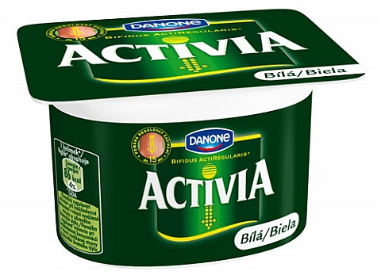
Utilitarian
Attitudes help people obtain awards and avoid punishment

Slide 5
Value-expressive
To express core values and strongly held beliefs

Slide 6
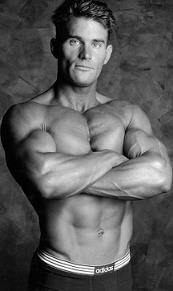
Ego-defensive
Attitude can serve as a defense against unpleasant emotions people do not want to consciously acknowledge
They are so stupid!

Slide 7
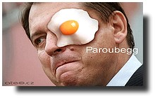
Social-adjustive
We all like to be accepted by others. Attitudes help us adjust to reference groups. People believe they will be more accepted by others if they take this side.

Slide 8
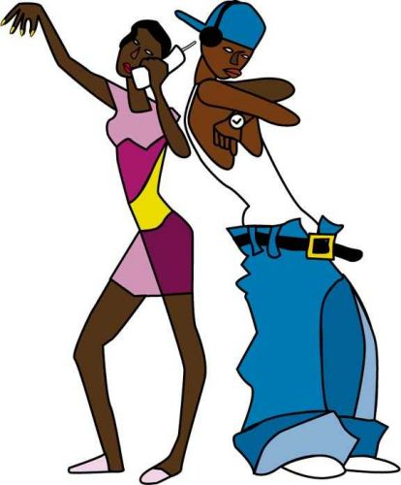
Social identity
People hold attitudes to communicate who they are and what they aspire to be.

Slide 9
Persuasion → Function matching
A persuasive message is most likely to change an attitude when the message is directed at the underlying function of attitude. Messages that match the function served by an attitude should be more compelling than those that are not relevant to the function addressed by the attitude.

