Slide 1
Elaboration Likelihood Model
(Petty, Cacioppo, 1986)

Slide 2
Elaboration Likelihood Model
Elaboration – the extent to which individual thinks about arguments contained in the communication
Likelihood – the probability that an event will occur
The model tells us when people are likely to elaborate, or not elaborate, on message
Low elaboration
High elaboration

Slide 3
Elaboration Likelihood Model
2 distinct ways (routes) people process communication
The CENTRAL ROUTE is characterized by cognitive elaboration. Individual carefully evaluates arguments, considers implications of the communicator’s ideas, and relate information to their own knowledge and values.
The PERIPHERAL ROUTE is very different. People examine message quickly and focus on simple cues. Key factors are physical appeal, speaking style, music, etc. People rely on mental shortcuts.

Slide 4
Argument evaluation
⇨ detailed thinker
Heuristics
(physical appeal, speaking style, music, etc)
⇨ cognitive miser

Slide 5
CENTRAL ROUTE
The central route involves message elaboration, defined as the extent to which a person carefully thinks about issue-relevant arguments contained in a persuasive communication

Slide 6
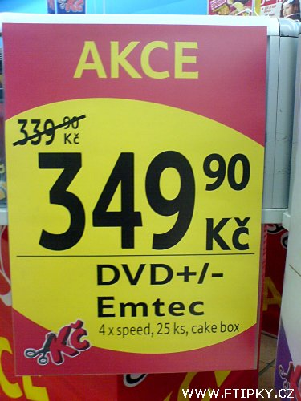
PERIPHERAL ROUTE

Slide 7
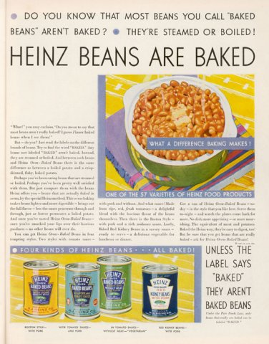
High elaboration ad (central route)

Slide 8
Low elaboration ad (peripheral route)

Slide 9
High elaboration ad (central route)

Slide 10
Low elaboration ad (peripheral route)

Slide 11
What determines what route we use?
Central route
Peripheral route
MOTIVATION & ABILITY

Slide 12
MOTIVATION
Involvement
Personally relevant issues are more likely to be processed on the central route; issues with little relevance take the peripheral route
(High I – Central, Low I - Peripheral)
Need for cognition
Personality characteristic – a need to understand the world and to employ thinking to accomplish this goal
Certain individuals have a need for cognitive clarity, regardless of the issue; these people will work through many of the ideas and arguments they hear.

Slide 13
Involvement
People given the same information can process it differently.
When personal relevance was high, people evaluated the merits of the presented information.
When personal relevance was low, people counted the number of arguments presented and made a simple inference: “more is better”
“Comprehensive final exam” experiment
Personally relevant issue
Personally irrelevant issue
Variables:
Speaker’s expertise
Arguments strength
vs.

Slide 14
When you are highly involved you are likely NOT to care what source you have
Favorable attitude
Expert source
0.4
0
- 0.4
Non-expert source
Unfavorable attitude
Low involvement
High involvement
Favorable attitude
0.4
Strong arguments
0
Weak arguments
- 0.4
Unfavorable attitude
Low involvement
High involvement
When you are highly involved you care about the arguments

Slide 15
ABILITY
Distractions (disrupt elaboration)
Knowledge

Slide 16
Central processing and arguments strength
Thoughtful consideration of strong arguments will produce positive shifts in attitude
The change is persistent over time
It resists counter-persuasion.
It predicts future behavior.
Thoughtful consideration of weak arguments can lead to negative boomerang effects
Mixed or neutral messages won’t change attitudes and in fact reinforce original attitudes.

Slide 17
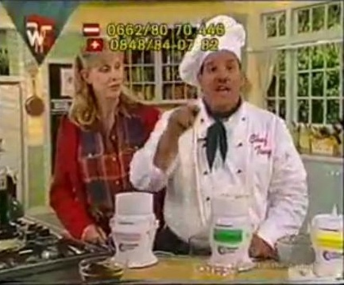
Peripheral route
Speaker’s credibility
Celebrity endorsers
But…short-lived attitude change

Slide 18
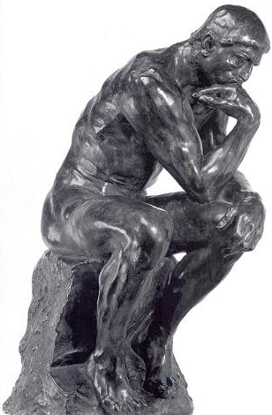
Elaboration continuum
Low personal relevance……………………………High personal relevance
High distraction……………………………….…………...…..Low distraction
Low accountability……………………………….……….High accountability
Low repetition………………………………………..………….High repetition
Low knowledge………………………………….……………..High knowledge
Low need for cognition……………………..………High need for cognition

Slide 19
Consequences
Stability of the attitude
Resistance to counter-persuasion
Attitude-behavior consistency
Central route to persuasion | Peripheral route to persuasion
Long-lived | Short-lived
Hard to change | Easy to change
Attitude more consistent with behavior | Attitude less consistent with behavior

Slide 20
Practical applications
If listeners are motivated and able to elaborate a message, you should rely on factual arguments
If listeners are unable or unwilling to elaborate a message, you should rely on packaging rather than content
WHAT ARE FUTURE TRENDS???

Slide 21
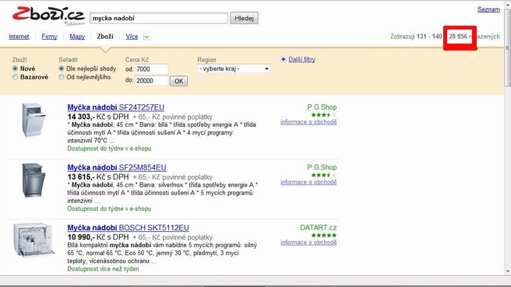
Future trends
More peripheral processing
Focus on emotions
The role of credibility, mental shortcuts, etc…

Slide 22
Celebrity endorsers + arguments
http://www.youtube.com/watch?v=jjXyqcx-mYY&feature=PlayList&p=D94F4A0FBC23F0F5&index=0&playnext=1
http://www.youtube.com/watch?v=ghSJsEVf0pU&feature=related

Slide 23
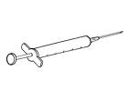
Inoculation theory (McGuire, 1961)
Resistance to persuasion can be induced by exposing individuals to a small dose of arguments against particular idea, coupled with appropriate criticism of these arguments

Slide 24
Inoculation theory
Forewarning
Individuals generate a large number of counterarguments, strengthening their opposition to the advocated position

Slide 25
One-sided or two-sided arguments?
Two-sided is better…
…but never use it when you are not able to refuse it!

