Slide 1
Brno 1
History

Slide 2
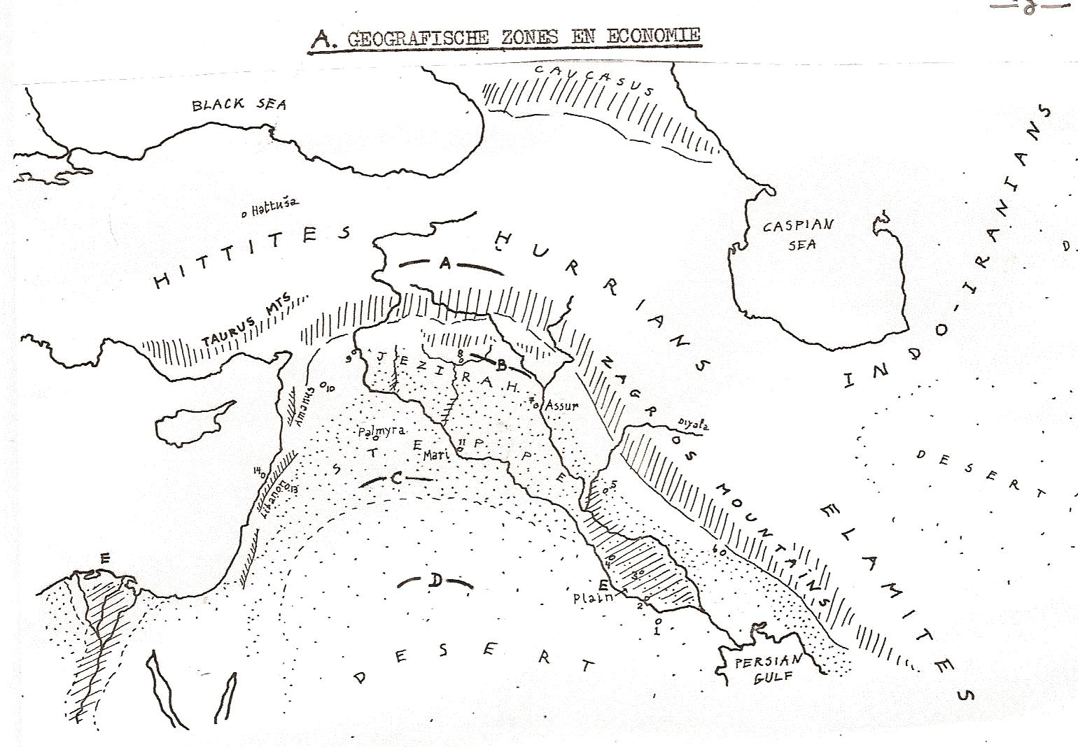
Geographic Zones and Economy

Slide 3
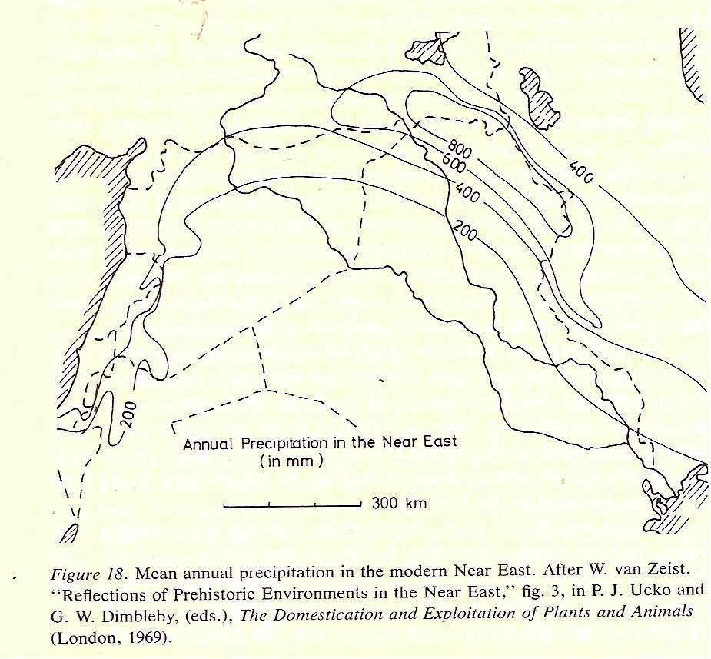
Farmers and Shepherds: Rainfall

Slide 4
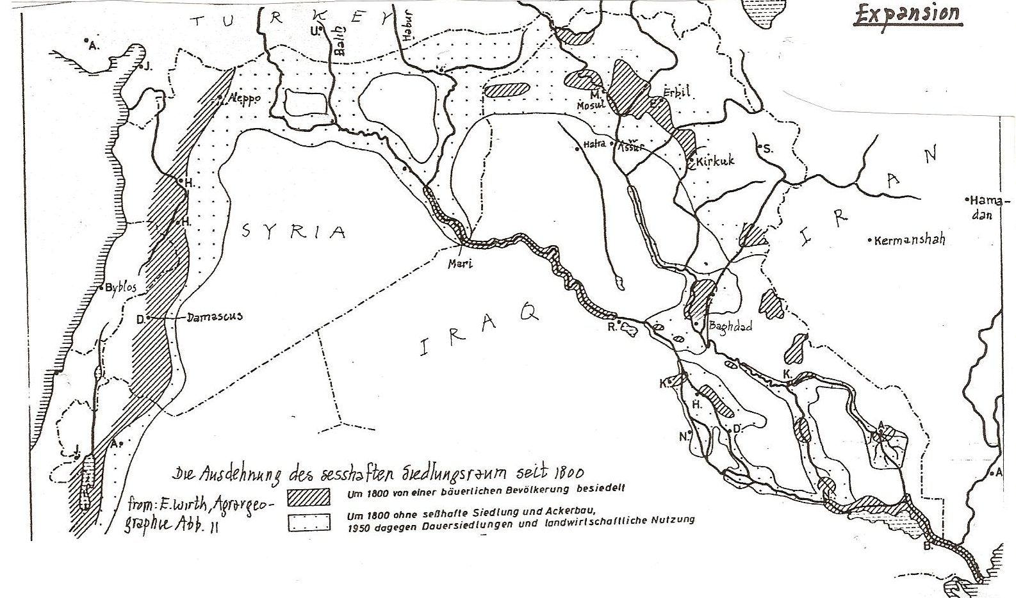
Steppe and State: Contraction and Expansion

Slide 5
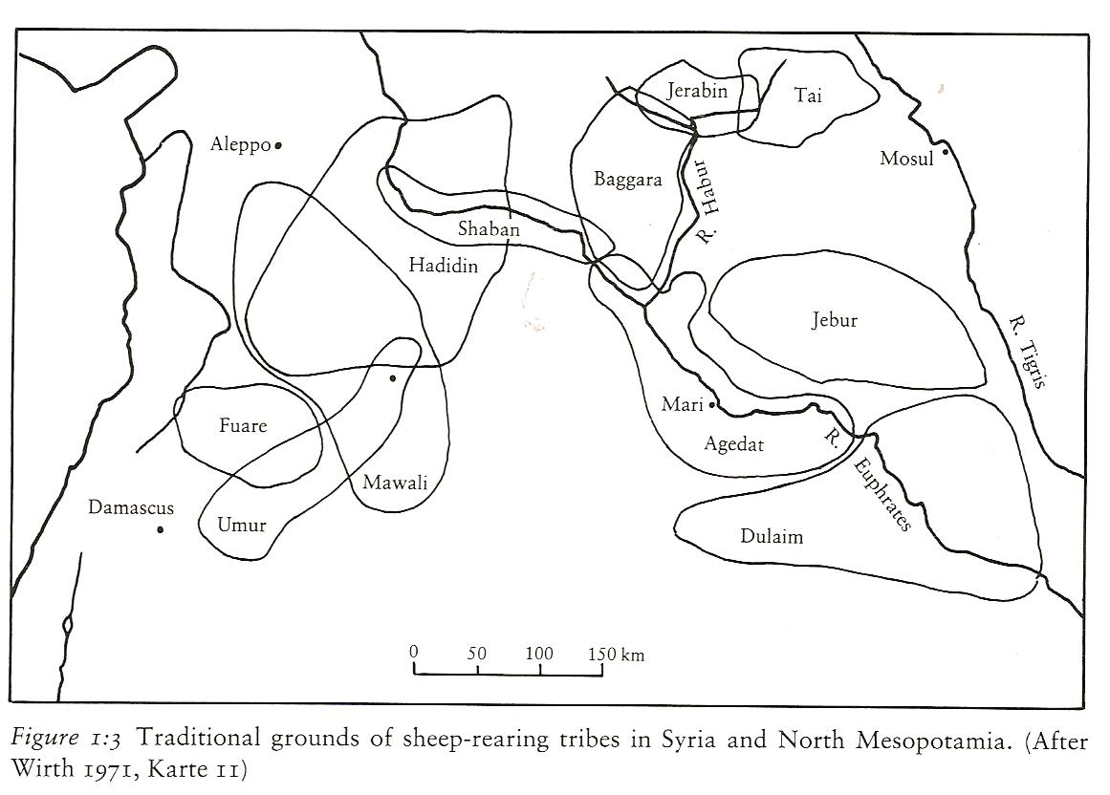
Use of Steppe: Tribes

Slide 6
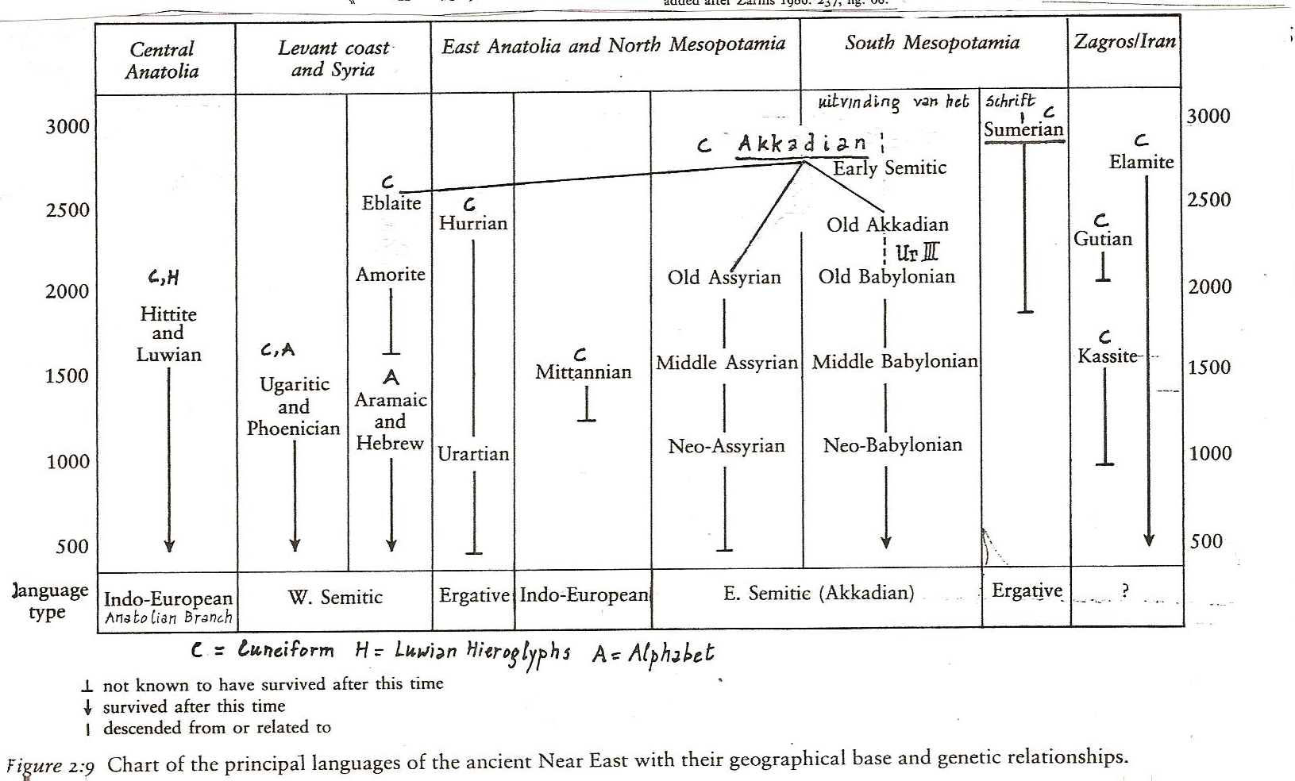
Languages and Scripts

Slide 7
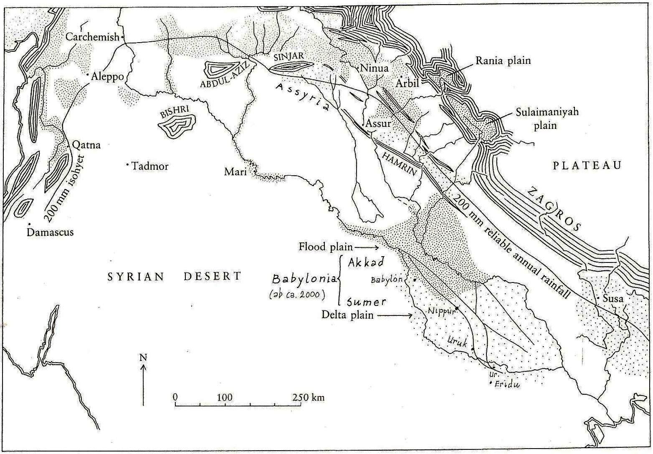
Third Millennium: Sumerians and Akkadians

Slide 8
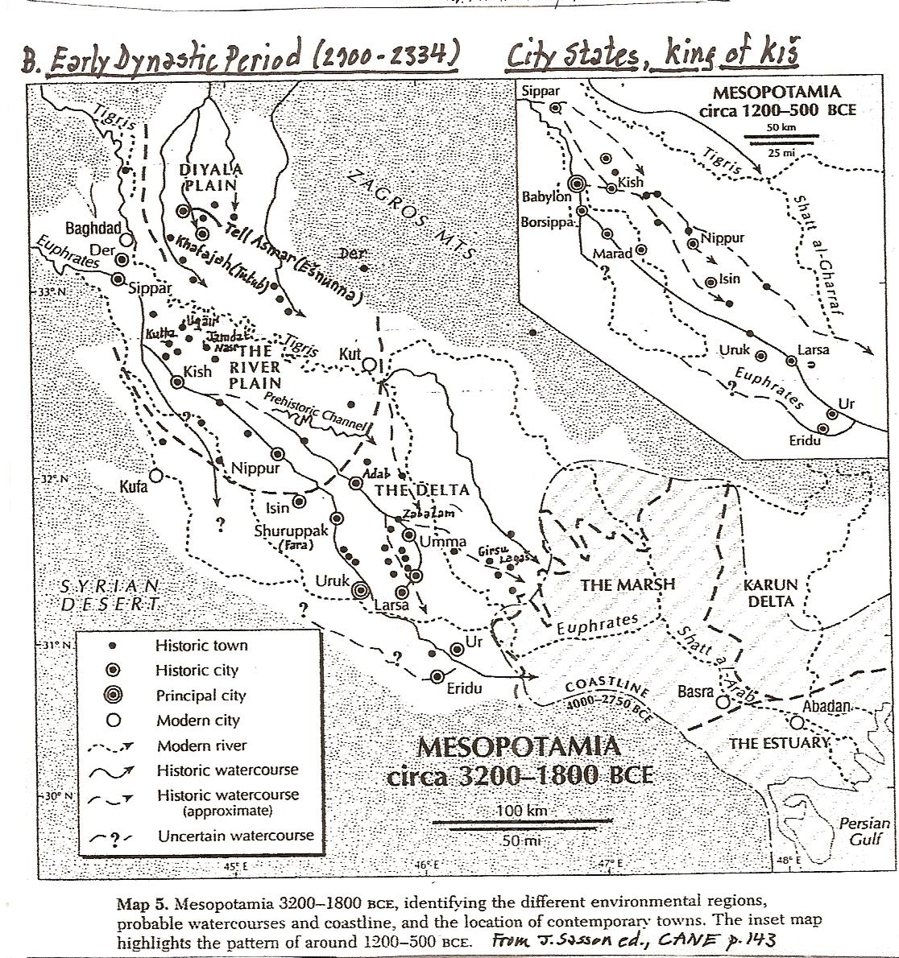
Earlier Third Millennium City States

Slide 9
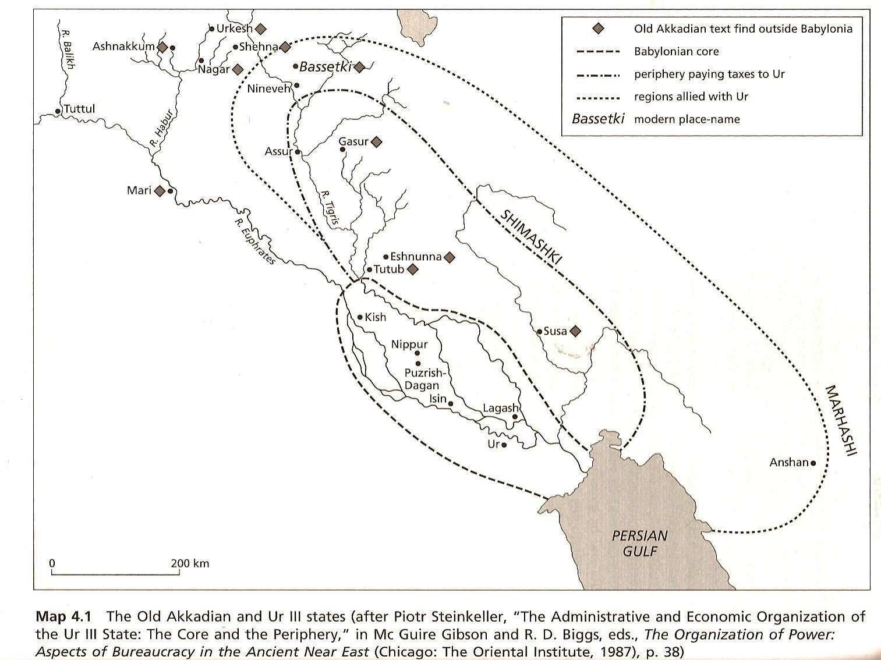
Later Third Millennium: Akkadian and Neo-Sumerian Empires

Slide 10
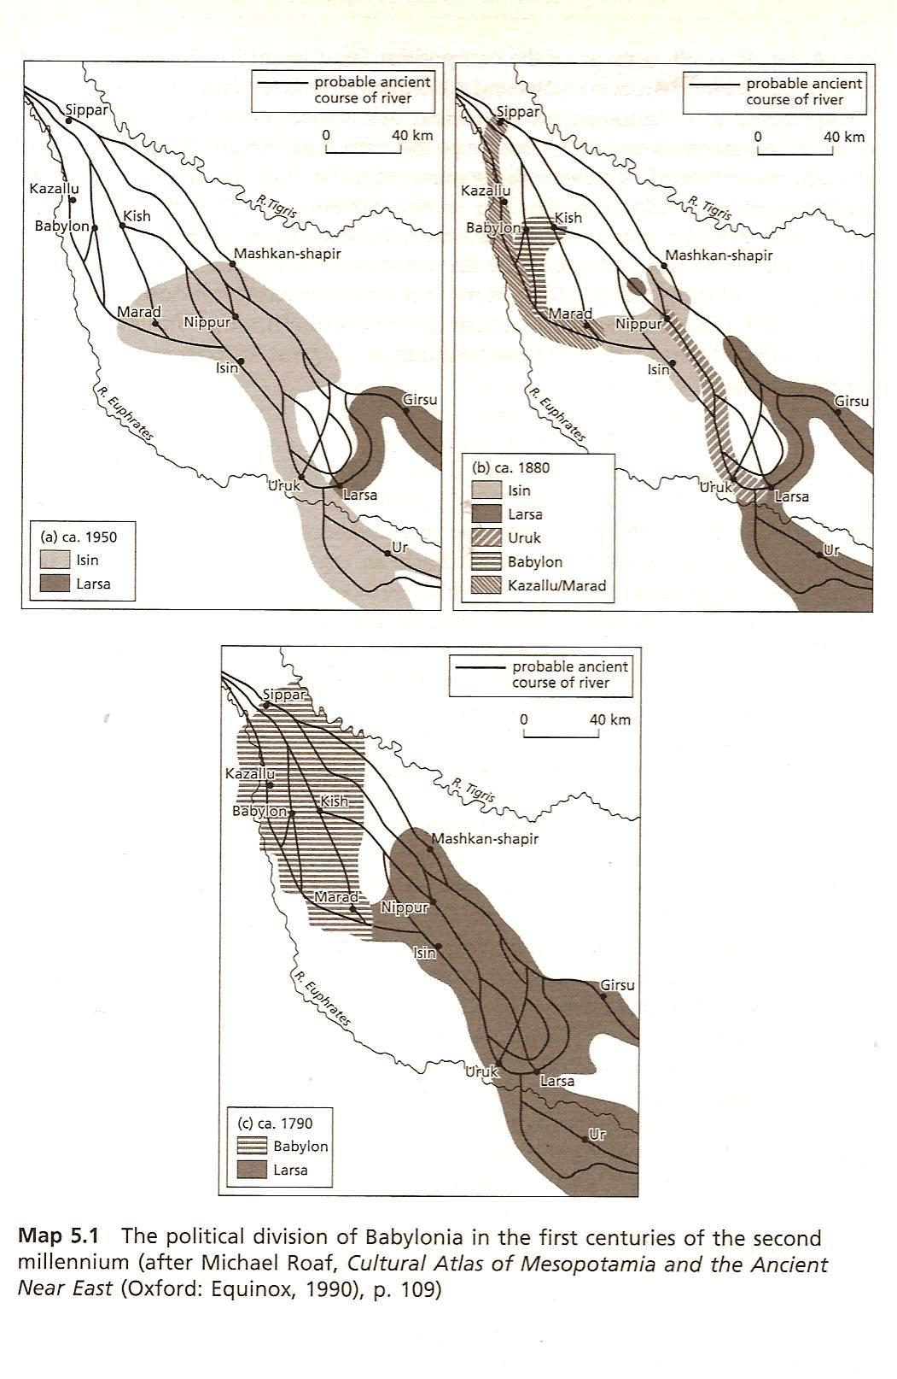
Early Second Millennium: Babylonia

Slide 11
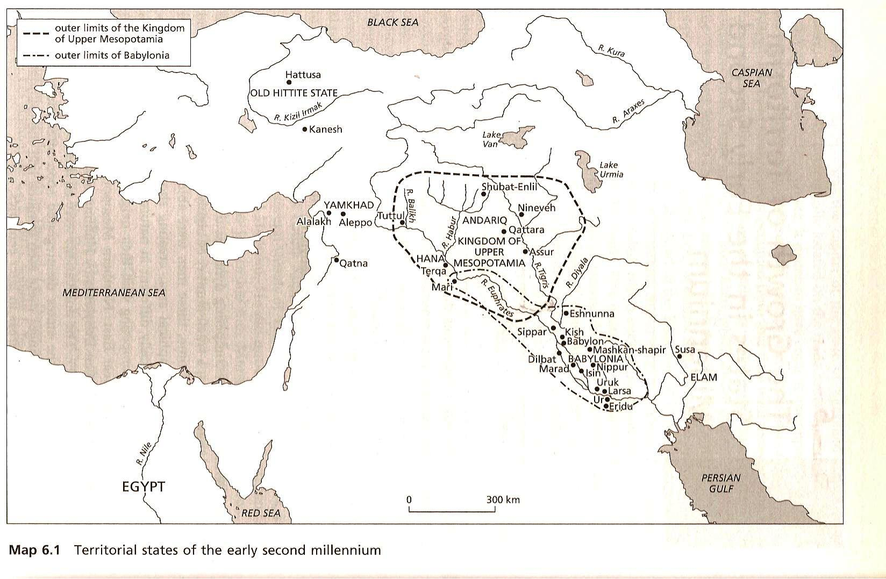
First Half Second Millennium: Babylonian and Assyrian Empires

Slide 12
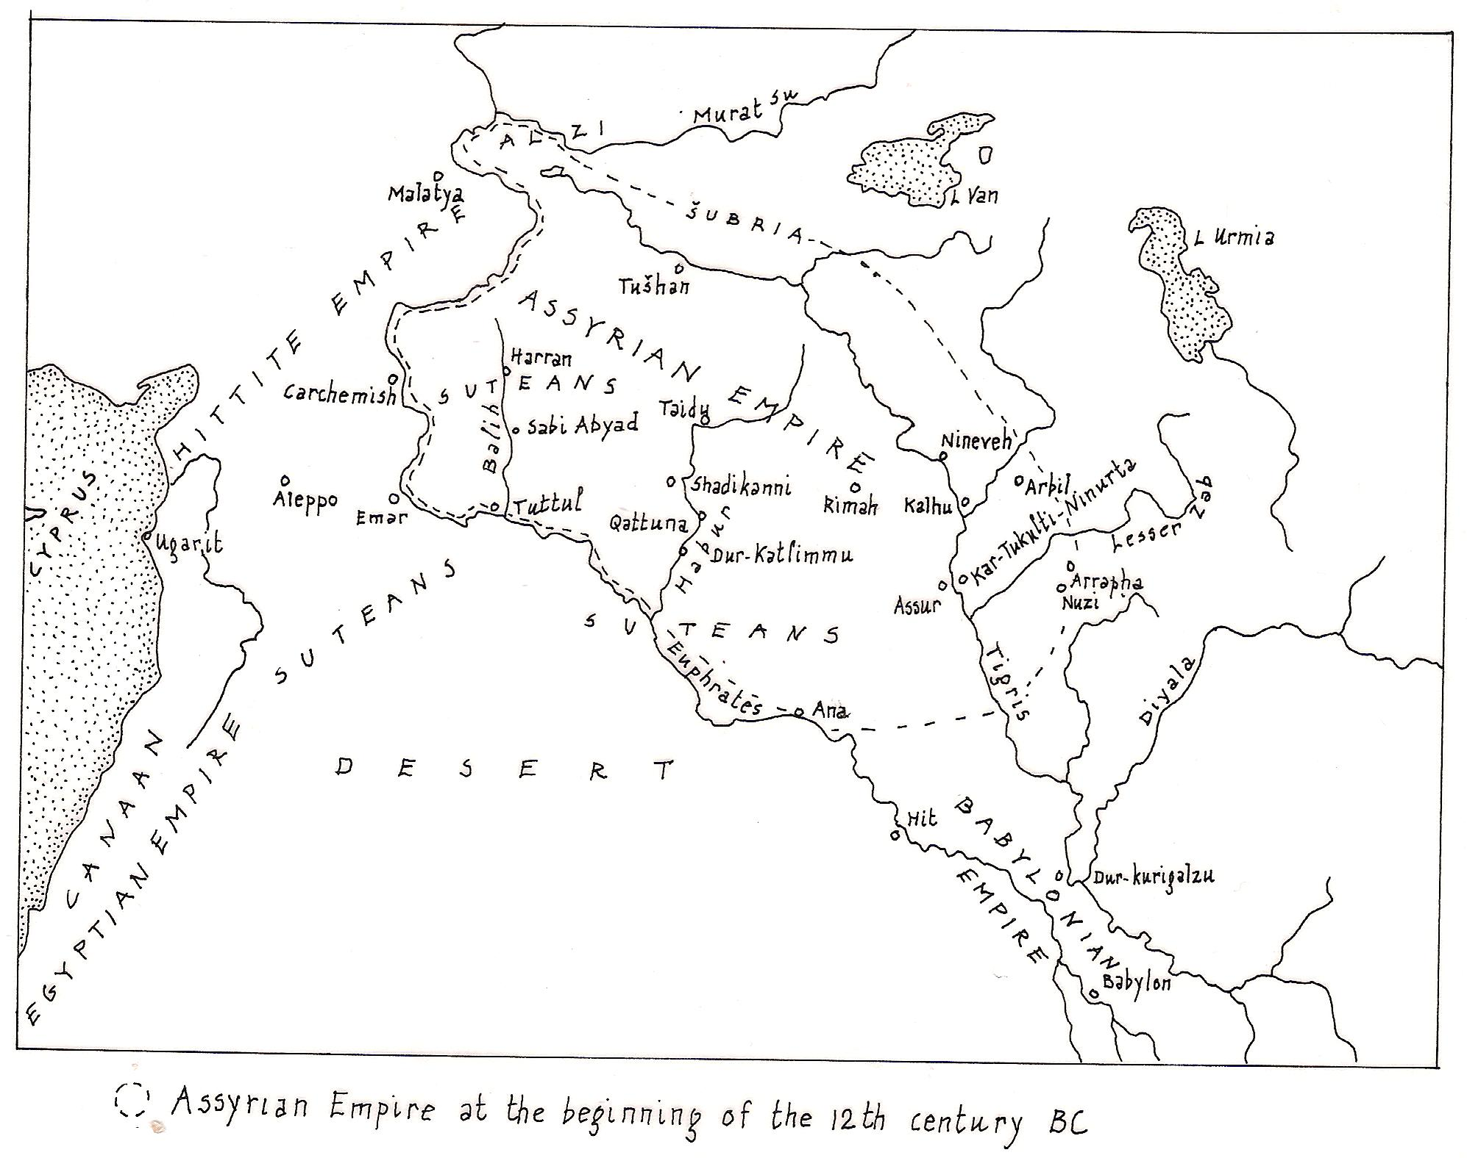
Late Bronze Age: Middle Assyrian Empire

Slide 13
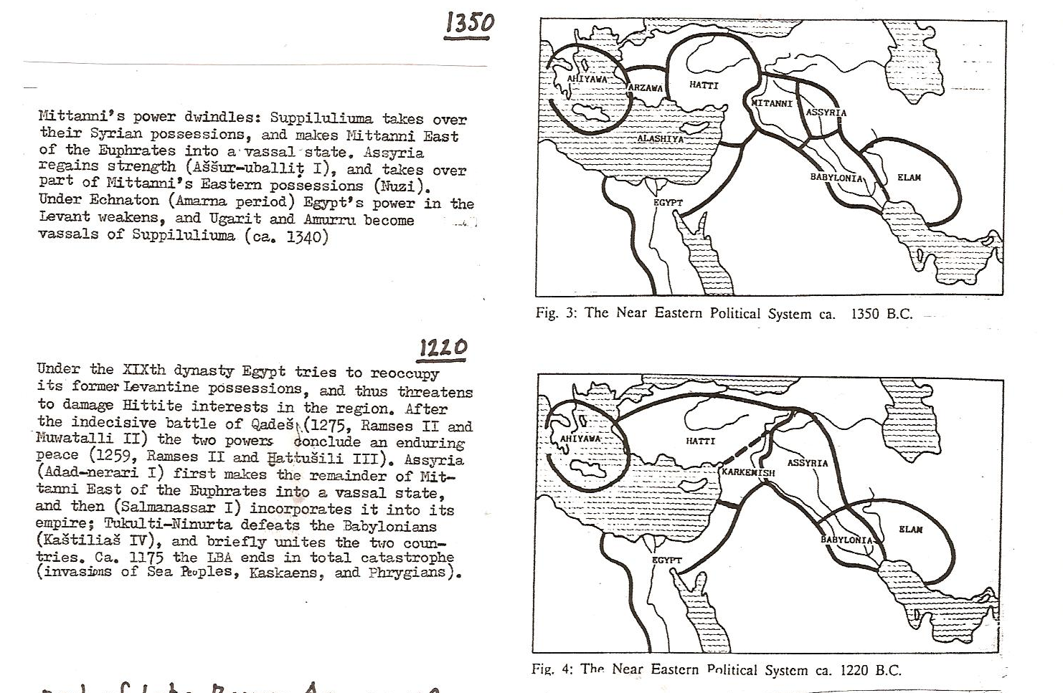
Late Bronze Age: Final Stages

Slide 14
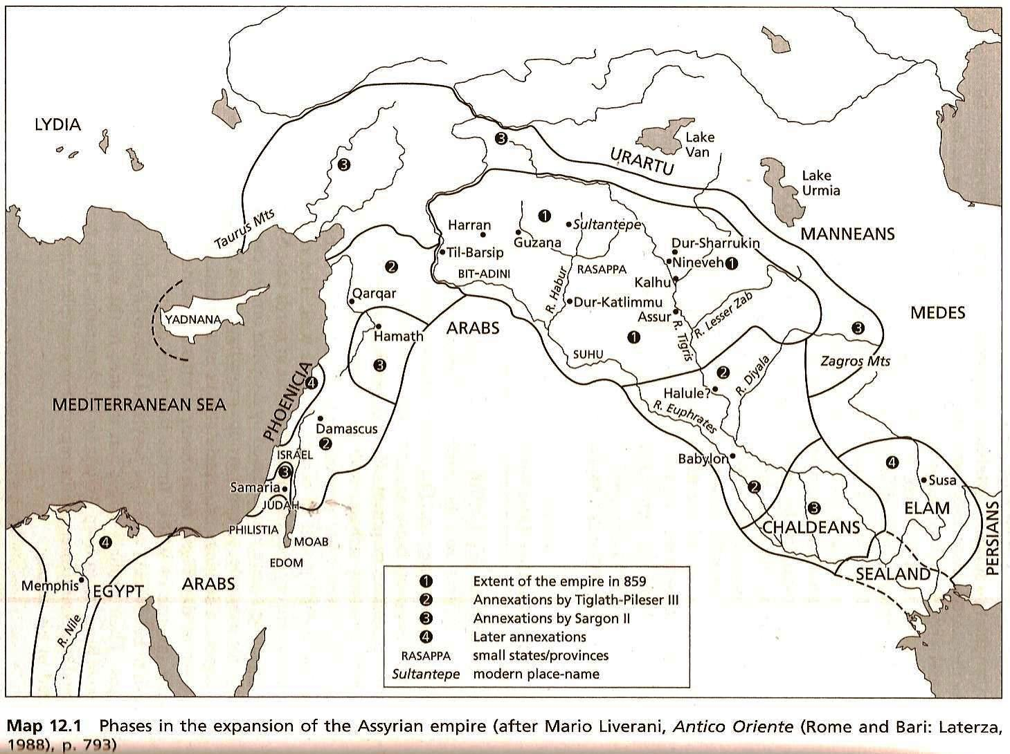
Iron Age: Neo-Assyrian Empire

Slide 15
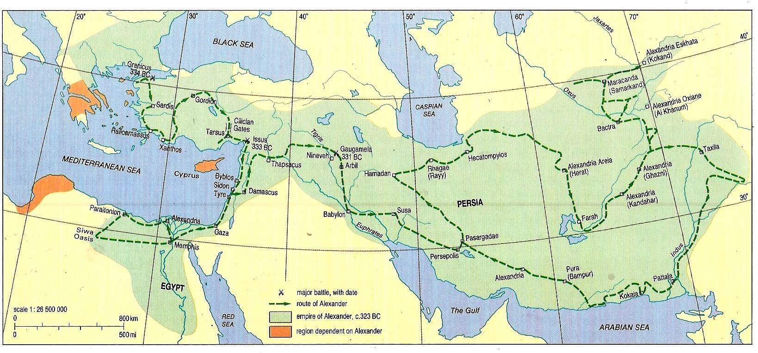
The End of Cuneiform: Cyrus and Alexander

