Slide 1
Foreign influence: Hindu
Uttarakuru in the Mahabharata:
  „South of the Nila mountains and north of the Sumeru there is the holy Uttarakuru, the home of the siddhas. The trees there have sweet fruit and are full of blossoms. All these blossoms have a fragrant smell and the fruit are delicious. Other trees are called „milk-giving“. These trees give milk and different food that has the taste of ambrosia. The soil of the land consists of gold dust. One part of the land shines in the splendour of various precious stones, rubies, diamonds, lapislazuli and others. The seasons are pleasant, the lakes are crystal clear. The inhabitants of the land never suffer from illness and are always cheerful. They live ten times ten thousand years…“

Slide 2
Kalki, the last of the ten avataras of the god Vishnu, mentioned in the Mahabharata and the Puranas (Kalkipuranam):
  At the end of the current Kali yuga, the „dark age“ (corresponding to the Buddhist conception of the „age of degeneration of the Buddhist dharma“), Vishnu will appear in the form of a pious brahman warrior called Kalki, who will rid the world of the barbarians and unruly members of the lower castes. Kalki’s apocalyptic war will purify the world, re-establish Brahman dominance of the social order, and thus institute a new golden age.

Slide 3
Manichean
„Adam, Noah/ Enoch and Abraham; there are also five others endowed with tamas in the familiy of demons and snake: Moses, Jesus, the White-Clad One, Muhammad and Mathanī – the eighth – who will belong to the darkness. The seventh will clearly be born in the city of Baghdad in the land of Mecca, where the mighty, ferocious idol of the barbarian, the demonic incarnation, lives in the world“ (Laghukālacakra-tantrarāja, chapter 1, verse 154) [Tibetan translation by Bu ston, Collected works, 1, Ka, 40-41]

Slide 4
Islamic
Adam, Noah,Abraham, Moses, Jesus, Muhammad: the list of the great messenger-prophets of Islamic tradition
The White-Clad One: the angel Gabriel? An Islamic heterodox sect?
The concealed one: the veiled prophet? The hidden Mahdi of the Shi’ite tradition?

Slide 5
The Indian Mahayana Buddhist context: buddhaksetra and other paradises
The three dhatu:
the realm of desire (kamadhatu). This is the wheel of existence with its six worlds, the world of the gods, demi-gods, men, animals, hungry ghosts and hell beings. All these beings are governed by their sexual desire.
the realm of form (rupadhatu). This realm is on or above mount Sumeru, the mountain at the center of our universe according to Indian and Buddhist mythology. It consists of four sub-levels that correspond to the four levels of meditation (dhyana). These sub-levels are again divided into different levels and are inhabited by gods who possess only a spiritual body and are without desire.

Slide 6
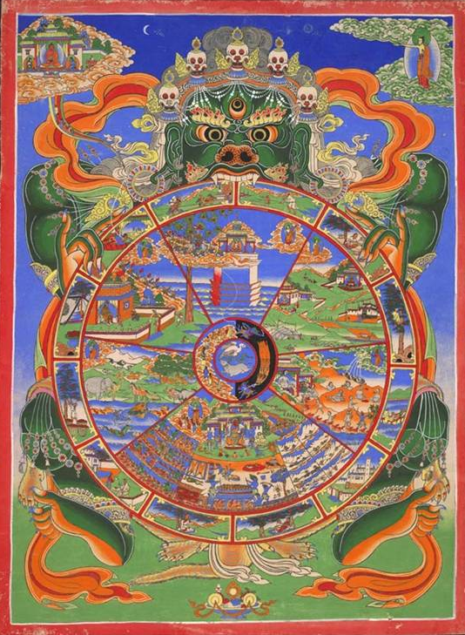
The Wheel of Life
(Srid pa‘i khor lo)

Slide 7
the realm of the formless (arupadhatu). The highest level, where sentient beings are reborn as pure minds, without possessing a body. This level is not fixed in location and consists again of four sub-levels, corresponding to the four immaterial meditations (samapatti). The samapatti are advanced meditation levels. In the arupadhatu deities without material body live who during long time intervals remain in meditation in which even conscious thoughts are extremely rare.

Slide 8
The five methods to be reborn in a buddhaksetra:
a pure way of life and the wish to become a Buddha;
veneration of the Buddha’s name and the giving of gifts/ offerings (pranidhana);
evocation of the Buddha’s name;
belief in the oath of the Buddha or Bodhisattvas to lead all living beings on the path to enlightenment;
meditation on the perfections of a buddhaksetra, the Buddhas and Bodhisattvas.

Slide 9
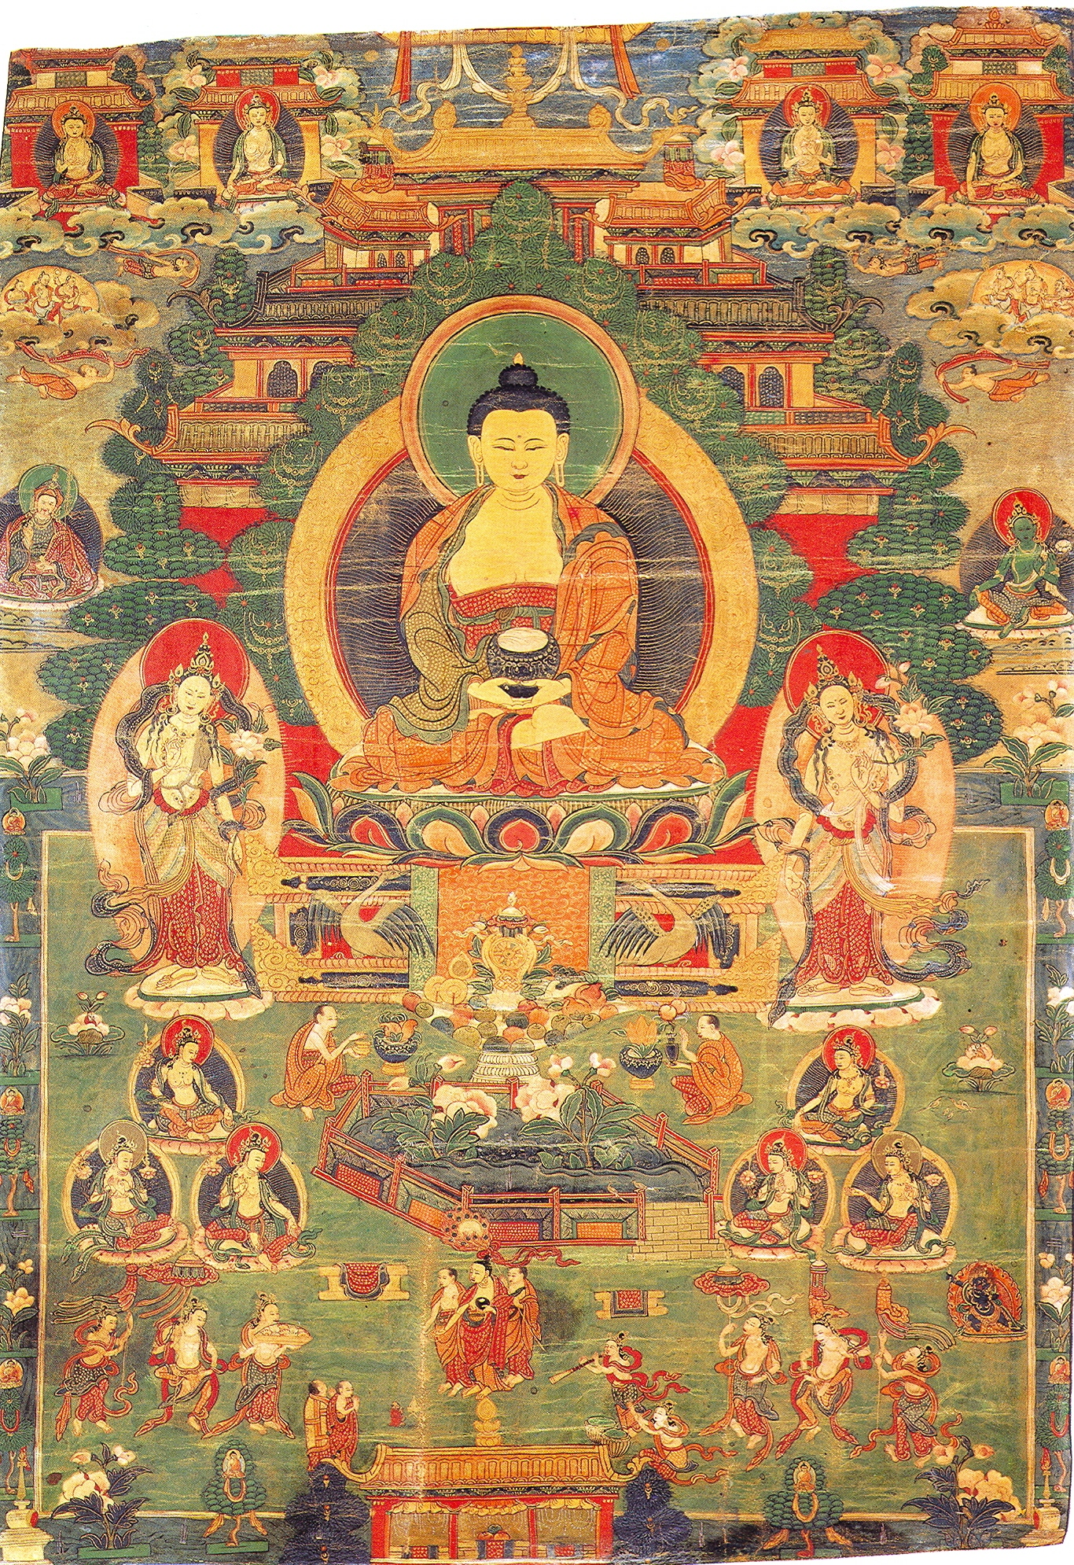
Sukhavati

Slide 10
The Phowa ceremony
The lama opens the brahmarandra («brahma-opening»), the fontanel, so that the consciousness can climb through the main psycho-psychical channel, leave the human body and immediately enter the Sukhavati.

Slide 11
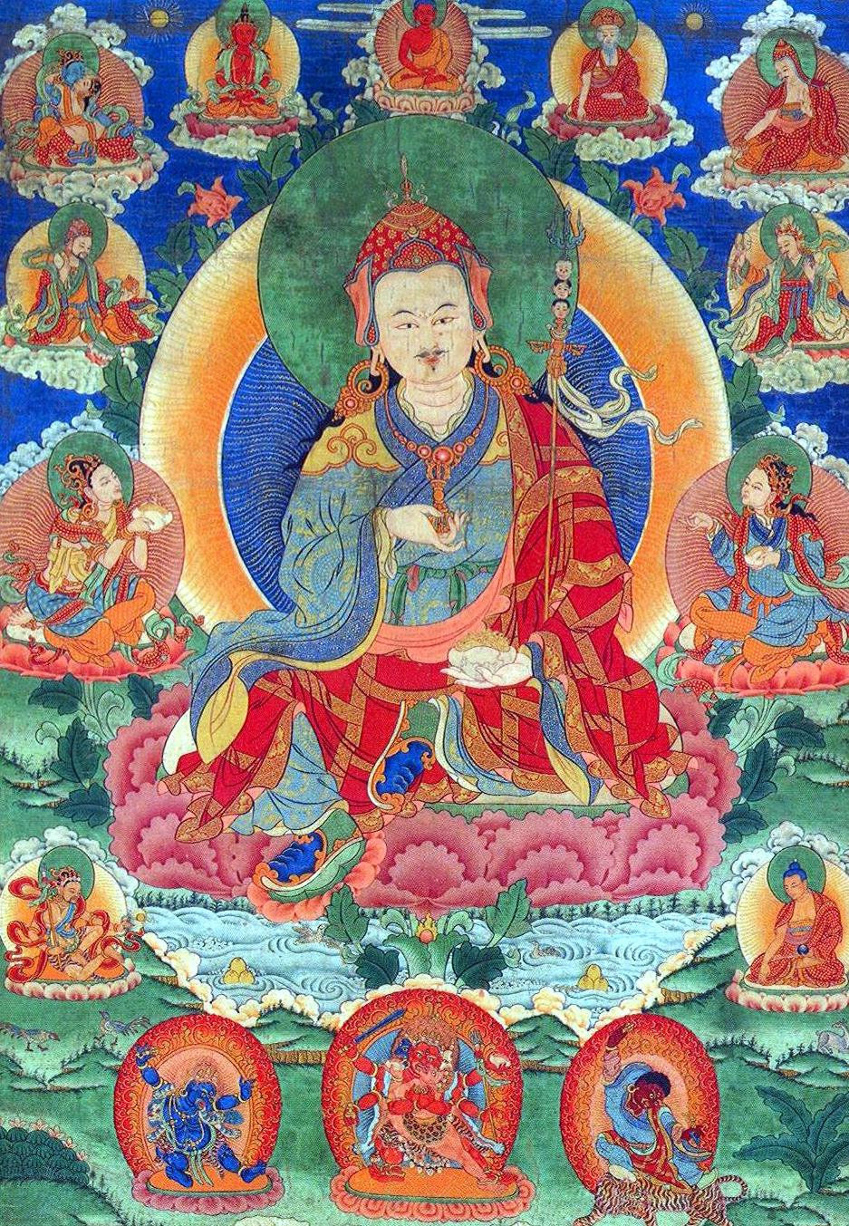
The Tibetan context: the Beyul

Slide 12
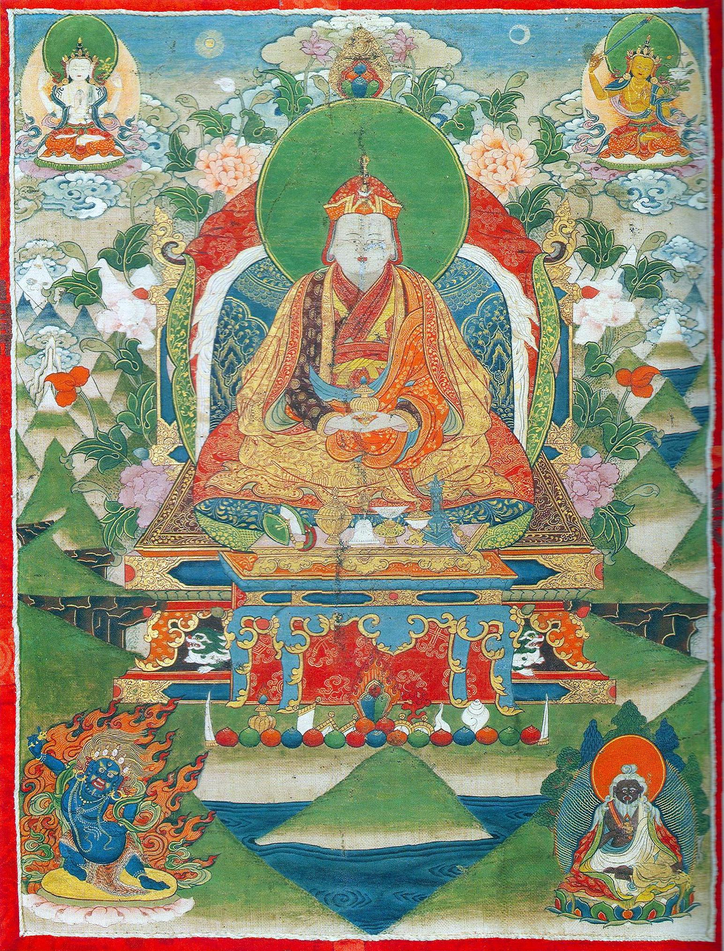
The Tertön Pemalingpa (1450-1521)

Slide 13
The outer appearance of a Beyul
« Now listen to the outer appearance of the hidden valley ! […] It is as if one has set foot into the land of the gods [….]. The mountains are pleasant, the corn fields are fertile. The region is surrounded by rows of snow mountains with summits shimmering white. […] The valleys are smooth and wide, and there are many flowers and fruit. The villages are pleasant to look at, and filled with lotus flowers. […] There are a lot of medicinal trees. The medicine is very powerful. […] This region is like the center of the Tibetan country. » (Klong chen rab byams pa Dri med `Od zer, Bum thang lha’i sbas yul gyi bkod pa la bsngags pa me tog skyed tshal)

Slide 14
The seven Beyul
Dremo jong, Sikkim. It was opened by Rig dzin gödem, a famous Tertön of the Nyingmapa (1337-1408)
(dedan) Kyidmolung in Kutang in Northen Nepal
Bepa Pemätshal (could be identical with the famous Pemakö to the northwest of Kongpo)
Rölpä khandroling west of the Mt. Everest. This Beyul is an important pilgrimage site for the local people.
Gyel kyi Khenpalung in the Khumbu region of Nepal. Another Khenpalung is in Bhutan, and according to oral information provided by Tashi Tshering from the LTWA, there is yet another Khenpalung in Kham.
lHä phodrang
Dromokhü in the Chumbi valley in Southern Tibet.

Slide 15
„During the time of degeneration [of the dharma] the troops of the Mongols will conquer the center of Tibet. They will annihilate all Tibetans …“
(sBas yul mkhan pa lung gis lam yig sa dpyad dang bcas pa, Fol. 11r1)

Slide 16
„In short, a hidden region is a region, to which one escapes in the face of wild enemy troops. Its character is that of a completely safe place.“ (rDo dmar Zhabs drung Mi `gyur rdo rje, gNam sgo zla gam gyi dngos `dzin phan bde snying po, Fol. 7v5/6)

Slide 17
The signs to open a Beyul
According to the sBas yul `bras mo ljongs kyi gnas yig there are
  1. visible signs (war, destruction, invasion)
  2. outer signs (natural disasters like earthquake)
  3. inner signs (social and religious breakdown)

Slide 18
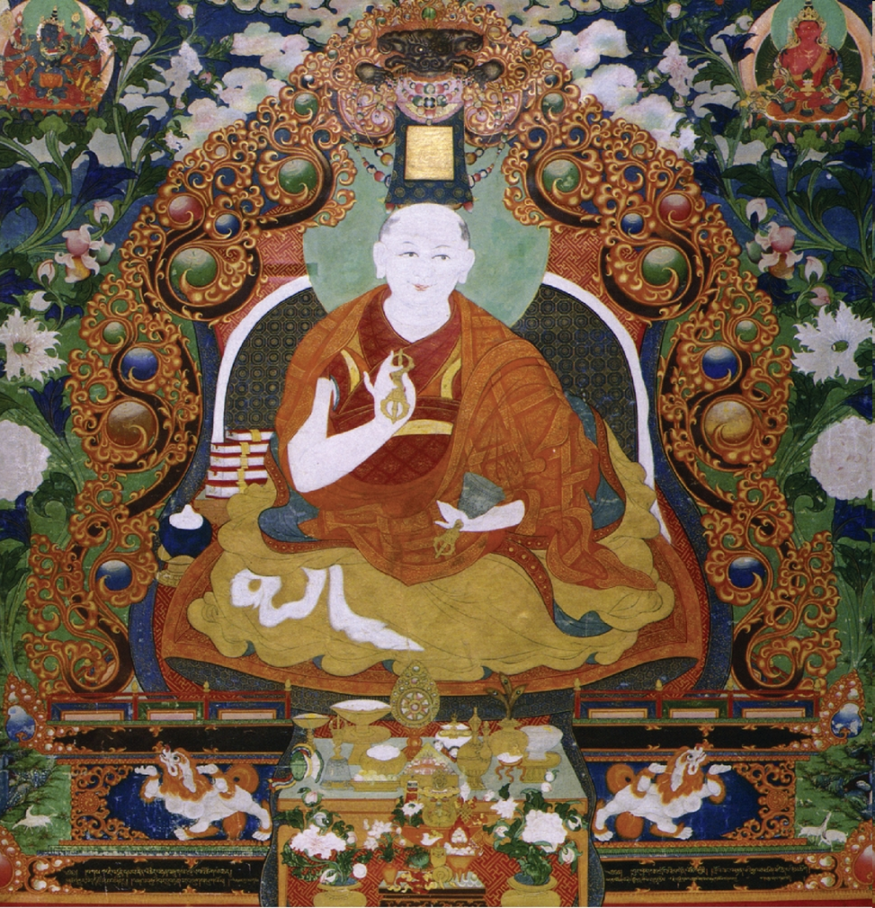
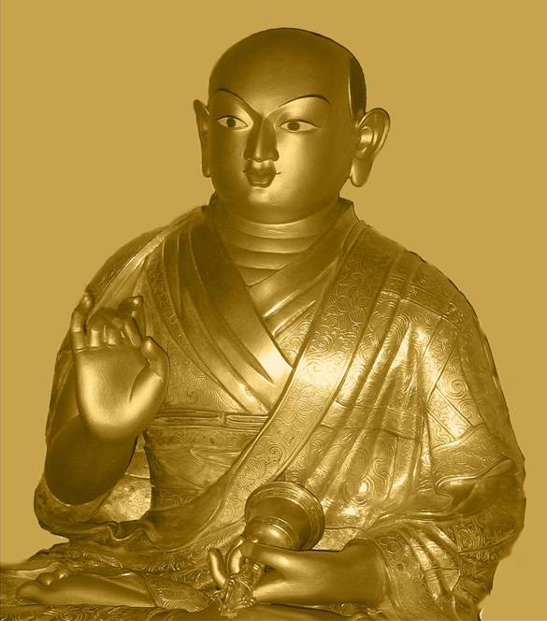
Mongolia - The Jebtsundamba Khutukhtus (Bogd Gegen)
Janabazar (1635-1723)

Slide 19
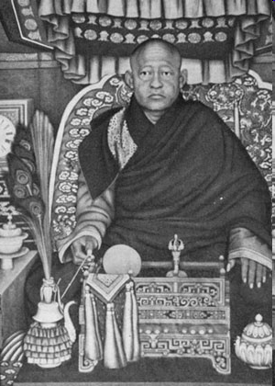
The 8th Bogd Gegen

Slide 20
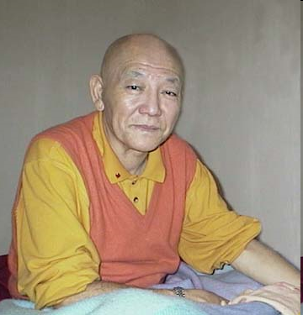
The 9th Bogd Gegen

Slide 21
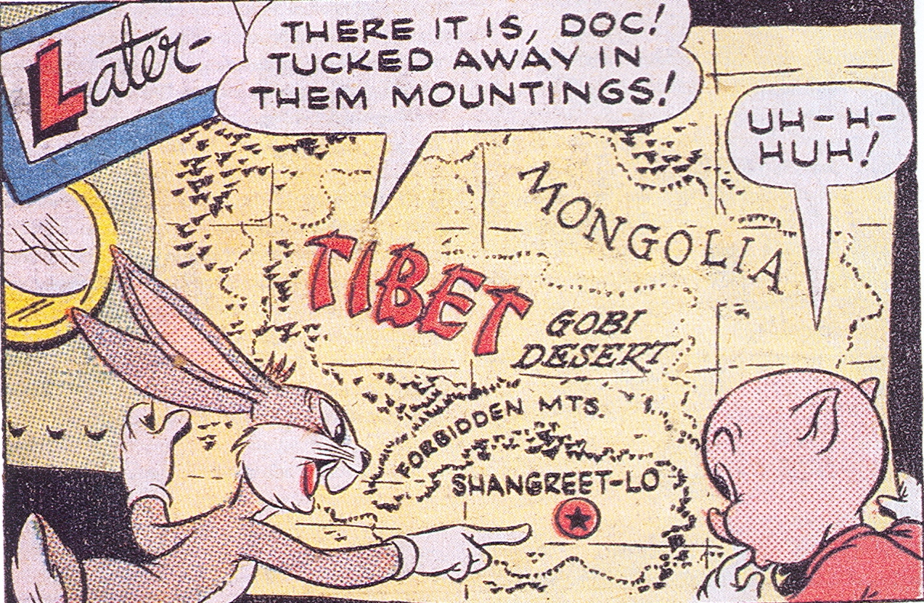
Shambhala goes global

