Slide 1
Bulgarian Pop-Culture nowadays

Slide 2
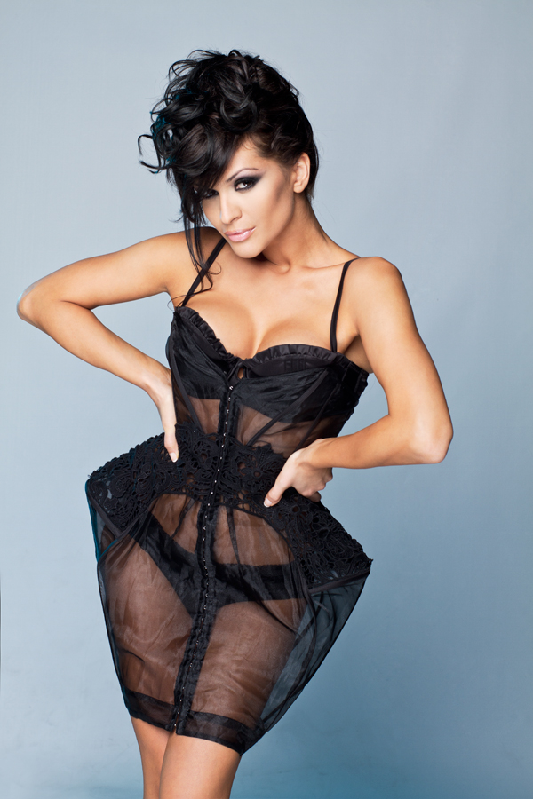
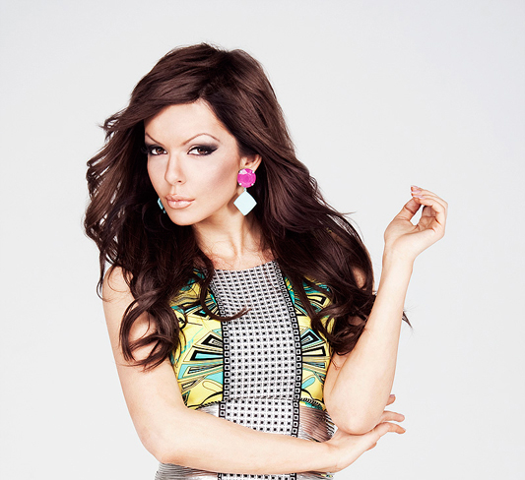
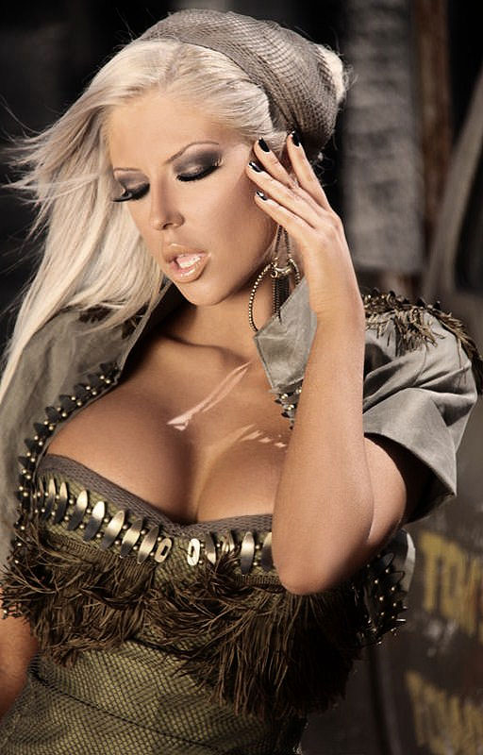
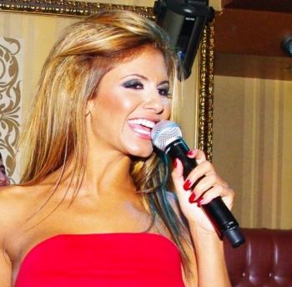
Chalga

Slide 3
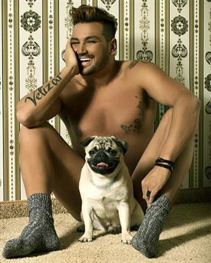
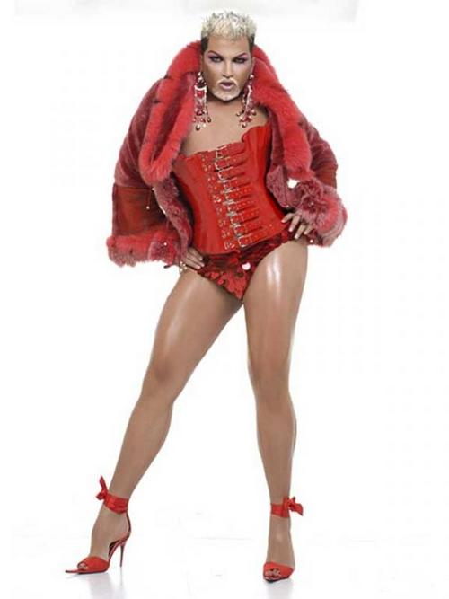
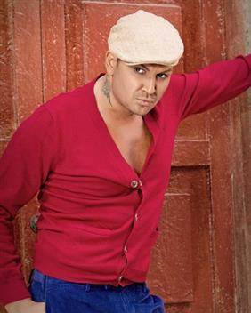
AZIS

Slide 4
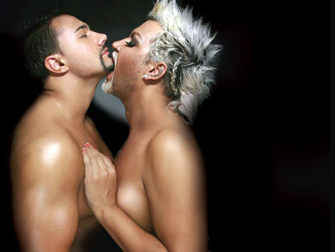
Russian Comedian Show, Руслан Белый
Azis - Hop

Slide 5
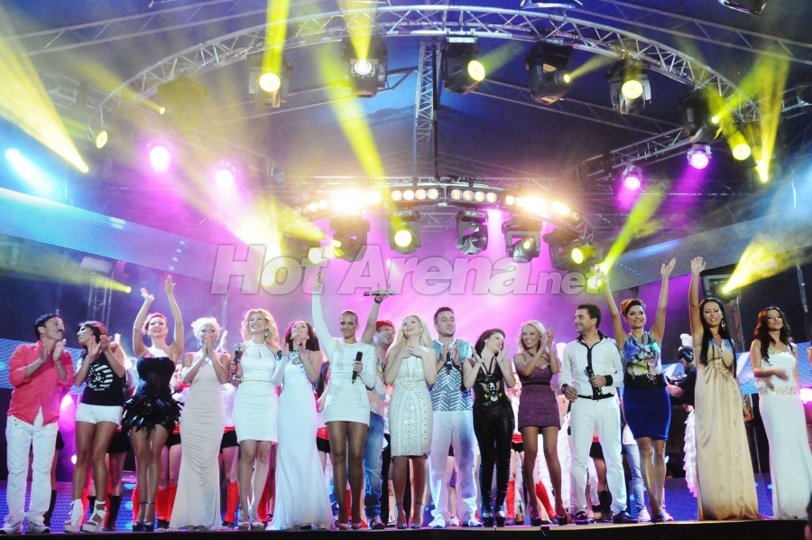
Music Company “Payner” („Пайнер“)

Slide 6
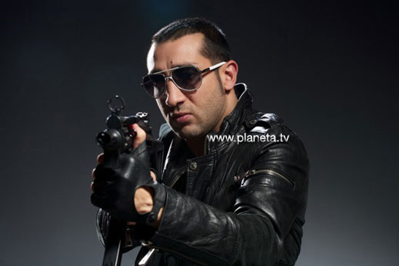
Tent / Палатка
Iliqn – Yo-Yo
Gamzata – Sefte
Boris – Lyubimets 13

Slide 7
Rap and Pop Music
100 kila – Az sam 6
Grafa – Causa Perduta
Billy The Kid feat. Mihaela Fileva – Kogato ti trqbvam

Slide 8
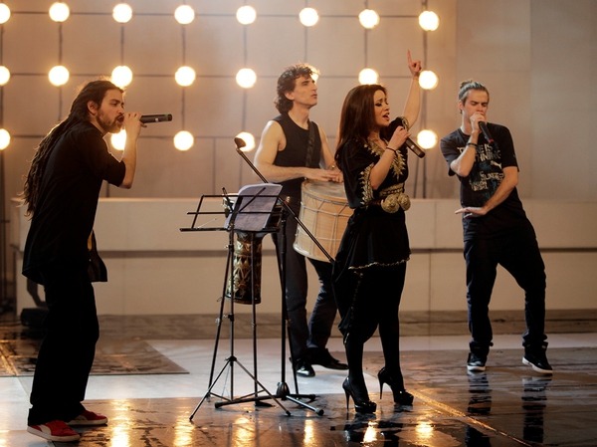
Eurovision
Elitsa I Stundji – Only Champions

Slide 9
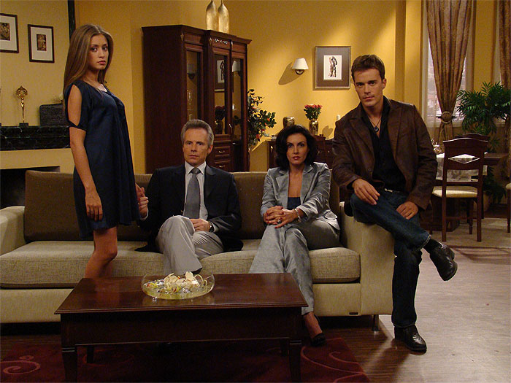
TV series

Slide 10
Glass Home/ Staklen dom
Undercover/ Pod prikritie
Revolitzia Z
Ungiven/ Nedadenite

Slide 11

Sofia Film Fest

Slide 12
The World is big and salvation lurks around the corner 2008
Mission London 2010
Eastern Plays/ Iztochni piesi 2009
TILT 2011

Slide 13
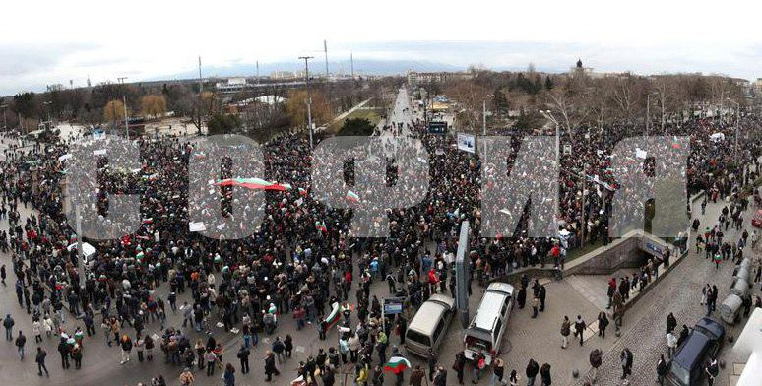
It’s one of those riots…
Slavi Trifonov – Nema takava darjava

Slide 14
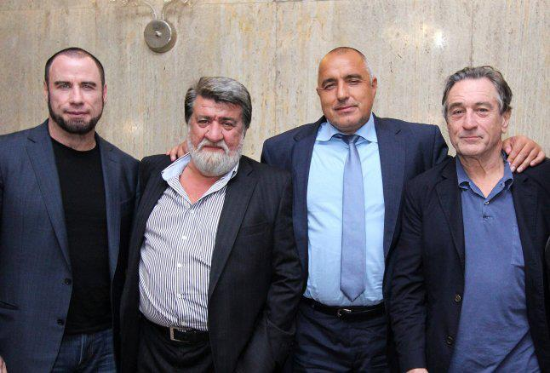

Slide 15
Thank You!
Sara Bozhinova
s.bozhinova@abv.bg

