Slide 1
Znečištění půdy
„You can see with your own eyes when the air is smoggy, or see when the color of a river is wrong, but for soil pollution you need special equipment to check the levels of various elements..”
Chen Nengchang
Notes:
http://www.chinahush.com/2009/10/21/amazing-pictures-pollution-in-china/
http://www.businessweek.com/articles/2013-02-25/soil-pollution-is-a-state-secret-in-china

Slide 2
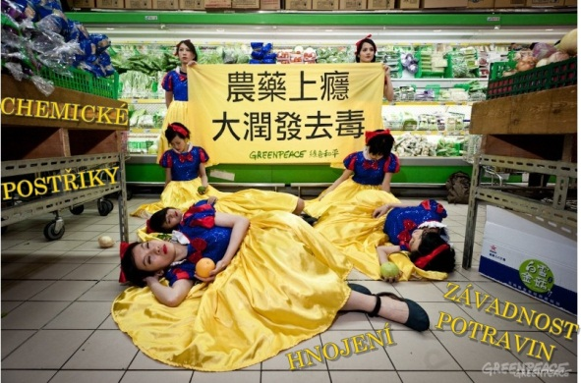
Notes:
http://www.greenpeace.org/eastasia/multimedia/photos/food-agriculture/snow-white-r-mart/

Slide 3
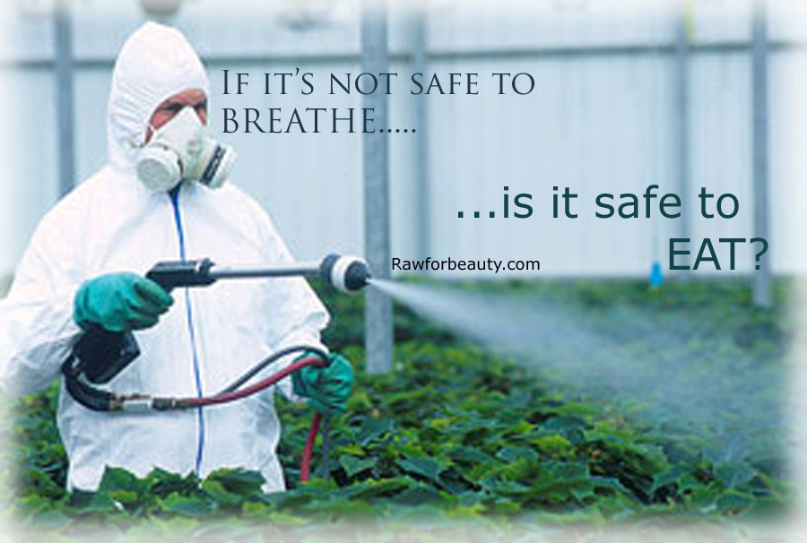

Slide 4
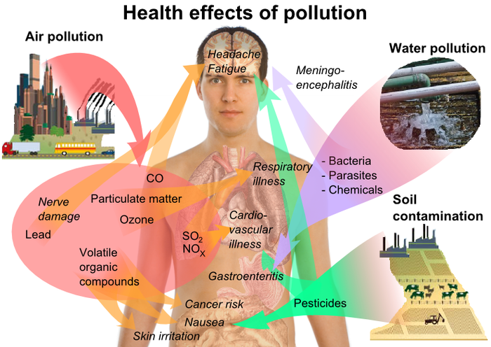

Slide 5
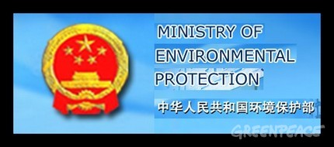
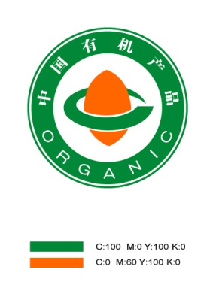


Slide 6
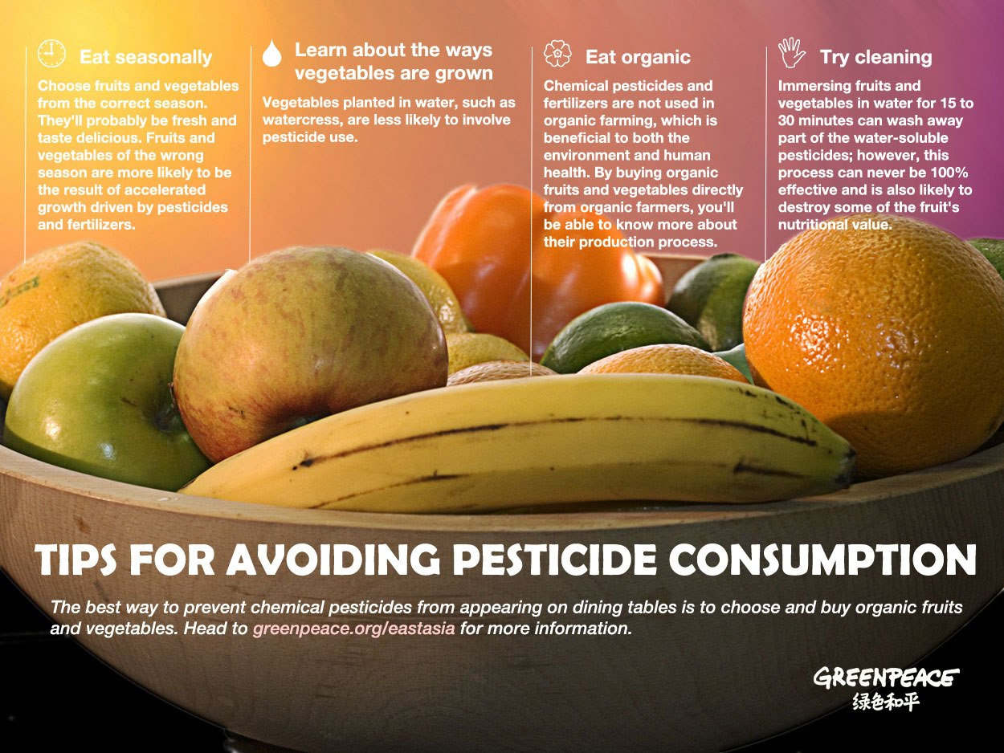

Slide 7
http://www.greenpeace.org/eastasia/Global/eastasia/publications/reports/food-agriculture/2012/Pesticide%20Hidden%20Ingredient%20Report%20Final.pdf
http://www.greenpeace.org/eastasia/news/blog/banned-pesticides-detected-on-vegetables-in-t/blog/36666/
http://www.velkaepocha.sk/2012042419437/Testy-ukazaly-ze-cinsky-caj-obsahuje-jedovate-pesticidy-video.html
http://www.jstor.org/stable/4409739
http://www.jstor.org/stable/2643191
http://www.chinadialogue.net/article/show/single/en/5153
http://www.ntdtv.cz/otravena-jablka-jen-tchaj-posledni-potravinovy-skandal-cina
Článek A CHINA ENVIRONMENTAL HEALTH PROJECT FACTSHEET - Pesticides and Environmental Health Trends in China- autorka Yang Yang
http://www.jstor.org/stable/4148247
http://www.jstor.org/stable/656133
http://www.czcn.org/autorske-clanky/2-autorske-clanky/4983-zpravodajstvi-oeu-tetina-inske-pdy-je-ohroena-erozi.html
ttp://www.chinahush.com/2009/10/21/amazing-pictures-pollution-in-china/
http://serenia-words.blogspot.cz/2013/01/clean-your-fruits-and-veggies-from.html
http://www.greenpeace.org/eastasia/multimedia/photos/food-agriculture/snow-white-r-mart/
http://www.greenpeace.org/eastasia/news/blog/want-to-eat-organic-in-china/blog/40399/

