Slide 1
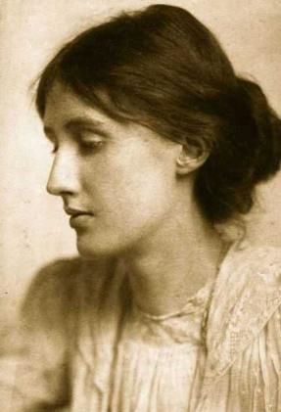
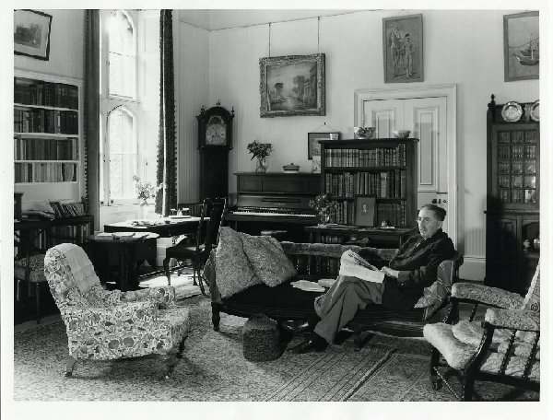
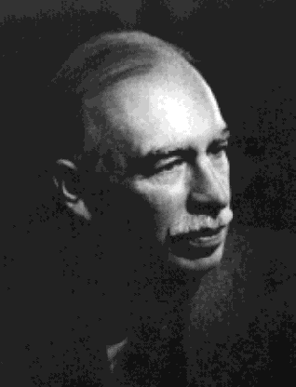
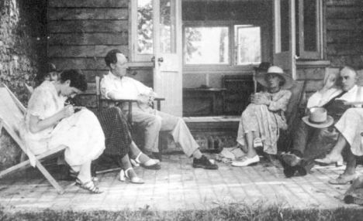
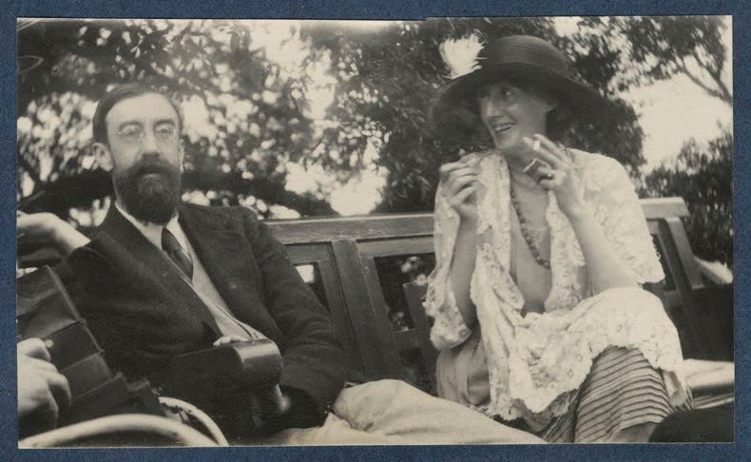
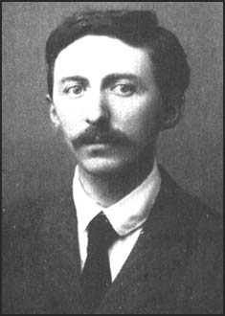
The Bloomsbury Group was an group of writers, intellectuals, philosophers and artists who held informal discussions in Bloomsbury. This collective of friends and relatives lived, worked or studied near Bloomsbury in London during the first half of the twentieth century. Their work deeply influenced literature, aesthetics, criticism, and economics as well as modern attitudes towards feminism, pacifism, and sexuality. Its best known members were
Virginia Woolf,
John Maynard Keynes,
E. M. Forster
and Lytton Strachey.
Virginia Woolf
J.M. Keynes
E.M. Forster
Virginia Woolf & Lytton Strachey

Slide 2
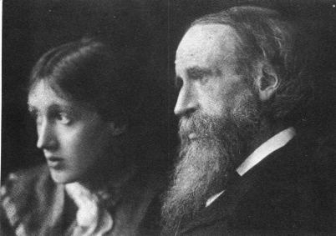
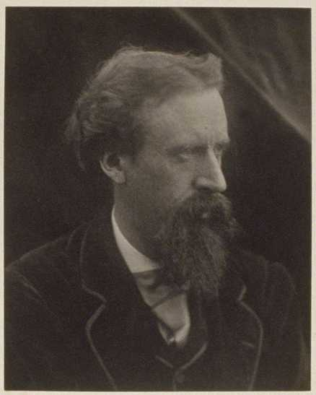
Leslie Stephen was a historian and literary critic. His first wife, Harriet Marian, was the daughter of the novelist William Makepeace Thackeray. His second wife, Julia Prinsep Jackson, was the niece of the pioneering photographer Julia Margaret Cameron.. With Julia, Leslie Stephen had four children: Vanessa, Thoby, Adrian and Virginia. Julia Jackson died young, and when Leslie Stephen died in 1904 the siblings moved to 46 Gordon Square, in Bloomsbury, London, where they began to receive guests "at home".
Virginia Woolf with her father, Sir Leslie Stephen 1902 Sir Leslie Stephen was a British historian , writer, philosopher.
Between 1850 and 1864, Leslie Stephen was a student, tutor, and a fellow at Cambridge. “I was a liberal after the fashion of those days: a follower of J. S. Mill... I read Comte, too, and became convinced among other things that Noah’s flood was a fiction... Upon my stating in the summer of 1862 that I could no longer take part in the chapel services, I resigned my tutorship.”

Slide 3
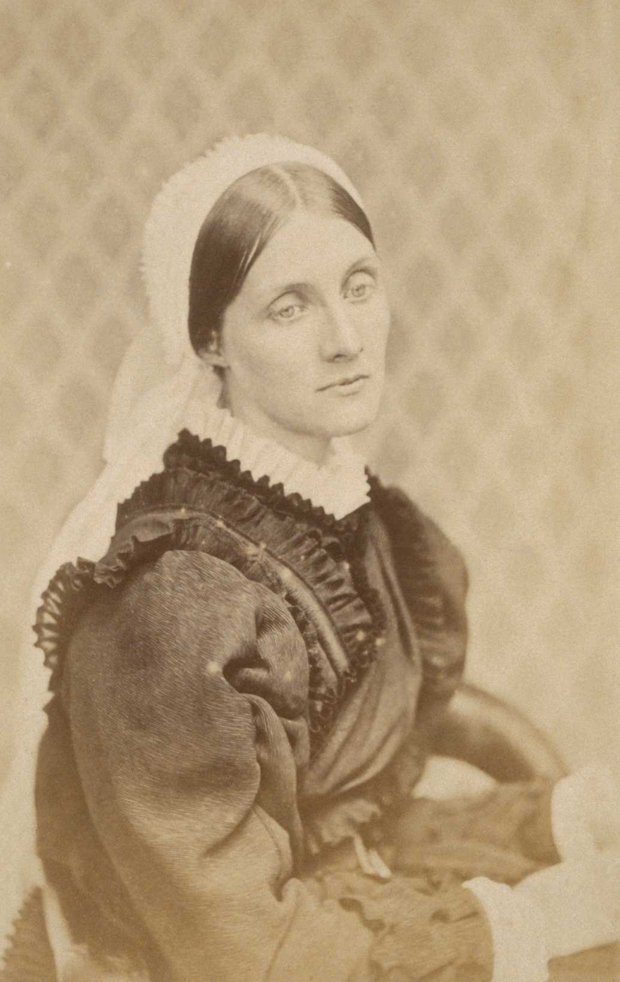
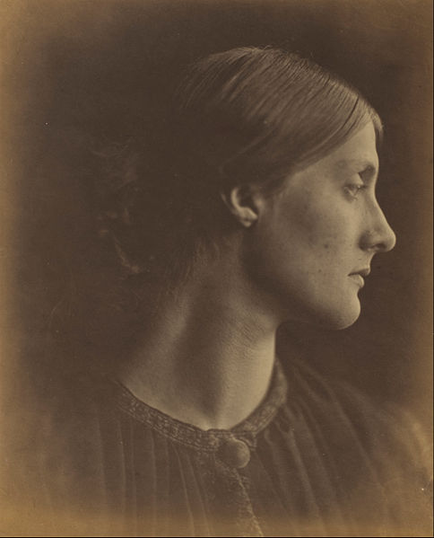
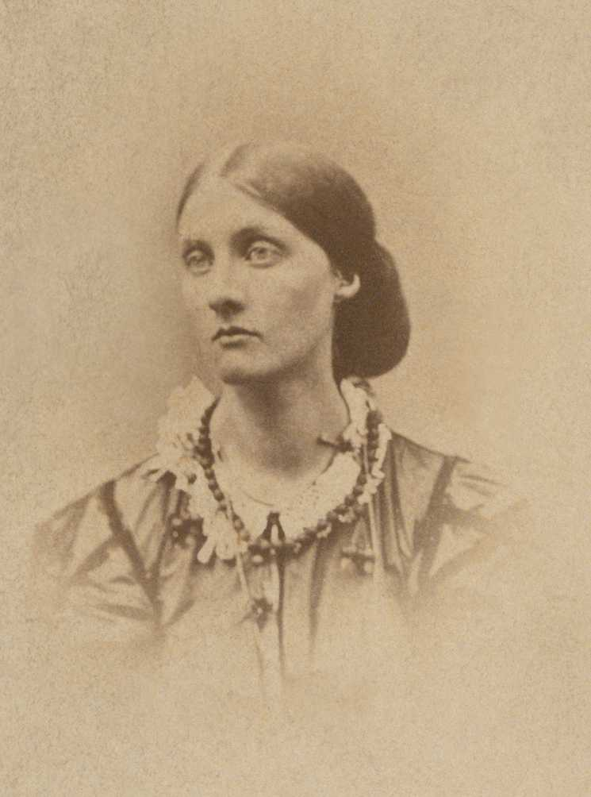
Julia Jackson (Woolf’s Mother) by Julia Margaret Cameron 1867-1870s

Slide 4
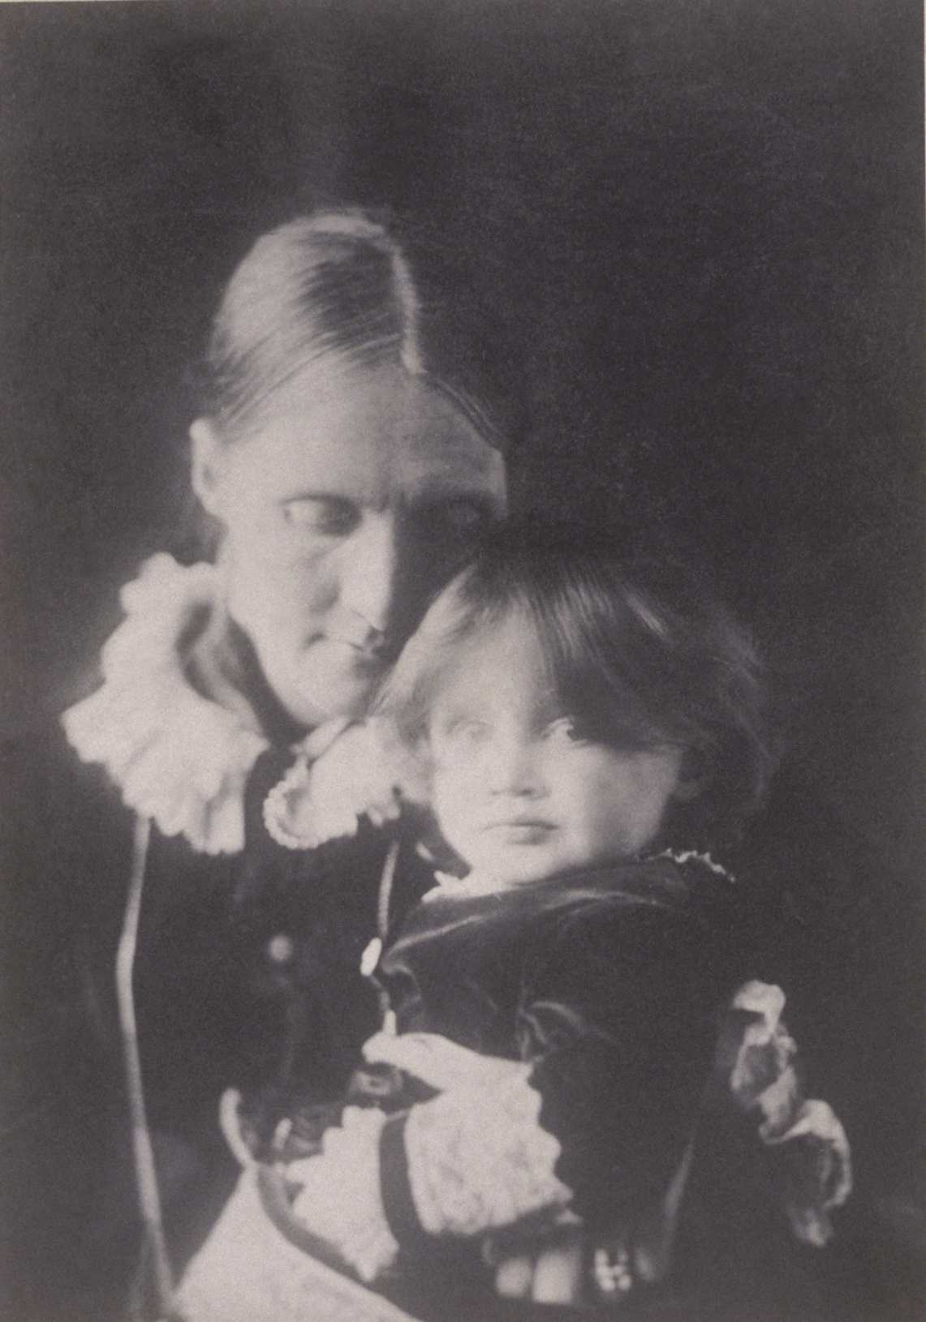
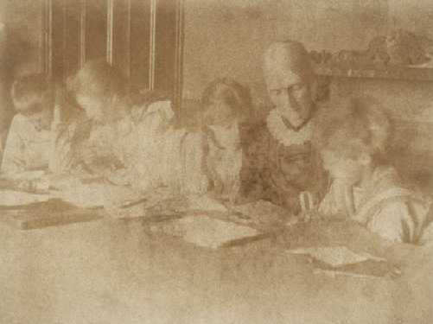
Thoby, Vanessa, Virginia, Julia, and Adrian Stephen
are seen here at Talland House. Even on holiday, the Stephen children were taught their lessons by Julia.
Julia Stephen with Virginia on her lap, 1884 by Henry H. H. Cameron (1852-1911)

Slide 5
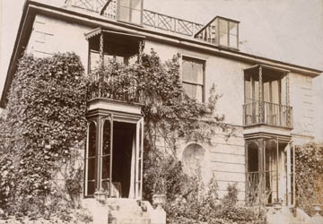
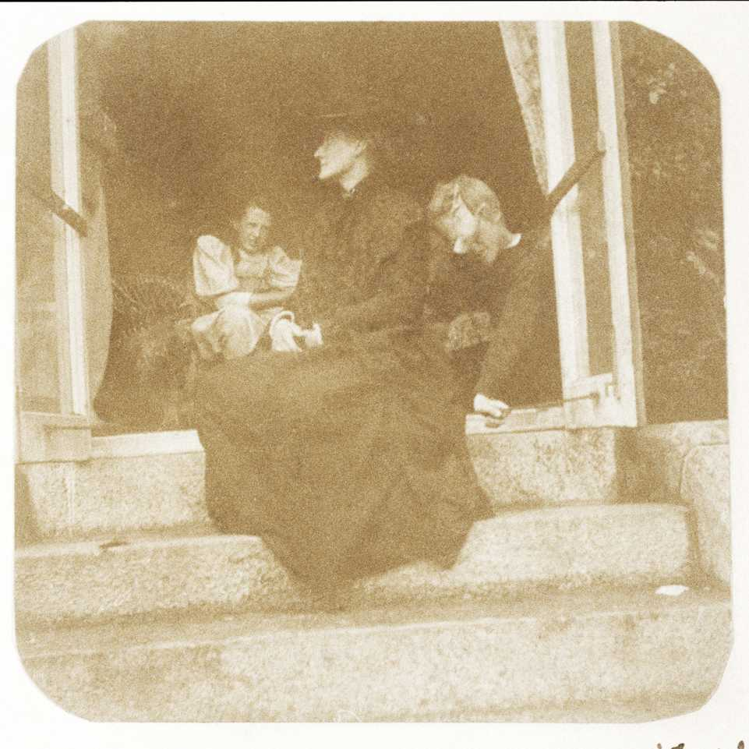
Front view showing
the balconies of Talland House
“The Window,” the first part of To the Lighthouse, is probably based upon this series of pictures and memories of St. Ives.
In this photograph, Julia is seated in profile outside the drawing room window at Talland House. Virginia and Adrian are inside the house.

Slide 6
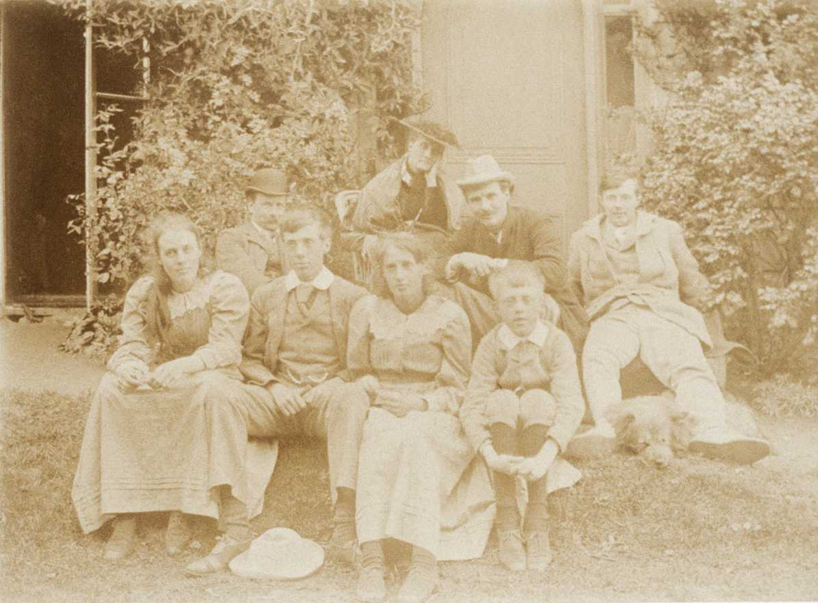
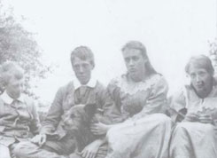
Adrian, Thoby, Vanessa and Virginia at St Ives, 1892.
Stephen-Duckworth group, 1892 This is a group photograph of Horatio Brown, Julia Duckworth Stephen, George Duckworth, Gerald Duckworth, Vanessa, Thoby, Virginia, and Adrian Stephen at Talland House with their dog Shag.

Slide 7
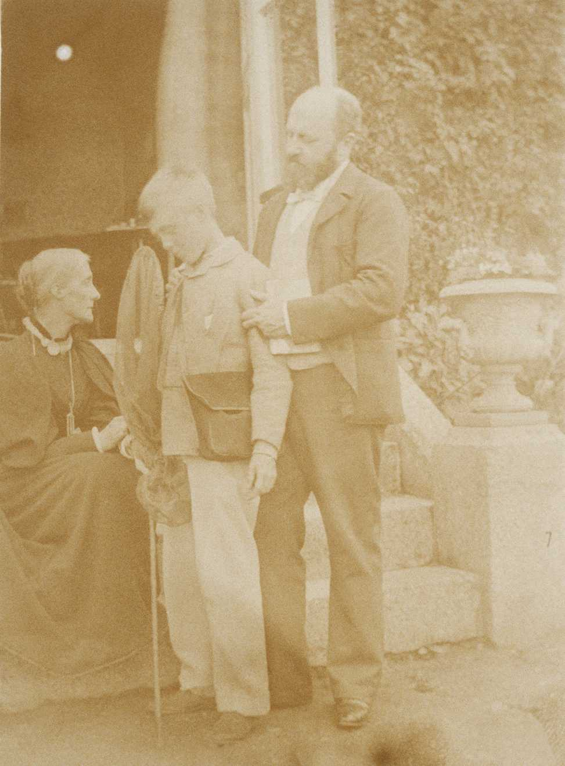
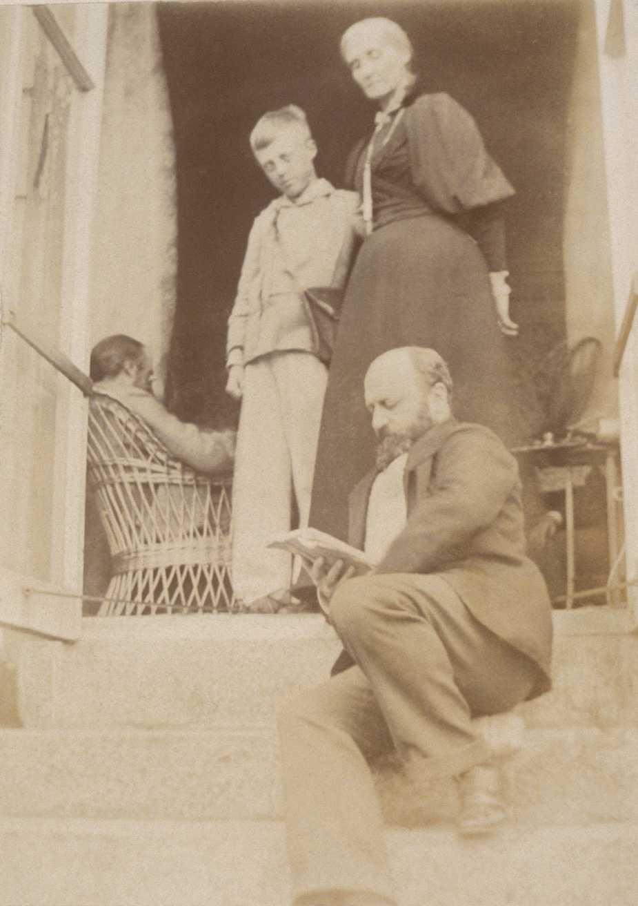
The novelist, Henry James paid regular visits to Talland House. He always loved Julia Stephen. In reference to Leslie Stephen, James said, ‘Good God how that man adores her!’

Slide 8
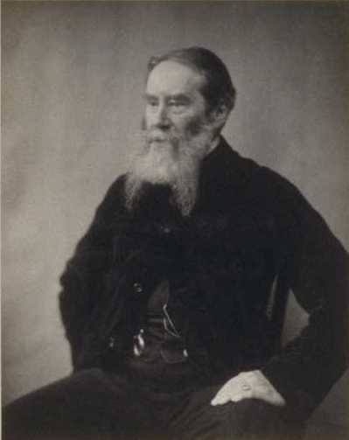
James Russell Lowell Possibly by Henry H. H. Cameron
In 1863 Leslie Stephen visited the United States where he formed a lifelong friendship with the American writer James Russell Lowell.
Lowell later became Virginia Woolf’s godfather and visited the Stephen family during their summer holidays in Cornwall. Stephen was a staunch adherent of the cause of the North in the American Civil War, and an enthusiastic champion of slavery emancipation. He met Abraham Lincoln while he was in Washington and wrote about his experiences when he returned to England. Stephen visited America again in 1868, with his wife Minny. During his second trip, he met Emerson, Charles Eliot Norton, and Oliver Wendell Holmes.

Slide 9
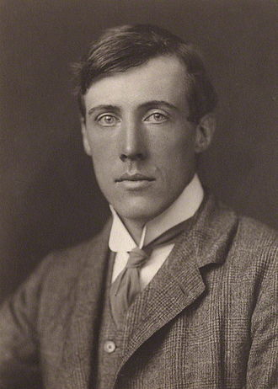
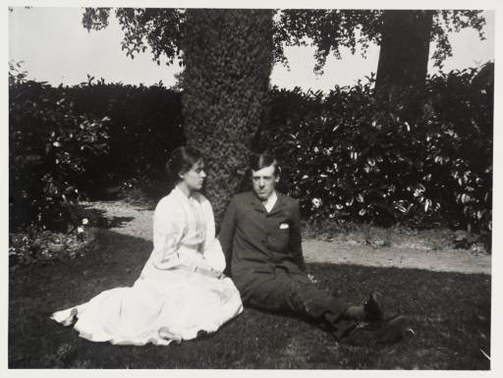
While working on a thesis at Cambridge, Lytton Strachey became close friends with Thoby Stephen and Clive Bell. Together with Thoby’s sisters Virginia and Vanessa, these five formed the core, original members of the Bloomsbury Group.
In 1905 Vanessa began the "Friday Club" and Thoby ran "Thursday Evenings" which became the basis for the Bloomsbury Group, which to some "was really Cambridge in London". Thoby's premature death in 1906 brought them more firmly together and they came what is now known as the "Old Bloomsbury" group who met in earnest beginning in 1912.
Thoby Stephen was a friend of Lytton Strachey
he contracted typhoid at the age of 26 died shortly thereafter.
1900 Vanessa Bell and her brother, Thoby Stephen

Slide 10
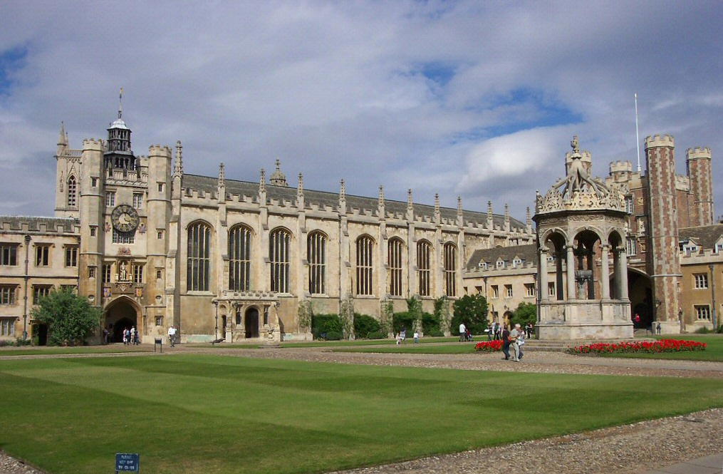
The male members of the Bloomsbury Group, except Duncan Grant, were educated at Cambridge at either Trinity or King’s College. Most of them, except Clive Bell and the Stephen brothers, were members of "the exclusive Cambridge society, the 'Apostles'". At Trinity in 1899 Lytton Strachey, Leonard Woolf, Saxon Sydney-Turner and Clive Bell became good friends with Thoby Stephen, and it was through Thoby and Adrian Stephen's sisters Vanessa and Virginia that the men met the women of Bloomsbury when they came down to London.[
In 1905 Vanessa began the "Friday Club" and Thoby ran "Thursday Evenings" which became the basis for the Bloomsbury Group, which to some "was really Cambridge in London".
Thoby's premature death in 1906 brought them more firmly togetherand they came what is now known as the "Old Bloomsbury" group who met in earnest beginning in 1912. In the 1920s and 1930s the group shifted when the original members died and the next generation had reached adulthood.

Slide 11
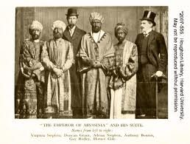
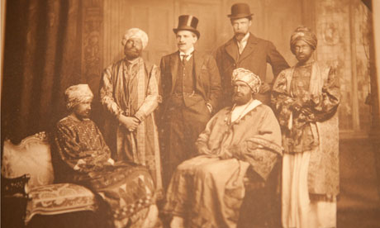
In 1910, Horace de Vere Cole and five friends, including Virginia Stephen and her brother Adrian Stephen coordinated and successfully carried out an elaborate hoax against the Royal Navy.
Cole began by sending a telegram to the HMS Dreadnought, moored in Dorset, telling the crew to expect a visit from a group of North African princes.
Dressed as the “The Emperor of Abyssinia” and his attendants, the group was received by the Dreadnought‘s crew, and was given a tour of the ship. The group spoke to each other in broken Latin, and shouted made-up words to show their appreciation.

Slide 12
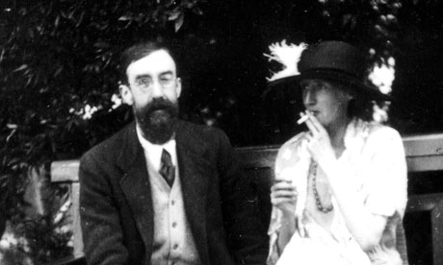
Lytton Strachey and Virginia Woolf
Another way of looking at the Bloomsbury group is to see it as the coming together of two extraordinary families, the Stephens and the Stracheys, around whose effulgence a constellation of others gathered.
http://www.theguardian.com

Slide 13
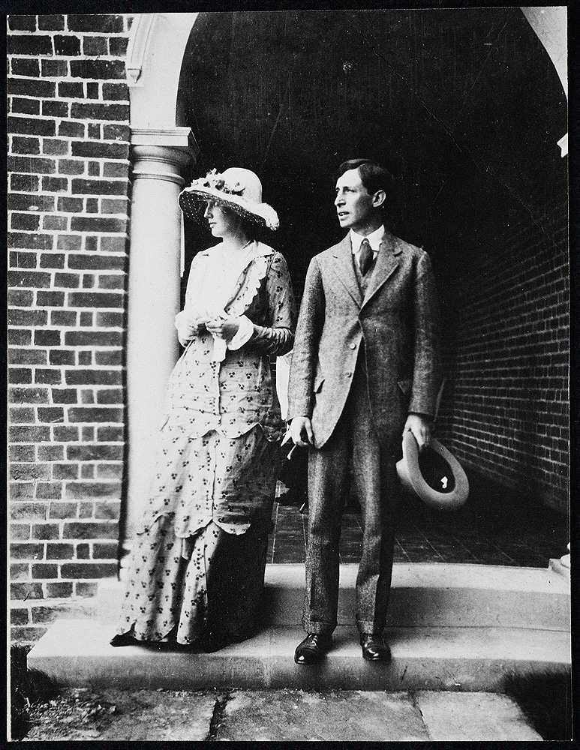
Lytton Strachey and Virginia Woolf began their careers by writing reviews and literary essays for The Times Literary Supplement and The Spectator. A protracted discussion of literature and points of style fills their correspondence. Strachehad proposed marriage y was “all of a heap” because he to Virginia Woolf before writing the letter shown on the left.
He eventually withdrew the offer, and suggested to his friend Leonard Woolf that he pursue Virginia. Virginia and Leonard Woolf wrote a 6 June 1912 letter to Lytton announcing their engagement. T
heir engagement photograph was taken at Dalingridge Place, the Sussex home of Virginia’s half-brother, George Duckworth. The wedding took place on 10 August 1912, and Virginia sent Lytton a postcard from Alfoxton House, Holford, on their honeymoon. (
Virginia and Leonard Woolf, 23 July 1912 (modern print).

Slide 14
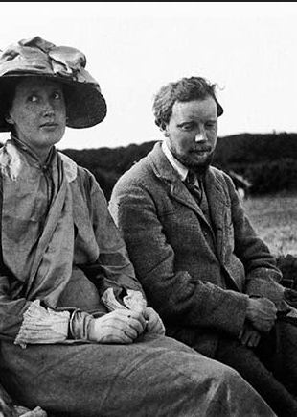
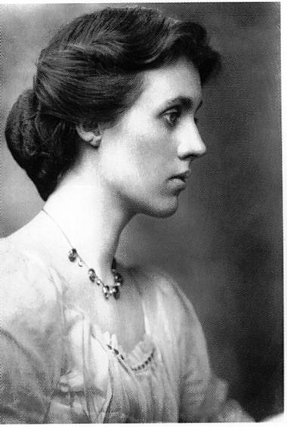
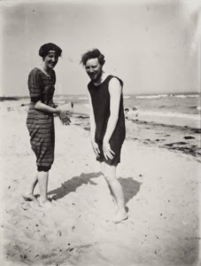
Virginia Woolf with Clive Bell in 1910
Virginia Woolf & Clive Bell 1909
Vanessa Bell

Slide 15
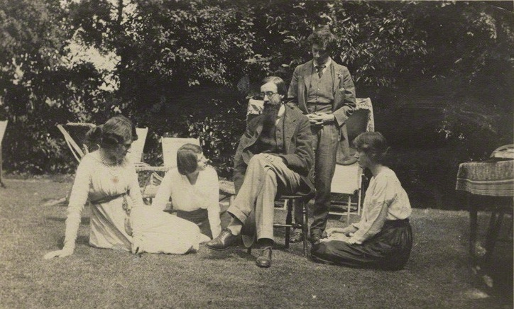
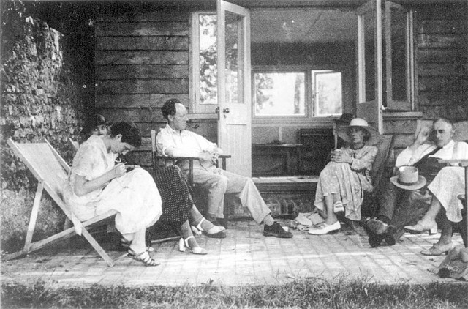
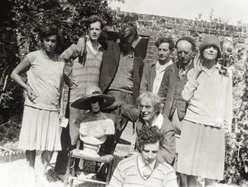
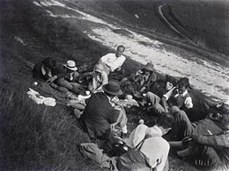
Above: Angelica/Vanessa/Clive Bell/Virginia Woolf, Maynard Keynes
Above: A Bloomsbury gathering at Garsington Manor, country home of Lady Ottoline Morrell, near Oxford. Left to right: Lady Ottoline Morrell, Mrs. Aldous Huxley, Lytton Strachey, Duncan Grant, and Vanessa Bell.

Slide 16
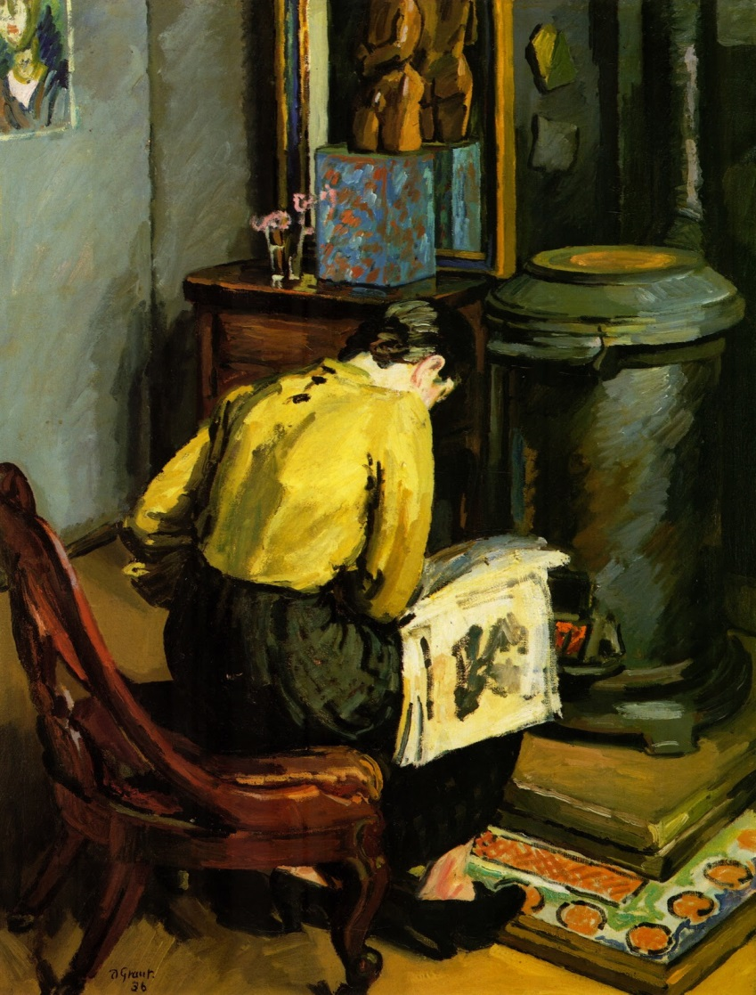
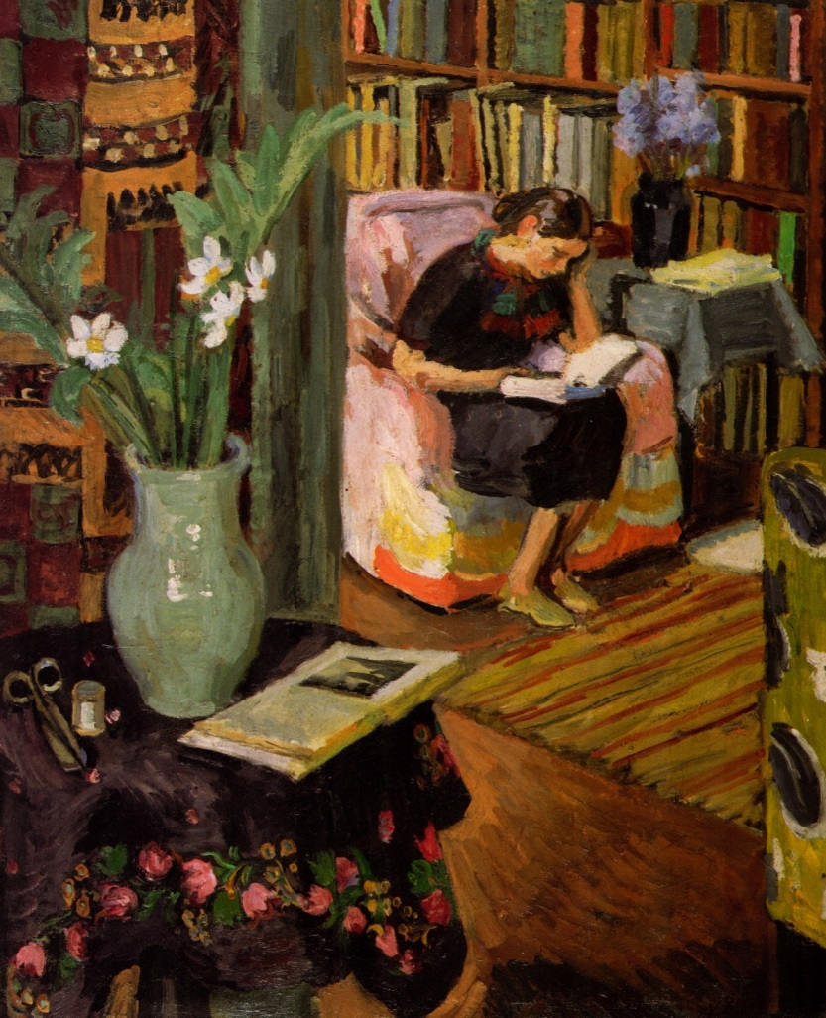
Above: Vanessa Bell (1879-1961) "Interior with the Artist's Daughter", 1935-6
Duncan Grant (1885-1978) "The Stove, Fitzroy Square", 1936. This is Duncan Grant's daughter Angelica reading by The stove in his studio. Duncan Grant was one of the central members of the Bloomsbury group.

Slide 17
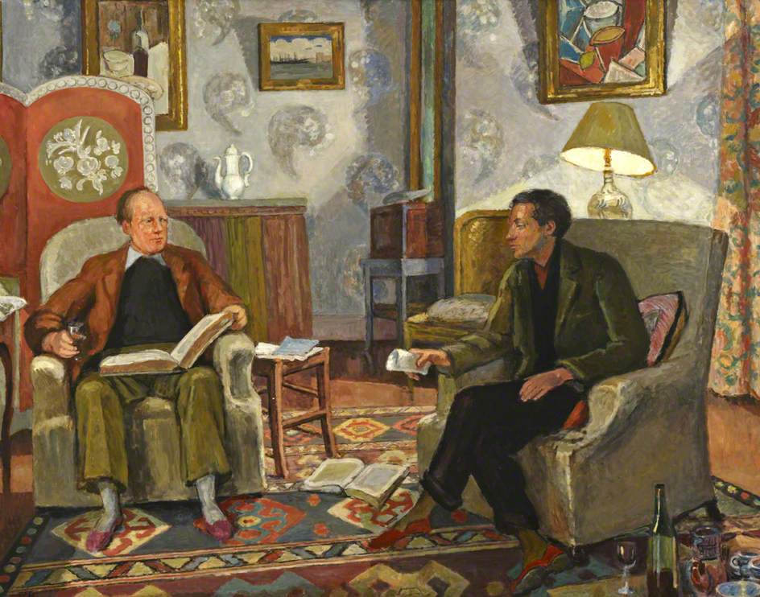
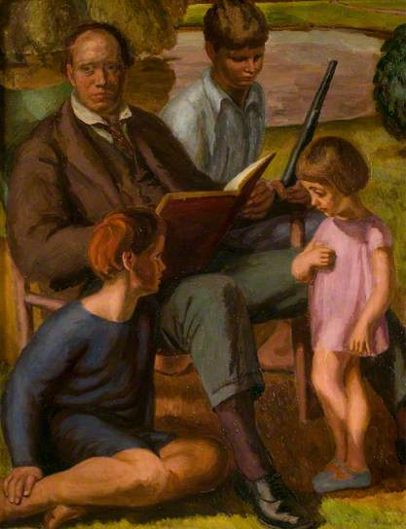
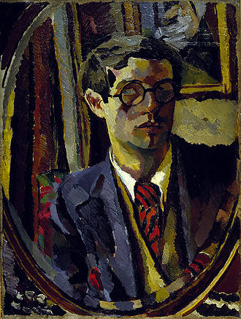
Vanessa Bell, painting of Clide Bell and Duncan Grant
Vanessa Bell, painting of Clide Bell and Children
Duncan Grant, Self Portrait, 1920

Slide 18
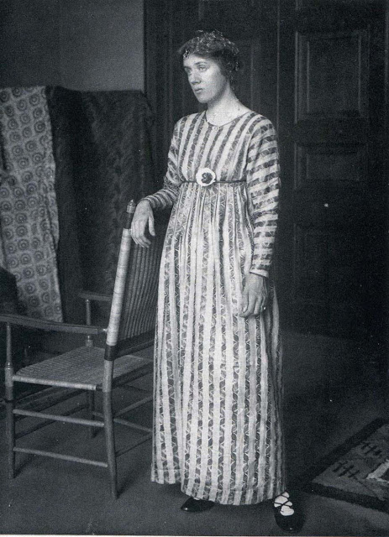
Vanessa was also involved in textile design, much of which was produced for Roger Fry's Omega Workshops, just before and during the First World War.

Slide 19
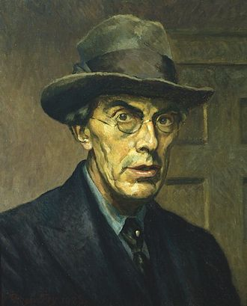
In 1911, Fry began an affair with Vanessa Bell, who was then experiencing a difficult recovery from the birth of her son Quentin. Fry offered her the tenderness and care she felt was lacking from her husband. They remained lifelong close friends, even though Fry's heart was broken in 1913 when Vanessa fell in love with Duncan Grant and decided to live permanently with him.
Fry died very unexpectedly after a fall at his home in London. His death caused great sorrow among the members of the Bloomsbury Group, who loved him for his generosity and warmth. Vanessa Bell decorated his casket before he was buried at Kings College Chapel in Cambridge. Virginia Woolf, Vanessa's sister, novelist and a close friend of his as well, was entrusted with writing his biography, published in 1940.
1928 self-portrait Roger Fry

Slide 20
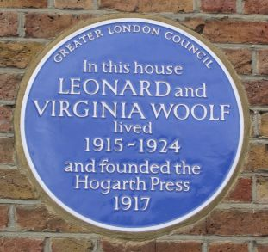
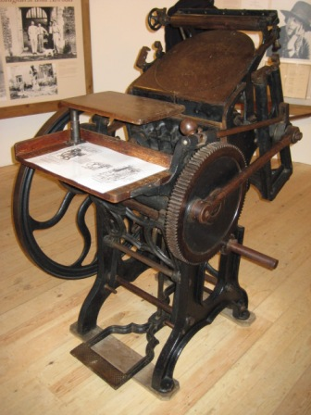
The Hogarth Press
Printing was a hobby for the Woolfs, and it provided a diversion for Virginia when writing became too stressful. The couple bought a handpress in 1917 for £19 (equivalent to about £900 in 2012) and taught themselves how to use it.
The press was set up in the dining room of Hogarth House, where the Woolfs lived, lending its name to the publishing company they founded.
In July they published their first text, a book with one story written by Leonard and the other written by Virginia. Between 1917 and 1946 the Press published 527 titles.

Slide 21
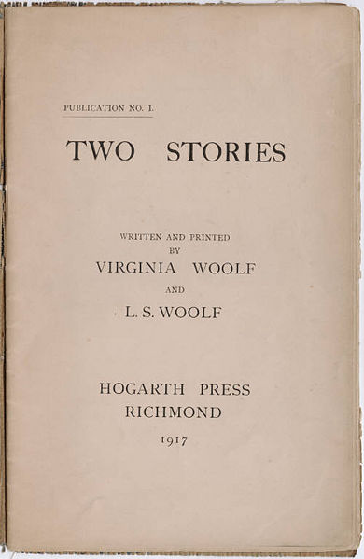
Through the beginning months of 1917, Virginia learned how to become a type compositor. Because Leonard was plagued with shaking hands, it was impossible for him to properly set type. Thus, while he ran the press machines, Virginia was responsible for the setting and distribution of type.
For each story printed at the Hogarth Press, Virginia needed to set each line, letter-by-letter, word-by-word. The line of type would need to fill the width of the composing stick, packed with differently sized pieces of spacing. Once an entire page was typeset, the block of lead pieces would need to be compressed together so that none of the words would fall out when the page was carried over to the nearby press. As self-taught beginners, the Woolfs had considerable problems.
In addition, both the first notice publicizing the establishment of the Hogarth press and their first publication, Two Stories, had irregular spacing and blotted ink, making their finished product amateurish.
Yet, as biographer Hermione Lee notes, these self-taught amateur printers quickly began to transform themselves into professional publishers.

Slide 22
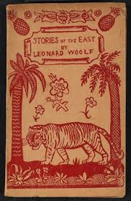
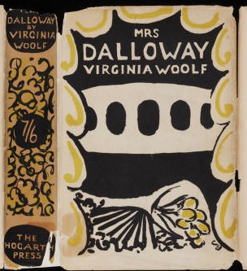
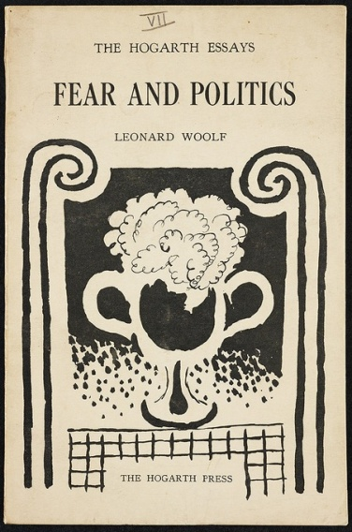
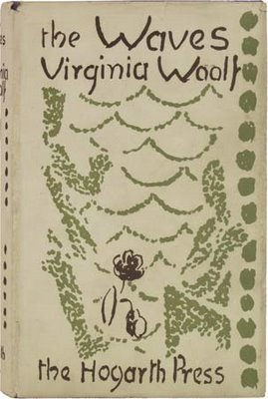
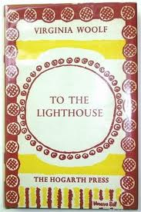
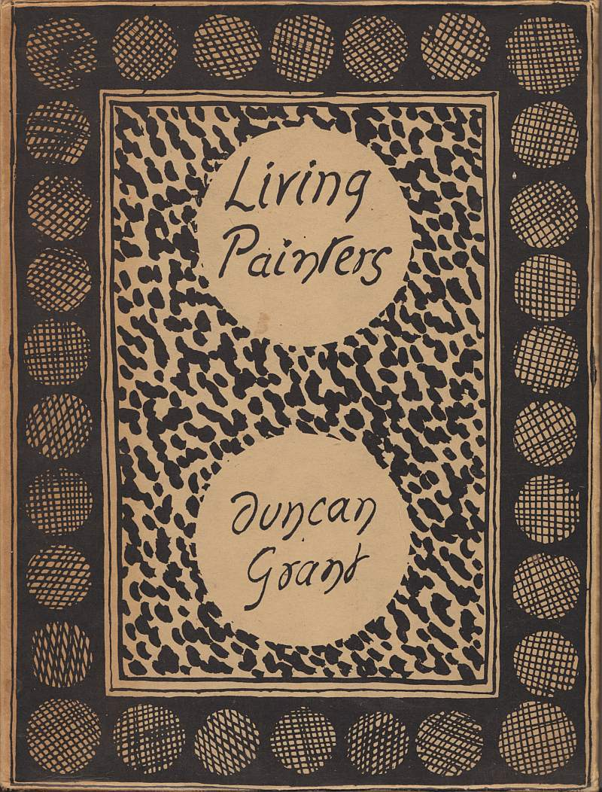
Hogarth Press

Slide 24
Freud’s Publishers

Slide 25
“The history of men's opposition to women's emancipation is more interesting perhaps than the story of that emancipation itself.”
“Thus, towards the end of the eighteenth century a change came about which, if I were rewriting history, I should describe more fully and think of greater importance than the Crusades or the Wars of the Roses.
The middle-class woman began to write. ”
“Lock up your libraries if you like; but there is no gate, no lock, no bolt that you can set upon the freedom of my mind.”
“A woman must have money and a room of her own if she is to write fiction.”
“Women have served all these centuries as looking glasses possessing the magic and delicious power of reflecting the figure of man at twice its natural size.”
“All women together ought to let flowers fall upon the tomb of Aphra Behn, for it was she who earned them the right to speak their minds.”

Slide 26
“Life is not a series of gig lamps symmetrically arranged; it is a luminous halo, envelop surrounding us,” Modern Fiction (1925), Woolf
In 1924 Woolf gave a talk at Cambridge called “Character in Fiction,” revised later that year as the Hogarth Press pamphlet Mr. Bennett and Mrs. Brown.

Slide 27
Eminent Victorians is a book by
Lytton Strachey
(one of the older members of the Bloomsbury Group), first published in 1918 and consisting of biographies of four leading figures from the Victorian era. Its fame rests on the irreverence and wit Strachey brought to bear on three men and a woman who had till then been regarded as heroes and heroine. They were:
Cardinal Manning
Florence Nightingale
Thomas Arnold
General Gordon
The book made Strachey's name and placed him firmly in the top rank of biographers, where he remains.

Slide 28
The Economic Consequences of the Peace was published in 1919 by John Maynard Keynes, the most influential economist of the 20th Century. Keynes attended the Versailles Conference as a delegate of the British Treasury and argued for a much more generous peace. The book was a best seller throughout the world and was critical in establishing a general opinion that the Versailles Treaty had forced such severe reparations on Germany that it would lead to financial ruin for the Germans and weaken the whole European economy.

Slide 29
A Passage to India (1924) is a novel by English author E. M. Forster set against the backdrop of the British Raj and the Indian independence movement in the 1920s.
The story revolves around four characters: Dr. Aziz, his British friend Mr. Cyril Fielding, Mrs. Moore, and Miss Adela Quested. During a trip to the Marabar Caves (modeled on theBarabar Caves of Bihar),Ad ela finds herself alone with Dr. Aziz in one of the caves, panics and flees; it is assumed that Dr. Aziz had attempted to assault her. Aziz's trial, and its run-up and aftermath, bring out all the racial tensions and prejudices between indigenous Indians and the British colonists who rule India.
Right: Duncan Grant (artist), EM Forster (author), Clive Bell (art critic) and his mistress Mary Hutchins

Slide 30
Woolf, like the rest of Bloomsbury, was strongly pacifist. In 1938, when Britain was on the brink of war with Germany, she published Three Guineas, a critique of patriarchy implicit in The Years. Its conclusion – that Britain needed to tackle sexism at home before it embarked on Germany’s problems – was high-minded but unrealistic. Maynard Keynes was furious with her and even Leonard, while admiring her arguments, disagreed, though for many women readers Three Guineas seemed to voice their own thoughts.
“No guinea of earned money should go to rebuilding the college on the old plan just as certainly none could be spent upon building a college upon a new plan: therefore the guinea should be earmarked "Rags. Petrol. Matches." And this note should be attached to it. "Take this guinea and with it burn the college to the ground. Set fire to the old hypocrisies. Let the light of the burning building scare the nightingales and incarnadine the willows. And let the daughters of educated men dance round the fire and heap armful upon armful of dead leaves upon the flames. And let their mothers lean from the upper windows and cry, "Let it blaze! Let it blaze! For we have done with this 'education!”

Slide 31
Vita Sackville-West (1892-1962), English born poet and novelist, wrote of her life in the Kent countryside. Her first novel was published in 1909 when she was only seventeen years old. Sackville-West is known for her private life as well; she was bisexual and had many affairs with women, including Virginia Woolf. She enjoyed an open marriage with Harold George Nicolson, a writer and politician who was also bisexual. In creating an unusual family, including two successful sons, Nigel and Benedict, the couple was far ahead of time.
Vita Sackville -West focused mainly on fiction, but also put her passion for gardening into essays and columns. The gardens she and her husband designed at their home, Sissinghurst Castle, are still visited and admired today.
Vita's son Nigel Nicolson (1973, p. 194) praises his mother: "She fought for the right to love, men and women, rejecting the conventions that marriage demands exclusive love, and that women should love only men, and men only women. For this she was prepared to give up everything… How could she regret that the knowledge of it should now reach the ears of a new generation, one so infinitely more compassionate than her own?“The affair for which Sackville-West is most remembered was with the prominent writer Virginia Woolf in the late 1920s. Woolf wrote one of her most famous novels, Orlando, described by Sackville-West's son Nigel Nicolson as "the longest and most charming love-letter in literature", as a result of this affair.
Vita Sackville-West in her twenties, by William Strang, 1918

Slide 32
This diagram gives a detailed overview of the Bloomsbury Group.
Chart by Bernhard Wenzl

