Slide 1
Women of the Sun: Alinta
Maxim Svistunov

Slide 2
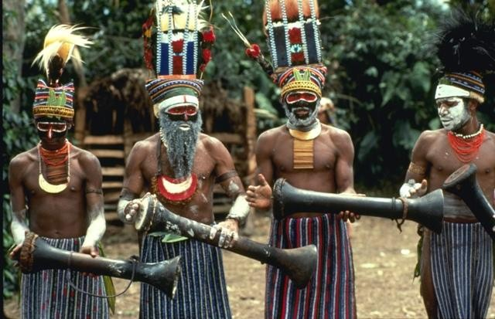
Historical Background
By the time the Europeans have arrived, there were about 2 million aborigines, divided into more than 500 tribes

Slide 3
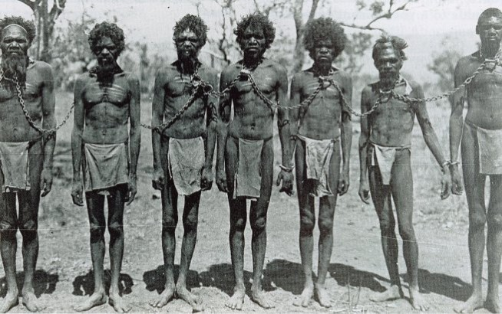
Historical Background
The colonization, accompanied by purposeful extermination of the Australians, has resulted into immense decrease in their population – 60,000 in year 1921

Slide 4
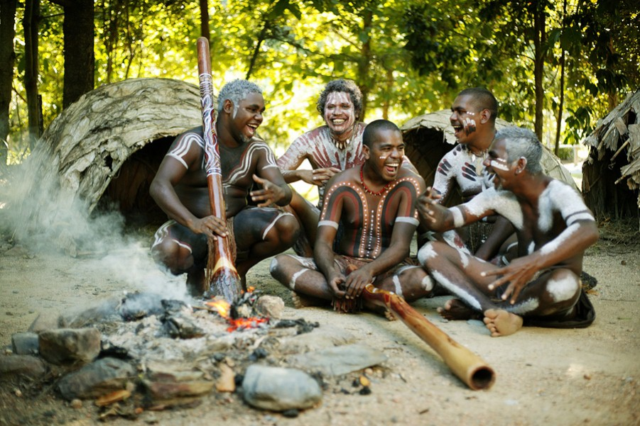
Historical Background
The material and medical support has helped to raise their numbers to ~300,000 people, which is only 1,5% of Australia’s population

Slide 5
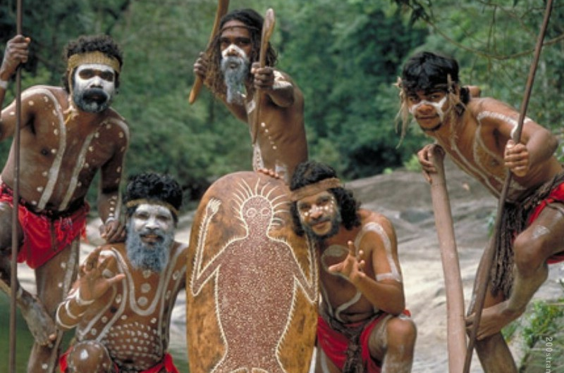
Historical Background
The Australian aborigines thought that there was not only the objective reality, but also another one, inhabited by spirits of their ancestors.
They thought there was a spiritual connection between themselves and their land

Slide 6
Alinta: Questions (specific)
How do the reactions of McNab and Findlay differ in response to the aborigines’ hospitality and help? 12:40
What are the differences in reaction of different tribe members to McNab and Findlay? Especially, the elders’ reactions. 08:30, 09:25, 11:35, 17:50, 20:10
What skills are expected from men and how do aborigines react to the lack of them in Findlay? 21:20
What can you say about McNab’s success in making contact with the aborigines? 22:40, 24:20, 30:20, 33:32, 35:45
Why exactly the tribe has accepted McNab, but was at once alarmed by the appearance of more white men years later (even before their very first contact to them)? 36:35

Slide 7
Alinta: Questions (specific)
What can you say about the negotiations between Goodman and the chief of the tribe? Does Goodman really respect the aborigines and their opinion about the land acquisition? 38:15, 43:20
Is the tribe being proactive in defense of their land or are they waiting for the danger to come close? 48:30 (a)
On which side do you think McNab is, in the end? In your opinion, did he have a choice? 49:50
What are the differences of the execution of McNab and Findlay? Do you think they matter? 25:50, 52:20
The confrontation between the white settlers and the Aborigines. What are the differences in their weaponry? Could the aborigines have won the battle? 55:50

Slide 8
Alinta: Questions (general)
On which side do you think McNab is, in the end?
What specific complaints does the tribe have about the settlers?
Remember the first meeting of the tribe with McNab and Findlay. Imagine that you are an aborigine and encounter a white man. In what ten words would you describe him?
What is the special role of women in decision-making processes? How do the men and women relate?
What is Alinta’s role in all this geopolitical business?
What other titles might have been appropriate for the film?
What is the role of ‘truth’ in the film? What ‘truth’ have the filmmakers sought to uncover?

Slide 9
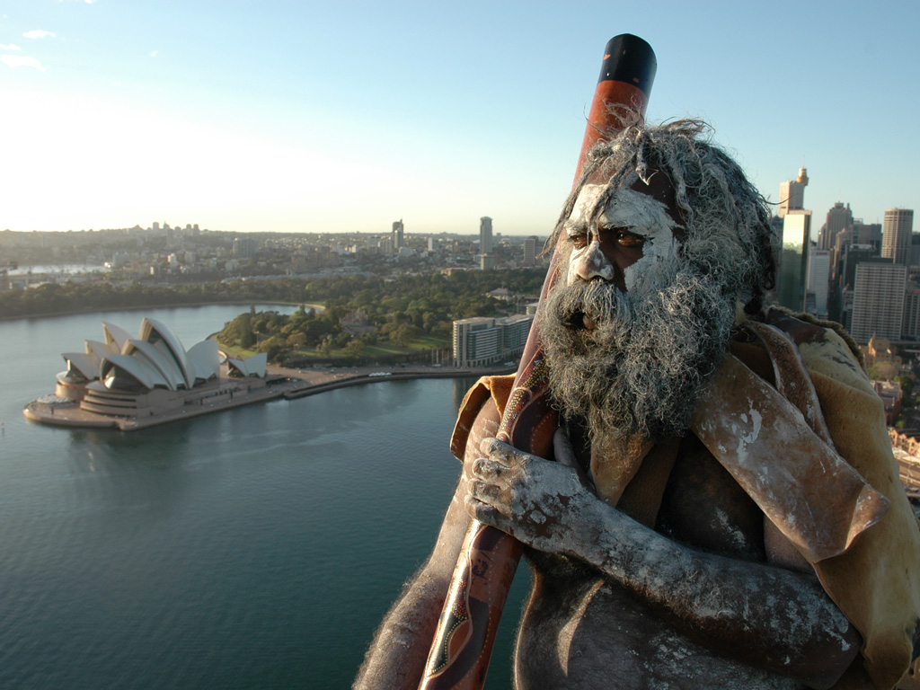
Thanks for your attention!

