Slide 1
Get a Chinese name
取个好名字
Yenjungchen02.2014

Slide 2
姓xìng -Last name
名 míng / 名字míngzì
-First Name
姓名

Slide 3
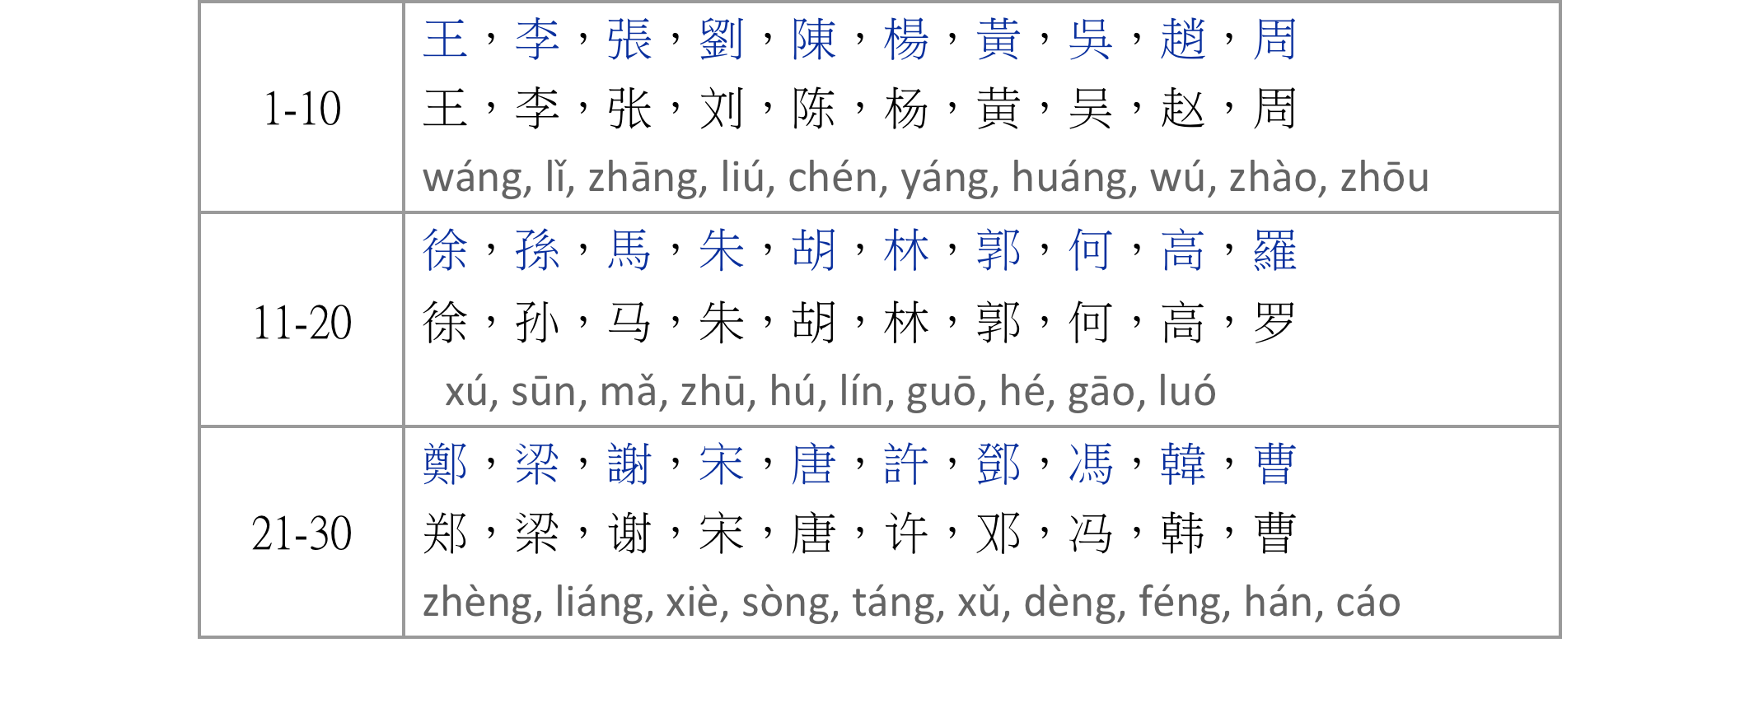
《中國百大姓氏/中国百大姓氏》
The Top100 Chinese Surnames in China

Slide 4
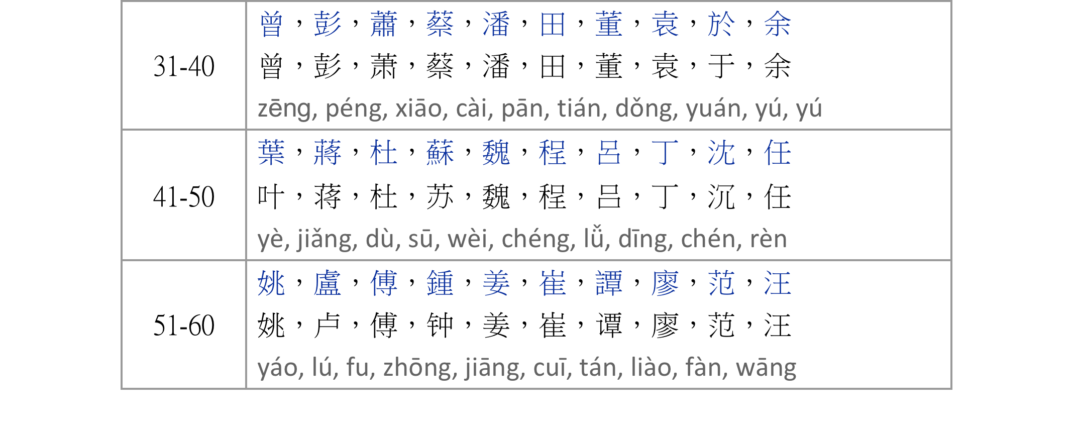
《中國百大姓氏/中国百大姓氏》
The Top100 Chinese Surnames in China

Slide 5
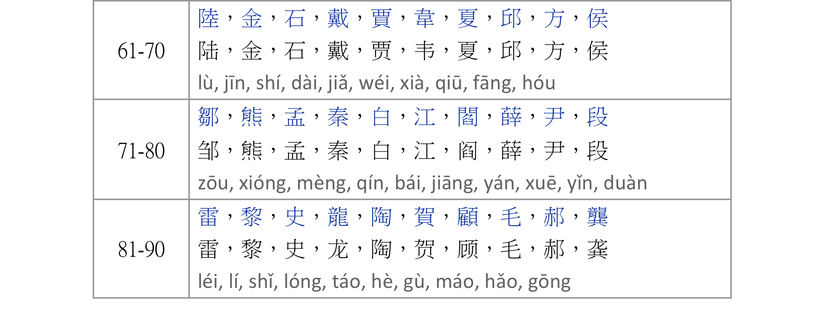
《中國百大姓氏/中国百大姓氏》
The Top100 Chinese Surnames in China

Slide 6
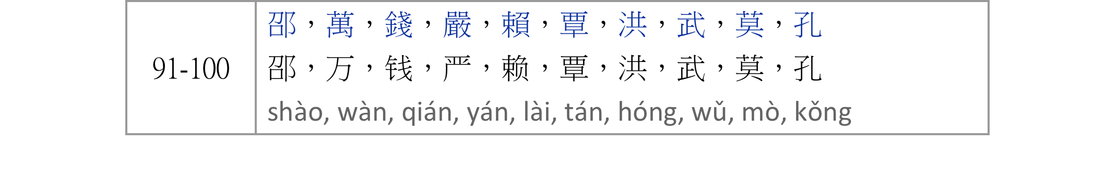
《中國百大姓氏/中国百大姓氏》
The Top100 Chinese Surnames in China

Slide 7
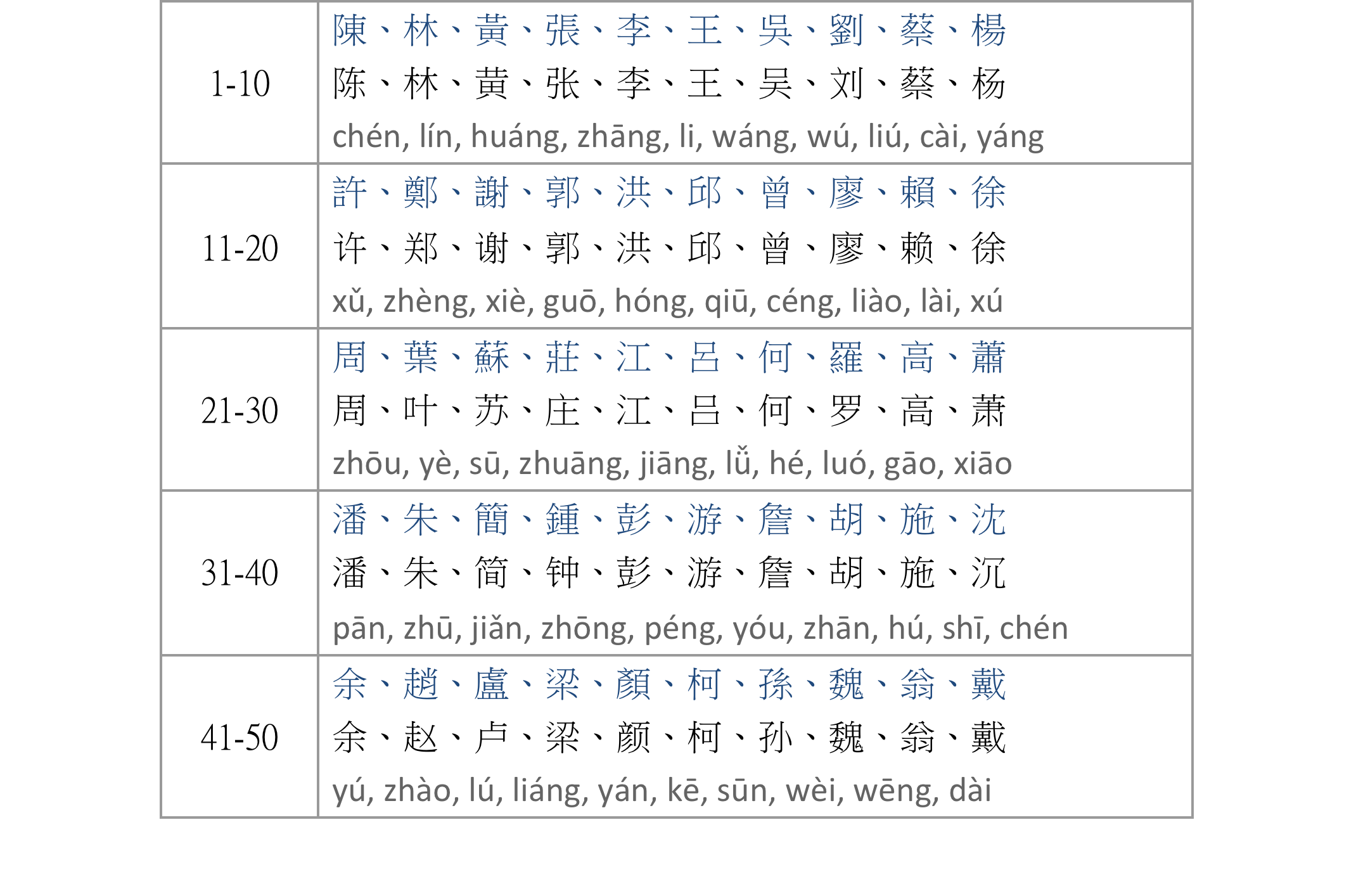
《台灣百大姓氏/台湾百大姓氏》
The Top100 Chinese Surnames in Taiwan

Slide 8
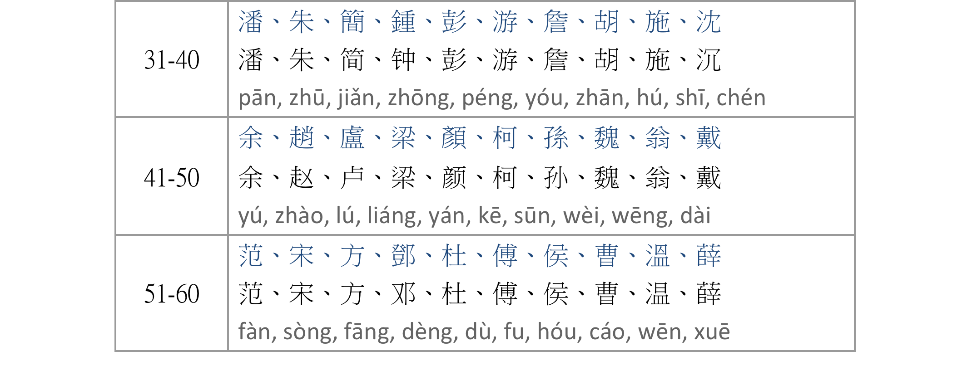
《台灣百大姓氏/台湾百大姓氏》
The Top100 Chinese Surnames in Taiwan

Slide 9
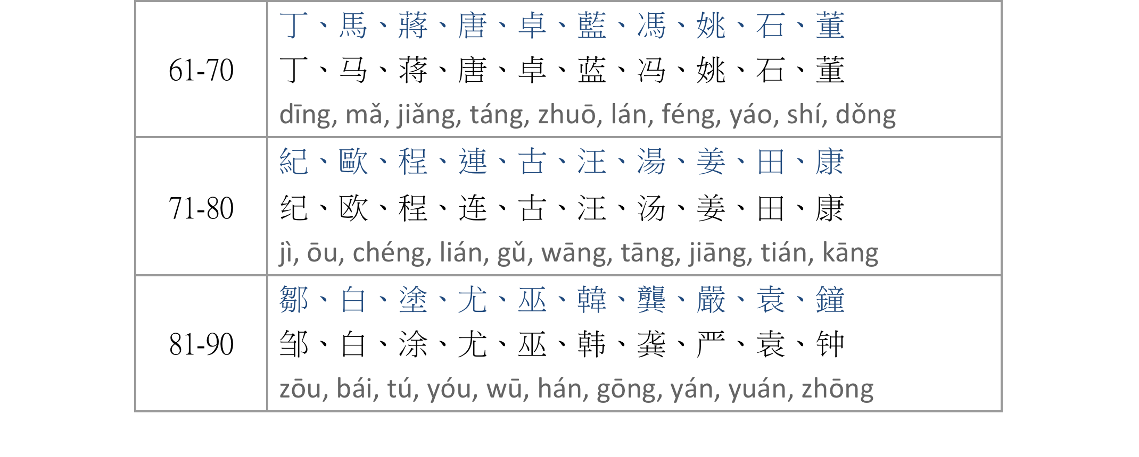
《台灣百大姓氏/台湾百大姓氏》
The Top100 Chinese Surnames in Taiwan

Slide 10
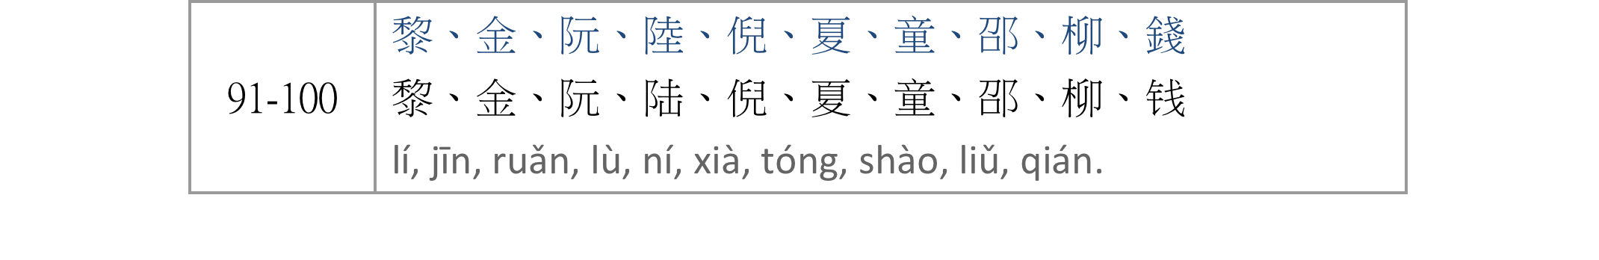
《台灣百大姓氏/台湾百大姓氏》
The Top100 Chinese Surnames in Taiwan

Slide 11
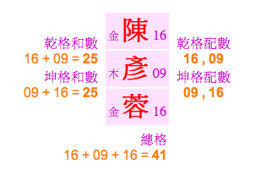
lucky strokes
幸運筆畫 / 幸运笔画
1、3、5、6、11、13、15、16、21、23、24、25、29、31、33、35、37、39、41、47、48、52、57、61、63、65、67、68、81。

Slide 12
Something you should know……
Many people from Mainland China use two-character names.
There is an art to choosing good names, and many parents consult a fortune-teller to name their newborn child. A good name is expected to pave the way to a successful and prosperous life.
Students of Mandarin don’t need to consult a fortune-teller. You can ask a Chinese-speaking friend to give you a name, it should be fairly easy to write and easy to pronounce.

Slide 13
Check out your Chinese name：
http://www.mandarintools.com/chinesename.html
http://www.cclookup.com

Slide 14
Do you have a lucky name?
http://www.123cha.com/xm/

