Slide 1
Drugs and addiction
Lisa Kracht Spring 2014
PSX_006: Psychotherapy

Slide 2
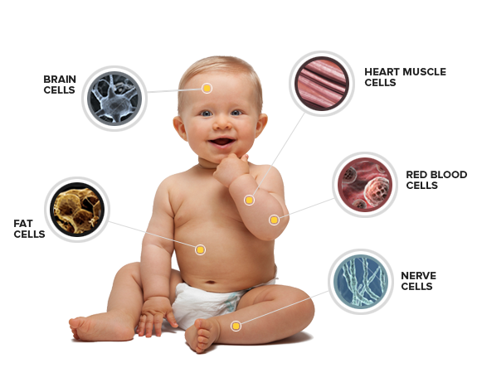
What is a drug?
“A medicine or other substance which has a physiological effect when ingested or otherwise introduced into the body”
Drug. (n.d.). In Oxford Dictionary Online. Retrieved from http://www.oxforddictionaries.com/definition/english/drug
Notes:
Add more distinguishing factors: Substance abuse drugs vs. pharmocology

Slide 3
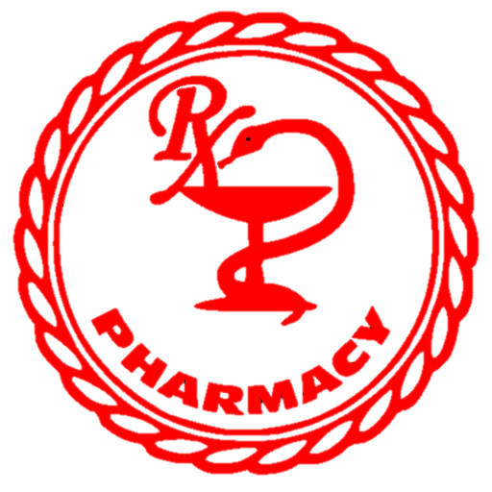
Pharmaceutical vs. recreation
Pharmaceutical Drugs
Recreational Drugs
A medicinal drug
Of, relating to, or engaged in pharmacy or the manufacture and sale of pharmaceuticals
(Merriaam-Webster, n.d.)
Chemical substances taken for enjoyment, or leisure purposes, rather than for medical reasons
Usually started to provide pleasure, or improve life in some way
Can lead to addiction, health and social problems and crime
Most are illegal
Three most popular: Marijuana (Cannabis), Heroin, Cocaine. (Frater, 2009)
(Harding, 2014)

Slide 4
Definitions To know
Drug Addiction
“Drug addiction is a dependence on an illegal drug or a medication. When you're addicted, you may not be able to control your drug use and you may continue using the drug despite the harm it causes. Drug addiction can cause an intense craving for the drug. You may want to quit, but most people find they can't do it on their own.” (Mayo Clinic, 2011)
Drug Abuse
“The recurrent use of illegal drugs, or the misuse of prescription or over-the-counter drugs with negative consequences. These consequences may involve problems at work, school, home or in interpersonal relationships; problems with the law; or physical risks that come with using drugs in dangerous situations.” (University of Maryland Medical Center, 2014).

Slide 5
Common signs and symptoms of drug addiction
You’ve built up a drug tolerance. You need to use more of the drug to experience the same effects you used to attain with smaller amounts.
You take drugs to avoid or relieve withdrawal symptoms. If you go too long without drugs, you experience symptoms such as nausea, restlessness, insomnia, depression, sweating, shaking, and anxiety.
You’ve lost control over your drug use. You often do drugs or use more than you planned, even though you told yourself you wouldn’t. You may want to stop using, but you feel powerless.
Your life revolves around drug use. You spend a lot of time using and thinking about drugs, figuring out how to get them, and recovering from the drug’s effects.
You’ve abandoned activities you used to enjoy, such as hobbies, sports, and socializing, because of your drug use.
You continue to use drugs, despite knowing it’s hurting you. It’s causing major problems in your life—blackouts, infections, mood swings, depression, paranoia—but you use anyway.
(Robinson, Smith, and Saisan, 2014)

Slide 6
Common signs and symptoms of drug abuse
You’re neglecting your responsibilities at school, work, or home (e.g. flunking classes, skipping work, neglecting your children) because of your drug use.
You’re using drugs under dangerous conditions or taking risks while high, such as driving while on drugs, using dirty needles, or having unprotected sex.
Your drug use is getting you into legal trouble, such as arrests for disorderly conduct, driving under the influence, or stealing to support a drug habit.
Your drug use is causing problems in your relationships, such as fights with your partner or family members, an unhappy boss, or the loss of old friends.
(Robinson, Smith, and Saisan, 2014)

Slide 7
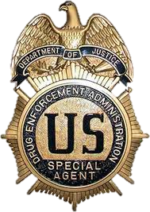
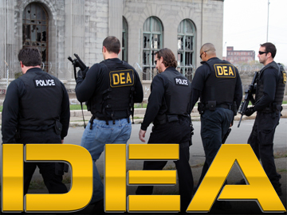
Types of drugs
In the United States, there are 5 schedules of drugs (controlled substances). Each drug is listed within one of these schedules and is criminalized and punished as the schedules are enforced. Each schedule is to show the abuse potential and legality of each type of drugs. (United States Drug Enforcement Administration, n.d.)

Slide 8
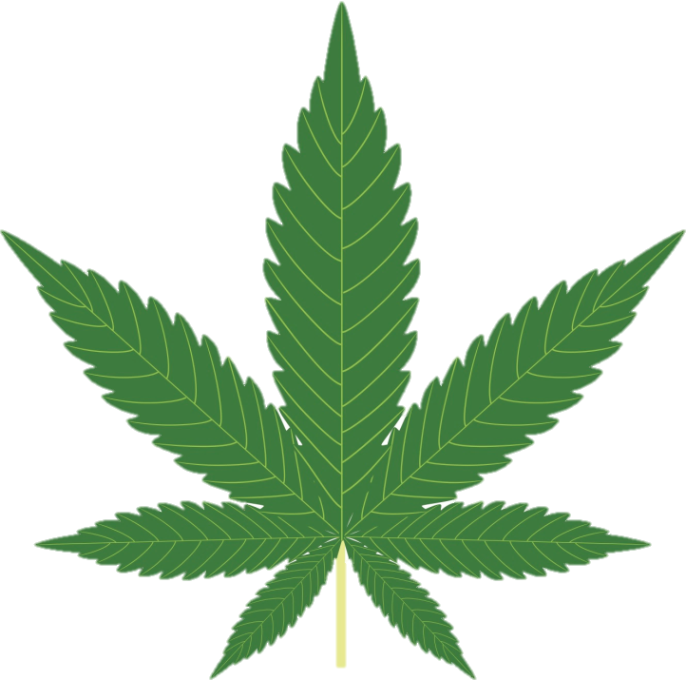
Schedule one Drugs
“Drugs with no currently accepted medical use and a high potential for abuse.”
Scheduled as such because they are thought to be the most dangerous.
Schedule one drugs include:
Heroin
Lysergic acid diethylamide (LSD)
Marijuana (cannabis)
Ecstasy
Methaqualone
Peyote
(United States Drug Enforcement Administration, n.d.)

Slide 9
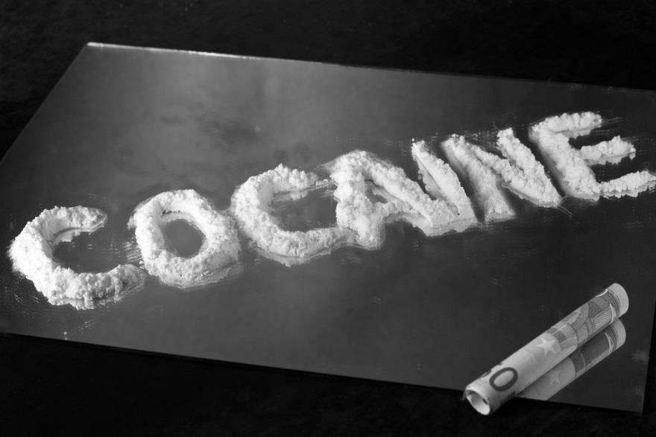
Schedule two drugs
“Drugs with a high potential for abuse with use potentially leading to severe psychological or physical dependence.”
Like schedule I drugs, schedule II drugs are also considered dangerous.
Schedule II drugs include:
Cocaine
Methamphetamine
Methadone
Hydromorphone (Dilaudid)
Meperidine (Demerol)
Oxycodone (OxyContin)
Fentanyl
Dexedrine
Adderall
Ritalin
(United States Drug Enforcement Administration, n.d.)
Notes:
less abuse potential than Schedule I drugs

Slide 10
Schedule three drugs
“Drugs with a moderate to low potential for physical and psychological dependence.”
Schedule III Drugs include:
Vicodin
Tylenol with codeine
Ketamine
Anabolic steroids
Testosterone
(United States Drug Enforcement Administration, n.d.)
Notes:
Schedule III drugs abuse potential is less than Schedule I and Schedule II drugs but more than Schedule IV.

Slide 11
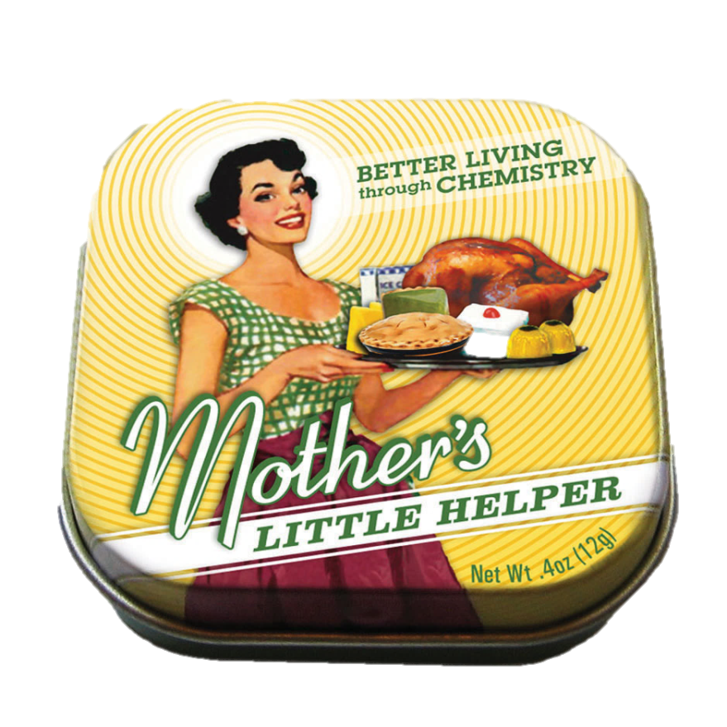
Schedule four drugs
“Drugs with a low potential for abuse and low risk of dependence.”
Schedule IV drugs include:
Xanax
Soma
Darvon
Darvocet
Valium
Ativan
Talwin
Ambien
(United States Drug Enforcement Administration, n.d.)

Slide 12
Schedule five drugs
Drugs/controlled substance with the lowest potential for abuse.
“Consist of preparations containing limited quantities of certain narcotics.”
Schedule Five Drugs include:
cough preparations with less than 200 milligrams of codeine or per 100 milliliters (Robitussin AC)
Lomotil
Motofen
Lyrica
Parepectolin
(United States Drug Enforcement Administration, n.d.)

Slide 13
Heroin
Heroin is an opioid
Opioid Use Disorder: “A problematic pattern of opioid use leading to clinically significant impairment or distress, as manifested by at least two …[diagnostic criteria]…occurring within a 12-month period” (American Psychiatric Association, 2013).
Opioid use disorder includes signs and symptoms that reflect compulsive, prolonged self-administration of opioid substances that are used for no legitimate medical purpose or, if another medical condition is present that requires opioid treatment, that are used in doses greatly in excess of the amount needed for that medical condition. (APA, 2013)
Prevalence: USA: ~0.37% among adults age 18 years and older in the community
Rates are higher in males than in females
Female adolescents may have a higher likelihood of developing opioid use disorders
(APA, 2013)
Notes:
Remember, this is a schedule one drug… high abuse potential and dangerous but no medically accepted use

Slide 14
Cocaine
Cocaine is a stimulant
“Cocaine is a strong central nervous system stimulant that increases levels of the neurotransmitter dopamine in brain circuits regulating pleasure and movement.” (National Institute on Drug Abuse, 2013).
Stimulant Disorder: “A pattern of amphetamine-type substance, cocaine, or other stimulant use leading to clinically significant impairment or distress” as diagnosed by the DSM-5 (APA, 2013)
Prevalence of stimulant use disorder with cocaine: U.S.: 0.2% among 12- to 17-year-olds and 0.3% among individuals 18 years and older.
Rates are higher among males than among females.
Rates are highest among 18- to 29-year-olds.
Notes:
Remember, this is a schedule two drug… high potential for abuse and dangerous with medical acceptance

Slide 15
Alcohol
Alcohol Use Disorder: “defined by a cluster of behavioral and physical symptoms, which can include withdrawal, tolerance, and craving.” (APA, 2013).
Alcohol Withdrawal: “Alcohol withdrawal is characterized by withdrawal symptoms that develop approximately 4–12 hours after the reduction of intake following prolonged, heavy alcohol ingestion. Because withdrawal from alcohol can be unpleasant and intense, individuals may continue to consume alcohol despite adverse consequences, often to avoid or to relieve withdrawal symptoms.” (APA, 2013)
Prevalence: In the U.S., ~4.6% among 12- to 17-year-olds and 8.5% among adults age 18 years and older (APA, 2013)
Rates of the disorder are greater among adult men (12.4%) than among adult women (4.9%). (APA, 2013)
Notes:
Alcohol is NOT a scheduled drug nor is it necessarily a controlled substance however there are many laws following the use of alcohol including age restrictions as well as intoxication restrictions (such as drinking and driving, etc.)

Slide 16
Cognitive behavioral therapy (CBT)
Cue Exposure
Addicts have classically conditioned reminders which derive from their environment. These reminders act as triggers and can spark a relapse. Studies show that extinguishing these cues by repeated exposure can help the addict avoid such relapse. (Frank, A. and Van Horn, D., 1998).
Contingency Management Interventions
“Giving patients tangible rewards to reinforce positive behaviors such as abstinence.” Studies show that these interventions are very effective. (National Institute on Drug Abuse, 2012).
Voucher-Based Reinforcement: “the patient receives a voucher for every drug-free urine sample provided.” Vouchers have value which can be used at local stores for food, products, or entertainment. The value starts low and gradually increases with each negative urine sample. If a urine sample is positive, the cycle starts over. (National Institute on Drug Abuse, 2012)
Prize Incentives: Uses the same concept as Voucher-Based Reinforcements but instead of using vouchers, you earn prize entries in drawings for prices. (National Institute on Drug Abuse, 2012).
Notes:
Many psychotherapy approaches depend on CBT, (frank, A. and Van Horn, D., 1998)

Slide 17
Interactional group psychotherapy
Alcoholics Anonymous/Narcotics Anonymous:
Support groups which are non-profit. Typically involve and are run solely by current or past addicts who have the desire to quit.
Alcoholics Anonymous (AA) is probably the most influential self-help organization in the world. (Finlay, 2000)
AA consists of men and women who, through their meetings, share their experiences, strength and hope with each other. These meetings are in hope that those struggling may solve their common problem and also help others.
The only requirement for membership is a desire to stop drinking.
There are no dues or fees for AA membership.
The primary purpose is to stay sober and help other alcoholics achieve sobriety.
It is estimated that there are approximately 114,000 groups and over 2,000,000 members in approximately 170 countries.
(Alcoholics Anonymous World Services, Inc, 2014)
Notes:
Also methadone

Slide 18
12 Steps of A.A.
We admit we were powerless over alcohol--that our lives have become unmanageable.
We have come to believe that a Power greater than ourselves could restore us to sanity.
We have made a decision to turn our will and our lives over to the care of God, as we understand what this Power is.
We have made a searching and fearless moral inventory of ourselves.
We have admitted to God, to ourselves and to another human being the exact nature of our wrongs.
We are entirely ready to have God remove all these defects of character.
We have humbly asked God to remove our shortcomings.
We have made a list of all persons we had harmed and have become willing to make amends to them all.
We have made direct amends to such people wherever possible, except when to do so would injure them or others.
We have continued to take personal inventory and when we were wrong promptly admitted it.
We have sought through prayer and meditation to improve our conscious contact with God as we understand what this higher Power is, praying only for knowledge of God's will for us and the power to carry that out.
Having had a spiritual awakening as the result of these steps, we have tried to carry this message to alcoholics and to practice these principles in all our affairs.
(The New York Times, 2014)
Notes:
You can see that the majority of the AA background revolves around God or a higher power. This has been tampered with over time but there is still belief that AA uses a higher power in their program.. Not necessarily God but perhaps society, the community, etc.

Slide 19
Support-Expressive Psychotherapy
Two Main Components:
Supportive techniques to help patients feel comfortable in discussing their personal experiences (Luborsky, 2000)
Expressive techniques to help patients identify and work through interpersonal relationship issues (Luborsky, 2000)
Special attention is paid to the role of drugs in relation to problem feelings and behaviors, and how problems may be solved without recourse to drugs (Luborsky, 2000)

Slide 20
Support-Expressive Psychotherapy Continued
487 patients, ages 18-60 who met DSM-IV criteria for cocaine dependence and reported cocaine use in the past 30 days.
Randomized to 1 of 4 different treatment conditions:
CBT and Group Drug Counseling (GDC)
Supportive-Expressive psychotherapy (SE) and GDC
Individual Drug Counseling (IDC) and GDC
GDC alone.
Patients who received SE treatment improved substantially
Follow-up assessments revealed a tendency for greater improvement in family/social problems for patients receiving SE GDC compared to those receiving IDC + GDC
Compared to the IDC + GDC group, more patients in SE + GDC, achieved abstinence sooner
Suggests a role for psychodynamic therapy in the treatment of cocaine dependence. In particular, for patients who can achieve initial abstinence, SE therapy appears as effective as other treatment approaches.
(Crits-Christoph, Gibbons, Gallop, Ring-Kurtz, Barber, Worley, Present, & Hearon, 2008)

Slide 21
Community Reinforcement Approach (CRA)
Follows the idea of rearranging a person’s life to make abstinence more rewarding than using
Eliminate positive reinforcement for using
Enhance positive reinforcement for sobriety
It is more than just the patient involved, CRA involves the patient, the therapist, significant others, family, etc.
Building motivation
identification of incentives for behavioral change
“inconvenience review checklist”
A list of frequent negative consequences of drinking, such as medical problems, marital problems, or difficulties at work.
Initiating Sobriety
Setting Goals
Sobriety Sampling
Analyze patterns of drug use
Identify situations in which drinking is most likely to occur as well as positive consequences of alcohol consumption that may have reinforced drinking in the past.
Personalize treatment
(Miller, Meyers, & Hiller-Sturmhofel, 1999)
Notes:
Because the use of alcohol or drugs is highly inforcing, CRA involved the idea of completely rearranging the patient’s lifestyles.
Developed by Hunt and Azrin in 1973 (initially for alcohol)

Slide 22
CRA Continued
Increasing positive reinforcement
increasing the client's sources of positive reinforcement that are unrelated to drug use.
As dependency on the drug increases, other activities decrease… It is important to reverse this by becoming involved again
Social and recreational counseling
Fill time previously spent drinking
Activity sampling
If the patient cannot decide on activities, activity sampling can encourage them to try out or renew various activities. This involves planning with the therapist and client.
NONDRINKING CONTEXT IS IMPORTANT
access counseling (removing barriers)
assistance in obtaining job, phones, place to live, etc.
Behavioral rehearsal
Therapists actually practice new coping skills, particularly those involving interpersonal communication, during the counseling sessions (drink/drug refusal, etc.)
Involving signiﬁcant others
Those who live with the patient can be helpful in identifying the social context of the client's drinking behavior and in supporting change in the behavior. Skills training may occur with the significant other or close relation
(Miller, Meyers, & Hiller-Sturmhofel, 1999 )

Slide 23
Disadvantages/Problems
Cost: It’s expensive!
Especially the Contingency Management Interventions!
It is difficult to change your behavior
Time!: Many programs have a specific time frame and some addicts need more time to get through their stages of addiction
Denial: Many addicts are in denial and won’t seek help!
Resistance: Many addicts will resist the help they get through these programs.

Slide 24
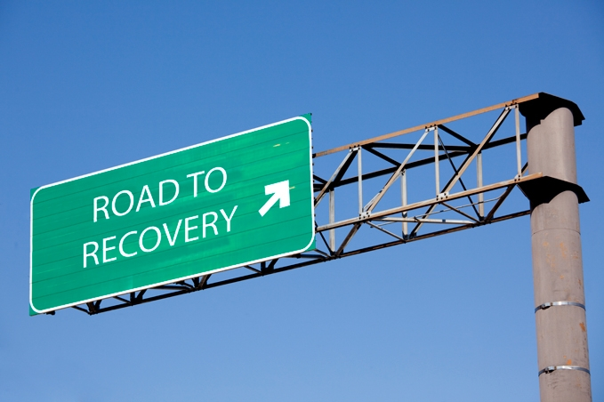
How can you help someone who has a drug problem?
Help them get past the stage of denial
Provide them with the support they need
Encourage them to seek help
Notes:
Be observant! Notice the differences!

Slide 25
References
Alcoholics Anonymous World Services, Inc., (2014). A.A. at a glance. Retrieved from http://www.alcoholics-anonymous.org/lang/en/catalog.cfm ?origpage=10&product=83
American Psychiatric Association, (2013). Diagnostic and statistical manual of mental disorders (5th ed.). Arlington, VA: American Psychiatric Publishing.
Crits-Christoph, P., Gibbons, M. B. C., Gallop, R., Ring-Kurtz, S., Barber, J. P., Worley, M., Present, J., and Hearon, B., (2008). Supportive-expressive psychodynamic therapy for cocaine dependence: A closer look. Psychoanalytic Psychology, 25, 483-498. doi: 10.1037/0736-9735.25.3.483
Drug, (n.d.). In Oxford Dictionary Online. Retrieved from http://www.oxforddictionaries.com/definition/english/drug
Finlay, S. W., (2000). Influence of Carl Jung and William James on the origin of Alcoholics Anonymous. Educational Publishing Foundation, 4, 3-12. doi: 10.1037//1089-2680.4.1.3
Frank, A. F. and Van Horn, D. H. A., (1998). Psychotherapy for cocaine addiction. Psychology of Addictive Behaviors, 12, 47-61. DOI: 10.1037/0893- 164X.12.1.47
Frater, J., (2009). Top 10 most popular recreational drugs. Listverse. Retrieved from http://listverse.com/2009/08/12/top-10-most-popular- recreational-drugs/
Harding, M., (2014). Recreational drugs. Patient.co.uk. Retrieved from: http://www.patient.co.uk/health/recreational-drugs
Luborsky, L., (2000). Principles of psychoanalytic psychotherapy: A manual for supportive-expressive treatment. New York: Basic Books.

Slide 26
References
Mayo Clinic Staff, (2011). Drug addiction. Retrieved from http://www.mayoclinic.org/diseases-conditions/drug- addiction/basics/definition/con-20020970
Merriam-Webster, (n.d.). Pharmaceutical. Retrieved from www.merriam- webster.com/dictionary/pharmaceutical
Miller, W. R., Meyers, R. J., and Hiller-Sturmhofel, S., (1999). The community- reinforcement approach. Alcohol Research & Health, 116-121.
National Institute on Druge Abuse, (2012). Contingency management interventions/motivational incentives (alcohol, stimulants, opioids, marijuana, nicotine). Retrieved from http://www.drugabuse.gov/publications/principles-drug-addiction- treatment-research-based-guide-third-edition/evidence-based- approaches-to-drug-addiction-treatment/behavioral-0
National Institute on Drug Abuse, (2013). Drug facts: Cocaine. Retrieved from http://www.drugabuse.gov/publications/drugfacts/cocaine
Robinson, L., Smith, M., & Saisan, J., (2014). Drug abuse & addiction: Signs, symptoms, and help for drug problems and substance abuse. Retrieved from http://www.helpguide.org/mental/drug_substance_abuse_addiction_sign s_effects_treatment.htm

Slide 27
References
The New York Times, (2014). Alcoholism and Alcohol Abuse. Retrieved from http://www.nytimes.com/health/guides/disease/alcoholism/psychothera py-and-behavioral-methods.html
United States Drug Enforcement Administration. (n.d.). Drug Scheduling. Retrieved from http://www.justice.gov/dea/druginfo/ds.shtml
University of Maryland Medical Center, (2014). Drug Abuse. Retrieved from https://umm.edu/Health/Medical/Ency/Articles/Drug-abuse

